Slide 1
Constructors , Inheritance , Arrays
Notes:
This Module covers :
Constructors
Static Blocks
this reference
Inheritance
Arrays

Slide 2
Constructors in Java
When you create a new instance (a new object) of a class using the new keyword, a constructor for that class is called. Constructors are used to initialize the instance variables (fields) of an object.
Constructors are similar to methods, but with some important differences.
Constructor name is class name.
Default constructor: If you don't define a constructor for a class, a default no parameter constructor is automatically created by the compiler.
Default constructor is created only if there are no constructors. If you define any constructor for your class, no default constructor is automatically created.
Notes:
Constructors and methods differ in three aspects of the signature: modifiers, return type, and name. Like methods, constructors can have any of the access specifiers: public, protected, private, or none (often called package or friendly). Unlike methods, constructors can take only access specifiers. Therefore, constructors cannot be abstract, final, native, static, or synchronized.
The return types are very different too. Methods can have any valid return type, or no return type, in which case the return type is given as void. Constructors have no return type, not even void.
Finally, in terms of the signature, methods and constructors have different names. Constructors have the same name as their class; by convention, methods use names other than the class name. If the Java program follows normal conventions, methods will start with a lowercase letter, constructors with an uppercase letter. Also, constructor names are usually nouns because class names are usually nouns; method names usually indicate actions.
Ask the trainees to modify the Student class done in the beginning of D1.A2 and populate values for the Student class using
constructors.

Slide 3
Parameterized Constructors in Java
A constructor without parameters is called as "default constructor" or "no-args constructor ".
Just like method overloading, constructors also can be overloaded. Same constructor declared with different parameters in the same class is known as constructor overloading.
A parameterized constructor in java is just a constructor which take some kind of arguments.Parameterized constructor is used to provide different values to the distinct objects.
Notes:
[ Example Provided – Cube.java ]
Show this demo program for Constructors , Constructor overloading , parameterized constructors and constructors with objects parameters
It is called default because if the programmer does not write himself, JVM creates one and supplies. The default constructor supplied by the JVM does not have any functionality (output).
Compiler differentiates which overloaded constructor is to be called depending upon the number of parameters and their sequence of data types.

Slide 4
Static Blocks
Static blocks are also called Static initialization blocks . A static initialization block is a normal block of code enclosed in braces, { }, and preceded by the static keyword. Here is an example:
static {
// whatever code is needed for initialization goes here
}
This code will be executed when JVM loads the class. JVM combines all these blocks into one single static block and then executes.
Notes:
Example Provided – staticBlock.java
Static blocks are also called Static initialization blocks . A static initialization block is a normal block of code enclosed in braces, { }, and preceded by the static keyword. class can have any number of static initialization blocks, and they can appear anywhere in the class body. The runtime system guarantees that static initialization blocks are called in the order that they appear in the source code. This code will be executed when JVM loads the class. JVM combines all these blocks into one single static block and then executes.
Static blocks are generally used when you want to flash a message like a welcome message even before the code in main method executes.
if you do not precede the block with "static" keyword, the block is called "constructor block" and will be executed when the class is instantiated. Static Initialisation blocks run only once when the class is first loaded. Constructor blocks run each time when the instance of the class is created.
Introduce constructor block through this demo program and discuss the difference between constructor and constructor block. Constructors can be used to initialize members of the objects of a class unlike constructor block which can be used only to trigger the block whenever the class in instantiated.
Also note that Constructor block will be called first and then objects will be created.and though a static variable will be loaded into memory first , the static block will be executed first.

Slide 5
this reference in java
this is a keyword in Java which can be used inside method or constructor of class.
It(this) works as a reference to current object whose method or constructor is being invoked.
this keyword can be used to refer any member of current object from within an instance method or a constructor.

Slide 6
this reference in java
This keyword can be very useful in case of Variable Hiding. We can not create two Instance/Local Variable with same name.
this keyword can be used to call overloaded constructor in java. if used than it must be first statement in constructor this() will call no argument constructor and this(parameter) will call one argument constructor with appropriate parameter.
Notes:
Example of this keyword for Variable Hiding
class JBT {
int variable = 5;
public static void main(String args[]) {
JBT obj = new JBT();
obj.method(20);
}
void method(int variable) {
variable = 10;
System.out.println("Value of Instance variable :" + this.variable);
System.out.println("Value of Local variable :" + variable);
}
}
Value of Instance variable :5
Value of Local variable :10
Demo Program for using this in constructors– This_constructor.java

Slide 7
this reference in java
Example of this keyword for Variable Hiding
class JBT {
int variable = 5;
public static void main(String args[]) {
JBT obj = new JBT();
obj.method(20);
}
void method(int variable) {
variable = 10;
System.out.println("Value of Instance variable :" + this.variable);
System.out.println("Value of Local variable :" + variable);
}
}
Value of Instance variable :5
Value of Local variable :10

Slide 8
Inheritance
Different kinds of objects often have a certain amount in common with each other.Yet each also defines additional features that make them different.
Object-oriented programming allows classes to inherit commonly used state and behavior from other classes.
In the Java programming language, each class is allowed to have one direct superclass, and each superclass has the potential for an unlimited number of subclasses:

Slide 9
Inheritance
Allows programmers to customize a class for a specific purpose, without actually modifying the original class (the superclass)
The derived class (subclass) is allowed to add methods or redefine them
The subclass can add variables, but cannot redefine them.
Reusability is the main advantage of inheritance
Java Inheritance defines an is-a relationship between a superclass and its subclasses

Slide 10

Inheritance Example
Class C is a subclass of class B (its superclass) if its declaration has the form
  class C extends B {
  …
  }
The subclass is a specialization of the superclass.
The superclass is a generalization of the subclass.

Slide 11
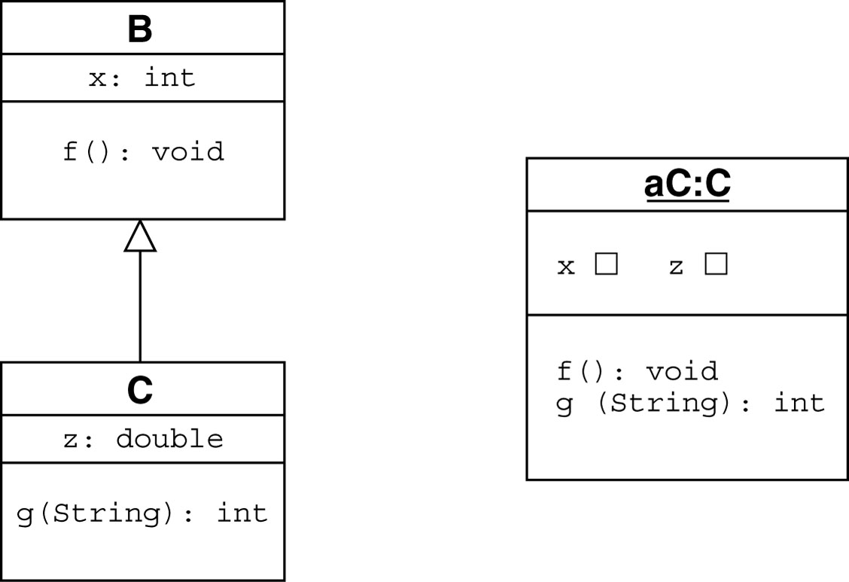
Inheritance Example

Slide 12
Inheritance Hierarchy
A class may have several subclasses and each subclass may have subclasses of its own.
The collection of all subclasses descended from a common ancestor is called an inheritance hierarchy.
The classes that appear below a given class in the inheritance hierarchy are its descendents.
The classes that appear above a given class in the inheritance hierarchy are its ancestors.

Slide 13
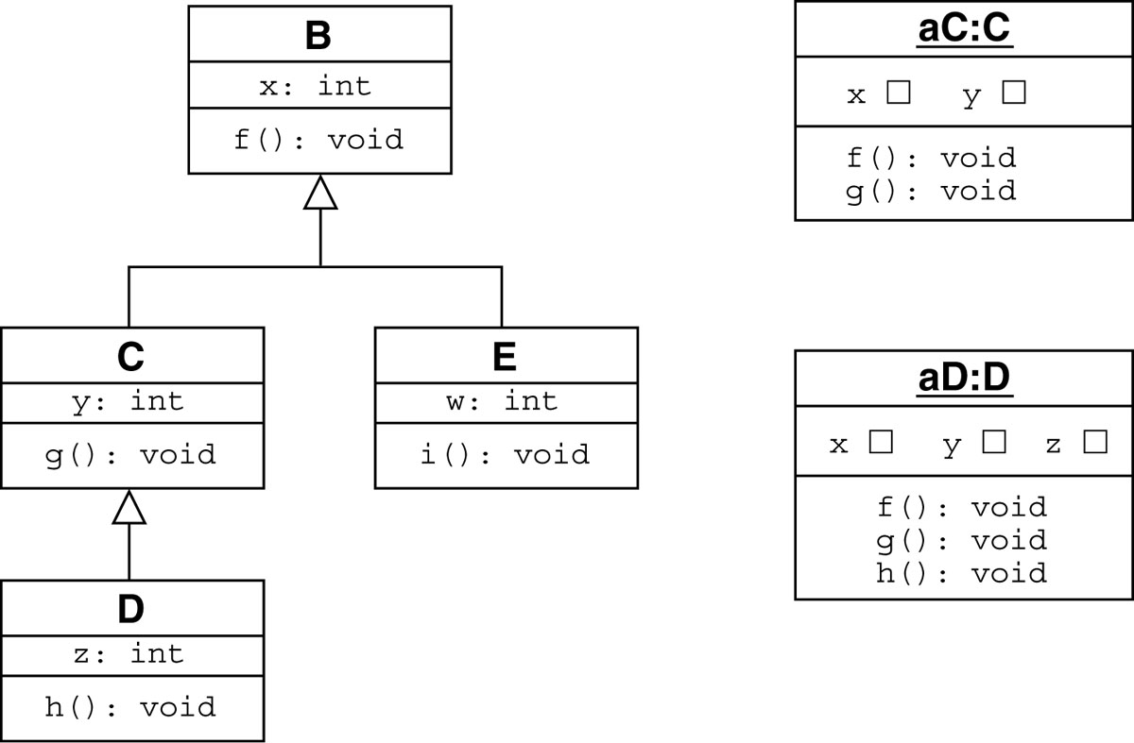
Inheritance Hierarchy

Slide 14
Types of Inheritance
On the basis of class, there can be three types of inheritance: single, multilevel and hierarchical.
Multiple and Hybrid is supported through interface only.

Slide 15
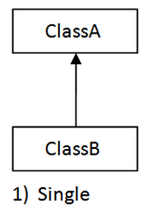
Types of Inheritance

Slide 16
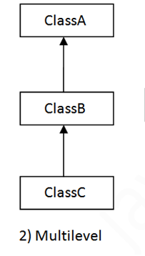
Types of Inheritance

Slide 17
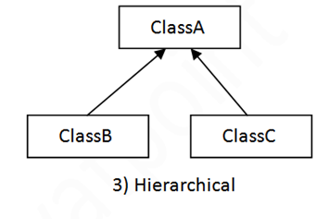
Types of Inheritance

Slide 18
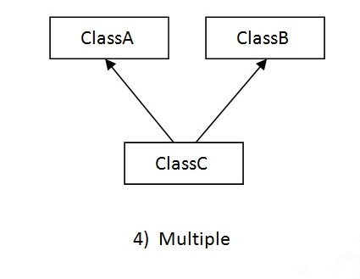
Types of Inheritance

Slide 19
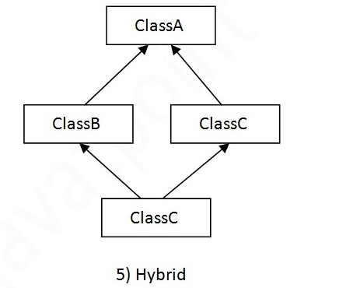
Types of Inheritance
Notes:
Why multiple inheritance is not supported in java?
To reduce the complexity and simplify the language, multiple inheritance is not supported in java through classes.
Take this case
class A{
void msg(){System.out.println("Hello");}
}
class B{
void msg(){System.out.println("Welcome");}
}
class C extends A,B{//suppose if it were
public static void main(String args[]){
C obj=new C();
obj.msg(); //Now which msg() method would be invoked?
}
}
**********
As a Demo program for inheritance show Inheritance.java and also ask them to name the type of inheritance used . In the program the final balance will be 4500 instead of 5000 ( be’cos 2 objects are used . Ask them to debug the program and discuss in this scenario why one single object for a customer will be apt. )

Slide 20
What is an Array
An array is a block of consecutive memory locations that hold values of the same data type.
Individual locations are called array’s elements.
When we say “element” we often mean the value stored in that element.
1.39
1.69
1.74
0.0
An array of doubles
Notes:
Arrays are not primitives. They are objects .
Rather than treating each element as a separate named variable, the whole array gets one name.Specific array elements are referred to by using array’s name and the element’s number, called index or subscript

Slide 21
Indices (Subscripts)
In Java, an index is written within square brackets following array’s name (for example, a[k]).
Indices start from 0; the first element of an array a is referred to as a[0] and the n-th element as a[n-1].
An index can have any int value from 0 to array’s length - 1.
Notes:
The convention of starting indices from 0 comes from C. It is easy to get used to.

Slide 22
Indices (cont’d)
We can use as an index an int variable or any expression that evaluates to an int value. For example:
a stores the address of the first element.
a [3]
a [k]
a [k - 2]
a [ (int) (6 * Math.random()) ]
Notes:
That’s the beauty of it: the index may be a variable calculated at run time; it can be used in algorithms.

Slide 23
Indices (cont’d)
In Java, an array is declared with fixed length that cannot be changed.
Java interpreter checks the values of indices at run time and throws ArrayIndexOutOfBoundsException if an index is negative or if it is greater than the length of the array - 1.
Notes:
Demo Program ArrayDemo.java

Slide 24
Initialization
An array can be declared and initialized in one statement. For example:
int [ ] scores = new int [10] ;
private double [ ] gasPrices = { 3.05, 3.17, 3.59 };
String [ ] words = new String [1000];
String [ ] cities = {"Atlanta","Boston","Cincinnati" };
Notes:
One way to create an array is with the new operator.
Alternatively, you can use the shortcut syntax to create and initialize an array:
An array can be instantiated and initialized in one statement or initialization can be postponed until later.
After you instantiate an array without initialization , default values are automatically assigned to it in the following manner.
byte – default value is zero
short – default value is zero
int – default value is zero
long – default value is zero, 0L
reference types – default value is null.
String Array in java
String weeks_days[] = new String[7]; // Without initializing the elements

Slide 25
Arrays as Objects
In Java, an array is an object. All methods of an Object can be invoked on an array. Arrays are stored in heap memory.
Array declaration:
anyType [ ] arrName;
Notes:
See Demo Program StudentArray.java
Ask them to try out the above program during the session and then give the solution.
Arrays which have elements that are objects are somewhat tricky. The programmer must create both the array, and each element. This is due to the fact that each element of the array is a reference to a Person, not the Person itself.
Person[] personArray; // declares a variable 'personArray' of type Person array.
personArray = new Person[7]; // creates slots to hold seven persons. No Person is created yet.
for (int i=0;i<7;i++)
{
personArray[i]= new Person(); // create each actual Person
}

Slide 26
Arrays as Objects (cont’d)
As with other objects, the declaration creates only a reference, initially set to null. An array must be created before it can be used.
One way to create an array:
arrName = new anyType [length] ;
Brackets, not parens!

Slide 27
Multi Dimensional Arrays
Java builds multi-dimensional arrays from many one-dimensional arrays, the so-called "arrays of arrays" approach.
Rows and columns in multidimensional java array are completely logical and depends on the way you interpret it.
Notes:
In Java, a 2-D array is basically a 1-D array of 1-D arrays, its rows. Each row is stored in a separate block of consecutive memory locations.
Java supports multi-dimensional arrays - 1-dimensional, 2-dimensional, 3-dimensional, ... In practice most arrays are one-dimensional, and two-dimensional (rows and columns) are also quite common. Higher dimensional arrays are less common but the same principles apply.
Two-dimensional arrays are used whenever the model data is best represented with rows and columns, or has two varying aspects (eg, gender and age, weight and height, ...).

Slide 28
2-D Arrays: Declaration
// 2-D array of char with 5 rows, 7 cols:
char[ ] [ ] letterGrid = new char [5][7];
// 2-D array of Color with 1024 rows, 768 cols:
Color[ ] [ ] image = new Color [1024][768];
// 2-D array of double with 2 rows and 3 cols:
double [ ] [ ] sample = { { 0.0, 0.1, 0.2 }, { 1.0, 1.1,1.2 } };
Notes:
It is simply a convention that the first index is “row” and the second “column.”
Demo Program : TwoD.java

Slide 29
Sort a Java Array
java api Arrays contains static methods for sorting. It is a best practice to use them always to sort an array.
int marks[ ] = { 98, 95, 91, 93, 97 };
Arrays.sort(marks);
Notes:
java.util.Arrays class contains various methods for manipulating arrays (such as sorting and searching). This class also contains a static factory that allows arrays to be viewed as lists.

Slide 30
Copy of an Array
Java provides four built in methods for making a copy of an array.
These methods are:
Object.clone()
Arrays.copyOf
Arrays.copyOfRange
Notes:
Example of cloning an array:
int [] numbers = { 2, 3, 4, 5};
int [] numbersClone = (int[])numbers.clone();
The “numbersClone” array now contains the same values, but the array object itself points a different reference than the “numbers” array.
Arrays.copyOf
int[] nums = {3,2,5,6,9,10};
int[] c = Arrays.copyOf(nums,nums.length); // This makes an exact copy of the array.
int[] b = Arrays.copyOf(nums,3); // copies the first 3 items. The resulting array is {3,2,5}
int[] a = Arrays.copyOf(nums,10); // copies the entire array and the remaining portion of the array is set to 0. The resulting array is {3,2,5,6,9,10,0,0,0,0}
Arrays.copyOfRange
This has to be the most flexible function for copying arrays. You specify the indices of the array to be copied.
The method prototype is as follows:
T[] Arrays.copyOfRange(T[] arr, int start, int end).
Manual Copying
nother method for copying arrays is manual copying. Basically you use loops and manually assign items to a new array. ( Not Recommended )

Slide 31
Check Your Understanding
1. Constructor will have name as similar to the _____ name.
Class
2. Constructors are used to ____ the instance variables of an object.
Initialize
3. Default constructor is invoked when there are no defined _______.
constructors
4. Static blocks are also called ______.
Static initialization blocks
5. Static block code will be executed when ____ loads the class.
JVM
6. ____ is a reference to current object whose method is being invoked.
this
7. Derived classes are _____.
Subclasses
8. Main advantage of inheritance is _________.
Reusability
9. Java interpreter throws _______ Exception if the index is negative or greater than the length of the array.
ArrayIndexOutOfBoundsException
10. ___, ____ and _____ are built in methods to have a copy of an array. object.clone,Arrays.copyOf, Arrays.copyOfRange

