Slide 1
Overview of Eclipse IDE
&
Abstraction
Notes:
This Module covers :
Overview of Eclipse
Abstract classes & Interface
instanceOf operator

Slide 2
Overview of Eclipse
Eclipse is an integrated development environment (IDE) for developing applications using the Java programming language and other programming languages such as C/C++, Python, PERL, Ruby etc.

Slide 3
Overview of Eclipse
The Eclipse platform which provides the foundation for the Eclipse IDE is composed of plug-ins and is designed to be extensible using additional plug-ins.
Developed using Java, the Eclipse platform can be used to develop rich client applications.
Notes:
Eclipse platform and other plug-ins from the Eclipse foundation is released under the Eclipse Public License (EPL). EPL ensures that Eclipse is free to download and install. It also allows Eclipse to be modified and distributed

Slide 4
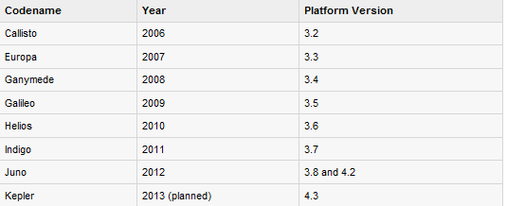
Eclipse Releases
Released
Notes:
Every year, since 2006, the Eclipse foundation releases the Eclipse Platform and a number of other plug-ins in June.

Slide 5
Downloading Eclipse
You can download eclipse from http://www.eclipse.org/downloads/.
The download page lists a number of flavours of eclipse.
On the windows platform, if you extracted the contents of the zip file to say c:\, then you can start eclipse by using c:\eclipse\eclipse.exe

Slide 6
Parts of an Eclipse Window
The major visible parts of an eclipse window are:
Views
Editors
Menu Bar
Toolbar

Slide 7
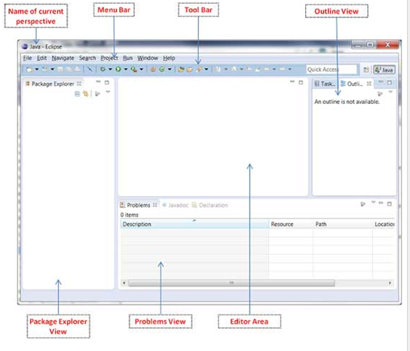
Parts of an Eclipse Window

Slide 8
Eclipse Perspective
An eclipse perspective is the name given to an initial collection and arrangement of views and an editor area.
Notes:
The default perspective is called java. An eclipse window can have multiple perspectives open in it but only one perspective can be active at any point of time. A user can switch between open perspectives or open a new perspective. A perspective controls what appears in some menus and tool bars.

Slide 9
Multiple Eclipse Windows
Multiple Eclipse Windows can be open at the same time.
To open a new window, click on the Windows menu and select the New Window menu item.
Each window can have a different perspective open in them
Notes:
For example you could open two Eclipse windows one in the Java perspective and the other in the Debug perspective. The window showing the Java perspective can be used for editing the java code and the window showing the debug perspective can be used for debugging the application being developed.

Slide 10
Eclipse Workspace
The eclipse workspace contains resources such as:
Projects
Files
Folders
The workspace has a hierarchical structure. Projects are at the top level of the hierarchy and inside them you can have files and folders.

Slide 11
Using the New Java Project wizard
The New Java Project Wizard has two pages.
On the first page:
Enter the Project Name
Select the Java Runtime Environment (JRE) or leave it at the default
Select the Project Layout which determines whether there would be a separate folder for the source code and class files. The recommended option is to create separate folders for sources and class files.
Notes:
Viewing the newly created project
The package explorer shows the newly created Java project. The icon that represents a Project is decorated with a "J" to show that it is a Java Project. The folder icon is decorated to show that it is a java source folder

Slide 12
Using the New Java Package wizard
Once the Java Package wizard comes up:
Enter/confirm the source folder name
Enter the package name
Click on the Finish button

Slide 13
Using the New Java Class wizard
Once the java class wizard comes up:
Ensure the source folder and package are correct
Enter the class name
Select the appropriate class modifier
Enter the super class name or click on the Browse
button to search for an existing class
Click on the Add button to select the interfaces implemented by this class

Slide 14
Running a Java Program
In the Package Explorer view:
Right click on the java class that contains the main method
Select Run As > Java Application
The same action can be performed using the Package Explorer view by selecting the class that contains the main method and pressing Alt + Shift + X, J

Slide 15
Java Build path
The Java build path is used while compiling a Java project to discover dependent classes .
It is made up of the following items:
Code in the source folders
Jars and classes folder associated with the project
Classes and libraries referenced by this project
Notes:
The java build path can be seen and modified by using the Java Build Path page of the Java Project properties dialog.
To bring up the Java Project properties dialog box, right click on a Java Project in the Package Explorer view and select the Properties menu item. On the left hand side tree select Java Build Path.
A common requirement seen while developing java applications is to add existing jars to the java build path. This can be accomplished using the Libraries tab. In the Libraries tab, just click on Add JARs if the jar is already in the Eclipse workspace or click on Add External JARs if the jar is elsewhere in the file system.
Other Projects in the same workspace can also be added to the current project’s build path.

Slide 16
Creating jars
The Jar File wizard can be used to export the content of a project into a jar file.
To bring up the Jar File wizard:
In the Package Explorer select the items that you want to export. If you want to export all the classes and resources in the project just select the project.
Click on the File menu and select Export.
In the filter text box of the first page of the export wizard type in "JAR".
Under the Java category select JAR file
Click on Next

Slide 17
Using the Jar File wizard
JAR is an archive file format typically used to aggregate many Java class files and associated metadata and resources into one file to distribute application software or libraries on the Java platform.
JAR files are built on the ZIP file format and have the .jar file extension
Notes:
To bring up the Jar File wizard:
In the Package Explorer select the items that you want to export. If you want to export all the classes and resources in the project just select the project.
Click on the File menu and select Export.
In the filter text box of the first page of the export wizard type in "JAR".
Under the Java category select JAR file
Click on Next
In the JAR File Specification page:
Enter the JAR file name and folder
The default is to export only the classes. To also export the source code Click on the "Export Java source files and resources" check box.
Click on Next to change the JAR packaging options
Click on Next to change the JAR Manifest specification
Click on Finish

Slide 18
Close Project
An eclipse workspace can contain any number of projects. A project can be either in the open state or closed state.
Open projects:
Consume memory
Take up build time especially when the Clean All Projects (Project > Clean all projects) with the Start a build immediately option is used
How to close a project?
If a project is not under active development it can be closed.
To close a project, from the Project select the Close Project menu item.

Slide 19
Reopening a Closed Project
To reopen a closed project,
in the Package Explorer view select the closed project .
click on the Project menu and select Open Project.

Slide 20
Build Project
The java builder is responsible for compiling the java source code and generating classes.
The java builder is notified of changes to the resources in a workspace and can automatically compile java code.
To disable automatic compilation deselect the Build Automatically option from the Project menu.

Slide 21
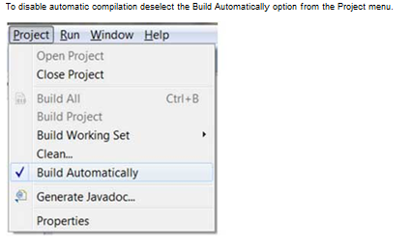
Build Project

Slide 22
Setting Preferences
The Preferences dialog allows Eclipse users to manage their preferences.
To invoke this dialog, click on the Window menu and select the Preferences menu item.

Slide 23
Using Content Assist
Within an editor, content assist helps reduce the characters typed by providing a context sensitive list of possible completions to the characters already typed.
The context assist can be invoked by pressing Ctrl + Space.
Notes:
If you are editing the body of a method in the java editor and press Ctrl + Space on a new line it will bring up a dialog showing:
The class variables
The class methods
Super class methods
Other relevant classes
If you type some characters or say switch ( switch statement ) and then press Ctrl + space the dialog box will show only items that start with the characters typed in.

Slide 24
Using Quick Fix
As you type characters into an eclipse editor it analyzes the document content for potential error and warnings. The java editor uses the java syntax to detect errors in the code.
When it finds error or warning, it:
Highlights errors using red squiggly lines
Highlights warnings using yellow squiggly lines
Displays errors and warnings in the Problem view
Adds a light bulb with a warning sign or error sign to the vertical ruler
Notes:
The quick fix dialog provides a list of possible corrections. The quick fix dialog can be invoked by:
Placing the mouse pointer on a squiggly line
Clicking on the light bulb
Placing the cursor in the highlighted text and selecting Quick fix from the Edit menu or pressing Ctrl + space

Slide 25
Using Hover Help
The java editor is associated with different type of hovers.
A hover provides additional information about the element under the mouse pointer.
Notes:
All the hovers associated with a java editor can be seen in the Java editor Hovers preference page.
In the java editor placing the mouse pointer over the class being imported displays the java doc associated with that class

Slide 26
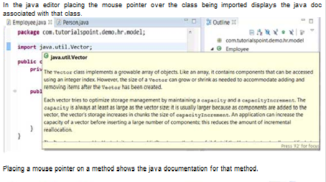
Using Hover Help

Slide 27
Searching the Workspace
The Eclipse search dialog box allows you to search for files that contain a literal or a character pattern in the entire workspace, a set of projects, a specific project or folders selects in the package explorer view.
The search dialog box can be invoked by:
Clicking on the Search menu and selecting Search or File or Java
Pressing Ctrl + H
Notes:
The File Search page allows you search any type of file but the Java Search page focuses on only Java files.
For example to search for usage of the Person type, in the Java Search page:
Enter Person into the search box
Set the search for radio button to Type
Set the limit to radio button to References
Click on Search

Slide 28
Refactoring using Eclipse
Renaming a class that is used widely throughout a project could take a lot of time but the Eclipse refactoring wizard makes the job easier by automatically detecting all dependencies on the class being renamed and modifying them also.

Slide 29
Refactoring using Eclipse
The refactor menu can be opened by:
Right clicking on a Java element in the Package Explorer view and selecting Refactor menu item
Right clicking on a Java element in the Java editor and selecting Refactor menu item
Selecting a Java element in either the Package Explorer view or Java Editor and pressing Shift + Alt + T

Slide 30
Managing Tasks
Programmers like to place TODO markers in their code which serves as a reminder for tasks that need to be completed.
Comments in the Java code that has the word TODO in them are recognized as task and shown on the marker bar and in the Tasks view.

Slide 31
Opening the Tasks View
To open the Tasks view:
Click on the Window menu and select Show View > Other
In the filter text box enter Tasks
Under General select Tasks
Click on OK
Notes:
The Tasks view can be used to view all the tasks and add tasks not associated with any resource
window , show view , tasks .

Slide 32
Plugins
The Eclipse platform which provides the foundation for the Eclipse IDE is composed of plug-ins and is designed to be extensible using additional plug-ins.
Several hundreds of plug-ins are available. Each plug-in adds more functionality to Eclipse. You can locate a plug-in that provides certain functionality by searching the Eclipse Market place (http://marketplace.eclipse.org/).
Notes:
From within the Eclipse IDE you can search the market place by using the Eclipse Marketplace dialog which can be invoked by clicking on the Help menu and selecting Eclipse Marketplace.
You can also install a plug-in by using the Install New Software menu item accessible from the Help menu (Help > Install New Software) . In this case you have to know the URL of the remote site from which the plug-in can be downloaded. You can supply this URL by clicking on the Add button. The install dialog box shows the plug-in components available in the remote site and allows you to install them.

Slide 33
To import Existing Projects into a workspace
You can use the Import Wizard to import an existing project into workspace.
From the main menu bar, select File > Import.... The Import wizard opens.
Select General > Existing Project into Workspace and click Next.
Choose either Select root directory or Select archive file and click the associated Browse to locate the directory or file containing the projects.
Under Projects select the project or projects which you would like to import.
Click Finish to start the import.

Slide 34
Shortcut Tips
Tip #1 - Creating Getters and Setters
Click on Source > Generate Getter and Setter to open the wizard that allows you to generate getter and setter methods.
Tip #2 - Locating a matching bracket
Select an opening or closing bracket and press Ctrl+Shift+P to find its matching bracket.
Tip #3 - Organizing Imports
Press Ctrl+Shift+O to organize all the imports.
Tip #4 - To get short cut key list
Press Cntrl+ Shift+ L

Slide 35
Abstraction
Abstraction is implemented through
Abstract Class
and
Interface

Slide 36
Abstract Classes
Java provides you with a special type of class, called an abstract class,which can help you, organize your classes based on common methods.
An abstract class lets you put the common method names in one abstract class without having to write the actual implementation code.

Slide 37
Abstract Classes
Following are the key points of abstract class –
Classes, which contain abstract methods, are called abstract classes.
A program cannot instantiate an abstract class as an object.It's sole purpose is to be subclassed (extended)
Abstract classes may contain a mixture of non-abstract and abstract methods.
Any concrete subclass, which extends the class containing abstract methods, must provide the implementation for all the abstract methods
Abstract method cannot be declared private.
Abstract classes can declare fields that are not static and final, and define public, protected, and private concrete methods.
Notes:
Abstract methods don't have a body. these are empty methods.So when declaring an abstract method, end the line with ";".
An abstract method is declared that way:
public abstract void abstractMethod();
An abstract class is a class that is declared abstract—it may or may not include abstract methods.A class can be declared abstract without abstract methods to block instantiation and also later if the class is to contain abstract methods.
An abstract class cannot be instantiated because it has incomplete methods and hence the JVM does not know how much memory to allocate.
An abstract class cannot be final , because if abstract class is final it cannot be extended and the purpose of an abstract class is to be extended.
If an abstract class extends the abstract class , all the abstract methods need not be implemented in the very next extended class but as a thumb rule the abstract methods has to be implemented within the next 3 inherited classes.

Slide 38
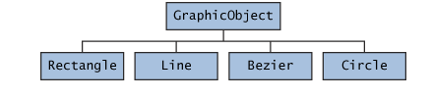
An abstract class example
Notes:
Demo Program :In package com.demoprograms.day3 - AbstractDemo.java ( Eclipse Workspace )
In an object-oriented drawing application, you can draw circles, rectangles, lines, Bezier curves, and many other graphic objects.
These objects all have certain states (for example: position, orientation, line color, fill color) and behaviors (for example: moveTo, rotate, resize, draw) in common.
Some of these states and behaviors are the same for all graphic objects (for example: position, fill color, and moveTo). Others require different implementations (for example, resize or draw).
First, you declare an abstract class, GraphicObject, to provide member variables and methods that are wholly shared by all subclasses, such as the current position and the moveTo method. GraphicObject also declares abstract methods for methods, such as draw or resize, that need to be implemented by all subclasses but must be implemented in different ways.
The below code can be coded and shown by the trainer in Eclipse IDE and demonstrated practically the compile time errors that are thrown
1) when a class with abstract methods is not declared abstract.
2) If implementation is given for an abstract method in the abstract class
3) If all the abstract methods are not implemented in the concrete class which extends the abstract class.
abstract class GraphicObject {
int x, y;
...
void moveTo(int newX, int newY) {
...
}
abstract void draw();
abstract void resize();
}
Each nonabstract subclass of GraphicObject, such as Circle and Rectangle, must provide implementations for the draw and resize methods:
class Circle extends GraphicObject {
void draw() {
System.out.println(“Drawing code for Circle”);
...
}
void resize() {
...
}
}
class Rectangle extends GraphicObject {
void draw() {
...
}
void resize() {
...
}
}

Slide 39
Interface
An interface is a collection of abstract methods.
A class implements an interface, thereby inheriting the abstract methods of the interface.
Unless the class that implements the interface is abstract, all the methods of the interface need to be defined in the class.
To implement the interface,use the implements keyword in the class declaration.
Notes:
An interface is not a class. Writing an interface is similar to writing a class, but they are two different concepts. A class describes the attributes and behaviors of an object. An interface contains behaviors that a class implements.
Interface can be used when you need multiple implementations of the same behavior.
The below code can be coded and shown in Eclipse IDE :
Demonstrate the foll:
1) Need not specify public and abstract for interface since methods in an interface are implicitly public and abstract.
2) Only public static final variables are allowed.
3) Methods are not allowed to be implemented in an interface
Eg.
/* File name : Account.java */
interface Account {
void deposit();
void withdraw();
}
class Savings implements Account
{
public void deposit(){
System.out.println("code for deposit in savings");
}
public void withdraw(){
}
}
class Current implements Account
{
public void deposit(){
System.out.println("code for deposit in current");
}
public void withdraw(){
}
}

Slide 40
Similarities of Interface and Class
An interface is similar to a class in the following ways:
An interface can contain any number of methods.
An interface is written in a file with a .java extension, with the name of the interface matching the name of the file.
The bytecode of an interface appears in a .class file.
Notes:
Demo Program : In packages com.demoprograms.day3.pack ( Inter_Demo.java) and com.demoprograms.day3.trial_pack ( Account.java,Ebank.java )
Interfaces have the following properties:
An interface is implicitly abstract. You do not need to use the abstract keyword when declaring an interface.
Each method in an interface is also implicitly abstract, so the abstract keyword is not needed.
Methods in an interface are implicitly public.

Slide 41
Difference between Interface and Class
You cannot instantiate an interface.
An interface does not contain any constructors.
All of the methods in an interface are abstract.
An interface cannot contain instance fields. The only fields that can appear in an interface must be declared both static and final.
An interface is not extended by a class; it is implemented by a class.
An interface can extend multiple interfaces.

Slide 42
Extending Interfaces
An interface can extend another interface, similarly to the way that a class can extend another class.
The extends keyword is used to extend an interface, and the child interface inherits the methods of the parent interface.
Notes:
The following Sports interface is extended by Hockey and Football interfaces.
//Filename: Sports.java
public interface Sports
{
public void setHomeTeam(String name);
public void setVisitingTeam(String name);
}
//Filename: Football.java
public interface Football extends Sports
{
public void homeTeamScored(int points);
public void visitingTeamScored(int points);
public void endOfQuarter(int quarter);
}
//Filename: Hockey.java
public interface Hockey extends Sports
{
public void homeGoalScored();
public void visitingGoalScored();
public void endOfPeriod(int period);
public void overtimePeriod(int ot);
}

Slide 43
Extending Multiple Interfaces
A Java class can only extend one parent class. Multiple inheritance is not allowed. Interfaces are not classes, however, and an interface can extend more than one parent interface.
The extends keyword is used once, and the parent interfaces are declared in a comma-separated list.
Notes:
For example, if the Hockey interface extended both Sports and Event, it would be declared as:
public interface Hockey extends Sports, Event

Slide 44
Which should you use, abstract classes or interfaces?
Consider using abstract classes if any of these statements apply to your situation:
You want to share code among several closely related classes.
You expect that classes that extend your abstract class have many common methods or fields, or require access modifiers other than public (such as protected and private).
You want to declare non-static or non-final fields. This enables you to define methods that can access and modify the state of the object to which they belong.

Slide 45
Which should you use, abstract classes or interfaces?
Consider using interfaces if any of these statements apply to your situation:
You expect that unrelated classes would implement your interface .
You want to specify the behavior of a particular data type, but not concerned about who implements its behavior.
You want to take advantage of multiple inheritance of type.

Slide 46
instanceOf Operator
The instanceof operator allows you determine the type of an object.
It takes an object on the left side of the operator and a type on the right side of the operator and returns a boolean value indicating whether the object belongs to that type or not.
Notes:
Demo Program : InstanceofDemo.java
In the demo program touch upon marker interfaces.
Marker interface is used as a tag to inform a message to the java compiler so that it can add special behaviour to the class implementing it. Java marker interface has no members in it. Eg. java.lang.Cloneable; java.io.Serializable;
Lets take the java.io.Serializable marker interface. It does not has any members defined it it. When a java class is to be serialized, you should intimate the java compiler in some way that there is a possibility of serializing this java class. In this scenario, marker interfaces are used.
In the above program , there is an user defined marker interface called MyInterface with no methods in it. It is used here to just to check out whether an object is an instance of it. Only simple user defined marker interfaces can be created But to do specific functionalites you have to change
in the JVM.
In the Demo program , also demonstrate the type of object creation done
Person obj = new Teacher(); ( where teacher extends Person)
creates memory for teacher but java allows creating a reference for Person and access it's members
obj is object of person and teacher.
Such type of object creation is used when :
When Person is an interface or an abstract class
When we want to predominantly access the members of Person because by default only parent class members will be listed.
If child class members have to be accessed , we can typecast as follows :
((Teacher)obj2). Will list both parent and child class members.
Teacher t =new person(); ( invalid )
- any random person cannot be a teacher

Slide 47
Check Your Understanding
1. Eclipse platform can be used to develop ____ applications.
Rich client
2. Classes which contain ______ methods are called abstract classes.
abstract
3. Abstract method cannot be declared private. Yes/No
Yes
4. An interface is a collection of _________.
Abstract methods
5. An interface is not _______ by a class, but it is _____ by a class.
Extended, Implemented

