Slide 1

JDBC
Notes:
This Module covers :
JDBC Architecture
JDBC Drivers
Types of Statements
Resultsets
Metadata
JDBC Transaction
Batch Processing

Slide 2
What is JDBC
JDBC stands for Java Database Connectivity.
JDBC works with Java on a variety of platforms, such as Windows, Mac OS, and the various versions of UNIX.
Notes:
JDBC can be used with Java components such as
Java Applications
Java Applets
Java Servlets
Java ServerPages (JSPs)
Enterprise JavaBeans (EJBs)
Note : Through JDBC we can also access Excel sheets,Flat files.

Slide 3
What is JDBC
JDBC is Java application programming interface that allows the Java programmers to access database management system from Java code.
JDBC is a core part of the Java platform and is included in the standard JDK distribution.
Notes:
Sun Microsystems released JDBC as part of JDK 1.1 on February 19, 1997. It has since formed part of the Java Standard Edition.
The JDBC classes are contained in the Java package java.sql and javax.sql.
The latest version, JDBC 4.1, is included in Java SE 7.

Slide 4
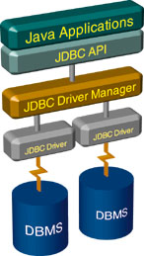
JDBC Architecture:
Connect
Query
Process
results
Close
Notes:
As seen from the above diagram, the DriverManager class is the traditional management layer of JDBC, working between the user and the drivers. It keeps track of the drivers that are available and handles establishing a connection between a database and the appropriate driver. In addition, the DriverManager class attends to things like driver login time limits and the printing of log and tracing messages.
Is JDBC 2 or 3 tier ?
JDBC for a 2-tier architecture
In this architecture, the client machine will typically be a Java application and the server machine will have a Relational Database installed on it. The client will send the statements to the database residing on the server and the result will be communicated back to the client.
JDBC for a 3-tier architecture
In such an architecture, the client machine will send the database access statements to the middleware, which will then send the statements to the database residing on the third tier of the architecture, which is normally referred to as the back end. The statements will be processed there and the result be returned back to the client through the middle tier. This scenario will typically have a Java Applet or a Web Browser as the client tier, an Application Server as the Middle-tier, and a Relational DBMS as the Back-end.

Slide 5
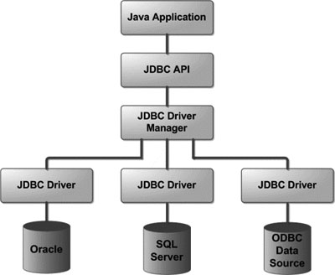
JDBC Architecture:
Notes:
The JDBC API provides the following interfaces and classes:
DriverManager: This class manages a list of database drivers. Matches connection requests from the java application with the proper database driver using communication subprotocol. The first driver that recognizes a certain subprotocol under JDBC will be used to establish a database Connection.
Driver: This interface handles the communications with the database server. You will interact directly with Driver objects very rarely. Instead, you use DriverManager objects, which manages objects of this type. It also abstracts the details associated with working with Driver objects.
Connection : This interface with all methods for contacting a database. The connection object represents communication context, i.e., all communication with database is through connection object only.
Statement : You use objects created from this interface to submit the SQL statements to the database. Some derived interfaces accept parameters in addition to executing stored procedures.
ResultSet: These objects hold data retrieved from a database after you execute an SQL query using Statement objects. It acts as an iterator to allow you to move through its data.
SQLException: This class handles any errors that occur in a database application.

Slide 6
What is JDBC Driver ?
JDBC drivers enable you to open database connections and to interact with it by sending SQL or database commands
Four Types of Drivers are provided.
Notes:
JDBC drivers implement the defined interfaces in the JDBC API for interacting with your database server.
JDBC driver implementations vary because of the wide variety of operating systems and hardware platforms in which Java operates. Sun has divided the implementation types into four categories, Types 1, 2, 3, and 4.

Slide 7
JDBC Drivers
1. JDBC-ODBC bridge
2. Part Java, Part Native Driver
3. Intermediate DAccess Server
4. Pure Java Drivers
Notes:
A database vendor or third-party developer writes a JDBC driver, which is a set of classes that implements these interfaces for a particular database system.
An application can use a number of drivers interchangeably.
JDBC drivers are available for most database platforms, from a number of vendors and in a number of different flavors.
Type 2 driver is also known as Native API driver
Type 3 driver is also known as Network protocol driver.
Type 4 driver is also known as Database protocol driver

Slide 8
1. JDBC-ODBC Bridge
• ODBC(Open DataBase Connectivity)
A set of APIs for database access
Originally only for windows platforms, later extended to
non-windows platforms
• The standard JDK includes classes for the JDBC-ODBC
bridge (sun.jdbc.odbc.JdbcOdbcDriver)
• There is no need for additional installation, but need
to configure the ODBC driver by creating data source names in your system

Slide 9
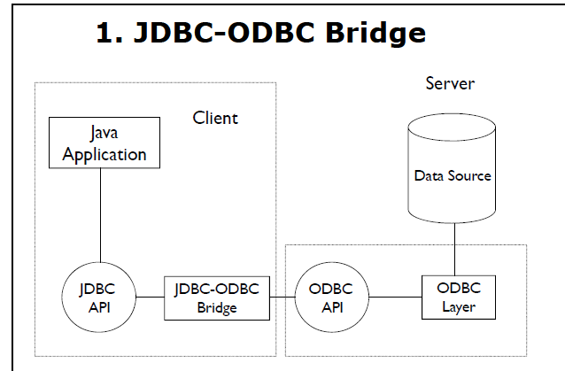
Notes:
Use of this driver is discouraged if the alternative of a pure-Java driver is available. The other implication is that any application using a type 1 driver is non-portable given the binding between the driver and platform.

Slide 10
2. Part Java, Part Native Driver
• A mixture of Java implementation and vendor-specific native APIs for data access
• This is similar to type 1 except that these have one less layer to go through and so is faster
• The native JDBC driver (part Java, part native code) must be installed on each client along with the vendor-specific native language API

Slide 11
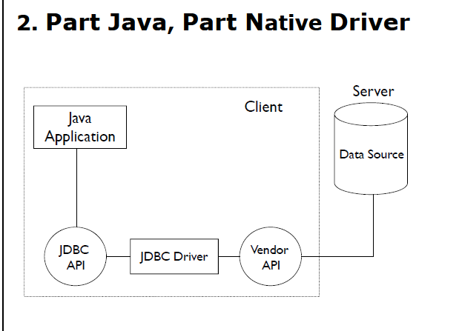
2. Part Java, Part Native Driver

Slide 12
3. Intermediate Database Access
Server
This type of driver sends the JDBC calls to a middleware server that can connect to different type of databases.
We should have a middleware server installed to work with this kind of driver.
This adds to extra network calls and slow performance. Hence this is also not widely used JDBC driver.

Slide 13
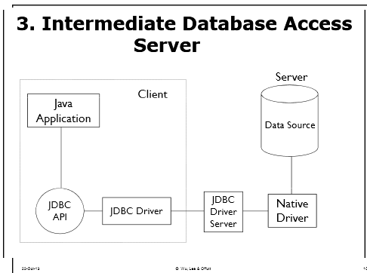
3. Intermediate Database Access
Server
Notes:
Like type 4 drivers, the type 3 driver is written entirely in Java. The same driver can be used for multiple databases .The number of databases the driver can support depends on how the middleware has been configured to support. The type 3 driver is platform independent as the platform-related differences are taken care of by the middleware.

Slide 14
4. Pure Java Driver
Converts the JDBC API calls to direct network calls using vendor-specific networking protocols
Makes direct socket connections with the database
It is the most efficient method to access database, both in performance and development time
It is the simplest to deploy
All major database vendors provide Type 4 JDBC drivers for their databases
Notes:
As the database protocol is vendor specific, the JDBC client requires separate drivers, usually vendor supplied, to connect to different types of databases. This type includes, for example, the widely used Oracle thin driver.
For example OJDBC jars provided by Oracle for Oracle DB and MySQL Connector/J for MySQL databases
Completely implemented in Java to achieve platform independence.

Slide 15
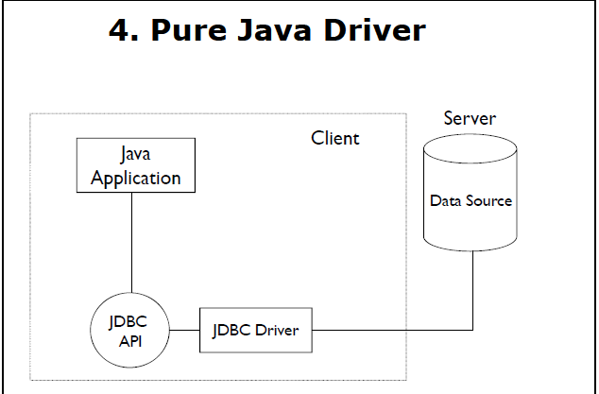

Slide 16
Which Driver should be used?
If you are accessing databases such as Oracle, Sybase the preferred driver type is 4.
If your Java application is accessing multiple types of databases at the same time, type 3 is the preferred driver.
Type 2 drivers are useful in situations where a type 3 or type 4 driver is not available yet for your database.
The type 1 driver is not considered a deployment-level driver and is typically used for development and testing purposes only.

Slide 17
Typical JDBC Programming Procedure
1. Import jdbc package
2. Load the database driver
2. Obtain a connection
3. Create and execute statements
4. Use result sets to navigate through the results
5 Close the connection

Slide 18
Import JDBC Packages
Include the following import statement at the beginning of your program:
import java.sql.*
Notes:
Java.sql package : Provides the API for accessing and processing data stored in a data source (usually a relational database) .
Javax.sql package : Provides the API for server side data source access and processing .This package supplements the java.sql package and as of the version 1.4 release, is included in the Java Platform .

Slide 19
Stage 1 – JDBC
Connect
Register JDBC driver
Query
Connect to the database
Process
results
Close

Slide 20
Register JDBC Driver:
This class is used to register and load the database driver. This can load the driver into memory and make a connection.
Class.forName( ) is used to register the driver:
Notes:
You must register your driver in your program before you use it. Registering the driver is the process by which the Oracle driver's class file is loaded into memory so it can be utilized as an implementation of the JDBC interfaces.
The most common approach to register a driver is to use Java's Class.forName() method to dynamically load the driver's class file into memory, which automatically registers it. This method is preferable because it makes the driver registration configurable and portable.
newInstance() method can also be used to work around noncompliant JVMs, but then you'll have to code for two extra Exceptions as follows:
try {
Class.forName("oracle.jdbc.driver.OracleDriver").newInstance();
}
catch(ClassNotFoundException ex) {
System.out.println("Error: unable to load driver class!");
System.exit(1);
catch(IllegalAccessException ex) {
System.out.println("Error: access problem while loading!");
System.exit(2);
catch(InstantiationException ex) {
System.out.println("Error: unable to instantiate driver!");
System.exit(3);
}

Slide 21
Eg. To register Driver with Class.forName()
try { Class.forName("sun.jdbc.odbc.JdbcOdbcDriver");
}
catch(Exception x)
{
}

Slide 22
Connect to the Database
DriverManager.getConnection() method to create a connection object.
The most commonly used form of getConnection() requires you to pass a database URL, a username, and a password:
Notes:
DriverManager object's getConnection( ) method is used to establish actual database connection.

Slide 23
Eg. To create a Connection
try{ Connection dbConnection=DriverManager.getConnection(url,"loginName","Password")
}
catch( SQLException x )
{
}
Notes:
Note : SQL Exception is a checked Exception.
The most commonly used form of getConnection() requires you to pass a database URL, a username, and a password:
Type 4 Driver [ Commonly used in production Environment ]
Assuming you are using Oracle's thin driver, you'll specify a host:port:databaseName value for the database portion of the URL.
If you have a host at TCP/IP address 172.16.1.29 and your Oracle listener is configured to listen on port 1521, and your database name is Nalanda, then complete database URL would then be:
Eg. jdbc:oracle:thin:@172.16.1.29 :1521:Nalanda.
Type 1 Driver
Jdbc:odbc:jdbcodbcDriverDsn
Eg. idbc:odbc:stud where stud is the datasource name.
Type 2 Driver
To connect to oracle using thin driver provided by Oracle
Jdbc:oracle:thin:@<TNSNAMES entry>
In the above example, we are using the OCI (Oracle Call Interface) libraries that are installed on the client machines from where the JDBC calls are to be made. Hence the sub protocol is ‘oracle’. The rest of the string gives details required by the Type 2 driver implementation for the oracle database.
[ The only requirement is that a driver be able to recognize its own URLs. ]

Slide 24
Stage 2
Connect
Query
Create a statement
Process
results
Query the database
Close

Slide 25
JDBC Statements
Once a connection is obtained we can interact with the database.
The JDBC Statement, CallableStatement, and PreparedStatement interfaces define the methods and properties that enable you to send SQL or PL/SQL commands and receive data from your database

Slide 26
JDBC Statements
Statement -Used for general-purpose access to your database.
PreparedStatement -Used when you plan to use the SQL statements many times. The PreparedStatement interface accepts input parameters at runtime.
CallableStatement-Used when you want to access database stored procedures. The Callable Statement interface can also accept runtime input parameters.

Slide 27
Creating Statement Object:
Statement stmt = null;
try {
stmt = conn.createStatement( );
. . .
}
catch (SQLException e) {
. . .
}
finally { . . .
}
Notes:
Demo Programs : First.java ( Using Type 4 Driver ) , First_Prop.java , Data.properties ( Using properties file ), DML_Demo.java.
Nalanda DB server details are given in D4.A2 .doc
Oracle JDBC Driver class has to be dynamically loaded :
Eg. Class.forName("oracle.jdbc.OracleDriver");
The above OracleDriver class is present in classes12.jar in JDK 1.2 & 1.3 , ojdbc14.jar in JDK 1.4 and ojdbc5.jar in JDK 1.5 and ojdbc6.jar in JDK 1.6.
The above jars can be found in oracle installations.
To set the classpath for the jar.
In command prompt need to give :
Set classpath=;classfilepath/ojdbc14.jar.jar;
Eg; D:\Oracle\app\oracle\product\10.2.0\server\jdbc\lib/ojdbc14.jar;
In Eclipse :
add classes12.jar to your project’s build path ,
right click project‐>Build Path‐>Configure Build Path
‐>Add classes12.jar as a external Jar.
Generic Statements are used for simple querying and to execute simple DMLs . Eg one row insertion
Before you can use a Statement object to execute a SQL statement, you need to create one using the Connection object's createStatement( ) method,
Once you've created a Statement object, you can then use it to execute a SQL statement with one of its three execute methods.
boolean execute(String SQL) : Returns a boolean value of true if a ResultSet object can be retrieved; otherwise, it returns false. Use this method to execute SQL DDL statements or when you need to use truly dynamic SQL.
int executeUpdate(String SQL) : Returns the numbers of rows affected by the execution of the SQL statement. Use this method to execute SQL statements for which you expect to get a number of rows affected - for example, an INSERT, UPDATE, or DELETE statement. For statements such as CREATE TABLE or DROP TABLE, which do not operate on rows, the executeUpdate() method is returns always zero.
ResultSet executeQuery(String SQL) : Returns a ResultSet object. Use this method when you expect to get a result set, as you would with a SELECT statement.
Note : Ask the trainees to check out on execution , what happens when there are no rows in the table.
.

Slide 28
PreparedStatement
The PreparedStatement interface extends the Statement interface which gives you added functionality with a couple of advantages over a generic Statement object.
This statement gives you the flexibility of supplying arguments dynamically.
Notes:
Demo Program : PrepStatementDemo.java
A Statement is usually compiled and executed each time it is submitted to the database; a PreparedStatement may be compiled once and executed
repeatedly with different parameters. It is used to do repetitive tasks eg. Repetitive insertions.
try {
String SQL = "Update Employees SET age = ? WHERE id = ?";
pstmt = conn.prepareStatement(SQL);
. . .
}
catch (SQLException e) {
. . .
}
finally {
. . .
}
In PreparedStatements parameters in JDBC are represented by the ? symbol, which is known as the parameter marker or place holder . You must supply values for every parameter before executing the SQL statement.
The setXXX() methods bind values to the parameters, where XXX represents the Java data type of the value you wish to bind to the input parameter. If you forget to supply the values, you will receive an SQLException.
Each parameter marker is referred to by its ordinal position. The first marker represents position 1, the next position 2, and so forth. This method differs from that of Java array indices, which start at 0.
All of the Statement object's methods for interacting with the database (a) execute(), (b) executeQuery(), and (c) executeUpdate() also work with the PreparedStatement object.

Slide 29
The CallableStatement Objects:
Just as a Connection object creates the Statement and PreparedStatement objects, it also creates the CallableStatement object which would be used to execute a call to a database stored procedure.
Using CallableStatement objects is much like using PreparedStatement objects. You must bind values to all parameters before executing the statement, or you will receive an SQLException.
Notes:
Demo Program : CallableStatementDemo.java
Oracle Procedure [ The procedure has to be created in Oracle meaning the proecedure will be created , compiled and stored in Oracle – instead of executing the proc through Oracle we will execute through java ]
create or replace procedure proc is
begin
delete from emp where ename='Deepthi';
end;

Slide 30
Parameter Types in Callable Statements
Three types of parameters exist: IN, OUT, and INOUT.
The PreparedStatement object only uses the IN parameter.
The CallableStatement object can use all three.
Notes:
Demo Program : Proc_in_out.java ( To invoke a Oracle Procedure with in and out parameter )
Oracle Procedure
create or replace procedure proc2(
id in emp.empno%TYPE,
empname out emp.ename%TYPE)
is
begin
select ename into empname from emp where empno=id;
end proc2;
Demo Program : Fun_Demo.java ( To invoke a Oracle function )
Oracle Function
CREATE OR REPLACE Function Findsal
( name_in IN varchar2 )
RETURN number
IS
csal number;
BEGIN
select sal into csal from emp where ename = name_in;
RETURN csal;
END;

Slide 31
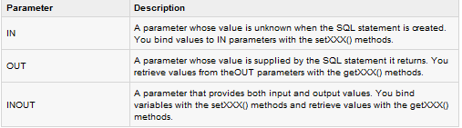
Parameter Types in Callable Statements
Notes:
If you have IN parameters, just follow the same rules and techniques that apply to a PreparedStatement object; use the setXXX() method that corresponds to the Java data type you are binding.
When you use OUT and INOUT parameters you must employ an additional CallableStatement method, registerOutParameter(). The registerOutParameter() method binds the JDBC data type to the data type the stored procedure is expected to return.
Once you call your stored procedure, you retrieve the value from the OUT parameter with the appropriate getXXX() method. This method casts the retrieved value of SQL type to a Java data type.

Slide 32
Querying the Database: Examples
Following Statements are used to execute Select statement:
Statement stmt = conn.createStatement();
ResultSet rset = stmt.executeQuery
("select NAME, VERTICAL from STUDENT");
Statement stmt = conn.createStatement();
int rowcount = stmt.executeUpdate
("delete from STUDENT where ID = 1000");
Notes:
As mentioned earlier, the Statement interface provides three different methods for executing SQL statements: executeQuery, executeUpdate, and execute.
The correct method to use is determined by what the SQL statement produces.

Slide 33
Stage 3
Connect
Query
Step through the results
Process
results
Assign results to Java
variables
Close

Slide 34
Resultsets
A ResultSet object maintains a cursor that points to the current row in the result set.
The term "result set" refers to the row and column data contained in a ResultSet object.

Slide 35
Resultsets
The SELECT statement is the standard way to select rows from a database and view them in a result set.
The java.sql.ResultSet interface represents the result set of a database query.
A ResultSet object maintains a cursor that points to the current row in the result set.

Slide 36
Three Categories of Resultset Methods
Navigational methods: used to move the cursor around.
Get methods: used to view the data in the columns of the current row being pointed to by the cursor.
Update methods: used to update the data in the columns of the current row. The updates can then be updated in the underlying database as well.

Slide 37
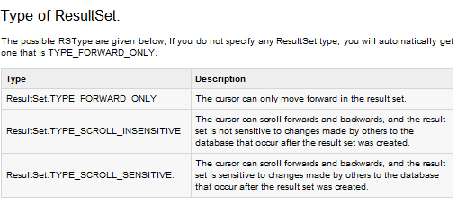
Type of ResultSet:
Notes:
Demo Program : RSDemo.java
The object of ResultSet maintains a cursor pointing to a particular row of data. Initially, cursor points to before the first row.
By default, ResultSet object can be moved forward only and it is not updatable. But we can make this object to move forward and backward direction by passing either TYPE_SCROLL_INSENSITIVE or TYPE_SCROLL_SENSITIVE in createStatement(int,int) method as well as we can make this object as updatable by giving
Statement stmt = con.createStatement(ResultSet.TYPE_SCROLL_INSENSITIVE,ResultSet.CONCUR_UPDATABLE);
Difference between TYPE_SCROLL_INSENSITIVE , and TYPE_SCROLL_SENSITIVE?
You will get a scrollable ResultSet object if you specify one of these ResultSet constants.The difference between the two has to do with whether a result set reflects changes that are made to it while it is open and whether certain methods can be called to detect these changes. Generally speaking, a result set that is TYPE_SCROLL_INSENSITIVE does not reflect changes made while it is still open and one that is TYPE_SCROLL_SENSITIVE does.

Slide 38
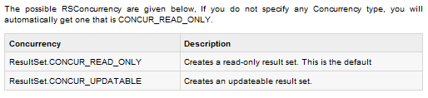
Concurrency of ResultSet:

Slide 39
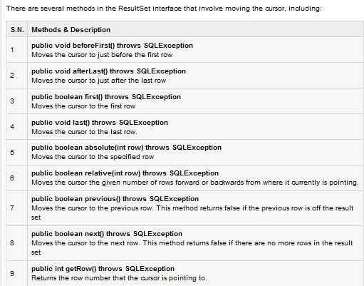
Navigating a Result Set:

Slide 40
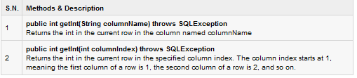
Viewing a ResultSet
For example, if the column you are interested in viewing contains an int, you need to use one of the getInt() methods of ResultSet:
Notes:
The ResultSet interface contains dozens of methods for getting the data of the current row.
There is a get method for each of the possible data types, and each get method has two versions:
One that takes in a column name.
One that takes in a column index.
Similarly there are get methods in the ResultSet interface for each of the eight Java primitive types, as well as common types such as java.lang.String, java.lang.Object, and java.net.URL.
There are also methods for getting SQL data types java.sql.Date, java.sql.Time, java.sql.TimeStamp, java.sql.Clob, and java.sql.Blob.

Slide 41
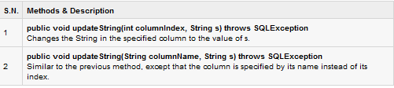
Updating a Resultset
As with the get methods, there are two update methods for each data type:
One that takes in a column name.
One that takes in a column index
Eg .

Slide 42
Updating a Resultset
Updating a row in the result set changes the columns of the current row in the ResultSet object, but not in the underlying database.
To update your changes to the row in the database, you need to invoke one of the following methods.

Slide 43
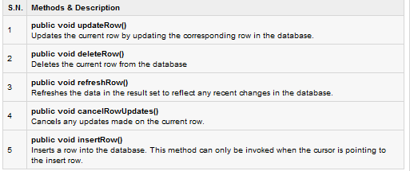
Update Methods
Notes:
Demo Program : UpdateableResultset.java

Slide 44
Stage 4
Connect
Query
Close the result set
Process
results
Close the statement
Close
Close the connection

Slide 45
Closing Statement Object
Just as you close a Connection object to save database resources, for the same reason you should also close the Statement object.
A simple call to the close() method will do the job. If you close the Connection object first it will close the Statement object as well. However, you should always explicitly close the Statement object to ensure proper cleanup.
Notes:
Statement stmt = null;
try {
stmt = conn.createStatement( );
. . .
}
catch (SQLException e) {
. . .
}
finally {
stmt.close();
}
close() applies to all kinds of Statements.

Slide 46
Closing JDBC connections:
At the end of your JDBC program, it is required explicitly close all the connections to the database to end each database session.
However, if you forget, Java's garbage collector will close the connection when it cleans up stale objects.

Slide 47
Closing JDBC connections
Relying on garbage collection, especially in database programming, is very poor programming practice. You should make a habit of always closing the connection with the close() method associated with connection object.
To ensure that a connection is closed, you could provide a finally block in your code. A finally block always executes, regardless if an exception occurs or not.
Notes:
To close above opened connection you should call close() method as follows:
conn.close();
When a Statement object is closed, its current ResultSet object, if one exists, is also closed.
However, the javadocs are not very clear on whether the Statement and ResultSet are closed when you close the underlying Connection.

Slide 48
Database MetaData Object
DatabaseMetaData is an interface to get comprehensive information about the database as a whole.
The Connection object can be used to get a DatabaseMetaData object
This object provides more than 100 methods to obtain information about the database

Slide 49
How to obtain Database Metadata?
1. To get the DatabaseMetaData Object
2. Use the object’s methods to get the metadata
DatabaseMetaData dbmd = conn.getMetaData();
DatabaseMetaData dbmd = conn.getMetaData();
String s1 = dbmd getURL();
String s2 = dbmd.getSQLKeywords();
boolean b1 = dbmd.supportsTransactions();
boolean b2 = dbmd.supportsSelectForUpdate();
Notes:
This interface is implemented by driver vendors to let users know the capabilities of a Database Management System (DBMS) in combination with the driver based on JDBC technology ("JDBC driver") that is used with it.
A user for this interface is commonly a tool that needs to discover how to deal with the underlying DBMS. This is especially true for applications that are intended to be used with more than one DBMS.
For example:
getURL(): Returns the URL for the DBMS
getSQLKeywords(): Retrieves a comma-separated list of all of this database's SQL keywords that are NOT also SQL92 keywords.
supportsTransactions(): Retrieves whether this database supports transactions. If not, invoking the method commit is no use, and the isolation level is TRANSACTION_NONE.
supportsSelectForUpdate(): Retrieves whether this database supports SELECT FOR UPDATE statements.

Slide 50
Resultset MetaData
ResultSetMetaData is an interface which contains methods to get information about the types and properties of the columns in the ResultSet object.
ResultSetMetaData object provides metadata, including:
  Number of columns in the result set
  Column type
  Column name
Notes:
Demo Program : RSMetadata.java
ResultSetMetaData
In JDBC, you use the ResultSet.getMetaData() method to return a ResultSetMetaData object, which describes the data coming back from a database query. This object can be used to find out about the types and properties of the columns in your ResultSet.

Slide 51
Resultset MetaData
To get the ResultSetMetaData object
2. Use the object’s methods to get the metadata
ResultSetMetaData rsmd = rset.getMetaData();
ResultSetMetaData rsmd = rset.getMetaData();
for (int i = 1; i <= rsmd.getColumnCount(); i++) {
String colname = rsmd.getColumnName(i);
int coltype = rsmd.getColumnType(i);
…
}
Notes:
Example
The example on the slide shows how to use a ResultSetMetaData object to determine the following information about the ResultSet:
The number of columns in the ResultSet.
The name of each column
The American National Standards Institute (ANSI) SQL type for each column
The java.sql.Types class defines constants that are used to identify ANSI SQL types. ResultSetMetaData.getColumnType() returns an integer value that corresponds to one of these constants.

Slide 52
Mapping Database Types to java.sql Types
ResultSet maps database types to Java types.
ResultSet rset = stmt.executeQuery
("select ID, DATE_OF_JOIN, SUPERVISOR
from STUDENT");
int id = rset.getInt(1);
Date rentaldate = rset.getDate(2);
String status = rset.getString(3);
Col Name
ID
DATE_OF_JOIN
SUPERVISOR
Type
NUMBER
DATE
VARCHAR2
Notes:
Mapping Database Types to Java Types
In many cases, you can get all the columns in your result set using the getObject() or getString() methods of ResultSet. For performance reasons, or because you want to perform complex calculations, it is sometimes important to have your data in a type that exactly matches the database column.

Slide 53
JDBC Transactions
With JDBC drivers:
  New connections are in autocommit mode
  Use conn.setAutoCommit(false) to turn autocommit off
To control transactions when you are not in autocommit mode:
  conn.commit(): Commit a transaction
  conn.rollback(): Roll back a transaction
Notes:
Demo Program : BatchUpdateDemo.java ( Demo for transaction and Batch Processing )
In the above program , at first comment the lines pertaining to commit such that it is in the default auto commit mode. The second DML statement to delete has a wrong identifier ( I is not a valid identifier in the trial table ) , still because every single statement is auto committed the first DML will be done though the second has an error . Now switch off autocommit ( uncomment the lines ) and execute the program . Since the second DML has an error , the first one will be rolled because both a part of a transaction.
Transactions with JDBC
With JDBC, database transactions are managed by using the Connection object. When you create a Connection obj ect, by default in autocommit mode, meaning that, after executing every statement by default it is commited.
You can change the autocommit mode by using setAutoCommit() method. Here is a full description of autocommit mode:
If a connection is in autocommit mode, all its SQL statements will be executed and committed as individual transactions.
If a statement returns a result set, the statement completes when the last row of the result set has been retrieved, or the result set has been closed.
If autocommit mode has been disabled, its SQL statements are grouped into transactions, which must be terminated by calling either commit() or rollback(). commit() makes permanent all changes since the previous commit or rollback and releases any database locks held by the connection.
rollback() drops all changes since the previous commit or rollback and releases any database locks. commit() and rollback() should only be called when in non-autocommit mode.

Slide 54
JDBC Transactions
That may be fine for simple applications, but there are three reasons why you may want to turn off auto-commit and manage your own transactions:
To increase performance
To maintain the integrity of business processes
To use distributed transactions
Notes:
Transaction Management in JDBC
Transaction represents a single unit of work.
The ACID properties describes the transaction management well. ACID stands for Atomicity, Consistency, isolation and durability.
Atomicity means either all successful or none.
Consistency ensures bringing the database from one consistent state to another consistent state.
Isolation ensures that transaction is isolated from other transaction.
Durability means once a transaction has been committed, it will remain so, even in the event of errors, power loss etc.
Advantage of Transaction Mangaement
fast performance It makes the performance fast because database is hit at the time of commit.

Slide 55
Commit & Rollback
Once you are done with your changes and you want to commit the changes then call commit() method on connection object as follows:
conn.commit( ); Otherwise, to roll back updates to the database made using the Connection named conn, use the following code:
conn.rollback( );

Slide 56
Batch Processing
Batch Processing allows you to group related SQL statements into a batch and submit them with one call to the database.
When you send several SQL statements to the database at once, you reduce the amount of communication overhead, thereby improving performance.
Notes:
Instead of executing a single query, we can execute a batch (group) of queries. It makes the performance fast.
The java.sql.Statement and java.sql.PreparedStatement interfaces provide methods for batch processing.
Advantage of Batch Processing - Fast Performance

Slide 57
Batch Processing
The addBatch() method of Statement, PreparedStatement, and CallableStatement is used to add individual statements to the batch.
The executeBatch() is used to start the execution of all the statements grouped together.
Just as you can add statements to a batch for processing, you can remove them with the clearBatch() method.

Slide 58
Check Your Understanding
1. JDBC is ______.
Java Database Connectivity
2. ODBC is ______.
Open Database Connectivity
3. Accessing database such as Oracle, Sybase the preferred driver type is ______.
4
4. _________ method is used to register the driver.
Class.forName()
5. _________ method is used to create a connection object.
DriverManager.getConnection()
6. ____, _____ and _____ are the types of parameters exists in callable statements.
IN, OUT and INOUT
7. ______ interface represents the result set of a database query.
java.sql.ResultSet
8. If the JDBC connection is not explicitly closed, Java's garbage collector will close the connection when it cleans up stale objects. Yes/No
Yes
9. ________ is used to save a transaction and _______ is used to cancel a transaction.
conn.commit(), conn.rollback()
10. _________ is used to start the execution of all the statements grouped together.
executeBatch()

