Slide 1
Exception Handling
Notes:
This Module covers :
Exception Class Heirarchy
Exception Handling Mechanism
Categories of Exceptions
Customized Exceptions

Slide 2
Exceptions
Exceptions are those that are not supposed to occur in a program.
Some exceptions (like division by zero) are avoidable through careful programming
Some exceptions (like losing a network connection) are not avoidable or predictable
Java allows programmers to define their own means of handling exceptions when they occur
Notes:
The exception is said to be thrown whenever an exceptional event occurs in java which signals that something is not correct with the code written and may give unexpected result.
An exceptional event is a occurrence of condition which alters the normal program flow. Exceptional handler is the code that does something about the exception.

Slide 3
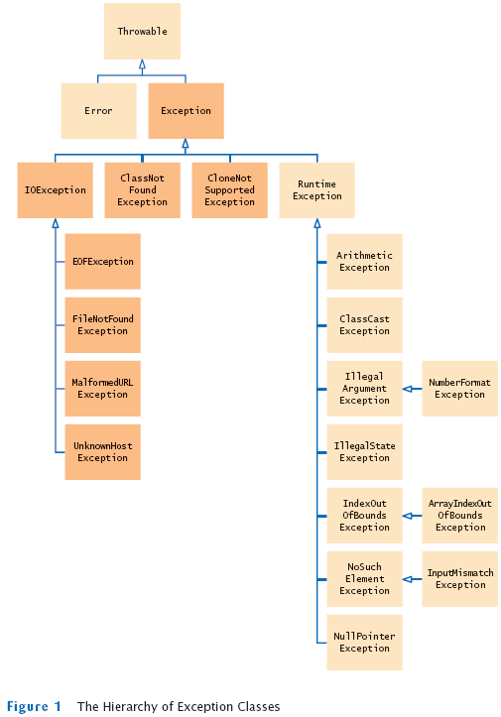
Hierarchy of Exception Classes
Notes:
All exception classes are subtypes of the java.lang.Exception class. The exception class is a subclass of the Throwable class. Other than the exception class there is another subclass called Error which is derived from the Throwable class.
Errors are not normally trapped from the Java programs. These conditions normally happen in case of severe failures, which are not handled by the java programs. Errors are generated to indicate errors generated by the runtime environment. Example : JVM is out of Memory. Normally programs cannot recover from errors.
In the above slide , the dark shaded ones fall under checked exceptions and the light shaded ones come under unchecked exceptions which are described later in the slides.

Slide 4
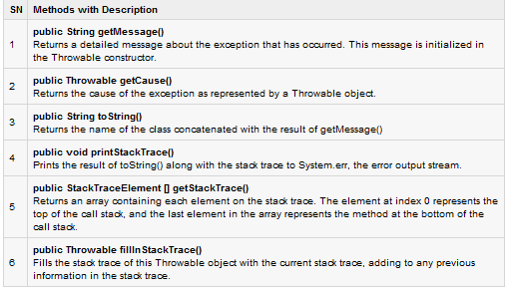
Methods of Throwable Class
Notes:
All of the above methods print error messages but in different forms as desired in the application.

Slide 5
Exception Subclasses - some egs
ClassNotFoundException-is thrown when a class is being referred, but no definition for the class with the specified name is found
IllegalAccessException-is thrown when a particular method is not found

Slide 6
Exception Subclasses - some egs
InstantiationException-occurs when you try to create an object of an abstract class or interface.
NumberFormatException-occurs when you want to convert a string in an incorrect format to a numeric format
Notes:
The above exceptions are predefined exceptions in java and are subclasses of the Exception class.

Slide 7
Exception-Handling Mechanism
When an unexpected error occurs in a method, java creates an object of the type Exception.
After creating the Exception object, java sends it to the program by throwing the exception.
Notes:
There are basically two broad categories of exceptions and errors:
JVM Exceptions: - These are exceptions/errors that are exclusively or logically thrown by the JVM.
Examples : NullPointerException, ArrayIndexOutOfBoundsException, ClassCastException.
Programmatic exceptions: - These exceptions are thrown explicitly by the application or the API programmers Examples: IllegalArgumentException, IllegalStateException.
For eg the developer can use IllegalArgumentException when he wants to indicate a method received an invalid argument. Like if a method is expecting a numeric value within a certain range and gets a value outside of that range.

Slide 8
Implementation of Exception Handling
Exceptions are handled in a program by using the following keywords :
try
catch
throw
throws
finally

Slide 9
Using try and catch statements
The try block encloses the statements that might raise an exception within it and defines the scope of the exception handlers
Catch block is used as an exception handler
Notes:
The code in which the exception may occur is enclosed in a try block, also called as a guarded region.
The catch clause matches a specific exception to a block of code which handles that exception.

Slide 10
Syntax of try ... catch block
try
{
//statements that cause an exception
}
catch(ExceptionName obj)
{
//error handling code
}
Notes:
Demo Program : SimpleExceptionDemo.java
In the above program , demonstrate printing the error messages with different methods of the throwable class
Only a try block cannot exist . It has to succeed by a catch block or finally block or both

Slide 11
Using Multiple Catch Statements
A single try block can have many catch blocks.
This is necessary when the try block has statements that raise different types of exceptions.
try{
}
Catch(Exceptionname obj)
{}
Catch(Exceptionname obj1)
{}
Notes:
Demo Program : MultipleExceptions.java
In the above program since both Arithmetic exception as well as Array index out of bounds exception are thrown test the trainees as to what the output would be.
Also in the demo program , change the order of catch shifting the
catch(Exception e)
{
System.out.println(e);
} as the first catch clause and interrogate them as to why it shows a compile time error.
Exception handlers can be written to catch a specific exception such as ArithmeticException or Array index out of bounds exception in the above example, or an entire group of exceptions by using a generic exception handlers.
Any exceptions not specifically handled within a Java program are caught by the Java run time environment .

Slide 12
try-catch-finally
try
{//block of code}
catch(exception1 obj)
{
System.out.println(“Exception1 has been raised”);
}
finally
{//block of code that is always executed irrespective of the exception being raised or not}
Notes:
The code in which the exception may occur is enclosed in a try block, also called as a guarded region.
The catch clause matches a specific exception to a block of code which handles that exception.And the clean up code which needs to be executed no matter the exception occurs or not is put inside the finally block.
possible combination to write try, catch finally block
1) try{
//lines of code that may throw an exception
}catch(Exception e){
//lines of code to handle the exception thrown in try block
}finally{
//the clean code which is executed always no matter the exception occurs or not.
}
2 try{
}finally{}
3 try{
}catch(Exception e){
//lines of code to handle the exception thrown in try block
}

Slide 13
finally clause
When an exception is raised , the statements in the try block written after the statement in which the exception occurred are ignored.The finally block is used to process certain statements, no matter whether an exception is raised or not.
The finally clause is executed after a try-catch block has been executed.
You can have only one finally block for an exception handler. The finally clause can be used to clean up the programming environment after the exceptions has been handled
Notes:
When exception is thrown control is transferred to method containing the catch block to handle the exception
Control does not return to procedure in which the exception was thrown unless it contains a finally clause
The finally block always executes when the try block exits. This ensures that the finally block is executed even if an unexpected exception occurs. But finally is useful for more than just exception handling — it allows the programmer to avoid having cleanup code accidentally bypassed by a return, continue, or break. Putting cleanup code in a finally block is always a good practice, even when no exceptions are anticipated.
Typically finally block contains release of connections, closing of result set etc.
There are certain exceptions when finally() is not executed
1. If the JVM exits while the try or catch code is being executed, then the finally block will not execute. (System.exit(0) in try block)
2. If the JVM runs out of memory entirely, it may just exit without catch or finally happening.
Remember in java after exception occurs execution halts unless there is a deliberate effort made by the developer to resume operation.

Slide 14
try-with-resources statement
JDK 7 introduces a new version of try statement known as try-with-resources statement.
This feature add another way of resource management without the finally clause , also referred to as automatic resource management
Notes:
JDK 6 or early version
public class Example1 {
public static void main(String[] args) {
BufferedReader br = null;
try {
String line;
br = new BufferedReader(new FileReader("C:\\testing.txt"));
while ((line = br.readLine()) != null) {
System.out.println(line);
}
} catch (IOException e) {
e.printStackTrace();
} finally {
try {
if (br != null)br.close();
} catch (IOException ex) {
ex.printStackTrace();
}
}
}
}
JDK 7
import java.io.BufferedReader;
import java.io.FileReader;
import java.io.IOException;
public class Example2 {
public static void main(String[] args) {
try (BufferedReader br = new BufferedReader(new FileReader("C:\\testing.txt")))
{
String line;
while ((line = br.readLine()) != null) {
System.out.println(line);
}
} catch (IOException e) {
e.printStackTrace();
}
}
}

Slide 15
try-with-resources statement
try(resource-specification)
{
//use the resource
}
catch()
{...}

Slide 16
Three Categories of Exceptions
Checked exceptions: A checked exception is an exception that is typically a user error or a problem that cannot be foreseen by the programmer. For example, if a file is to be opened, but the file cannot be found, an exception occurs. These exceptions cannot simply be ignored at the time of compilation.
Unchecked exceptions: A runtime exception is an exception that occurs that probably could have been avoided by the programmer. As opposed to checked exceptions, runtime exceptions are ignored at the time of compilation.
Notes:
Checked exceptions must be handled when they occur. The classes that extend Throwable class except RuntimeException and Error are known as checked exceptions e.g.IOException, SQLException etc. Checked exceptions are checked at compile-time. Most programmer defined exceptions are for checked exceptions .
Checked exceptions are expected to handled by the developer at compile time. Runtime exceptions do not need to be. Errors often cannot be, as they tend to be unrecoverable.
Unchecked exceptions do not have to be handled (e.g. ArrayIndexOutOfBounds or NullPointer) . The classes that extend RuntimeException are known as unchecked exceptions e.g. ArithmeticException, NullPointerException, ArrayIndexOutOfBoundsException etc. Unchecked exceptions are not checked at compile-time rather they are checked at runtime. Unchecked runtime exceptions represent conditions that, generally speaking, reflect errors in your program's logic and cannot be reasonably recovered from at run time.

Slide 17
Three Categories of Exceptions
Errors: These are not exceptions at all, but problems that arise beyond the control of the user or the programmer.
Errors are typically ignored in your code because you can rarely do anything about an error. For example, if a stack overflow occurs, an error will arise. They are also ignored at the time of compilation.
Notes:
Error is irrecoverable e.g. OutOfMemoryError, VirtualMachineError, AssertionError etc.
Difference between Error and Exception
An error is an irrecoverable condition occurring at runtime such as OutOfMemory error. These JVM errors cannot be repaired at runtime.Though error can be caught in catch block but the execution of application will come to a halt and is not recoverable.
While exceptions are conditions that occur because of bad input etc. e.g. FileNotFoundException will be thrown if the specified file does not exist. Or a NullPointerException will take place if you try using a null reference. In most of the cases it is possible to recover from an exception (probably by giving user a feedback for entering proper values etc.)

Slide 18
throw vs throws
throws is included in the method's declaration part, with a list of exceptions that the method can possible throw
throw is used to throw an exception in a program, explicitly.
Notes:
Java compiler very well knows about the exceptions thrown by some methods so it insists us to handle them. throws is necessary for all exceptions (except for Error & RuntimeException & their sub-classes).
We can either use throws clause on the surrounding method or a try and catch exception handler.Basic difference between the 2 approaches to exception handling. ( try … catch , throws ) is :
If you catch an exception, you are handling the exception at that point.If you specify an exception in "throws", you are delegating the handling to the caller.
You can declare multiple exception thrown by method in throws keyword by separating them in common
e.g. throws IOException, ArrayIndexBoundException etc,
while you can only throw one instance of exception using throw keyword
e.g. throw new IOException("not able to open connection").
throws keyword cannot be used anywhere except method signature while throw keyword can be used inside method or static initializer block

Slide 19
User Defined or Customized Exceptions
You can also create your own exception sub class simply by extending java Exception class and
Override the toString () method of Throwable class
( or )
2. Pass a message string when throwing an object of the custom exception class
Notes:
Demo Program : CustomException1
The above program is an example of custom checked exception . ( Interrogate the trainees to identify whether it is checked or unchecked custom exception ) The toString() method of the Throwable class ( since Exception class extends from Throwable , Exception class inherits the same ) is overridden to display the customized error message.
Demonstrate to the trainees by commenting the try …… catch block and how an compile error is thrown in the above demo.
Changing class NegativeAgeException1 extends Exception
to
class NegativeAgeException1 extends RuntimeException makes it an unchecked exception . Now try …. Catch or throws is optional.
Demo Program : CustomException2.java
In the above demo , a customized error message is passed when throwing the exception
throw new ExceptionClassName(messageString);
Eg.
throw new NegativeAgeException("Age cannot be negative");
For eg.
In the above “Age cannot be negative “ is passed as an argument in the super class constructor by calling
NegativeAgeException(String Message)
{
super(Message);
}
[The normal Exception class just has 2 constructors where one of them has no parameters, and the other one has 1 parameter where you can define some Exception message. ]
To create you own exception extend the Exception class or any of its subclasses.
e.g.
1 class MyException extends Exception { } // this will create Checked Exception
2 class MyException extends IOException { } // this will create Checked exception
3 class MyException extends NullPointerException { } // this will create UnChecked exception
4 class MyException extends RuntimeException { } // this will create UnChecked exception
How should a developer decide when to make a custom checked Exception or custom unchecked Exception?
If an application can reasonably be expected to recover from an exception, make it a customs checked exception. If an application cannot do anything to recover from the exception, make it an unchecked exception.
CustomException3 if needed can be given as a classroom exercise if time permits.

Slide 20
User Defined or Customized Exceptions
All exceptions must be a child of Throwable.
If you want to write a checked exception that is automatically enforced by the Handle or Declare Rule, you need to extend the Exception class.
If you want to write a runtime exception, you need to extend the RuntimeException class.
We can define our own Exception class as below:
class MyException extends Exception{ }
Notes:
When to go for an Exception ?
The thumb rule for throwing exceptions is you do so when your code has entered into an UNRECOVERABLE INVALID state. if data is compromised or you cannot wind back the processing that occurred up to the point then you must terminate it. your processing logic will eventually fail elsewhere. if you can recover somehow then do that and do not throw exception.

Slide 21
Chaining of Exceptions
This feature allow you to relate one exception with another exception, i.e one exception describes cause of another exception.
Two new methods were added to Throwable class to support chained exception.
getCause() method returns the actual cause associated with current exception.
initCause() sets an underlying cause(exception) with invoking exception.
Notes:
Demo Program : ChainedExceptionDemo.java
For example, consider a situation in which a method throws an ArithmeticException because of an attempt to divide by zero but the actual cause of exception was an I/O error which caused the divisor to be zero. The method will throw only ArithmeticException to the caller. So the caller would not come to know about the actual cause of exception. Chained Exception is used in such type of situations.

Slide 22
Method Overriding with Exception Handling
If super class method does not declare any exception, then sub class overriden method cannot declare checked exception but it can declare unchecked exceptions.
Notes:
Example of Subclass overridden Method declaring Checked Exception
import java.io.*;
class Super
{
void show() { System.out.println("parent class"); }
}
public class Sub extends Super
{
void show() throws IOException //Compile time error
{ System.out.println("parent class"); }
public static void main( String[] args )
{
Super s=new Sub();
s.show();
}
}
Example of Subclass overridden Method declaring Unchecked Exception
import java.io.*;
class Super
{
void show(){ System.out.println("parent class"); }
}
public class Sub extends Super
{
void show() throws ArrayIndexOutOfBoundsException //Correct
{ System.out.println("child class"); }
public static void main(String[] args)
{
Super s=new Sub();
s.show();
}
}

Slide 23
Check Your Understanding
1.When an unexpected error occurs in a method, java creates an object of the type ____.
Exception
2. _______ is thrown when a particular method is not found.
IllegalAccessException
3. ________ occurs when you want to convert a tring in an incorrect format to a numeric format.
NumberFormatException
4. Exceptions are handled using keywords _____, _____, ______, _______ and ______.
try, catch, throw, throws, finally
5. Catch block is used as an _________.
Exception handler
6. Finally clause is executed after a try-catch block has been executed. Yes/No
Yes
7. ______ exceptions are probably could have been avoided by the programmer. runtime/unchecked
8. All exceptions must be a child of _________.
throwable
9. ________ class is extended to write a runtime exception.
RuntimeException
10. ______ sets an underlying cause with invoking exception.
initCause()

