Slide 1
Threads
Notes:
This Module covers :
Life cycle of thread
Ways to create threads
Synchronization of Threads

Slide 2
Threads
A thread is a lightweight process – a single sequential flow of execution within a program
Threads make possible the implementation of programs that seem to perform multiple tasks at the same time (e.g. multi-threaded Web servers)
A new way to think about programming
Java’s multithreading system is built upon the Thread class , it’s methods and it’s companion interface , the Runnable interface
Notes:
Java provides built-in support for multithreaded programming. A multithreaded program contains two or more parts that can run concurrently. Each part of such a program is called a thread, and each thread defines a separate path of execution
Multithreading is mostly used in games, animation etc.
Thread is basically a lightweight subprocess, a smallest unit of processing. Multiprocessing and multithreading, both are used to achieve multitasking. But we use multithreading than mulitprocessing because threads share a common memory area. They don't allocate separate memory area so save memory, and context-switching between the threads takes less time than processes.

Slide 3
Thread-based Multitasking (Multithreading)
Threads share the same address space.
Thread is lightweight.
Cost of communication between the thread is low.
Note: At least one process is required for each thread.

Slide 4
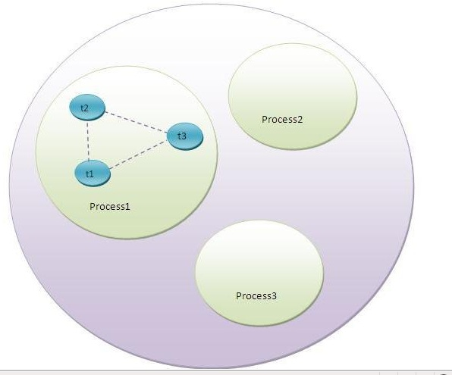
Multithreading
Notes:
A thread is a lightweight sub process, a smallest unit of processing. It is a separate path of execution. It shares the memory area of process.

Slide 5
The Main Thread
When a java program starts , one thread begins running immediately which is called the Main thread of the program.
It is the one which executes when the program begins
All the other threads will be spawned from the main thread
Notes:
Demo Program : CurrentThreadDemo.java
The key to utilizing multithreading support effectively is to think concurrently rather than serially. For example, when you have two subsystems within a program that can execute concurrently, make them individual threads.
With the careful use of multithreading, you can create very efficient programs. But If there are too many threads, you can actually degrade the performance of your program rather than enhance it.
Commonly used Constructors of Thread class:
Thread()
Thread(String name)
Thread(Runnable r)
Thread(Runnable r,String name)

Slide 6
  Life Cycle of a Thread
A thread goes through various stages in its life cycle. For example, a thread is born, started, runs, and then dies. Following is the life cycle of a thread.
•New: A new thread begins its life cycle in the new state. It remains in this state until the program starts the thread. It is also referred to as a born thread.
•Runnable: After a newly born thread is started, the thread becomes runnable.There can be many threads in the RUNNABLE state, but only one can be in the RUNNING state.
•Waiting: Sometimes a thread transitions to the waiting state while the thread waits for another thread to perform a task.A thread transitions back to the running state only when another thread signals the waiting thread to continue executing.
•Timed waiting: A runnable thread can enter the timed waiting state for a specified interval of time. A thread in this state transitions back to the runnable state when that time interval expires or when the event it is waiting for occurs.
•Terminated: A runnable thread enters the terminated state when it completes its task or otherwise terminates.
Notes:
A thread can be in one of the above states . According to sun, there is only 4 states new, runnable, waiting /timed waiting and terminated. There is no running state. But for better understanding a running state can be included. The life cycle of the thread is controlled by JVM

Slide 7
  Thread Priorities
Every Java thread has a priority that helps the operating system determine the order in which threads are scheduled.
Java priorities are in the range between MIN_PRIORITY (a constant of 1) and MAX_PRIORITY (a constant of 10). By default, every thread is given priority NORM_PRIORITY (a constant of 5).
Threads with higher priority are more important to a program and should be allocated processor time before lower-priority threads.
Notes:
However, thread priorities cannot guarantee the order in which threads execute and very much platform dependent
3 constants defiend in Thread class:
public static int MIN_PRIORITY
public static int NORM_PRIORITY
public static int MAX_PRIORITY
Default priority of a thread is 5 (NORM_PRIORITY). The value of MIN_PRIORITY is 1 and the value of MAX_PRIORITY is 10.

Slide 8
How to create Java Threads
There are two ways to create a Java thread:
Extend the java.lang.Thread class
Implement the java.lang.Runnable interface

Slide 9
Extending the Thread class
In order to create a new thread we may subclass java.lang.Thread and customize what the thread does by overriding its empty run method.
The run method is where the action of the thread takes place.
The execution of a thread starts by calling the start method.
Notes:
Demo Program : ExtendThread.java
Note that the main thread does not wait for the child thread to exit and exits if the main thread has finished it’s task
Also note that after staring a thread, the same thread can never be started again. If you does so, an IllegalThreadStateException is thrown.

Slide 10
Implementing the Runnable interface
In order to create a new thread we may also provide a class that implements the java.lang.Runnable interface
Preferred way in case our class has to subclass some other class
A Runnable object can be wrapped up into a Thread object
  Thread(Runnable threadOb)
  Thread(Runnable threadOb, String name)
The thread’s logic is included inside the run method of the runnable object.
Notes:
Demo Program : ThreadDemo2.java
In the above demo though the main thread finishes the task first , join method is called by the main thread , which blocks itself till the child thread joins.
Compare the output of ExtendThread.java ThreadDemo2.java.
The join() method waits for a thread to die. In other words, it causes the currently running threads to stop executing until the thread it joins with completes its task.
threadOb is an instance of a class that implements the Runnable interface and the name of the new thread is specified by the String name.
After the new thread is created, it will not start running until you call its start( ) method, which is declared within Thread. The start( ) method’s signature :
void start( );
start() method of Thread class is used to start a newly created thread. It performs following tasks:
A new thread starts(with new callstack).
The thread moves from New state to the Runnable state.
When the thread gets a chance to execute, its target run() method will run.
At a time only one thread is executed. If you sleep a thread for the specified time,the thread shedular picks up another thread and so on.

Slide 11
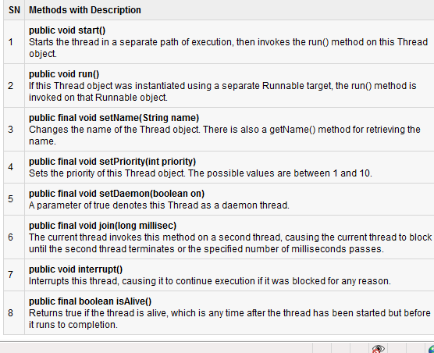
Important Methods of the Thread Class
Notes:
Note that each thread starts in a separate call stack. If run() is called without start() the run() method goes onto the current call stack rather than at the beginning of a new call stack. The threads will be treated as normal object rather than thread object.

Slide 12
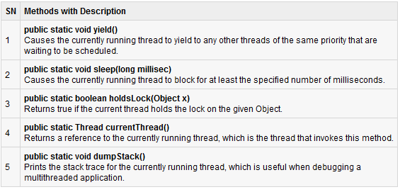
Static Methods of the Thread Class
Notes:
Demo Program : MyThread.java , PriorityDemo.java
Two simple programs to demonstrate some of the above methods.
In the demo program MyThread.java there are two types of threads user thread and daemon thread. The daemon thread is a service provider thread. It provides services to the user thread. Its life depends on the user threads i.e. when all the user threads dies, JVM terminates this thread automatically.
Points to remember for Daemon Thread:
It provides services to user threads for background supporting tasks. It has no role in life than to serve user threads.
Its life depends on user threads.
It is a low priority thread.

Slide 13
Synchronization of Threads
In many cases concurrently running threads share data and must consider the state and activities of other threads.
If two threads can both execute a method that modifies the state of an object then the method should be declared to be synchronized, allowing only one thread to execute the method at a time.
If a class has at least one synchronized methods, each instance of it has a monitor. A monitor is an object that can block threads and notify them when it is available.
Notes:
Synchronization is the capabilility of control the access of multiple threads to any shared resource. Synchronization is better in case we want only one thread can access the shared resource at a time.
Why use Synchronization?
The synchronization is mainly used to
1. To prevent thread interference.
2. To prevent consistency problem.

Slide 14
Synchronization of Threads (cont.)
Example:
public synchronized void updateRecord() {
// critical code goes here …
}
Only one thread may be inside the body of this function. A second call will be blocked until the first call returns or wait() is called inside the synchronized method.
Notes:
Demo Program : SynchronizationDemo.java
In the above demo, 3 strings are passed targeting the same object.Even though each thread sleeps for 2 secs , since synchronized calls are made on the object , control does not go to the next thread (t2) unless the thread (t1) finishes the task.
In the demo program , Comment the synchronized block and show the difference in the output to the trainees
Mutual Exclusive helps keep threads from interfering with one another while sharing data. This can be done
1.by synchronized method
2. by synchronized block
To make a method synchronized, simply add the synchronized keyword to its declaration:
Synchronized void meth1()
{
}
synchronized block
Synchronized block can be used to perform synchronization on any specific resource of the method.
Suppose you have 50 lines of code in your method, but you want to synchronize only 5 lines, you can use synchronized block.
Rather if you put all the codes as a synchronized method , all lines in the method
void meth1()
{
// some lines of code
synchronized(obj) // synchronized block
{
}
}

Slide 15
Methods used for Inter Thread Communication
To avoid polling, Java includes an elegant interprocess communication mechanism via the following methods:
wait( ): This method tells the calling thread to give up the monitor and go to sleep until some other thread enters the same monitor and calls notify( ).
notify( ): This method wakes up the first thread that called wait( ) on the same object.
notifyAll( ): This method wakes up all the threads that called wait( ) on the same object. The highest priority thread will run first
Notes:
Demo Program : ThreadTest.java
In the above program , Thread 1 enters the synchronized block prints out the sum of two values from two arrays and calls wait on the synchronized common object.This causes thread 1 to lose the monitor of synchronized object, and gives the other thread 2 to acquire the lock.
Thread 2 enters the synchronized block , prints out the sum value of two values from two arrays . Thread 2 calls wait and then notify method on the share object and making the other thread T1 (T1 is waiting to acquire lock for the common synchronized instance) to acquire the lock.
In a polling system, the consumer would waste many CPU cycles while it waited for the producer to produce. Once the producer was finished, it would start polling, wasting more CPU cycles waiting for the consumer to finish, and so on. Clearly, this situation is undesirable.
To avoid polling, Java includes an elegant interprocess communication mechanism via the above methods.
A wait() only makes sense when there is also a notify(), so it's always about communication between threads, and that needs synchronization to work correctly. Semantically, you never just wait(). You need some condition to be satisified, and if it is not, you wait until it is.

Slide 16
Suspend Resume & Stop methods of Thread
The suspend( ), resume( ), and stop( ) methods defined by Thread class which were used to managing the execution of threads, must not be used for new Java programs and obsolete in newer versions of java.
The wait( ) and notify( ) methods that are inherited from Object can be used to control the execution of a thread.
Notes:
public void suspend()
This method puts a thread in suspended state and can be resumed using resume() method.
public void stop()
This method stops a thread completely.
public void resume()
This method resumes a thread which was suspended using suspend() method.

Slide 17
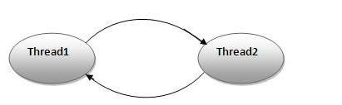
Thread Deadlock
A special type of error that you need to avoid that relates specifically to multitasking is deadlock, which occurs when two threads have a circular dependency on a pair of synchronized objects.
For example, suppose one thread enters the monitor on object X and another thread enters the monitor on object Y. If the thread in X tries to call any synchronized method on Y, it will block as expected. However, if the thread in Y, in turn, tries to call any synchronized method on X, the thread waits forever, because to access X, it would have to release its own lock on Y so that the first thread could complete
Notes:
Deadlock can occur in a situation when a thread is waiting for an object lock, that is acquired by another thread and second thread is waiting for an object lock that is acquired by first thread. Since, both threads are waiting for each other to release the lock, the condition is called deadlock. Such situations has to be avoided while coding in a Multithreaded application.

Slide 18
Volatile Modifier in java
If you are working with the multithreaded programming, the volatile keyword will be more useful.
When multiple threads using the same variable, each thread will have its own copy of the local cache for that variable. So, when it’s updating the value, it is actually updated
in the local cache not in the main variable memory. The other thread which is using the same variable doesn’t know anything about the values changed by the another thread.
To avoid this problem, if you declare a variable as volatile, then it will not be stored in the local cache. Whenever thread are updating the values, it is updated to the main memory. So, other threads can access the updated value.

Slide 19
Check Your Understanding
1. Cost of communication between the thread is high. Yes/No
No
2. After a newly born thread is started, the thread becomes _______.
Runnable
3. By default, every thread is given priority called _______.
NORM_PRIORITY
4. Threads can be created by extending _______.
java.lang.Thread
5. The execution of a thread starts by calling the _____ method.
start
6. ________ method tells the calling thread to give up the monitor and go to sleep until some other thread enters the same monitor and calls notify().
wait()
7. A variable is declared as _______ to allow other threads to access or update value in the main memory but not in local cache.
Volatile
8. ________ occurs when two threads have a circular dependency on a pair of synchronized objects.
Deadlock
9. _____ method is where the action of the thread takes place.
run
10. A runnable thread enters the terminated state when the task is ______ or ______.
completed, terminated

