Slide 1
Regular Expressions, Enums,Annotations & Assertions
Notes:
This session gives an overview of Regular Expressions., Enums,Annotations & Assertions

Slide 2
The regex package
Java provides the java.util.regex package for pattern matching with regular expressions.
A regular expression is a special sequence of characters that helps you match or find other strings or sets of strings, using a specialized syntax held in a pattern. They can be used to search, edit, or manipulate text and data.
Notes:
A regular expression is a textual pattern used to search in text. In other words, the text is searched for occurrences of the pattern .
This package has been introduced in Java 1.4.

Slide 3
Java.util.regex.Pattern
The java.util.regex.Pattern class, or the Pattern class for short, is the main access point of the Java regular expression API.
Whenever you need to work with regular expressions, you start with the Pattern class.
Notes:
Demo Program : PatternDemo.java
The above demo searches the string in the text variables for an occurrence of the word "is", allowing zero or more characters to be present before and after the word (the two .* parts of the pattern).

Slide 4
Pattern.matches()
The fastest way to check if a regular expression pattern matches a text is to use the static Pattern.matches() method.
The Pattern.matches() method is fine if you just need to check a pattern against a text a single time, and the default settings of the Pattern class are appropriate.

Slide 5
Pattern.compile()
If you need to match a text against a regular expression pattern more than one time, you need to create a Pattern instance using the Pattern.compile() method.
Once you have obtained a Pattern instance, you can use that to obtain a Matcher instance. The Matcher instance is used to find matches of the pattern in texts.
Notes:
Demo Program : PatternCompile_Demo.java
In the above program , the pattern is compiled and kept such that that this compiled pattern can be reused to search in different strings.

Slide 6
Pattern.split()
The split() method in the Pattern class can split a text into an array of String's, using the regular expression (the pattern) as delimiter.
Eg.
String text = "A sep Text sep With sep Many sep Separators";
String patternString = "sep";
Pattern pattern = Pattern.compile(patternString);
String[] split = pattern.split(text);
System.out.println("split.length = " + split.length);
for(String element : split){
System.out.println("element = " + element);
}
Notes:
This example will split the text in the text variable into 5 separate strings on the delimiter seps. Each of these strings are included in the returned String array.

Slide 7
Pattern.pattern()
The pattern() method of the Pattern class simply returns the pattern that the Pattern instance was compiled
Eg.
String patternString = "sep";
Pattern pattern = Pattern.compile(patternString);
String pattern2 = pattern.pattern();
Notes:
In the example on the slide the pattern2 variable will contain the value sep, which was the value the Pattern instance was compiled from.

Slide 8
find() of Matcher
The find() method searches for occurrences of the regular expressions in the text passed to the Pattern.matcher(text) method, when the Matcher was created.
If multiple matches can be found in the text, the find() method will find the first, and then for each subsequent call to find() it will move to the next match.
Notes:
Demo Program : FindDemo.java

Slide 9
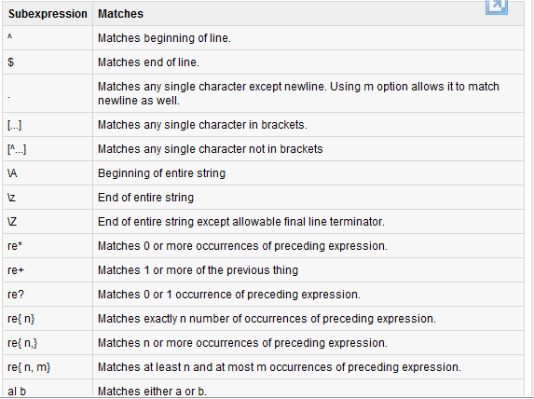
regular expression metacharacter syntax available in Java:
Notes:
Demo Program : StringMatcher.java , StringMatcherTest.java

Slide 10
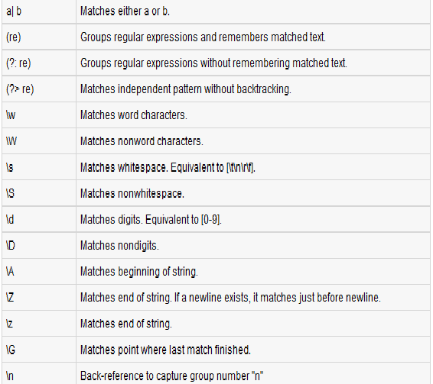
regular expression metacharacter syntax available in Java:

Slide 11

Enums

Slide 12
What is enum
An enum type is a special data type that enables for a variable to be a set of predefined constants.
The variable must be equal to one of the values that have been predefined for it.
Notes:
All enums implicitly extend java.lang.Enum. Since Java does not support multiple inheritance, an enum cannot extend anything else.

Slide 13
What is enum
Because they are constants, the names of an enum type's fields are in uppercase letters.
In the Java programming language, you define an enum type by using the enum keyword.
For example, you would specify a days-of-the-week enum type as:
public enum Day { SUNDAY, MONDAY, TUESDAY, WEDNESDAY, THURSDAY, FRIDAY, SATURDAY }
Notes:
Demo Program : EnumTest.java
You should use enum types any time you need to represent a fixed set of constants. That includes natural enum types such as the planets in our solar system and data sets where you know all possible values at compile time—for example, the choices on a menu, command line flags, and so on.

Slide 14
Features of enum
Java programming language enum types are much more powerful than their counterparts in other languages.
The enum declaration defines a class (called an enum type). The enum class body can include methods and other fields. The compiler automatically adds some special methods when it creates an enum.
Notes:
For example, enums have a special static values method that returns an array containing all of the values of the enum in the order they are declared.

Slide 15
Features of enum
You should use enum types any time you need to represent a fixed set of constants.
enum need to be declared with only the public or default modifier like non-inner class.
The constructor for an enum type must be package-private or private access. It automatically creates the constants that are defined at the beginning of the enum body.
Notes:
Demo Program : Planet.java
In the above program , the enum Planet is used just like a class with constructor,properties and methods,

Slide 16
Annotations

Slide 17
Annotations in Java
Annotations provide data about a class that is not part of the programming logic itself. They have no direct effect on the code they annotate. Other components can use this information.
Annotations can be preserved at runtime (RetentionPolicy.RUNTIME)
or
are only available at development time (RetentionPolicy.SOURCE).
Notes:
Annotations, a form of metadata, provide data about a program that is not part of the program itself. Annotations have no direct effect on the operation of the code they annotate.
The programmer says what should be done and tools emit the code to do it.Annotations were introduced in JDK 1.5

Slide 18
Uses of Annotations
Information for the compiler — Annotations can be used by the compiler to detect errors or suppress warnings.
Compile-time and deployment-time processing — Software tools can process annotation information to generate code, XML files, and so forth.
Runtime processing — Some annotations are available to be examined at runtime.
Notes:
The annotation type can be one of the types that are defined in the java.lang or java.lang.annotation packages of the Java SE API.
Annotations can be applied to declarations: declarations of classes, fields, methods, and other program elements

Slide 19
Format of an Annotation
In its simplest form, an annotation looks like the following:
@Entity
The at sign character (@) indicates to the compiler that what follows is an annotation.
In the following example, the annotation's name is Override:
@Override
void mySuperMethod() { ... }

Slide 20
Some predefined Annotations
@Override
The @Override annotation can be added to a method. It is used by the Java compiler to check if the annotated method really overrides a method of an interface or the extended class.
@Deprecated
The @Deprecated annotation can be used on a field, method, constructor or class and indicates that this element is outdated and should not be used anymore. Adding Deprecated to the class does not deprecate automatically all its fields and methods.
Notes:
Demo Program : PredefinedAnnotationDemo.java
In the above demo program , demonstrate how even if the method disp() is wriiten wrong because of a typo , compiler will not report , now with Annotations ( from java 1.5) , annotating with @override in the child class method will make sure that the parent and child class method signature are one and the same .

Slide 21
Annotations That Apply to Other Annotations
Annotations that apply to other annotations are called meta-annotations.
There are several meta-annotation types defined in java.lang.annotation.

Slide 22
@Retention
@Retention annotation specifies how the marked annotation is stored:
RetentionPolicy.SOURCE – The marked annotation is retained only in the source level and is ignored by the compiler.
RetentionPolicy.CLASS – The marked annotation is retained by the compiler at compile time, but is ignored by the Java Virtual Machine (JVM).
RetentionPolicy.RUNTIME – The marked annotation is retained by the JVM so it can be used by the runtime environment.

Slide 23
@Documented
@Documented annotation indicates that whenever the specified annotation is used those elements should be documented using the Javadoc tool

Slide 24
@Target
@Target annotation marks another annotation to restrict what kind of Java elements the annotation can be applied to. A target annotation specifies one of the following element types as its value:
ElementType.ANNOTATION_TYPE can be applied to an annotation type.
ElementType.CONSTRUCTOR can be applied to a constructor.
ElementType.FIELD can be applied to a field or property.
ElementType.LOCAL_VARIABLE can be applied to a local variable.
ElementType.METHOD can be applied to a method-level annotation.
ElementType.PACKAGE can be applied to a package declaration.
Notes:
@Target(ElementType.METHOD)
@Retention(RetentionPolicy.SOURCE)
@Documented
public @interface MyAnnotation {
public String author() default "Polaris";
public String version() default "1.0";
public String shortDescription();
public String[] reviews();
}

Slide 25
Custom Annotations
We can create our own annotations and use it.
We need to declare a annotation type and then use the respective annotation in java classes.

Slide 26
Example of a Custom Annotation
/*
* Describes the team which wrote the code
*/
@Documented
public @interface Team {
int teamId();
String teamName();
String teamLead() default "[unassigned]";
String writeDate(); default "[unimplemented]";
}
Notes:
Annotations in Java are actually a form of interfaces only and hence the definition of an annotation type resembles to that of an interface. The keyword 'interface' is preceded by the symbol '@' in an annotation definition.

Slide 27
Usage of the Custom Annotation in a java class
... a java class ...
@Team(
teamId = 73,
teamName = "Rambo Mambo",
teamLead = "Yo Man",
writeDate = "3/1/2014"
)
public static void readFile(File inputFile) { ... }
... java class continues

Slide 28
Assertions

Slide 29
Assertions
An assertion is a statement in the Java programming language that enables you to test your assumptions about your program.
For example, if you write a method that calculates the speed of a particle, you might assert that the calculated speed is less than the speed of light.

Slide 30
Assertions
Each assertion contains a boolean expression that you believe will be true when the assertion executes. If it is not true, the system will throw an error.
By verifying that the boolean expression is indeed true, the assertion confirms your assumptions about the behavior of your program, increasing your confidence that the program is free of errors.
Notes:
Experience has shown that writing assertions while programming is one of the quickest and most effective ways to detect and correct bugs. As an added benefit, assertions serve to document the inner workings of your program, enhancing maintainability.

Slide 31
Forms of Assertions Statements
The assertion statement has two forms. The first, simpler form is:
assert Expression₁ ;
where Expression₁ is a boolean expression. When the system runs the assertion, it evaluates Expression₁ and if it is false throws an AssertionError with no detail message.
Notes:
Demo Program : AssertionForm1.java
If you use assertion, It will not run simply because assertion is disabled by default. To enable the assertion, -ea or -enableassertions switch of java must be used.
Compile it by: javac AssertionForm1.java
Run it by: java -ea AssertionForm1
In Eclipse , to execute the above program , under run , VM arguments –ea switch has to be given.

Slide 32
Forms of Assertions Statements
The second form of the assertion statement is:
assert Expression₁ : Expression₂ ;
where:
Expression₁ is a boolean expression.
Expression₂ is an expression that has a value. (It cannot be an invocation of a method that is declared void.)
Notes:
Demo Program : AssertionForm2.java
Use this version of the assert statement to provide a detail message for the AssertionError. The system passes the value of Expression₂ to the appropriate AssertionError constructor, which uses the string representation of the value as the error's detail message.
The purpose of the detail message is to capture and communicate the details of the assertion failure. The message should allow you to diagnose and ultimately fix the error that led the assertion to fail. Note that the detail message is not a user-level error message, so it is generally unnecessary to make these messages understandable in isolation, or to internationalize them. The detail message is meant to be interpreted in the context of a full stack trace, in conjunction with the source code containing the failed assertion.

Slide 33
When not to use Assertions
There are some situations where assertion should be avoid to use. They are:
According to Sun Specification, assertion should not be used to check arguments in the public methods because it should result in appropriate runtime exception e.g. IllegalArgumentException, NullPointerException etc.
Do not use assertion, if you don't want any error in any situation.

Slide 34
Check Your Understanding
1. ______ package is used for pattern matching with regular expressions.
java.util.regex
2. _________ method is used to check a pattern against a text a single time.
pattern.matches
3. _____ method in the Pattern class can split a text into an array of Strings, using the regular expression as a delimiter.
Split()
4. ______ type is a special data type that enables for a variable to be a set of predefined. constants.
enum
5. enum needs to be declared with only ____ or ____ modifiers.
public, default
6. ________ annotation can be used on a field, method, constructor or class and indicates that this element is outdated and should not be used anymore.
@Deprecated
7. Meta annotations are defined in _________.
java.lang.annotation
8. _________ marked annotation is retained by the JVM so it can be used by the runtime environment.
RetentionPolicy.RUNTIME
9. _______ is a statement in the java programming language that enables you to test your assumptions about your program.
Assertion
10. Assertion should be avoided, if you don't want any error in any situation. Yes/No
Yes

