Slide 1
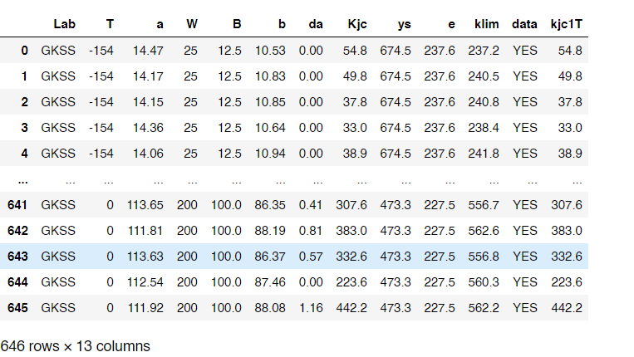
MAIN DATASET
Contained 646 rows [Contained all temperatures]
70% used for training
30% used for testing
Columns for Training And Test dataset considered were
[T , a , W, B, b , da, ys, e]

Slide 2
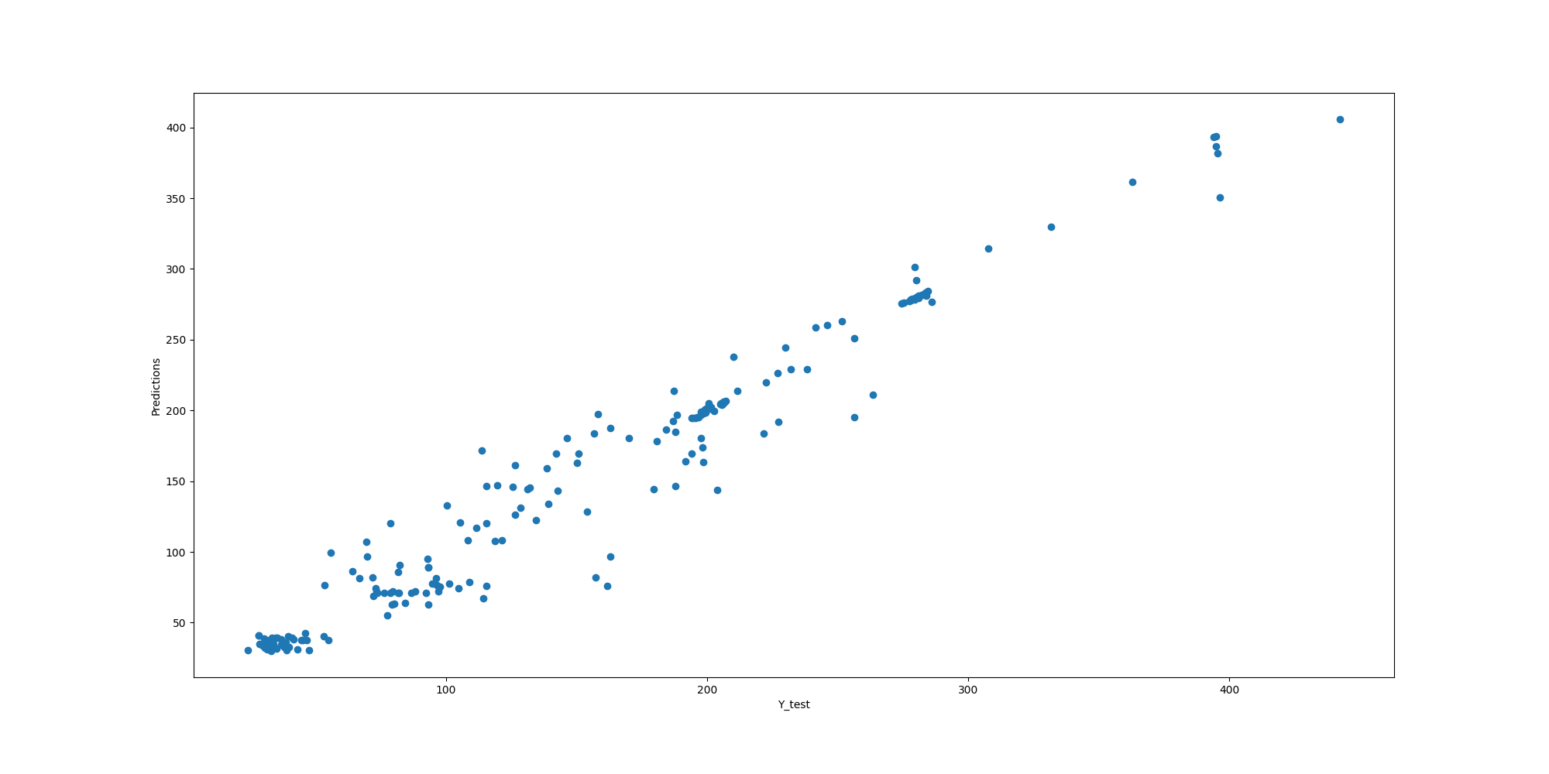
Overall Predictions on Test around 194 rows
Model Predictions on Test Dataset
Represents 30% of total size
Mean Absolute Error: 13.021255277368658 R2 Score: 0.956243407590483 Root Mean Squared Error: 19.865490747313906

Slide 3
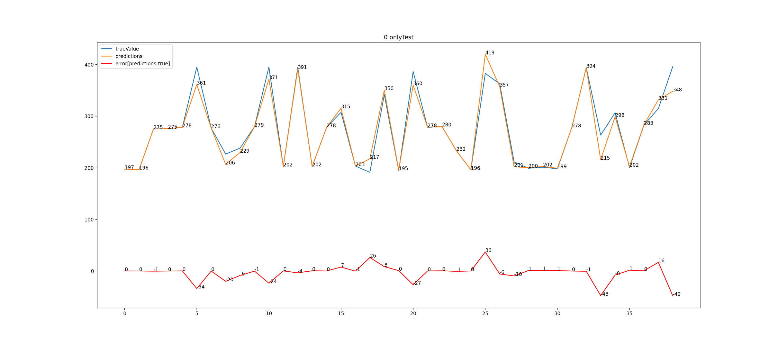
T=0degC
Mean Absolute Error: 14.139963541666638 R2 Score: 0.7528834794325895 Root Mean Squared Error: 20.661328261868533
The R2 scores and other errors for this and a particular temp plots does not explain the model:
Rather they explain the variation of that subset of temperature, it is so because the model was trained on the dataset containing all temperatures at once otherwise we would need to make a different model for each temperature
So the r2 score of previous slide represents the model
The Errors are shown to understand the plots
For this and all further graphs x axis represents index and y represents results

Slide 4
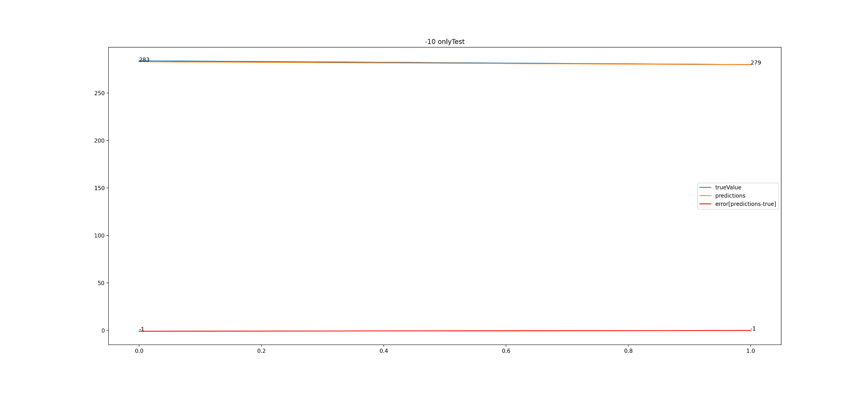
T=-10degC
Mean Absolute Error: 0.5185000000000457 R2 Score: 0.8932878749999527 Root Mean Squared Error: 0.6533364370676025
-10 had around 10 values so 2 values were chosen in test datset

Slide 5
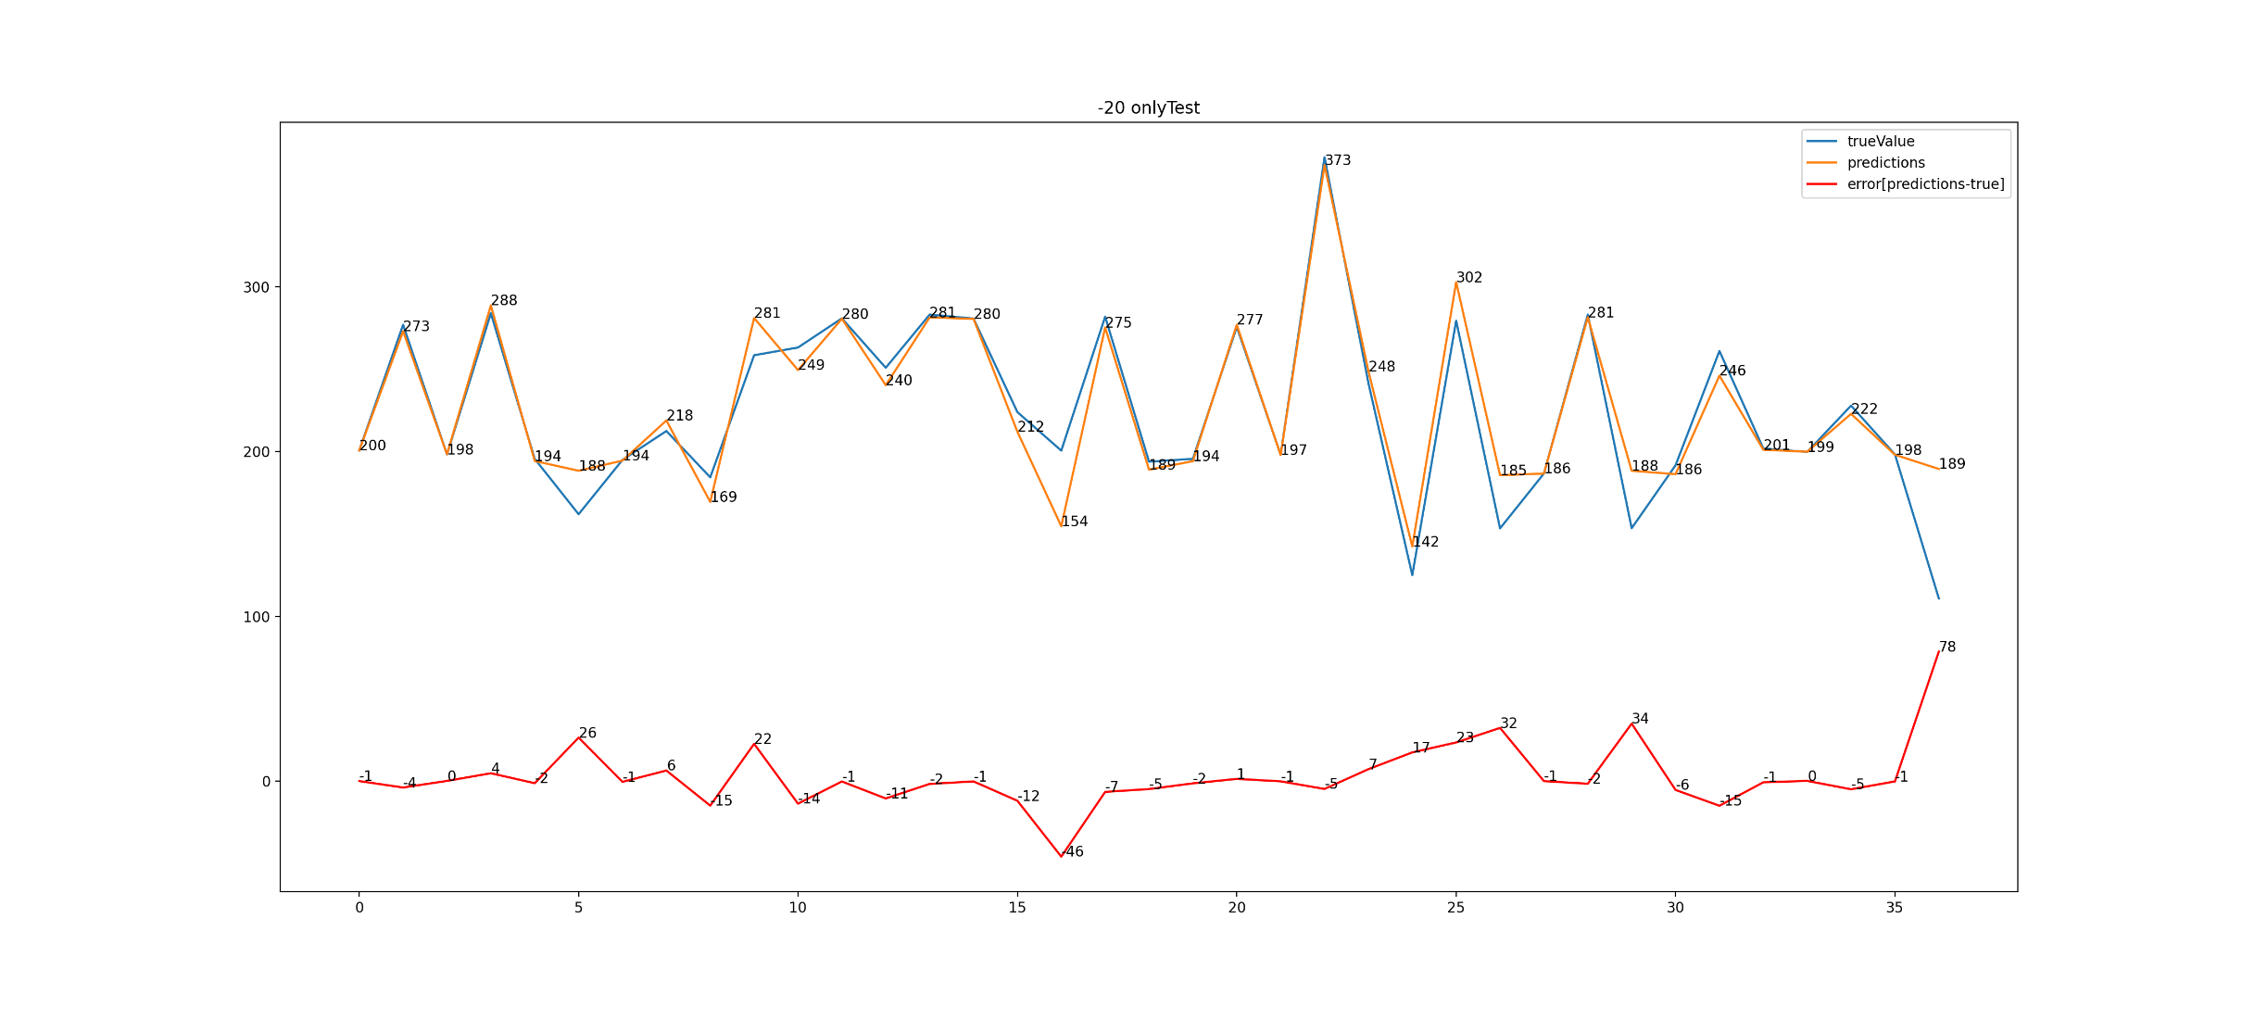
-20 deg only
Mean Absolute Error: 10.974007722007698 R2 Score: 0.8702139956994518 Root Mean Squared Error: 19.29299996953817

Slide 6
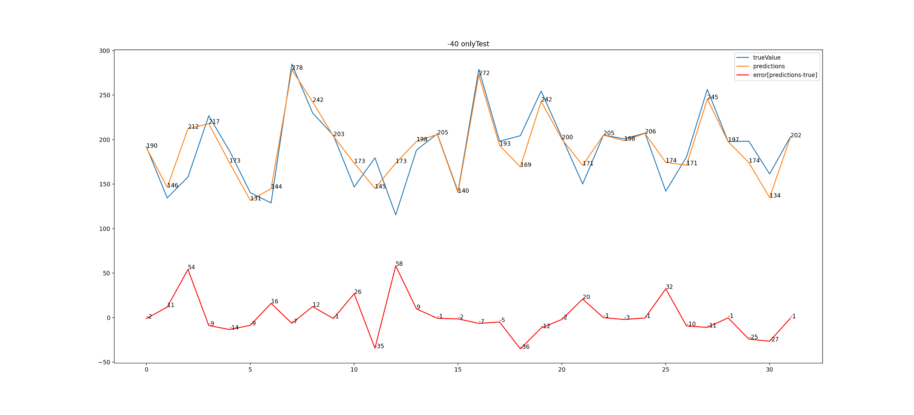
T=-40degC
Mean Absolute Error: 14.139963541666638 R2 Score: 0.7528834794325895 Root Mean Squared Error: 20.661328261868533

Slide 7
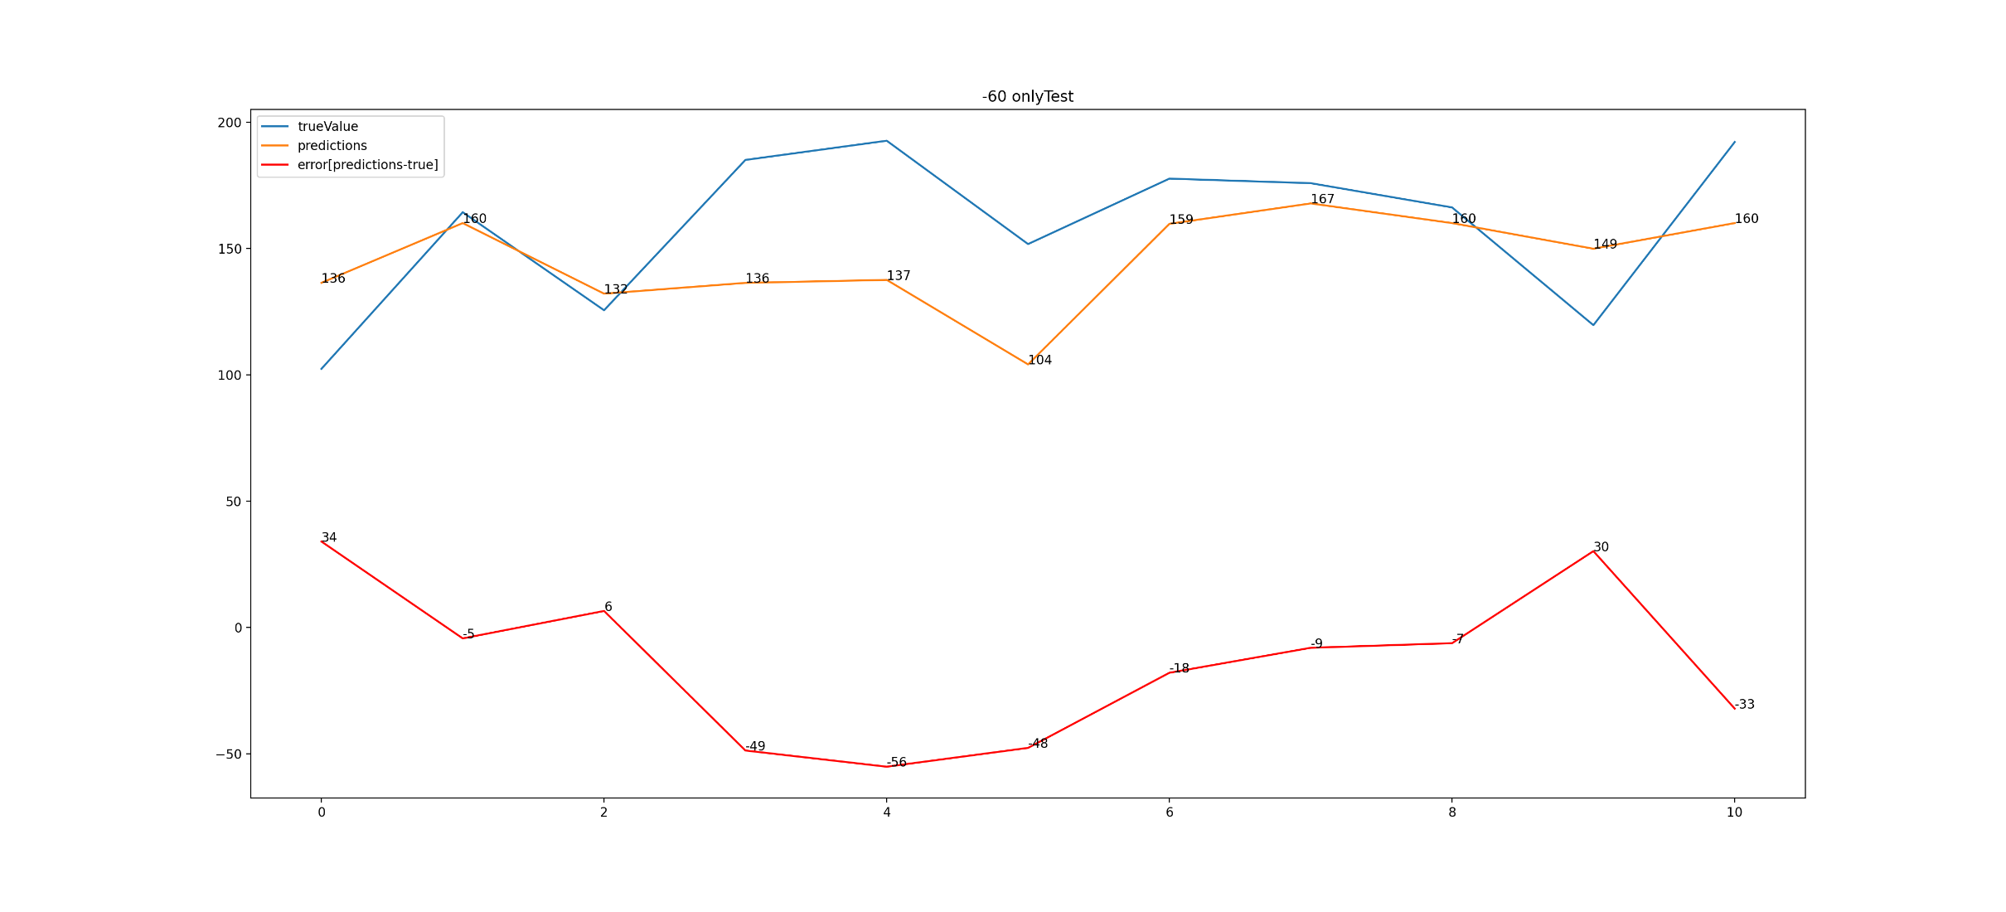
Mean Absolute Error: 26.43182575757578 R2 Score: -0.17916064933521447 Root Mean Squared Error: 31.996127083093974

Slide 8
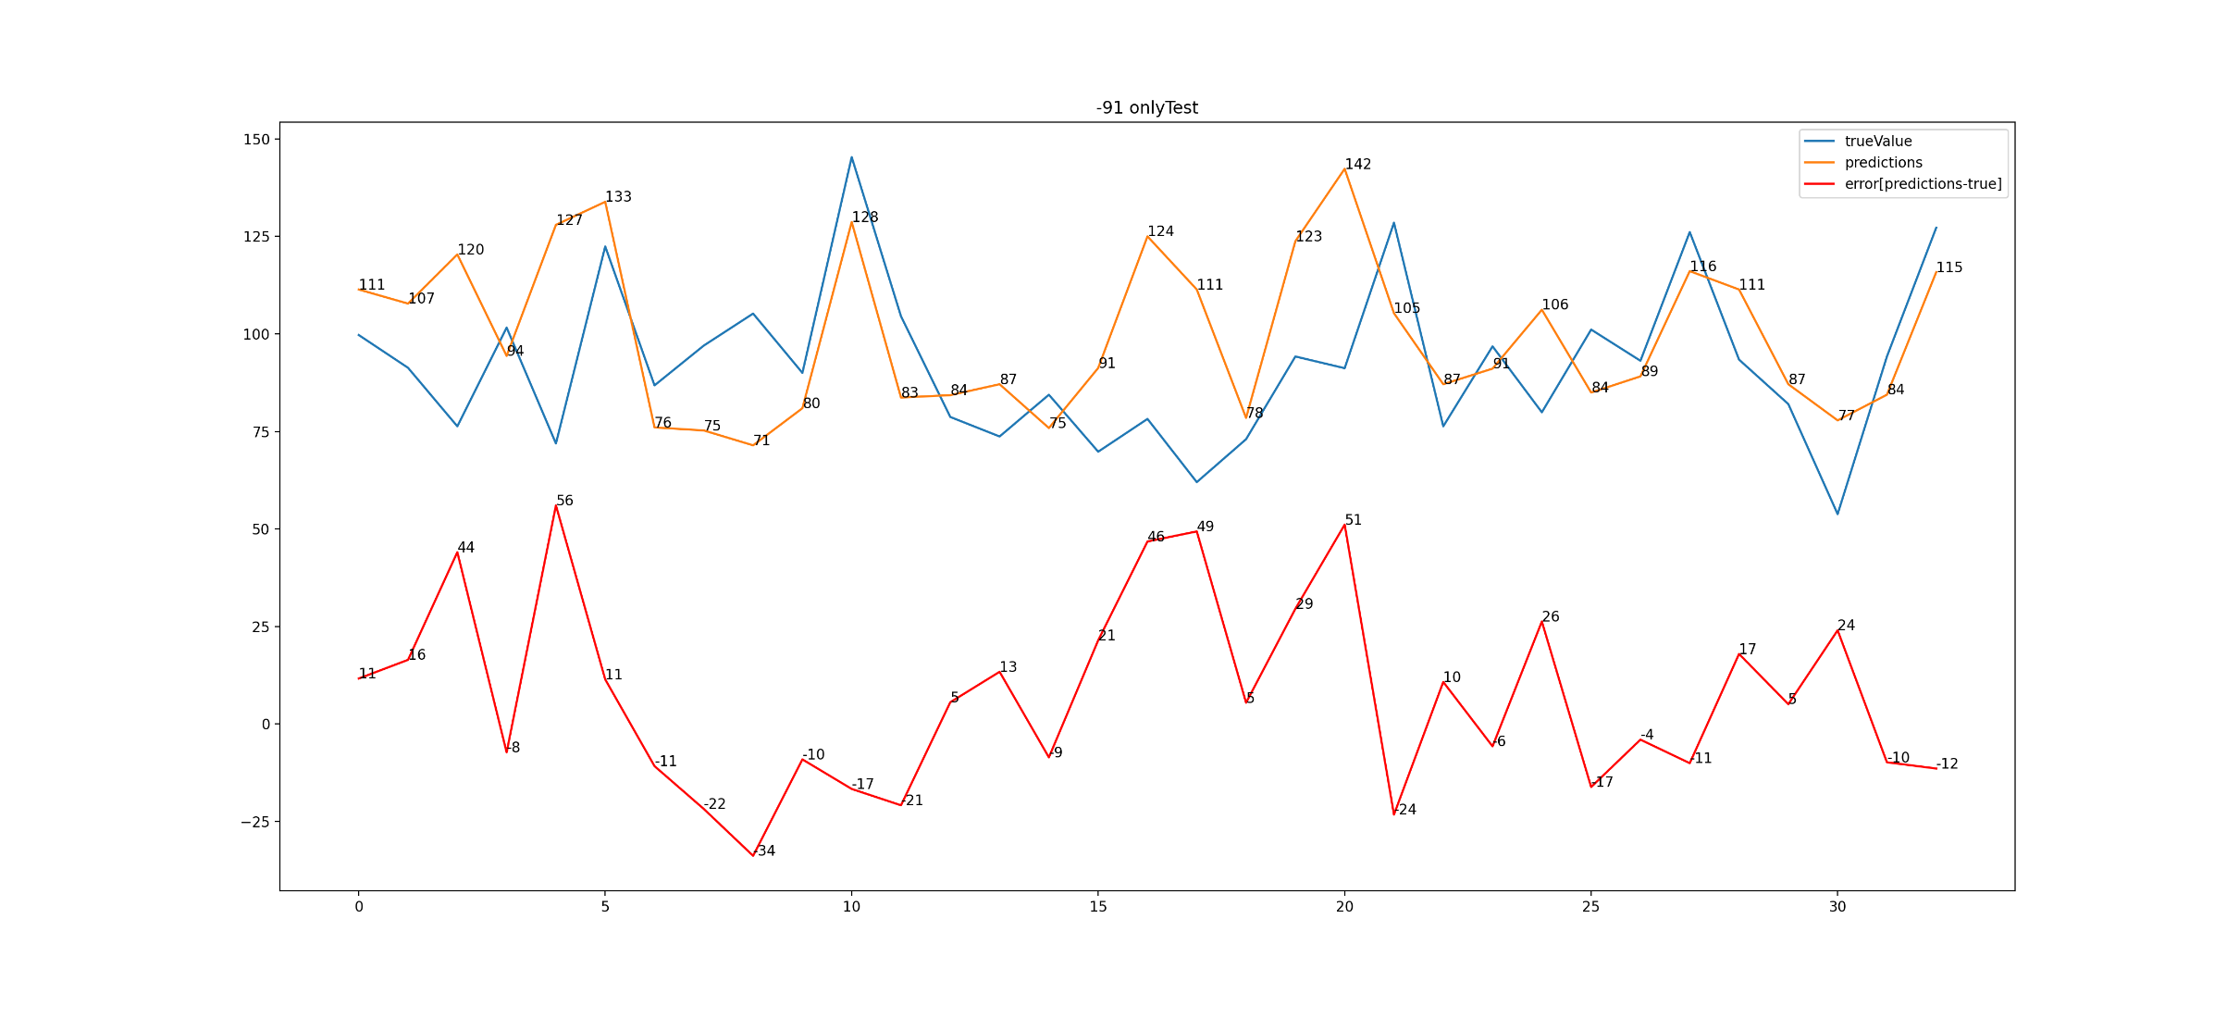
Mean Absolute Error: 19.860511616161617 R2 Score: -0.506254127447757 Root Mean Squared Error: 24.608880716659492

Slide 9
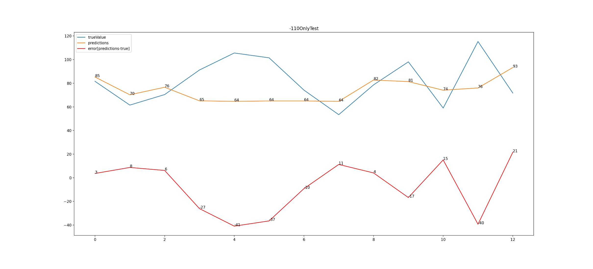
Results where T=-110 in test dataset
Mean Absolute Error: 18.413413553113575 R2 Score: -0.4683649647830397 Root Mean Squared Error: 22.467783260975736

Slide 10
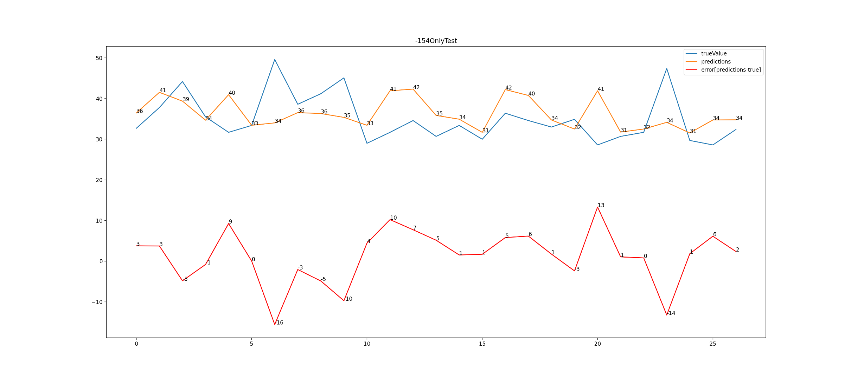
Results where T=-154 in test dataset
Mean Absolute Error: 5.1985948853615485 R2 Score: -0.36946698733028516 Root Mean Squared Error: 6.669509289264066

