Slide 1

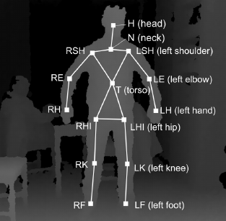
Human Activity Recognition using Skeleton Data from RGBD Sensors
Authors:
Enea Cippitelli Samuele Gasparrini Ennio Gambi Susanna Spinsante
-Presented By: Dhanesh Pradhan

Slide 2

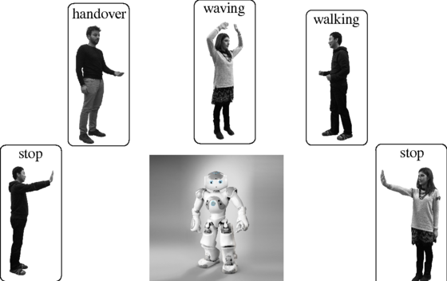
Overview: Problem Statement
Overview
Develop Human Activity Recognition Algorithm exploiting skeleton data extracted by RGBD sensors
System Architecture
Result 1
Result 2
Result 3
Result 4
Conclusion

Slide 3

Overview: CAD-60 Dataset
Overview
Description:
60 RGB-D videos
4 subjects
5 different environments
12 activities
Issues:
System Architecture
Result 1
Result 2
Result 3
3 Right handed person
1 Left handed person
Result 4
Conclusion

Slide 4
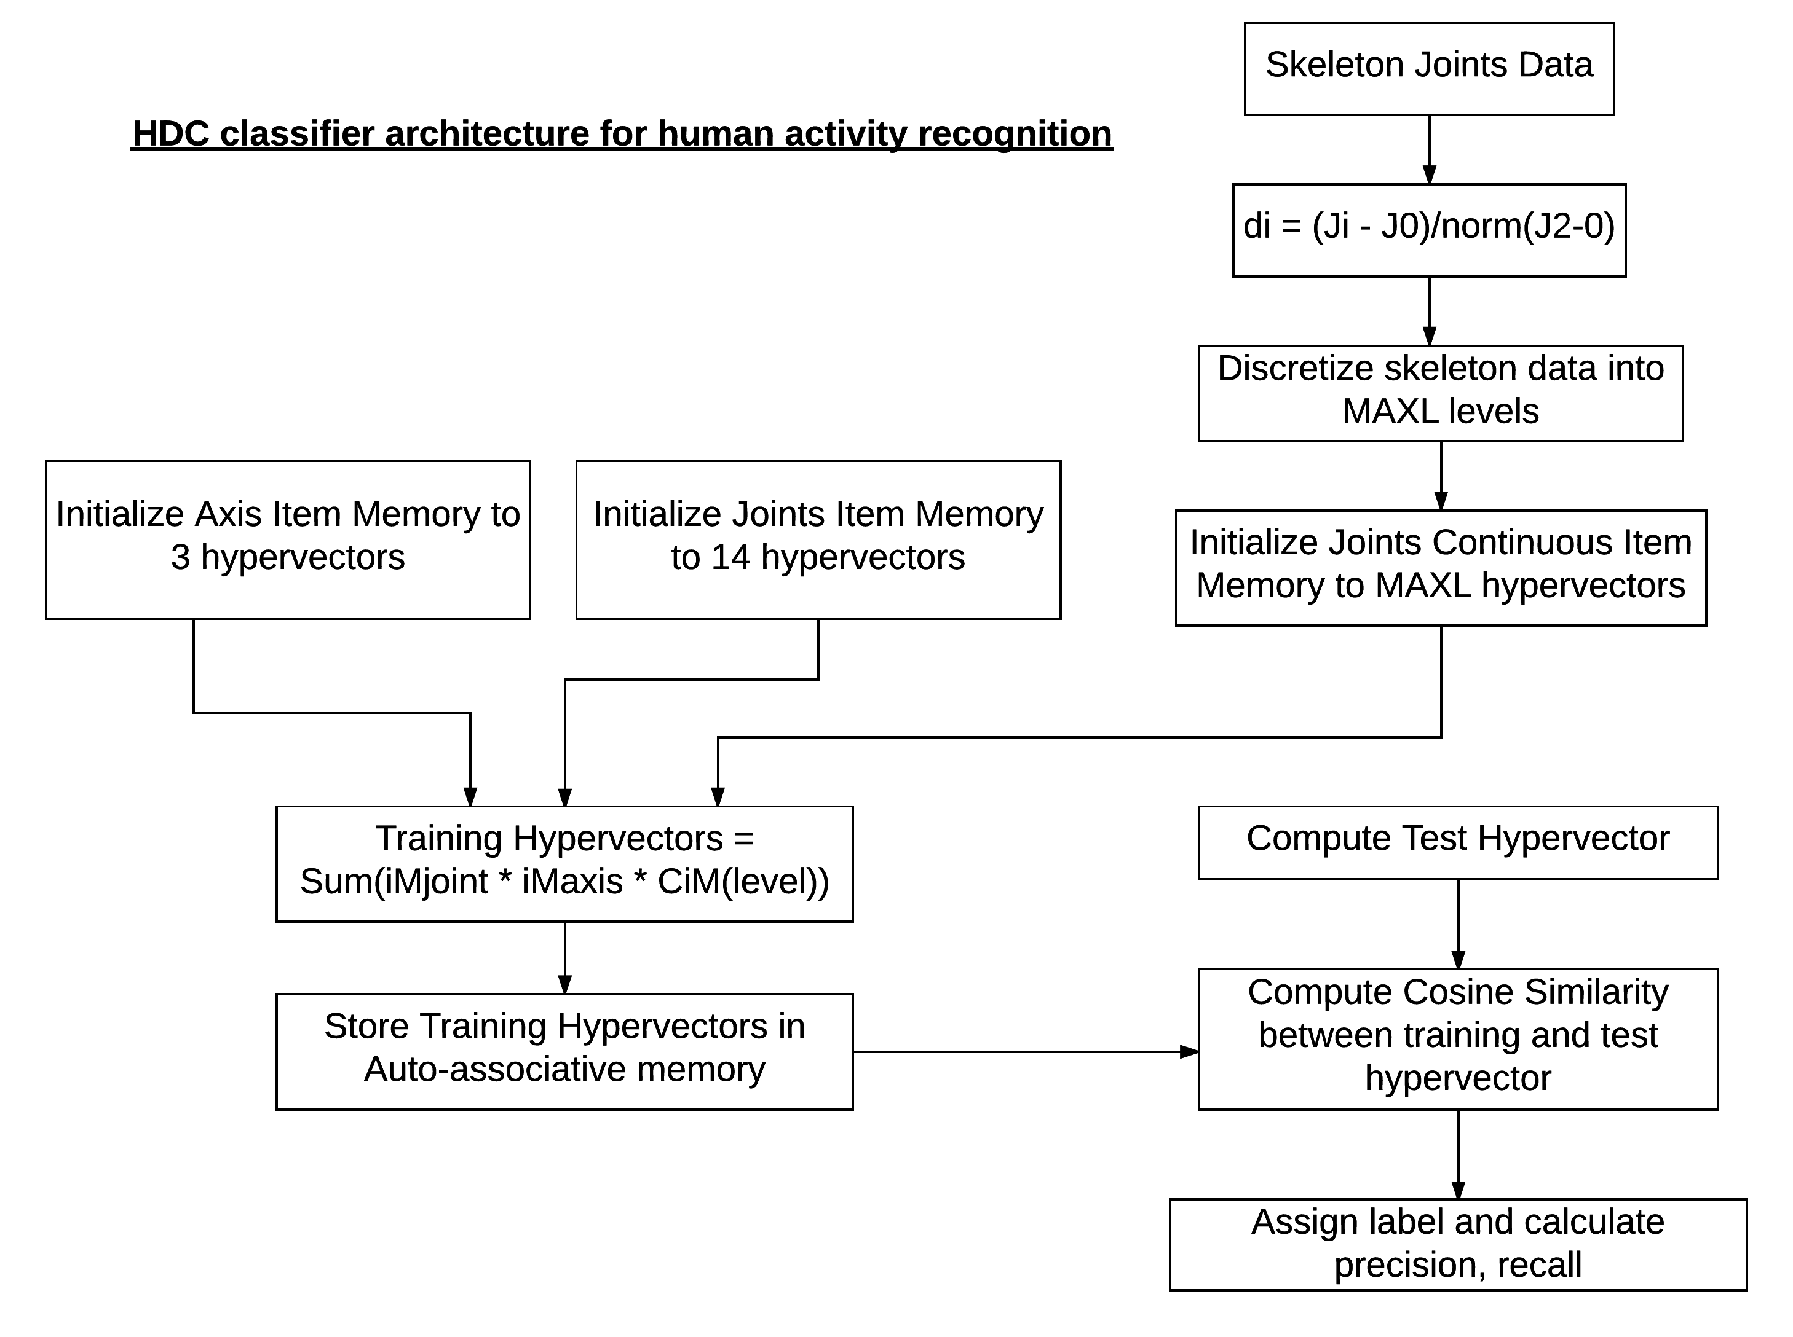
System Architecture
Data pre-processing
Overview
Kinect gives 14 joints + torso
x,y,z axes
System Architecture
Result 1
MAXL Discrete data levels
Result 2
Result 3
Result 4
Prediction metric =
Cosine similarity
Compute training hypervector and store in memory
Conclusion

Slide 5
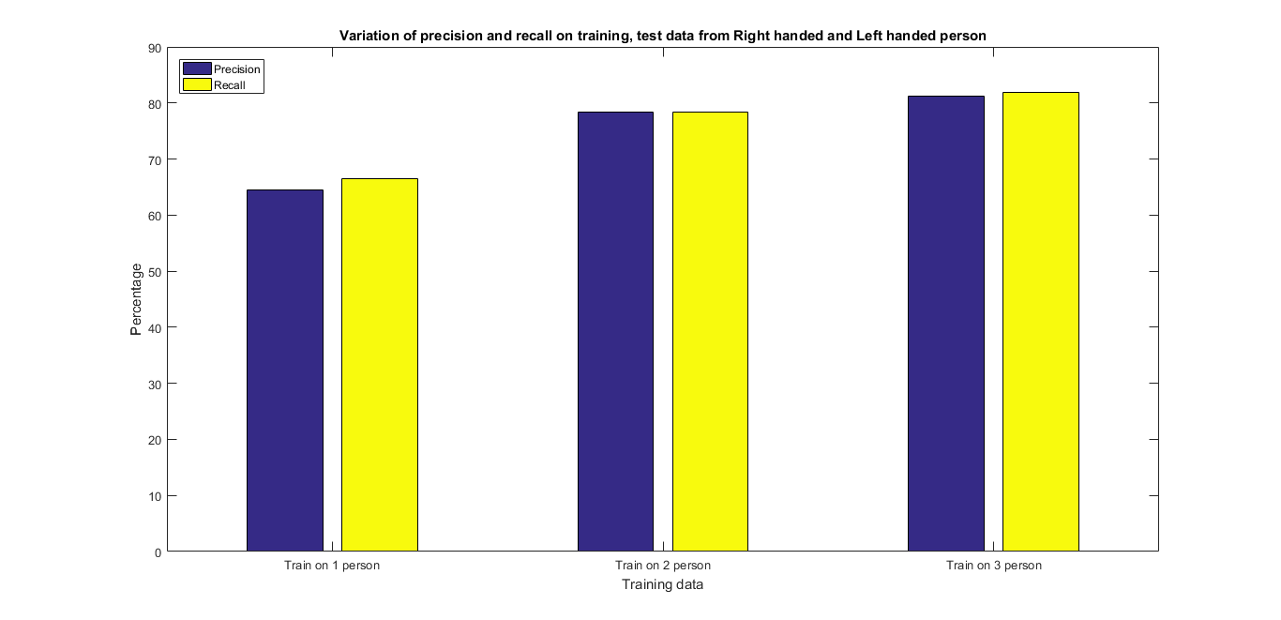
Result: Training on Right and Left handed person
82 %
78 %
Overview
65 %
System Architecture
Result 1
Result 2
Result 3
Result 4
Low precision and recall values due to uneven training data
Conclusion

Slide 6
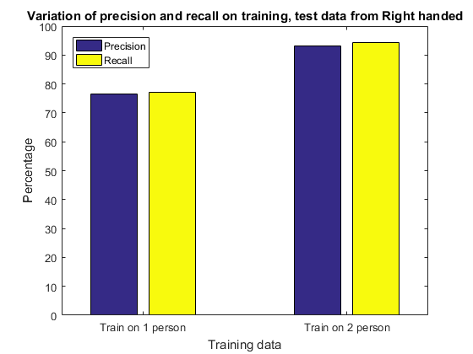
Result: Training on Right
94 %
Overview
78 %
System Architecture
Result 1
Result 2
Result 3
Result 4
Training and Testing done only on Right handed person
Conclusion

Slide 7
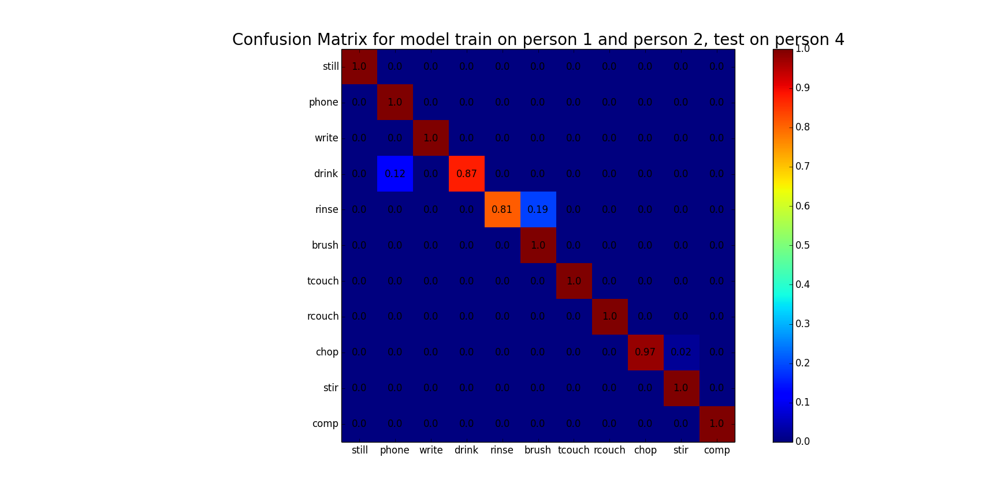
Result: Confusion Matrix
Overview
System Architecture
Result 1
Result 2
Result 3
Result 4
Conclusion

Slide 8
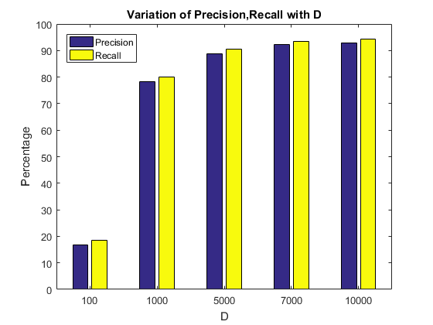
Result: Variation of precision and recall with D
Overview
System Architecture
Result 1
Result 2
Result 3
Result 4
Conclusion

Slide 9
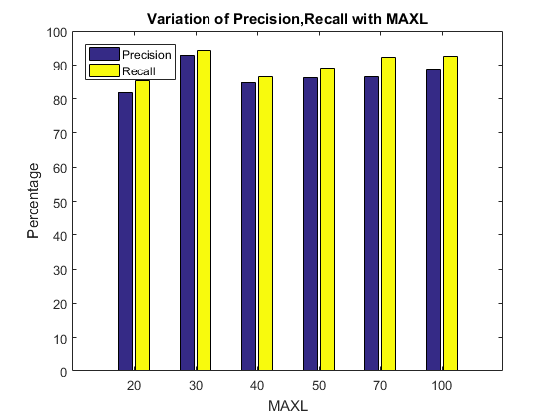
Result: Variation of precision and recall with MAXL
Overview
System Architecture
Result 1
Result 2
Result 3
Result 4
Conclusion

Slide 10
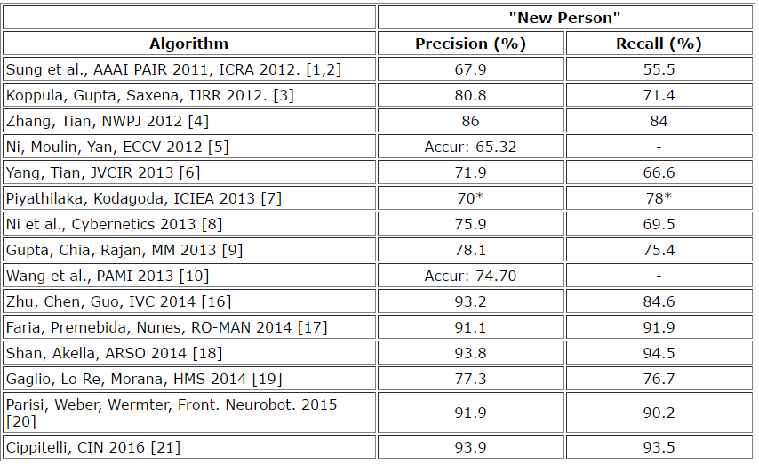
Comparison of Results
Overview
System Architecture
Result 1
Result 2
Result 3
Result 4
Pradhan, HDC 2017: Precision (81.18 %) and Recall (81.88 %)
Or
Pradhan, HDC 2017: Precision (93.04 %) and Recall (94.27 %)
(Only right handed person)
Conclusion

Slide 11
Conclusion
Overview
Code is available at : https://github.com/dhaneshp/HDC-Human-Activity-Recognition
Precision and Recall can be improved by getting more training data for left handed person
Record video from Kinect
Mirror data from right handed person
Spatial and Temporal Hyperdimensional Computing needs to be applied together to improve results
Use combination of features:
skeleton + joint orientation + HOG RGB + HOG depth
System Architecture
Result 1
Result 2
Result 3
Result 4
Conclusion

