Slide 1
Hyperdimensional Biosignal Processing: A Case Study for EMG−based Hand Gesture Recognition
Abbas Rahimi†, Simone Benatti‡, Pentti Kanerva†, Luca Benini‡*, Jan M. Rabaey†
†UC Berkeley, ‡University of Bologna, and *ETH Zurich

Slide 2
Outline
Background in HD Computing
EMG−based Hand Gesture Recognition
Embedded Platform for EMG Acquisition
Mapping EMG Signals to HD Vectors
Spatiotemporal HD Encoding
Experimental Results

Slide 3
Brain-inspired Hyperdimensional Computing
Hyperdimensional (HD) computing:
Emulation of cognition by computing with high-dimensional vectors as opposed to computing with numbers
Information distributed in high-dimensional space
Supports full algebra
Superb properties:
General and scalable model of computing
Well-defined set of arithmetic operations
Fast and one-shot learning (no need of back-prop)
Memory-centric with embarrassingly parallel operations
Extremely robust against most failure mechanisms and noise
[P. Kanerva, An Introduction to Computing in Distributed Representation with High-Dimensional Random Vectors, 2009]

Slide 4
What Are Hypervectors?
Patterns (mapped to hypervector) as basic data representation in contrast to computing with numbers!
Hypervectors are:
high-dimensional (e.g., 10,000 dimensions)
(pseudo)random with i.i.d. components
holographically distributed (i.e., not microcoded)
Hypervectors can:
use various coding: dense or sparse, bipolar or binary
be combined using arithmetic operations: multiplication, addition, and permutation
be compared for similarity using distance metrics

Slide 5
Mapping to Hypervectors
Each symbol is represented by a 10,000−D hypervector chosen at random:
A = [−1 +1 −1 −1 −1 +1 −1 −1 ...]
B = [+1 −1 +1 +1 +1 −1 +1 −1 ...]
C = [−1 −1 −1 +1 +1 −1 +1 −1 ...]
D = [−1 −1 −1 +1 +1 −1 +1 −1 ...]
...
Z = [−1 −1 +1 −1 +1 +1 +1 −1 ...]
Every letter hypervector is dissimilar to others, e.g., ⟨A, B⟩ = 0
This assignment is fixed throughout computation
Item Memory (iM)
“a”
A
8
10,000

Slide 6
HD Arithmetic
Addition (+) is good for representing sets, since sum vector is similar to its constituent vectors.
⟨A+B, A⟩=0.5
Multiplication(*) is good for binding, since product vector is dissimilar to its constituent vectors.
⟨A*B, A⟩=0
Permutation (ρ) makes a dissimilar vector by rotating, it good for representing sequences.
⟨A, ρA⟩=0
* and ρ are invertible and preserve distance

Slide 7
Computing a Profile Using HD Arithmetic
A trigram (3−letter sequence) is represented by a 10,000−D hypervector computed from its Letter Vectors with permutation and multiplication
Example: “eat” → ρ ρ E * ρ A * T
E = −1 −1 −1 +1 +1 −1 +1 −1 ...
A = −1 +1 −1 −1 −1 +1 −1 −1 ...
T = −1 −1 +1 −1 +1 +1 +1 −1 ...
−−−−−−−−−−−−−−−−−−−−−−−−−−−−−−−−
“eat”= +1 +1 −1 −1 +1 +1 ...
Example: “ate” → ρ ρ A * ρ T * E
A = −1 +1 −1 −1 −1 +1 −1 −1 ...
T = −1 −1 +1 −1 +1 +1 +1 −1 ...
E = −1 −1 −1 +1 +1 −1 +1 −1 ...
−−−−−−−−−−−−−−−−−−−−−−−−−−−−−−−−−
“ate” = −1 +1 −1 +1 −1 +1 ...
Applications | N−grams | HD | Baseline
Language identification [QI’16, ISLPED’16] | N=3 | 96.7% | 97.9%
Text categorization [DATE’16] | N=5 | 94.2% | 86.4%
EMG gesture recognition [ICRC’16] | N={3,4,5} | 97.8% | 89.7%

Slide 8
Outline
Background in HD Computing
EMG−based Hand Gesture Recognition
Embedded Platform for EMG Acquisition
Mapping EMG Signals to HD Vectors
Spatiotemporal HD Encoding
Experimental Results

Slide 9
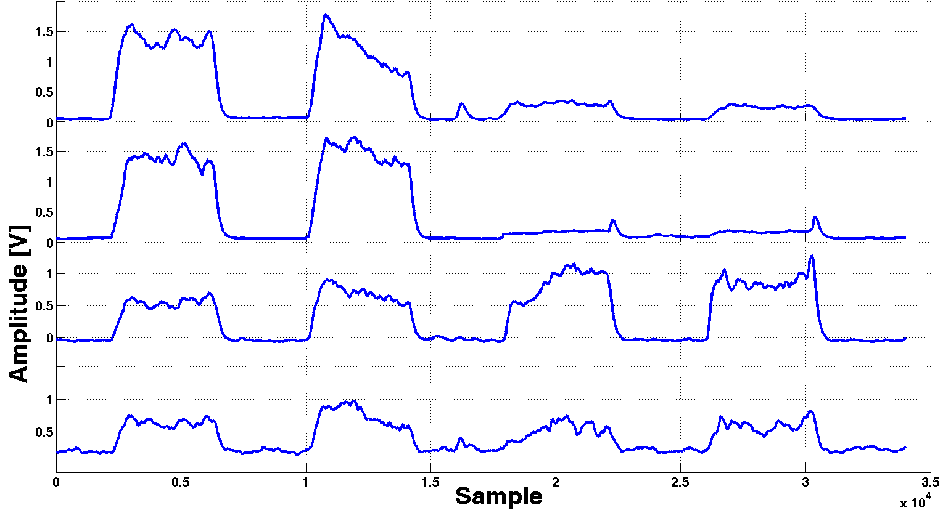
Embedded Platform for Electromyography (EMG)
Block diagram of a versatile embedded platform [TBCAS’15]
Placement of EMG electrodes on the subjects’ forearms
Four EMG sensors
Sampled at 1K Hz
Max amplitude: 20 mV
Five gestures: {closed hand, open hand, 2−finger pinch, point index, rest}

Slide 10
Experimental Setup
SVM Flow (baseline)
25% of dataset
Training dataset
SVM Training Algorithm
SVM Model
EMG dataset
Data segmentation and labelling
SVM Classification Algorithm
Gesture 1
Test dataset
Full dataset
Gesture 5
Our Proposed HD Flow
25% of dataset
Training dataset
HDC Encoder
GV
Associative Memory
EMG dataset
Data segmentation and labelling
Query
GV
Test dataset
HDC Encoder
Associative Memory
Gesture 1
Full dataset
Gesture 5

Slide 11
Signal Partitioning for Encoding
Closed hand
Spatial encoding
R1
R2
R3
R4
R5
Temporal encoding, e.g., pentagram
Notes:
Label channels

Slide 12
Mapping to HD Space
Item Memory (iM) maps channels to orthogonal hypervectors.
CiM maps quantities continuously to hypervectors.
Q: 21 levels
CiM
CiM(S_{CH1}[t])
iM
⟨ iM(CH1), iM(CH2) ⟩ = 0 ⟨ iM(CH2), iM(CH3) ⟩ = 0
⟨ iM(CH3), iM(CH4) ⟩ = 0
CH1
iM
iM(CH1)
Q: 21 levels
CiM
CiM(S_{CH2}[t])
CH2
iM
iM(CH2)
CiM
⟨ CiM(0), CiM(1) ⟩ = 0.95 ⟨ CiM(0), CiM(2) ⟩ = 0.90
⟨ CiM(0), CiM(3) ⟩ = 0.85
⟨ CiM(0), CiM(4) ⟩ = 0.80
….
⟨ CiM(0), CiM(20) ⟩ = 0
Q: 21 levels
CiM
CiM(S_{CH3}[t])
CH3
iM
iM(CH3)
Q: 21 levels
CiM
CiM(S_{CH4}[t])
CH4
iM
iM(CH4)

Slide 13
Spatiotemporal Encoding
Spatial encoder
Q: 21 levels
CiM
CiM(S_{CH1}[t])
*
CH1
iM
iM(CH1)
*
Q: 21 levels
CiM
CiM(S_{CH2}[t])
Temporal encoder
*
CH2
iM
iM(CH2)
ρ(R[t−1])
ρ²(R[t−2])
ρ^{N−1}(R[t−N+1])
+
R[t]
ρ
ρ
…
ρ
Q: 21 levels
CiM
CiM(S_{CH3}[t])
*
CH3
iM
iM(CH3)
Q: 21 levels
CiM
CiM(S_{CH4}[t])
*
N−gram[t]
CH4
iM
iM(CH4)
GV(Label[t]) += N−gram[t]
Bind a channel to its signal level: iM(CH1) * CiM(SCH1[t])
Generate a holistic record (R[t]) across 4 channels by addition
Rotate (ρ) a record to capture sequences

Slide 14
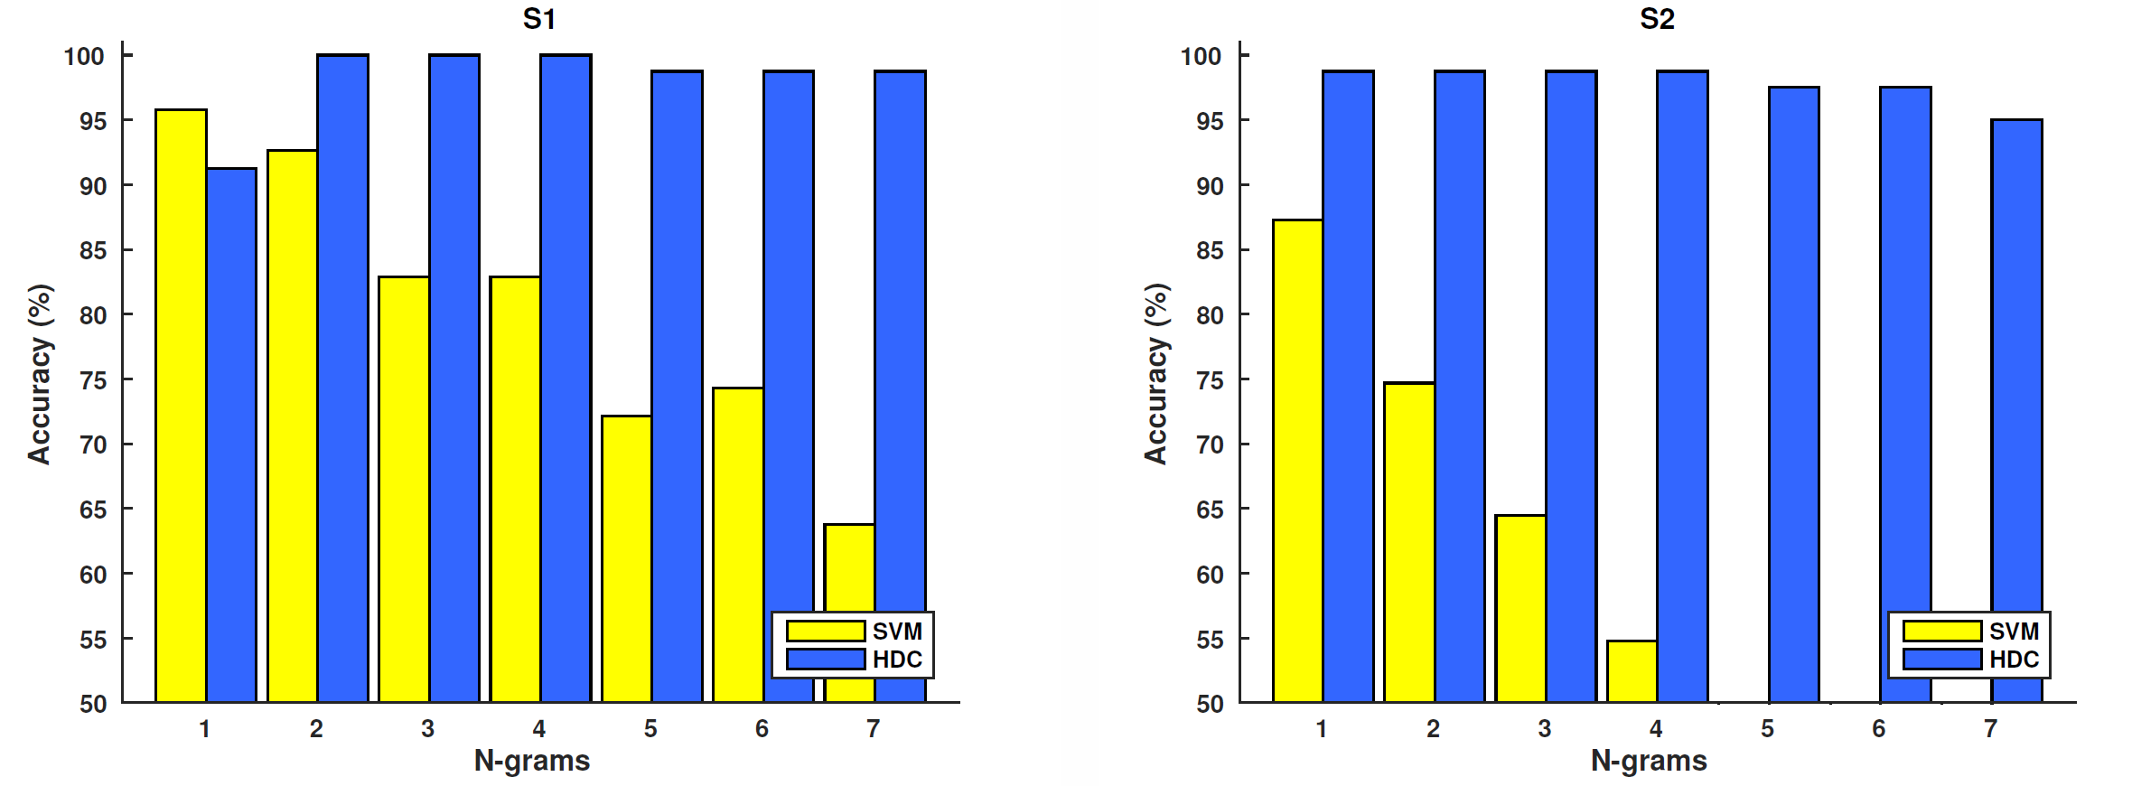
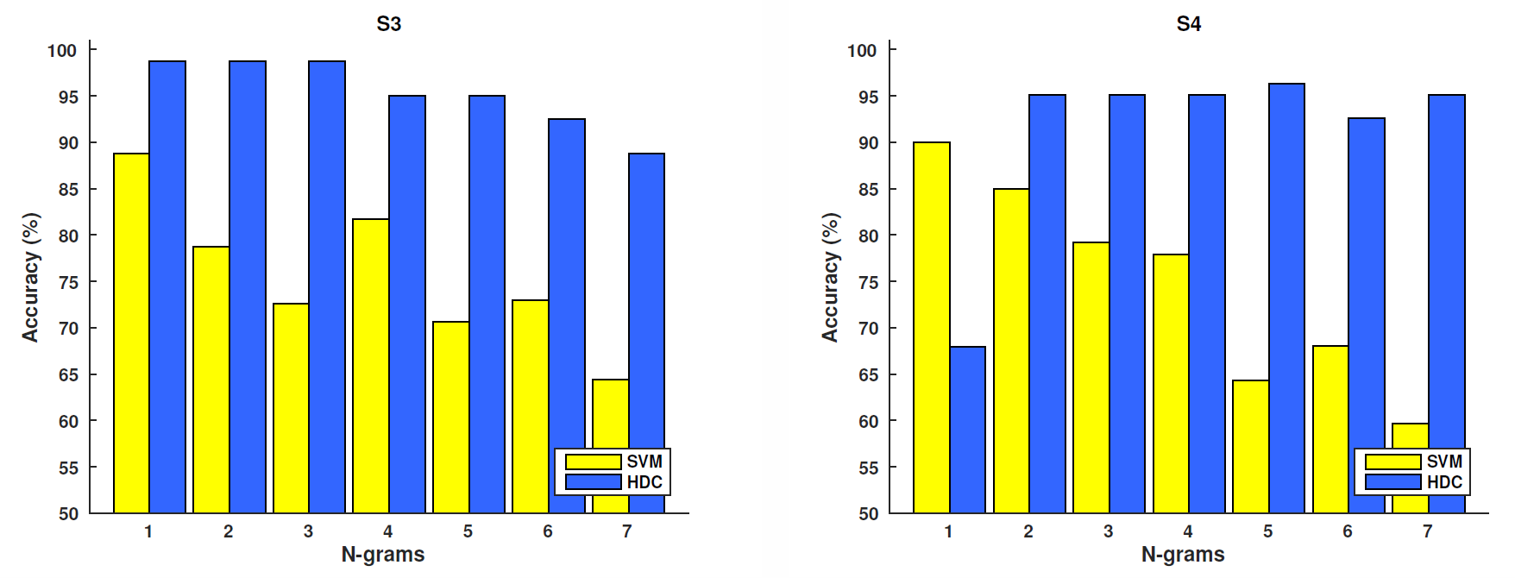
Person-to-person Differences
HDC has up to 100% accuracy (on average 8.1% higher than SVM) with equal training!

Slide 15
Adaptive Encoder
How can we robustly reuse the encoder across different test subjects?
Train with the best N−gram
Adaptively tune N−grams in the encoder based on stored patterns in AM using feedback
Plant
Encoder
Associative Memory (AM)
EMG
Channels
Spatial Encoding
Query GV
GV (Label=1)
Cosine
Temporal
Encoding
GV (Label=2)
…
N
GV (Label=5)
Controller
Actuation:
change N
argmax cosine−similarity
Measurement: cosine similarity
N

Slide 16
Similarity Is VERY Low for Tested≠Trained N−grams

Slide 17
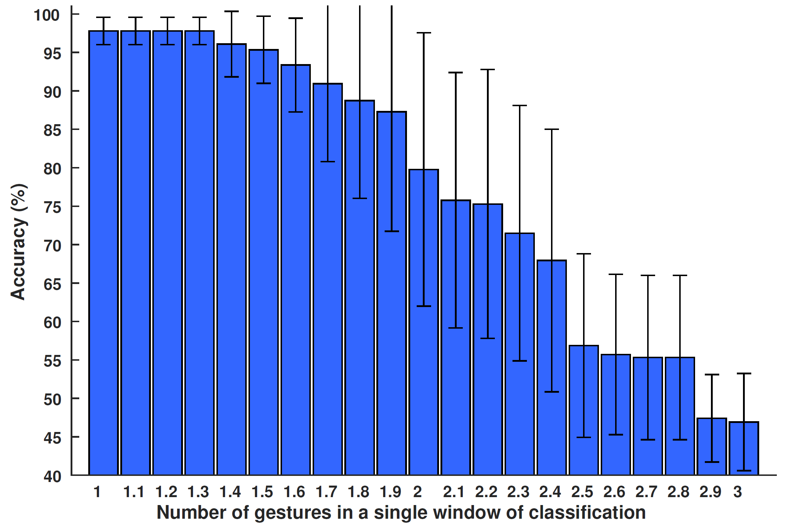
Accuracy with Overlapping Gestures
What if the classification window contains multiple gestures?
Peak-accuracy up to 30% overlapping between two gestures

Slide 18
HDC Learns Fast
97.8% accuracy with only 1/3 the training data required by state-of-the-art SVM
Increasing training 10% to 80% → increases SVs from 30 to 155 (higher execution)

Slide 19
Summary
Simple vector−space operations are used to encode analog input signals for classification
Compared to state-of-the-art SVM:
A high level of accuracy (97.8%) with only 1/3 the training data
HD encoder adjusts to
variations in gesture−timing across different subjects
30% overlapping between two neighboring gestures
Next: online and continuous learning!

Slide 20


Acknowledgment
This work was supported in part by Systems on Nanoscale Information fabriCs (SONIC), one of the six SRC STARnet Centers, sponsored by MARCO and DARPA.

