Slide 1
Fake News Identification
By-
Ashish Kumar (195569)
Mayur Kumar (195554)
Sitaram Rathi (195567)
Navdeep Singh Rathore (195571)

Slide 2
Goal of the project
Stance detection -
Agree
Disagree
Unrelated
Discuss

Slide 3
Focus of the project
Knowledge Representation
Neural network learns
Results achievement
Skip-Thought model Embedding(4800+4800)
TF-IDF featuring(10000)
External features
Sentiment analysis (4+4)
Tf-idf score (3)
N-gram character match(2-16)(15)
N-gram word match(2-6)(5)
Simple MLP network with some Activity regularization, concatenation and Batch Normalization layers as we speak.
Since due to low resources we trained model on 0.2% data and achieved a highly overfitting results,i.e., low bias and high variance (as expected).

Slide 4
Knowledge Representation
Skip-Thought model’s Embedding
Self-supervised learning
Uses learned weights to represent knowledge of a given sentence
Uses concept of Word2Vec embedding
CBOW modelling technique
Skip-gram modelling technique
100% tutoring fit

Slide 5
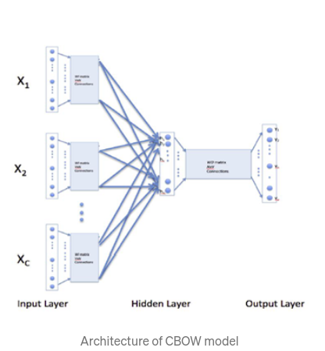
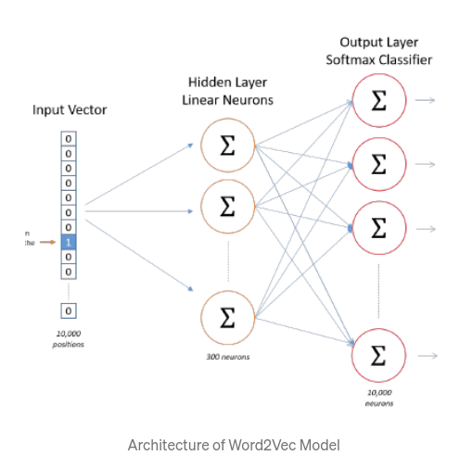
Word2Vec

Slide 6
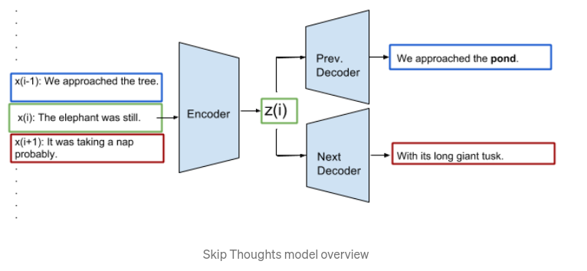
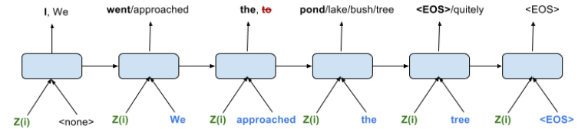
Skip-Thought Embedding

Slide 7
Feat1 = headline_feat * body_feat
Feat2 = | headline_feat - body_feat |
Final_Vector = Concatenate Feat1 and Feat2

Slide 8
Features Extraction
Tf-IDF Embedding
Vectorization similar to One-Hot Encoding
Tf vectors * IDF vectors => Tf-IDF vectors (element mul.)
Tf = Term-frequency (occurrence frequency)
IDF = Inverse-Document Frequency = 1 + log(#documents/#documents in which words occur)
1 is added for smoothening

Slide 9
Knowledge Representation
External Features
VADER sentiment analysis
Valence Aware Dictionary and sEntiment Reasoner
Handle multiple sentiments in a single sentence
NLTK package
Maps lexical features to emotion intensities
Understand capitalization and punctuation
Understand basic context
Process
Stemming
Lemmatization
Stopwords
Part of Speech Tagging (POS)
Noun, Pronoun, Adjective, …
Named Entity Recognition (using Ghostscript)
Chunking (Grouping)
Sentiment Analysis

Slide 10
Features Extraction
External Features (Headline-Body pair)
TF-IDF scores
3 features
Cosine similarity
Manhattan
Euclidean
N-Gram Character Matching
N = [2…16]
15 features
N-Gram Word Matching
N = [2…6]
5 features

Slide 11
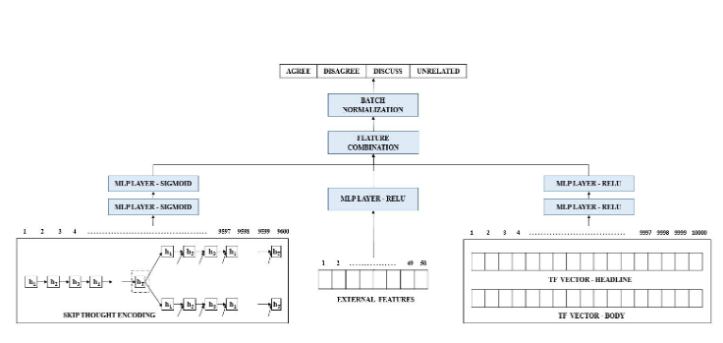
Model architecture

Slide 12
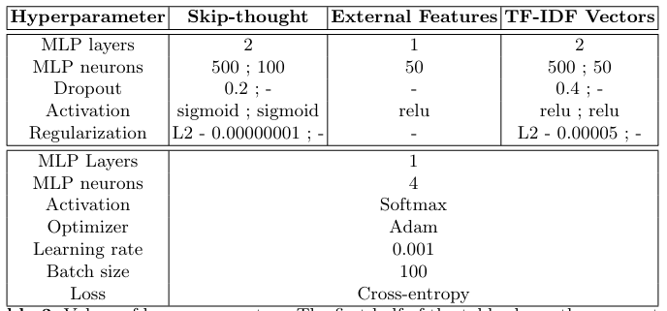
Model Parameters & Hyperparameters

Slide 13
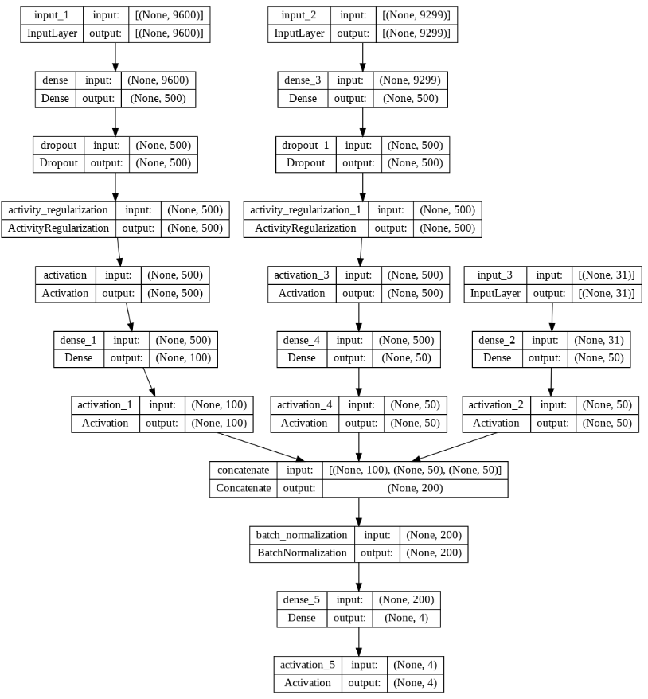
UML Model
This is how the UML diagram of our model looks like. The shapes passed to each layer is shown in the diagram.

Slide 14
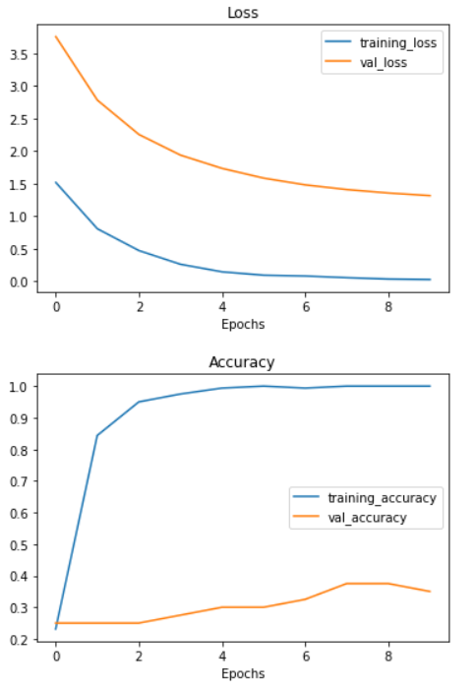
Loss-curves
Perfectly overfitting loss-curves. Requires more data to be trained on to achieve a proper fit with high specifications of the cpu and gpu and with high memory.

Slide 15
Challenges deep-dive
Challenge 1
Challenge 2
Challenge 3
Expand skip-thought model
More good representation can be done if skip-thought model is implemented and trained on paragraphs and their weights are used.
Sentiment Analysis
Expand corpus of word or data to achieve a greater extent of sentiment analysis. Deploy the use of multiple punctuation marks and emojis while training a sentimental model.
Complexity of training
Lowering the memory and resources complexity for training and deployment is a huge challenge.

Slide 16
Solution
Implementing skip-thought model for paragraphs is new era to be discussed. (Never been implemented yet)
Deploy more labours to label data manually for sentiment analysis. Use emoji embedding layers and punctuational embedding layers to improve VADER sentiment analysis.
Use fog networking to deploy our model, where the training is continuously done in a main server and testing, evaluation and deployment is done in fog networks.

Slide 17
Implementation

Slide 18
Contributions :-
Ashish Kumar - Model preparation & Training
Mayur Kumar - Model testing and UI designing
Navdeep Singh Rathore - Backend developing and code conversion
Sitaram Rathi - Backend-Frontend Incharge & Presentation

Slide 19
THANK YOU

