Slide 1
Crop Yield Prediction System
- Ashish Kumar Sahoo (2224100029)
Under the guidance of
Mrs. Rojalin Mallick
(Faculty of MCA)

Slide 2
Introduction
Agriculture is the backbone of our civilization, and its productivity significantly impacts on global food security
The integration of machine learning techniques has revolutionized traditional farming practices by enabling accurate predictions of crop yields.
This advancement not only aids farmers in optimizing their resources but also plays a pivotal role in ensuring a sustainable and resilient food supply chain

Slide 3
Problem Statement:
Crop yield varies from year to year making crop management difficult and affecting food Security.
Also Farmers need information regarding crop yield before sowing seeds in their fields
So accurate information about the history of crop yield is an important thing for making decisions related to agricultural risk management.

Slide 4
Objective
The main objective of crop yield prediction is to create accurate models that forecast the amount of crops that will likely grown in a particular area.
These models aim to assist farmers in making better decisions about resource management, and harvesting, ultimately optimizing agricultural practices for improved productivity and food security.
It can help farmers and businesses predict crop yield for a particular season.

Slide 5
Software Used
Anaconda : Used for creating python virtual environment.
Jupyter Notebook , VS Code : IDE
Python
Modules : NumPy, Pandas, Matplotlib, Seaborn, Plotly.express , statsmodels and Flask

Slide 6
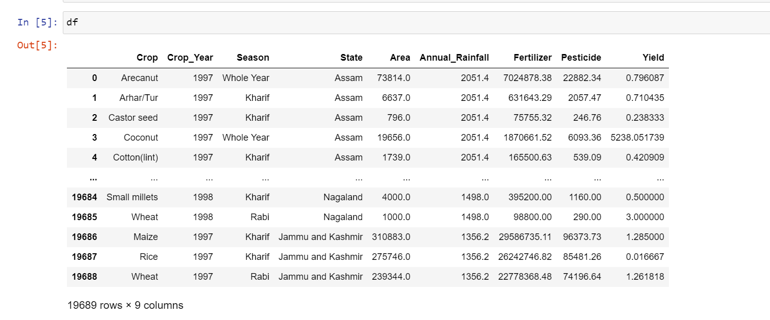
1. Dataset

Slide 7
Data Processing
Check Missing values
Check Duplicates
Check data Type
Check no. of Unique values in each column

Slide 8
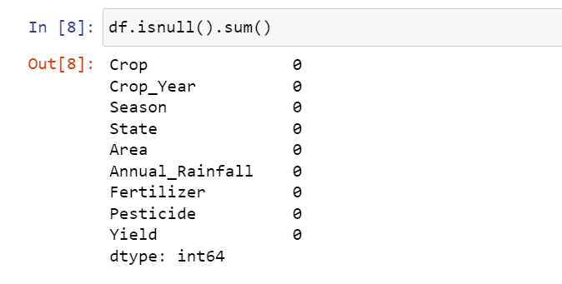
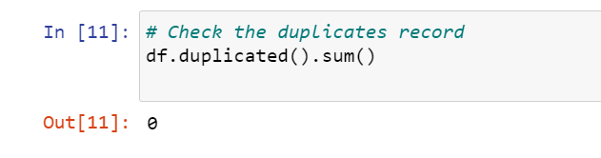
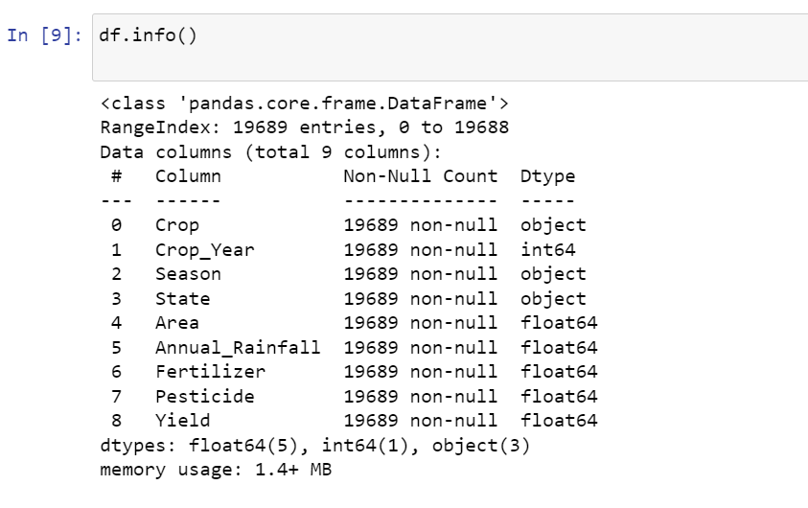
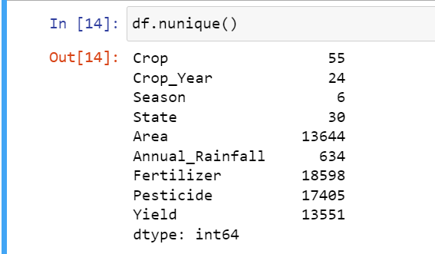

Slide 9
Exploring the data

Slide 10
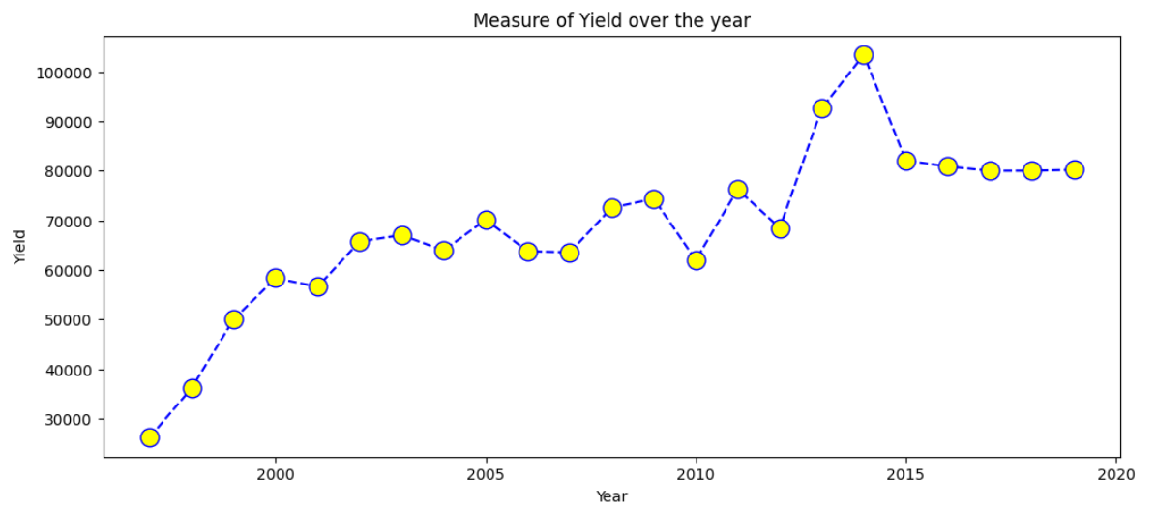
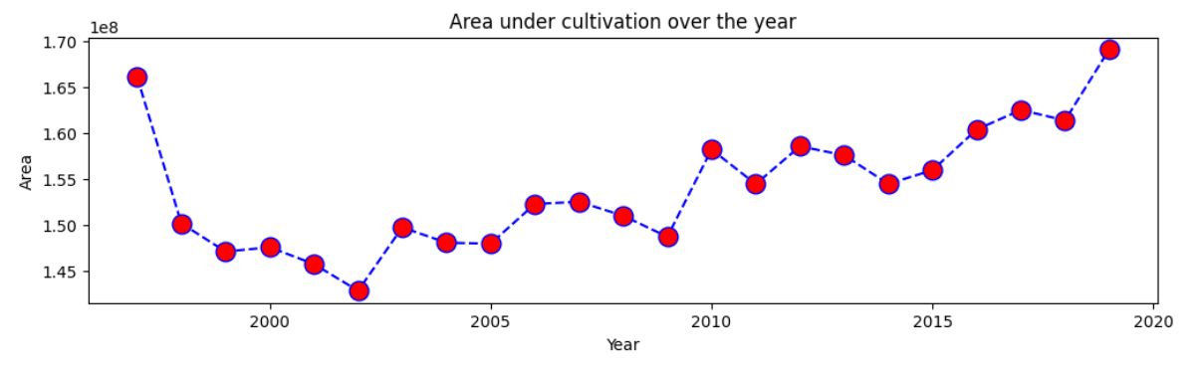

Slide 11
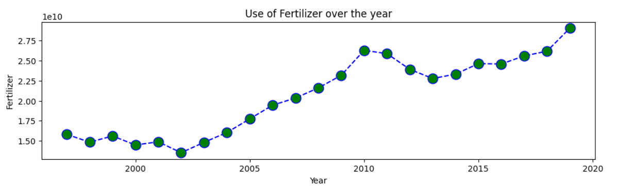
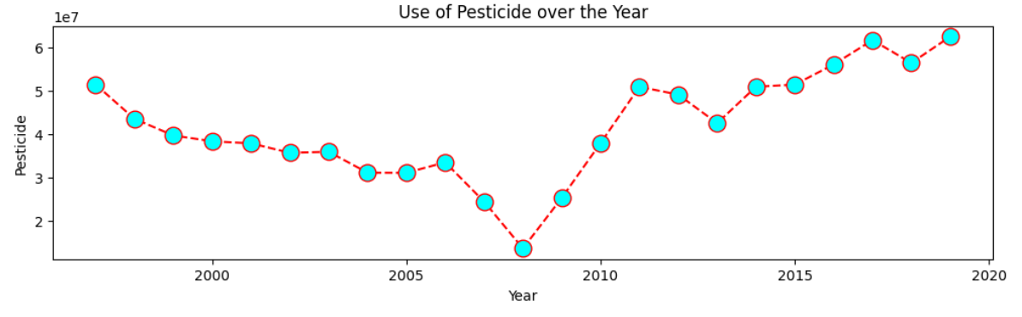

Slide 12
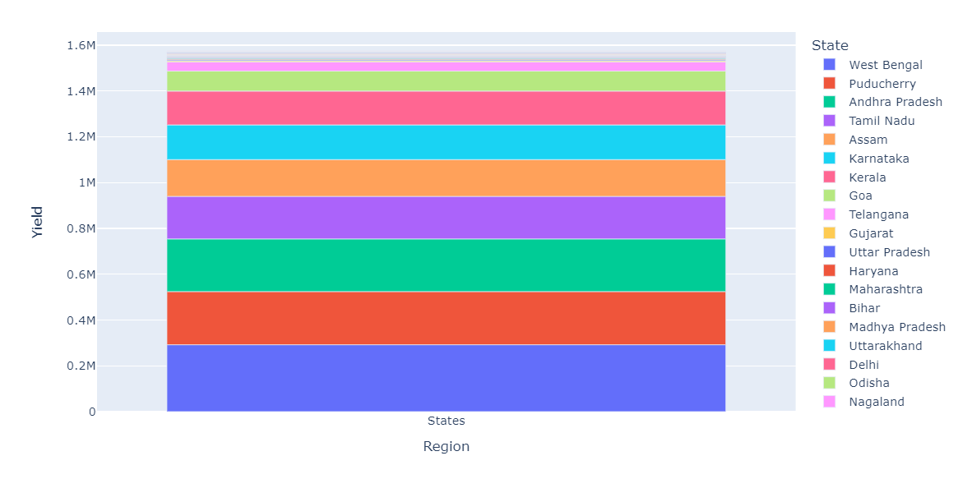
AGICULTURAL YIELD IN DIFFERENT STATES

Slide 13
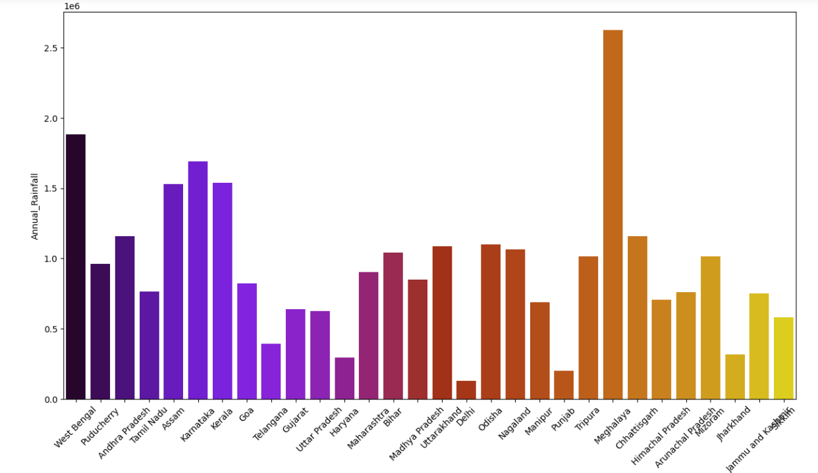
VISUALIZING RAINFALL DATA ACROSS DIFFERENT STATES

Slide 14
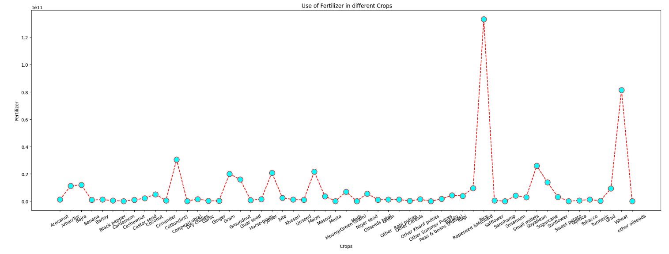
THE IMPACT OF CROP SELECTION AND FERTILIZER USE

Slide 15
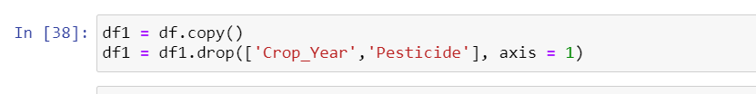

Slide 16
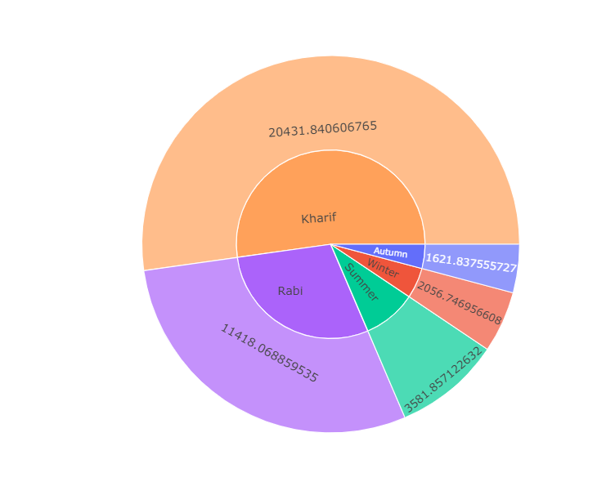
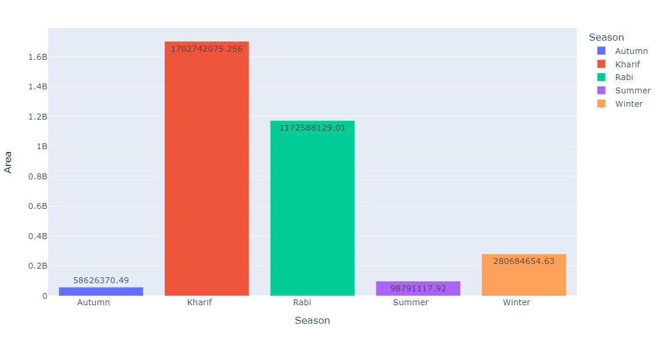
Seasonal Patterns of Cultivated Land Use

Slide 17
Conclusion from EDA
Crop yield is significantly influenced by factors like Seasons, annual rainfall, and fertilizer.
Certain crop varieties exhibit higher yields based on specific environmental conditions, such as rainfall and seasons
Also uses of fertilizer can positively impact overall crop productivity

Slide 18
As any value prediction problem is a regression problem, our model will test various regression algorithms and pick the most efficient one.
For any regression algorithm we must have two types of variables :
Dependent variables: The values that we will be predicting.
Independent variables: The variables whose values will be used for the prediction.

Slide 19
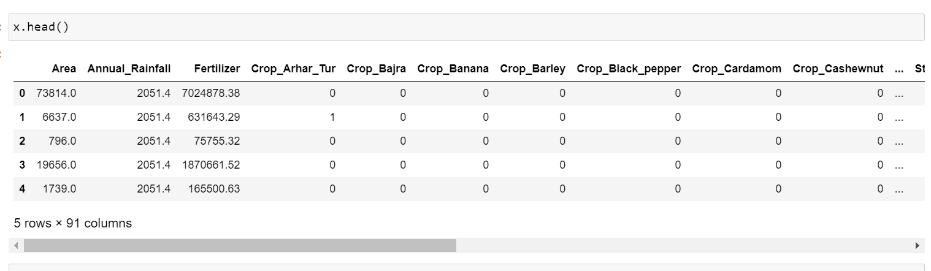
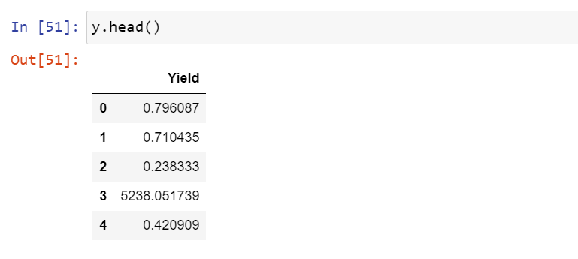
Independent Variables
Dependent Variables

Slide 20
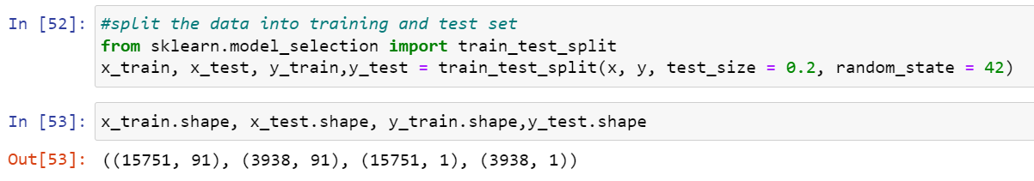
Splitting the Data into Train and Test set

Slide 21
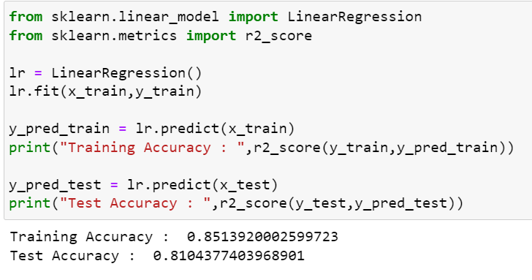
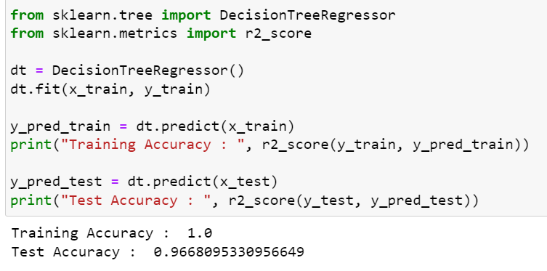
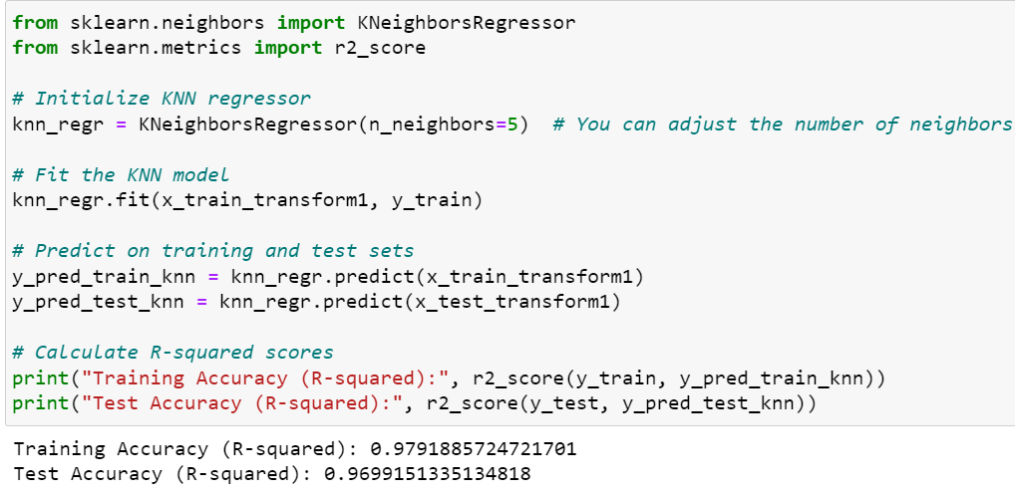
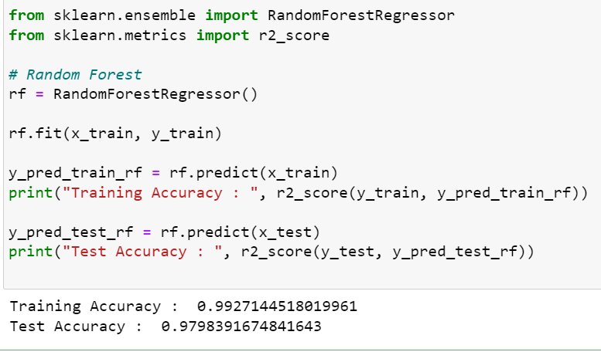
Results

Slide 22
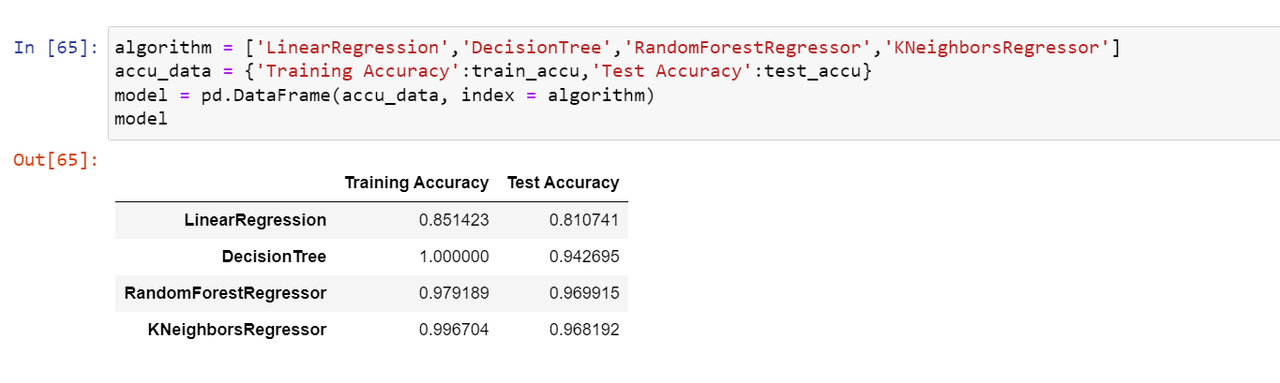
RESULTS

Slide 23
Algorithm Used
Random Forest Regression:: Random Forest models are employed to predict the relationship between multiple variables or factors. The variable being predicted (solved for by the model) is termed the dependent variable, while the variables utilized to forecast the value of the dependent variable are known as independent variables.
In Random Forest regression, multiple decision trees collectively form the model. Each observation comprises multiple values corresponding to various independent variables and the dependent variable.

Slide 24
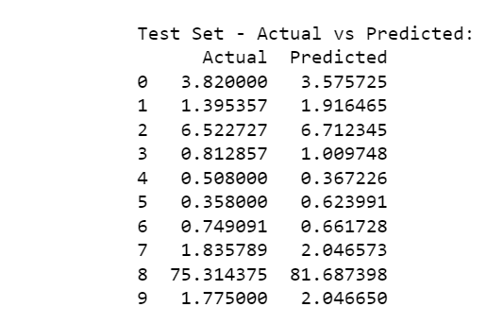
ACTUAL VALUE VS PREDICTED VALUE

Slide 25
Screenshots

Slide 26
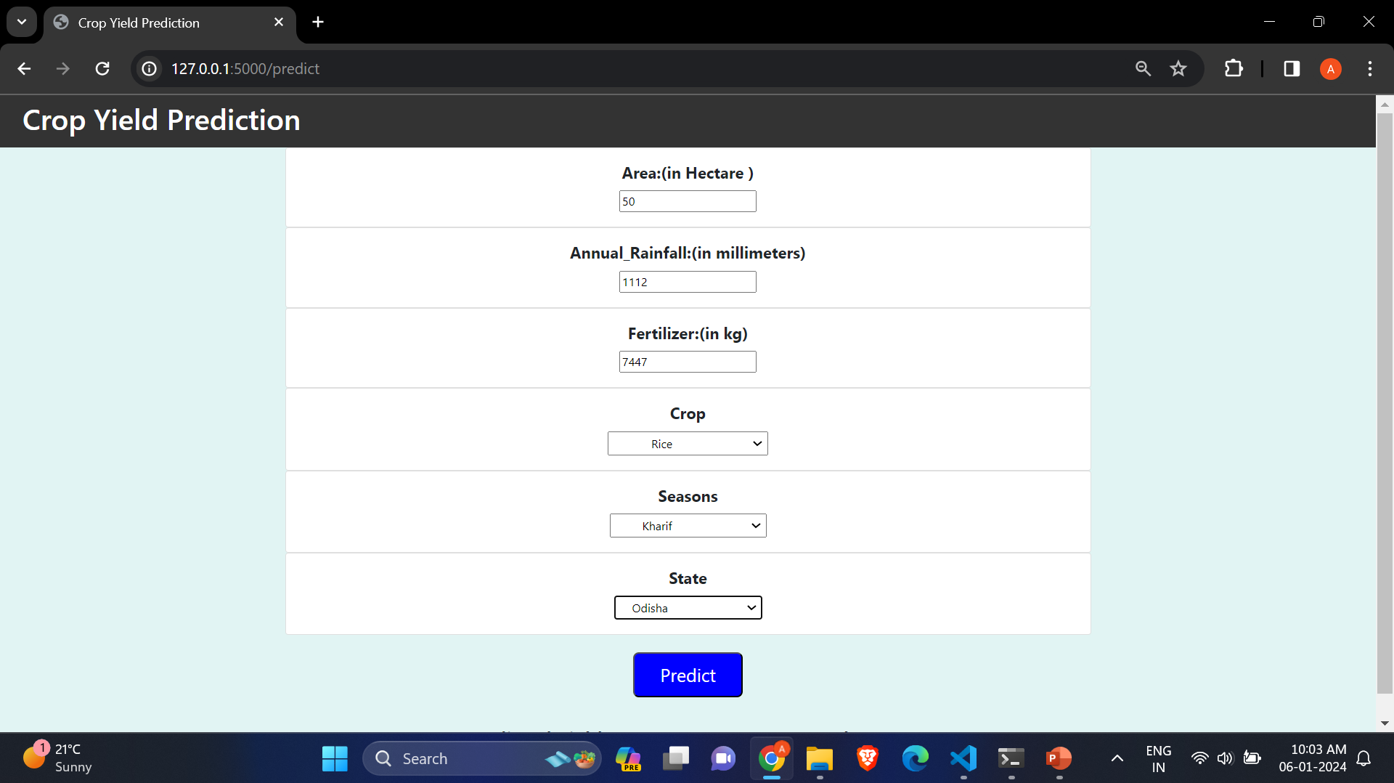

Slide 27
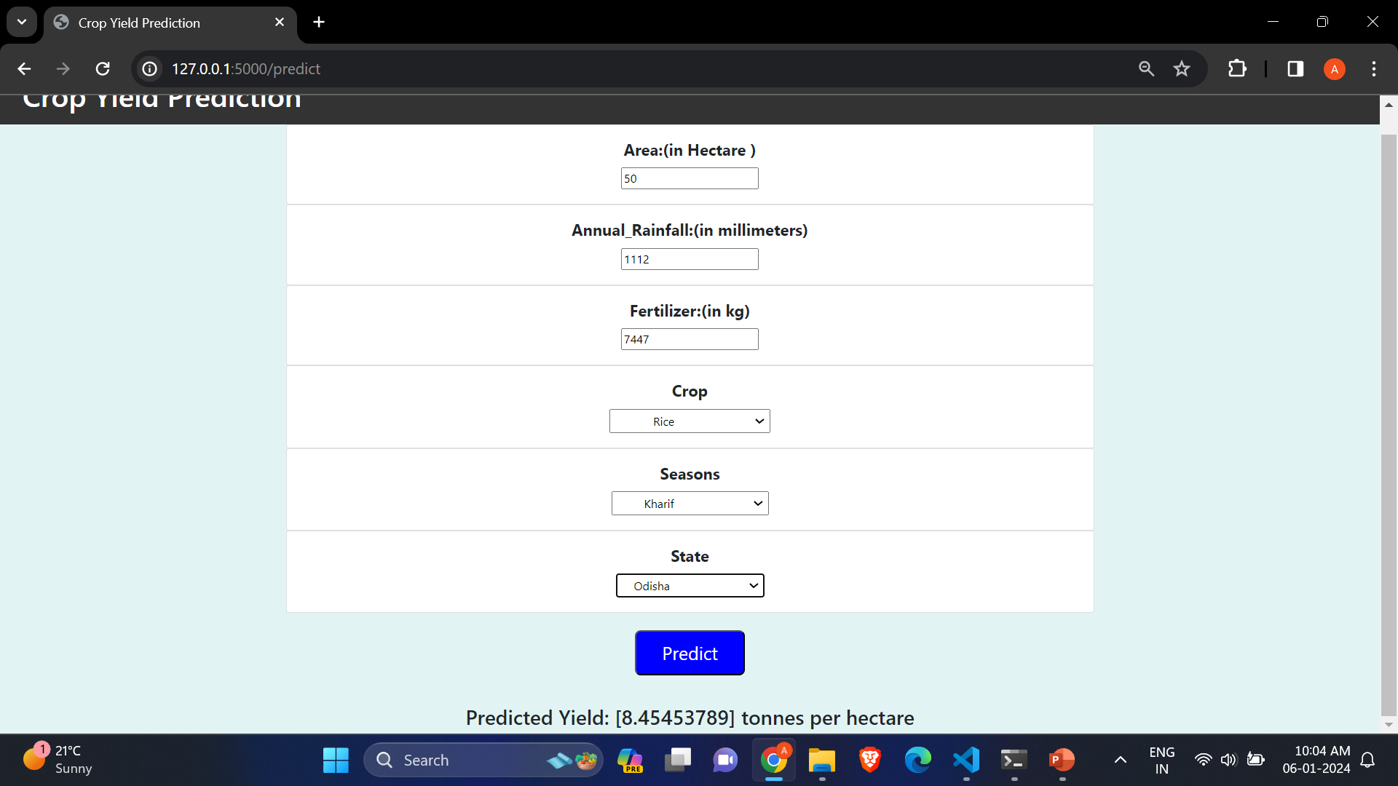

Slide 28
Thank you

