Slide 1
AI-Based Customer Churn Prediction and Retention Analytics
MCA Minor Project | Artificial Intelligence and Machine Learning
[Student Name], [Roll No.]
Guides: Reeti Jaswal (E13367), Palwinder Kaur Mangat (E9422)
Notes:
Introduce yourself, the project title and your guides. State the goal: predict who will leave, explain why, and suggest what to do.

Slide 2
Why customer churn matters
7,043
1,869
26.54%
customers in the IBM Telco dataset
customers churned
overall churn rate
Problem: companies cannot tell in advance who will leave or why.
Solution: predict churn risk, explain the main factors, suggest retention actions.
Output is decision support, not a guarantee of customer behaviour.
Notes:
Churn means a customer leaves. In this dataset about one in four customers left. Retention teams cannot call everyone, so ranking customers by risk helps.

Slide 3
Objectives
1
2
3
Clean data without leakage
Analyse churn patterns (EDA)
Compare five ML models
4
5
6
Predict risk with explanations
Suggest retention actions
SQLite, Power BI, React web app
Notes:
Seven objectives from the synopsis, grouped into six blocks.

Slide 4
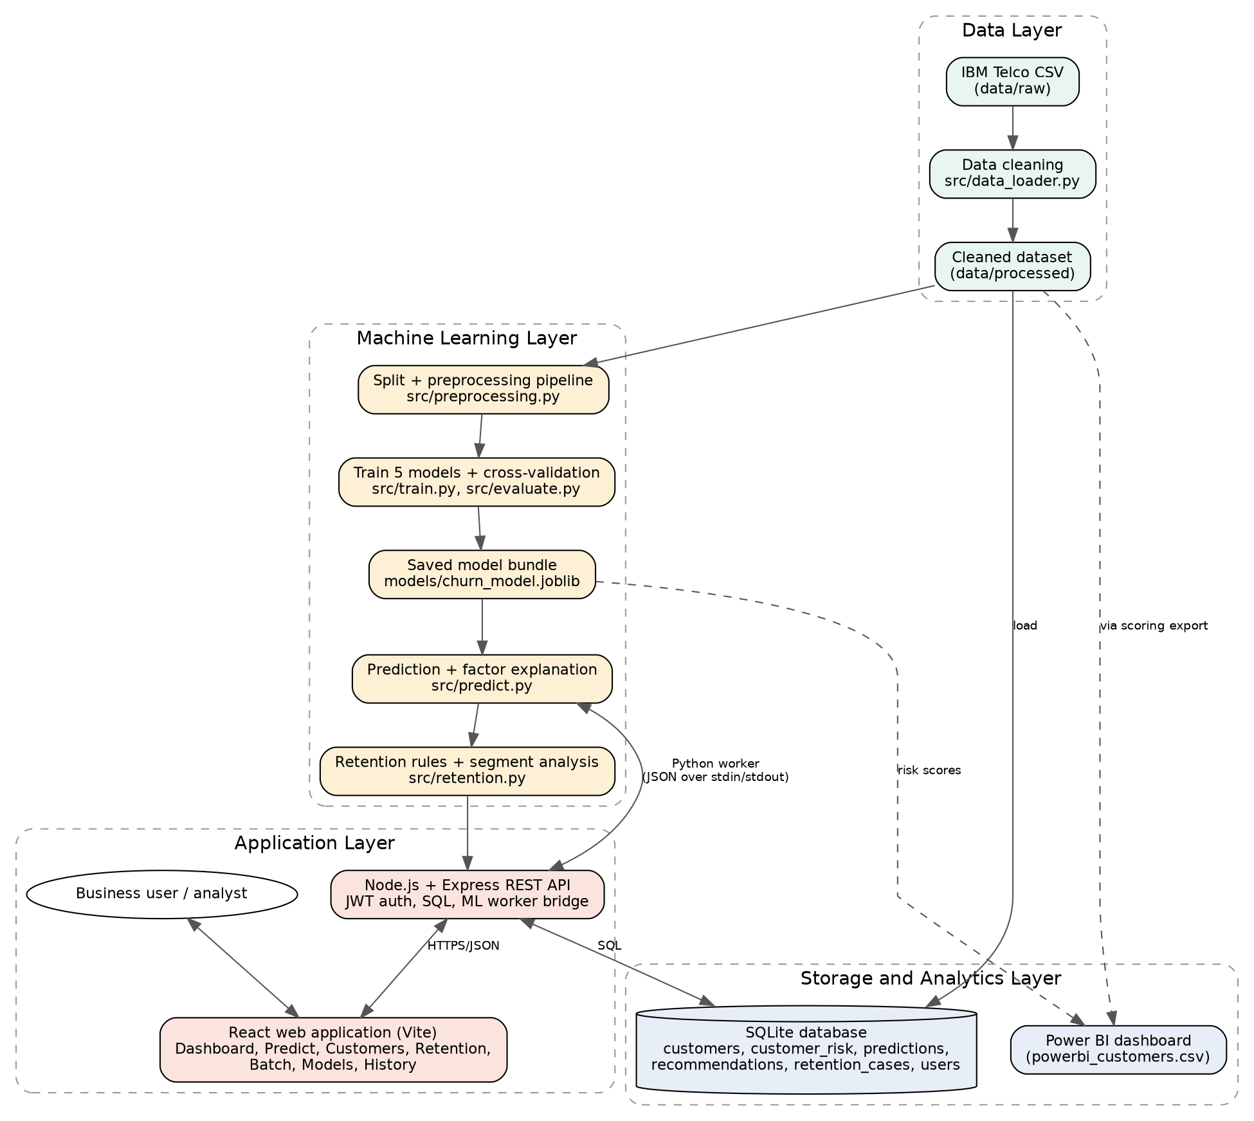
System architecture
Notes:
Four layers: data, machine learning, storage and analytics, and application. The React app calls an Express API, which uses SQLite and a Python worker holding the saved model.

Slide 5
Dataset and cleaning
Check | Finding
Size | 7,043 rows, 21 columns
Duplicates / missing | 0 / 0
TotalCharges | Text type; 11 blanks (tenure 0) set to 0
Target | Churn: 1,869 yes (26.54%), 5,174 no
Split | 80/20 stratified: 5,634 train, 1,409 test
Encoding | Scaled numerics + one-hot categories = 40 inputs
Notes:
IBM Telco Customer Churn. Eleven blank TotalCharges values all belonged to customers with zero tenure, so they were set to 0 instead of deleting the rows.

Slide 6
EDA: contract and tenure drive churn
Notes:
Month-to-month customers are 55% of the base but 88.6% of churners. The first 12 months are the riskiest.

Slide 7
EDA: payment, internet and support
Notes:
These are associations, not proven causes. Electronic check may simply mark newer, month-to-month customers.

Slide 8
Methodology and leakage prevention
1
2
3
4
5
Clean data
Stratified split
Pipeline: scale + encode + model
5-fold CV, pick by F1
Test once, save model
Seed 42 everywhere for reproducibility.
Class weights handle the 26.5% minority class.
Model chosen by a rule set before seeing test results.
Notes:
Split first, then fit the scaler and encoder on training data only. Preprocessing and model live in one Pipeline so cross-validation stays clean.

Slide 9
Model comparison (held-out test set)
Model | Accuracy | Precision | Recall | F1 | ROC-AUC
Logistic Regression | 0.738 | 0.504 | 0.783 | 0.614 | 0.842
Decision Tree | 0.755 | 0.527 | 0.757 | 0.621 | 0.832
Random Forest | 0.760 | 0.533 | 0.778 | 0.633 | 0.843
Gradient Boosting | 0.747 | 0.516 | 0.802 | 0.628 | 0.845
XGBoost (selected) | 0.750 | 0.520 | 0.783 | 0.625 | 0.846
XGBoost selected: highest mean 5-fold cross-validated F1 on training data (0.634).
Notes:
All five models are close. Differences between them are only a few customers out of 374 churners, so the ranking is not conclusive.

Slide 10
Why accuracy alone misleads
0.809 to 0.750
XGBoost accuracy falls...
0.535 to 0.783
...but its recall rises
Notes:
Without balancing the models look more accurate but miss almost half of the churners. Missing a churner is costly, so recall matters.

Slide 11
What the selected model finds
293
81
271
764
churners found (TP)
churners missed (FN)
false alarms (FP)
stayers correct (TN)
Threshold | Precision | Recall | F1
0.3 | 0.441 | 0.901 | 0.592
0.5 | 0.526 | 0.798 | 0.634
0.7 | 0.646 | 0.569 | 0.605
Lower threshold finds more churners but flags many more customers. Cross-validated on training data.
Notes:
At the default 0.5 threshold. About half of flagged customers really churn, so retention offers should be low cost.

Slide 12
Risk categories separate customers well
Bands
Low below 0.30, Medium 0.30 to 0.60, High 0.60 or more.
Caution
High group averages a score of 0.78 but actually churned at 57%, so do not read the score as an exact probability.
Notes:
Each customer was scored by a model that never saw that customer (out-of-fold). The score is a ranking, not a calibrated probability.

Slide 13
The web application
Dashboard
Predict + What-if
Retention workspace
KPIs and click-to-filter charts
Gauge, factors, advice, live scenarios
Queue, status tracking, CSV export
Batch scoring
Models
React + Express + SQLite
Upload a CSV, score every row
Metrics, ROC, thresholds
Responsive, dark mode, JWT login
Notes:
Demo plan: sign in, Dashboard (click a bar to cross-filter), Predict a risky customer then the what-if simulator, Retention queue, Batch scoring, then the Power BI dashboard. Show it on a phone-sized window too.

Slide 14
Retention suggestions (to be tested)
Pattern | Churn in data | Suggested action
Month-to-month | 42.7% vs 6.8% long contracts | Offer longer-contract incentive
Tenure up to 12 months | 47.4% vs 17.1% | Onboarding and early check-ins
Electronic check | 45.3% vs 16.0% automatic | Encourage automatic payment
No tech support | 41.6% vs 15.2% | Offer a support trial
Fiber optic | 41.9% vs 19.0% DSL | Check quality, review pricing
Associations in historical data, not proven causes.
Notes:
Every suggestion is based on a measured association. None has been tested, so pilot with an A/B test before rolling out.

Slide 15
Limitations and future scope
Limitations
Public sample dataset, one snapshot
Models perform very similarly
No extensive tuning
Score is not a calibrated probability
Recommendations untested
Future scope
SHAP explanations
Probability calibration
Profit-based threshold
A/B test retention actions
Cloud deployment, batch upload
Notes:
Be upfront about limitations. They are part of good research.

Slide 16
Conclusion
Contract type and tenure are the strongest churn signals.
XGBoost: test recall 0.783, precision 0.520, ROC-AUC 0.846.
Risk groups churned at 5.3%, 25.4% and 57.0%.
A working full-stack prototype: React, Express, SQLite, ML model.
Notes:
Thank the guides and invite questions.

