Slide 1

Seasonal Agriculture Performance Analysis
Ashish Sharma
Chandigarh University
AICTE STU ID : STU69e8ccaff3a6c1776864431

Slide 2

PROBLEM STATEMENT
Agricultural activities are influenced by seasonal variations in environmental conditions, farming practices, resource availability and market conditions. As a result, agricultural performance may differ from one season to another. However, raw agricultural data does not clearly explain how agricultural performance changes across seasons or what patterns can be observed in different seasonal conditions. The problem is to analyze the given agricultural dataset and investigate seasonal differences in agricultural performance by identifying meaningful patterns, trends, relationships and variations within the available data.

Slide 3
Project Description
This project, Seasonal Agriculture Performance Analysis looks at how farming results change during Indias three growing seasons. Kharif, Rabi and Zaid. The data covers states, districts and types of crops. It includes a number of factors: weather conditions like rainfall, temperature, humidity, sunlight, soil pH and soil moisture. It also includes farming methods such as how water's provided, the use of fertilizers and pesticides and the quality of seeds. In addition it looks at results like how much is produced how much is sold the cost involved the income made the profit earned, how well water is used and the risk of disease or pests.
The study uses a data science process. It starts with cleaning the data dealing with missing information and repeated entries. Then it looks at factors two factors and many factors together. It also performs tests like one-way ANOVA to see if the differences in crop results between seasons are real. In addition, to looking at the seasonal differences the project also looks closely at how each crop does and how each state performs. It also checks how different ways of watering crops work in each season.

Slide 4

WHO ARE THE END USERS?
Farmers and agricultural cooperatives are planning their crop planting and irrigation choices based on each season. They think about what grows when and how much water they’ll need.
State agriculture departments and policymakers are working on support programs. They want to help farmers by offering advice, subsidies or tools that match the time of year.
Agri-fintech companies and crop insurance providers are looking at risks and how much money farmers might make. They use this info to design loans, insurance plans or financial help that fits each season.
Researchers and students are studying how farming performs in seasons. They track things like yields, weather and prices to understand trends and help improve farming over time.

Slide 5

Technology Used
  Python (Pandas, NumPy) for data cleaning and analysis
  Matplotlib and Seaborn for data visualization
  SciPy for statistical testing (ANOVA)
  Jupyter Notebook for development

Slide 6
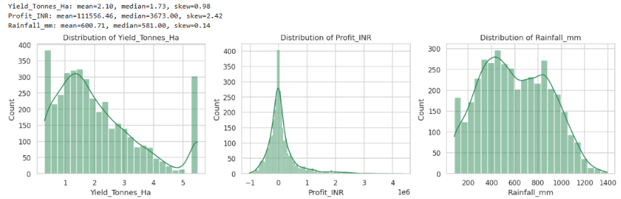
RESULTS
Univariate Analysis

Slide 7
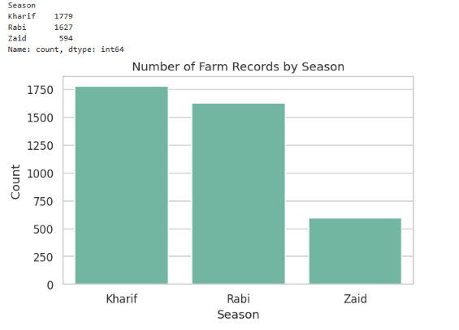
RESULTS
Seasonal Overview — Record Counts & Distribution

Slide 8
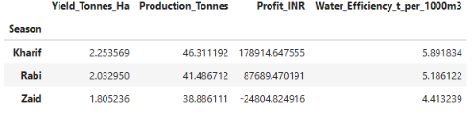
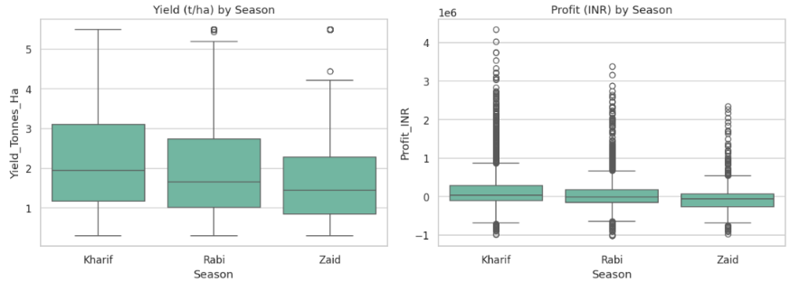
RESULTS
Bivariate Analysis — Question 1: How does agricultural performance (Yield, Profit) vary across seasons?

Slide 9
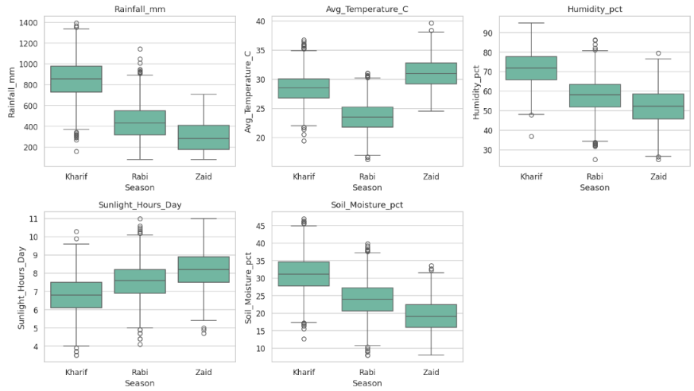
RESULTS
Question 2 — Environmental conditions by season (rainfall, temperature, humidity, sunlight)

Slide 10
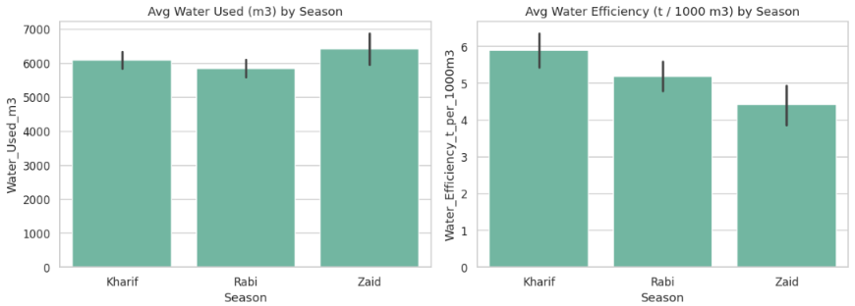
RESULTS
Question 3 — Resource usage across seasons (fertilizer, pesticide, water)

Slide 11
Future scope
Yield Prediction
  Develop ML models such as Random Forest, XGBoost or Gradient
Profit Prediction
  Build a model to predict expected profit or profit margin
Crop Recommendation System
  Create a recommendation engine that suggests the most suitable crop for a particular season and region.
Smart Irrigation Recommendation
  Extend the current comparison of Drip, Flood, Rainfed and Sprinkler irrigation into a recommendation system.
Disease and Pest Risk Prediction
  Build a classification/regression model to predict disease/pest risk.

Slide 12
GitHub Link
https://github.com/ashish8847/VOIS-AICTE-DATA-ANALYTICS--Major-Project-Seasonal-Agriculture-Performance-Analysis.git

Slide 13

VOIS Course completion certificate -
Course name- Data Visualization

Slide 14
Thank you
.
.

