Slide 1
Approaches to creating web services
Bottom Up Approach
starts with the service implementation and then build the deployable Web service component.
Top Down Approach
Start with building Web service component and service definition and then implementing the logic
We will be using Bottom Up Approach

Slide 2
Steps
Set the AXIS2 as Web Service preferences.
Create a simple java class in a dynamic web project
Create a web service out of Java class
Run

Slide 3
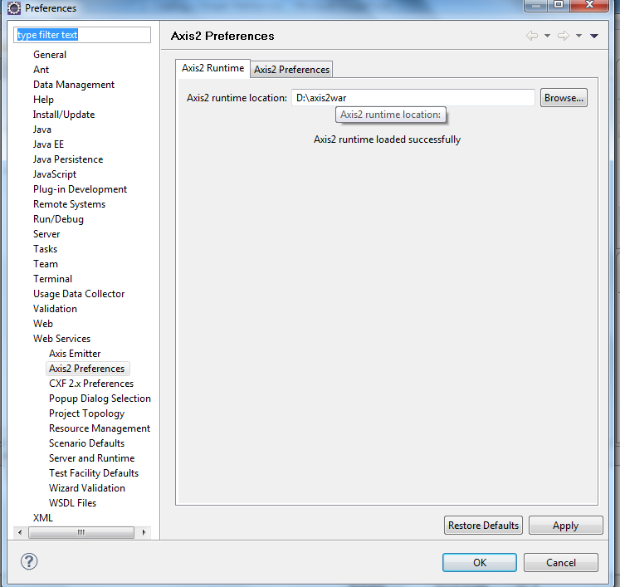
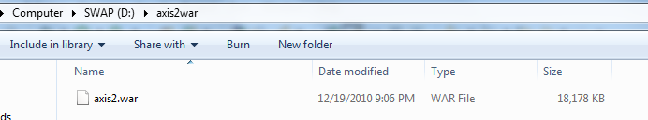
Step 1: Set the AXIS 2 as preferences
Copy axis2.war (1.5.4) in a folder
Go to Windows→ Preferences in Eclipse and set the location folder.

Slide 4
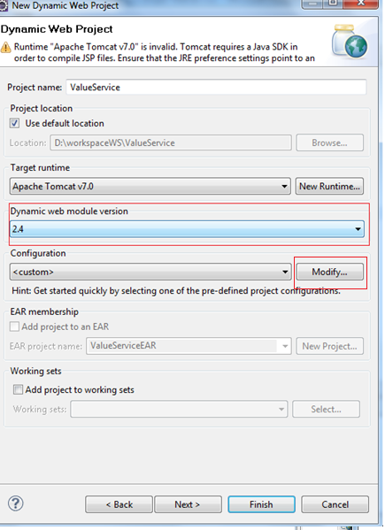
Step 2: Create a Java Class in web application
Create a Dynamic Web project with version 2.4.
Under Configuration, click on Modify
Notes:
If axis2.war file version is 1.6.x then dynamic web project with version 2.5 must be created

Slide 5
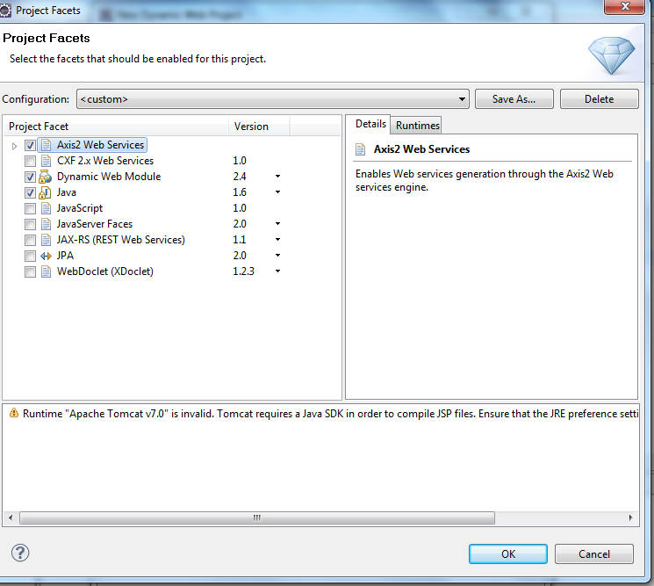
Select AXIS2 Web Services
And click on OK

Slide 6
Create a simple Java class
package ws;
public class Value {
public double CmValue(double in){
return 2.45*in;
}
public double FeetValue(double in){
return 0.834*in;
}
}

Slide 7
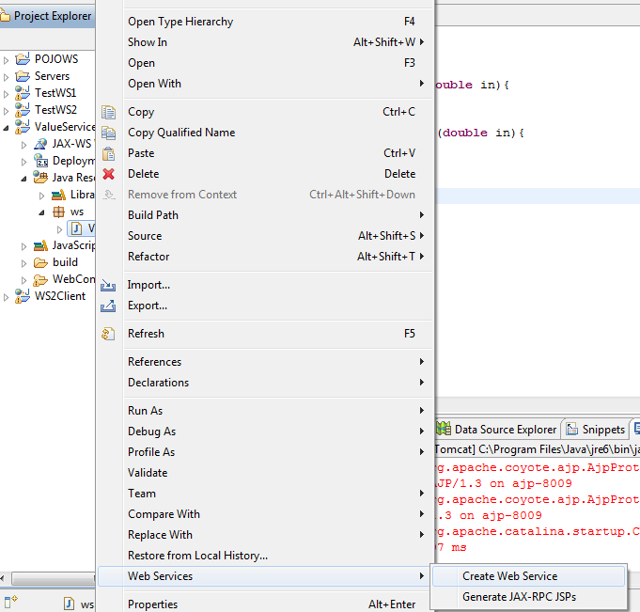
Step 3: Convert java class to Web Service
Right click on the java class and select Web Services →Create Web Service

Slide 8
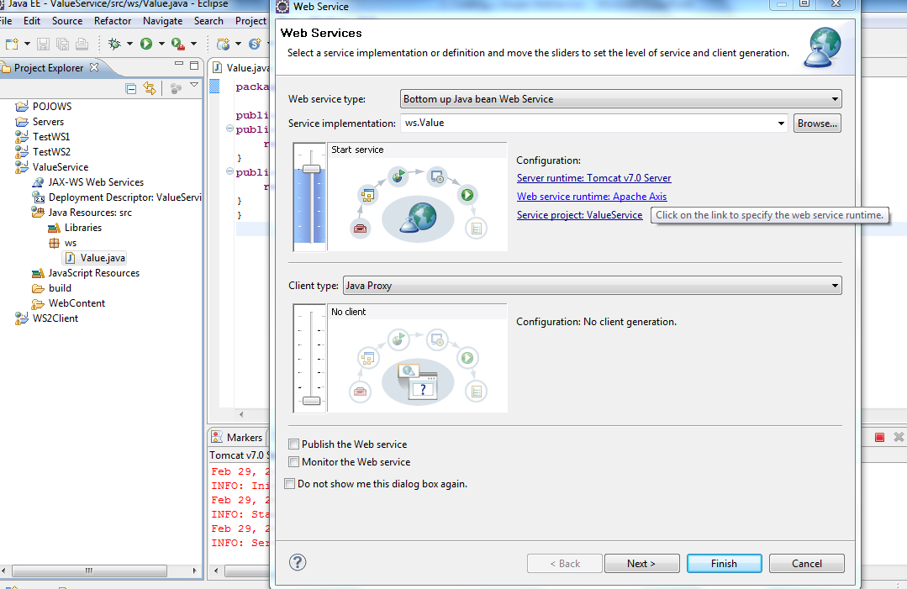
Click the link Web services runtime Apache Axis

Slide 9
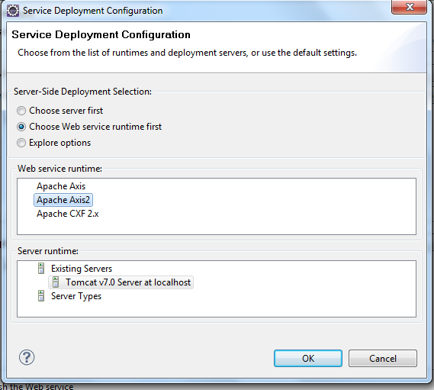
Select Apache Axis2 and click OK and then click Next

Slide 10
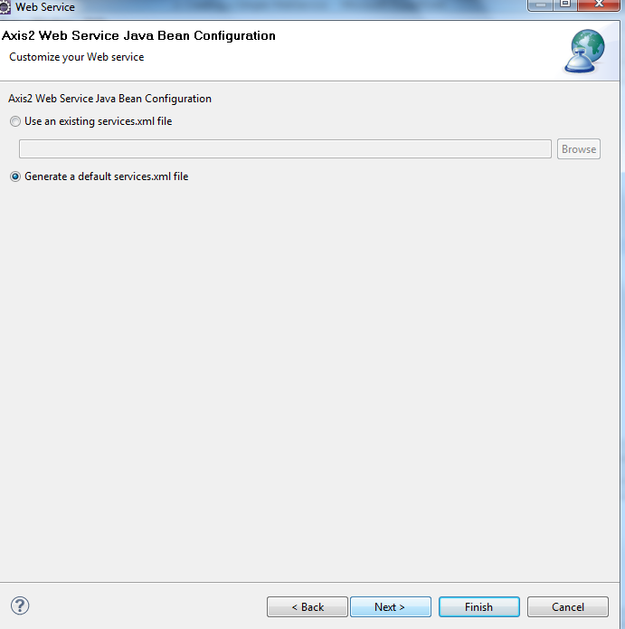
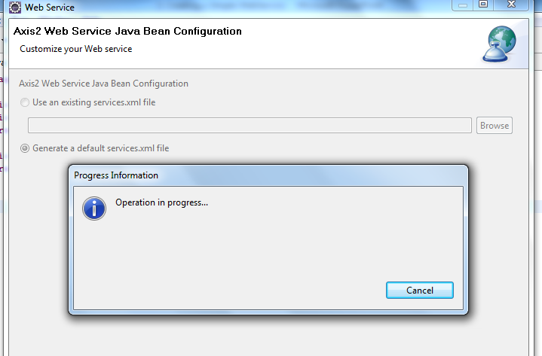
Select Generate default service.xml file and click Next. You will see some Operation in progress.

Slide 11
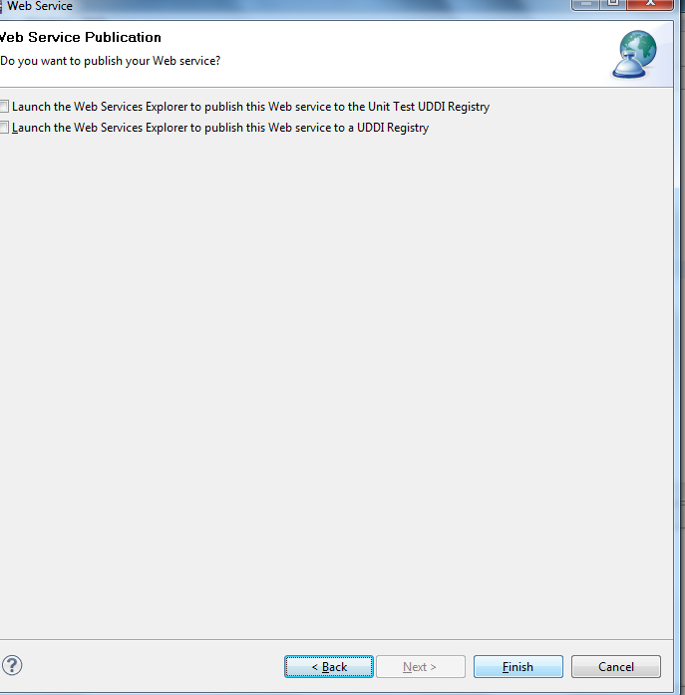
Click on Finish. If the server is not started, a button will be shown to start server and you can start server from here.

Slide 12
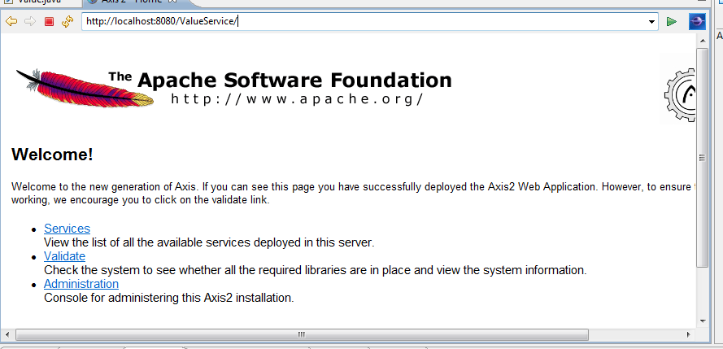
Step 4: Run
Type http://localhost:8080/ValueService/ on the browser
Click on Services

Slide 13
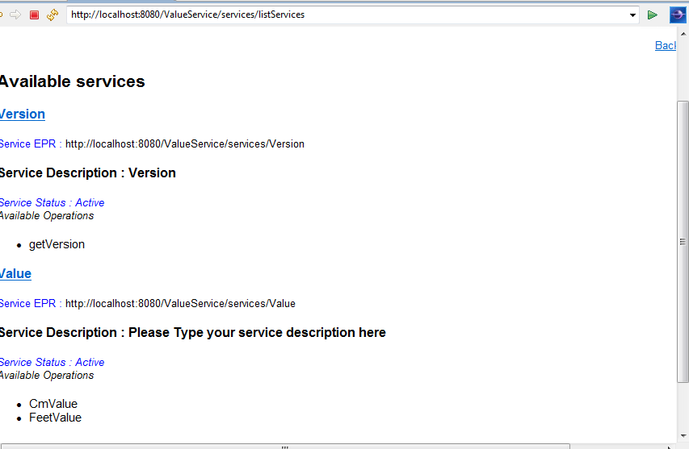
Click on Value

Slide 14
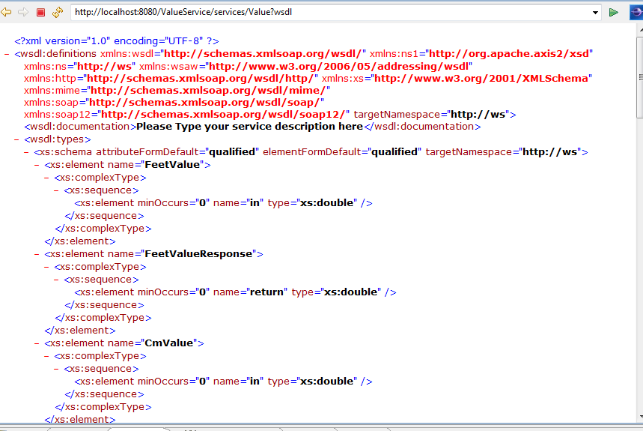
Copy the URL of the WSDL in clipboard since we will be using this to create test client

Slide 15
Steps to create a web service test client
Create a dynamic web application
Create a web service client
Test

Slide 16
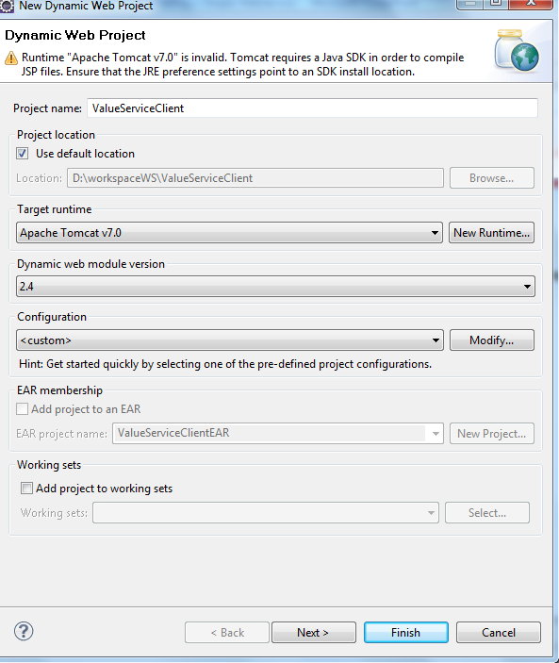
1. Create a dynamic web application
Create a dynamic web application of version 2.4 and click on Finish

Slide 17
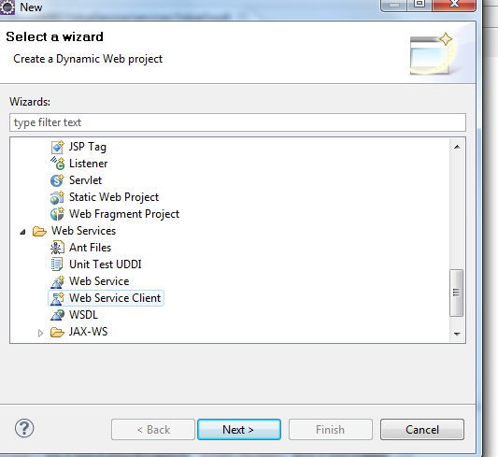
2. Create a web service client
Right click on the web module and click on New→Others
In the dialog box, go and locate “Web Services” and select Web Service Client under it.
Click Next

Slide 18
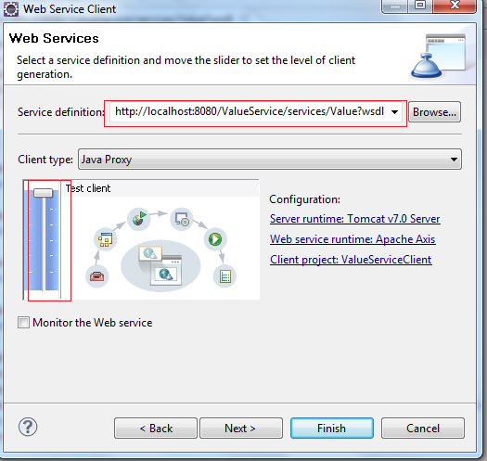
Paste the service wsdl url in Service definition.
Bring Slider right to the top.
Click Next and again Next
Some processing happens and then you are taken to the dialog that is in the next slide.

Slide 19
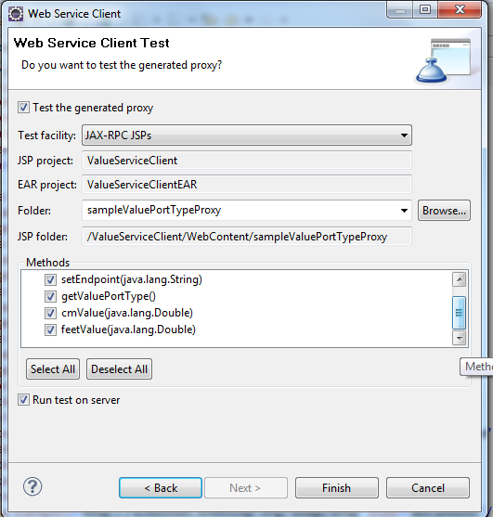
Click on Finish

Slide 20
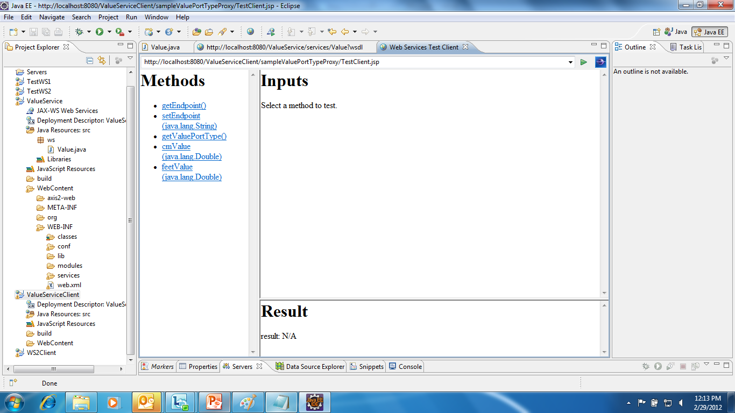
3. Test
A page shows up where we can test the web service methods

Slide 21
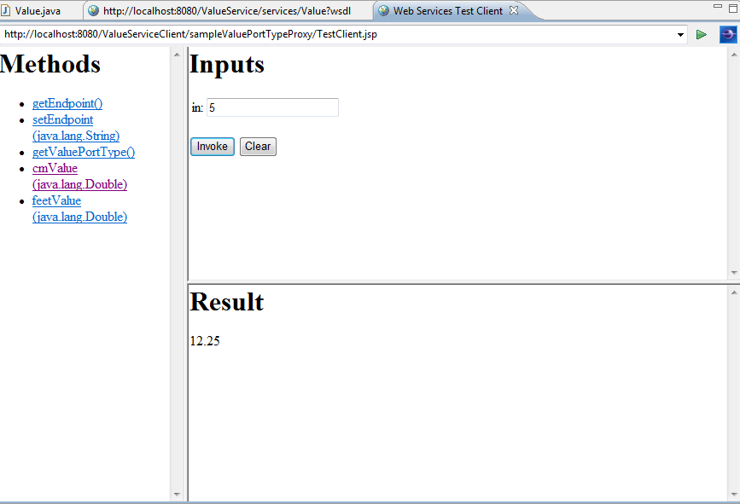
Click on the method cmValue() . Enter some number and click on Invoke. You will find the Result displayed in the lower screen

Slide 22
Components of a WSDL
Types
A container for data type definitions using XML schema.
Message
Definition of the data being communicated (input parameters and return type)
Port type
An abstract set of one or more operations
Operation: An abstract description of an action with the input and output messages.
Binding
A binding defines message format and protocol details for operations and messages defined by a particular portType. There may be any number of bindings for a given portType
Service
A collection of related ports.

Slide 23
Understanding WSDL
The namespace declaration for WSDL
<?xml version="1.0" encoding="UTF-8" ?>
<wsdl:definitions xmlns:wsdl="http://schemas.xmlsoap.org/wsdl/" xmlns:ns1="http://org.apache.axis2/xsd" xmlns:ns="http://ws" xmlns:wsaw="http://www.w3.org/2006/05/addressing/wsdl" xmlns:http="http://schemas.xmlsoap.org/wsdl/http/" xmlns:xs="http://www.w3.org/2001/XMLSchema" xmlns:mime="http://schemas.xmlsoap.org/wsdl/mime/" xmlns:soap="http://schemas.xmlsoap.org/wsdl/soap/" xmlns:soap12="http://schemas.xmlsoap.org/wsdl/soap12/" targetNamespace="http://ws">
<wsdl:documentation>Please Type your service description here</wsdl:documentation>

Slide 24
Types
The types that we need for our web service are composed of all the parameters that we send and return in the web service methods.
<wsdl:types>
<xs:schema attributeFormDefault="qualified" elementFormDefault="qualified" targetNamespace="http://ws">
<xs:element name="FeetValue">
<xs:complexType>
<xs:sequence>
<xs:element minOccurs="0" name="in" type="xs:double" />
</xs:sequence>
</xs:complexType>
</xs:element>
<xs:element name="FeetValueResponse">
<xs:complexType>
<xs:sequence>
<xs:element minOccurs="0" name="return" type="xs:double" />
</xs:sequence> </xs:complexType> </xs:element>
Input parameter type that will be used for the FeetValue method.
Note that “in” is the name of the parameter
Return value that will be used for FeetValue method. Note that “return” is the dummy name of the parameter that is returned

Slide 25
Input parameter type and return value that will be used for the CmValue method
<xs:element name="CmValue">
<xs:complexType>
<xs:sequence>
<xs:element minOccurs="0" name="in" type="xs:double" />
</xs:sequence>
</xs:complexType>
</xs:element>
<xs:element name="CmValueResponse">
<xs:complexType>
<xs:sequence>
<xs:element minOccurs="0" name="return" type="xs:double" />
</xs:sequence>
</xs:complexType>
</xs:element>
</xs:schema>
</wsdl:types>

Slide 26
Messages
We have specified what are the types. Now we need to specify what data-types will be used for message transfers. This is done using <wsdl:message>.
<wsdl:message name="CmValueRequest">
<wsdl:part name="parameters" element="ns:CmValue" />
</wsdl:message>
<wsdl:message name="CmValueResponse">
<wsdl:part name="parameters" element="ns:CmValueResponse" />
</wsdl:message>
<wsdl:message name="FeetValueRequest">
<wsdl:part name="parameters" element="ns:FeetValue" />
</wsdl:message>
<wsdl:message name="FeetValueResponse">
<wsdl:part name="parameters" element="ns:FeetValueResponse" />
</wsdl:message>
These was created in <wsdl:types>

Slide 27
Port type
Here we specify Operations with respect to the methods that we want to put as services with input and output parameters given with reference to the what was defined in <wsdl:message> We have 2 operations here
<wsdl:portType name="ValuePortType">
<wsdl:operation name="CmValue">
<wsdl:input message="ns:CmValueRequest" wsaw:Action="urn:CmValue" />
<wsdl:output message="ns:CmValueResponse" wsaw:Action="urn:CmValueResponse" />
</wsdl:operation>
<wsdl:operation name="FeetValue">
<wsdl:input message="ns:FeetValueRequest" wsaw:Action="urn:FeetValue" />
<wsdl:output message="ns:FeetValueResponse" wsaw:Action="urn:FeetValueResponse" />
</wsdl:operation>
</wsdl:portType>

Slide 28

Binding
Specifies URN names and types to be used with respect to SOAP protocols.
<wsdl:binding name="ValueSoap11Binding" type="ns:ValuePortType">
<soap:binding transport="http://schemas.xmlsoap.org/soap/http" style="document" />
<wsdl:operation name="CmValue">
<soap:operation soapAction="urn:CmValue" style="document" />
<wsdl:input><soap:body use="literal" /> </wsdl:input>
<wsdl:output> <soap:body use="literal" /> </wsdl:output>
</wsdl:operation>
<wsdl:operation name="FeetValue">
<soap:operation soapAction="urn:FeetValue" style="document" />
<wsdl:input><soap:body use="literal" /> </wsdl:input>
<wsdl:output> <soap:body use="literal" /> </wsdl:output>
</wsdl:operation>
</wsdl:binding>

Slide 29
Service
Finally service specifies the URL that will be used based on the port types
<wsdl:service name="Value">
<wsdl:port name="ValueHttpSoap11Endpoint" binding="ns:ValueSoap11Binding">
<soap:address location="http://localhost:8080/ValueService/services/Value.ValueHttpSoap11Endpoint/" />
</wsdl:port>
<wsdl:port name="ValueHttpSoap12Endpoint" binding="ns:ValueSoap12Binding">
<soap12:address location="http://localhost:8080/ValueService/services/Value.ValueHttpSoap12Endpoint/" />
</wsdl:port>
<wsdl:port name="ValueHttpEndpoint" binding="ns:ValueHttpBinding">
<http:address location="http://localhost:8080/ValueService/services/Value.ValueHttpEndpoint/" />
</wsdl:port> </wsdl:service></wsdl:definitions>

