Slide 1
Introduction

Slide 2
Types of web service clients
Static client
synchronous
asynchronous
Dynamic client
synchronous
asynchronous

Slide 3
Synchronous and asynchronous
Synchronous
Asynchronous
Client Application
Client Application
Web service
request
Web service
request
response
Response notification

Slide 4
Static client
Stub or proxy is required at the client end to make invocation.
The invocation can be compared to RMI invocation.
The Static Proxy client can invoke methods of a web service directly via the proxy.
This stub defines all the methods that the service endpoint interface defines.
If the web service is going to be stable then this technique could be used.

Slide 5
Pros and cons
The advantage of this is that it is simple and easy to code.
The disadvantage is that since the Static Stub client is a class that is statically bound to a service endpoint interface. Any change in web service definition will lead to the stub being discarded. A new stub must be regenerated and transported to the client.

Slide 6
Static stub types
Blocking/synchronous
The client application waits till the operation is completed.
Simple and common way
Non Blocking/ asynchronous
Client application immediately gets the control back without waiting fro web service to return. The response is retrieved using the Callback object.
Advantage of this approach is that this allows the client application to invoke several web services simultaneously without needing to wait for the response of previous operations.

Slide 7
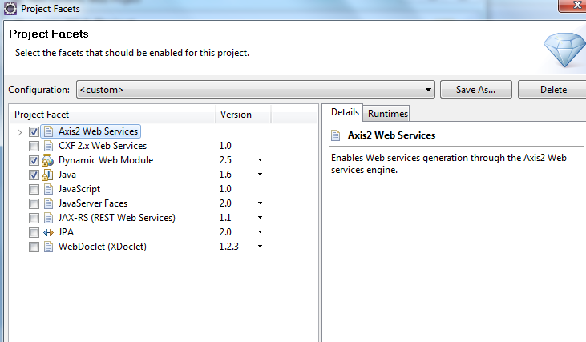
Generating classes for static stub
Create a web project in the same way as we created web service application.
Create a Dynamic Web project with version 2.4.
Under Configuration, click on Modify and select Axis2 Web services

Slide 8
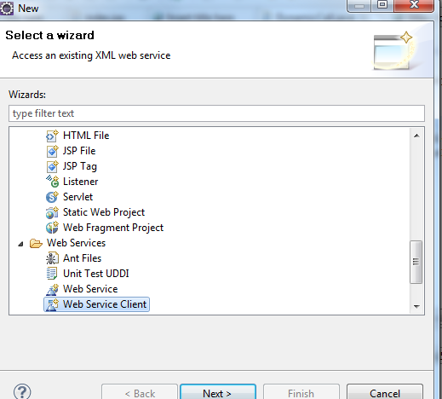
Create a web service client by right click on the web module and click on New→Others
In the dialog box, go and locate “Web Services” and select Web Service Client under it.
Click Next

Slide 9
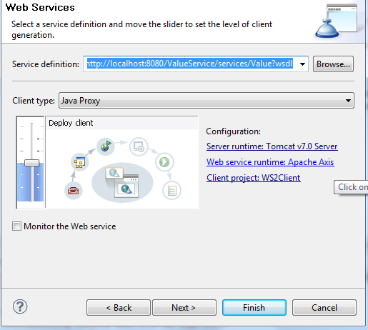
Type the service definition URL and then select Web Service runtime Apache Axis.

Slide 10
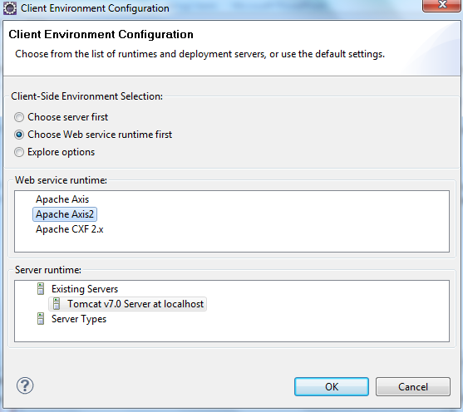
Select Apache Axis2 and click OK.

Slide 11
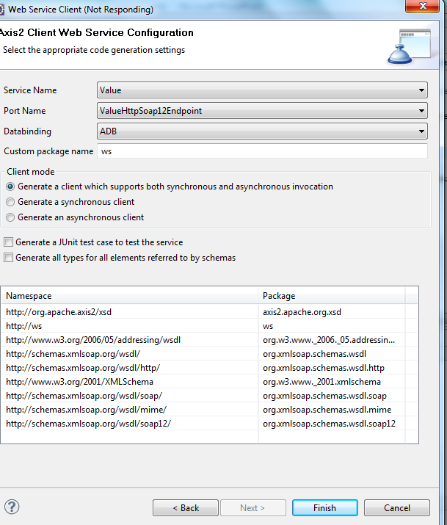
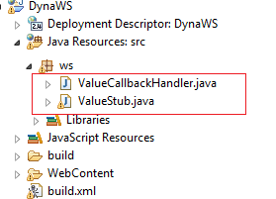
Select “Generate a client which supports both synchronous and asynchronous invocation”.
Click Finish
You will find 2 classes generated
ValueStub and ValueStubCallback

Slide 12

Accessing service -static synchronous way
Synchronous client can be created by using instance for ValueStub that got created.
The ValueStub has methods that acts as proxy for the actual web service operation.
It requires us to create instances of parameter and return types.
index.jsp
<jsp:useBean id="p” class="ws.ValueStub"/>
<%
ws.ValueStub.CmValue c= new ws.ValueStub.CmValue();
c.setIn(12);
ws.ValueStub.CmValueResponse r= p.cmValue(c);
%>
<%=r.get_return() %>
Parameter type
Return type

Slide 13
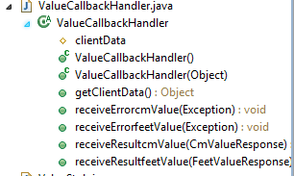
Accessing service -static asynchronous way
Asynchronous client requires us to create instance for Stub class and using startXXX methods to invoke web service. These methods need a call back handler class to be passed apart from the parameters.
The callback handler class instance will take care of the handling the return result.
A callback handler class by extending the callback class that was generated called ValueCallbackHandler.
There are receiveResultXXX method(s) for all web service methods. These do nothing. When the web service method returns, these methods are called. These methods have a parameter that carry the result.
We need to override the method of our interest and handle the result the way we want.

Slide 14
Servlet Code for static asynchronous call
protected void doGet(HttpServletRequest request, HttpServletResponse response) throws ServletException, IOException {
ws.ValueStub w= new ws.ValueStub();
PrintWriter out=response.getWriter();
out.println("calling service");
ws.ValueCallbackHandler callback= new ws.ValueCallbackHandler(){
public void receiveResultcmValue( ws.ValueStub.CmValueResponse result){
System.out.println(result.get_return());
}
};
ws.ValueStub.CmValue c= new ws.ValueStub.CmValue();
c.setIn(12);
w.startcmValue(c, callback);
System.out.println("you see this first");
out.println("called service");}

Slide 15

Result of the asynchronous call
Server console
Though we have the statement printing this after we have made the web service call, we will see this printed first because the servlet does not wait for the web service call to return!

Slide 16
Tell me what
We created a generated a test client automatically in the previous session as soon as the we created web service. What type was that?
We did not create AXIS2 web client. We created older AXIS client. We generated only static sub or proxy in that case. We did not generate any callback class for asynchronous call.

Slide 17
Dynamic Clients
In case of dynamic client, the stub creation for a given WSDL happens at runtime.
No previously generated stub is required.
This is useful for testing web services that may change their definitions.
The dynamic proxy needs to be re-instantiated but not re-generated as is the case with stub.

Slide 18
ServiceClient API
ServiceClient API allows dynamic invocation of web services by having the client code provide the EndPoint Address and the message that need to be sent.
It send and receives the messages in the form of XML.
ServiceClient only accepts the payload of the SOAP message that will be sent.
Using ServiceClient, we can invoke a service in a synchronous manner or in an asynchronous manner.

Slide 19
Code to create synchronous dynamic client
Create ServiceClient
ServiceClient client = new ServiceClient();
Create Option ( used to set end point and operation)
Options opts = new Options();
Set endpoint address and action
opts.setTo(new EndpointReference("http://localhost:8080/ValueService/services/Value");
opts.setAction("urn:FeetValue");
Set option reference to ServiceClient
client.setOptions(opts);
Send and receive SOAP message( OMElement instance)
OMElement res = client.sendReceive(createPayLoad());

Slide 20
Send and receive SOAP message
AXIOM is the object model for Apache Axis 2, the next generation of the Apache web services engine.
AXIOM API consist of OMElement which the basic building block used to create xml elements.
Payload that we need to create to send as part of SOAP message is created using AXIOM API
ServiceClient’s sendReceive method parameter and return type are both in the form of OMElement
OMElement sendReceive(OMElement operation);

Slide 21
Example: synchronous dynamic client
Create web application in the same way how we created for the static client in the Eclipse WTP ( 2.4 web application with Axis 2 enabled).
Create a servlet.
package s;
import java.io.*;
import javax.servlet.*;
import javax.servlet.http.*;
import org.apache.axiom.om.OMAbstractFactory;
import org.apache.axiom.om.OMElement;
import org.apache.axiom.om.OMFactory;
import org.apache.axiom.om.OMNamespace;
import org.apache.axis2.addressing.EndpointReference;
import org.apache.axis2.client.Options;
import org.apache.axis2.client.ServiceClient;

Slide 22
public class TestDynaServlet extends HttpServlet {
protected void doGet(HttpServletRequest request, HttpServletResponse response) throws ServletException, IOException {
ServiceClient client = new ServiceClient();
Options opts = new Options();
opts.setTo(new EndpointReference(
http://localhost:8080/ValueService/services/Value ));
opts.setAction("urn:FeetValue");
client.setOptions(opts);
OMElement res = client.sendReceive(getPayLoad());
PrintWriter out= response.getWriter();
out.println(res);
}
url of the service without “?wsdl”. Note thata here URL for wsdl is http://localhost:8080/ValueService/services/Value?wsdl
URN as specified in binding section of wsdl
<soap:operation soapAction="urn:FeetValue" style="document" />

Slide 23

public static OMElement getPayLoad() {
OMFactory fac = OMAbstractFactory.getOMFactory();
OMNamespace omNs=fac.createOMNamespace("http://ws", "ns");
OMElement method = fac.createOMElement("FeetValue", omNs);
OMElement value = fac.createOMElement("FeetValueRequest", omNs);
value.setText("10");
method.addChild(value);
return method;
}
}
All the other values can be obtained from the below extract of WSDL

Slide 24

Execution
OMElement res = client.sendReceive(getPayLoad());
The string value of res that is returned is actually
<ns:FeetValueResponse xmlns:ns="http://ws"><ns:return>8.34</ns:return></ns:FeetValueResponse>
Since we are displaying this in thw web page the tags don’t appear!

Slide 25
Asynchronous dynamic client
The first four code statements to create asynchronous client is same as synchronous client.
While calling, we need to use sendReceiveNonBlocking and pass payload OMElement reference and AxisCallback reference.
client.sendReceiveNonBlocking(getPayLoad(), callback);

Slide 26
AxisCallback
AxisCallback interface must be implemented and passed as parameter to sendReceiveNonBlocking().
There are four methods that needs to be overridden
onMessage – This is invoked when a message is received
onFault – Sometimes you may receive fault as part of the service invocation, and the user might be interested in that. This method helps to achieve that.
onError – This is invoked when something goes wrong on the client side during service invocation.
onComplete – This is invoked to notify when the message exchange pattern (MEP) is complete.

Slide 27
Example
// same imports as the previous example
/* new imports */
import org.apache.axis2.client.async.AxisCallback;
import org.apache.axis2.context.MessageContext;
protected void doGet(HttpServletRequest request, HttpServletResponse response) throws ServletException, IOException {
ServiceClient client = new ServiceClient();
Options opts = new Options();
opts.setTo(new EndpointReference("http://localhost:8080/ValueSe rvice/services/Value"));
opts.setAction("urn:FeetValue");
client.setOptions(opts);

Slide 28
AxisCallback callback = new AxisCallback() {
public void onError(Exception e) { e.printStackTrace(); }
public void onComplete() {
System.out.println("completed");
}
public void onFault(MessageContext arg0) { arg0.getFailureReason().printStackTrace();}
public void onMessage(MessageContext arg0) {
System.out.println(arg0.getEnvelope().getBody() );
}
};
client.sendReceiveNonBlocking(getPayLoad(), callback);
System.out.println("Done");
}
This will be printed first since it is an asynchronous call

Slide 29
public static OMElement getPayLoad() {
OMFactory fac = OMAbstractFactory.getOMFactory();
OMNamespace omNs = fac.createOMNamespace("http://ws", "ns");
OMElement method = fac.createOMElement("FeetValue", omNs);
OMElement value = fac.createOMElement("FeetValueRequest", omNs);
value.setText("10");
method.addChild(value);
return method;
}
}
No change here
Server console

