Slide 1
Introduction

Slide 2
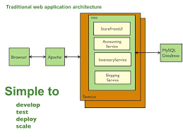

Slide 3
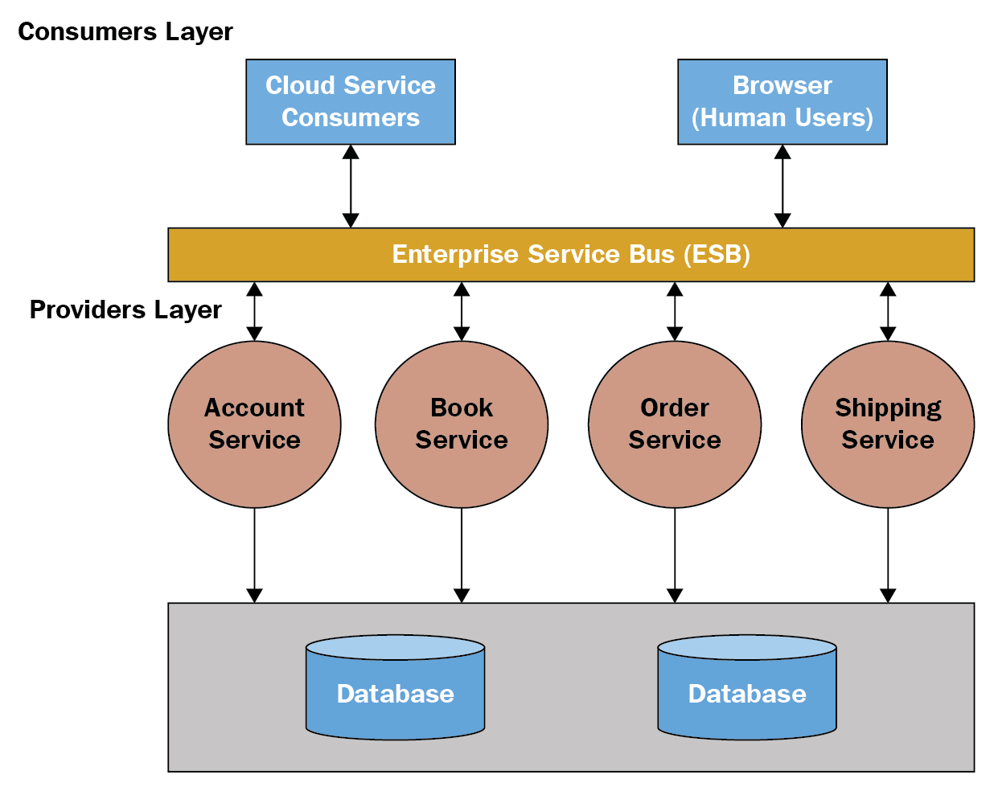

Slide 4
SOA – SERVICE ORIENTED ARCHITECTURE
SOA, or service-oriented architecture, defines a way to make software components reusable via service interfaces. These interfaces utilize common communication standards in such a way that they can be rapidly incorporated into new applications without having to perform deep integration each time.

Slide 5
What are web services?
W3C definition
A software system designed to support interoperable Machine to Machine interaction over a network.
They are self-contained, self describing application components which can be used by other applications over the internet.
They are discovered using UDDI (Universal descriptor, discovery and integration)
They communicate using open protocols SOAP (Simple Object Access Protocol)
The basic web services platform is XML + HTTP.

Slide 6
Why web services?
Interoperability
Allows heterogeneous applications to work together as if they are one.
For instance, .NET and JEE application can work together by exposing services via web service interface
Reuse existing application
Already existing components of applications can be reused by making them as services available over net that can be called upon by any other application.
For instance Microsoft has made web services available in SharePoint Online that can be used by the developer.

Slide 7
SOA (Service oriented architecture)
W3C definition
Set of components which can be invoked and whose interface descriptions can be published and discovered.
Service Broker
Service Provider
Service Requester
internet
2. Find service
1. Register service
3. invoke
4. Run

Slide 8
Other SOA and their problems
RMI: Requires Java
CORBA: Requires compatible ORBs
DCOM: Requires Windows
Advantage of web service
Apart from platform-independence, web services provide richer specification and also provide more complete set of protocols for security, transaction etc.

Slide 9
UDDI
Universal Descriptor, Discovery and Integration
Provides facilities to publish and find Web Services.
A directory for storing information about web services. It acts like a service broker, enabling service requester to find a suitable service provider.
UDDI communicates via SOAP

Slide 10
SOAP(Simple Object Access Protocol)
It is a communication protocol used by the applications describing the format for sending messages.
It is platform independent since it uses XML, simple and extensible.
Built on top of HTTP and others. SOAP over HTTP most common
The SOAP specification defines the envelope structure, encoding rules, and conventions for representing remote procedure calls and responses.
SOAP Engines embedded in J2EE Application Servers. For example the Apache Axis is a soap engine embedded in application severs like Tomcat, Jboss, IBM Websphere has its own SOAP engine.
SOAP 1.1 and 1.2 versions

Slide 11
SOAP message structure
soap:Envelope
soap:Header
soap:Body
soap:Fault
SOAP Envelope is the root element of a SOAP message
Optional SOAP Header contains application-specific information like authentication etc. Attributes defined in the SOAP Header defines how a recipient should process the SOAP message.
The required SOAP Body element contains the actual SOAP message intended for the ultimate endpoint of the message.
The optional SOAP Fault element is used to indicate error messages.

Slide 12
A sample SOAP Request Packet
POST /ws1/index.jsp HTTP/1.1
Host: www.xyz.com
Content-Type: text/xml; charset="utf-8"
Content-Length: xxx
SOAPAction: ""
<soap:Envelope xmlns:soap="http://www.w3.org/2003/05/soap-envelope">
<soap:Header>
</soap:Header>
<soap:Body>
<m:SayHello xmlns:m="http://www.hello.org">
<m:Name>Sam</m:Name>
</m:GetStockPrice>
</soap:Body>
</soap:Envelope>
message name
parameter name
parameter value

Slide 13
URN
A unified resource name (URN) uniquely identifies the service to clients. It must be unique among all services deployed in a single SOAP server, which is
identified by a certain network address. A URN is encoded as a universal resource identifier (URI). We commonly use the format urn:UniqueServiceID.
In the previous example the URN for the urn:Hello

Slide 14
A sample SOAP Response Packet
HTTP/1.1 200 OK
Content-Type: text/xml; charset="utf-8"
Content-Length: xxx
<soap:Envelope xmlns:soap="http://www.w3.org/2001/12/soap-envelope" soap:encodingStyle="http://www.w3.org/2001/12/soap-encoding"> <soap:Body xmlns:m=" http://www.hello.org"> <m:SayHelloResponse> <m:Message>Hello Sam</m:Message> </m:SayHelloResponse> </soap:Body> </soap:Envelope>
return value

Slide 15
WSDL
Web Services Description Language
It is XML based.
Enables application to communicate with each other in an automated way.
WSDL describes the network services offered by the provider (an endpoint).
Used to describe the interface of the Web Service and where an implementation is running
Used to locate web services

Slide 16
Roles
The Web Services provider creates the Web Service and installs it on an application server.
The Web Services requestor writes the client application that invokes the Web Service.
The Web Services broker runs a UDDI Registry where providers publish their Web Services and requestors find the Web Services.
SOAP is the protocol to invoke a Web Services, and it is also a protocol that can be used to publish and locate Web Services in the UDDI Registry. The registry can also be accessed from a Web browser.

Slide 17
Components
Service Broker
Service Requester
Service Provider
UDDI
Publish web service using WSDL
JAXR API
Locate web service using WSDL
JAXR API
SOAP Browser
Web services
Client Application
Invoke
JAX-RPC API
SOAP

Slide 18
Axis 2
Apache Axis2™ is a Web Services / SOAP / WSDL engine, the successor to the widely used Apache Axis SOAP stack.
In other words, it is an engine for working with Web services. It provides the capability to add Web services interfaces to Web applications.
It is available in Java and C.
It can also be used as a standalone server application.
Apache Axis2 not only supports SOAP 1.1 and SOAP 1.2, but it also has integrated support for the widely popular REST style of Web services.

Slide 19
Important Features
Speed
Axis2 uses its own object model and StAX (Streaming API for XML) thereby making parsing is faster and efficient.
Low memory foot print
Designed to use less memory and use of StAX overall results in low memory footprint.
AXIOM -
Axis2 light-weight object model, AXIOM, for message processing which is extensible, highly performance and is developer convenient.

Slide 20
Hot Deployment -
Axis2 is equipped with the capability of deploying Web services and handlers while the system is up and running.
Asynchronous Web services
Axis2 now supports asynchronous Web services and asynchronous Web services invocation using non-blocking clients and transports.
Flexibility and Stability
Easier to extend AXIS thereby making it flexible and has a set of published interfaces which makes the whole thing more stable
WSDL support
WSDL 1.1 and 2.0 allows to build stubs to access remote services

Slide 21
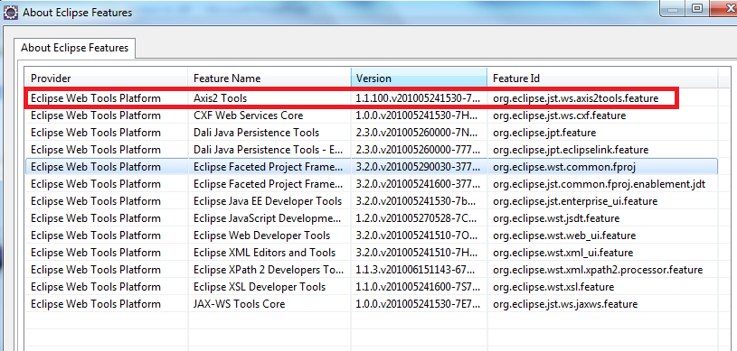
Tools and Technologies
Tools/ technologies
Axis 2
Tomcat 7.0
Eclipse Java EE IDE for Web Developers, Version: Helios Release
This release comes with AXIS 2 installed.

