Slide 1
MicroServices

Slide 2
A 'microservice' is a software development technique—a variant of the service-oriented architecture (SOA) architectural style that structures an application as a collection of loosely coupled services. In a microservices architecture, services are fine-grained and the protocols are lightweight. The benefit of decomposing an application into different smaller services is that it improves modularity and makes the application easier to understand, develop, test, and more resilient to architecture erosion.^{[1]} It parallelizes development by enabling small autonomous teams to develop, deploy and scale their respective services independently.^{[2]} It also allows the architecture of an individual service to emerge through continuous refactoring.^{[3]} Microservices-based architectures enable continuous delivery and deployment.
https://en.wikipedia.org/wiki/Microservices

Slide 3
What are microservices?
Microservices –
Also known as the microservice architecture
An architectural style that structures an application as a collection of loosely coupled services, which implement business capabilities. T
The microservice architecture enables the continuous delivery/deployment of large, complex applications

Slide 4
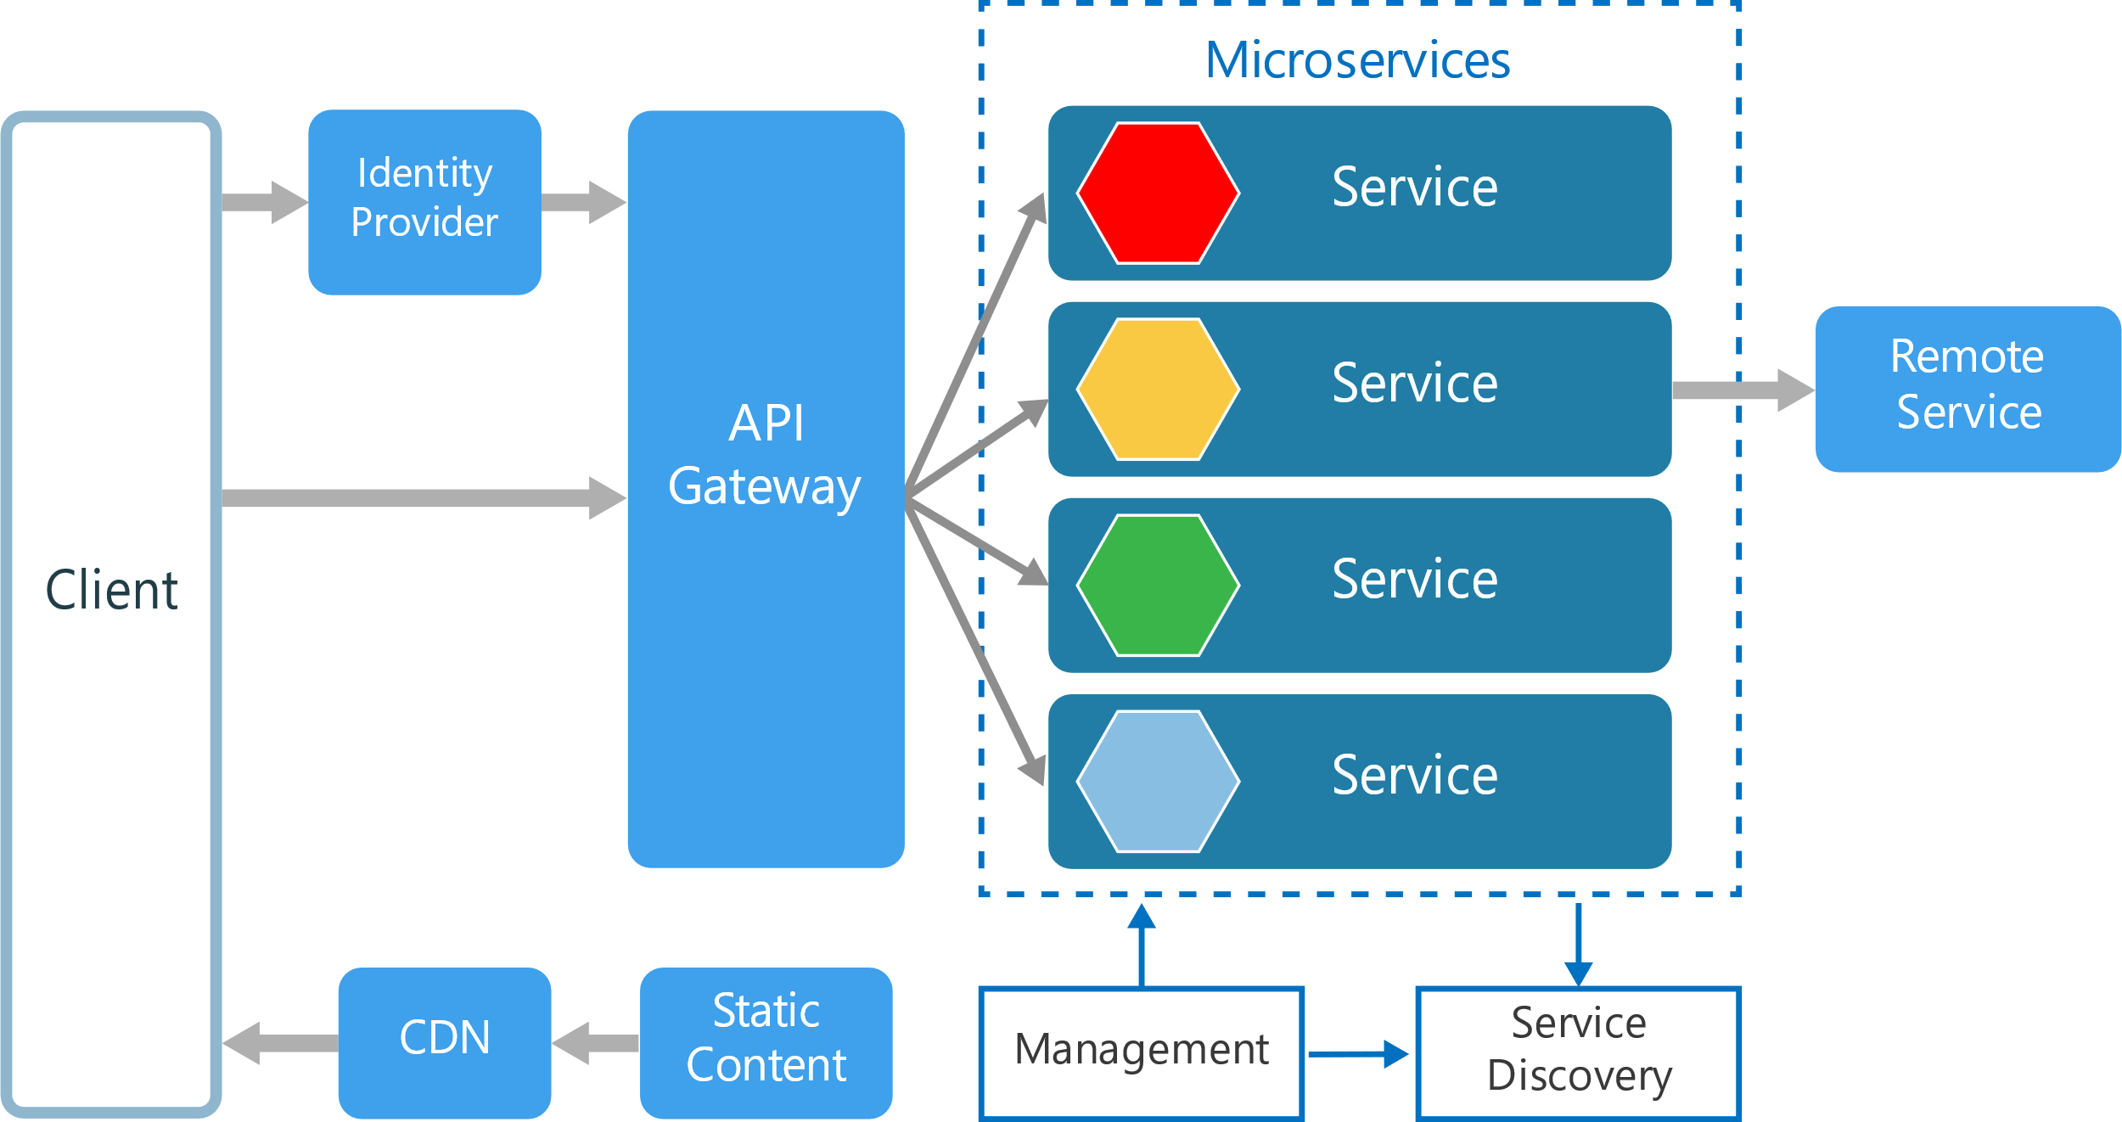






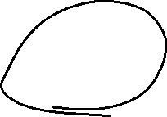






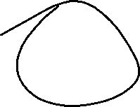




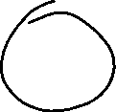



MicroService Architecture

Slide 5
Drawbacks of Monolithic Architecture
this simple approach has a limitation in size and complexity.
Application is too large and complex to fully understand and made changes fast and correctly.
The size of the application can slow down the start-up time.
You must redeploy the entire application on each update.
Impact of a change is usually not very well understood which leads to do extensive manual testing.
Continuous deployment is difficult.
Monolithic applications can also be difficult to scale when different
Another problem with monolithic applications is reliability. Bug in any module (e.g. memory leak) can potentially bring down the entire process. Moreover, since all instances of the application are identical, that bug will impact the availability of the entire application.

Slide 6


Reasons for Microservices
Easier to understand Small services
When you have small services, and you are responsible for them, it is easier to understand the boundaries of your services, and it will be easier for you to learn what the service does, as oppose to a monolith, where you will never know where your service ends, and where the other service starts
Services are independently deployable
You can deploy services independently. So if you have a feature, that is ready and tested and all, you don’t have to wait for some other components to finish something that is not related to your stuff at all. So you can go live without having to wait for anyone.

Slide 7


Why MS?
Easier to adopt to newer technology (retire vs rewrite)
When you have small little Microservices, and if a new technology comes up that is a very good fit for your service purposes, you can easily ditch the service and rewrite it with the new technology, without the need to rewrite the whole system which could cost you a fortune.
Easier to scale small services
If one or more features in your system are used more than the others, you can just scale up those specific services, and not the whole system or other services that aren’t used as much. This Microservices specification will become more important when you are using Cloud providers like Azure or AWS, where if you scale your whole system up, you are basically wasting money because it is not efficient.

Slide 8
Rules for a good MS architecture
Independent − Each microservice should be independently deployable.
Coupling − All microservices should be loosely coupled with one another such that changes in one will not affect the other.
Business Goal − Each service unit of the entire application should be the smallest and capable of delivering one specific business goal.

Slide 9






Challenges of Microservices Architecture
Bounded Context – Working Dos and Donts
Configuration Management
Dynamic Scale up and Down.
Visibility - Identification of a bug
Fault Identification
Pack of Cards if not architecture properly.- fault tolerance

Slide 10

Spring Cloud
https://projects.spring.io/spring-cloud/
Spring Cloud provides tools for developers to quickly build some of the common patterns in distributed systems (e.g. configuration management, service discovery, circuit breakers, intelligent routing, micro-proxy, control bus, one-time tokens, global locks, leadership election, distributed sessions, cluster state). Coordination of distributed systems leads to boiler plate patterns, and using Spring Cloud developers can quickly stand up services and applications that implement those patterns. They will work well in any distributed environment, including the developer's own laptop, bare metal data centres, and managed platforms such as Cloud Foundry.

Slide 11











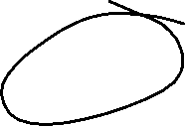



Netflix
Provides patterns to address the challenges of Microservices.
Eureka – Naming and Locating services
Histrix -- Fault tolerance /Circuit Breaker
Zuul -- API Gateway
Ribbon -- Client Load Balancing
Feign -- proxy
Swagger --
ETC…

Slide 12
Spring Cloud Config
Spring Cloud Config provides server and client-side support for externalized configuration in a distributed system. With the Config Server you have a central place to manage external properties for applications across all environments. The concepts on both client and server map identically to the Spring Environment and PropertySource abstractions, so they fit very well with Spring applications, but can be used with any application running in any language. As an application moves through the deployment pipeline from dev to test and into production you can manage the configuration between those environments and be certain that applications have everything they need to run when they migrate. The default implementation of the server storage backend uses git so it easily supports labelled versions of configuration environments, as well as being accessible to a wide range of tooling for managing the content. It is easy to add alternative implementations and plug them in with Spring configuration.

Slide 13
Spring Cloud Config Server
Configuration for all microservices can be stored in a central repository like git and Spring Config Server manages the configuration.

Slide 14
How to address challenges of MicroServices
Challenge of Dynamic Scale up and Scale Down
Naming Server (Eureka) --
Service registry
Service Discovery
Also gives information of how many instances are running.
Ribbon (Client Side Load Balancing)-
Load is evenly distributed
Dynamic up and down scaling of instances
Feign (Easier REST Clients)
Mechansim for writing simple rest clients

Slide 15
Visibility and Monitoring
Zipkin Distributed Tracing –
Spring cloud Sleuth
Assign an id to request across multiple components
NETFLIX Api Gateway -- Unified interface for multiple MicroServices like logging, security, analytics etc..
Zuul API Gateway
Fault tolerance with hystrix

