Slide 1

JBOSS EAP TRAINING SESSION
BY
VARAD SIR

Slide 2
Discuss point summary
S.N | Discuss Point
1 | Module
2 | Extension
3 | Subsystem
4 | Profile
5 | Socket-binding
6 | Interface
7 | Management
8 | Handlers
9 | Default-security-domain
10 | Pools
10 | Datasource and Docker

Slide 3
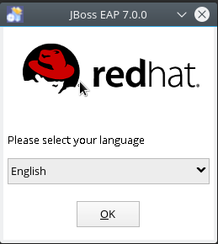
Jboss EAP Installation steps
Got to jar darictory and run below command:
[root@dosker eap-class]# java -jar jboss-eap-7.0.0-installer.jar
Hit ok button and got to netxt step

Slide 4
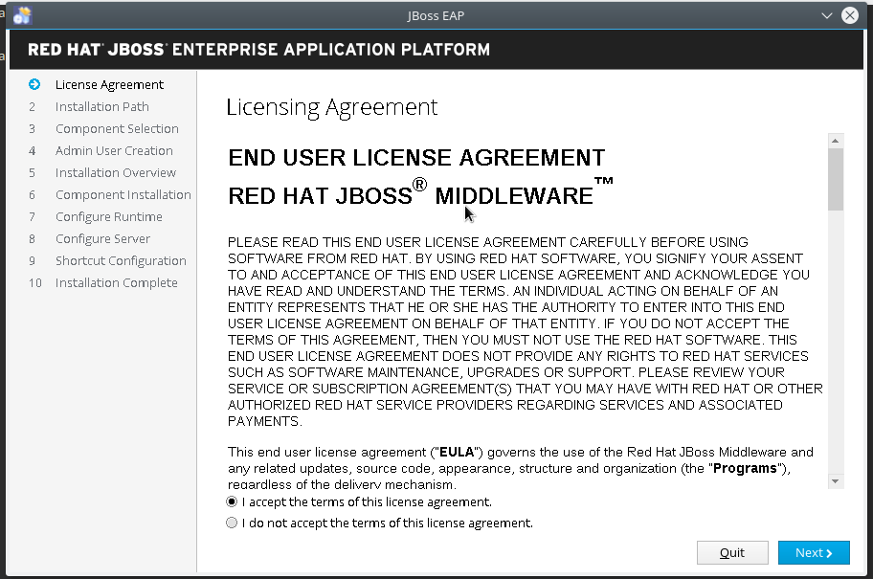
Select accepet the terms and go to next step

Slide 5
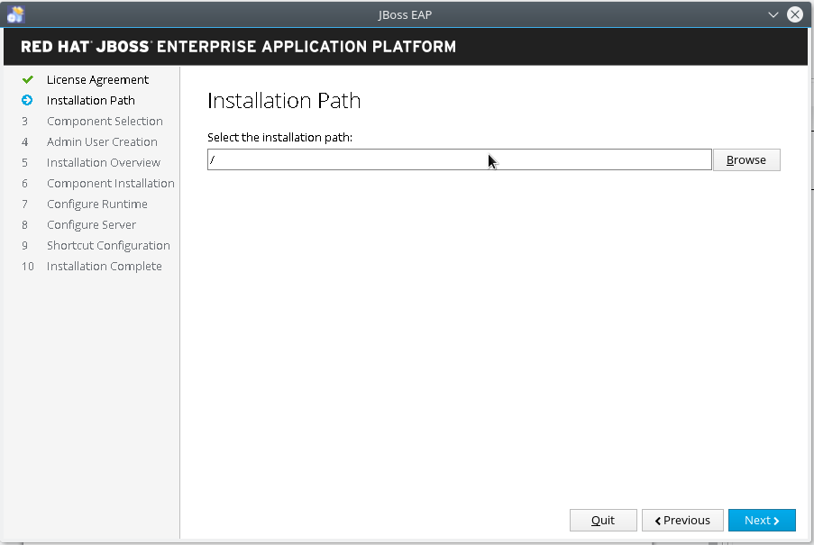

Slide 6
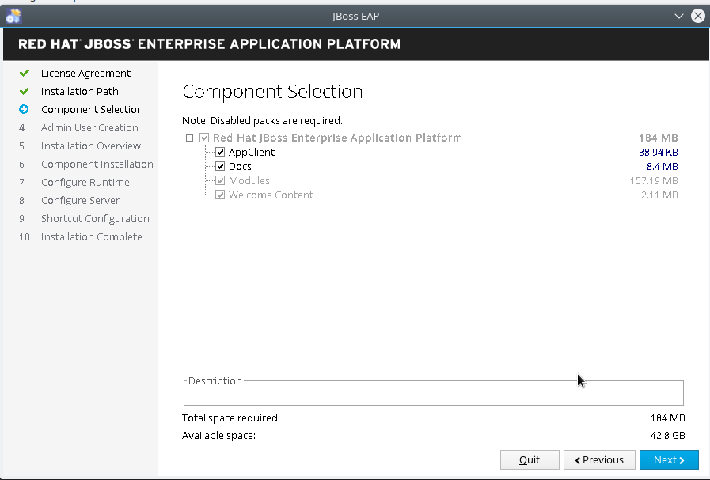
Hit the next button and go to next step

Slide 7
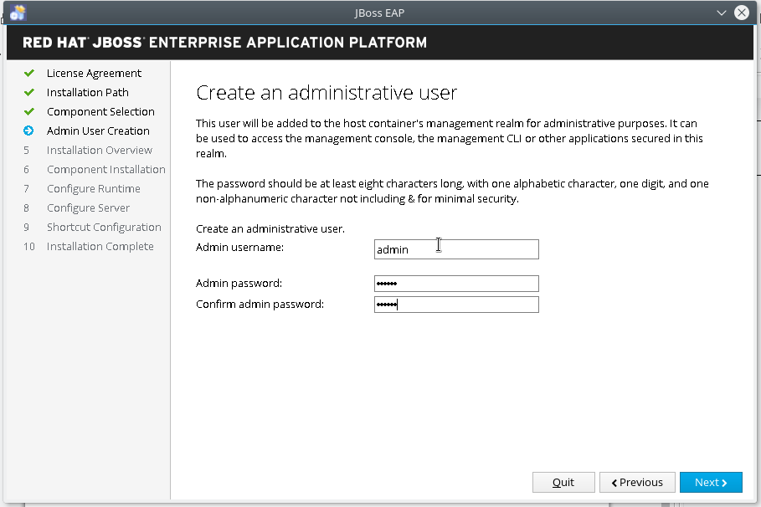
Inter the passord of admin user and hit next button go to next step

Slide 8
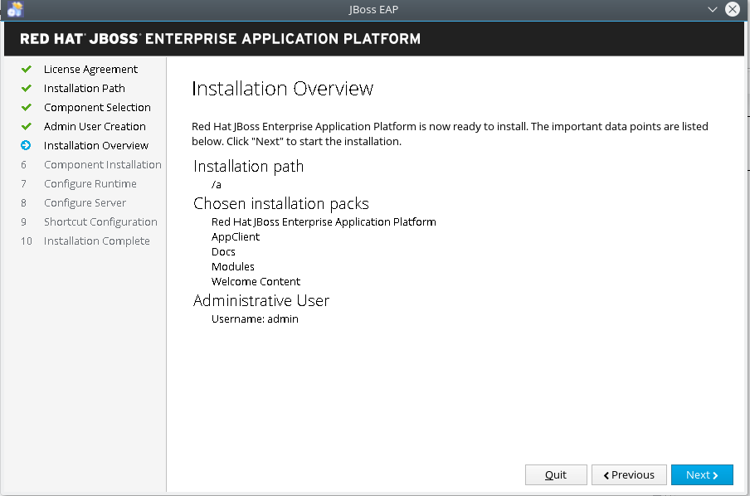
Check Installation Overview and Hit next button for go to next step

Slide 9
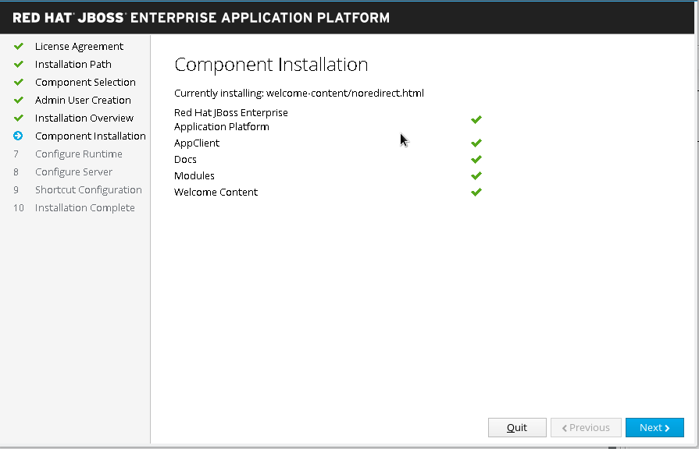
Installation component afte Hit Next Button

Slide 10
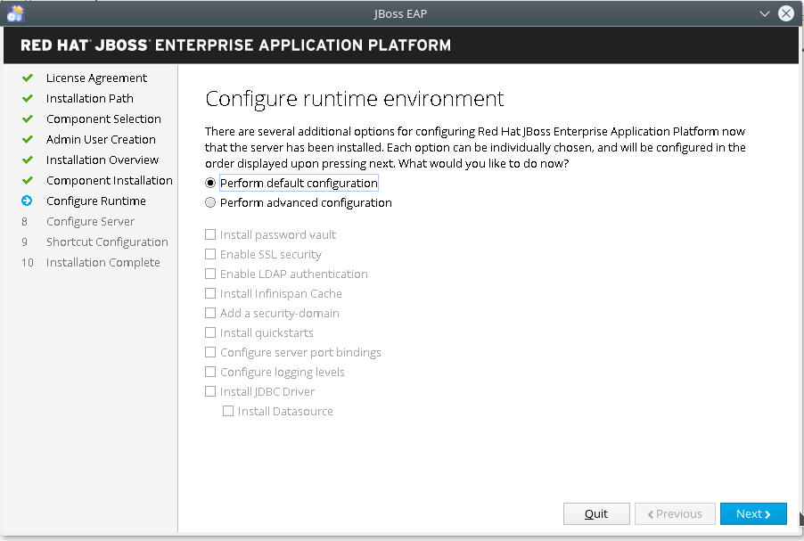
Selct Prform default configuration and Hit next Button go to next step

Slide 11
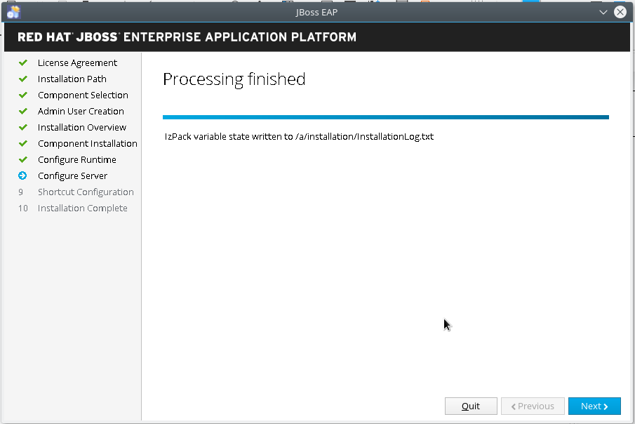
Jboss EAP Installation Processing finished and Hit next button and go to next step

Slide 12
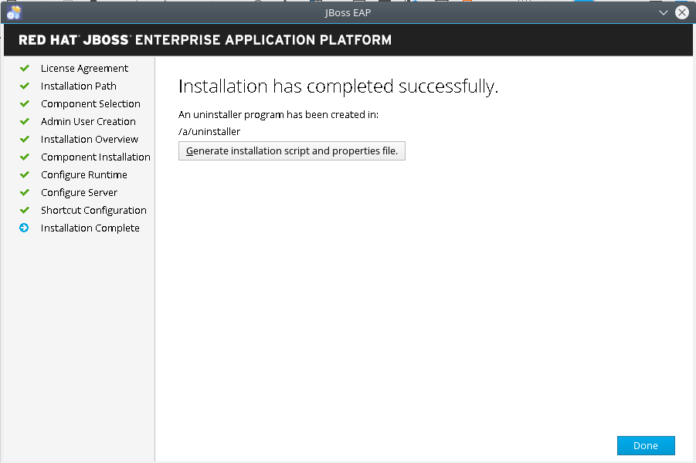
If required previous configuration step please create properties file and Hit next button
Noe,Jboss EAP installation is completed

Slide 13
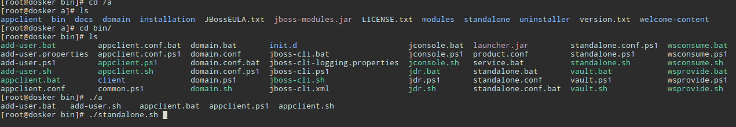
Start Jboss EAP
Steps:
1. First Go to Jboss Installation Directory
2. Second Go to bin directory server
3. Start Jboss Application server use below command
[root@dosker bin]# ./standalone.sh

Slide 14
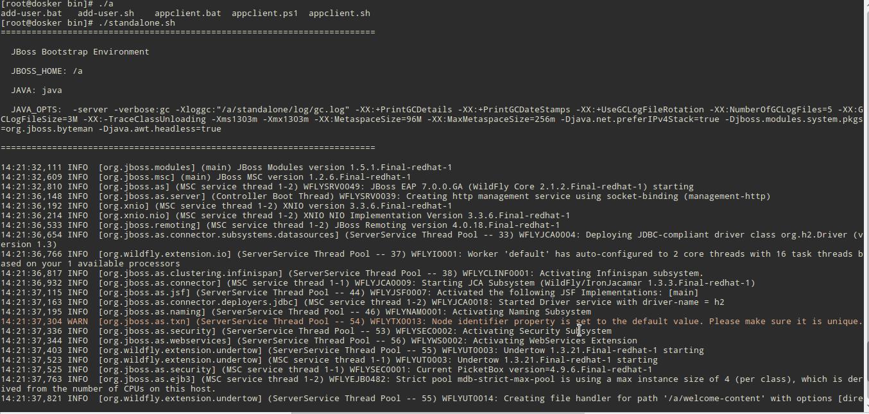
Jboss EAP Console Log

Slide 15

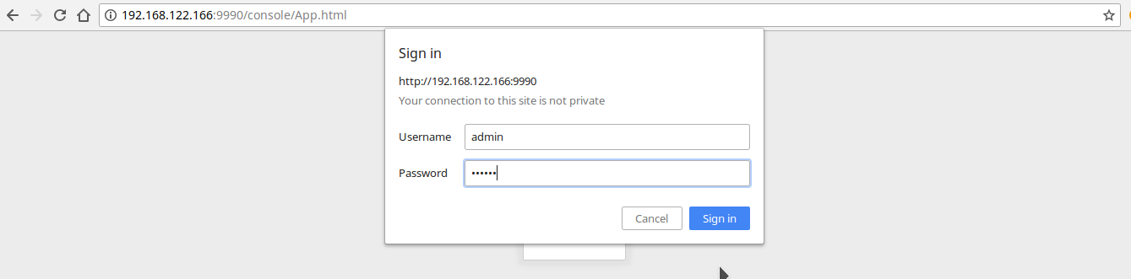
Check Jboss server running or not use screenshot
Logn Jboss Management Console

Slide 16
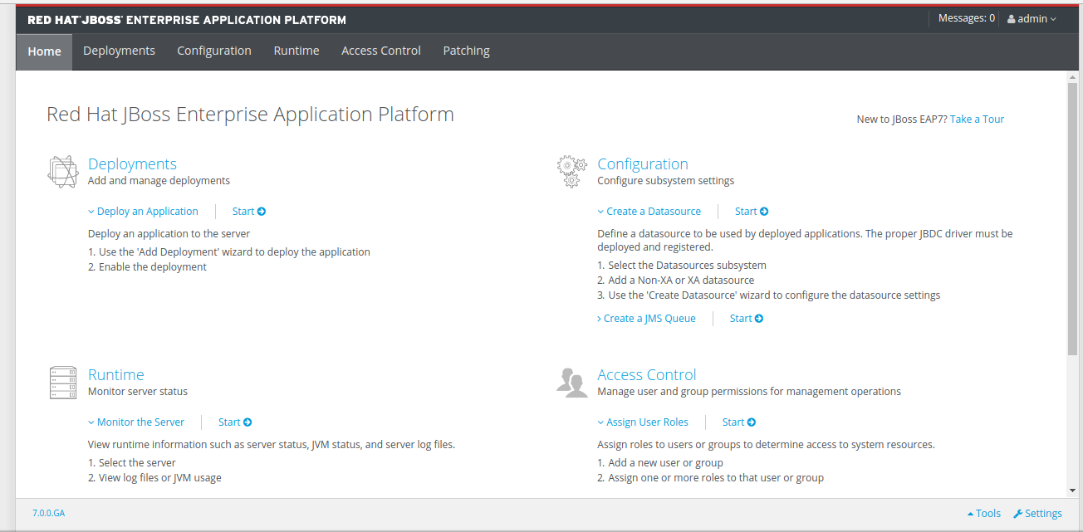
Jboss Management Console

Slide 17
Docker Container
Create a docker container of mysql DB
1. Install docker in any OS but OS kernel Version 3.10 or higher of the Linux kernel. The latest version of the kernel available for you.
Use below command for Install docker:
[root@dosker ~]# yum install docker
Start and Enable docker services:
root@dosker ~]# systemctl start docker; systemctl enable docker
Run below command and check docker images are avilabele or not:
[root@dosker ~]# docker images
REPOSITORY TAG IMAGE ID CREATED SIZE
Run below command and check container is running or not:

Slide 18
Varad Sir has share docker image of mariadb Now using this image we have to create container and create DB in this container for using this DB in Jboss application server.
Steps:
Load docker Images Use below command:
[root@dosker eap-class]# docker load -i ldap-mariadb.tar
Use below command Check and verify docker image load or no
[root@dosker eap-class]# docker images
REPOSITORY TAG IMAGE ID CREATED SIZE
osixia/openldap latest 8a00c53296d9 4 months ago 231 MB
localhost:5000/mariadb 10.2.9 629d7f88b09c 8 months ago 397 MB
[root@dosker eap-class]#
Use below command change docker Image Tag:
[root@dosker eap-class]# docker tag localhost:5000/mariadb:10.2.9 mariadb:10.2.9

Slide 19
Use Below Command create container and mount eternal volume:
[root@dosker docker-commands]# docker run -it -d --name mariadb -p 3306:3306 -v /app_data/sarathi/mysql_store:/var/lib/mysql -e MYSQL_ROOT_PASSWORD=redhat@123 mariadb:10.2.9
113623c9dd67567ff1f21b047103b211005f9a09cf36a55e97be7fa9d09c4e6a
[root@dosker docker-commands]# docker ps
CONTAINER ID IMAGE COMMAND CREATED STATUS PORTS NAMES
113623c9dd67 mariadb:10.2.9 "docker-entrypoint..." 3 seconds ago Up 2 seconds 0.0.0.0:3306->3306/tcp mariadb
[root@dosker docker-commands]#
Use below command and login mariadb server:
[root@dosker docker-commands]# mysql -h127.0.0.1 -u root -p
Enter password:
Welcome to the MariaDB monitor. Commands end with ; or \g.
Your MariaDB connection id is 8
Server version: 10.2.9-MariaDB-10.2.9+maria~jessie mariadb.org binary distribution
Copyright (c) 2000, 2017, Oracle, MariaDB Corporation Ab and others.
Type 'help;' or '\h' for help. Type '\c' to clear the current input statement.
MariaDB [(none)]>

Slide 20
Now create DB use below command
MariaDB [(none)]> show databases;
+--------------------+
| Database |
+--------------------+
| information_schema |
| mysql |
| performance_schema |
+--------------------+
3 rows in set (0.01 sec)
MariaDB [(none)]> create database keenable;
Query OK, 1 row affected (0.00 sec)
MariaDB [(none)]>

Slide 21
MariaDB [(none)]> use keenable;
Database changed
MariaDB [keenable]> create table test (ID INT(12), password VARCHAR(15));
Query OK, 0 rows affected (0.28 sec)
MariaDB [keenable]> show create table test;
+-------+---------------------------------------------------------------------------------------------------------------------------------+
| Table | Create Table |
+-------+---------------------------------------------------------------------------------------------------------------------------------+
| test | CREATE TABLE `test` (
`ID` int(12) DEFAULT NULL,
`password` varchar(15) DEFAULT NULL
) ENGINE=InnoDB DEFAULT CHARSET=latin1 |
+-------+---------------------------------------------------------------------------------------------------------------------------------+
1 row in set (0.00 sec)
MariaDB [keenable]> insert into test value ('12', 'redhat@123');
Query OK, 1 row affected (0.11 sec)
MariaDB [keenable]> select * from test;
+------+------------+
| ID | password |
+------+------------+
| 12 | redhat@123 |
+------+------------+
1 row in set (0.01 sec)
MariaDB [keenable]>
Use beloe command create table:

Slide 22
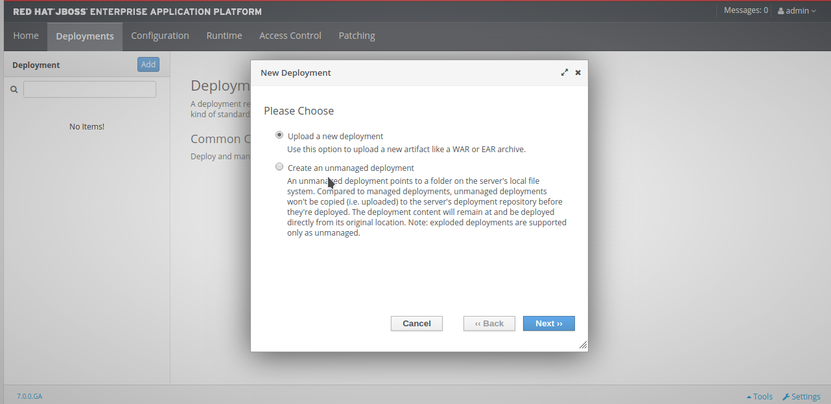
Click Add button and upload a new deployment

Slide 23
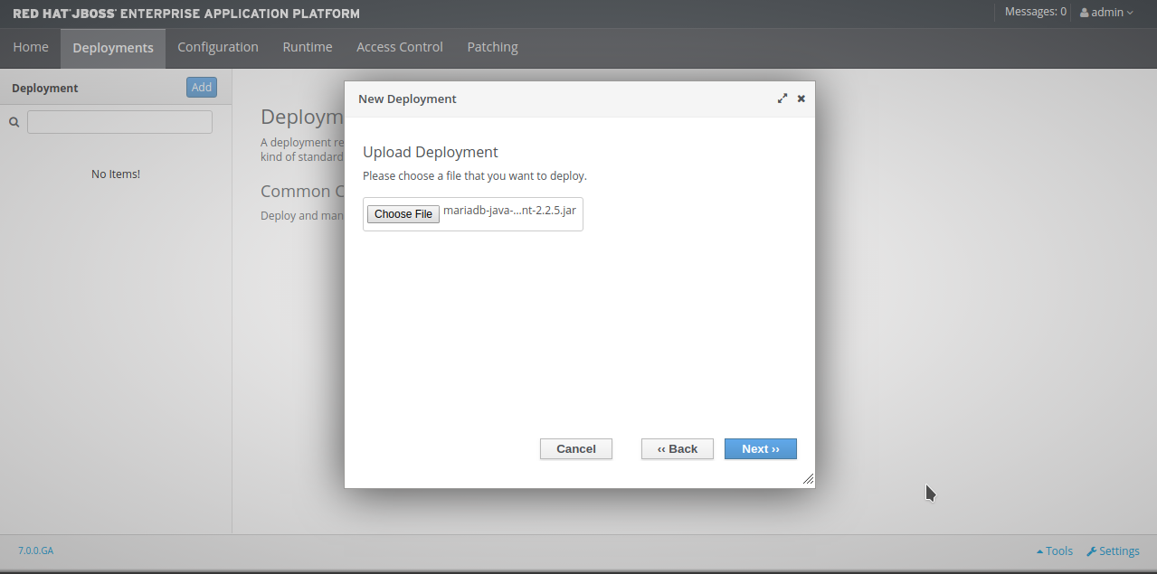
Hit Choose file button and select jar file and Hit next button for go to next step

Slide 24
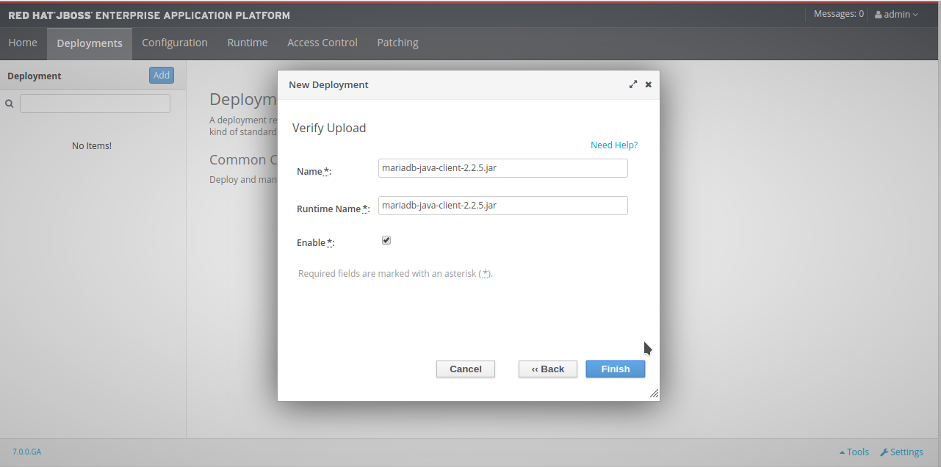
Now Verify jar name and Hit Finish Button

Slide 25
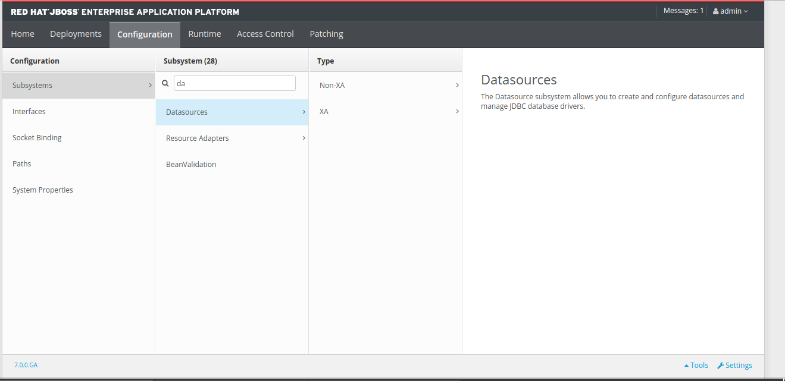
Click Confugration tab and select subsystem and add datasourcs

Slide 26
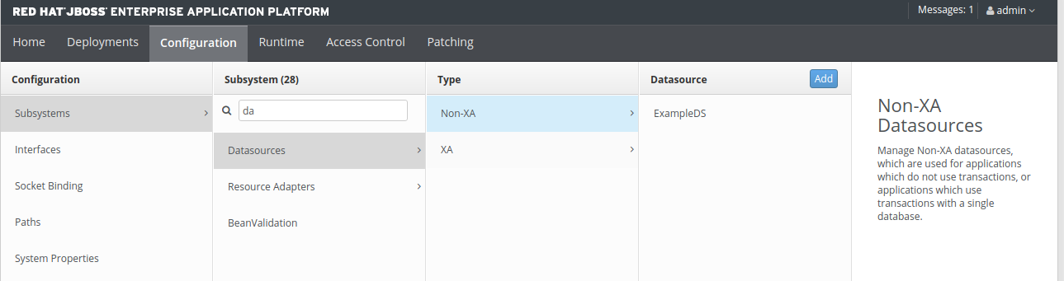
Select data source type
Two types of data source:
1. Non XA -> On one DB server like Mysql
2. XA -> Multiple DB server Like oracle DB,Mysql,Mariadb

Slide 27
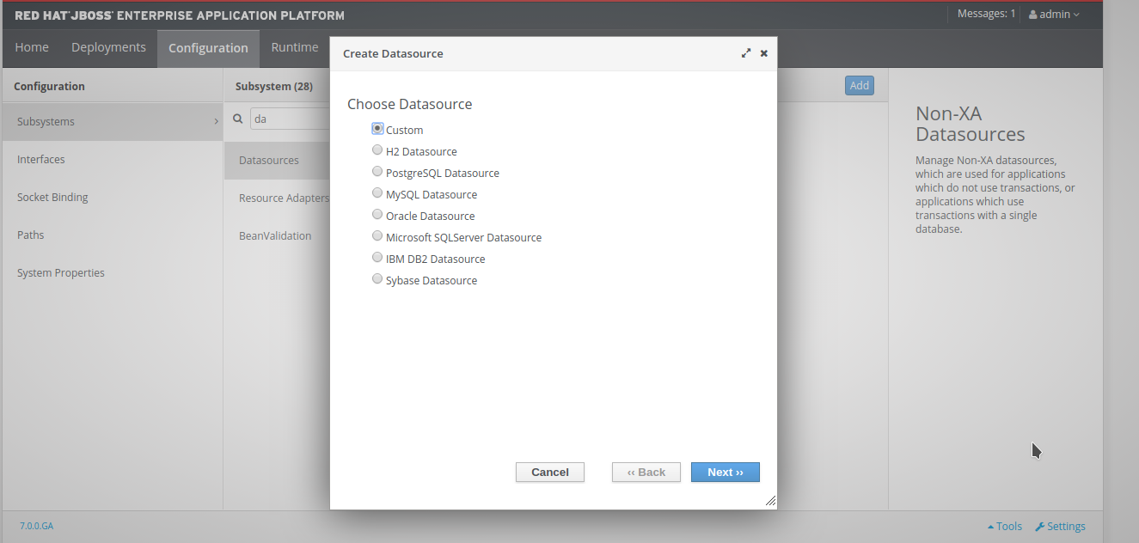
Select DB type and Hit Next Button

Slide 28
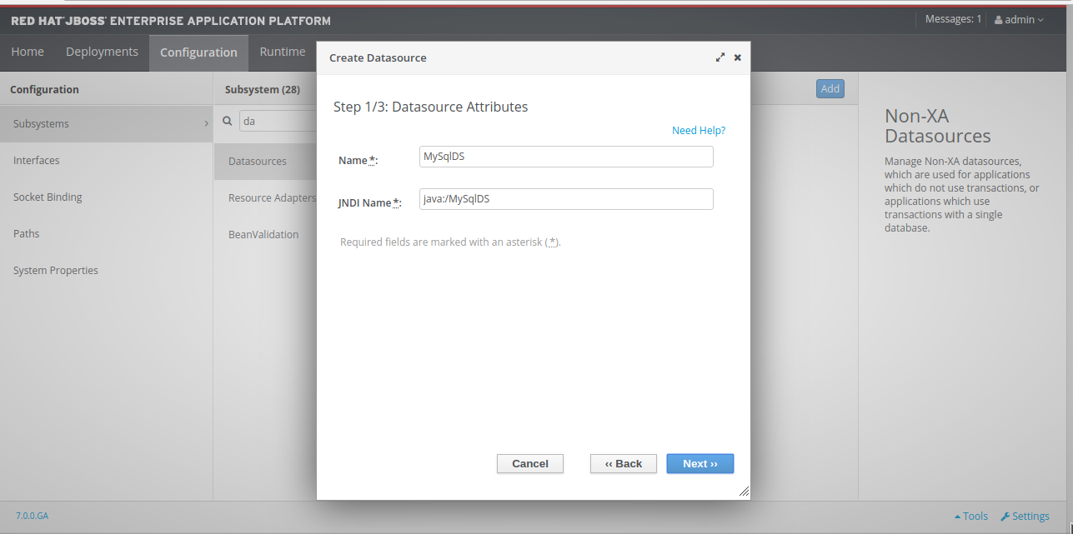
Create data source

Slide 29
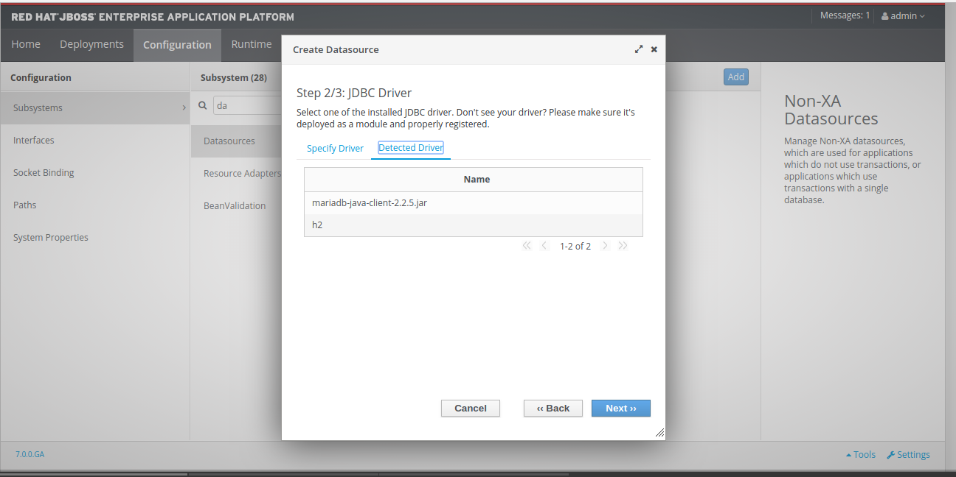
Click Dected Driver select the mariadb driver and Hit next button

Slide 30
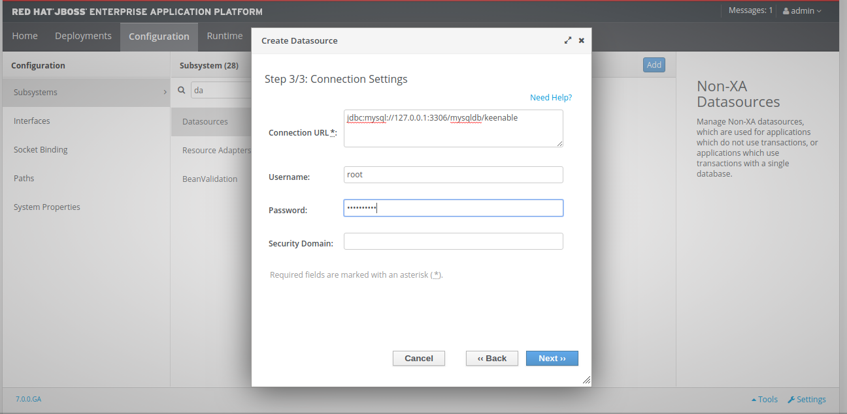
Configure DB details:

Slide 31
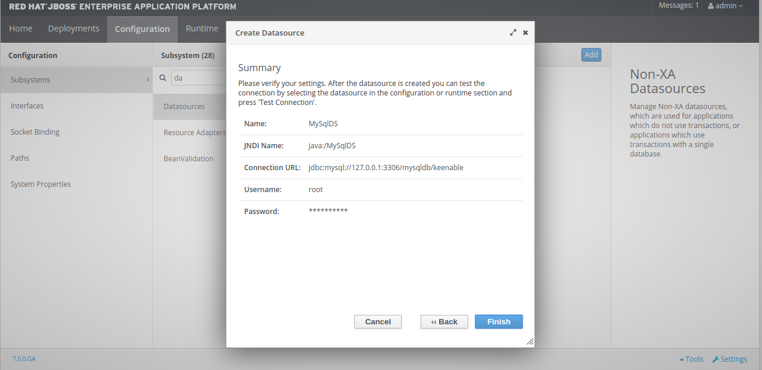
Check Data source summary

Slide 32
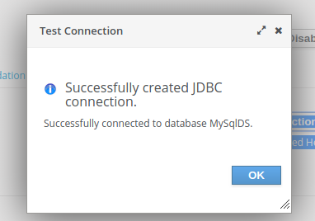
Now check doployment working or not

Slide 33
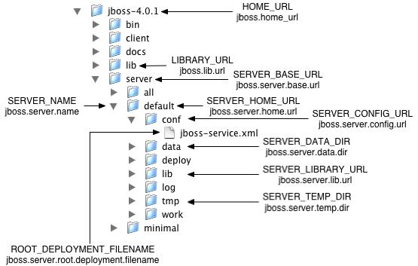

Slide 34
