Slide 1
IBM University Engagement Project Submission
“Exploring the Power of Agentic AI with IBM Granite and LangFlow”

Slide 2
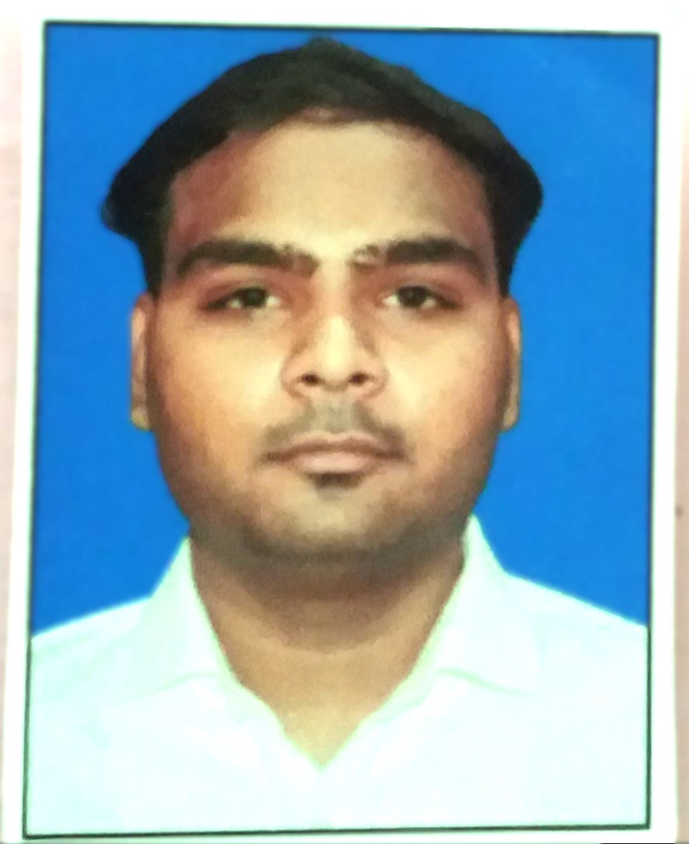
Project Tile – IBM AI Research Agent using Granite&Langflow
Domain of Project – [ Education / Academic Research ]
Student Name | Recent Passport Photo | Email ID | Mobile number [WhatsApp]
Ashish sarwan |  | sarwanashish192@gmail.com | 9829724411

Slide 3
Problem Statement -
Problem Statement: Researchers, students, and faculty members spend hours searching for relevant academic papers and reading long abstracts to extract key insights. Current search tools only provide lists of papers but do not summarize the core methodology, findings, or suggest future research gaps. This manual process is time-consuming, overwhelming, and slows down the pace of innovation.
The Objective:
To build an AI-powered Research Agent using IBM Granite and Langflow that:
1 . Automatically fetches recent, relevant research papers from arXiv based on a user's topic.
2 . Utilizes the IBM Granite model to generate a concise 3-point summary of the paper's abstract.
3. Suggests a future hypothesis based on the research, saving hours of manual reading time and accelerating the research process.
The Objective

Slide 4
Proposed Solution -
Proposed Solution: AI-Powered Research Agent
The proposed solution is an intelligent Research Agent built using IBM watsonx.ai, IBM Granite models, and Langflow. It automates the literature review process through the following steps:
Automated Search: The user enters a research topic in a Streamlit interface, and the agent automatically fetches the latest relevant papers from the arXiv database.
Langflow Integration: The application uses a Langflow workflow (via API) to orchestrate the summarization process.
IBM Granite Reasoning: The abstract of the fetched paper is sent to the IBM Granite model (ibm/granite-4-h-small), which generates a structured 3-point summary and suggests a future hypothesis.
User-Friendly Output: The Streamlit dashboard displays the paper details, direct link, and the AI-generated summary.
This solution transforms a time-consuming manual task into a fast, automated, and intelligent workflow, empowering researchers to focus on innovation rather than reading.
Aap ise paste karein aur phir next slide (Technology Used) par jayein!

Slide 5
Technology Used
IBM Granite Model:
ibm/granite-4-h-small (Natural Language Processing, Reasoning, and
Summarization).
IBM watsonx.ai: For model deployment, API access, and AI governance.
Langflow: For designing, orchestrating, and testing the Agentic AI workflow visually.
Langflow API: To integrate the Langflow workflow with the frontend.
Streamlit (Python): For building the interactive, user-friendly frontend interface.
arXiv API: To fetch real-time, authentic research papers
. Python: Core programming language for backend logic and API requests

Slide 6
Langflow component Used -
Chat Input: To receive the user's research query.
IBM watsonx.ai (Granite Model) : The core LLM node (ibm/granite-4-h-small) used for reasoning, text generation, and summarization.
Agent : Orchestrates the workflow and manages the tools to provide the final response.
Web Search / URL Tool : Used to fetch and extract information from online sources.
Chat Output : To display the final AI-generated summary to the user.

Slide 7
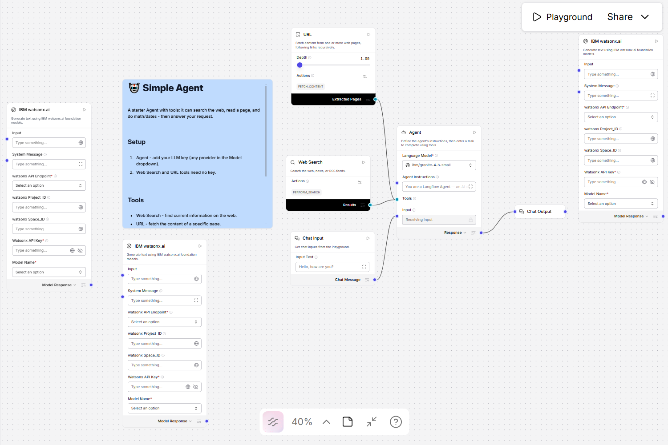
Langflow workflow -

Slide 8
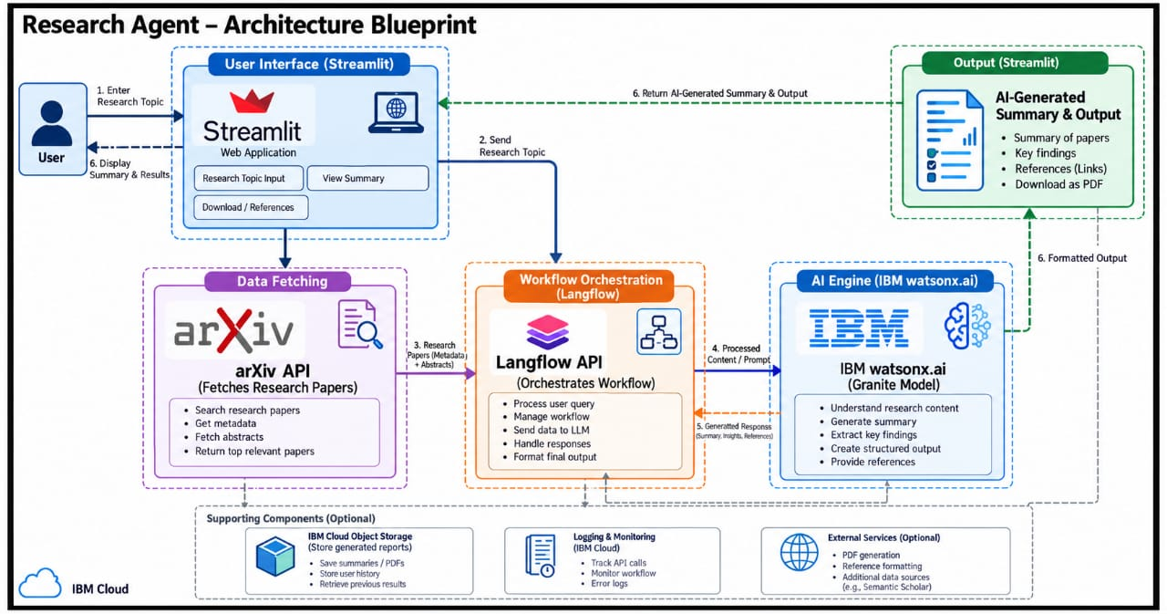
Architecture blueprint

Slide 9

Role of Agentic AI in the Research Agent
Role of Agentic AI in the Research Agent:
Agent from a simple chatbot into an autonomous system. Here is how it adds Agentic AI transforms our Research
Autonomous Task Execution: Instead of just answering questions, the agent acts on its own. It takes a simple topic, automatically connects to arXiv, and fetches relevant research papers without manual search.
Contextual Reasoning (via IBM Granite): The agent understands the complex abstract of the fetched paper and applies reasoning to extract the core methodology and key findings.
Structured Output Generation: It proactively creates a structured 3-point summary and suggests a future hypothesis, acting like a digital research assistant.
Workflow Orchestration: Using Langflow, the agent seamlessly coordinates between the data fetching API and the IBM Granite model, ensuring a smooth end-to-end user experience.

Slide 10
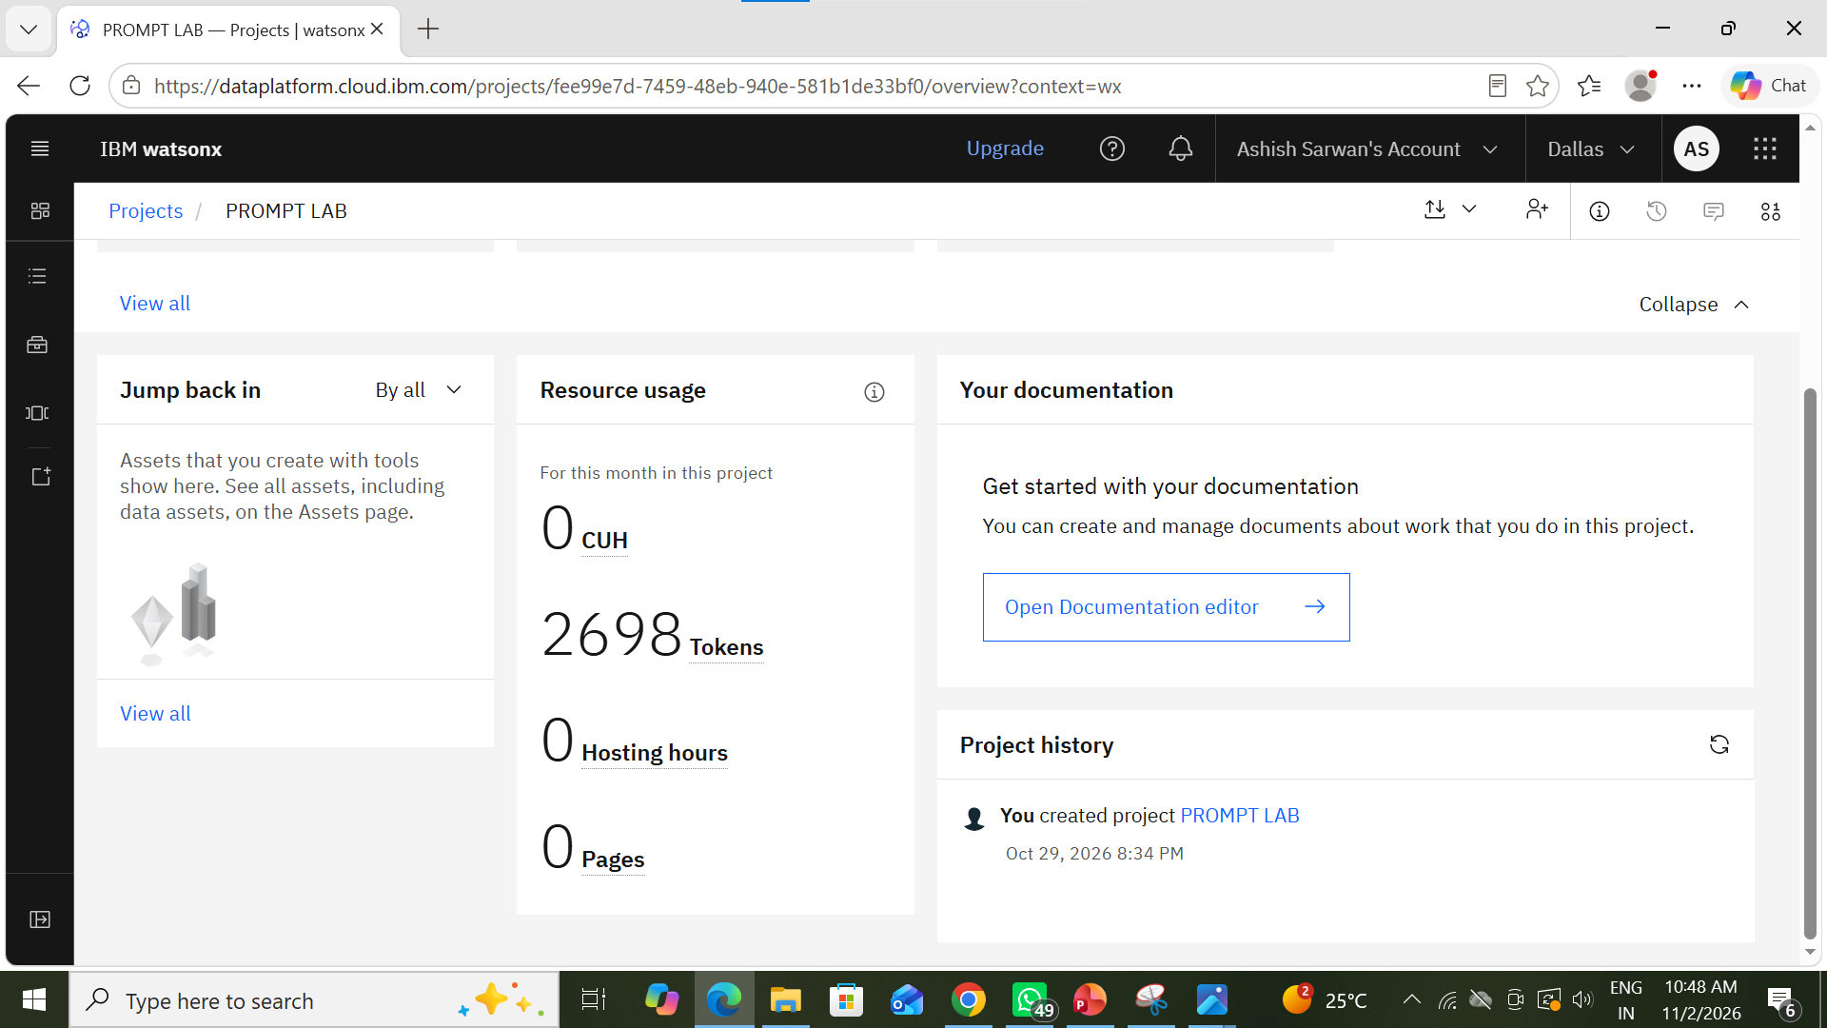
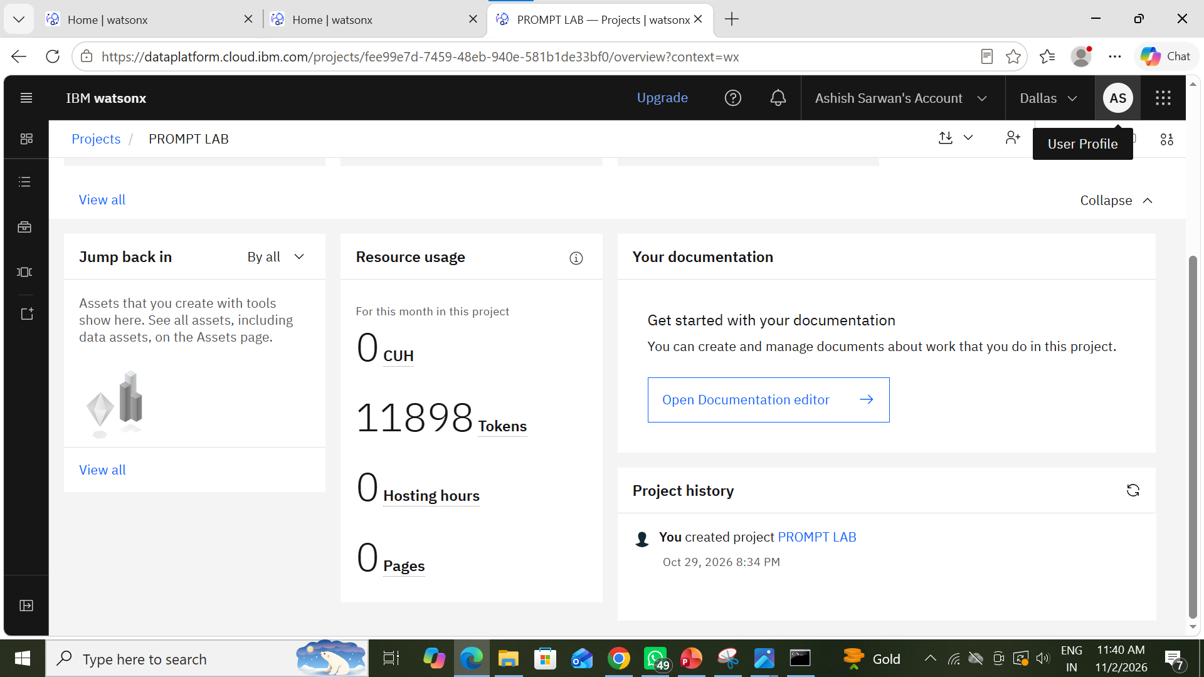
Token Usage
11,761 token are used
Before Prompt
After the Prompt
·
·
·

Slide 11
Novelty and Uniqueness
End-to-End Automation: Unlike standard search engines, this agent automates the entire workflow—from fetching real-time research papers from arXiv to generating a structured summary—in a single click.
Langflow Integration: The core logic is visually orchestrated using Langflow, making the AI workflow transparent, easy to modify, and scalable.
IBM Granite Reasoning: It leverages IBM's Granite model for deep contextual understanding and hallucination-free summarization of complex academic texts.
Future Hypothesis Generation: Going beyond simple summarization, the agent actively suggests future research hypotheses based on the paper's findings, acting as a true research assistant.

Slide 12
Git Hub Link
https://github.com/ashish98297244/IBM_Research_Agent
YOUTUBE LINK -
https://youtu.be/ecV8OWyKZ1o?si=OIuQdu4S0jlMcXWO
·
·
·

Slide 13
Future Scope
Full PDF Integration using IBM Docling: Currently, the agent summarizes the abstract. In the future, we can integrate IBM Docling to parse the full PDF, allowing the AI to summarize the entire research paper, including methodology and results.
Multi-Agent System: We can create multiple specialized agents—one for literature review, one for data analysis, and one for citation generation—that collaborate to write a complete research report.
Vector Database (RAG) Integration: By storing past research papers in a Vector Database (like FAISS or Chroma), users can ask questions across thousands of papers and get grounded answers.
Export to PDF/Docx: Adding a feature to download the generated summary and hypothesis directly as a formatted Word or PDF document for easy sharing.
·
·
·

Slide 14
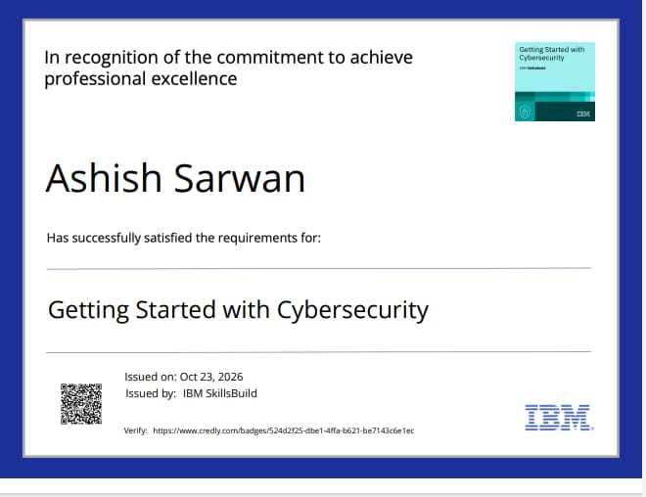
Certificates Earned:
Please add your credly certificate

Slide 15
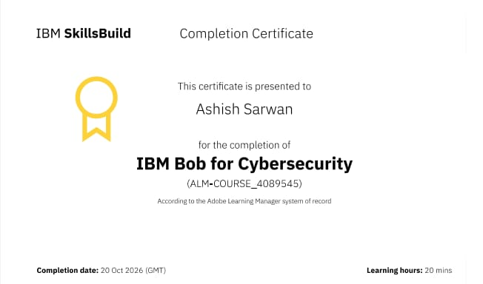
Certificates Earned:​
Add your IBM BOB Certificate

Slide 16


