Slide 1
Will They Claim It?
Team Members:
Anurodh Raina
Ashish Tiwari
Chirag Agrawal
Shubendu Biswas
Hackathon: Supervised Machine Learning
Presented By : Tathya Vaigaynik

Slide 2
Problem Statement
Risk management processes form an integral part of the insurance industry. Insurers consider every available quantifiable factor to develop profiles of high and low insurance risk for their prospective policyholders.
Level of risk determines the insurance premiums of these policies. To this end, insurers collect a vast amount of information about policyholders and insured objects.

Slide 3
Machine Learning Steps
1.Data Pre-Processing & Exploratory Data Analysis
2.Feature Selection Pipeline
3.Model Creation
4.Ensemble Method
Increasingly, statistical methods and tools based on data mining techniques are being used to determine insurance policy risk levels.
We discuss the use of predictive analytics for assessing insurance risk in the following sections.

Slide 4
Raw Dataset
Dataset:
The data consists of records of roughly 52000 instances and 11 features.
There are 10 independent variables and 1 target that describes whether the insurances will be claimed or not.
Target: Claim Status (Claim)
Name of agency (Agency)
Type of travel insurance agencies (Agency.Type)
Distribution channel of travel insurance agencies (Distribution.Channel)
Name of the travel insurance products (Product.Name)
Duration of travel (Duration)
Destination of travel (Destination)
Amount of sales of travel insurance policies (Net.Sales)
The commission received for travel insurance agency (Commission)
Age of insured (Age)
The identification record of every observation (ID)

Slide 5
Data Pre-Processing
Data pre-processing is a major task in any machine learning model, without pre-processing the model will not give good results as desired.
Why ?:
First and foremost thing is to verify that is there a missing value in dataset, if yes we had to impute the value for missing.
Outlier detection.
Duplicate Data Detection
Scaling the numeric data to standardize.

Slide 6
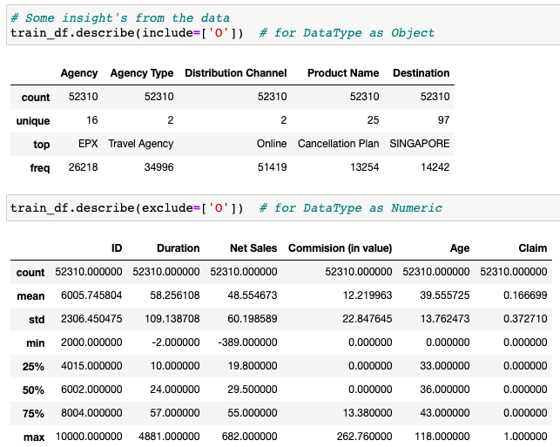
Exploratory Data Analysis (EDA)
EDA helps gaining the better insight about data.
Exploratory Data Analysis
(EDA)

Slide 7
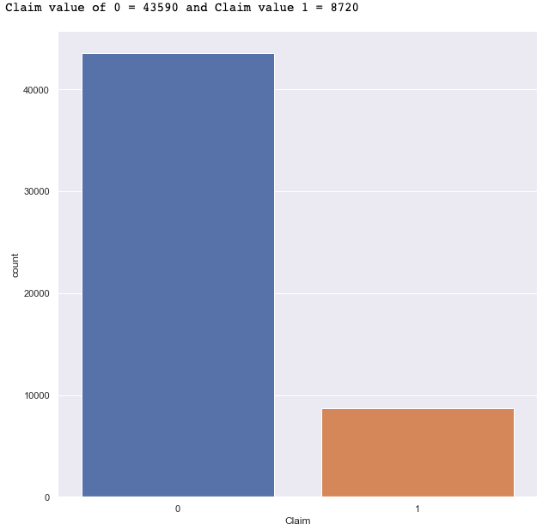

Outliers were detected using Z-Score with threshold as 3
Before Outlier Detection Data Distribution
After Outlier Detection Data Distribution

Slide 8
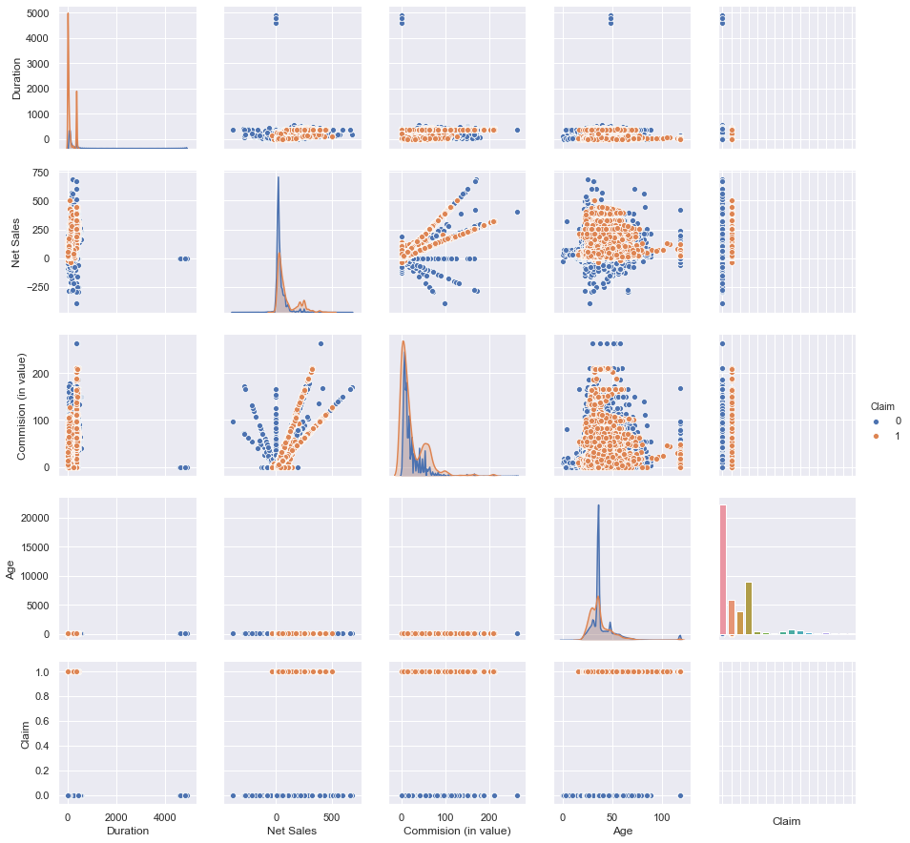
Pair Plots

Slide 9
Features Pre-Processing
Total of two encoding methods were used for encoding the categorical variables which are:
One Hot Encoding
Response coding
And for Numerical features we used -> Standardize Scale
Pairs of methods were used to evaluate the features such as XgBoost Classifier with both One hot encoding and another with Response coding.

Slide 10
Models and Approaches
We initially used all the basic models for classification with hyperparameter tuning but without the treatment of class imbalance of the target variable.
Although some of these models gave a decent 75% precision score, none of them were a good fit(overfitting).
We even managed to get 92% precision score with the Voting Classifier, but it was at the cost of a really low test ROC_AUC score so we had to scratch that model and used class_weight = balanced.

Slide 11
Model Matrix with Response coding and Standard Scale
Classification Models | Best Hyper-parameter | Train AUC | Test AUC | Precision
 |  |  |  | 0 | 1
KNN Classifier (Brute Force) | K = 11 | 0.95 | 0.91 | 0.708 | 0.728
KNN Classifier(KD Tree) | K =11 | 0.95 | 0.91 | 0.746 | 0.712
Logistic Regression(L2) | C =100 | 0.82 | 0.84 | 0.684 | 0.737
Decision Tree | Depth = 50 Sample Split = 40 | 0.97 | 0.91 | 0.779 | 0.766
Random Forest | Depth = 150 n_estimators = 300 | 0.99 | 0.97 | 0.793 | 0.787
GBDT(XGBoost) | Depth = 110 n_estimators = 300 | 0.99 | 0.98 | 0.787 | 0.793

Slide 12
Model Matrix with One-Hot Encoding and Standard Scale
Classification Models | Best Hyper-parameter | Train AUC | Test AUC | Precision
 |  |  |  | 0 | 1
KNN (Brute Force) | K = 7 | 0.97 | 0.93 | 0.818 | 0.750
KNN (KD Tree) | K =7 | 0.97 | 0.93 | 0.818 | 0.750
Logistic Regression(L2) | C = 100 | 0.86 | 0.85 | 0.778 | 0.727
Decision Tree | Depth = 160 Sample Split = 40 | 0.97 | 0.92 | 0.787 | 0.755
Random Forest | Depth = 300 n_estimators = 300 | 0.92 | 0.90 | 0.789 | 0.736
GBDT(XGBoost) | Depth = 115 n_estimators = 300 | 0.99 | 0.98 | 0.805 | 0.790

Slide 13
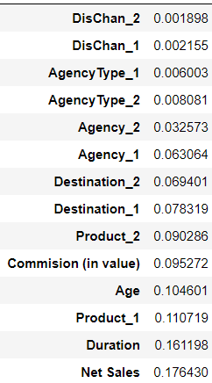
Feature Selection and Engineering
By using XGBoost feature_importance attribute, we removed two columns from the predictors set : Distribution Channel and Agency Type. After removing above mentioned columns our model is still stable and precision got increased.

Slide 14
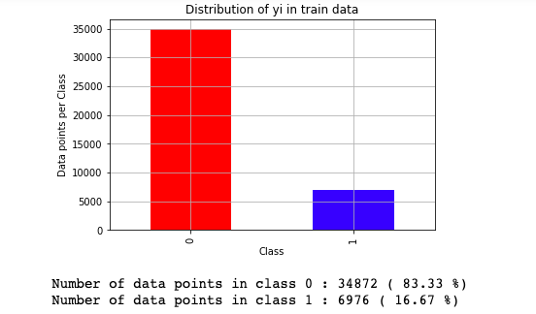
Training XGBoost with Manual Class Balancing
We are taking class weights according to train data distribution.
Since the data is imbalanced, we took the weights as following:
For Class 0, Weight = (6976 / 34872) = 0.20004588208
For Class 1, Weight = (34872 / 6976) = 4.99885321101
We used this class weights to fit the training data on XGBoost with response coding and One Hot Encoding.

Slide 15
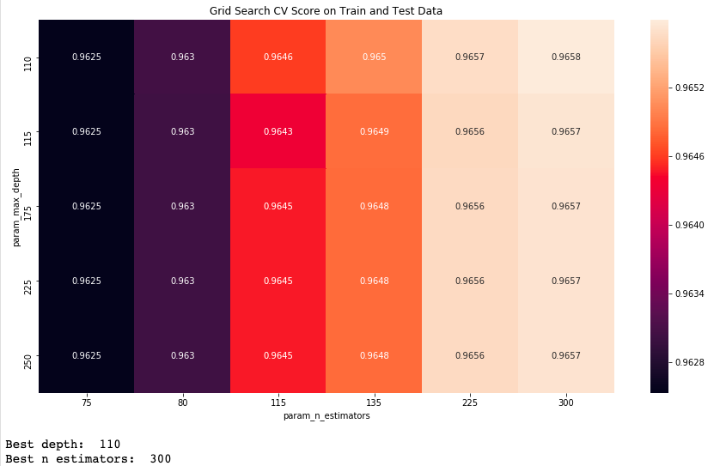
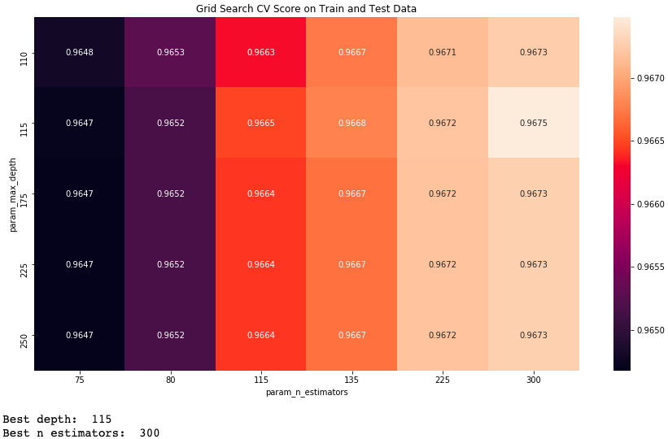
Grid Search on XGBoost (max_depth, n_estimators)
Response Coding + Standard Scale ​
One Hot Encoding + Standard Scale​

Slide 16
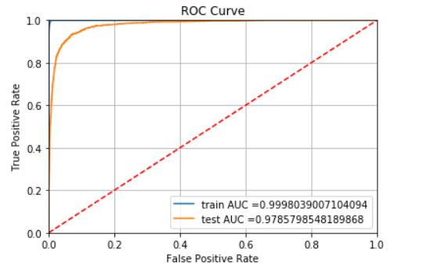
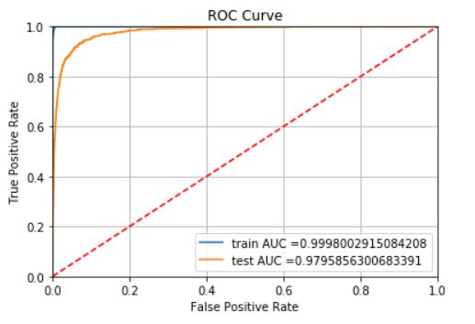
ROC AUC curve of final model with best hyperparameter and feature selection
Response coding + Standard Scale
One Hot Encoding + Standard Scale

Slide 17
Key Points
One hot encoding proved better than response coding in terms of precision score but it was only by 0.10 percent.
Response coding was predicting using only 10 features while OHE used 142 features so time and space complexity of response coding is far much better than ohe.
So for better precision we can use OHE and for better time space complexity we can use response coding according to business requirement.

Slide 18
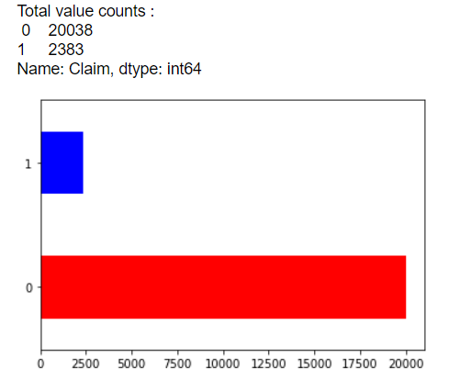
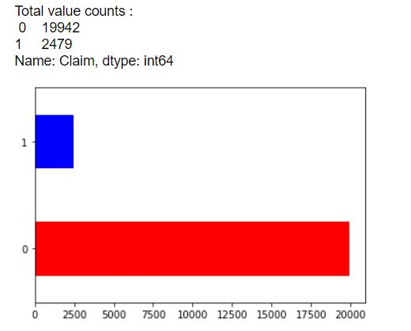
Conclusion
We used the test data to predict the output with our best model (XgBoost with feature selection and transformation)
Response coding + Standard Scale
One Hot Encoding + Standard Scale

Slide 19
Will Machine Learning help?
To improve operational efficiency from claim registration to settlement.
Enhancing the customer experience while reducing the claims settlement time.
These insights can help a carrier save millions of dollars in claim costs through proactive management, fast settlement, targeted investigations and better case management.
In doing so, insurance companies can also reduce costs and generate substantial business growth.

Slide 20
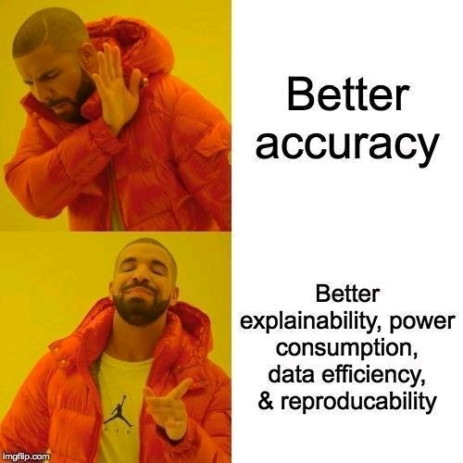
Thank you!!!

