Slide 1
Architecture
GRAPH, GRAPHRAG, ONTOLOGY, AGENTS, MCP

Slide 2
Business Problem
As a part of Financial Crime Monitoring / Investigation, <not limited to> we are interested to know about patterns / anomalies in customer behaviour based on the products, transactions and the channel through which they transact.
We perform various capabilities of monitoring (few of them are listed below)
CUSTOMER RISK ASSESSMENT, CUSTOMER DUE DELLIGENCE, ENHANCED DUE DELLIGENCE
SANCTIONS SCREENING
TRANSACTION MONITORING
REGULATORY REPORTING
FOREGIN TAX MONITORING & REPORTING
GOVERNMENT NOTICES
Under Monitoring and Operational lens, it becomes very critical to find concealed relationships between different entities and detect anomalies based on abstraction.
Entities we are interested in
CUSTOMER, EMPLOYEE, PRODUCT, TRANSACTION, MERCHANT, ADDRESS, DEVICE, OSINT, ALERTS, CASES, REGULATORY REPORTS, OTHER (s)
Scenario
Retrieval of relationships across different entity attributes for a Customer being investigated.
There are standard explicit relationships which we show currently to our investigators based on concrete relationships established across different data entities.
The implementation of Ontology with Agents on top will help us extend the explicit relationships to be enriched with abstract relationships between different entities (centring around the Customer being investigated).
This also enables NLP to be implemented and allows for queries to be executed at run time centring around the Customer being investigated.
The POC was undertaken to figure out the best way to connect different entities and understand the relationships between them (not just concrete relationships but abstraction included).
This pack talks to solutions and patterns (extensible / reusable) which can connect to any more entities we want to add in future.
Current entities included in POC
CUSTOMER, PRODUCT, TRANSACTION, MERCHANT, ADDRESS, DEVICE
The POC aims at demonstrating how Graph + Ontology can be set up within Snowflake & / or what is needed to be done if we want Independent solution stacks to be stitched together.
Note
The concrete relationships are already established and available via tables / views on Financial Crime Snowflake.
The abstract relationship construct will go into the Ontology semantics which will be generated in a BATCH mode (as a one-off on Day1 → followed by updates based on daily deltas).
Raw Data → Already integrated on Financial Crime Snowflake.
Abstract Relationships based on Ontology semantics → Runs daily as BATCH to update “ONT” tables and views.
NLP via Agents → Queries RAW Data + ONT tables / views to generate insights / execute run time queries.
It also talks to the patterns of setting up Cortex agents for NLP + MCP on top of these data sets.
The division currently leverages QUANTEXA for GRAPH based visualisation for entity relationships.
QUANTEXA solution is not just limited to visualisation but also does end-to-end Transaction Monitoring for our Institutional division at Westpac.

Slide 3
GRAPH, GRAPHRAG, ONTOLOGY
Implementing graph involves identifying core entity <nodes>, relationship <edges>, attributes for references
Implementing an ontology involves defining a domain's key entities, relationships, and rules so machines can automatically process and reason with the information. Depending on infrastructure, we can implement an ontology using formal Semantic Web standards, Graph Database frameworks, or Enterprise data platforms
Options
Custom Built | Snowflake Native
Warrants FILE STORAGE – ADLS, S3, GCS SNOWFLAKE EXTERNAL VOLUME AND STORAGE INTEGRATION GRAPH DB WITH UI VECTOR DB WITH UI UI → COULD BE UNIFIED UI BUT CUSTOM BUILT (MESH, AZURE WEBAPP, APP ON K8) INTEGRATIONS BETWEEN (DATA SOURCE – FILE STORAGE – SNOWFLAKE – GRAPH DB + VECTOR DB – UI) MODELLING PLATFORM WITH ACCESS TO SNOWFLAKE, GRAPH DB, VECTOR DB FEATURE STORE – NATIVE TO MODELLING PLATFORM (IF NOT HOSTED OUTSIDE) | Warrants FILE STORAGE – ADLS, S3, GCS SNOWFLAKE EXTERNAL VOLUME AND STORAGE INTEGRATION SNOWFLAKE GRAPH, GRAPHRAG, ONTOLOGY SETUP – ALL NATIVE UI → COULD BE UNIFIED VIA SNOWFLAKE WEB APP, CUSTOM UI ON MESH / K8 (SPCS / AKS) LEVERAGE SNOWFLAKE NATIVE GRAPH, GRAPHRAG AND ONTOLOGY CAPABILITIES TO REDUCE COMPLEX INTEGARTION BETWEEN MULTIPLE SOLUTION STACKS, DATA HOPS, FAILURE POINTS, SEPRATE ACCESS FOR DATA TO MODELS, FEATURE STORE INTEGRATION OPEX SAVING (SAVES US FROM STANDING AND STITCHING UP MULTIPLE SOLUTION COMPONENTS)
5
UI
DATA
3
DATA
6
ONTOLOGY
ABSTRACTION
1
SNOWFLAKE
MESH UI /
UI ON K8
SNOWFLAKE
GRAPH DB
MESH UI /
UI ON K8
SF APP RUNTIME / SPCS
VECTOR DB
5
ADLS / S3 /
GCS
ADLS / S3 /
GCS
4
2
MODELLING PLATFORM
UI
5
TO UNDERSTAND THE COMPLEXITY OF HOW THINGS HANG TOGETHER – THE REQUEST IS TO NOT LOOK AT SILOS BUT UNDERSTAND HOW THINGS ON EACH COMPONENT WORK INTERNALLY
GRAPH → STORAGE, RETRIVAL, DATA INTEGRATION (BATCH – FULL VS DELTA + REALTIME) + ONTOLOGY + LLM + VISUALISATION

Slide 4
Snowflake – Solution Call Outs
The code for the setup, semantic models and cortex agent is all available here → Snowflake ML, Agentic Framework - CTO Strategy and Architecture - Westpac Enterprise Confluence
All tests were performed on the existing warehouse we have on our DEV database <A01A0E_GBU_FINCRIME_POC> , schema <GRAPH_ONTOLOGY>
L → typically ~8 vCores | 6XL → typically ~512 vCores
All tests were performed on Non-Prod data with volumes stimulated for Customer, Account, Transaction, Device, Merchant, Address as entities.
Ingress of data is managed into KG_NODE and KG_EDGE table → Plan is to amend the patterns and design already put in place for the data ingestion pipelines already running in Production, and the subsequent respective procedures can be called to generate insights into dedicated SF tables for consumer to consume feature data
Alternate Option → we can write streamlit or snowflake webapp to visualize this data
We have tested scenarios for the max hop, so the assumption is, IF HOP 10 WORKS, HOP 3 /5 / 7 WILL DEFINITELY WORK.
Abstraction rules are implemented as different variations → separate PYTHON code / Python code wrapped into a Stored Procedure / Stored Procedure – SQL / Model based implementation.
  Separate real time ingestion test has been performed via Kafka Sink Connector into the base tables for Graph, RAG and Ontology executions.
  Vendor has confirmed "Snowflake released a new capability called Snowflake DataStream. This is a native Snowflake offering and does away with Kafka sink connector. It is currently in Private Preview – but eventually that will become the workhorse for low latency ingestion in the future."
Outputs of each of the above runs are being
  Written to SF tables for downstream to consume
  Patterns already in Production to consume via MeshUI, Appian, Models (AzureML or SF based) - Integration leveraging Westpac snowflake jar file. (already uploaded to the Artifactory)
  Outputs can be written to Parquet / CSV file which can be sent to downstream via EBIP

Slide 5
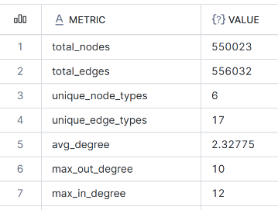
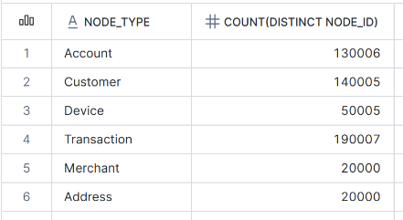
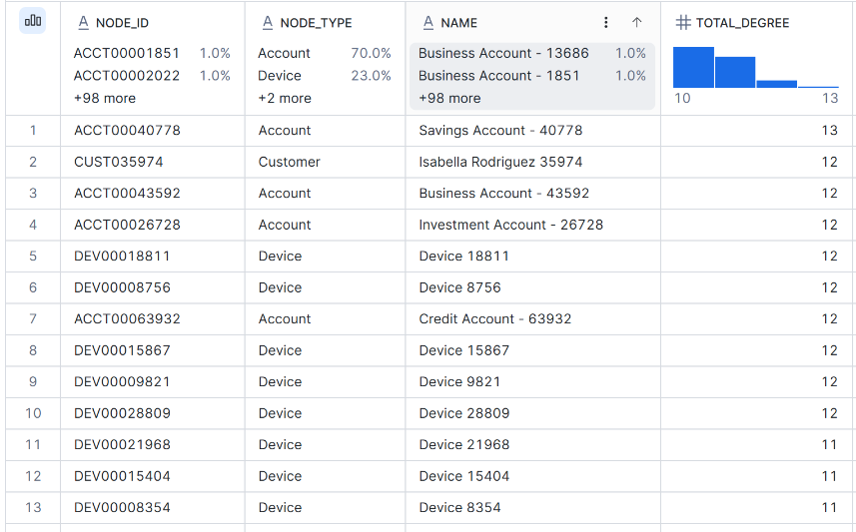
Snowflake – Solution Stats
The code for the setup, semantic models and cortex agent is all available here → Snowflake ML, Agentic Framework - CTO Strategy and Architecture - Westpac Enterprise Confluence
Setup
high-degree nodes (potential hubs)
Capability
fan-out-detection → One customer account logs in or makes transactions from many different devices in a short time.
fan-in-detection → Many different customer accounts log in from the same device in a short time.
cycle-detection → A cycle means we start from one account or device, follow the connections (transactions or shared devices), and eventually come back to where we started. A 7-hop cycle detection means: check if such a loop exists within 7 steps (hops). A hop can be Account → Device (login) , Device → Account (login), Account → Account (transaction)
deep-traversal → The maximum number of steps (or “hops”) you can take from your starting point. Start at one node (e.g., a specific customer). Follow connections to related nodes (e.g., their accounts → transactions → devices → other accounts → other customers). Keep going up to 10 steps away from the starting point. Collect all the nodes and relationships you find along the way.
ponzi-detection → A Ponzi scheme is a type of fraud where money from customers is used to pay other customers but based on - Same devices or IP addresses being used for multiple accounts. Circular transactions — money going in a loop between a group of accounts.
cluster-detection → Cluster detection (or clustering) is a way to group similar things together without being told exactly what the groups should be. We used clustering to look at customer data — for example: Transactions: how often money came in and out. Devices: phone, laptop, tablet, location, IP address, etc.
shared-device-network-detection → Customers using same device - min 2 and network size – 3 / same device - min 3 and network size – 5
synthetic-identity-detection → 100K transactions with realistic fraud patterns Transaction time: Most between 6 AM - 11 PM, but suspicious ones often at odd hours Amount: Fraudulent tend to be higher, but add noise Merchant: Suspicious transactions use uncommon merchants more often Location: Suspicious transactions more likely in risky locations
temporal-window → A temporal window (also called a time window or sliding window) → a fixed or variable time span over which we collect and process data points. Aim is to focus on a subset of data in a given time range rather than the entire dataset. We are doing this via Ontology semantics as our data points have start and end effective dates.

Slide 6
Snowflake – POC Findings
The code for the setup, semantic models and cortex agent is all available here → Snowflake ML, Agentic Framework - CTO Strategy and Architecture - Westpac Enterprise Confluence
Procedure Name *** | Executions | Avg Time (s) | Min Time (s) | Max Time (s) | Credits Consumed
FAN-IN ACROSS ALL NODE TYPES, THRESHOLD = 1,3,5,7 | 5 | 5.36 | 1.82 | 18.41 | 0.0002
FAN-OUT ACROSS ALL NODE TYPES, THRESHOLD = 3 | 4 | 1.634 | 1.019 | 2.684 | 0.000401
CLUSTER_DETECTION 300k + MIN_CLUSTER_SIZE = 3 | 1 | 15.992 | 15.992 | 15.992 | 0.000046
CLUSTER_DETECTION_OPTIMIZED 500k + MIN_CLUSTER_SIZE = 3 | 2 | 5.86 | 4.93 | 6.78 | 0.0001
DEEP_TRAVERSAL CUSTOMER - 10*HOPS | 1 | 8.829 | 8.829 | 8.829 | 0.000181
DEEP_TRAVERSAL_OPTIMIZED CUSTOMER - 10*HOPS | 3 | 11.883 | 4.697 | 16.386 | 0.000112
SHARED_DEVICE_NETWORK_DETECTION MIN_SHARED_USERS / MIN_NETWORK_SIZE = (2,3) MIN_SHARED_USERS / MIN_NETWORK_SIZE = (3,5) | 2 | 3.24 | 2.75 | 3.74 | 0.0001
*** Each credit has a multiplication factor of 4.73 (costs in USD)
Each procedure can be dynamically invoked with a feature output table name, threshold/hops and node / edge types as parameters (as applicable)
Costing → Production stats for DATA INGRESS (IN PRODUCTION)
One-Off data load - Time taken – 9 hrs
31 mil customers + 42mil accounts + Other data = 500GB + Transactions (13 months of txn) = ~30TB <~ 38M / day>
Cost = $5K USD (one-off) based on 1*4XL
Daily workload – 3 hr
31 mil customers + 42mil accounts + Other data = 500GB + <daily full load of cust and account> + Transactions (~38mil txn)
Cost = $20 K / Yr USD based on 1*M
-------------------------------------------------------------------------------------------------------------------------------------------------------------------------------------------------------------------------------------------------------------------------------------
Costing → Production stats for DATA ANALYSIS / MODEL EXECUTION (NOT IN PRODUCTION YET)
Cost = USD $310K / yr (80 models using data above)
Breakdown
Feature Engineering - credit 17,676
ML Training (HIGHMEM_X64_L - compute pool) - credit 7,856
ML Inference - credit 35,352
ML Evaluation & Observability on 80 models - credit 4,419
All credits add up to ~65,300 *4.73
Costings have been reviewed and released by vendor

Slide 7
Recommendation
Implementation on SNOWFLAKE
Snowflake
Warrants FILE STORAGE – ADLS, S3, GCS SNOWFLAKE EXTERNAL VOLUME AND STORAGE INTEGRATION SNOWFLAKE GRAPH, GRAPHRAG, ONTOLOGY SETUP – ALL NATIVE UI → COULD BE UNIFIED VIA SNOWFLAKE WEB APP, CUSTOM UI ON MESH / K8 (SPCS / AKS) LEVERAGE SNOWFLAKE NATIVE GRAPH, GRAPHRAG AND ONTOLOGY CAPABILITIES TO REDUCE COMPLEX INTEGARTION BETWEEN MULTIPLE SOLUTION STACKS, DATA HOPS, FAILURE POINTS, SEPRATE ACCESS FOR DATA TO MODELS, FEATURE STORE INTEGRATION OPEX SAVING (SAVES US FROM STANDING AND STITCHING UP MULTIPLE SOLUTION COMPONENTS)
Justification
Implement the solution within Snowflake where all data is already integrated in Production via daily automated jobs.
Financial crime Snowflake is already implemented with all the capabilities needed for this solution to be implemented.
Saves integration, compute, storage, operational overheads which come with stitching individual technology components together.
Costs are baked into each of the platform solutions already put in place.
  FCSAI → Financial Crime setup (with ADLS integrations) and majority of data already provisioned and end-to-end automated.
  NGM Standard Transaction Monitoring → ML models and costing for all data that is already provisioned as an end-to-end automated solution via FCSAI.
The solution works natively within the Snowflake ecosystem with no need to provision additional dedicated infrastructure, define new / amend existing integration patterns or raise concerns about network impacts (as supposed to solution'd independently needing integration / network traversals).
The downstream systems within Financial Crime are already integrated to Snowflake and separate POCs have been done at various timeframes to test the integration and respective consumption patterns with the outcomes being viable and performant.
As the data execution runs and features are stored as Snowflake Tables, Internal Sharing pattern can be enabled for downstream consumption for Non-Financial Crime tenants on Snowflake.
If needed, the features / outputs can also be exported to a Parquet file and shipped to downstream systems via EBIP
ML Platform
DATA
SNOWFLAKE
MESH UI /
UI ON K8
SF APP RUNTIME / SPCS
ADLS / S3 /
GCS
POC - NGM Standard FACE-AML TO Snowflake ML - CTO Strategy and Architecture - Westpac Enterprise Confluence

Slide 8
Appendix
GRAPH, GRAPHRAG, ONTOLOGY, AGENTS, MCP

Slide 9
Solution
CUSTOM BUILT - GRAPH, GRAPHRAG, ONTOLOGY

Slide 10
GRAPH – Storage, Retrieval
Custom Built
Graph database stores data by relationships natively along side entities there by avoiding need for expensive / complex joins / indexed lookups at runtime (INDEX FREE ADJENCY) CONCEPT → https://confluence.srv.westpac.com.au/display/AIA/Graphs+DBs+for+Knowledge+Graphs+for+GraphRAG+pattern PAPER BASED ASSESSMENT → Vector Stores - Selection & Assessment - AI Services - Westpac Enterprise Confluence & Knowledge Graphs Assessment - AI Services - Westpac Enterprise Confluence ASSESSMENT → Fraud Graph — Benchmark Dashboard POC (NEO4J VS TIGER GRAPH) → Graph, GraphRAG - Analytics - CTO Strategy and Architecture - Westpac Enterprise Confluence
NEO4j Node, Edge, Property (key-value) | TigerGraph Vertex, Edge, Property
Storage Records use specialised fixed sizes binary files for storage; the DB calculates a record’s exact position on disk using its ID Node.db → Raw NODEs Relationship.db → EDGE Records Properties.db → Key-Value pair (name, email, address etc) Labels.db → Categories / Types (User, Product, Device etc) Query EXECUTION Every record inside NODE / RELATIONSHIP is fixed and same size, so when a data is requested Say NODEID #150, the DB just does Size*150 and reaches the exact record in the file. JOINS Lookup happens as above say for Customer – “abc pty ltd” (in Node.db) This node contains the exact byte address for the first edge (in Relationship.db) The edge record contains the exact byte address for the next node This is how things are chained together | Storage → Native Parallel Graph Rather that static fixed size lines in file, it treats every single vertex (node) and edge as active, parallel storage and computational unit. 3 Tier storage → RAM, CPU, DISK Storage layers Partitions → Segments concepts (Data grouping works on Vertex type for data locality) For a RECORD , ID MAPPING → [EXTERNALID] [INTERNALID] VERTEX STORE → [INTERNALID] [ATTRIBUTES / PROPERTIES] EDGE STORE → [TARGETID] [TARGETID] [EDGE PROPERTIES] Query BIDIRECTIONAL ID MAPPING When data is loaded, it converts data attributes to internal compact ID. This Id maps directly to the array slot in memory COLOCATED VERTEX DATA Attributes / Properties are stored right along side the vertex in the same memory allocation. Old graphs are stored in separate files with Pointer references. These too are stored along side the node SEGMENTED EDGE DATA EDGEs are partitioned by Source & Internal ID. EDGE attributes are directly collocated with destination targets Data Compression As everything is in RAM, it uses GSE (Graph Storage Engine) based compression scheme. 10X compression ratio. How → Tokenize repetitive strings, mapping ID to bit-vectors and strips out empty bytes. Distributed Sharding (auto partitioning) Auto distribution when graph becomes too large for a single machine and automatically distributes it to the cluster. VERTEX HASHING Vertex is assigned to specific machine based on ID EDGE DISTRIBUTION If 2 connected nodes are across different machines, the connection is established by duplicating the edge information across both machines OR we have an option to stream across network for linkages

Slide 11
GRAPH – Data Integration (Batch + Realtime)
Custom Built Batch ingestion in graph databases involves the insertion or updating of nodes and relationships in bulk. Realtime ingestion in graph databases involves capturing streaming data from sources such as Kafka, MQTT, or webhooks and updating the graph .
NEO4j Node, Edge, Property (key-value) CSV -> APOC iterate -> MERGE -> Update properties | TigerGraph Vertex, Edge, Property CSV -> GSQL loading job -> Upsert -> Parallel bulk insertion
BATCH LOAD CSV MERGE ensures idempotent updates—nodes/relationships are created if they do not exist, otherwise updated. For very large datasets, Neo4j’s neo4j-admin import tool is recommended for initial imports (offline batch import). // Load nodes from CSV LOAD CSV WITH HEADERS FROM 'file:///nodes.csv' AS row MERGE (n:Customer {id: row.id}) SET n.name = row.name; // Load relationships from CSV LOAD CSV WITH HEADERS FROM 'file:///relationships.csv' AS row MATCH (a:Customer {id: row.source_id}), (b:Account {id: row.target_id}) MERGE (a)-[r:CUST_OWNS_PRODUCT]->(b) SET r.since = row.since; APOC PROCEDURES apoc.periodic.iterate helps process large CSVs in batches, improving memory management and performance. CALL apoc.periodic.iterate( "LOAD CSV WITH HEADERS FROM 'file:///nodes.csv' AS row RETURN row", "MERGE (n:Customer {id: row.id}) SET n.name = row.name", {batchSize:1000, parallel:true}) REAL TIME Kafka Streams, APOC triggers Stream Data via Kafka: Neo4j has an official Neo4j Streams plugin for Kafka integration. This allows consumption of real-time events and apply them as graph updates. Cypher Updates: Incoming messages can trigger MERGE or CREATE Cypher queries to update nodes and relationships. Neo4j Aura or Enterprise: Use the transactional API for real-time performance; transactions ensure consistency during updates. | BATCH TigerGraph is optimized for high-velocity and low-latency updates and provides GSQL and Loading Jobs: LOADING JOB - GSQL TigerGraph’s loading jobs allow for upserts: existing nodes are updated, and new nodes are inserted. CREATE LOADING JOB loadPersonJob FOR GRAPH MyGraph { DEFINE FILENAME dataFile; LOAD dataFile TO VERTEX Person VALUES ($"id", $"name") USING SEPARATOR=","; }RUN LOADING JOB loadPersonJob USING dataFile="person.csv"; BULD EDGE INGESTION Supports parallel loading for large datasets, and updating edge properties efficiently. CREATE LOADING JOB loadFriendshipJob FOR GRAPH MyGraph { DEFINE FILENAME relFile; LOAD relFile TO EDGE FRIENDS_WITH VALUES ($"source_id", $"target_id", $"since") USING SEPARATOR=","; }RUN LOADING JOB loadFriendshipJob USING relFile="relationships.csv"; REAL TIME Stream Loading Jobs, REST++ TigerGraph is optimized for high-velocity graph ingestion and supports GSQL streaming jobs and REST++ endpoints: Stream Loading Jobs: Define STREAM jobs to continuously ingest data, similar to Kafka-to-TigerGraph pipelines. UPSERT Semantics: TigerGraph allows UPSERT operations (create-or-update nodes/edges) natively. Parallelism: Supports multi-threaded edges and node updates on large graphs, typically performing better than Neo4j for very large real-time workloads.
EXEC Summary For Neo4j, use MERGE with apoc.periodic.iterate for incremental updates to avoid duplicates. For TigerGraph, leverage GSQL loading jobs, enabling scalable upserts and parallel processing. For very large graphs initially, Neo4j may need neo4j-admin import, while TigerGraph can handle bulk batch ingestion natively.

Slide 12
GRAPH – Data Integration (Realtime)
Custom Built Realtime ingestion in graph databases involves capturing streaming data from sources such as Kafka, MQTT, or webhooks and updating the graph .
NEO4j Node, Edge, Property (key-value) | TigerGraph Vertex, Edge, Property
REAL TIME DATA INGESTION → Kafka Streams, APOC triggers # Language: Python from neo4j import GraphDatabase from kafka import KafkaConsumer import json # Connect to Neo4j uri = "bolt://localhost:7687" driver = GraphDatabase.driver(uri, auth=("neo4j", "password")) def update_graph(tx, user_id, action): tx.run("MERGE (u:User {id: $user_id}) " "SET u.last_action = $action", user_id=user_id, action=action) # Kafka consumer consumer = KafkaConsumer( 'user-actions’, bootstrap_servers=['localhost:9092'], value_deserializer=lambda m: json.loads(m.decode('utf-8'))) for message in consumer: data = message.value with driver.session() as session: session.write_transaction(update_graph, data["user_id"], data["action"]) KafkaConsumer listens for real-time messages. Neo4j MERGE ensures nodes are created if they do not exist. write_transaction updates the graph with new data as it arrives. Note → Webhooks Use Python, Flask (simple webhook listener) | REAL TIME Stream Loading Jobs, REST++ # Python example for TigerGraph REST API import requests import json TG_REST_URL = "http://localhost:9000" TOKEN = "YOUR_TOKEN_HERE" GRAPH = "MyGraph" def add_or_update_vertex(user_id, action): url = f"{TG_REST_URL}/graph/{GRAPH}/vertices/User/{user_id}" payload = { "attributes": {"last_action": action} } headers = {"Authorization": f"Bearer {TOKEN}"} response = requests.post(url, json=payload, headers=headers) print(response.json()) # Simulated Kafka listener from kafka import KafkaConsumer consumer = KafkaConsumer('user-actions', bootstrap_servers=['localhost:9092'], value_deserializer=lambda m: json.loads(m.decode('utf-8'))) for message in consumer: data = message.value add_or_update_vertex(data["user_id"], data["action"]) Use TigerGraph REST API or built-in streaming/Kafka ingestion features. Note → Webhooks TigerGraph can expose REST endpoints or GraphStudio REST queries to receive webhook POSTs. Incoming webhook JSON payloads can be mapped to vertex or edge insert/update operations via POST /graph/{graph}/vertices or /edges.
EXEC Summary Neo4j: Use Neo4j Python Driver with Kafka or MQTT consumers for dynamic graph updates. TigerGraph: Use TigerGraph REST API or built-in streaming/Kafka ingestion features. Both platforms support real-time updates, enabling seamless modification of nodes and edges by listening to streaming data sources or webhooks.

Slide 13
GRAPH – Data Science
Custom Built
NEO4j | TigerGraph
Graph Data Science (GDS) library The GDS library provides a wide range of graph algorithms categorized into problem classes such as centrality, community detection, similarity, pathfinding, and more. These algorithms are accessible via Cypher procedures, making them easy to integrate into existing Neo4j workflows. It supports graph projections, allowing users to create in-memory representations of their graph data for efficient computation. Additionally, GDS includes tools for node embeddings, topological link prediction, and the Pregel API for custom algorithm development. | Instead of a separate plug-in library, TigerGraph embeds its graph analytics and machine learning capabilities directly into its native parallel processing engine using GSQL. TigerGraph Algorithm Capabilities (GDS Equivalent) Graph Data Science Library: TigerGraph provides a library of pre-built, optimized algorithms in GSQL for graph analytics, including PageRank, Community Detection (Louvain), Connected Components, and Shortest Path. Parallel Execution: TigerGraph's strength is its ability to run these algorithms in parallel across a distributed cluster, designed for massive datasets and deep (multi-hop) traversals. Machine Learning (GraphRAG/GNN):TigerGraph supports Graph Machine Learning, including Graph Neural Networks (GNNs) and GraphRAG (Retrieval-Augmented Generation) to incorporate graph structure into AI models. TigerVector: As of v4.2, TigerGraph supports native vector search, enabling advanced vector similarity searches for RAG, which can outperform specialized vector databases.
Conclusion
TigerGraph is generally cheaper to run than Neo4j for large-scale, high-performance, and deeply connected datasets.
While Neo4j is often easier to start with for small projects, TigerGraph’s superior performance and higher compression efficiency can result in significantly lower infrastructure costs (up to 77% less in some case studies) when dealing with massive data volumes.
Here is a breakdown of the cost comparison between TigerGraph and Neo4j:
Storage and Infrastructure Costs (Efficiency Advantage)
  Storage Efficiency: TigerGraph is more storage-efficient, often requiring 10x to 19x less storage space than Neo4j. This drastically reduces the cost of memory (RAM) and disk space, which are the main cost drivers for large graphs.
  Performance Scaling: Because TigerGraph uses a native parallel graph engine, it can process complex queries (deep queries involving 3+ hops) faster than Neo4j, avoiding the need for excessively large, costly infrastructure to handle complex queries.
  Real-world Savings: A case study showed that for large-scale enterprise use cases, TigerGraph provided a 77% reduction in infrastructure costs compared to competitors.
Pricing Models
  TigerGraph: Generally priced based on the volume of data stored rather than just query performance or hardware size, although they do offer a "pay-as-you-go" hourly model. It provides a generous free tier (300GB) for development, which is quite competitive for early-stage evaluation.
  Neo4j: Often viewed as cheaper for small-to-medium-sized projects with its easy-to-use AuraDB cloud service. However, as the graph grows to a terabyte-scale, its licensing (Enterprise Edition) and infrastructure costs can become high.
Total Cost of Ownership (TCO) Factors
  Learning Curve: GSQL (TigerGraph's query language) has a steeper learning curve (4–8 weeks for proficiency) than Cypher (Neo4j), which might increase initial development personnel costs.
  Development Speed: Neo4j is generally considered easier to set up, faster to start with, and has a larger developer community, which can make it cheaper for rapid prototyping and smaller, less complex projects.

Slide 14
ONTOLOGY
MAP SEMANTIC DEFINITIONS TO EXISTING DATA SOURCES (DATABASE, APIs etc) & QUERY THEM USING STANDARD OPEN-SOURCE SEMANTIC WEB TECHNOLOGY / GRAPH DB
1. Define Ontology (Schema – core entity <classes>, relationship, attributes)
2. Semantic Web & Linked Data (W3C Standards)
This is the most formal and widely accepted method for sharing structured data across systems.
RDF (Resource Description Framework): Represents data as simple subject-predicate-object statements (triples).
OWL (Web Ontology Language): Adds massive logical reasoning capabilities to RDF, allowing systems to infer new information from explicitly defined rules.
SPARQL: The standard query language used to extract and manipulate data from RDF stores.
TURTLE <Terse RDF Triple Language>: compact, human-readable syntax for expressing RDF graphs. It represents data as triples — each consisting of a subject, predicate, and object — and supports abbreviations to reduce repetition.
OTHERS → JSON-LD, Python – rdflib , owlready2
How to use: design the ontology visually or programmatically using editors and then host it on a triplestore (e.g., GraphDB).
3. Knowledge Graphs & Graph Databases
Ideal for integrating mixed data formats (structured and unstructured) and powering semantic search and AI applications.
Labeled Property Graphs (LPGs): Stores nodes (entities) and edges (relationships) while allowing to attach properties (attributes) directly to those connections.
How to use: build an ontology schema and drive data ingestion using graph databases. Query relationships directly using languages like Cypher or GQL.
4. Enterprise Platforms & Data Catalogs
Many modern organizations implement ontologies to unify disparate databases, track data lineage, and build operational workflows.
Domain-Driven Modeling: Focuses on mapping real-world business objects rather than system-specific databases.
Data Binding: Direct mapping of unstructured text and structured tables to the conceptual ontology layer.
How to use: leverage Platforms that provide built-in Ontology Managers where we define object types, map physical data sources to them, and expose the semantic layer for Human or AI-driven workflows.
5. Lightweight Taxonomies and Vocabularies
SKOS (Simple Knowledge Organization System): Built to encode classifications and thesauri, defining relationships like "broader than" or "narrower than"
Key considerations
Ontologies are critical if we are going to build agents which need to accurately understand concepts, relationships and rules
Difficulty with building Ontologies are they take a lot of effort to construct. Notations such as OWL/RDF are difficult to learn and construct native. However, when constructed they offer major benefits.
When we create an ontology, we model the data, information, knowledge and process. Notations such as OWL/RDF do not represent rules and process well, and we have to produce our own convention. Also, tools in the industry vary on how they represent rules and process . eg. Neoj4 does not represent rules in their tool and queries
Challenge for us as an organisation is how to rapidly enable the business/technology to construct ontologies from their material (eg. policies and requirements) and how we can easily embed in agents, etc.
Also need to think about how ontologies can be used for different purposes - and how as a model they can be deployed in a connected or disconnect mode.

Slide 15
ONTOLOGY – Approach
TOP-DOWN Vs BOTTOM-UP methodologies
________________________________________________________________________
Use Case 1: Automated Fraud & Anti-Money Laundering (AML) Detection
Fraud and AML detection rely heavily on uncovering hidden connections, tracking transaction chains, and verifying complex regulatory compliance rules.
TOP-DOWN APPROACH (Recommended) BOTTOM-UP APPROACH
Global Risk & Compliance Laws Core Transaction & Entity Data
│ │
▼ ▼
Define abstract risk typologies Ingest raw event logs & transfers
(e.g., "Structuring", "Layering") (e.g., wire_id, swift_code)
│ │
▼ ▼
Enforce consistent structural rules Identify high-risk patterns on the fly
Why Top-Down Wins: AML requires strict regulatory consistency. A top-down approach lets model abstract risk behaviour's (like "Structuring" or "Layering") based on legal definitions before mapping them to actual data. This ensures logical rules catch suspicious paths universally, regardless of which local branch processed the transfer.
The Bottom-Up Risk: If we build bottom-up from local branch transaction logs, we will inherit fragmented data definitions. A wire transfer in Europe might use different database fields than a wire transfer in Asia, leaving blind spots where fraud patterns can slip through unnoticed.
______________________________________________________
Use Case 2: Centralising a 360-Degree Customer View
This use case focuses on data integration: breaking down corporate silos to unify retail accounts, credit cards, mortgages, and CRM data into a single profile.
TOP-DOWN APPROACH BOTTOM-UP APPROACH (Recommended)
Universal "Legal Entity" Rules Existing Siloed Production DBs
│ │
▼ ▼
Rigid master schema constraints Map & match existing system keys
(Can stall project for months) (e.g., CreditCard_DB ID == Checking_DB ID)
│ │
▼ ▼
Theoretical customer profile Unified, operational Customer View
Why Bottom-Up Wins: Bank already possesses the customer data across dozens of active databases. A bottom-up approach allows to harvest these existing schemas, instantly resolve identity matches (e.g., confirming Checking_Acct.Holder is the same person as Credit_Card.User), and generate immediate business value.
The Top-Down Risk: Starting top-down forces into endless corporate alignment meetings trying to define the perfect, universal concept of a "Customer" or "Account" across retail, commercial, and wealth management divisions, frequently stalling the project before any code is written.
___________________________________________________________
Use Case 3: Powering an LLM Financial Advisor (GraphRAG)
This architecture connects ontology to an AI pipeline so a Large Language Model can accurately reason over complex financial advice, product terms, and customer financial goals.
MIDDLE-OUT APPROACH (The Ideal Hybrid)
High-Level Frameworks
(e.g., Regulations)
▲
│
┌──────────────────────────────────────┐
│ Core Conversational Nouns (The Middle) │
│ (e.g., Investment Product, Financial Goal) │
└──────────────────────────────────────┘
│
▼
Siloed Product Data
(e.g., PDF Terms, Interest Rates)
Why Middle-Out Wins: An LLM interacts using natural, human concepts. Start in the middle by modeling the exact conversational nouns clients use (e.g., FinancialGoal, InvestmentProduct, InterestRate).
Extending the Hierarchy: Look Down (Bottom-Up) to ingest the concrete data the LLM needs to reference, such as product disclosure PDF texts, current interest rate tables, and fee schedules.
Look Up (Top-Down) to attach regulatory guardrails (e.g., ensuring an investment product node is logically linked to a strict RiskSuitabilityTier compliance concept) to prevent the LLM from hallucinating unsafe financial advice.

Slide 16
ONTOLOGY - LLM
To connect an ontology to an AI or Large Language Model (LLM) retrieval pipeline for reasoning, uild a Knowledge Graph-Enhanced RAG (GraphRAG) .
This architecture replaces standard vector search with structured semantic context, eliminating hallucinations and enabling multi-hop logical reasoning
1. Vectorise and Index the Ontology
To make ontology searchable by an LLM, index both its unstructured text and its structured semantic relationships.
Hybrid Embedding: Generate text embeddings for entity names, descriptions, and properties.
Graph Embedding: Use algorithms like Node2Vec to convert structural connections and hierarchy paths into mathematical vectors.
Vector Store Integration: Store these vectors in databases that support both graph queries and vector searches.
2. Extract Entities from the User Query
When a user asks a question, the pipeline must identify which parts of the text match ontology.
Named Entity Recognition (NER): Use lightweight models or LLM prompting to extract key entities, attributes, and relationships from the prompt.
Entity Linking: Map the extracted words directly to the unique resource identifiers (URIs) or node IDs inside ontology to resolve ambiguity (e.g., matching "Apple" to the fruit vs. the tech company).
3. Retrieve Context via Graph Traversal
Instead of retrieving isolated text snippets, pull an interconnected subgraph based on the matched entities.
Multi-Hop Retrieval: Look up the target node and fetch all connected entities within 1 to 3 degrees of separation (e.g., Entity A → controls → Entity B → manufactures → Product C).
Rule-Based Inferencing: Use a semantic reasoner to execute OWL logical rules before the LLM sees the data, creating new explicit facts from implicit relationships.
4. Construct the Graph-Augmented Prompt
Convert the retrieved structured data into a natural language format that the LLM can easily read and reason against.
Serialization: Convert the retrieved triples or paths into structured strings, Markdown tables, or declarative sentences (e.g., Convert (CustomerA, owns, AccountB) into " CustomerA owns AccountB").
System Prompting: Instruct the LLM to use only the provided ontological facts to deduce its final answer.
[System Prompt]:
You are a logical reasoning assistant. Use the verified facts below to answer the user's question. Do not assume facts outside this context.
[Ontology Facts]:
- Customer_1 has_product Loan.
- Loan has_offset_account_for_savings.
- Loan has_loanaccount_with_balance_1M.
- Loan with_balance_1M includes offset_saving.
[User Question]:
Can we give offset_saving to Customer_1?
5. Generate and Validate the Response
The LLM processes the facts, executes the final reasoning step, and delivers the answer.
Deterministic Reasoning: The LLM easily concludes: Yes, because Customer_1 has a 1M loan.
Fact-Checking Loop: Use the ontology to validate the LLM's output. If the LLM generates a response claiming a relationship that explicitly violates ontology rules, flag or block the output.

Slide 17
Solution
GRPAH DB - ONTOLOGY

Slide 18
ONTOLOGY – Graph DB
Implementing OWL ontology on GraphDB requires translating OWL’s logical construct to strict type property graph.
Graph DBs CANNOT natively parse OWL files.
How we can implement Ontology on Graph DB
RUNTIME QUERY
  Cypher for Neo4j, GSQL for TigerGraph etc
SEPRATE STANDALONE PROCESS
  GRPAH SCHEMA MAPPING
    OWL translation to Graph DB
  PRE-COMPUTE
    Restrictions / Inference Rules
Tiger Graph Neo4j
Steps on implementation
Translate OWL classes, properties and restrictions into TG schema
  Vertex, Edge, Attributes
    OWL CLASS → TG VERTEX (multi-level hierarchies <implemented via VERTEX Inheritance>)
    CREATE VERTEX
    OWL PROPERTIES → TG EDGE
    CREATE DIRECTED EDGE
    OWL RESTRICTIONS → enforced via GSQL Constraints
      Use GSQL constraints
      Use pre-processing
      Transitive OR Symmetric properties rules
      Customer A uses Device X to fund Account B, then CustA is linked to AccB
      Account A can only have Y linked Customers where each Customer has 1 device registered
Parsing to flatten the data leveraging
  OWLAPLY (PYTHON)
  OWLAPI (JAVA)
Load data using GSQL
CREATE GRAPH <NAME> (VERTEX, EDGE)
OWL Axioms to Property Graph Implementation
Must be written explicitly → hasValues , FunctionalProperty
Neosemantics -Importing RDF/OWL data into Neo4j, automatically converting classes, individuals, and properties into nodes and relationships, while retaining semantic meaning.
External Reasoner (like HermiT or Pellet) -
Materialize inferred edges before storing them in Neo4j.

Slide 19
Solution
SNOWFLAKE - GRAPH, GRAPHRAG, ONTOLOGY

Slide 20
SNOWFLAKE
Snowflake has a structured layered approach for solving for Graph & Ontology features.
Physical Storage – Raw data into KG_NODE & KG_EDGE tables
Ontology Metadata – Define YAMLs with class hierarchy, synonyms and business definition on data
Views – Auto generated dynamic semantic views for Cortex Agents to query
Note
Snowflake’s implementation DOES NOT USE traditional semantic web framework like RDF (Resource Description Framework), OWL (Web Ontology Language), TURTLE OR N-TRIPLES
Snowflake has NO NATIVE graph database or graph algorithms at all; we rely on Neo4j's native app (65+ algorithms) or RelationalAI for graph analytics.
All the neo4j ones and RelationalAI ones are available to use within Snowflake context ****
If we still want to use the standard frameworks
WE MUST CREATE A PYTHON STORED PROCEDURE USING (RDFLIB) + (.OWL, .RDF, .TTL / .NT) WHICH FLATENS THE COMPLEX SCHEMAS AND DOES THE EXTRACTION OF CLASS HIERARCHY AND LOADS KG_NODE AND KG_EDGE TABLES.
  Steps for Implementation
    Create internal stage to host the ontology files (.OWL, .RDF, .TTL / .NT)
    Use the ontology-stack-builder skill and this ends up doing all the heavy lifting for ingestion and processing.
      It will end up writing a Python code for us which refers to the ontology file saved on internal stage and uses RDFLIB to automatically read / update graph structure and generates / extracts
        Class hierarchies (subclass, ancestor-descendant rules etc)
        Object Properties (domain, range, inverse relationship etc)
        Individual entities (concrete data entities)
    The above process does the parsing of incoming data and normalises graph facts and loads them to KG_NODE and KG_EDGE tables
ONCE THE DATA IS IN KG_NODE & KG_EDGE TABLES (either via Custom Ingestion Procedure OR standard industry frameworks), THE ONTOLOGY EXECUTION, FEATURE GENERATION, CORTEX AGENT FOR QUERYING THE DATA – THIS PART OF THE IMPLEMENTATION IS THE SAME.
It is NOT MANDATORY to use an OWL (Web Ontology Language) framework in Snowflake.
While we can import and parse OWL files into Snowflake, the modern standard for implementing enterprise ontologies natively in the platform relies on relational tables and semantic views rather than traditional semantic web frameworks.
Snowflake allows to operationalize existing OWL definitions by parsing them (e.g., via Python libraries like rdflib) and simply loading the extracted classifications and properties into Snowflake's native node-edge structures.
Separate Slide shows how “THIS” can be implemented.
****
For enablement and implementation of Graph (Neo4j) and GraphRAG (RelationalAI) capabilities within Snowflake, kindly refer → Snowflake ML, Agentic Framework - CTO Strategy and Architecture - Westpac Enterprise Confluence

Slide 21
SNOWFLAKE – Data Flow
DATA FLOW
Snowflake managed iceberg tables
Snowflake Stored Procedure + Tables + Views
Snowflake Stored Procedure + Tables + Views
Cortex Agent & Analyst
Source of Truth
OR
System of
Record
BATCH – SP BASED FRAMEWORK (LIVE IN PROD)
FINANCIAL CRIME
SNOWFLAKE
RT – KAFKA SINK CONNECTOR
FUTURE (Snowflake DataStream. This is a native Snowflake offering and does away with Kafka sink connector and auth stuffs. It is currently in Private Preview )
2
3
4
STORAGE
FINCRIME SYNAPSE ADLS
PARQUET
Data Ingestion
ONTOLOGY PROCEDURES
FEATURE GENERATION PROCEDURES
CORTEX AGENTS
1
Data Ingestion – BATCH / REAL-TIME
Output
Data is written to a Snowflake Managed Iceberg table backed by data stored in ADLS G2 (WBC AZURE ELZ) → KG_NODE AND KG_EDGE AND OTHER BASE TABLES ARE POPULATED WITH DATA.
2
Ontology updates via Inference Procedures
Output
ONT_* TABLES ARE POPULATED
3
Feature Generation based on #1 and #2
Output
FEATURE TABLES ARE POPULATED (FAN_IN, FAN_OUT, CLUSTER_ANALYSIS, PONZI_DETECTION, CYCLE_DETECTION, SHARED_DEVICE_NETWORK etc)
4
Cortex Agents & Analyst
Output
NLP based querying to the data (We can have the agent query data created under 1,2,3)
ALL THE FLOWS CAN BE CHAINED TOGETHER LEVERAGING SNOWFLAKE TASKS
ALL DETAILS AROUND EACH STEP AND HOW IT EXECUTES IS CAPTURED IN THE NEXT SLIDES

Slide 22
SNOWFLAKE - Solution
Snowflake ML, Agentic Framework - CTO Strategy and Architecture - Westpac Enterprise Confluence
1
STORED
PROCEDUREs
2
STREAMS
3
DATA
NODE,
EDGE,
VIEWS
TASKS
ONTOLOGY
UPDATES
TABLEs / VIEWs
STORED PRODCEDUREs
4
THESE STEPS ARE THE SAME IRRESPECTIVE OF HOW THE DATA IS LOADED INTO NODE & EDGE TABLES
STREAM
  Kafka Sink Connector
  OR
  Snowflake DataStream. This is a native Snowflake offering and does away with Kafka sink connector and auth stuffs. It is currently in Private Preview
BATCH
  Stored Procedure based ingestion
CORTEX AGENT & ANALYST
USE ROLE ACCOUNTADMIN;
GRANT EXECUTE TASK ON ACCOUNT TO ROLE SFLK_GBU_A01A0E_DEVELOPER_DEV;
-- Grant EXECUTE MANAGED TASK as well (required for serverless tasks)
GRANT EXECUTE MANAGED TASK ON ACCOUNT TO ROLE SFLK_GBU_A01A0E_DEVELOPER_DEV;
4) Schema Validation
LEVERAGING SEMATIC MODEL “.YML” FILES FOR IT
+
Run Governance and Exception Handling
LEVERAGING SEMATIC MODEL “.YML” FILES FOR IT & SP CORRESPONDING TO EACH
One-Off data load - Time taken – 9 hrs
31 mil customers
42mil accounts
Other data = 500GB
Transactions (13 months of txn) = ~30TB <~ 38M / day>
Cost = $5K USD (one-off)
based on 1*4XL
Daily workload – 3 hr
31 mil customers
42mil accounts
Other data = 500GB
<daily full load of cust and account>
Transactions (~38mil txn)
Cost = $20 K / Yr USD
based on 1*M
Python based procedure to ingest data into KG_NODE & KG_EDGE tables
Snowflake Stream for CDC on #1
CREATE OR REPLACE STREAM node_changes_stream ON TABLE KG_NODE
CREATE OR REPLACE STREAM edge_changes_stream ON TABLE KG_EDGE
Tasks
CREATE OR REPLACE TASK tsk_automate_ontology
WAREHOUSE = “”
SCHEDULE = ‘’
WHEN SYSTEM$STREAM_HAS_DATE(‘node_changes_stream’) OR SYSTEM$STREAM_HAS_DATE(‘edge_changes_stream’)
AS
CALL (SP_<ONTOLOGY_PROCEDURES>)
--tasks are created in suspended state and need activation
ALTER TASK tsk_automate_ontology RESUME

Slide 23
SNOWFLAKE - Solution Details
Snowflake ML, Agentic Framework - CTO Strategy and Architecture - Westpac Enterprise Confluence
SOLUTION FLOW
4
KNOWLEDGE GRAPH
(Concrete)
CORTEX AGENT
&
ANALYST
1
5
ONTOLOGY
SEMANTIC
(Abstract)
3
2
❄️ SNOWFLAKE
GENERATED
ONTOLOGY
VIEWS
(Dynamic)
ONTOLOGY
METADATA
(Config)
NODE TABLES
EDGE TABLES
VIEWS
METADATA
SEMANTIC
USERS
GRAPH
ANALYSTICS
(Algorithms)
Layer 1 — Physical Storage
Tables → KG_NODE <ENTITIES> & KG_EDGE <RELATIONSHIPS>
At this layer, Snowflake stores facts only — object instances and relationship instances. There is no abstraction, inheritance, or business meaning encoded here.
Layer 4 — Semantic Models
Tables → KG_NODE <ENTITIES> & KG_EDGE <RELATIONSHIPS>
Knowledge Graph, Ontology, Metadata, Graph Analytics
Layer 2 — Ontology Metadata: Declarative definitions of business meaning
Tables → ONT_CLASS, ONT_RELATIONSHIP_DEF, ONT_OBJECT_SOURCE
The ontology metadata layer defines what the data means, not how it is stored. Classes, hierarchies, and relationships are declared independently of physical tables.
Layer 5 — Cortex Agent
Orchestrates semantic models and graph analytics
Layer 3 — Generated Ontology Views: Dynamic abstraction and unification
Views → VW_ONT_REPRESENTATION
Ontology views are not hand-written SQL. They are compiled representations of the ontology, generated automatically from metadata and regenerated whenever the model changes.

Slide 24
Snowflake – Solution Layers
Ontology on Snowflake is delivered as an integrated, end-to-end capability across three parts
Layer 5 - Cortex Agent: Orchestrates semantic models and graph analytics tools
Layer 4 - Semantic Models: Knowledge Graph (concrete), Ontology (abstract), Metadata (introspection), Graph Analytics (algorithms)
Layer 3 - Generated Views: Auto-generated abstract views (VW_ONT_CUSTOMERS, VW_ONT_OWNS_PRODUCT)
Layer 2 - Ontology Metadata: Classes, relationships, properties, permissions, inference rules
Layer 1 - Physical Storage: KG_NODE (entities) + KG_EDGE (relationships)
Graph Features
Graph analytics are provided via Snowflake Container Services (SPCS) running with 5 tools:
LAYERS | CONCEPT | COMMENTS
1–3 | KG_NODE, KG_EDGE tables + ontology metadata + abstract views | An object–relationship foundation with ontology metadata that captures business meaning natively in Snowflake. Create KG_NODE and KG_EDGE tables, ontology metadata tables (ONT_CLASS, ONT_RELATION_DEF, etc.), and generated abstract views (VW_ONT_CUSTOMERS, VW_ONT_OWNS_PRODUCT).
4 | Specialized Cortex Analyst semantic models | Purpose-built semantic models optimized for concrete queries (Knowledge Graph Model), abstract reasoning (Ontology Model), and governance (Metadata & Governance Model).
5 | Cortex Agent + graph analytics tools | Intelligent agent orchestration with Cortex Agent, graph-powered reasoning via NetworkX, and natural-language interaction across all semantic models. Snowflake has NO NATIVE graph database or graph algorithms at all; we rely on Neo4j's native app (65+ algorithms) or RelationalAI for graph analytics. All the neo4j ones and RelationalAI ones are available to use within Snowflake context
TOOL | DESCRIPTION | ALGORITHM (not limited to the below – these ones have been tested by Architecture team)
graph_shortest_path | Find connection paths between entities | Dijkstra's algorithm
graph_centrality_analysis | Entity importance metrics | Betweenness, closeness, degree, eigenvector
graph_community_detection | Group identification | Louvain algorithm
graph_transfer_network_analysis | Player transfer patterns | Custom transfer analysis
graph_temporal_analysis | Network evolution over time | Time-series network metrics

Slide 25
Snowflake - Solution Objects
LAYER 1: PHYSICAL STORAGE LAYER
KG_NODE: Entity storage table → Stores all entities (customers, products, transactions, device etc) with flexible VARIANT properties
KG_EDGE: Relationship storage table → Stores all relationships between entities with temporal validity (effective start/end dates/relationship type etc)
LAYER 3: ENTITY VIEWS (Convenience Views) → Type-specific views over KG_NODE for easier querying
V_CUSTOMERS, V_PRODUCTS, V_TRANSACTIONS, V_DEVICE etc
LAYER 3: RELATIONSHIP VIEWS (Convenience Views) → Type-specific views over KG_EDGE for easier querying
V_CUSTPRODUCT_OWNED, V_CUSTTRANSACTIONS_DONE, V_CUSTDEVICE_OWNED, V_PRDCTTRANSACTIONS_DONE etc
LAYER 2: ONTOLOGY METADATA LAYER → Metadata tables that define the ontology structure
ONTOLOGY REGISTRY, OBJECT TYPE SOURCE MAPPINGS, CLASS DEFINITIONS (Object Types), RELATIONSHIP DEFINITIONS (Link Types), PROPERTY DEFINITIONS, INFERENCE RULES, DATA QUALITY CONSTRAINTS, ACTIONS (Operations), CLASS AND RELATIONSHIP MAPPINGS, INTERFACES (Polymorphism), FUNCTION CATALOG, OBJECT VIEWS (UI Configuration / Governance), PERMISSIONS AND ROLES, INFERRED EDGES
LAYER 3: ONTOLOGY VIEWS GENERATOR → Stored procedure to auto-generate abstract views from metadata
SP_GENERATE_ONTOLOGY_VIEWS → Generates abstract views from ONT_CLASS_MAP metadata
Generates abstract ontology views by reading metadata from ONT_CLASS and ONT_CLASS_MAP tables. For each abstract class, creates a UNION ALL view combining all concrete implementations.
INFERENCE AND CONSTRAINT PROCEDURES → Stored procedures for ontology inference and data quality
SP_INFER_TRANSITIVE → Computes transitive closure for a relationship
Computes transitive closure for a relationship type. If A->B and B->C via the same relationship, infers A->C.
SP_INFER_INVERSE → Creates inverse relationships
Creates inverse relationships based on ONT_RELATION_DEF.INVERSE_REL_NAME. If PRODUCT_OWNED has inverse HAS_CUSTOMER, creates HAS_CUSTOMER edges.
SP_RUN_ONTOLOGY_INFERENCE → Master procedure to run all enabled inference rules
Runs all enabled inference rules in the correct order.
SP_CHECK_CARDINALITY_SINGLE → Checks cardinality constraints (e.g., 1:1 relationships)
Checks that a relationship has at most one edge per source node. Records violations in ONT_CONSTRAINT_VIOLATION.
SP_CHECK_REFERENTIAL → Checks referential integrity (edges reference valid nodes)
Checks that all edge endpoints reference existing nodes. Records violations in ONT_CONSTRAINT_VIOLATION
LAYER 3: ABSTRACT VIEWS → Pre-built abstract views for the ontology layer
VW_ONT_CUSTOMERS - Abstract CUSTOMER View -- Unifies all CUSTOMER types
VW_ONT_PRODUCT - Abstract PRODUCT View -- Unifies all PRODUCT types
VW_ONT_TRANSACTIONS - Abstract TRANSACTIONS View -- Unifies all TRANSACTIONS types
REL_RESOLVED - Unified Relationship View -- Combines all concrete relationships with type resolution
VW_ONT_OWNS -- Abstract “ONWER" relationship -- Unifies CUSTOMER, PRODUCT, TRANSACTION relationships
VW_ONT_AFFILIATED_WITH - Abstract "affiliated with" relationship -- Unifies CUSTOMER AND PRODUCT relationships based on CUSTOMER RELATIONSHIP
ONT_CLASS_CLOSURE - Recursive closure of class hierarchy -- For finding all subtypes of an abstract class
SEED DATA: ONTOLOGY METADATA -- Populates the ontology metadata tables
ONTOLOGY REGISTRY, SHARED PROPERTIES -- Reusable property definitions across classes, ABSTRACT CLASSES, CONCRETE CLASSES, CLASS PROPERTIES, RELATIONSHIP DEFINITIONS, CLASS MAPPINGS (Abstract -> Concrete), RELATIONSHIP MAPPINGS (Abstract -> Concrete), INTERFACES, INFERENCE RULES, ACTION TYPES, FUNCTIONS, ROLES AND PERMISSIONS, OBJECT VIEW DEFINITIONS (for governance), OBJECT SOURCE MAPPINGS, LINK SOURCE MAPPINGS
SEMANTIC MODELS
SEMANTIC MODEL.YML
graph model using node-edge architecture with convenience views for natural language querying
SEMANTIC MODEL ONTOLOGY.YML
semantic model providing abstract classes (Customers, Products, Transactions, Device) and relationships (Cust-Product, Cust-Txn, Produc-Txn, Cust-Device) that unify concrete entity views through metadata-driven dynamic view generation
METADATA GOVERNANCE MODEL.YML
metadata and data governance model - enables introspection of ontology structure, permissions, data quality, and available capabilities

Slide 26
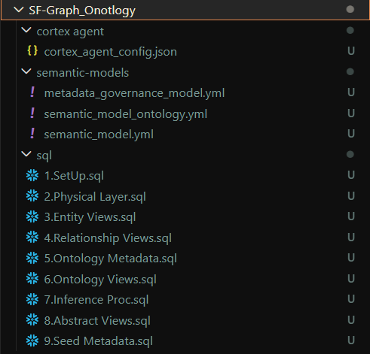
Snowflake – E2E Code
CORTEX AGENT
Intelligent agent orchestration with Cortex Agent, graph-powered reasoning via NetworkX, and natural-language interaction across all semantic models.
SEMANTIC MODELS
(Layer 4): Purpose-built semantic models optimized for
Concrete queries and statistics (Knowledge Graph Model),
Abstract relationship patterns (Ontology Model) and
Data model introspection (Metadata & Governance Model)
SET-UP
(Layers 1-3): A flexible object–relationship foundation with ontology metadata that captures business meaning natively in Snowflake.
Create
KG_NODE and KG_EDGE tables
Ontology metadata tables (ONT_CLASS, ONT_RELATION_DEF, etc.)
Generated abstract views (VW_ONT_CUSTOMER, VW_ONT_PRODUCT, REL_RESOLVED etc).
References
Ontology on Snowflake: Part 1 — Overview and Data Model | by Tianxia Jia | Snowflake Builders Blog:…
Ontology in Snowflake: Building Cortex Agents
The code for the setup, semantic models and cortex agent is all available here → Snowflake ML, Agentic Framework - CTO Strategy and Architecture - Westpac Enterprise Confluence

Slide 27
Snowflake – Scheduling & Execution
Execution can of all these concepts and capabilities can be as
  SQL Objects
  SQL Procedure – Wrapping a Python code in it
  Standalone Python code
  Python Models
  R Models
All components can be chained together using TASKS
CREATE OR REPLACE TASK scheduled_task
WAREHOUSE = GBU_A01A0E_FINCRIME_XS_WH
SCHEDULE = 'USING CRON 0 9 * * * UTC' -- Runs every day at 9 AM UTC
AS
EXECUTE NOTEBOOK A01A0E_GBU_FINCRIME_POC.GRAPH_ONTOLOGY. SFLK_GBU_A01A0E_SER_READWRITE_DEV. fraud_detection_xgboost_training();
AS
EXECUTE NOTEBOOK A01A0E_GBU_FINCRIME_POC.GRAPH_ONTOLOGY. SFLK_GBU_A01A0E_SER_READWRITE_DEV. fraud_detection_xgboost_training(‘<ARGUMENTS>’);
AS
BEGIN
CALL A01A0E_GBU_FINCRIME_POC.GRAPH_ONTOLOGY.LOAD_ICEBERG_TM_TRANSACTIONS_PROC();
END;
Arguments passed via a TASK onto a MODEL / NOTEBOOK & Read / Consumed for usage
import sys
# sys.argv[0] is the notebook name (e.g., ' fraud_detection_xgboost_training.ipynb')
# sys.argv[1] is the first user argument (‘cis_1234567')
# sys.argv[2] is the second user argument (‘acc_9876543')
# Set fallback defaults just in case you run the notebook manually
CUSTOMER_KEY = sys.argv[1]
ACCOUNT_KEY = sys.argv[2]
If we don't want to rely on the strict positional order of sys.argv, we can pass the string as key-value pairs and split them inside Python

Slide 28
Snowflake – Error Handling
To route pipeline failure notifications directly out of data warehouse environment via email
-- 1. Create a Native Email Notification Router (Requires ACCOUNTADMIN role)
CREATE OR REPLACE NOTIFICATION INTEGRATION owl_pipeline_email_int
TYPE = EMAIL
ENABLED = TRUE
ALLOWED_RECIPIENTS = (‘fcsai_support_groupL2@westpac.com.au'); -- Must be verified Snowflake users
-- 1. Alerts monitoring tables require Change Tracking turned on
ALTER TABLE pipeline_audit_log SET CHANGE_TRACKING = TRUE;
-- 2. Build the automated Alert Engine
CREATE OR REPLACE ALERT alert_owl_ingestion_failures
WAREHOUSE = GBU_A01A0E_FINCRIME_XS_WH
SCHEDULE = 'USING CRON 0 * * * * UTC' -- Evaluates hourly
IF (
EXISTS (
SELECT 1
FROM pipeline_audit_log
WHERE status = 'FAILED'
AND execution_ts >= DATEADD('hour', -1, CURRENT_TIMESTAMP())
)
)
THEN CALL SYSTEM$SEND_EMAIL(
'owl_pipeline_email_int',
' fcsai_support_groupL2@westpac.com.au',
‘ALERT: Ontology OWL Pipeline Ingestion Failure Detected',
'The Snowflake processing engine encountered file structure mismatches or structural exceptions during parsing within the last hour.\n\nPlease review failed executions by running:\nSELECT * FROM pipeline_audit_log WHERE status = ''FAILED'' ORDER BY execution_ts DESC;'
);
-- 3. Alerts are created in a suspended state; resume it to activate
ALTER ALERT alert_owl_ingestion_failures RESUME;

Slide 29
Snowflake – Ontology OWL – Turtle < Terse RDF Triple Language >
Store your .owl ontology file on an external stage and process it directly inside a Snowflake stored procedure.
As an OWL file is unstructured RDF/XML or Turtle <Terse RDF Triple Language> data, we cannot query it using traditional SQL COPY INTO commands.
We would use a Python stored procedure leveraging the SnowflakeFile class to stream and parse the file directly from the stage.
We would create a treamlit app that exposed this OWL file to the end user via the UI to enable editing via UI to make it easier. This could be a Snowflake WebApp as well.
1) PE, EXTERNAL VOLUME AND STAGE CREATION → 1 ONE-OFF TASK
2) Sample Stored Procedure parsing of .owl (RDF format based)
CREATE OR REPLACE PROCEDURE parse_owl_ontology(file_relative_path STRING)
RETURNS STRING
LANGUAGE PYTHON
RUNTIME_VERSION = '3.10'
PACKAGES = ('snowflake-snowpark-python') -- Add standard python xml packages if needed
HANDLER = 'main'
AS
$$
from snowflake.snowpark.files import SnowflakeFile
import xml.etree.ElementTree as ET
def main(session, file_relative_path):
# 1. Generate the absolute stage path
stage_file_url = f"@fcsai_external_owl_stage/{file_relative_path}"
# 2. Open and stream the file directly from the external stage
with SnowflakeFile.open(stage_file_url, 'r') as file:
# Read file contents as a string or pass to an XML parser
file_content = file.read()
# Example: Simple parsing logic (e.g., counting character length)
# could also use ET.fromstring(file_content) to navigate RDF nodes
file_length = len(file_content)
return f"Successfully processed OWL file. Size: {file_length} characters."
$$;
3) Execution → CALL parse_owl_ontology(‘fi_cusacctxndev.owl');
Samples
Multi-Relationship OWL File (finance_ontology_v2.ttl)
Database Architecture (Star Schema)
  CREATE INDIVIDUAL ENTITY TABLES HERE (FACTS / DIMENSIONS or NODES / EDGES) – Base tables to store RAW data and Relationships
  FOR SIMPLE RELATIONSHIPS - Use Semi-Structured Arrays
  Stored Procedure with Dynamic Array Aggregation
Querying the Many-to-Many Output Table
  CALL ingest_owl_to_star_schema('finance_ontology_v2.ttl')
If there is a need for dedicated semantic web packages like rdflib to parse the graph nodes, use them via the Snowflake Anaconda Channel. If not, download to Artifactory, run ISG Scan, upload it to stage, and include it in procedure's IMPORTS clause

Slide 30
Snowflake – Ontology with OWL (Options)
RDF (Resource Description Framework) is a standard model for representing graph-structured data, and it can be expressed in multiple serialization formats beyond Turtle and RDF/XML.
1. N-Triples
A line-based, plain text format for RDF.
Each line is a single RDF triple (subject predicate object .).
Ideal for large datasets and streaming applications because of its simplicity.
2. N-Quads
Extension of N-Triples, adds a fourth element: graph context.
Suitable for storing multiple RDF graphs in a single file.
3. JSON-LD
RDF represented as JSON, making it easier to integrate with web applications.
Supports linked data principles and context definitions to map JSON keys to RDF predicates.
4. RDFa (RDF in Attributes)
Embeds RDF statements directly in HTML or XHTML using attributes like about, property, typeof.
Useful for publishing semantic data on the web.
5. TriG
Extends Turtle to support multiple named graphs in a single file.
Helpful for datasets that contain graph collections.
6. HDT (Header, Dictionary, Triples)
Binary RDF format optimized for compression and fast querying.
Commonly used when working with very large RDF datasets.
Summary
Turtle/N-Triples/Trig: Text-based, readable, developer-friendly.
RDF/XML: Legacy, XML-oriented applications.
JSON-LD: Web-friendly, integrates with JavaScript and APIs.
RDFa: Embedded in HTML for semantic web publishing.
HDT: Efficient for storage and querying massive RDF graphs.
Sample representation
1. Turtle (Terse RDF Triple Language)
@prefix bank: <http://example.org/bank#> .
bank:Customer123 a bank:Customer ;
bank:hasAccount bank:Account456 ;
bank:ownsDevice bank:Device789 .
2. RDF/XML
<rdf:RDF xmlns:rdf="http://www.w3.org/1999/02/22-rdf-syntax-ns#" xmlns:bank="http://example.org/bank#"> <bank:Customer rdf:about="http://example.org/bank#Customer123">
<bank:hasAccount rdf:resource="http://example.org/bank#Account456"/>
<bank:ownsDevice rdf:resource="http://example.org/bank#Device789"/>
</bank:Customer>
</rdf:RDF>
3. N-Triples
<http://example.org/bank#Customer123> <http://example.org/bank#hasAccount>
<http://example.org/bank#Account456> .
<http://example.org/bank#Customer123> <http://example.org/bank#ownsDevice>
<http://example.org/bank#Device789> .
How to generate Ontology
Use natural language or diagrams to generate OWL file
LLMs / CLIs
W3C RDF Validator tool
FluentEditor
Chowlk (Diagram to OWL)
AceWiki / ACE
Pritege
RDFlib (Python Library)
We need to pin down which standard model we want to use for representing graph-structured data, it can be expressed in multiple serialization formats.
Selection of any of these won't impact how it can be leveraged in Snowflake and how Snowflake will run these.

Slide 31
Snowflake – Extension to MCP ***
A complete MCP (Model Context Protocol) server implementation for graph analytics can be the next extension to this.
This can enable NetworkX-powered graph analytics tools that integrate with Cortex Agent.
SNOWFLAKE
This has not been built & tested.
On paper <as a concept> sounds achievable.
Snowflake SPCS (Container Services)
Docker Container
Python Setup
FastMCP framework
NetworkX graph analytics
  Not limited to but options (graph_shortest_path, graph_community_detection)
HTTP endpoints (port 5000)
Custom tools
HTTPs
Cortex Agent (Service Functions)

Slide 32
Solution
UI - Visualisation

Slide 33
UI - Visualisation
HANDS ON POC (NEO4J VS TIGER GRAPH) → Graph, GraphRAG - Analytics - CTO Strategy and Architecture - Westpac Enterprise Confluence
NEO4j | TigerGraph | Snowflake
Neo4j Bloom is the Graph Visualization for Python (neo4j-viz) library. Native & Integrated Alternatives (Within Snowflake) Neo4j Graph Visualization for Python (neo4j-viz): Available in the official Snowflake Anaconda repository, this library enables interactive exploration (zooming, panning, moving nodes, hovering) within Jupyter Notebooks in Snowflake. It is the recommended tool for visualizing graph projections. NeoDash (Dashboarding): A web-based, low-code tool that connects to Neo4j via Bolt to create interactive dashboards with graph, table, and chart views. It is highly customizable and can be used to display graph results. Specialized Graph Visualization Tools (External) Linkurious Enterprise: A powerful, user-friendly alternative designed for collaborative graph exploration, analysis, and investigation (e.g., fraud detection). GraphAware Hume: Combines graph visualization with knowledge graph management, offering advanced exploration and NLP features. SemSpect: A tool for visualizing large-scale graphs, focusing on a top-down, schema-based approach. Gephi: A leading open-source tool for graph visualization and network analysis. Developer & Library-Based Options Neo4j Visualization Library (NVL): A TypeScript/React library that powers the new Neo4j Browser and Bloom, available for developers to build custom embedded visualizations. Cytoscape.js: A widely used, open-source JavaScript library for advanced graph rendering. Cosmograph: A performant WebGL-based library, good for rendering large graphs. | GraphStudio (Built-in GUI): Explore Graph: This feature allows to query and visualize data,, showing nodes (vertices) and lines (edges). Interactive Exploration: can select specific vertices to explore connections, hover for attribute details, and adjust the layout. Schema Visualization: View the structure of graph data. pyTigerGraph (Python SDK): Use the drawSchema() function to visualize the graph structure directly in Jupyter Notebooks. Third-Party Tools (For complex/embedded visualization): ReGraph: React SDK for building advanced network visualizations. KeyLines: JavaScript SDK for building web-based graph apps. KronoGraph: For timeline-based visualizations. TigerGraph Insights: A low-code tool for creating interactive dashboards, allowing for visual data exploration through widgets. | Native & Integrated Alternatives (Within Snowflake) Neo4j Graph Visualization for Python (neo4j-viz): Available in the official Snowflake Anaconda repository, this library enables interactive exploration (zooming, panning, moving nodes, hovering) within Jupyter Notebooks in Snowflake. It is the recommended tool for visualizing graph projections. Streamlit in Snowflake: can build custom, web-based applications inside Snowflake that use the neo4j-viz library to visualize graph data. Snowflake App Runtime with python NeoDash (Dashboarding): A web-based, low-code tool that connects to Neo4j via Bolt to create interactive dashboards with graph, table, and chart views. It is highly customizable and can be used to display graph results. Snowflake App Runtime builds Node.js apps (with a focus on Next.js).
Entries in GREEN have been POCd with workable examples and outcomes captured here →
VISUALISATION (NEO4J & TIGERGRAPH) Graph, GraphRAG - Analytics - CTO Strategy and Architecture - Westpac Enterprise Confluence
VISUALISATION (SNOWFLAKE) Snowflake ML, Agentic Framework - CTO Strategy and Architecture - Westpac Enterprise Confluence

Slide 34
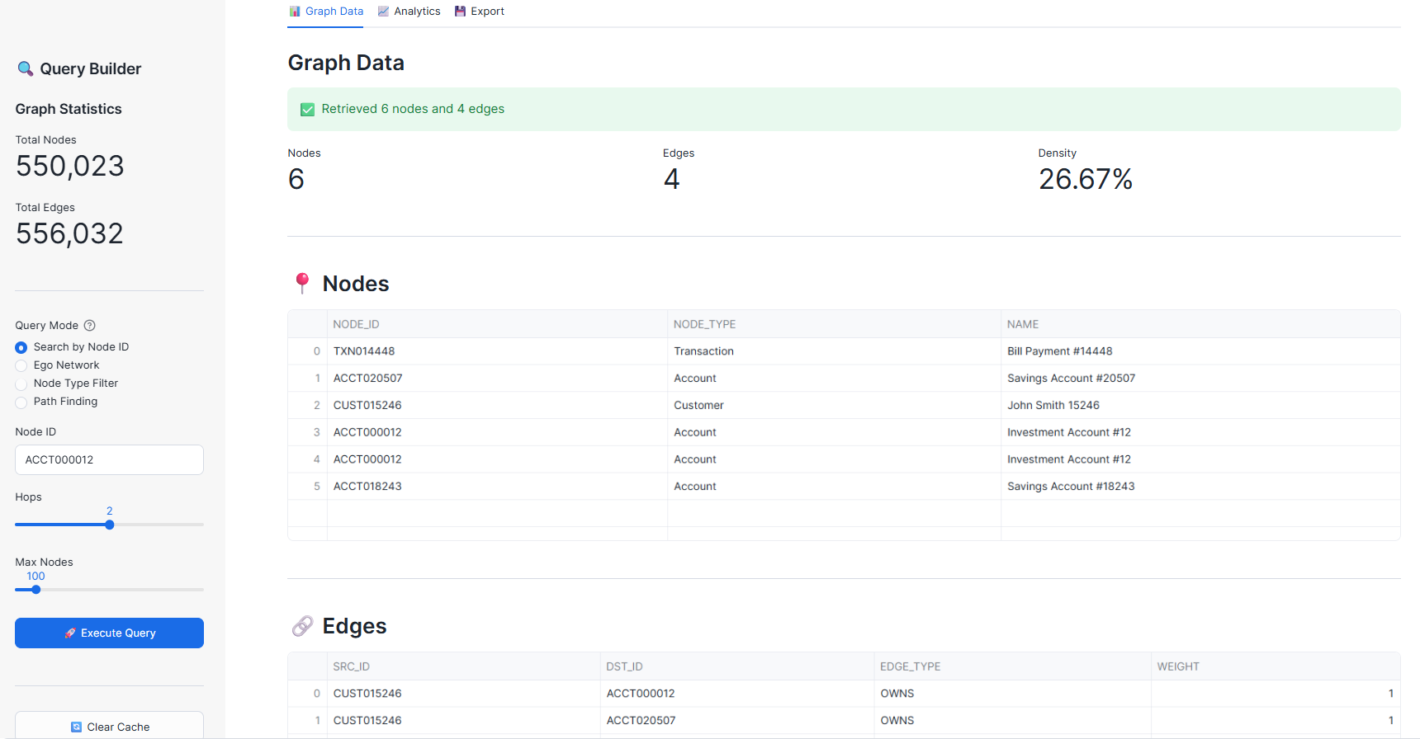
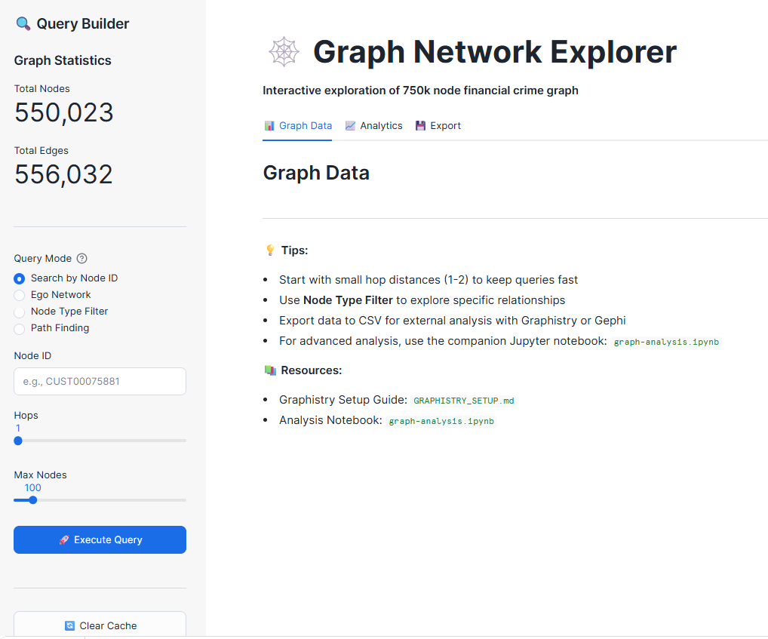
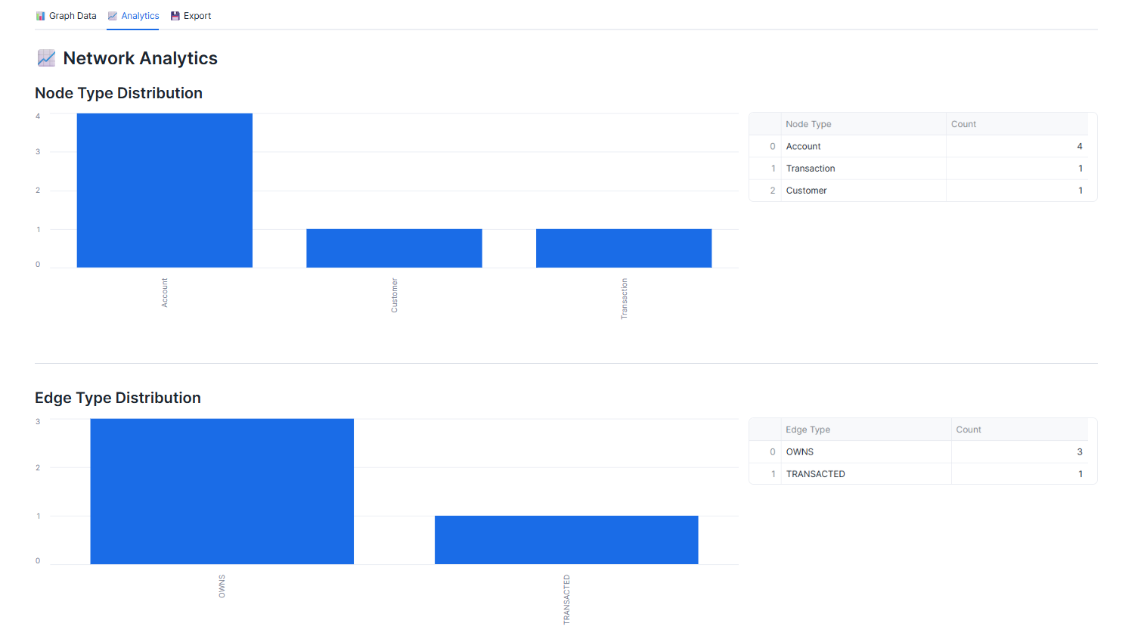
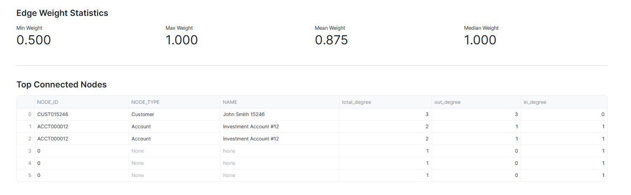
UI - Visualisation
User Interaction Options
Output

Slide 35
End-to-End Architecture (REAL-TIME Only)
DATA SOURCES
☸ AKS CLUSTER — Confluent Platform (Self-Managed)
❄️ SNOWFLAKE
RDBMS
(CDC)
Kafka Connect
(Source)
─────────
Debezium CDC
JDBC Polling
KAFKA BROKERS
Kafka
Connect
(Sink)
─────
Snowflake
Connector
Snowpipe
Streaming
(Ingestion Method)
CDC
JDBC
PUBLISH
Snow pipe
Streaming
Avro
Avro
Broker 1
Broker 2
Broker 3
PostgreSQL
(JDBC)
Managed Iceberg Tables
──────────────
iceberg_lakehouse.raw
Topics
cdc.* | jdbc.*
Schema Registry
(Avro / JSON Schema)
DLQ
Dead Letter
Queue
REST APIs
Quorum
External Volume
(Azure Blob Storage)
File Systems
(CSV/JSON)
KRaft Controllers
Monitoring
Prometheus
Grafana
Control Center
Ctrl 1
Ctrl 2
Ctrl 3
Key-Pair Auth
kafka_svc_user
Applications
(XML/JSON)
Confluent for Kubernetes (CFK) Operator — Manages all Confluent components
Analytics & BI
(Query Layer)

Slide 36
Confluent Kafka Solution
☸ AKS CLUSTER — Confluent Platform (Self-Managed)
Self‑managed Confluent Kafka on AKS, Sydney region, 3 brokers, multi‑AZ, ~50 TPS)
Ingress = 35 msgs/sec * 50 KB ≈ 1750 KB/sec With RF=3 → write amplification ≈ 5250 KB/sec
Per-broker sizing
Storage = throughput × retention × replication (100 GB per broker)
Daily data ≈ 1750 KB/s × 86400
≈ 150 GB/day 7 days
= ~150 GB With RF=3 → ~450 GB
total cluster Per broker = ~150 GB +20% buffer → ~180 GB/broker
AKS
Cluster design
Brokers: 3
AZ: 3 (Sydney zones)
Replication factor: 3
Partitions: 3–6 per topic
Per broker
4 vCPU
8–16 GB RAM
100–200 GB Premium SSD
1 pod per node
Parameter | Assumption
Message size | 50 KB (small events)
TPS | 35 msgs/sec
Replication factor | 3 (required for multi‑AZ)
Retention | 3–7 days
☸ AKS CLUSTER — Confluent Platform (Self-Managed)
Kafka Connect
(Source)
─────────
Debezium CDC
JDBC Polling
KAFKA BROKERS
Kafka
Connect
(Sink)
─────
Snowflake
Connector
Avro
Avro
Broker 1
Broker 2
Broker 3
Topics
cdc.* | jdbc.*
Resource | Recommendation
vCPU | 4 cores
Memory | 8–16 GB
Disk | 100–200 GB SSD (Premium SSD / Managed disk)
NIC | Standard (1–5 Gbps is enough)
Schema Registry
(Avro / JSON Schema)
DLQ
Dead Letter
Queue
Quorum
KRaft Controllers
Monitoring
Prometheus
Grafana
Control Center
Ctrl 1
Ctrl 2
Ctrl 3
⚙️ Confluent for Kubernetes (CFK) Operator — Manages all Confluent components

