Slide 1
Architecture
AI, ML, GENAI, AGENTIC

Slide 2
Concepts
Artificial Intelligence (AI)
AI is the broad idea of teaching computers to think or act in ways that mimic human intelligence. This includes recognizing images, understanding speech, translating languages, or playing games. AI can be
simple (like a spam filter) or more complex (like a chatbot).
Machine Learning (ML)
Machine learning is a subset of AI where computers learn from data instead of being explicitly programmed. For example, showing a computer, thousands of pictures of cats and dogs allows it to learn how to
identify cats automatically. ML is behind many AI applications today, such as recommendation systems on Netflix or fraud detection in banks.
General AI (AGI)
General AI, or Artificial General Intelligence (AGI), is AI with humanlike intelligence across many tasks, not just one. Unlike today’s AI, which can focus on specific tasks, general AI could learn and adapt to
almost anything humans can do. This type of AI does not exist yet and is mostly theoretical.
Agentic AI
Agentic AI refers to AI systems that can take autonomous actions to achieve goals. Instead of just answering questions or performing one task, these systems can plan, make decisions, and act in the world—for instance, a robotic assistant could move objects, control other software, or schedule tasks independently. Agentic AI is a step beyond toollike AI because it has a degree of independence in pursuing objectives
Large Language Models (LLMs)
Large language models are AI systems trained on massive amounts of text to understand and generate humanlike language. Examples include ChatGPT. They can write stories, answer questions, translate languages, or summarize text by predicting the next word based on patterns they've learned from the data. While impressive, they don’t truly "understand" like humans do—they detect patterns and generate plausible responses.
Summary
In simple terms:
AI = computers doing smart tasks.
Machine Learning = AI learning from data.
General AI = AI that could think and learn like humans (still theoretical).
Large Language Models = AI trained on lots of text to talk or write like a human.
Agentic AI = AI that can act on its own to achieve goals.

Slide 3
Model Concepts
CONCEPT
Foundation Models
Foundation models are a broad class of AI models characterized by their massive scale and general-purpose capability.
They are trained on diverse datasets across modalities (e.g., text, images, audio, code) using self-supervised or semi-supervised learning. Key features include:
Multi-modality support: Can be adapted or fine-tuned for text, vision, speech, or combinations thereof.
Pre-training as a baseline: Developed using large uncurated datasets to learn general representations, which serve as a foundation for specialized downstream tasks.
Versatility: Can power multiple applications such as question answering, summarization, classification, reasoning, and multi-modal generation.
Examples: GPT series (text), CLIP (text + image), DALL·E (image generation from text prompts).
Large Language Models (LLMs)
Large language models are a subset of foundation models specifically operating on textual data. Key features:
Text-focused: Trained on large corpora of natural language and code.
Language understanding and generation: Excel in tasks like translation, summarization, reading comprehension, and dialogue.
Scale: Typically, billions or trillions of parameters.
Examples: GPT, LLaMA, PaLM, Claude.
In essence, all LLMs are foundation models, but not all foundation models are LLMs because some foundation models handle images, audio, or multi-modal inputs.
RELATIONSHIP
LLMs are specialized instances of foundation models.
Foundation models provide the architecture, pre-training, and conceptual framework, while LLMs are the textual instantiation optimized for language tasks.
PRACTICAL ILLUSTRATION
Foundation model perspective: Think of it as a general-purpose engine that can produce embeddings or behaviours across modalities.
LLM perspective: Think of it as a language-specific engine derived from the general-purpose foundation model.

Slide 4
Model Size
Model Size and Architecture
Large LLMs typically contain billions of parameters, enabling them to capture vast amounts of linguistic and world knowledge.
Mini LLMs may have millions to low billions of parameters, significantly reducing memory and storage requirements. The smaller parameter count often restricts the model's ability to generalize or handle very nuanced tasks.
Performance and Capabilities
Large LLMs excel at tasks requiring complex reasoning, multi-turn dialogue, summarization of long text, and domain adaptation. Their size allows better handling of context and subtleties in language.
Mini LLMs are faster and require less GPU memory, making them suitable for edge devices or real-time applications but can exhibit lower accuracy, less coherent text generation, and more sensitivity to ambiguous queries.
Resource Requirements
Large LLMs need powerful hardware such as high-memory GPUs or TPUs for inference and training, making them costlier to deploy and operate.
Mini LLMs can run on standard consumer-grade hardware or even mobile devices after optimization, with lower energy consumption and faster response times.
Training and Fine-Tuning
Large LLMs are often trained on massive datasets, requiring weeks of distributed training. Mini LLMs can often be fine-tuned quickly on smaller datasets using techniques like LoRA (Low-Rank Adaptation) or prompt tuning, enabling task-specific adaptation with minimal compute resources.
Applications
Large LLMs are preferred for research, enterprise applications, multi-domain chatbots, and advanced content generation where quality and reasoning matter.
Mini LLMs are useful for on-device assistants, smaller-scale NLP tasks, embedded systems, or applications where latency and cost are critical.
SELECTION CRITERIA
Choosing between large and mini LLMs involves balancing accuracy, speed, deployment cost, and resource availability. Large models generally provide superior capabilities but at high cost, whereas smaller models offer efficiency at the expense of nuanced performance. In many practical scenarios, distilled or optimized mini LLMs provide an effective compromise, retaining much of the performance of large models while being resource-friendly.

Slide 5
Concept - ML
Machine learning is a subset of AI where computers learn from data instead of being explicitly programmed. For example, showing a computer, thousands of pictures of cats and dogs allows it to learn how to identify cats automatically. ML is behind many AI applications today, such as recommendation systems on Netflix or fraud detection in banks.
TECHNIQUEs
Supervised Learning
Supervised learning involves training a model on a labelled dataset, meaning each input has a corresponding output. The objective is to predict outputs from new inputs.
Common techniques include:
  Regression: Predicts continuous values (e.g., house prices, temperature). Algorithms include Linear Regression, Ridge Regression, Lasso Regression.
  Classification: Predicts discrete categories (e.g., spam detection, disease diagnosis). Algorithms include Logistic Regression, Decision Trees, Random Forests, Support Vector Machines (SVM), k-Nearest Neighbors (k-NN), and Neural Networks.
Unsupervised Learning
Unsupervised learning models work with unlabelled data, finding patterns, structures, or relationships without predefined outcomes.
Common techniques include:
  Clustering: Groups similar data points together. Examples: k-Means, Hierarchical Clustering, DBSCAN.
  Dimensionality Reduction: Reduces the number of features while retaining important information. Examples: Principal Component Analysis (PCA), t-SNE, Autoencoders.
  Association Rule Learning: Discovers relationships between variables, such as in market basket analysis. Example: Apriori algorithm.
Semi-Supervised Learning
This is a hybrid approach using a small amount of labelled data and a large amount of unlabelled data to improve learning accuracy.
Techniques often extend supervised learning algorithms with methods like self-training or graph-based approaches.
Reinforcement Learning (RL)
RL focuses on training agents to make sequential decisions by interacting with an environment and receiving rewards or penalties.
Core techniques include:
  Q-Learning and Deep Q-Networks (DQN): Learn optimal action-value functions.
  Policy Gradient Methods: Directly optimize the policy mapping states to actions.
  Actor-Critic Methods: Combine value-based and policy-based approaches for stability.
Deep Learning
Deep learning involves neural networks with multiple layers (deep architectures) capable of learning high-level representations from raw data.
Techniques include:
Convolutional Neural Networks (CNNs): Specialized for image and video analysis.
Recurrent Neural Networks (RNNs) and LSTM/GRU: Designed for sequential or time-series data like language, speech, and stock prices.
Generative Adversarial Networks (GANs): For generating new, realistic examples in images, text, or audio.
Transformers: State-of-the-art for natural language processing and large-scale sequence modelling.
Ensemble Methods
Ensemble techniques combine predictions from multiple models to improve accuracy and robustness.
Common approaches include:
Bagging: Reduces variance by averaging predictions (e.g., Random Forests).
Boosting: Sequentially improves weak learners to reduce bias (e.g., AdaBoost, Gradient Boosting, XGBoost, LightGBM).
Stacking: Combines different model types using a meta-learner for final predictions.
Machine learning offers a variety of techniques tailored to the type of data and problem goals:
Supervised learning for labelled data prediction
Unsupervised learning for pattern discovery in unlabelled data
Semi-supervised learning for partially labelled datasets
Reinforcement learning for sequential decision-making tasks
Deep learning for complex, high-dimensional data
Ensemble methods to boost prediction performance

Slide 6
Concept – GEN AI
Generative AI operates by learning the underlying structure and distribution of data, enabling it to produce original outputs that resemble the training data. Unlike traditional AI systems that primarily classify or predict, generative AI's focus is on creation and synthesis.
This includes generating realistic human-like text, creating images from descriptions, composing music, or even producing synthetic video sequences.
Key Techniques
Neural Networks: Deep learning models, particularly convolutional and recurrent neural networks, can capture complex patterns in data. These networks form the foundation of many generative AI systems.
Transformers: Models like GPT (Generative Pre-trained Transformer) rely on attention mechanisms to generate coherent and context-aware text from large datasets. They have broad applicability in natural language processing tasks.
Generative Adversarial Networks (GANs): GANs involve two networks—a generator creating synthetic data and a discriminator distinguishing real from generated data—which play a minimax game until the generator produces highly realistic outputs.
Variational Autoencoders (VAEs): VAEs learn a latent space representation of data and generate new output by sampling and decoding from this space. This produces smooth variations in the generated data.
Applications
Text Generation: Writing articles, summarizing content, creating chatbots, or drafting code.
Image and Video Generation: Producing digital art, photorealistic images, or deepfakes.
Audio Synthesis: Creating music, voiceovers, or realistic speech from text.
Design and Engineering: Generating product designs, architectural layouts, or simulations based on learned patterns.

Slide 7
Concept – AGENTIC AI
Core Definitions
Agentic AI: A branch of AI focused on autonomous systems capable of making decisions, planning actions, and executing tasks. It emphasizes agency, autonomy, and goal-oriented behavior.
AI Agent: The fundamental building block of agentic AI—a self-contained system with the ability to:
  Perceive its environment through sensors, APIs, or data streams.
  Reason using algorithms, models, and prior knowledge.
  Act by executing decisions in digital or physical domains.
  Learn from experience to improve future performance.
  Types include reactive, deliberative, learning, hybrid, single-agent, multi-agent, hierarchical, and domain-specific agents.
Key Agentic AI Capabilities
Autonomy & Goal-Oriented Behaviour: Ability to operate without human intervention and to pursue defined objectives.
Perception: Collecting and interpreting environmental data, e.g., images, text, and sensor inputs.
Reasoning: Making decisions based on data, rules, and learned patterns.
Action Execution: Performing tasks via APIs, software commands, or robotics.
Tool Use: Leveraging external systems such as databases, search engines, and software APIs to broaden functionality.
Learning & Adaptation: Improving over time using reinforcement or self-supervised learning.
Interaction & Social Ability: Communicating and coordinating with other agents or humans in multi-agent setups.
Context Engineering: Designing input and environmental context to optimize agent performance.
Orchestration: Coordinating multiple agents and managing workflows to achieve complex objectives.
Related Concepts and Frameworks
Multi-Agent Systems: Environments where multiple agents collaborate or compete to solve problems.
Hierarchical Agents: Structures where higher-level agents coordinate lower-level agents for efficient task management.
Agentic RAG (Retrieval-Augmented Generation): Combining memory, embeddings, and knowledge retrieval with agentic reasoning to perform complex tasks.
Model Context Protocol (MCP): Standardized communication protocol for agent interactions across different platforms and AI components.
Frameworks: Popular infrastructures for agentic AI development include LangChain, LlamaIndex, AgentFlow, and CrewAI.
Human-AI Collaboration: AI agents are often paired with human teams for enhanced productivity, leveraging human judgment and AI computation.
Risks and Governance
Unreliable or Unethical Decisions: Rogue actions can cause harm if uncontrolled.
Cybersecurity: Agents with extensive access raise security challenges.
Accountability: Determining responsibility when AI agents make errors.
Operational Oversight: Continuous monitoring, metrics, and governance frameworks are essential.
Distinctions
Agentic AI vs Traditional AI: Traditional systems follow predefined rules; agentic AI exhibits autonomous decision-making.
Agentic AI vs Generative AI: Generative AI outputs content; agentic AI uses content to achieve workflows and enact real-world tasks.

Slide 8
Options – LLMs
OpenAI LLMs → GPT Series (GPT-4o, GPT-5, o3)
Strengths: General-purpose reasoning, conversation, multimodal inputs (text + image + audio), coding assistance, summarization, multi-step problem solving.
Special Abilities: GPT-4o supports voice input/output, large context windows (up to 128K tokens), and real-time multimodal interaction. GPT o3 is reasoning-focused, excelling in mathematics, coding, and scientific problem-solving via chain-of-thought reasoning.
Use Cases: Chatbots, AI agents, code generation, document analysis, educational tools.
Anthropic LLMs → Claude Series (Claude Sonnet 4, Claude Opus 4)
Strengths: Safe and steerable conversational AI with strong long-context retention; reasoning across large documents; instruction-following; enterprise-ready applications.
Special Abilities: Multimodal input/output (Sonnet, Opus); adaptive reasoning effort; excels in maintaining context across multi-turn dialogues.
Use Cases: Enterprise chat systems, customer support, instruction-based AI systems, content summarization.
Google DeepMind LLMs → Gemini Series (Gemini 2.5 Pro, Flash, Flash-Lite)
Strengths: Reasoning, planning, and multimodal integration; handles extremely long contexts; good for agentic AI systems.
Special Abilities: Supports text, audio, image, and video processing; outputs multimodal content; adjustable “thinking time” for complex tasks.
Use Cases: Advanced research tools, workflow automation, multi-step planning agents, multimodal information synthesis.
PaLM 2 (Bison-001) & Bard
Strengths: Pattern-based learning, multilingual proficiency, commonsense reasoning, logic, and advanced coding.
Use Cases: Translation, problem solving, knowledge extraction, and real-time internet-connected AI applications (Bard).
xAI LLMs → Grok Series (Grok 3, Grok 4 variants)
Strengths: Fast conversational AI integrated with X (formerly Twitter); real-time updates; humorous or reactive conversation in dynamic online settings.
Special Abilities: Supports text, image, and speech inputs; some agentic capabilities for tool use; Grok Code Fast optimized for coding tasks.
Use Cases: Social chatbots, live content moderation, dynamic agent interaction, coding assistants.
Meta LLMs → LLaMa Series (LLaMa 2, 3)
Strengths: Open-weight, fine-tunable for private deployment; excels in long-term language understanding and reasoning; strong performance across benchmarks.
Use Cases: Research experimentation, enterprise AI development, local deployments requiring fine-tuning or integration into custom workflows.
Orca
Strengths: Efficient, high-performing reasoning similar to GPT-4 with fewer parameters; multimodal integration.
Use Cases: Lightweight agent deployment, coding, knowledge reasoning on local devices.
Cohere LLMs → Command and Aya Series
Strengths: Enterprise-focused, multilingual instruction following, reasoning and translation; Aya supports 101 languages.
Use Cases: Business intelligence, multilingual assistants, translation services, application-specific LLM fine-tuning.
Mistral LLMs
Strengths: Efficiency, reasoning, coding, and multimodal interactions; supports both open-weight and selective proprietary models.
Use Cases: Research, coding assistants, agentic AI, local or enterprise deployment with open models.
DeepSeek LLMs → R1 Series
Strengths: Reasoning-focused, open-weight; excels in long-context tasks and structured workflows using attention scaling.
Use Cases: Open-source reasoning agents, AI planning, and complex problem-solving applications.
Falcon LLMs (TII)
Strengths: Lightweight and scalable; optimized for efficiency; supports multiple languages.
Use Cases: NLP tasks such as text generation, classification, and sentiment analysis on local devices or cloud.
GPT-4o and Claude Sonnet 4 dominate general purpose conversation,
Gemini and Claude Opus excel at reasoning-intensive tasks,
Open-weight models (LLaMa, DeepSeek R1) thrive in custom, controlled deployments.

Slide 9
Evaluations, Observability, Telemetry & Capability
The best way to perform AI evaluations, observability, telemetry, and capability assessments is multilayered, integrating data, model, infrastructure, and behavioral monitoring; distributed tracing and telemetry using standards like OTEL; continuous automated and human-in-the-loop evaluators; and lifecycle aware observability spanning training, deployment, inference, and feedback phases.
Layer | Focus | Key Metrics | Tools/Methods
Data | Quality & drift | Schema changes, missing/duplicate values, drift detection | Data validator pipelines, anomaly detection
Model | Accuracy & reliability | Accuracy decay, hallucinations, bias, confidence, token usage | Continuous evaluators, human-in-the-loop, A/B testing
Infrastructure | Performance & scaling | Latency, throughput, GPU/CPU use, API uptime | OTEL telemetry, monitoring with Grafana/Prometheus/K8s-native tools
Behavior | Safety & trust | Ethical risks, hallucinations, output anomalies | Red-teaming, post-deployment sampling, automated alerts
Capabilities | AI evaluation | Task adherence, groundedness, tool-call accuracy, safety | Automated + human evaluators, SDKs, lifecycle benchmarking
Best Practise
Baseline Establishment: Measure initial data distribution, model performance, and KPI thresholds during a stable production period (2–4 weeks recommended).
Realtime Monitoring: Implement automated alerts using thresholds for drift, accuracy decay, hallucinations,
latency spikes, or user KPI drops.
Layered Drift Detection: Combine data, prediction, and error pattern shifts to improve detection reliability and
reduce false positives (~60–70% reduction achievable with dynamic thresholds).
Retraining Strategy: Use a hybrid approach—time-based and event-triggered retraining:
  Data drift: often corrected with incremental retraining.
  Concept drift: may require full retraining, feature engineering, or model redesign.
Automated Retraining Pipelines: Deploy CI/CD pipelines or AI agents to automatically retrain and redeploy
models when drift thresholds are crossed.
Alert Management: Use dynamic thresholds, deduplicated alerts, and escalation workflows (Slack/PagerDuty
integration) to prevent alert fatigue.
Proactive Analytics: Use dashboards that combine metrics, errors, KPI trends, and costs to support
decision-making. Include root cause analysis (RCA) tools.
Continuous Evaluation: Evaluate model health across accuracy, precision, recall, throughput, latency, and
drift metrics regularly for adaptive learning and performance recovery.
What do need to monitor
Performance Metrics: latency, throughput, error rates.
Drift Metrics:
  Data drift: changes in input distribution (Kolmogorov-Smirnov, Population Stability Index, Jensen-Shannon divergence).
  Concept drift: changes in input-output relationships or model assumptions; detected via prediction distribution shifts and KPI trend monitoring.
Quality Metrics: hallucinations, output relevance, toxicity, coherence, faithfulness.
Security & Privacy Metrics: prompt injections, data/PII leakage, compliance measures.
Cost Metrics: token usage, infrastructure costs, API costs.
User Experience/KPI Metrics: response quality, conversion/engagement KPIs, prompt alignment.
How do we monitor
OpenTelemetry + Grafana/Prometheus + MLflow (with Evidently or custom integrations)
Vendor solutions → Evidently AI, Arize.ai, WhyLabs, Coralogix AI Center

Slide 10
Solution Stack – Cloud Providers
AWS, MICROSOFT & GOOGLE
Oracle, IBM, Alibaba Cloud – Not Considered

Slide 11
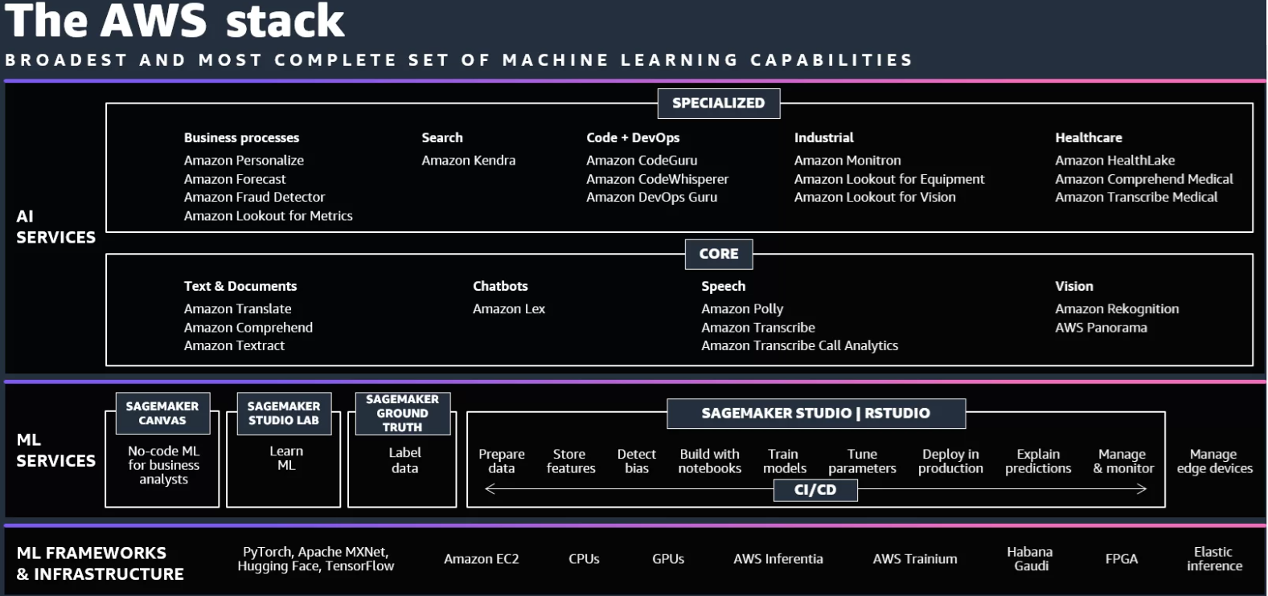
AWS

Slide 12
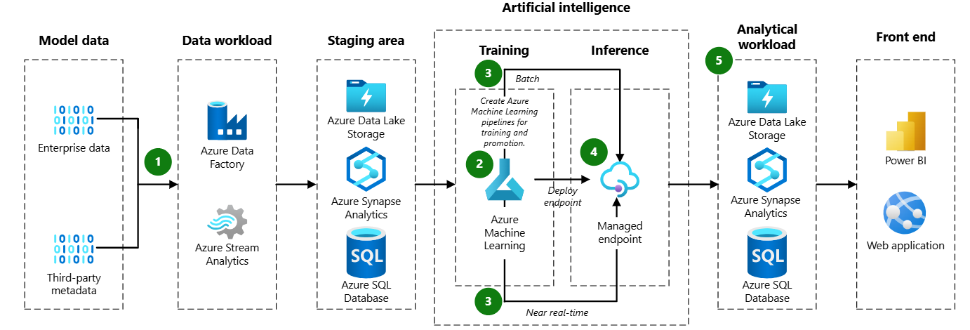
AZURE

Slide 13
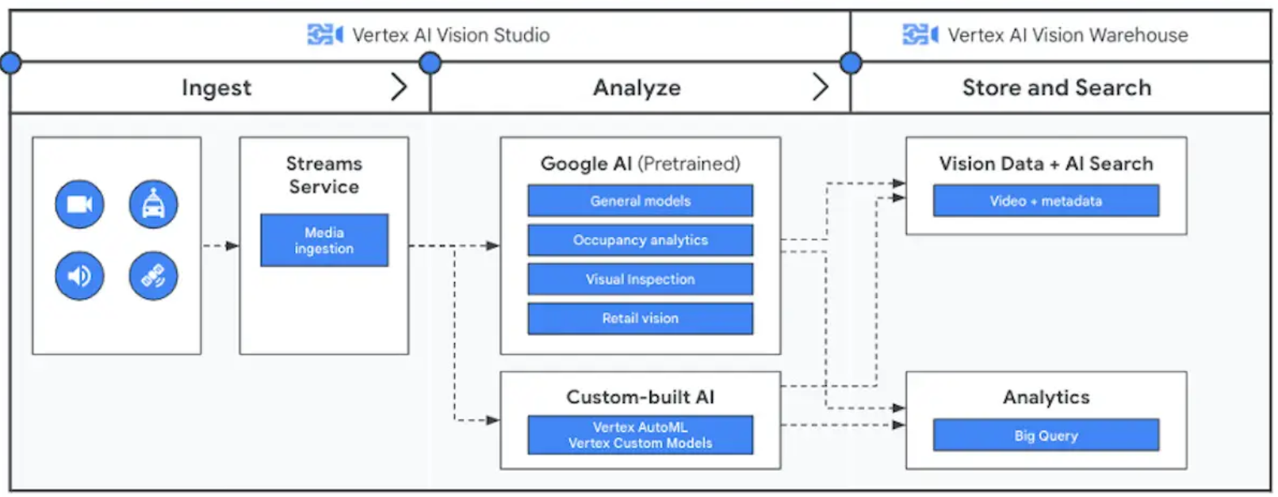
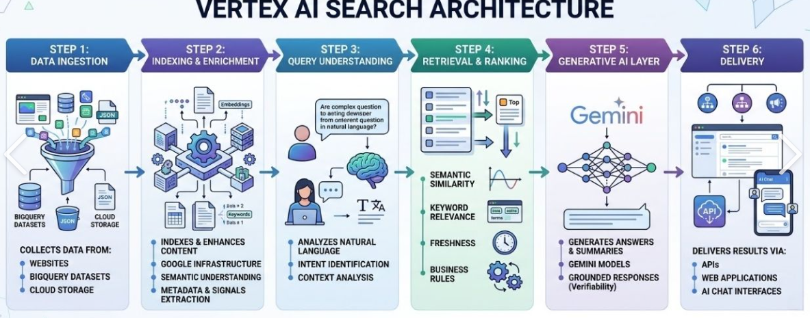
GOOGLE

Slide 14
Solution Alternatives
Capability | AWS Service | Alternatives | Evaluation & Usage
SEARCH | KENDRA | IBM Watson Discovery ElasticSearch Clause Match Sapient Open AI
CONVERSATION | LEX | IBM Watson Assistant Azure BOT Service Google Cloud Dialogue Flow Drift LivePerson
 | TRANSCRIBE | Azure Cognitive Services Whisper (Open AI) Verint (CSS) IBM Watson Google Speech Recognition Dragon Anywhere Speechnotes Mozilla DeepSpeech Automatic speech recognition (ASR) service that performs speech to text | Accuracy - Word Error Rate (WER = (Substitutions + Deletions + Insertions) / Total words spoken Privacy Others → Transcription + Natural Language Processing + Sentiment Analysis
 | CALL ANALYTICS
TEXT | TRANSLATE | Azure Cognitive Services Google Translate IBM Watson Language Translator Bing Translator Neural machine translation service, that uses deep learning models to deliver more accurate and more natural sounding translation than traditional statistical and rule-based translation algorithms. Automatically identifies the source language when it is not specified. | Evaluation on Quality - Round trip translation (source to target and back to source) Privacy - on-device translation engine vs cloud-based translation tools (Back off the Otter.ai incident) Extended Evaluation around idiomatic expressions, cultural nuances & complex syntax Capability → Document Translation, Active custom translation, Custom terminology, Profanity masking, Formality Configuration, Auto source language detection. Usage → Realtime (Txt, HTML, DOCx, PPTx, XLSx, Xliff file) Batch (Txt, HTML, DOCx) → Translate documents stored in bucket.
 | COMPREHEND | Google Cloud Natural Language API Microsoft Text Analytics API IBM Watson Natural Language Understanding SpaCy Natural language processing (NLP) service that uses machine learning (ML) to discover insights from text. | Capability → Custom entity recognition, Custom classification, Entity recognition, Sentiment analysis, Targeted sentiment, PII identification and redaction, Toxicity detection, Prompt safety classification Key-phrase extraction, Events detection, Language detection, Syntax analysis, Topic modelling, Multiple language support Usage → Single-document synchronous, Multi-document synchronous – collection of up to 25 documents, Asynchronous batch – put the documents into S3 bucket and start an asynchronous job to analyse the documents. Amazon Comprehend stores the results of the analysis in the S3 bucket/folder that is specified in the request.

Slide 15
Solution Alternatives
Capability | AWS Service | Alternatives | Evaluation & Usage
SPEECH | TEXTRACT | Datacap Hyperscience Azure OCR Google OCR IBM Datacap Tesseract | Character Error rate Word Error rate Layout Error rate - Quality metrics around deviation between OCR output Vs Original image (pertaining to layout, structure formatting etc) Support on document types
 | RECOGNITION | Microsoft Computer Vision Azure Face API & Custom vision services Google Cloud Vision IBM visual recognition Image recognition and video analysis with ML - Content Moderation & Identity Verifcation | Capability→ Custom Labels, Image features
 | POLLY | Google Cloud Text to Speech Azure Text to Speech IBM Watson Text to Speech Descript Readspeaker
AI/ML PLATFORMS | SAGEMAKER INFRERENCE | IBM Watson Studio Azure Machine Learning Google Cloud AutoML Vertex AI H2O AI Cloud Matlab | SAGEMAKER – CLARIFY → Model interoperability & explainability MACIE - Data security and data privacy service that uses ML and pattern matching to discover and protect sensitive data, to automate PII discovery prior to applying the right de-identification technique. Azure – InterpretML + Responsible AI dashboard and tool kit
 | SAGEMAKER JUMPSTART
 | SAGEMAKER AUTOPILOT
 | SAGEMAKER CLARIFY
 | BEDROCK | Open AI Azure Open AI Google Vertex AI NVIDIA DGX Cloud
 | BEDROCK - TITAN FM (Part of BEDROCK)

Slide 16
Agentic Stack

Slide 17
Considerations
Aspect | AWS | Azure | GCP
Model Ecosystem | Bedrock model hub (multi-vendor) | OpenAI models & Azure Model Catalog | Gemini, open-source models
Orchestration | Lambda, ECS, Step Functions | AI Studio, Functions, AKS | Cloud Run, GKE, Vertex AI pipelines
Enterprise Integration | Strong with AWS services | Microsoft 365 stack | BigQuery/Dataflow-centric
Memory & State | AgentCore Memory | Vector stores & Cosmos DB | Vertex AI Agents memory + pipelines
Observability | CloudWatch + third-party | Azure Monitor | Vertex AI native monitoring
Best Fit | Flexibility, DIY, platform engineers | Copilots for employees, enterprise governance | Data-native, analytical AI agents
AWS | AZURE | GOOGLE
Amazon Bedrock AgentCore: Enterprise-grade platform for deploying and managing autonomous AI agents. Features include: AgentCore Runtime: Secure execution with session isolation and long running workflows (up to 8 hours). AgentCore Memory: Long-term and short-term memory infrastructure for context-aware agents. AgentCore Identity: Integrates with Amazon Cognito, Microsoft Entra ID, Okta for secure authentication. AgentCore Gateway & Code Interpreter: Enables tool executions, secure code execution, and web-based interactions. Observability: Realtime telemetry via AWS CloudWatch, compatible with third-party LLM observability tools (LangSmith, Helicone, etc.). Amazon Nova & TwelveLabs Integration: Custom model fine-tuning and multi-modal processing for complex agentic tasks. Orchestration: Serverless-first architecture using Lambda, ECS, Fargate, Step Functions; Python centric orchestration often via LangChain, LangGraph, or custom SDKs. Tooling & Data Integration: Connects seamlessly to S3, Aurora, DynamoDB, Glue, OpenSearch, vector stores, and message queues | Azure OpenAI Service & Azure AI Studio: Managed GPT models (currently GPT5.1, o3) with enterprise controls and private networking. Integrated agent orchestration (tool calling, evaluation, monitoring) Built in vector store connectivity (Cosmos DB, Azure AI Search). Orchestration Patterns: Azure Functions, AKS, Logic Apps for custom flows. Azure AI Studio offers opinionated scaffolding for agent development, reducing assembly work. Enterprise Integrations: Tight connectivity with Microsoft 365, Teams, SharePoint, and GitHub for internal enterprise copilots. | Vertex AI + Gemini Models: Comprehensive ML and LLM platform integrating: Generative AI Studio, Vertex AI Agents / Agent Builder. Embeddings, RAG pipelines, vector search. Evaluation tooling and monitoring. Orchestration: Container-based workflows (Cloud Run, GKE), task execution, and multi-step pipelines integrated tightly with BigQuery and Dataflow. Tooling & Data Integration: Ideal for analytical workloads—data-heavy agentic systems leveraging BigQuery, vector search, and ML pipelines. Supports opensource models (Gemma, Llama, etc) for flexible deployment.

Slide 18
Standard Solution

Slide 19
Standard Solution
Greenfield – Engineered
by Choice
PERSONAs
DATA SCIENTIST, BUSINESS USER etc
SOURCE OF TRUTH
or
SYSTEM OF RECORD
Vendor solution
COULD BE A SINGLE PLATFORM
Cloud native
COULD BE A SINGLE PLATFORM
AI/ML / GENAI PLATFORM
IDE, INFERENCE → BATCH, REALTIME
AGENTIC PLATFORM
BATCH
OR
NEAR RT
OR
RT
COULD BE A SINGLE PLATFORM
COMPUTE
STORAGE
FILE STORAGE, DATABASE, GRAPH DB, VECTOR STORE etc

