Slide 1
Hibernate Training
Ankur Singh
Solution Architect Technology
9-July-2018

Slide 2
Agenda
Hibernate Framework
Why Hibernate
Architecture
Modules
Features
Session Factory
Mapping Files

Slide 3



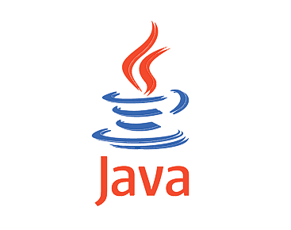



Different Java Frameworks

Slide 4
Hibernate Framework

Slide 5
Hibernate Overview
Object-relational mapping or ORM is the programming technique to map application domain model objects to the relational database tables. Hibernate is java based ORM tool that provides framework for mapping application domain objects to the relational database tables and vice versa.
Non-invasive framework, means it wont forces the programmers to extend/implement any class/interface, and in hibernate we have all POJO classes so its light weight.

Slide 6
Benefits of Hibernate
Supports mapping of java classes to database tables and vice versa. It provides features to perform CRUD operations across all the major relational databases.
Eliminates all the boiler-plate code that comes with JDBC and takes care of managing resources
Supports transaction management and make sure there is no inconsistent data present in the system
Since we use XML, property files or annotations for mapping java classes to database tables, it provides an abstraction layer between application and database.
Helps in mapping joins, collections, inheritance objects and we can easily visualize how our model classes are representing database tables.
Provides a powerful query language (HQL) that is similar to SQL. However, HQL is fully object-oriented and understands concepts like inheritance, polymorphism and association
Open source project from Red Hat Community and used worldwide
Easy to integrate with other Java EE frameworks

Slide 7
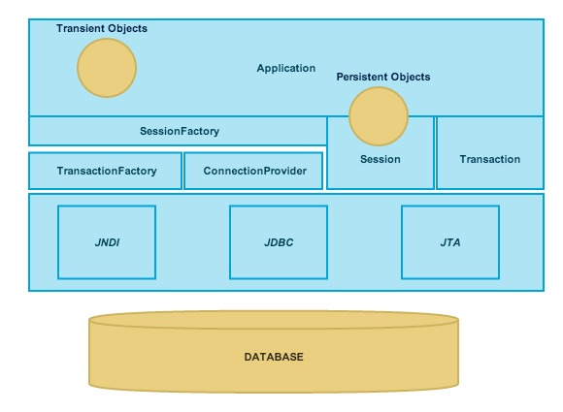
Hibernate Architecture
Layered architecture which helps the user to operate without having to know the underlying APIs.
Hibernate makes use of the database and configuration data to provide persistence services (and persistent objects) to the application
uses various existing Java APIs, like JDBC, Java Transaction API(JTA), and Java Naming and Directory Interface (JNDI)

Slide 8
Core components of hibernate
Configuration
The Configuration object is the first Hibernate object you create in any Hibernate application. It is usually created only once during application initialization. It represents a configuration or properties file required by the Hibernate.
The Configuration object provides two keys components −
Database Connection − This is handled through one or more configuration files supported by Hibernate. These files are hibernate.properties and hibernate.cfg.xml.
Class Mapping Setup − This component creates the connection between the Java classes and database tables.
SessionFactory
Configuration object is used to create a SessionFactory object. The SessionFactory is a thread safe object and used by all the threads of an application.
The SessionFactory is a heavyweight object; it is usually created during application start up and kept for later use. One SessionFactory object per database using a separate configuration file.
Session
A Session is used to get a physical connection with a database. The Session object is lightweight and designed to be instantiated each time an interaction is needed with the database. Persistent objects are saved and retrieved through a Session object.
The session objects should not be kept open for a long time because they are not usually thread safe

Slide 9
Core components of hibernate (cont.)
Transaction
To manage database transactions. Transactions in Hibernate are handled by an underlying transaction manager and transaction (from JDBC or JTA).
This is an optional object, not needed if managing transactions in their own application code.
Query
Query instance is used to bind query parameters, limit the number of results returned by the query, and finally to execute the query
Query objects use SQL or Hibernate Query Language (HQL) string to retrieve data from the database
Criteria
Used to create and execute object oriented criteria queries

Slide 10
Session Factory
SessionFactory provides three methods
getCurrentSession
Returns the session bound to the context. But for this to work, we need to configure, session context. Here is the configuration-
<property name="hibernate.current_session_context_class">thread</property>
Since this session object belongs to the hibernate context, we don’t need to close it. Once the session factory is closed, this session object gets closed
Note: session objects are not thread safe
openSession
Always opens a new session. We should close this session object once we are done with all the database operations
openStatelessSession
Returns instance of StatelessSession.
It does not implement first-level cache and it doesn’t interact with any second-level cache. Since it’s stateless, it doesn’t implement transactional write-behind or automatic dirty checking or do cascading operations to associated entities
It’s more like a normal JDBC connection and doesn’t provide any benefits that come from using hibernate framework
Useful in scenario like loading bulk data into database and we don’t want hibernate session to hold huge data in first-level cache memory

Slide 11
Session
Session provides two methods get() & load(), following are the difference between the two-
get() loads the data as soon as it’s called whereas load() returns a proxy object and loads data only when it’s actually required, so load() is better because it support lazy loading.
Since load() throws exception when data is not found, we should use it only when we know data exists.
We should use get() when we want to make sure data exists in the database.

Slide 12
FAQ

Slide 13
Thank you

