Slide 1



ATTIVAZIONE “MACCHINA CRM” DI GRUPPO Kick Off Formatori
WebServices for Java
Feb 2015
Modena, Luglio 2010
Notes:
1

Slide 2
Objective
The goals of this presentation are:
What are Web Services?
Why we need to learn web services?
Web Service Components
Types of Web Services
Java Web Services API
Web service design approaches
JAVA Web Services courses link

Slide 3
What are Web Services?
Services available via the Web.
Meant mainly for application to application communication (as opposed to users directly)
- Enables Business-to-Business transactions.
Web service is a language independent way of communication.
E.g., a web service is contacted on a URL using the SOAP protocol over HTTP.

Slide 4
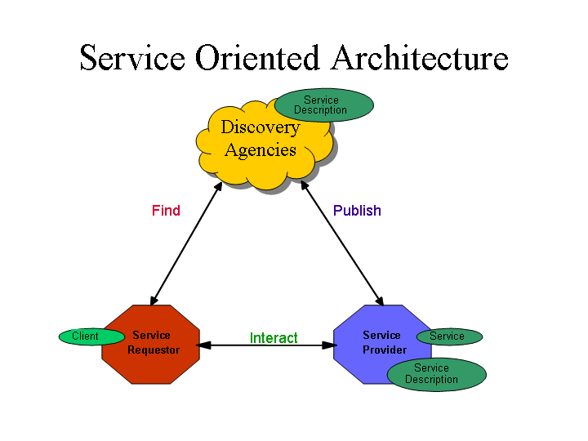
Service Oriented Architecture (SOA)
Service Oriented Architecture or SOA is a design pattern. It is designed to provide services to other applications through protocol. It is a concept only and not tied to any programming language or platform.
Web services is a technology of SOA most likely.

Slide 5
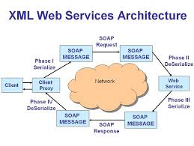
Cont..

Slide 6
Web Service Examples
A stock quote service.
An application requires the current value of a stock, the web service returns it.
A route finder for delivery of goods.
Given an initial and a final location, find the most cost-effective delivery route.
A weather service, a map service, a web search service…
any composition of Web services.

Slide 7
Why we need to learn Webservices?
Webservices should be used if no UI is involved and web-applications if a GUI is required. Is the choice all that simple?
Exposing the existing function on to network:
A Web service is a unit of managed code that can be remotely invoked using HTTP, that is, it can be activated using HTTP requests. So, Web Services allows you to expose the functionality of your existing code over the network. Once it is exposed on the network, other application can use the functionality of your program.
Connecting Different Applications ie Interoperability:
Web Services allows different applications to talk to each other and share data and services among themselves. Other applications can also use the services of the web services. For example VB or .NET application can talk to java web services and vice versa. So, Web services is used to make the application platform and technology independent.

Slide 8
Cont..
Standardized Protocol:
Web Services uses standardized industry standard protocol for the communication. All the four layers (Service Transport, XML Messaging, Service Description and Service Discovery layers) uses the well defined protocol in the Web Services protocol stack. This standardization of protocol stack gives the business many advantages like wide range of choices, reduction in the cost due to competition and increase in the quality.
Low Cost of communication:
Web Services uses SOAP over HTTP protocol for the communication, so you can use your existing low cost internet for implementing Web Services. This solution is much less costly compared to proprietary solutions like EDI/B2B. Beside SOAP over HTTP, Web Services can also be implemented on other reliable transport mechanisms like FTP etc.

Slide 9
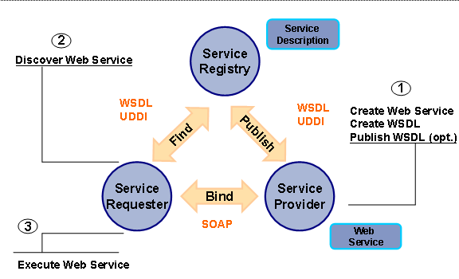
Web Service Components

Slide 10
HTML Limitations
Lack of Extensibility
No new tags/attributes allowed.
Fixed Tag Structure
Emphasis on presentation in markup.
No Validation
No data-checking or types.
In contrast to SGML (Standard Generalized Markup Language).
But SGML is too complex to be appealing.
So, XML comes to the rescue.

Slide 11
What is XML?
Extensible Markup Language.
HTML++, SGML--.
Document Type Definitions (DTD) precisely define valid tags and their grammar.
Not backward compatible with HTML.
System-independent and vendor-independent.
Product of the World Wide Web Consortium (W3C), trademarked by MIT.

Slide 12
XML Sample
<?xml version="1.0"?>
<PUBLICATION>
<TITLE>Why I am Overworked</TITLE>
<AUTHOR role="author">
<FIRSTNAME>Fred</FIRSTNAME>
<LASTNAME>Smith</LASTNAME>
<COMPANY>Jones and Associates</COMPANY>
</AUTHOR>
<ABSTRACT>This is the abstract</ABSTRACT>
</PUBLICATION>

Slide 13
XML DTD Sample
<?xml version="1.0"?>
<!DOCTYPE PUBLICATION
[<!ELEMENT PUBLICATION(TITLE,AUTHOR+,ABSTRACT*)>
<!ELEMENT AUTHOR (FIRSTNAME, LASTNAME,
(UNIVERSITY | COMPANY)?)>
<!ATTLIST AUTHOR role (author|techwriter) "author">
<!ELEMENT FIRSTNAME (#PCDATA)>
<!ELEMENT LASTNAME (#PCDATA)>
<!ELEMENT UNIVERSITY (#PCDATA)>
<!ELEMENT COMPANY (#PCDATA)>
<!ELEMENT ABSTRACT (#PCDATA)>
]>

Slide 14
What Makes XML Portable?
The schema (DTD) is associated with a document which allows to perform validation on the document.
Human-readable/writable.
Independent of presentation (formatting).

Slide 15
SOAP
SOAP is an XML-based protocol for exchanging information between computers.
SOAP is XML. That is, SOAP is an application of the XML specification.
SOAP is acronym for Simple Object Access Protocol
SOAP is a communication protocol
SOAP is designed to communicate via Internet
SOAP can extend HTTP for XML messaging
SOAP provides data transport for Web services
SOAP can exchange complete documents or call a remote procedure
SOAP can be used for broadcasting a message
SOAP is platform and language independent
SOAP is the XML way of defining what information gets sent and how

Slide 16
SOAP message
Envelope: ( Mandatory ) Defines the start and the end of the message.
Header: ( Optional ) Contains any optional attributes of the message used in processing the message, either at an intermediary point or at the ultimate end point.
Body: ( Mandatory ) Contains the XML data comprising the message being sent.
Fault: ( Optional ) An optional Fault element that provides information about errors that occurred while processing the message

Slide 17
A SOAP Message Structure
<?xml version="1.0"?>
<SOAP-ENV:Envelope
xmlns:SOAP-ENV="http://www.w3.org/2001/12/soap-envelope" S
OAP-ENV:encodingStyle="http://www.w3.org/2001/12/soap-encoding">
<SOAP-ENV:Header>
...
...
</SOAP-ENV:Header>
<SOAP-ENV:Body>
...
...
<SOAP-ENV:Fault>
...
...
</SOAP-ENV:Fault>
</SOAP-ENV:Body>
</SOAP_ENV:Envelope>

Slide 18
What is WSDL?
Web Services Description Language
WSDL is written in XML
WSDL is an XML document
WSDL is used to describe Web services
What operations does the service expose?
WSDL is also used to locate Web services
Where is the web service located?

Slide 19
WSDL Major Elements
Element | Defines
<definitions> | Must be the root element of all WSDL documents. It defines the name of the web service.
<types> | Describes all the data types used between the client and the server
<message> | Describes the data being exchanged between the web service providers and consumers.
<portType> | Combines multiple message elements to form a complete one-way or round-trip operation
<binding> | Provide concrete information on what protocol is being used to transfer portType operations
<service> | Element defines the ports supported by the web service

Slide 20
WSDL Structure
<definitions>
<types> definition of types...
</types>
<message> definition of a message.
</message>
<portType> definition of a port...
</portType>
<binding> definition of a binding
</binding>
</definitions>

Slide 21
WSDL - <portType> Element
The <portType> element is the most important WSDL element.
It defines a web service, the operations that can be performed, and the messages that are involved.
The <portType> element can be compared to a function library (or a module, or a class) in a traditional programming language.
<portType name="glossaryTerms"> <operation name="getTerm"> <input message="getTermRequest"/> <output message="getTermResponse"/> </operation>
</portType>

Slide 22
WSDL - <message> Element
The <message> element defines the data elements of an operation.
Each messages can consist of one or more parts. The parts can be compared to the parameters of a function call in a traditional programming language.
<message name="getTermRequest">
<part name="term" type="xs:string"/>
</message>
<message name="getTermResponse">
<part name="value" type="xs:string"/>
</message>

Slide 23
WSDL - <types> Element
The <types> element defines the data type that are used by the web service.
For maximum platform neutrality, WSDL uses XML Schema syntax to define data types.
<types>
<xsd:schema>
<xsd:import schemaLocation="http://localhost:8080/Jaxws- Converter/converter?xsd=1"
namespace="http://jaxws.samples.geronimo.apache.org" />
</xsd:schema>
</types>

Slide 24
WSDL Operation Types
Type | Definition
One-way | The operation can receive a message but will not return a response
Request-response | The operation can receive a request and will return a response
Solicit-response | The operation can send a request and will wait for a response
Notification | The operation can send a message but will not wait for a response

Slide 25
WSDL Sample Binding
The <binding> element provides specific details on how a portType operation will actually be transmitted over the wire.
The bindings can be made available via multiple transports including HTTP GET, HTTP POST, or SOAP.
<binding type="glossaryTerms" name="b1">
<soap:binding style="document“ transport=
"http://schemas.xmlsoap.org/soap/http" />
<operation>
<soap:operation soapAction="http://example.com/getTerm"/>
<input> <soap:body use="literal"/> </input>
<output> <soap:body use="literal"/> </output>
</operation>
</binding>

Slide 26
WSDL - <service> Element
The <service> element defines the ports supported by the Web service. For each of the supported protocols, there is one port element. The service element is a collection of ports.
Web service clients can learn the following from the service element:
where to access the service,
through which port to access the web service, and
how the communication messages are defined.
<service name="Hello_Service">
<port binding="tns:Hello_Binding" name="Hello_Port">
<soap:address location="http://www.examples.com/SayHello/"> </port>
</service>

Slide 27
UDDI
UDDI is an XML-based standard for describing, publishing, and finding Web services.
UDDI stands for Universal Description, Discovery and Integration.
UDDI is a specification for a distributed registry of Web services.
UDDI is platform independent, open framework.
UDDI can communicate via SOAP, CORBA, Java RMI Protocol.
UDDI uses WSDL to describe interfaces to web services.
UDDI is seen with SOAP and WSDL as one of the three foundation standards of web services.
UDDI is an open industry initiative enabling businesses to discover each other and define how they interact over the Internet.

Slide 28
1. SOAP Web Services
SOAP stands for Simple Object Access Protocol.
It is a XML-based protocol for accessing web services.
SOAP is XML based protocol.
It is platform independent and language independent.
SOAP defines its own security known as WS Security.
Disadvantages of Soap Web Services
Slow: SOAP uses XML format that must be parsed to be read. It defines many standards that must be followed while developing the SOAP applications. So it is slow and consumes more bandwidth and resource.
WSDL dependent: SOAP uses WSDL and doesn't have any other mechanism to discover the service.

Slide 29
2. RESTful Web Services
REST stands for REpresentational State Transfer.
REST is an architectural style not a protocol.
Advantages of RESTful Web Services
Fast: RESTful Web Services are fast because there is no strict specification like SOAP. It consumes less bandwidth and resource.
Language and Platform independent: RESTful web services can be written in any programming language and executed in any platform.
Can use SOAP: RESTful web services can use SOAP web services as the implementation.
Permits different data format: RESTful web service permits different data format such as Plain Text, HTML, XML and JSON.

Slide 30
SOAP vs REST Web Services
REST is best when …
Rapid prototyping and quick demos for end users are important.
Data is not highly structured or well defined by a schema – so you want to experiment and see the data in a browser and write code based on that.
SOAP is best when …
Bullet-proof integration of systems is important.
Well defined application interfaces are needed.
Data conforms to a schema.
QoS (e.g., guaranteed delivery) issues are important.

Slide 31
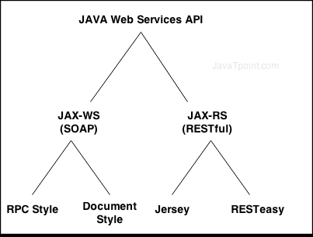
Java Web Services API:

Slide 32
JAX-WS
RPC Style
RPC style web services use method name and parameters to generate XML structure.
The generated WSDL is difficult to be validated against schema.
In RPC style, SOAP message is sent as many elements.
RPC style message is tightly coupled.
In RPC style, SOAP message keeps the operation name.
In RPC style, parameters are sent as discrete values.

Slide 33
RPC Style WSDL file:
In WSDL file, it doesn't specify the types details.
<types/>
For message part, it defines name and type attributes.
<message name="getHelloWorldAsString">
<part name="arg0" type="xsd:string"/>
</message>
<message name="getHelloWorldAsStringResponse">
<part name="return" type="xsd:string"/>
</message>
For soap:body, it defines use and namespace attributes.
<binding name="HelloWorldImplPortBinding" type="tns:HelloWorld">
<soap:binding transport="http://schemas.xmlsoap.org/soap/http" style="rpc"/>
<operation name="getHelloWorldAsString">
<soap:operation soapAction=""/>
<input><soap:body use="literal" namespace="http://javatpoint.com/"/></input>
<output><soap:body use="literal" namespace="http://javatpoint.com/"/></output>
</operation>
</binding>

Slide 34
JAX-WS
Document Style
Document style web services can be validated against predefined schema.
In document style, SOAP message is sent as a single document.
Document style message is loosely coupled.
In Document style, SOAP message loses the operation name.
In Document style, parameters are sent in XML format.

Slide 35
Document Style WSDL file:
In WSDL file, it specifies types details having namespace and schemaLocation.
<types>
<xsd:schema>
<xsd:import namespace="http://javatpoint.com/" schemaLocation="http ://localhost:7779/ws/hello?xsd=1"/>
</xsd:schema>
</types>
For message part, it defines name and element attributes.
<message name="getHelloWorldAsString">
<part name="parameters" element="tns:getHelloWorldAsString"/>
</message>
<message name="getHelloWorldAsStringResponse">
<part name="parameters" element="tns:getHelloWorldAsStringResponse"/>
</message>

Slide 36
Cont..
For soap:body, it defines use attribute only not namespace.
<binding name="HelloWorldImplPortBinding" type="tns:HelloWorld">
<soap:binding transport="http://schemas.xmlsoap.org/soap/http" style="document"/>
<operation name="getHelloWorldAsString">
<soap:operation soapAction=""/>
<input><soap:body use="literal"/></input>
<output><soap:body use="literal"/></output>
</operation>
</binding>

Slide 37
JAX-RS
Annotation Framework
Dispatch URI’s to specific classes and methods that can handle requests
Allows you to map HTTP requests to method invocations
A beautiful example of the power of parameter annotations
Nice URI manipulation functionality

Slide 38
JAX-RS Annotations
@Path
Defines URI mappings and templates
@ProduceMime, @ConsumeMime
What MIME types does the resource produce and consume
@GET, @POST, @DELETE, @PUT, @HEADER
Identifies which HTTP method the Java method is interested in

Slide 39
JAX-RS Parameter Annotations
@PathParam
Allows you to extract URI parameters/named URI template segments
@QueryParam
Access to specific parameter URI query string
@HeaderParam
Access to a specific HTTP Header
@CookieParam
Access to a specific cookie value
@MatrixParam
Access to a specific matrix parameter
Above annotations can automatically map HTTP request values to
String and primitive types
Class types that have a constructor that takes a String parameter
Class types that have a static valueOf(String val) method
List or Arrays of above types when there are multiple values
@Context
Access to contextual information like the incoming URI

Slide 40
JAX-RS Resource Classes
JAX-RS annotations are used on POJO classes
The default component lifecycle is per-request
Same idea as @Stateless EJBs
Root resources identified via @Path annotation on class

Slide 41
JAX-RS Implementations
Jersey
One nice value-add feature of Jersey is the Jersey Test Framework which lets you run and test your Jersey REST services inside JUnit/.
Supports true asynchronous (ie web sockets etc...) connections through either Atmosphere or 2.0 version.
Has support for Spring and standard injection containers (ie @Inject).
Glassfish bundles it.
Its much more modular than the other JAX-RS projects.
It has a URI Builder
Does not necessarily require servlet container.
Some MVC support through Viewables

Slide 42
Cont..
RestEasy
Much of the above but most notable supports view technologies (see HTMLEasy)
It does have asynchronous connection support
Cache support
EJB support
Arguably the best Spring integration (MVC handler).
More security support including early OAuth 2.0 support

Slide 43
Web service design approaches
Contract last or Bottom up approach:
When using contract last approach , you first write your java code then you create web service contract(WSDL) .There are various kinds of tools which can generate WSDL on the basis of java code.
Contract first or Top Down Approach :
It is reverse of contract first. Here you first define web service contract . You define all the elements of WSDL first then after that you create your java logic.

Slide 44
JAVA Web Services courses link
http://javabrains.koushik.org/topics/javaee#
http://www.mkyong.com/tutorials/jax-ws-tutorials/
http://www.mkyong.com/tutorials/jax-rs-tutorials/

