Slide 1
Sentiment Analysis
Assignment 1

Slide 2
Architecture
Data preprocessing - NLTK library
Word to integer encoding
Word embedding - gensim library: Word2Vec
Neural Net with zero hidden layers and Softmax Activation -TensorFlow – Keras
Prediction using the above model

Slide 3
Results - Train
Class | Precision | Recall | F1 Score | Support
1 | 0.37 | 0.61 | 0.46 | 4059
2 | 0.39 | 0.02 | 0.03 | 2265
3 | 0.30 | 0.19 | 0.23 | 3612
4 | 0.46 | 0.03 | 0.06 | 6871
5 | 0.77 | 0.93 | 0.84 | 33193
Accuracy |  |  | 0.69 | 50000
Macro - averaged | 0.46 | 0.36 | 0.33 | 50000
Weighted - averaged | 0.64 | 0.69 | 0.62 | 50000
Confusion Matrix
 | 1 | 2 | 3 | 4 | 5
1 | 2490 | 19 | 207 | 21 | 1322
2 | 997 | 40 | 250 | 15 | 963
3 | 968 | 11 | 683 | 58 | 1892
4 | 748 | 13 | 611 | 236 | 5271
5 | 1463 | 19 | 531 | 183 | 38997

Slide 4
Results - Test
Class | Precision | Recall | F1 Score | Summary
1 | 0.42 | 0.62 | 0.5 | 1271
2 | 0.19 | 0.01 | 0.02 | 630
3 | 0.29 | 0.20 | 0.24 | 911
4 | 0.42 | 0.03 | 0.05 | 1404
5 | 0.72 | 0.91 | 0.80 | 5784
Accuracy |  |  | 0.63 | 10000
Macro - averaged | 0.41 | 0.35 | 0.32 | 10000
Weighted - averaged | 0.57 | 0.63 | 0.56 | 10000
Confusion Matrix
 | 1 | 2 | 3 | 4 | 5
1 | 791 | 3 | 100 | 7 | 370
2 | 287 | 5 | 82 | 2 | 254
3 | 266 | 5 | 185 | 12 | 443
4 | 214 | 6 | 12 | 40 | 1011
5 | 336 | 7 | 40 | 34 | 5263

Slide 5
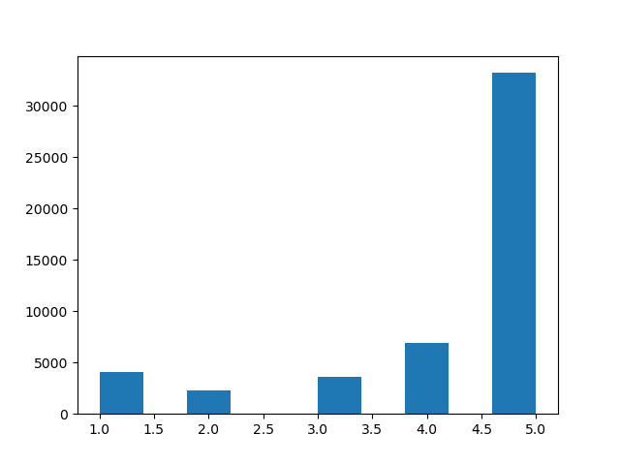
Observations
Imbalanced Dataset
Similar evaluation metrics for Train and Test Dataset
Removing stop-words from reviews have increased accuracy from 18% to 63%
Low ratings are mappings to few negative words like crap, waste.
- What crap. Would need a lot more power to do. Expected 1; Predicted 1
- This is not crap. It is working. Expected 3; Predicted 1

