Slide 1
CS772: DL4NLP Assignment Evaluation
Team Id : 25
Debabrata Biswal, 203050024
Ashish Aggarwal, 203050015
Keshav Agarwal, 203050039
08/03/2021

Slide 2
Problem Definition
Identifying the rating of a review using sentiment analysis
Input dataset contains reviews and their rating score between 1 to 5 - low to high
Given a review, we predict the rating score.

Slide 3
Architecture
Data preprocessing - validation set split using sklearn - NLTK library(stopword)
Word to integer encoding - manually
Word embedding - Word2Vec using gensim - Glove - FastText
Neural Net with TensorFlow – Keras - one trainable embedding layer - one hidden layers(256 neurons) - Softmax Activation
Prediction and Evaluation - keras - sklearn

Slide 4
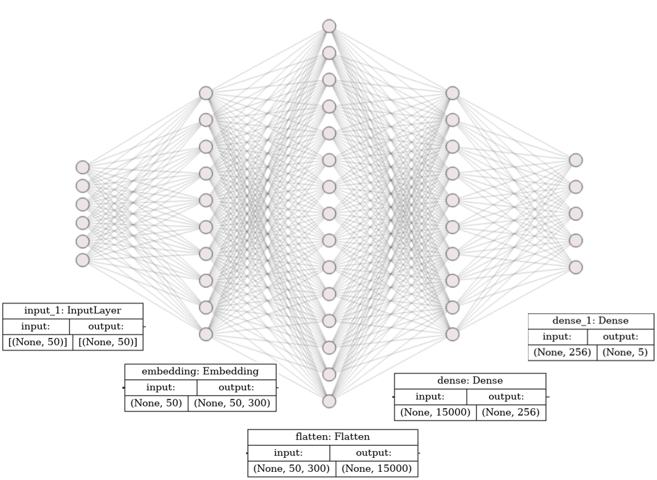
NN Architecture
Softmax activation
Relu/sigmoid activation

Slide 5
Table 1: Layers vs embeddings (sigmoid)
No. of hidden layers | Word2vec | GloVe | fastText
0 | 0.64 0.69 0.66 0.69 | 0.64 0.68 0.65 0.68 | 0.64 0.69 0.66 0.69
1 (256 neurons) | 0.64 0.68 0.66 0.68 | 0.63 0.67 0.64 0.67 | 0.64 0.68 0.66 0.68

Slide 6
Table 2: Data imbalance addressed (sigmoid)
 | word2vec | GloVe | fastText
UnderSampling | 0.67 0.60 0.62 0.60 | 0.65 0.61 0.62 0.61 | 0.67 0.63 0.64 0.63

Slide 7
Table 3: Layers vs Embeddings (ReLU)
No. of hidden layers | word2vec | GloVe | fastText
0 | 0.64 0.69 0.66 0.69 | 0.64 0.68 0.65 0.68 | 0.64 0.69 0.66 0.69
1 (256 neurons) | 0.64 0.68 0.66 0.68 | 0.63 0.68 0.65 0.68 | 0.64 0.68 0.66 0.68

Slide 8
Table 4: Data imbalance addressed (ReLU)
 | word2vec | GloVe | fastText
UnderSampling | 0.67 0.60 0.62 0.60 | 0.65 0.61 0.62 0.61 | 0.67 0.63 0.64 0.63

Slide 9
Confusion matrix for the best model
Classified
 | 1 | 2 | 3 | 4 | 5
1 | 871 | 73 | 132 | 34 | 161
2 | 245 | 72 | 147 | 53 | 113
3 | 116 | 60 | 329 | 180 | 226
4 | 40 | 21 | 199 | 342 | 802
5 | 61 | 19 | 129 | 358 | 5217
Actual

Slide 10
Qualitative analysis with some examples
Balancing the dataset improves the precision but reduces the overall accuracy.
Adding a hidden layer does not add to accuracy.
Retaining the negative sentiment stopwords improves the accuracy.
Sentiment is based on independent word instead of context. - Product is bad. prediction: class 1 with probability 0.52 - Product is not bad. prediction: class 1 with probability 0.80
Unknown sentence gives a probability distribution according to train data distribution.

Slide 11
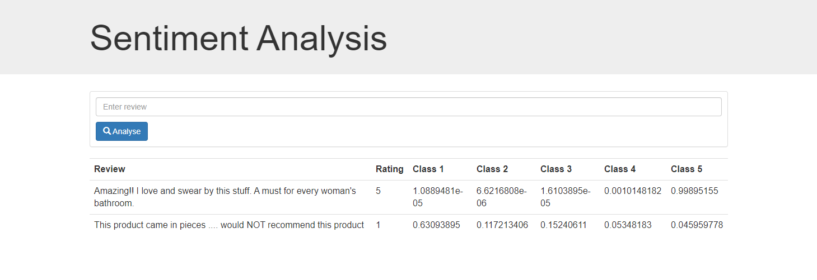
GUI screenshot/working
Flask based Web application to predict ratings based on reviews

