Slide 1

Retrieval Head Atlas
A Role-Decomposed Circuit for Semantic Long-Context Retrieval
Advisor: Prof. Vineeth N Balasubramanian
May 2026
MDS Capstone
Presented By
ASHISH ANAND | CS23MTECH15007
Notes:
Good afternoon. This is Ashish from the MDS 2023 batch, and this is the continuation of my capstone project, Retrieval Head Atlas. In the previous submission, I studied literal long-context copying: can a model find a hidden code in a long prompt, and which attention heads help it do that? In this submission, I extend the project to a more realistic question: when the query is semantic, and not just exact copying, what internal circuit carries the answer?

Slide 2

Semantic Retrieval Is the Harder Black Box
Accuracy Still Hides Mechanism
•
The previous work mapped heads for literal long-context copying.
•
The new task asks through aliases, paraphrases, relations, and distractors.
•
Research question: which heads carry answer identity, and which heads only support retrieval?
Notes:
The motivation is the same as last semester, but the task is harder. A language model can answer from a long context, but accuracy only tells us that the answer came out correctly. It does not tell us whether the model found the exact span, whether it used a broad distributed representation, or whether a small circuit routed the answer. This matters even more for semantic retrieval, where the question might use an alias, a paraphrase, or a relation instead of repeating the exact phrase.

Slide 3









Previous Submission: What Was Already Established
Mapping
Necessity
Sufficiency
Sparse retrieval activity concentrated in later layers, especially 19-23.
Targeted ablation showed the suspect heads were causal for long-range retrieval.
Patching revealed redundancy: answer information was broader than the first shortlist.
Notes:
Before I move into the new work, I want to briefly anchor what was already submitted last semester. The first version of Retrieval Head Atlas mapped a literal needle-in-a-haystack task. The main result was that retrieval activity was sparse and concentrated in later layers, mainly around layers 19 to 23. Then ablation showed those suspect heads were not just correlated with retrieval, because removing them selectively hurt the hard long-range setting. Finally, patching showed an important nuance: the system was specialized for necessity, but answer information was also more redundant than the first head list suggested. This is the foundation I build on here.

Slide 4
This Submission: From Head List to Head Roles
Task
Question
Evidence
Same project line, harder setting: semantic queries instead of literal copying.
Not just which heads matter, but whether they address, support, or carry answer content.
Same toolkit, now extended with semantic ablation, role grouping, and answer patching.
Notes:
This submission starts from that foundation rather than replacing it. Last semester the project asked: which attention heads are involved in literal retrieval? This semester I ask the next question: when retrieval becomes semantic, what role does each important head play? Some heads may directly address the answer span, some may support the computation, and only some may carry answer identity strongly enough to repair a corrupted run.

Slide 5

Experimental Probe
Controlled semantic retrieval
Model: Qwen2.5-1.5B-Instruct
Early / middle / late
Task: Retrieve a six-digit answer from 8k and 16k token contexts.
Answer scored at query step
8k / 16k context
•
Semantic variants: literal, alias, paraphrase, relational, distractor-heavy.
•
Needle position: early, middle, and late in the context.
Notes:
The model is still Qwen2.5-1.5B-Instruct, so the comparison remains clean. I use controlled long-context prompts at 8k and 16k tokens, with a marked answer-bearing span placed early, middle, or late in the context. The query comes in five semantic variants: literal, alias, paraphrase, relational, and distractor-heavy. The main score is teacher-forced log probability of the correct answer tokens, which lets us see effects even when final accuracy is high.

Slide 6



Methodology: Three Questions, Three Tools
1. Trace (Where?)
2. Ablate (Needed?)
3. Patch (Carries?)
Measure whether a head attends to the answer span, distractors, or query tail.
Remove heads or groups and test whether correct-answer probability falls.
Copy clean activations into a corrupted run to test answer-content transfer.
Notes:
The method intentionally reuses the earlier interpretability pipeline. Attention tracing asks where a head looks at the query step. Ablation asks whether the model needs that head or group of heads. Activation patching asks whether clean activations from that head can repair a corrupted prompt and restore probability on the clean answer. The difference is that I now compare these tools to separate head roles rather than collapse everything into one ranking.

Slide 7
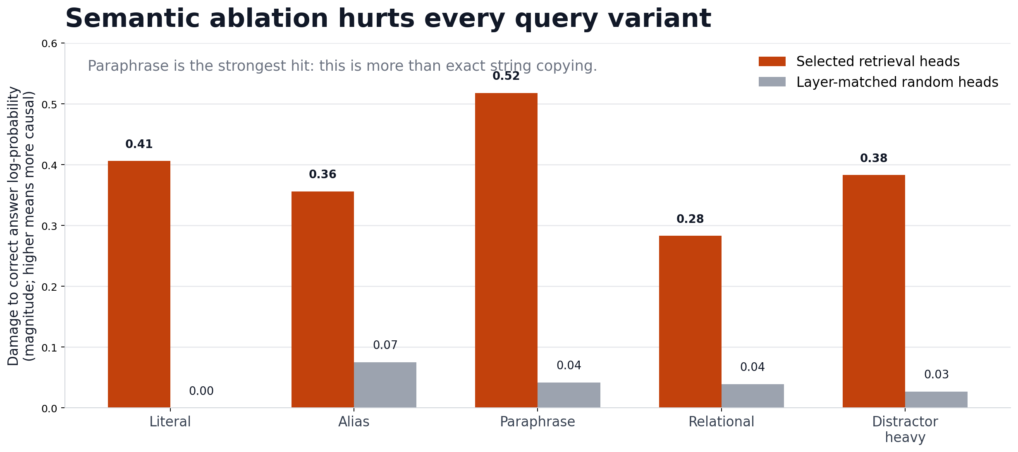
Semantic Retrieval Uses a Causal Head Neighborhood
Notes:
The first new result is that the previous retrieval-head neighborhood remains causally relevant when the task becomes semantic. When I ablate the selected retrieval heads at the query step, correct-answer log probability drops for every variant. The paraphrase condition is especially important because it is least like literal copying. This tells us the heads are involved in semantic retrieval, not only exact string matching.

Slide 8
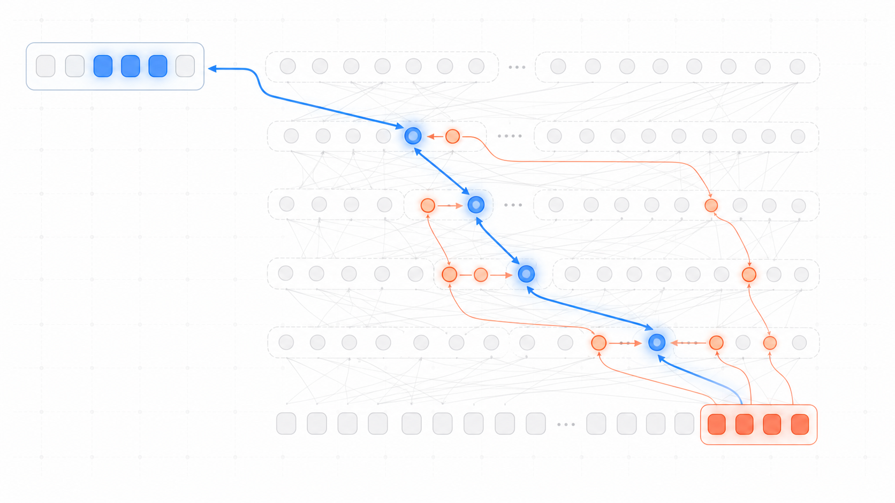
The Random Controls Became a Clue
A broader circuit, not a tiny shortlist
Some random draws were damaging because they sampled real support heads near the original retrieval-head cluster.
Broader sweep: identify active heads outside the original top-k list.
Group tests: separate address heads, non-address support, query-tail support, and controls.
Next question: which groups are necessary, and which actually carry answer identity?
Notes:
One interesting moment in the project was that some random controls were more damaging than expected. Instead of treating that as noise, I used it as a clue. A broader sweep showed that those random sets were sometimes sampling additional support heads from the same late-layer neighborhood. So the story expanded: we were not looking at one tiny shortlist, but at a broader semantic retrieval circuit with different kinds of members.

Slide 9
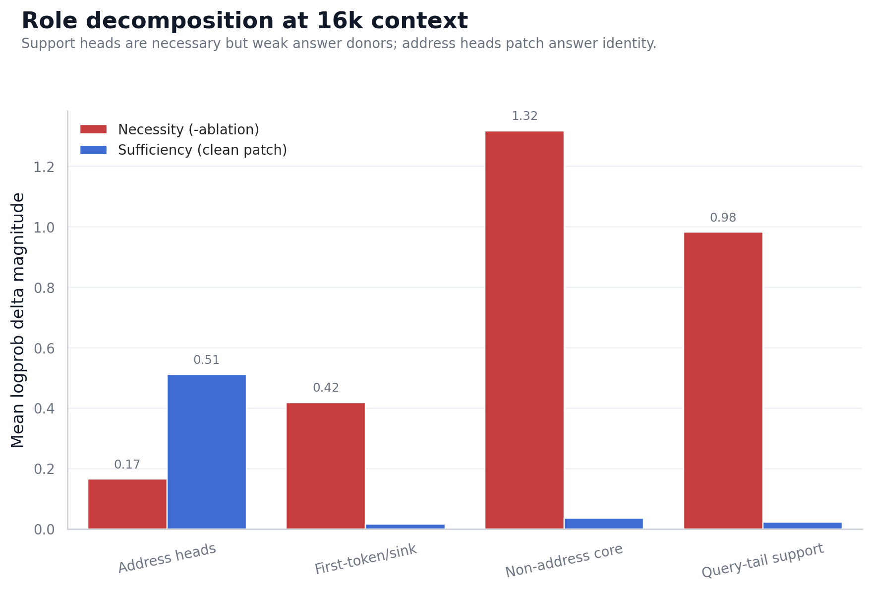
The Circuit Splits into Address Heads and Support Heads
Notes:
After grouping the heads functionally, the role split becomes clear. Answer-address heads directly attend to the answer-bearing span. Support heads do not necessarily point to the answer, but ablating them strongly damages the model. In this result, non-address core heads and query-tail support heads are much more damaging under ablation than the direct address group. That means support heads are not decorative; the model needs them.

Slide 10
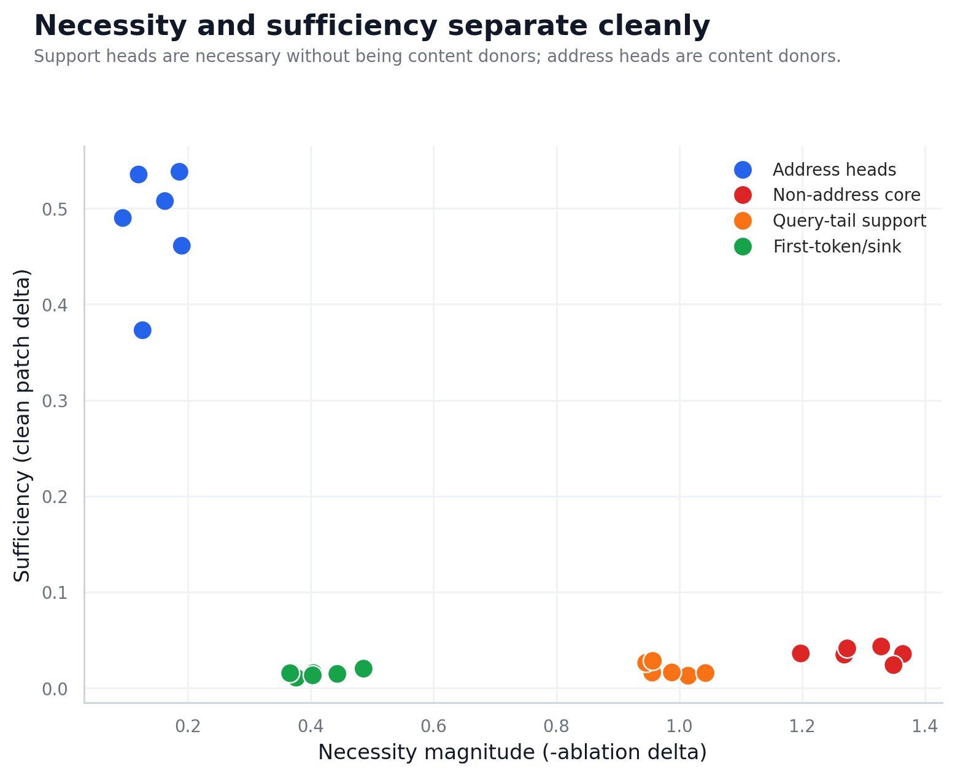

Necessity and Sufficiency Separate Cleanly
Ablation finds what the model needs; patching finds what carries answer identity.
Interpretation: support heads are crucial for the computation, but answer-address heads carry the transplantable answer signal.
Notes:
The key conceptual result is that necessity and answer-content sufficiency separate cleanly. Support heads are very necessary under ablation, but when I patch their clean activations into a corrupted run, they barely restore the clean answer. Answer-address heads show the opposite pattern: they are less damaging as a group under ablation, but they carry much more patchable answer identity. This resolves the earlier redundancy result into a clearer role decomposition.

Slide 11
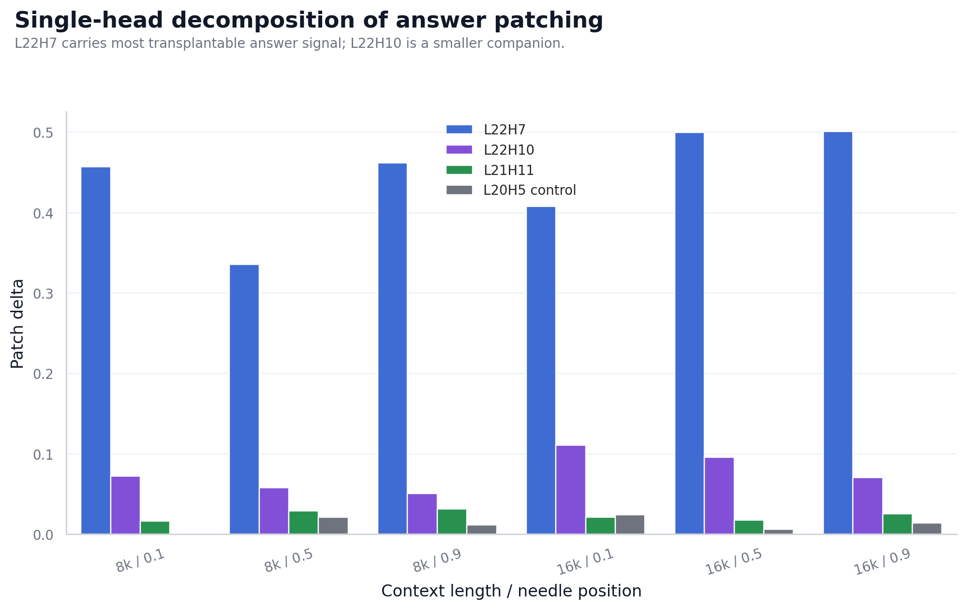
L22H7 Dominates the Answer-Content Pathway
Notes:
The answer-address group itself is also not uniform. Single-head patching shows that L22H7 carries most of the transplantable answer signal. L22H10 is a smaller companion, and L21H11 looks address-like but is weak as a standalone answer donor. This is useful because it prevents an overly simple conclusion: direct attention to the answer does not automatically mean the head carries the main answer identity.

Slide 12
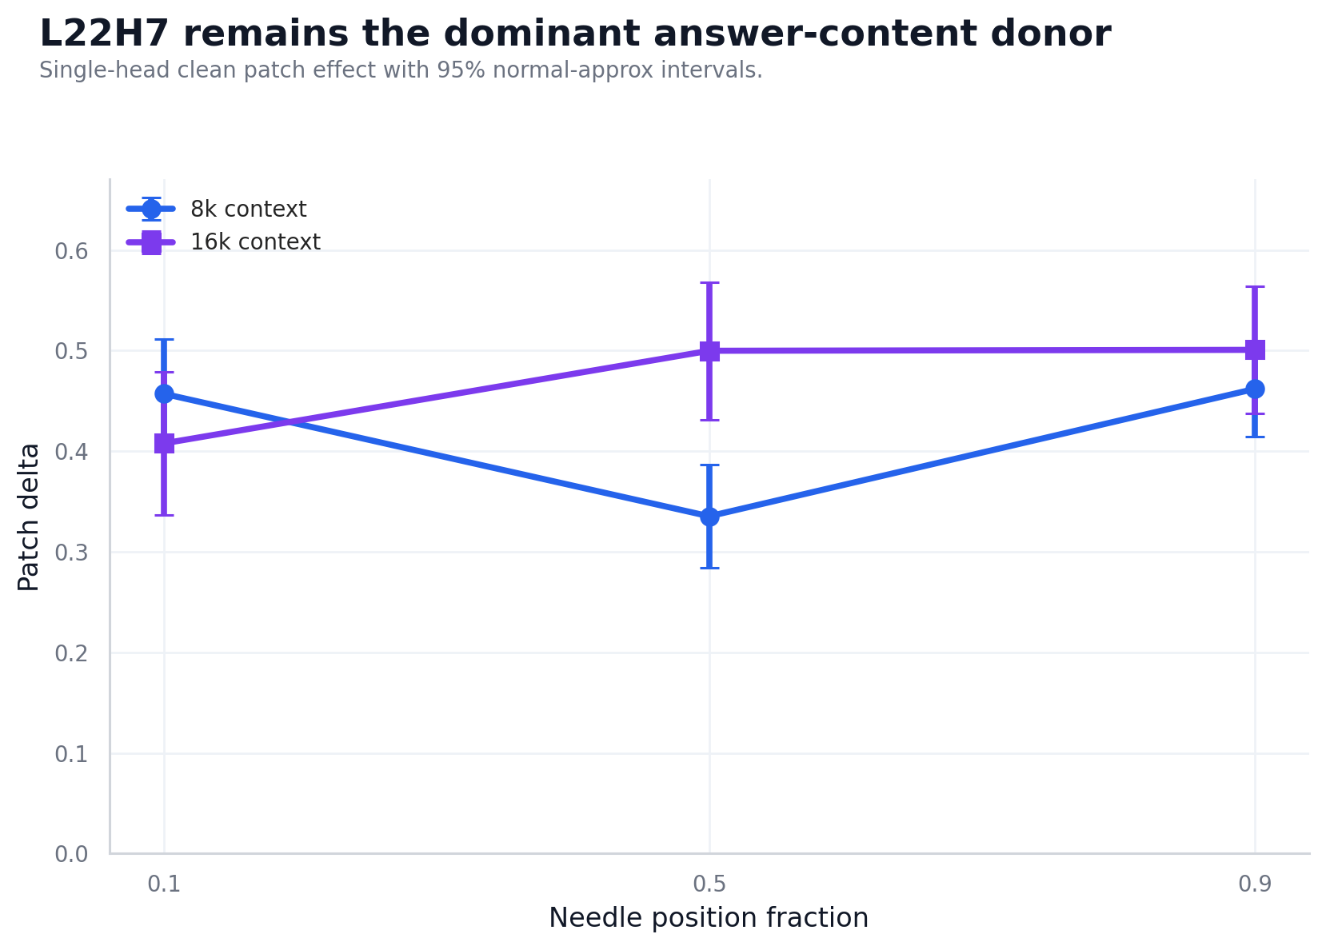
L22H7 Generalizes Across Context Length and Position
Notes:
The L22H7 result holds across the tested settings. It remains positive at 8k and 16k context lengths, and when the answer is early, middle, or late. There is a small dip at the 8k middle position, but the effect remains clearly positive. The important point is that the same head keeps aligning attention, activation difference, and causal patching evidence across the main grid.

Slide 13
Synthesis: Important Heads Have Different Roles
Address / content
Support
Result
L22H7 attends to the answer span and carries the clean answer under patching.
Non-address and query-tail heads are necessary but weak answer donors.
Semantic retrieval is a role-decomposed circuit, not a flat head ranking.
Notes:
So the final story is not simply that the model has retrieval heads. The stronger claim is that semantic long-context retrieval is role-decomposed. One small address and content pathway, dominated by L22H7, carries answer identity. A broader support neighborhood is strongly necessary for retrieval to work, but does not itself transplant the answer under this patching setup. This explains why attention, ablation, and patching can appear to disagree unless we separate head roles.

Slide 14

Limitations & Future Work
Controlled prompts: Great for mechanism tests, but still synthetic rather than natural documents.
Next Steps
One model: Current evidence is for Qwen2.5-1.5B-Instruct; other models may use different circuits.
Larger confirmation runs, more models, natural-document probes, and finer circuit localization.
Patching granularity: Current site is head-level attention output; future work should isolate Q/K/V, logits, and MLPs.
Notes:
There are still important limitations. The prompts are controlled and synthetic, which is useful for mechanistic intervention but not the same as natural documents. The model is only Qwen2.5-1.5B-Instruct, so other models may use different circuits. The patching site is still head-level attention output; future work should isolate query, key, value, attention logits, and MLP contributions. A paper version should also run larger confirmation grids and test more models.

Slide 15

References
Notes:
The work builds on the transformer architecture, mechanistic interpretability as circuit analysis, causal tracing and activation patching, long-context retrieval analysis, and retrieval-head work. These references are the main intellectual background for why we can treat a model's internals as a testable mechanism rather than only a black-box predictor.

Slide 16
Thank You
Notes:
To close, the contribution of this submission is a clearer mechanism for semantic retrieval. We started with a literal retrieval-head atlas, then moved to semantic prompts and discovered that important heads have different roles. L22H7 is the clearest answer-content head, while other support heads make retrieval possible. So the new submission is not a separate project dropped on top of the earlier one; it is the next layer of the same investigation. Thank you.

