Slide 1



ANALYSING AND PREDICTING VAGLWB SURRENDERS
By:
ASHISH GUPTA
UConn Graduate Consultant
MS Business Analytics & Project Management

Slide 2
Agenda
Key Findings
Executive Insights
Recommendations
Predictive Model (SEMMA Approach)
Sampling
Data Exploration/Munging
Data Modification/Reduction
Modeling
Model Assessment/Results
Questions
Appendix

Slide 3

Key Takeaways: Contracts are Risky if..
High
1. Policy Age
2. Minimum Age at Onset
Low
1. Account Value at beginning of year
2. Duration and Amount of Surrender Charge
3. Owner Age
No Beneficiary!!
Cost Structure → L-Share (Short Surrender Charge, e.g., 3-4 years)
Surrender Charges charged “since Issue”

Slide 4
Executive Insights – Let’s dive deep

Slide 5
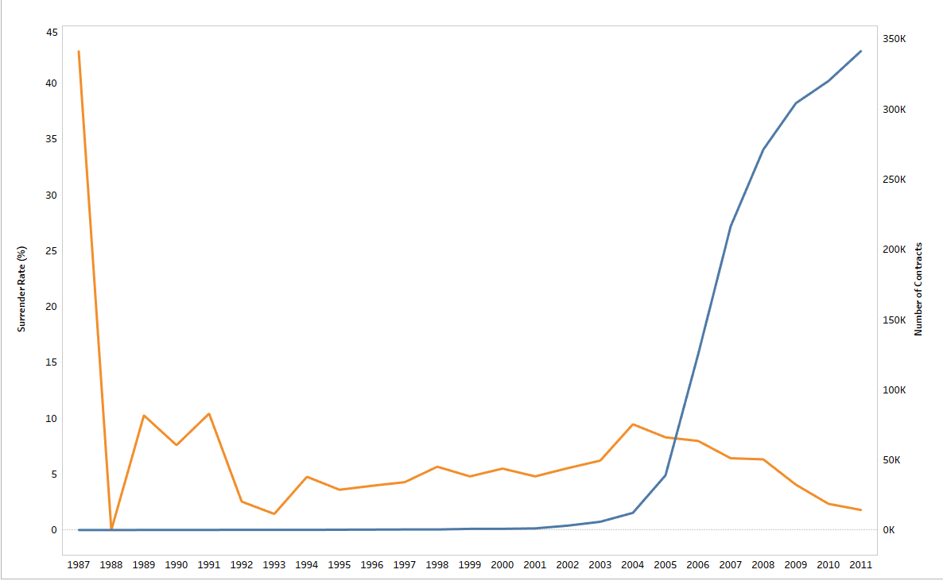

Key Variable: Date of Issue (Policy Age)
•Industry boomed after year 2004, period when Baby Boomers started investing in annuities.
•Slight increasing trend in surrender rate with time before 2004
•Decreasing surrender rate trend ever since Industry boom.
Surrenders and Contracts over time
Threshold Surrender Rate=4.69%

Slide 6

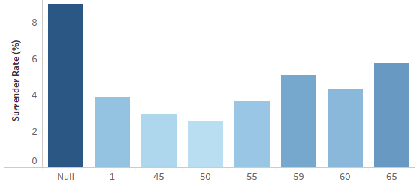
Key Variable – Minimum Age at Onset
Surrender Rate by Minimum Age at Onset
Policies with Higher Minimum Owner Age at Onset of lifetime payments have more likelihood of surrender
Missing values of Higher Minimum Owner Age at Onset of lifetime payments have the highest surrender rate
Threshold Rate= 4.69%
Minimum Age at Onset

Slide 7
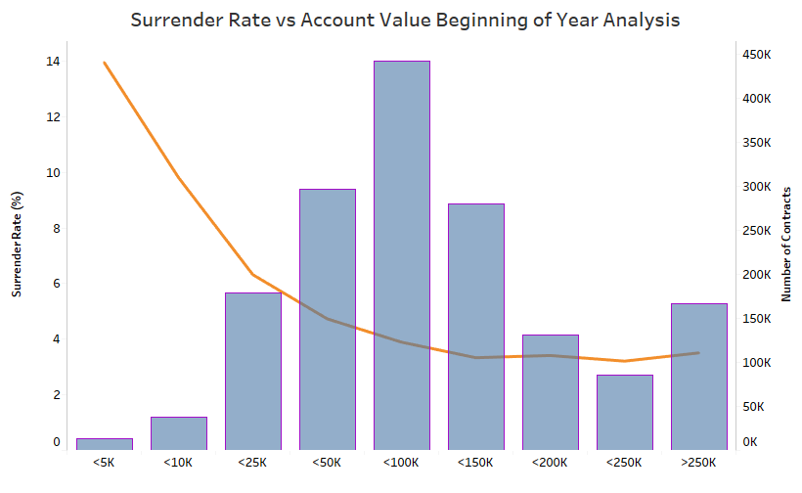

Key Variable – Account Value
Account Value less than $25,000 has high surrender rates compared to baseline
Surrender rate goes as high as 14% for account value less than $5,000
Threshold rate = 4.69%
Account Value (in Dollar) at Beginning of the year

Slide 8
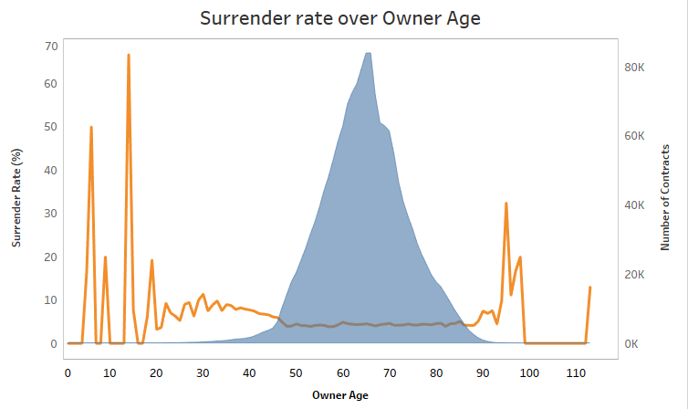

Key Variable: Owner Age
95% of contract owners are in the age group of 46 – 86
Surrender rates are high for the rest 5%
Threshold rate = 4.69%

Slide 9
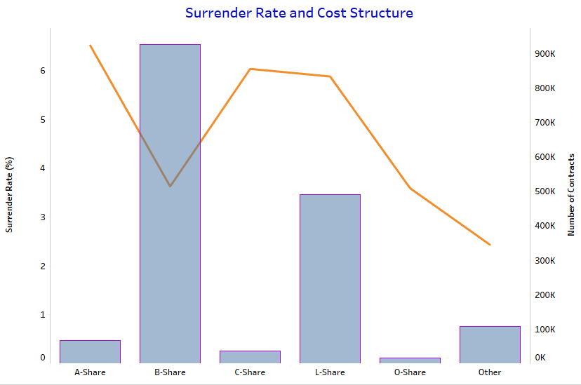

Key Variable: Cost structure
A-share class, C-share class and L-share class correspond to relatively higher surrender rates
Particularly, L-share class is the area of concern.
B-share class could be considered as benchmark for other cost structure GLWB annuities.
5.8%
3.6%
Cost Structure

Slide 10

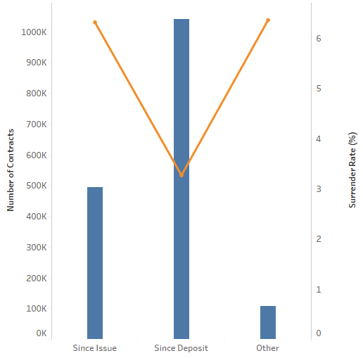
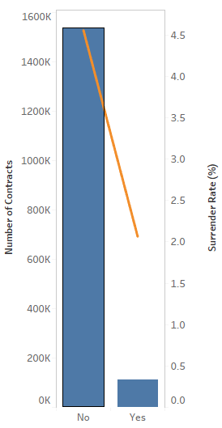
Key Variables: Surrender basis and Presence of Secondary Annuitant
Surrender Rate by Surrender Basis
Surrenders by presence of Secondary Annuitant
Less surrender rate is associated with surrender basis – “Since Deposit” and “Other”
Clearly, less surrender rate when owner has secondary annuitant
Surrender basis
Secondary Annuitant

Slide 11
Recommendations
Minimum age of onset
Restructure to reduce the minimum age of onset subject to RMD rules.
Account Value
Encourage more investments in annuities to reduce surrenders. One approach could be – once account value drops below a certain threshold offer matching top-ups up-to certain value (let’s say $500) similar to what we see when opening new IRA accounts.
Owner Age
Increase personalized engagement with younger annuity owners as they might be going through financial readjustments or looking at trying different avenues for retirement planning.

Slide 12
Recommendations
Cost Structure, Duration and Rate of Surrender Charge:
Companies are encouraged to revise policies to stretch out surrender charges over a longer period and as a mitigation, lower the rates of the charges. For existing customers, offer an option to lower surrender charges if they accept higher durations. This suggestion has to be taken keeping in mind the competitive landscape.
Inflexible Policies:
Add checklist question when annuitant asks for surrender. If "Rider charge" for GLWB rider is the reason, then a rider cancellation can be negotiated in lieu of complete surrender.
Absence of Secondary Annuitant may be a red flag suggesting possible surrenders

Slide 13
Modeling Approach - SEMMA

Slide 14
Data Munging
Variable Selection
Model Building
Model Assessment
Sampling
Removed data redundancy by eliminating repeating contracts
Considered 1.6 million unique contracts of 2.3 million
Sampled 20% of total contracts into Test data using Proportional Stratification
Trained and Validated different proportional samples (For Example: Surrenders: Non-Surrenders = 1:1, 1:2, 1:3, 1:4, 1:5 and original proportion)

Slide 15

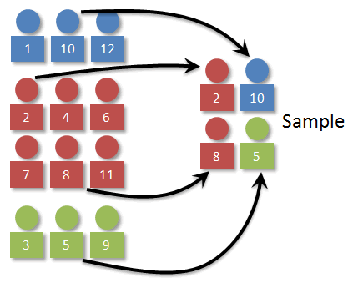
Data Munging
Variable Selection
Model Building
Model Assessment
Sampling
Unique 1.6M
Total 2.3M
Train & Validation
1:1, 1:2, 1:3, 1:4, Original Prop
Test – 10%
Stratified Original Proportion

Slide 16
Data Munging
Variable Selection
Model Building
Model Assessment
Sampling
Missing Data Glimpse
Few Companies like 0015, 0080 and 1981 have not reported data for certain variables significantly
For continuous features, imputed with descriptive statistics like Mean and Median as per their distribution
For Categorical features, created new levels “Level_NA” to capture the information in missing data, if any
Feature Engineering Glimpse
Computed new feature which tells in which year surrender charge becomes 0, such that it captures the information from 10 different variables
Computed Flag variable - “Whether Secondary Annuitant or not” based on features like Secondary Annuitant’s Birth, Age and Sex

Slide 17
Data Munging
Variable Selection
Model Building
Model Assessment
Sampling
Variable Rejection Stage
Rejected features not important to model
Rejected features based on Chi-square
Rejected features not important to Business
Variable Selection Stage
Selected features based on Business (Control, Impact, Strategy)
Selected features with the help of variable Clustering
Business Value Model
Variable Selection
Variable Rejection
Business Value Model

Slide 18
Data Munging
Variable Selection
Model Building
Model Assessment
Sampling
Designed Two Modeling Approaches:
Best Predictive Model
Business Value Model
Simple Decision Tree Model explained variable importance which helps for Business Decision Making
Developed Random Forest Models which robustly predicted the Surrenders up to 80% correctly on balanced data sets
Ensembled several Random Forest Models, built on different sample proportions, to report on stratified test (unbalanced) data

Slide 19
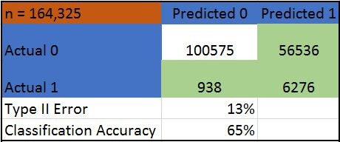
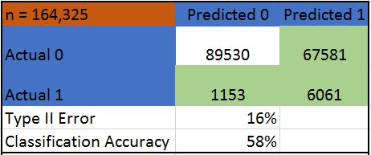
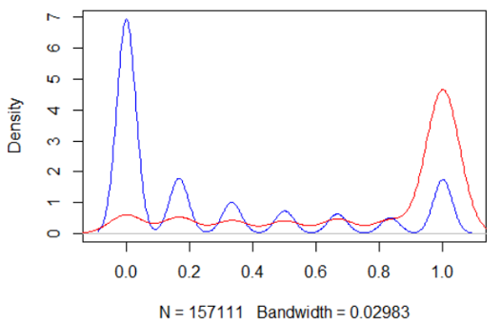
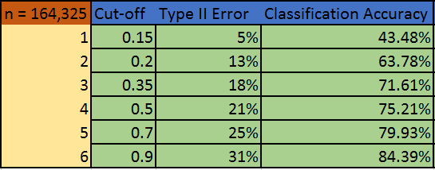
Data Munging
Variable Selection
Model Building
Model Assessment
Sampling
Business Value Model
Best
Predictor
VS
ENSEMBLE MODEL

Slide 20

Questions ?

Slide 21
APPENDIX
Contracts detail
Data Exploration – Nulls
Data Modification Philosophy
Feature Engineering
Modeling – (Precision - Recall Tradeoff)

Slide 22

Data Exploration - CONTRACTS
Contracts | Count
UNIQUE | 1643249
REPEATING | 676793
NON-REPEATING | 966456
Repeating Contracts (Not-Surrendered in 2012) | 675902
Appear in 2013 as Not-surrendered | 653533
Appear in 2013 as Surrendered | 22369
Approach: Deleted all these contracts from 2012
Repeating Contracts (Surrendered in 2012) | 891
Appear in 2013 as Surrendered | 888
Apear in 2013 as Not-surrendered | 3
Approach: Deleted all these contracts from 2013
Non-Repeating Contracts
Appear in 2013 only | 457344
Appear in 2012 only | 509112

Slide 23
Data Exploration - NULLS
Company 0015 has not reported whether policies have fixed account
Company 0080 has not reported no. of subaccounts data
Company 1981 is not reporting CUMLPREM data and CUMLWITHD
Many missing data fields for company 1981
Very high correlation of CURPREM NA’s with TARGET.
Several patterns of NA’s could be identified among several related variables.

Slide 24
Data Modification Philosophy
No data better than bad data.
No missing data at prediction time (in to-be predicted “test” cases)
Very few to no imputations in categorical variables.
Any feature’s Null values exhibiting high correlation with target were first tested if they could possibly be post events.
Business sense over statistical/predictive techniques.

Slide 25
Data Modification and Feature Engineering
Identified several columns as Post-effect and therefore, Rejected
Reduced 10 variables SURCHG_YR1 – YR10 into 2 features - SURCHG_YR_Start & SURCHG_YR0
Extracted feature S_Annuitant from variables S_Age, S_Sex, S_Gender
Extracted feature WBL_MAX_WTHD_COMPLEXITY from WBL_MAX_WITHD_PCT_(1-6)
If required, imputed continious variables NA’s with their respective mean or median as per distribution.
Captured NA’s separetely as per their relation with Target (scope for further research)

Slide 26
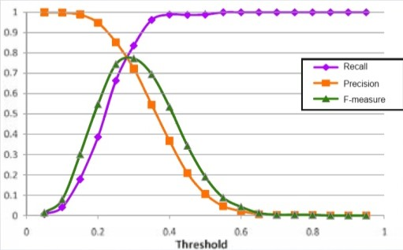
MODELING – PRECISION-RECALL TRADEOFF
Trade-off between Precision and Recall
Modeled on different proportions
Cross Validated on different prop
Reported three classes
Model assessment metric – PR Curve, Precision-Recall Tradeoff (F1 Score), AUC

Slide 27
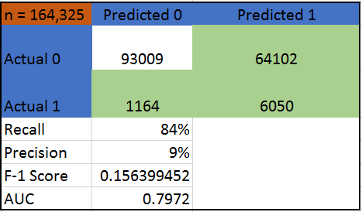
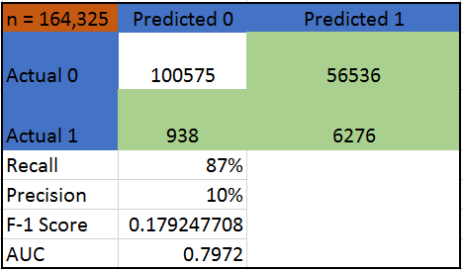

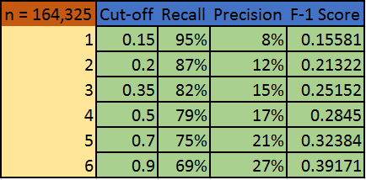
MODELING – PRECISION-RECALL TRADEOFF
Best Classifier
Reported on Test, 10% Stratified sample
LINEAR MODELS VS RANDOM FOREST
Business Value Model
Reported on Test, 10% Stratified sample
One Sample VS Multiple Samples

