Slide 1

Structure-based Prediction of Interacting Partners of WDR13
Sankara Nethralaya, Chennai
Final Seminar: 11/07/2013
Ashish Baghudana, 2011B1A7575G
(M.Sc. Biological Science and B.E. Computer Science)
Mentor: Dr. V. Umashankar
BITS-Pilani K. K. Birla Goa Campus

Slide 2
Presentation Plan
Introduction and Recap
Results and Discussion
Methodology: Protein Structure Prediction and Refinement
Background Research on WDR13
Methodology: Physical Docking and Analysis
Conclusion
Recommendations
1
Project Aims and Objectives
2
3
4
5
6

Slide 3
Project Aims and Objectives
To Study
WD40 domains to understand their role in different proteins.
WDR13, a WD40 protein, that is highly conserved in many organisms.
To Predict
The structure of WDR13 and to understand its structure-function relationship.
To predict the interacting partners of WDR13 on the basis of its structure.

Slide 4
Introduction: Starting Point for the Study
WDR13 knockout caused increased beta-cell proliferation in mice, which resulted in an increase in insulin production (VP Singh, 2012).
At the same time, overexpression of WDR13 resulted in a retardation of cell growth.
Overexpression of WDR13 led to upregulation of p21.

Slide 5
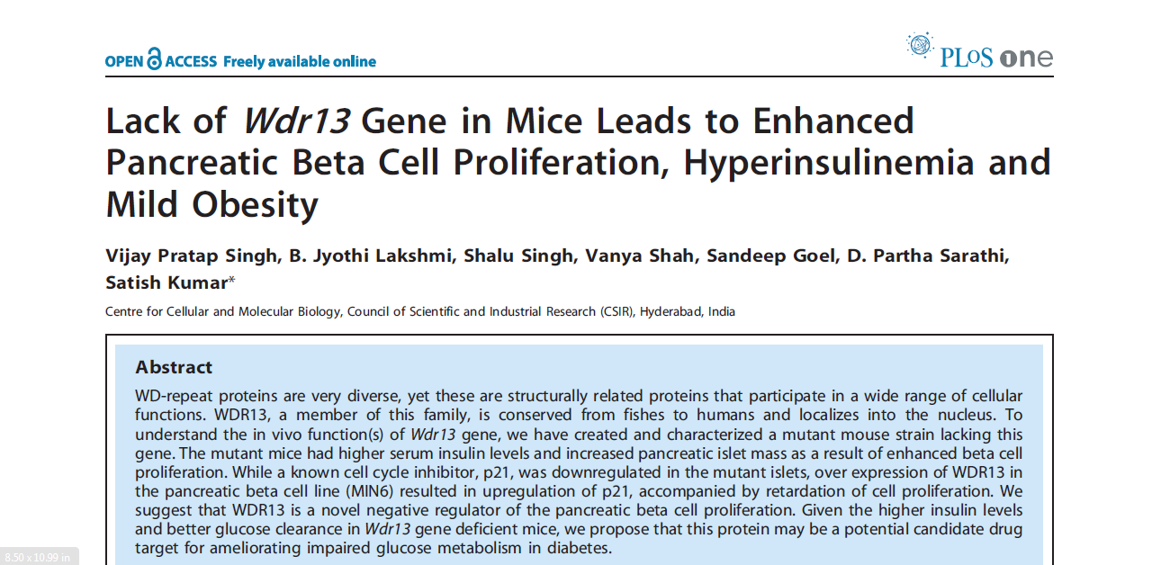

Slide 6
Introduction: Starting Point for the Study
WDR13 was also found in high concentration in the brain (particularly, the hippocampus) following synaptogenic lesion (Mitch Price, 2003).
The detection of WDR13 in the hippocampus in association with Calcineurin during neuronal regeneration suggests a regulatory function for WDR13.

Slide 7
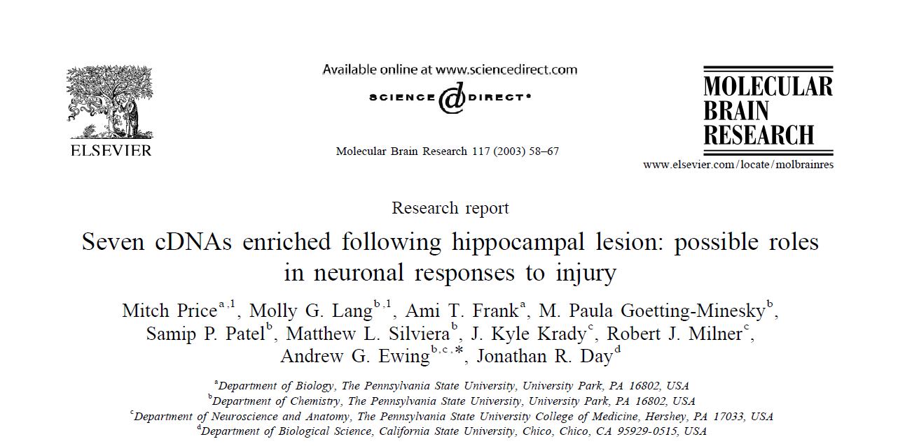

Slide 8
WDR13 Structure Prediction: Approach
We used MODELLER and I-TASSER for structure prediction of WDR13.
MODELLER is a homology modelling tool and directly copies coordinates for known matched sequences.
I-TASSER uses fold recognition, that is, it fits a particular fold in to the sequence.

Slide 9
WDR13 Structure Refinement: Approach
We performed extensive structure refinement on WDR13 using Loop Refinement and Energy Minimization.
For Loop Refinement, we used MODELLER’s loop refine script (iterative refinement took about 25 times) and some online servers such as ModRefine and KoBaMin.
For energy minimization, we used GROMACS.

Slide 10
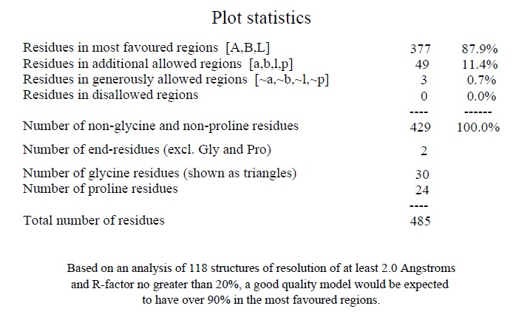
Ramachandran Plot Statistics After Refinement

Slide 11
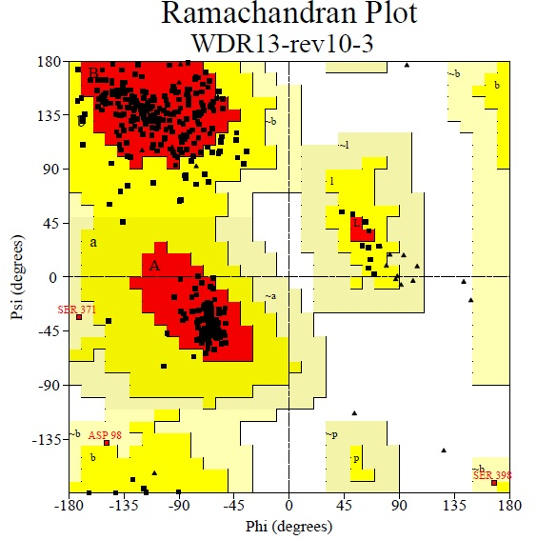

Slide 12
GROMACS Energy Minimization
The structure of WDR13 was obtained after loop refinement and was taken for Energy Minimization using GROMACS.
The potential energy plot is shown in the next slide.

Slide 13
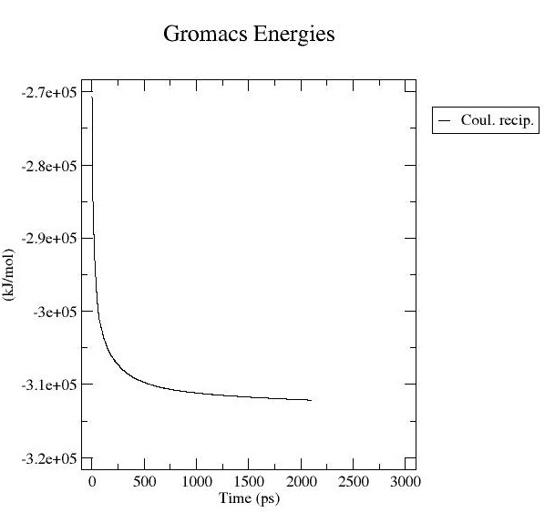

Slide 14
Testing Structure Stability
After Energy Minimization, we performed a Molecular Dynamics simulation on WDR13.
This first requires equilibration with ions and NVT and NPT runs.
This is followed by a Molecular Dynamics simulation for 1 ns.

Slide 15
Testing Structure Stability
In our molecular dynamics simulation, we observed WDR13 to be extremely stable. This was indicated by steady temperature and pressure plots over the duration of simulation.
We also plotted RMSD of the protein structure and found it was less than 3 angstrom. This is considered an extremely stable structure.
The next three slides show these plots.

Slide 16
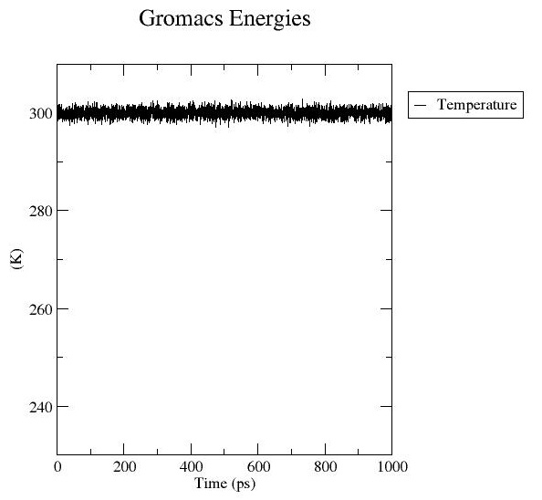
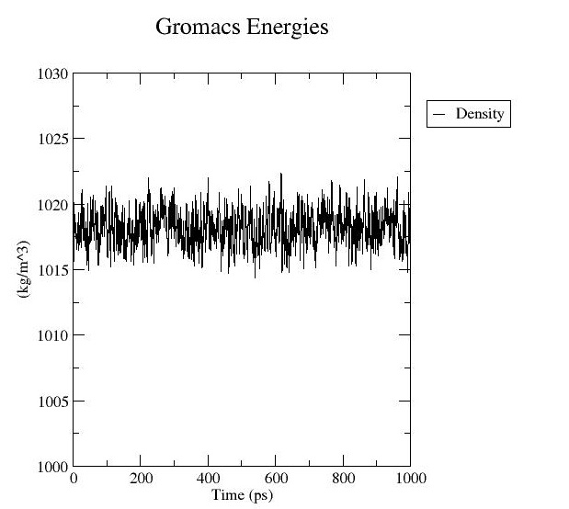

Slide 17
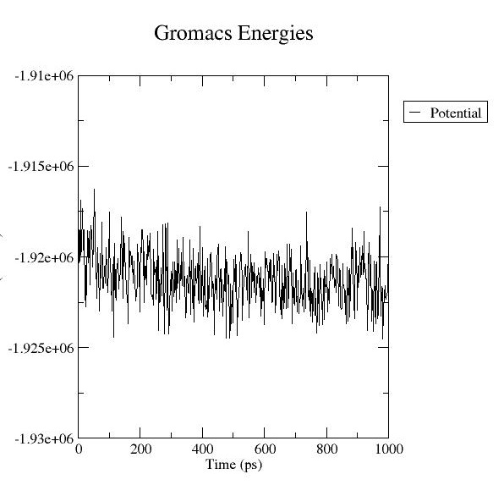

Slide 18
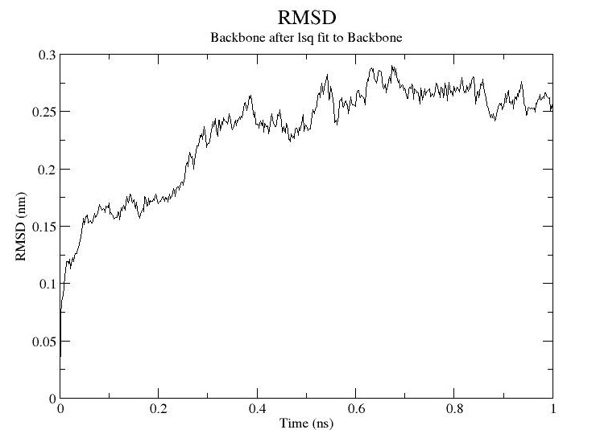

Slide 19
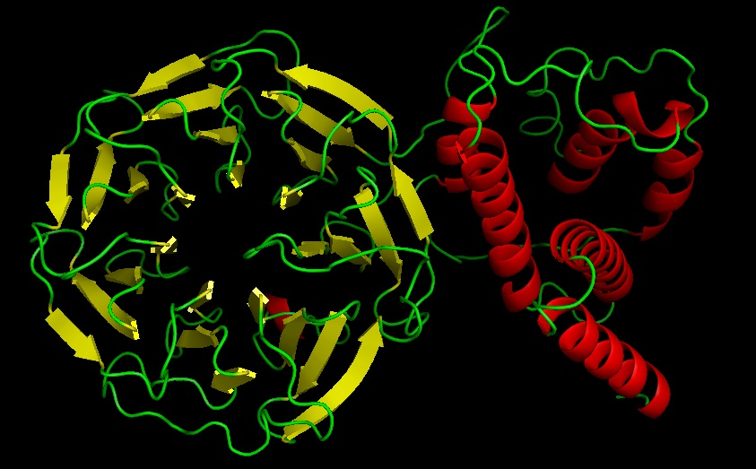
WDR13 Final Structure

Slide 20
Collection of Dataset
We collected data for WDR13 on the basis of literature survey, co-expression, co-localization and database predictions.
For database predictions, we used STRING and GeneMania.
We further narrowed down our dataset on the basis of availability of known PDB structures.

Slide 21
Dataset
Literature Survey | Colocalization | Coexpression | Database Predictions
Estrogen Receptors: ER-alpha, ER-beta Histone Deacetylase: HDAC1, HDAC3, HDAC7 PHIP1: Pleckstrin Domain Homology Interacting Protein | Calcineurin: PPP3CA, PPP3CB, PPP3CC (Mitch Price, 2003) Serine-Threonine Protein Phosphatase 2A Hippocalcin (Shared calcium domain) Astrotactin AKAP5: A kinase (PRKA) anchor protein 5 (Interacts with Calcineurin) | p21 (CDKN1a) | Transforming Growth Factor β (TGFβ) TGFβ Receptor 1 (TGFβR1) NF-κB: p50 and p65 Jun FtsJ1 WDR45 FKBP1A PIM1 CCND3

Slide 22
Final Dataset used for Physical Docking
For docking, we used the following proteins along with WDR13.
ER-alpha, ER-beta, HDAC3, HDAC7, Calcineurin, Calmodulin, TGFβR1, CCND3, FKBP1A, PIM1, NF-κB.
Of the dataset, ER-alpha, ER-beta, HDAC3 and HDAC7 are known interacting partners for WDR13 (Sathish Kumar, 2012).
We submitted the structures of these compounds to 5 online docking algorithms.

Slide 23
Docking Algorithms Used
ClusPro, GrammX, HexDock, PatchDock and ZDock.
All algorithms used are different, hence a similar prediction of the interface would increase the chances of the protein to be a true interacting partner (.
Notes:
Cluspro uses Clustering, GrammX uses smoothed Lennard Jones potential, HexDock uses FTT, PatchDock uses Object Recognition and Image Segmentation techniques used in Computer Vision, ZDock uses a modified version of FTT

Slide 24
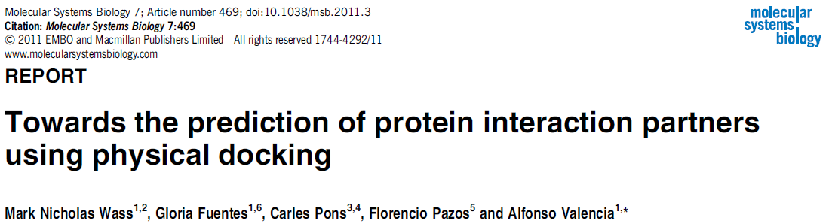
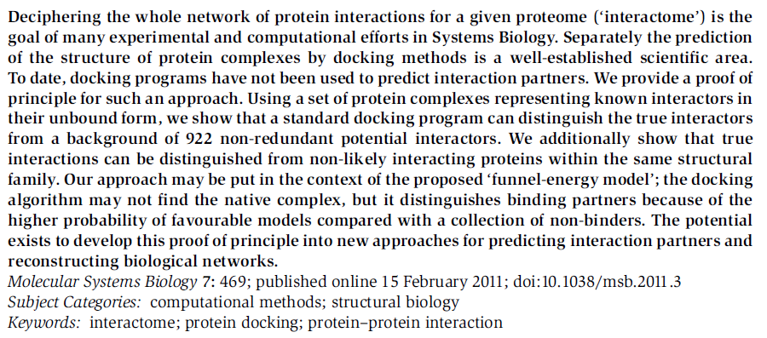

Slide 25
Physical Docking: Approach
WDR13 was uniformly submitted as the receptor and proteins from the dataset were submitted as ligands.
Overall, 12 sets of proteins were submitted for docking. Across 5 algorithms, we got 60 complexes.
These complexes were analyzed for the interface region using PyMOL and DIMPLOT.

Slide 26
Results and Discussion
If multiple algorithms predicted the same region as the interface region for a ligand, we took that ligand to have a higher chance of interacting with WDR13.
We also analyzed the secondary structure at the interface using an online algorithm 2P2IDB (Protein-Protein Interaction Inhibition Database)
We found that 3 out of the 8 experimental proteins qualified both these tests.

Slide 29
Results and Discussion
We found FKBP1A, PIM1 and TFGβR1 to have maximum consensus regions between multiple algorithms
In FKBP1A, region 30 to 55 was predicted by 4 out of 5 docking algorithms: ClusPro, GrammX, HexDock and Zdock
Regions 80 to 90 and 100 to 110 were predicted by 3 out of 5 algorithms.

Slide 30
Results and Discussion
In PIM1, regions 45 to 50, 165 to 175 and 200 to 205 were predicted by 3 algorithms
In TGFβR1, region 230 to 240 was predicted by 3 algorithms.
Regions 210 to 220, 320 to 325 and 420 to 430 were predicted by 2 algorithms each.

Slide 31
Results and Discussion
Interaction with FKBP1A and TGFβR1 seems to provide a link to the control of p21 (CDKN1a) shown in β-cell regulation.
TGFβR1 and FKBP1A are known interacting partners.
Hence, WDR13 might act through TGFβR1 and FKBP1A to act as a switch during β-cell proliferation

Slide 32
Interaction Route: First Possibility
WDR13
TGFβR1
FKBP1A
p21 and β-cell regulation

Slide 33
Results and Discussion
PIM1 is involved in controlling NFAT transcription factors.
This is linked to Calcineurin/NFAT signaling which regulates beta cell proliferation.
There is also a report on cross-talk between p21, Calcineurin and NFAT.

Slide 34
Interaction Route: Second Possibility
WDR13
PIM1
p21 and β-cell regulation
Calcineurin/
NFAT

Slide 35
Results and Discussion
We also found WDR13 might have a role in Wnt signaling pathway.
We submitted the structure of WDR13 for function prediction to an online server 3d2GO.
3d2GO is an Imperial College, London initiative that uses a machine learning technique called Support Vector Machine.
Our results are as follows.

Slide 36
3d2GO Results for WDR13
GO Term | Description | Confidence
GO:0005515 | Protein Binding | 0.83
GO:0005737 | Cytoplasm | 0.81
GO:0005634 | Nucleus | 0.55
GO:0007165 | Signal Transduction | 0.48
GO:0005488 | Binding | 0.29
GO:0016055 | Wnt Receptor Signaling Pathway | 0.28

Slide 37
Results and Discussion
To assess the confidence level more reliably, we also gave a known protein, G-β subunit to 3d2GO.
The results we got are summarized in the next slide.

Slide 38
3d2GO Results for G-β Subunit
GO Term | Description | Confidence
GO:0005515 | protein binding | 0.78
GO:0007165 | signal transduction | 0.48
GO:0016055 | Wnt receptor signaling pathway | 0.28
GO:0006350 | transcription | 0.27
GO:0005737 | cytoplasm | 0.21
GO:0005856 | cytoskeleton | 0.20

Slide 39
Results and Discussion
G-β has known functions in both signal binding as well and the Wnt receptor signaling pathway.
Given that WDR13 gets a similar confidence for both these functions, it has a very probably role in the Wnt pathway.
We also found a study of how Wnt/Ca²⁺ controls NFAT transcription factors through Calcineurin and how Wnt signaling plays a role in beta-cell proliferation.

Slide 40
Interaction Route: Third Possibility
WDR13
Wnt/Ca2+
Calcineurin
p21 and β-cell regulation

Slide 41
Visualization of the WDR13 Pathway
p21 and β-cell regulation
WDR13 through TGFβR1 and FKBP12
WDR13 through PIM1 and Calcineurin/NFAT
WDR13 through Wnt signaling pathway
?

Slide 42
Conclusions
WDR13 is an extremely important protein in cell growth. It has already been implicated in diabetes. It may further have a role in cancer due to its control over p21.
We found FKBP1A, TGF-beta-R1 and PIM1 as potential interacting partners for WDR13.
The first two proteins are involved in regulation of p21 expression, while the third is involved in regulation of NFAT (specifically NFATC1).

Slide 43
Conclusions
The project highlights an in silico method of predicting interacting partners based on the structure of a protein.
While the method is far from being completely accurate, it can be used reliably to narrow down a dataset and focus on specific proteins, thereby saving both time and cost.

Slide 44
Recommendations
While this project has tried to predict the structure and interacting partners of WDR13 using bioinformatics tools alone, significant validation would be required to justify our findings.
Further using bioinformatics tools, we can study heat maps and electrostatic plots for protein complexes.
Wet lab techniques such as co-immunoprecipitation would be required in the final stage of confirming an interacting partner.

Slide 45
Thank You

