Slide 1
PLOTTERX
Prasanth | Ashish | Kushal | Manan | Advait | Saiprasad

Slide 2

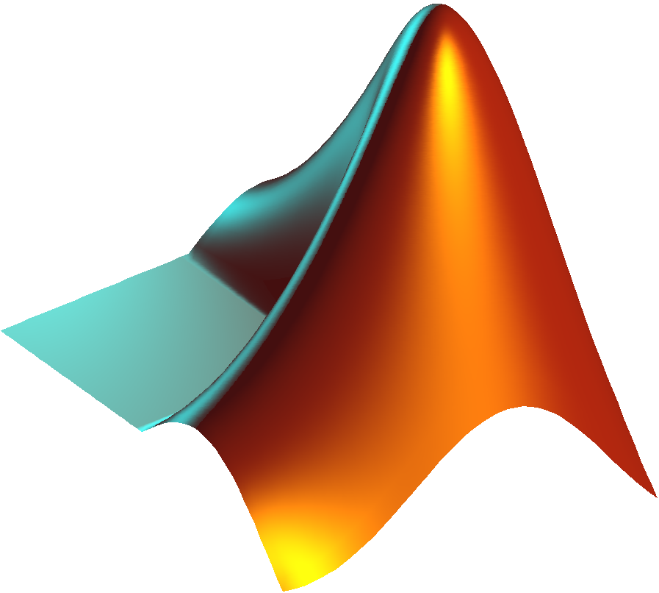
INSPIRATION
GOALS
Make a robust app that recognizes, populates and graphs a time varying 3 dimensional math plot
Practice and learn collaborative coding

Slide 3
OUTCOME
BEST PRACTICES
Process Major Math Equations
Plot 4 dimensions w/ 1 being pseudo time
Interactive UI
Pan-Zoom-Rotate
Color Graded Function Plot
Platform Independent
All Modules as Classes
Rigorous Const Implementation
Efficient GL command processing
Parallelization
Separate Error file & Constants File
Reusable Modules
Code Coverage – 60 percent

Slide 4
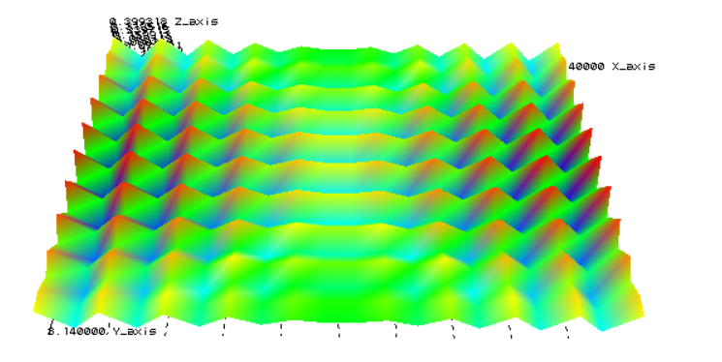
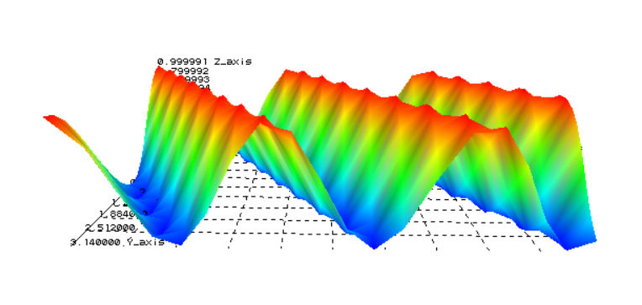
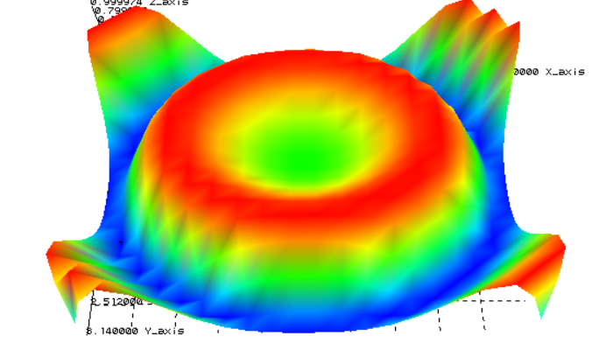
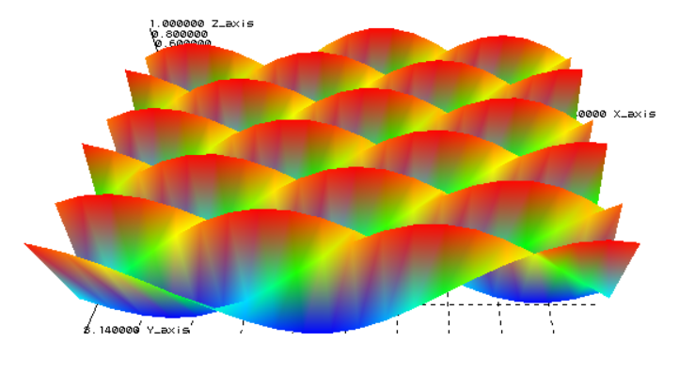
SHOWTIME
cos(x*t)+sin(y*t)
cos(5+t*x-y)
SIN(T*(X^2+Y^2))
sin(x*exp(t)+exp(t)*y)

Slide 5
OVERALL STRUCTURE
User Interface
Parser
Func Evaluator
Graph Renderer
Generate Mesh
Data Table

Slide 6
CLASS STRUCTURE
Variable.h
Parser.h
FuncEval.h
Errors.h
Constants.h
UserInterface.h
PlotterX.h
DataTable.h
Camera.h
TestModules.h
GraphRender.h
TimeCurve.h
Surface.h

Slide 7
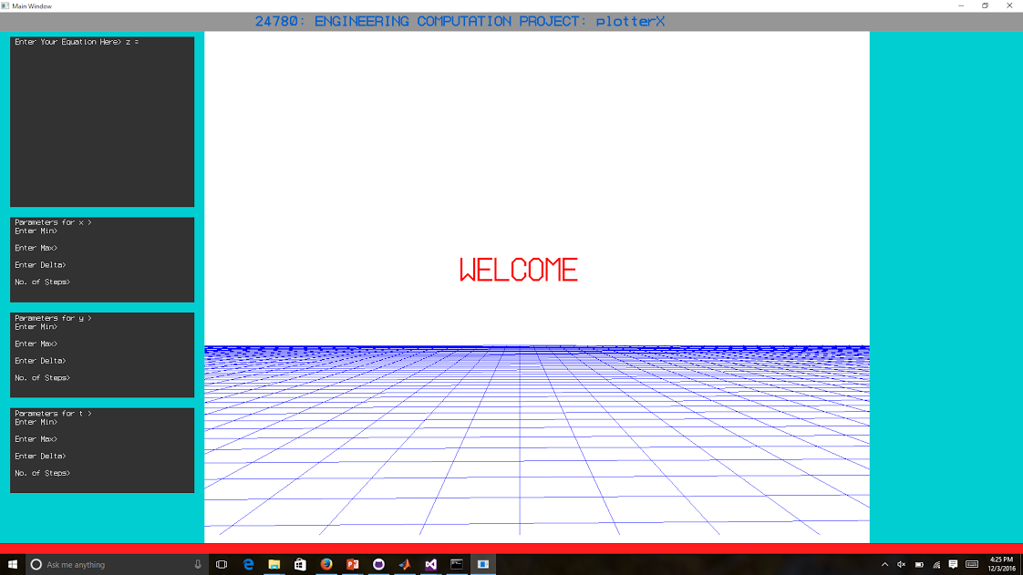
MODULE: USER INTERFACE
Make an interactive user interface to take in inputs and show the rendered graph
Structure:
Implementation:
Each input box shares the properties
Define the coordinates for each box and type of data it is going to take.
Add validation for the inputs
Implemented class inheritance to reuse the shared properties
Challenges:
Outcome:
Resizing window
Rescaling the entire UI
Transforming UI inputs into inputs, the other modules can accept
An interactive and intuitive UI taking the necessary inputs and showing the rendered graph

Slide 8
MODULE: PARSER
Understand user input and give value of expression for the value of variables
For example:
Infix: (x/t)
Postfix: xt/
Structure:
Implementation:
String Equation evaluation
Infix to Postfix Conversion
Postfix expression evaluation
x,y,t values
Implemented std::stack to evaluate postfix operation
Implemented class Token to manage the value and type of each read token
For example:
Infix: (x+y*t^5)
Postfix: xyt5^*+
Challenge:
Outcome:
Unary operators vs. binary operators
Token[value][type] to class Token
Any combination in x,y,t of:
Polynomial
Trigonometric
Logarithmic, Exponential
Absolute value

Slide 9
MODULE: DATA MANAGEMENT
Ensuring data is stored, transformed and accessed in an efficient way
Structure:
Implementation:
DataTable (Vector of Vectors)
Explicit checks to ensure the data table is filled in correctly and sequentially.
Dynamic number of columns.
DataTable is modelled as vector of vectors
Template class to handle variety of data
Separate table for mesh data and coordinate data to avoid data duplication
Surface DataTable Stores mesh of one Time Step
Challenges:
Outcome:
Finding efficient way to store time varying data of similar type.
Devising an efficient way to find the mesh in minimal time possible.
The module can used standalone to store tabular data of same type.
Allows user defined checks to be performed while data insertion
TimeCurves Vector of Surface Stores Surfaces for all Time Steps

Slide 10
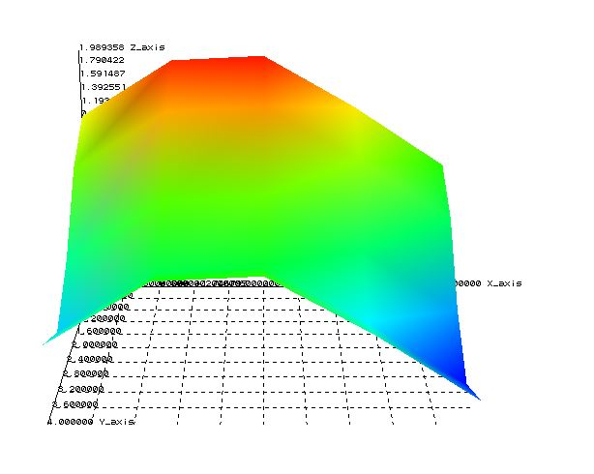
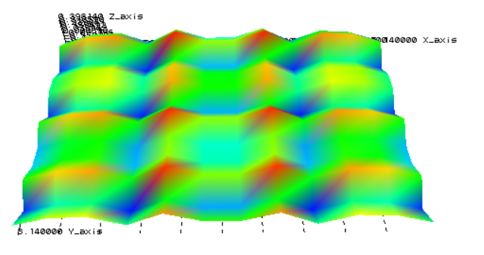
MODULE: GRAPH RENDERER
Display interactive plot of the time-varying user-specified function
Structure:
Implementation:
Data extraction from DataTable Class
Determine nature of the data (2D lines / 3D surface)
Generate plot list to display as animation
Accept user inputs to interact with the plot
Data table is represented as a mesh of the function over independent variables
Small triangular elements used plot to surfaces
Displayed graphics using GLDisplayList for improved performance
Challenges:
Outcome:
Color Gradation over the contour of the surface
Introduction of 6 DOFs along 3 axes
Fast Graphics Rendering through optimization of display pattern
Could be used as a standalone module to plot from given Data
Generates interactive plot of the function with axes and values to improve readability

Slide 11
Thank you
Questions?

