Slide 1

Mini-Project group-2
Statistics and Exploratory Data Analysis Project
Members:
Ruchir Tidke
Piyush Khupse
Shubham Rajput
Sudarshan Pagar
Ashish Bikkad

Slide 2
Overview :
This Statistics and EDA project is designed to train and test you on basic Data Exploratory and Statistical techniques used in the industry today. Apart from bringing you to speed with basic descriptive and inferential methods, you will also deep dive into a dataset and perform thorough cleaning and analysis in order to draw useful business insights from the data. This will expose you to what data scientists do most often–Exploratory Data Analysis.
Goals :
Using the core statistical theoretical concepts and knowledge to solve real time problem statements.
Visualize a real time industry scenario where one can use these statistical concepts.
Detailed data analysis and number crunching using statistics
Exhaustive report building using EDA and visualization techniques to help the business take decisions using insights from the data

Slide 3
Specifications :
Part -I is concept based and walks you through various concepts of descriptive statistics, probability distributions and inferential statistics including conﬁdence intervals and hypothesis testing.
Part -II on the other hand is dataset based and explore various data cleaning options, data analysis options and using EDA to derive deep and meaningful insights for the business

Slide 4
PART-A

Slide 5
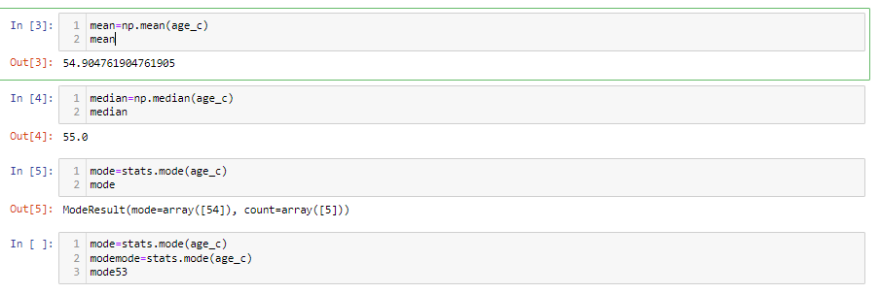
Q1. Compute the mean, median and the mode of the data

Slide 6
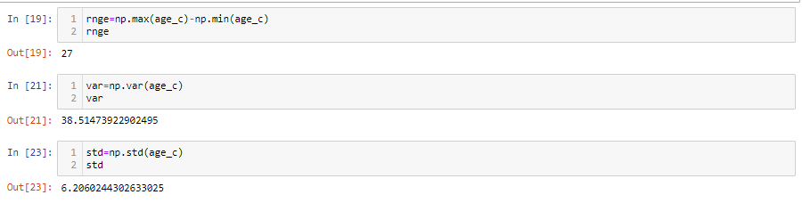
Q2. Compute the range , variance and standard deviation of CEO ages

Slide 7
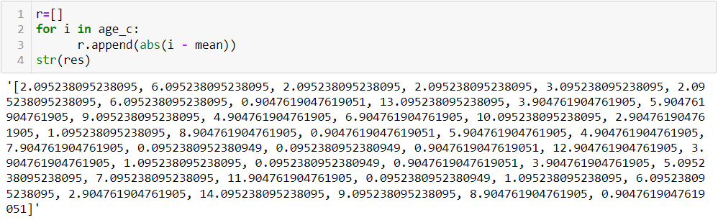
Q3. Find the mean deviation for the data . The mean deviation is defined as below.

Slide 8
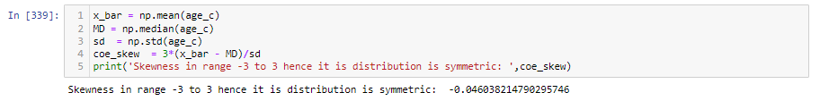
Q4. Calculate the Pearson coefficient of skewness and comment on the skewness of the data

Slide 9
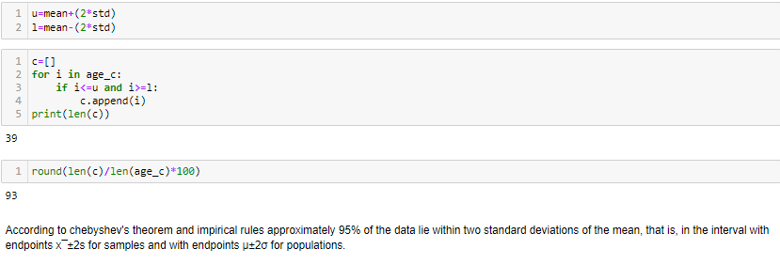
As we can see than 39 data values lie within two standard deviations which is approximately 93%. It is similar to the answer from chebyshev's theorem which states that 95% of the data lie within two standard deviations of the mean.
Q5. Count the number of data values that fall within two standard deviations of the mean. Compare this with the answer from Chebyshev’s Theorem.

Slide 10
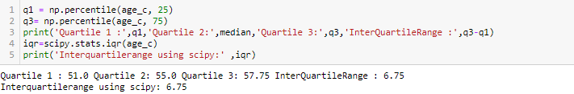
Q6. Find the three quartiles and the interquartile range (IQR)

Slide 11
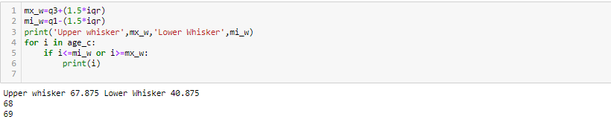
Q7. Are there any outliers in the data set?
There are 2 outliers in given the data set(Datapoints: 68,69)

Slide 12
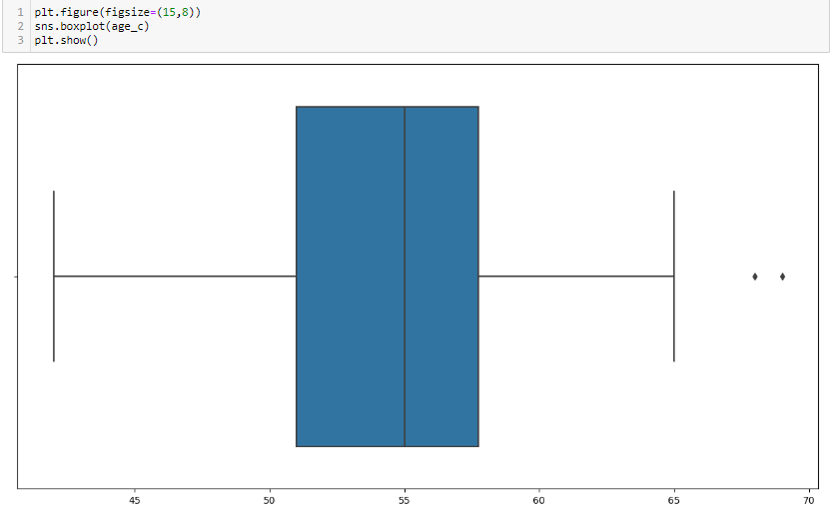
Q8. Draw a boxplot of the dataset to confirm.
2 Outliers are clearly visible in the above boxplot.

Slide 13

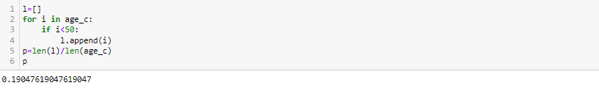
Q9. Find the percentile rank of the datapoint 50
.
Q10. What is the probability that a person becoming a CEO is below 50 years of age ?
The probability that a person becoming a CEO is below 50 years of age is 0.1904.

Slide 14
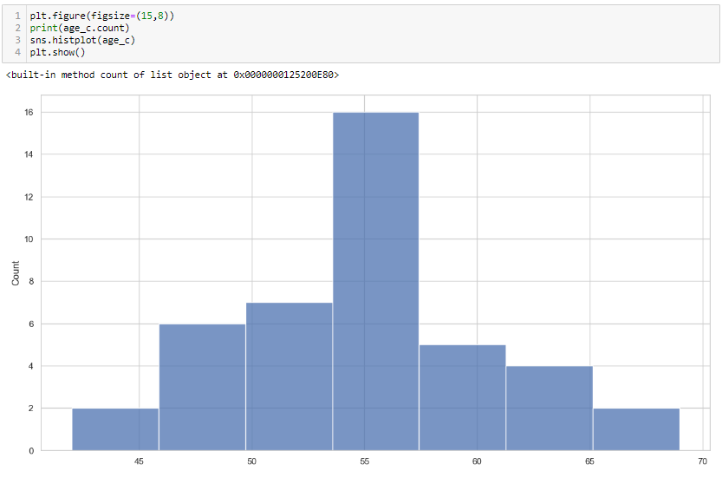
Q11. Create a frequency distribution for the data and visualize it appropriately

Slide 15
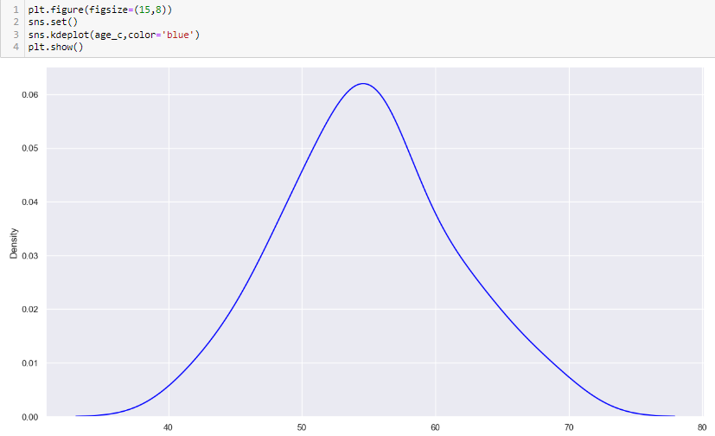
Q12. Create a probability distribution of the data and visualize it appropriately

Slide 16
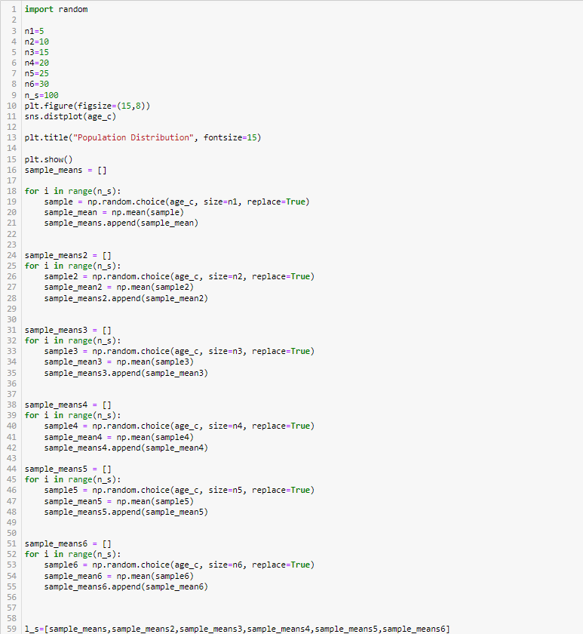
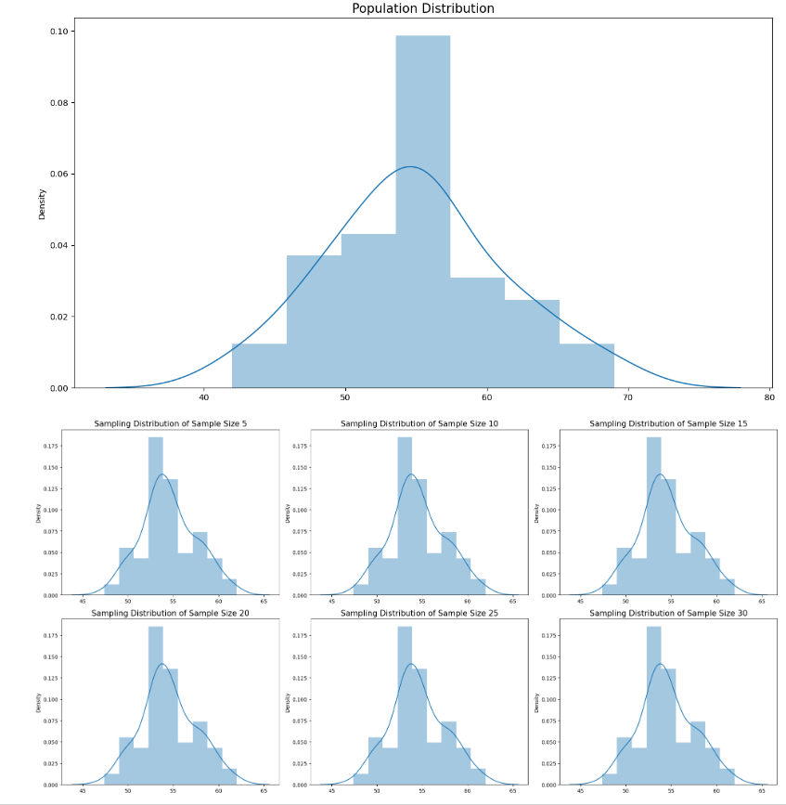
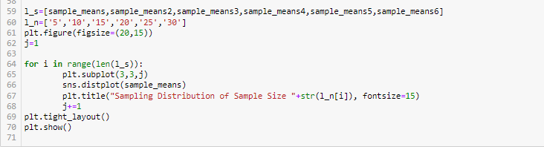
Q13. What is the shape of the distribution of this dataset?
We can see from the above sampling distribution of sample means of sample size 5,10,15,20,25,30 that
they all are normally distributed and it follows the Central Limit Theorem.

Slide 17
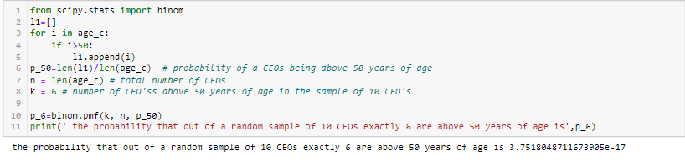
Q14.Treat this dataset as a binomial distribution where p is the probability that a person of 10 CEOs of Fortune 500 companies exactly 6 are above 50 years of age?
The probability that out of a random sample of 10 CEOs exactly 6 are above 50 years of age is 3.7518048711673905e-17

Slide 18
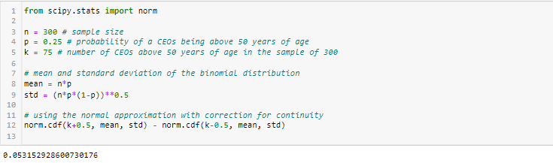
Q15. A study claims that 25% of all Fortune 500 companies becoming a CEO are above

Slide 19
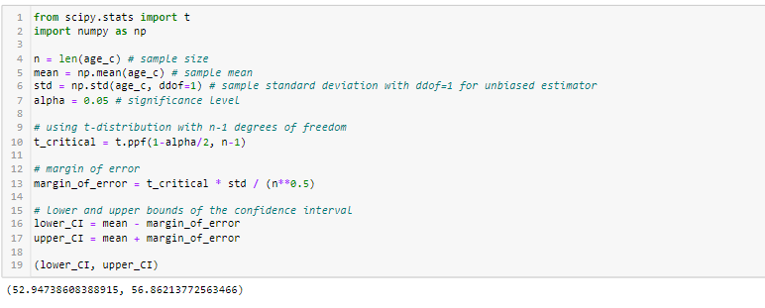
Q16. Compute a 95% Confidence Interval for the true mean age of the population of CEOs for the given dataset using appropriate distribution
The mean 54 lies within the interval 52 and 56 so we fail to reject the null hypothesis.

Slide 20
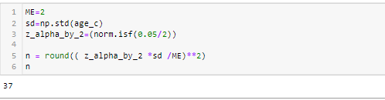
Q17. A data scientist wants to estimate with 95% confidence the proportion of CEOs of Fortune 500 companies are above 60 years in the population. Another recent study showed that 25% of CEOs interviewed were above 60. The data scientist wants to be accurate within 2% of the true proportion. Find the minimum sample size necessary
The minimum sample size necessary is 37

Slide 21
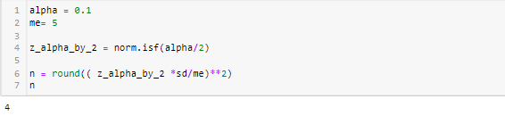
Q18. The same data scientist wants to estimate the true proportion of CEOs ascending to the post and above 60 years. She wants to be 90% confident and accurate within 5% of true proportion. Find the minimum sample size necessary
The minimum sample size necessary is 4.

Slide 22
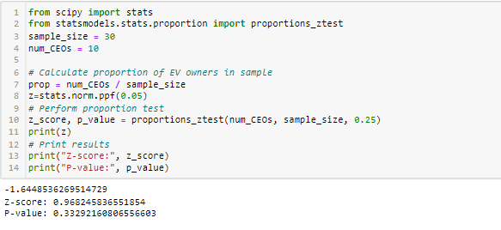
Q19. A researcher claims that currently 25% of all CEOS are above 60 years . Test his claim with an alpha =0.05 if out of a random sample of 30 CEOs only 10 are above 60 years
Here pvalue is more than level of significance 0.05, so we cannot find the enough evidence to reject the null hypothesis.
So we can not reject the researchers claims that currently 25% of all CEOS are above 60 years

Slide 23
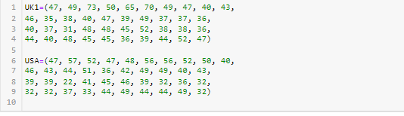
Q20. Assume you are a data scientist for the Fortune 500 companies. You are asked to research the question whether the CEO ages of UK are on average older than the CEO ages of Americans. you take a random sample of 40 CEO ages from America and UK and the data is as follows

Slide 24
a. What are your hypotheses?
mu1=Average ages of ceos in uk
mu2=Average ages of ceos in usa
H0: mu1<=mu2 or mu1-mu2<=0
H1: mu1>mu2 or mu1-mu2>0
b. What significance level will you use?
We will use Significance level of 5%
c. What statistical test will you use?
We will use Z-test for the given datasets.

Slide 25
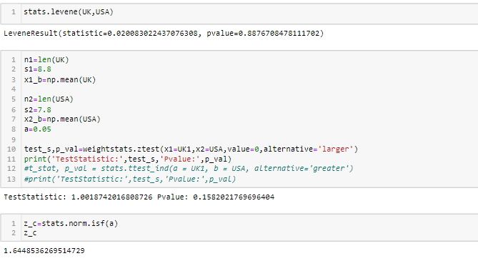
d. What are the test results? (Assume s1 = 8.8 and s2= 7.8)
After Performing the test it can be observed that Pvalue is more than alpha(0.05)
e. What is your decision?
We cant find enough evidence to reject null hypothesis

Slide 26
f. What can you conclude?
So we Fail to reject the claim that the CEO ages of UK are on average older than
the CEO ages of Americans
g. Do you feel that using the data given really answers the
original question asked?
The given data does not provide conclusive evidence to answer the original Question of
whether the CEO ages of UK are
on average older than the CEO ages of Americans.
h. What other data might be used to answer the question?
A larger sample size from the population and the standard deviation of population might be useful for answering the question.

Slide 27
PART-B Topic - Credit Card Fraud Detection
Introduction
It is important that credit card companies are able to recognize fraudulent credit card transactions sothat customers are not charged for items that they did not purchase.
Dataset Description
The dataset contains transactions made by credit cards in September 2013 by European cardholders.This dataset presents transactions that occurred in two days, where we have 492 fraudsout of 284,807 transactions.
Data Dictionary
a) It contains only numeric input variables. Unfortunately, due to confidentiality issues, we cannot provide the original features and more background information about the data. Features V1, V2, … V28 are the principal components obtained with PCA, the only featureswhich have not been transformed with PCA are 'Time' and 'Amount'.
b) Feature 'Time' contains the seconds elapsed between each transaction and the first transaction in the dataset.
c) The feature 'Amount' is the transaction Amount.
d) Feature 'Class' is the response variable and it takes value 1 in case of fraud and 0 otherwise.

Slide 28
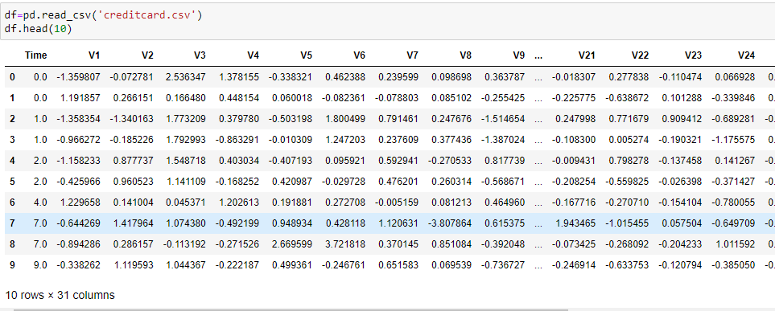
Q1. Import the dataset and view the first 10 rows of it.

Slide 29

Q2. Display shape/dimension of the Dataset

Slide 30
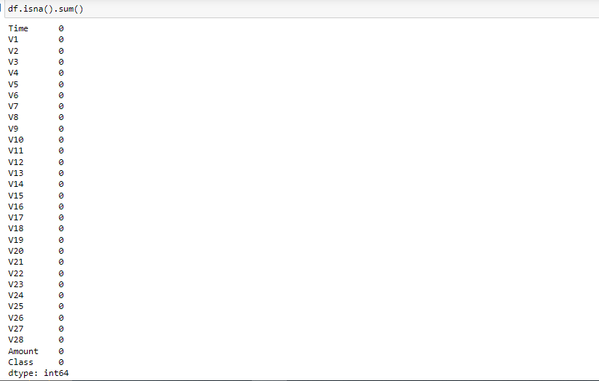
Q3.Check for the missing values.Display number of missing values per column.

Slide 31
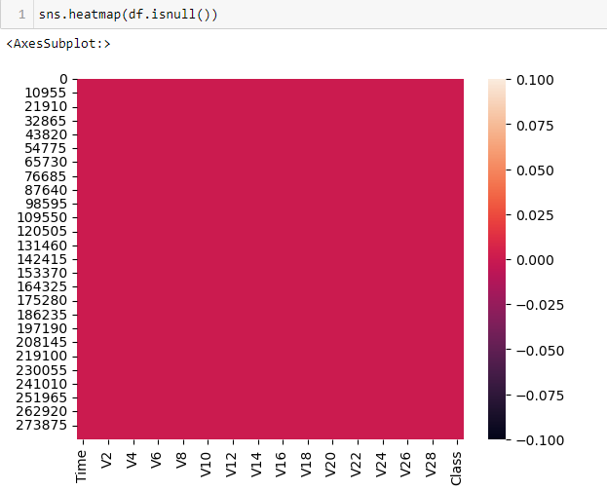
Visual representation of null values

Slide 32
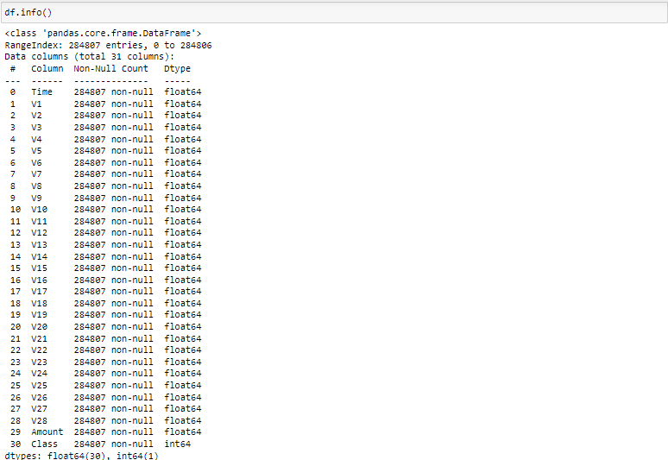
Q4. Check the datatype, number of non-null values and name of each variable in the dataset.

Slide 33
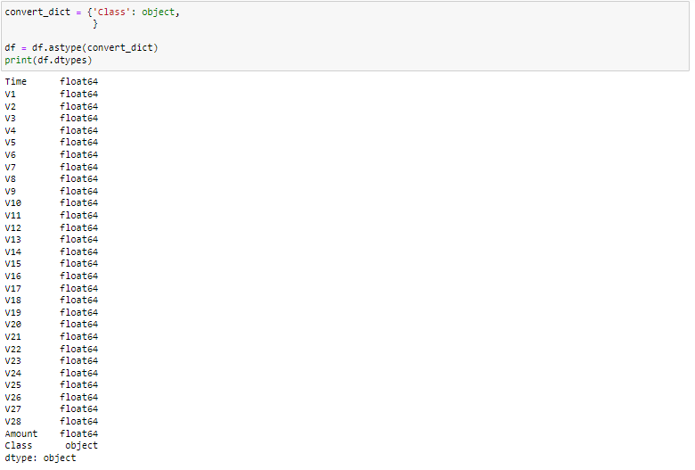

Slide 34
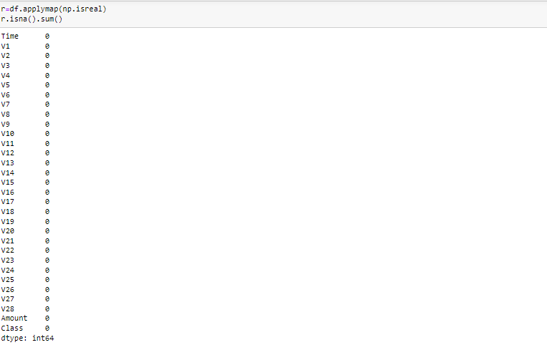
Q5. Check if there are any non-real characters in the dataset
There are no non real characters in the dataset.

Slide 35
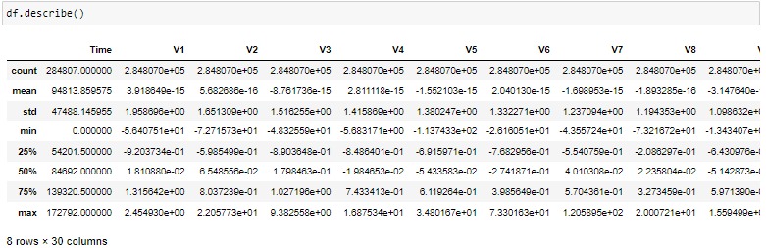
Q6. Check the descriptive statistics of the dataset.

Slide 36
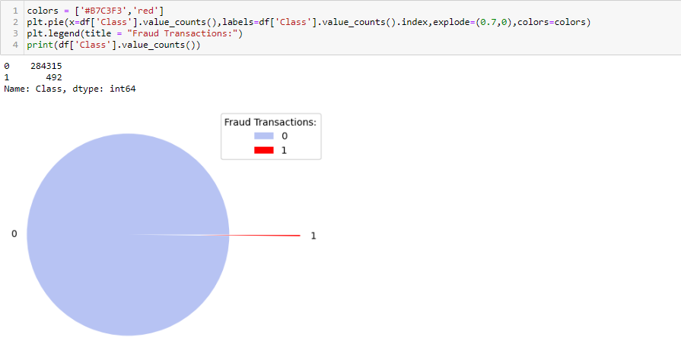
Q7. Check the number of fraudulent transactions in the dataset and visualize using pie chart and bar plot.

Slide 37
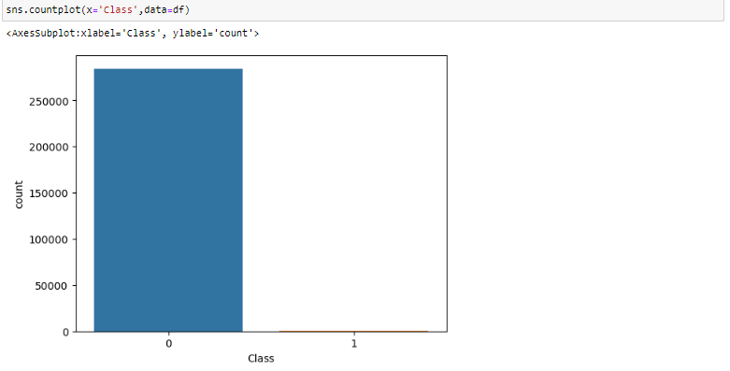

Slide 38
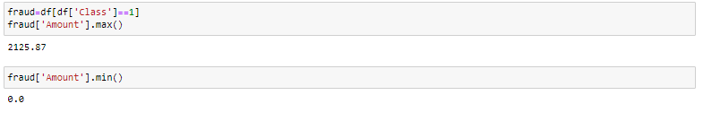
Q8. Check the maximum and minimum fraudulent amount.

Slide 39
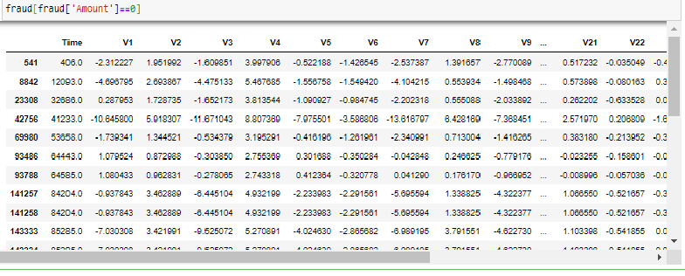
Q9. Check the number of transactions where the transaction amount is zero and consider as a fraud transaction.

Slide 40
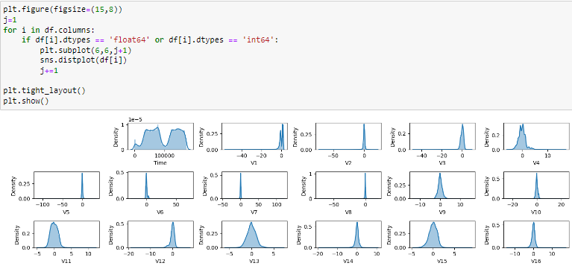
10. Check the distribution of columns. List down columns that are normally distributed. List down columns that are not normally distributed.

Slide 41
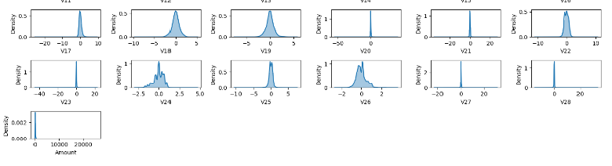
We can clearly see that from above plot that from V1 to V28 variables are normally distributed.
Variable 'Time' and 'Amount' do not follow normal distribution

Slide 42
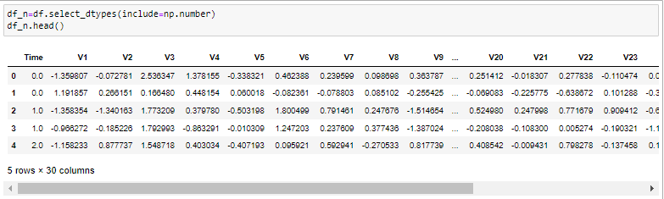
Q11. List down columns that are highly skewed.

Slide 43
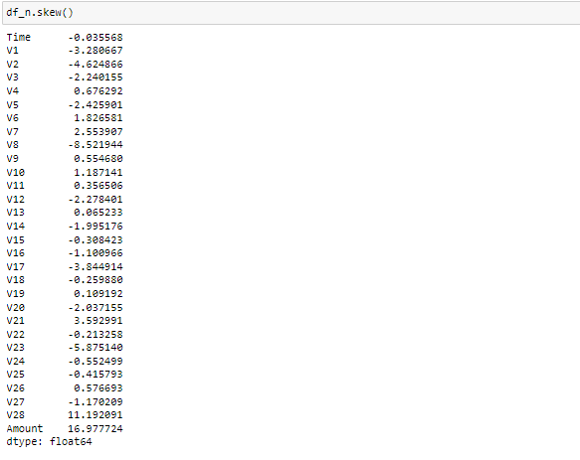

Slide 44
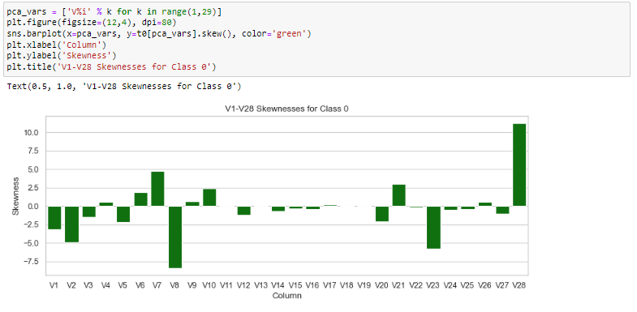

Slide 45
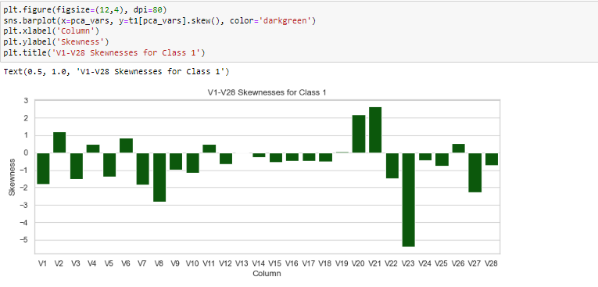
From above plot we can see fraudulent transaction has more skewness than normal transaction.

Slide 46
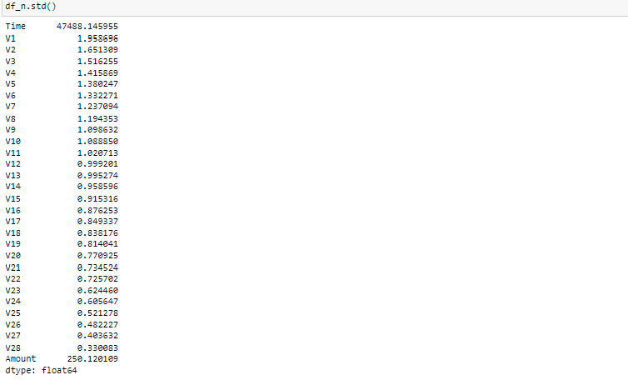
Q12. With the help standard scaler, normalize the respective column distribution.

Slide 47
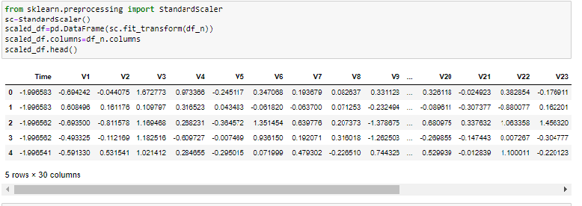

Slide 48
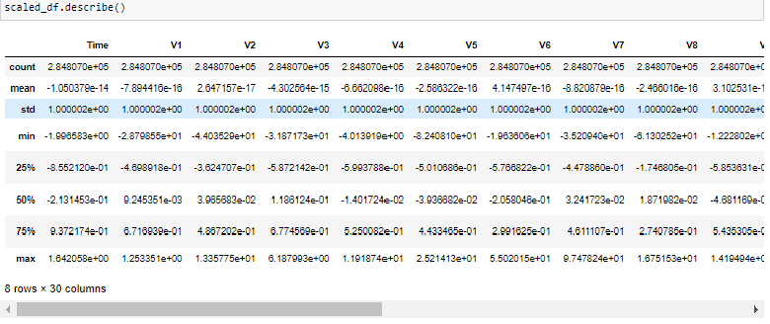

Slide 49
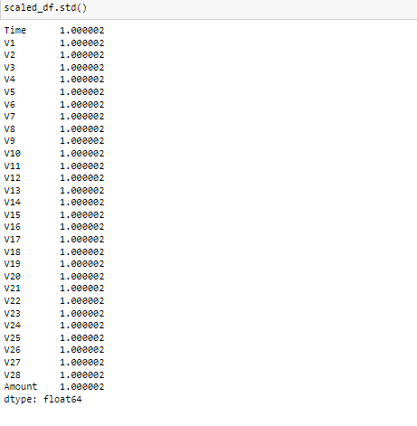

Slide 50
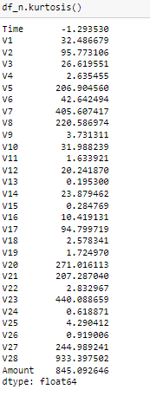
Q13. List down columns that have high kurtosis.

Slide 51
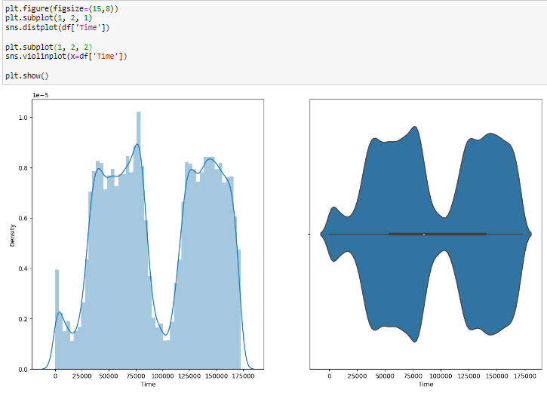
Q14. What is the distribution of Time and Amount columns in the dataset ?

Slide 52
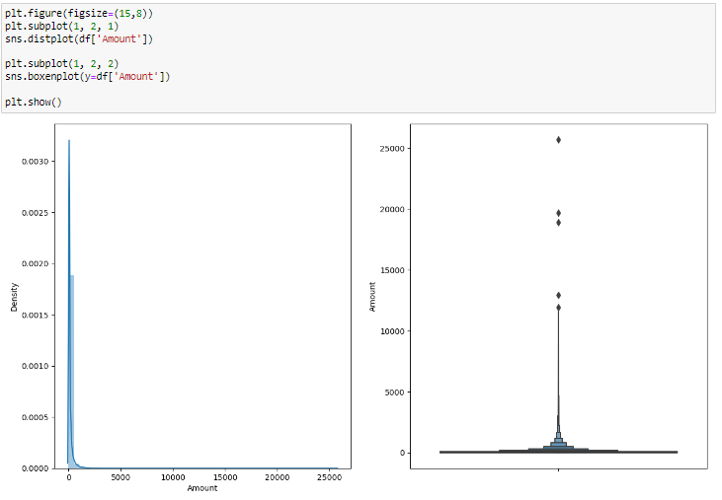

Slide 53
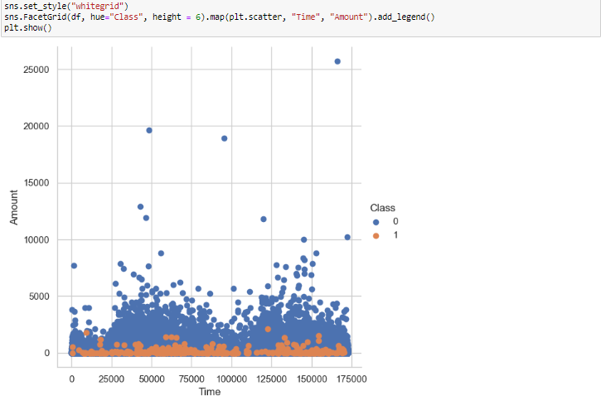
From the above two plots it is clearly visible that there are frauds only on the transactions which have
transaction amount approximately less than 2500. Transactions which have transaction amount approximately above 2500 have no fraud.
As per with the time, the frauds in the transactions are evenly distributed throughout time.

Slide 54
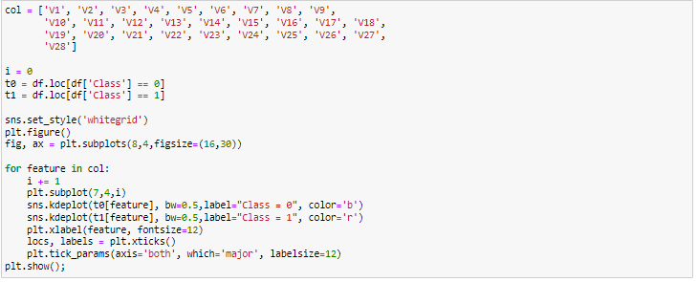
Q15. Find the distribution of all variables with respect to the outcome ‘Class’ variable.

Slide 55
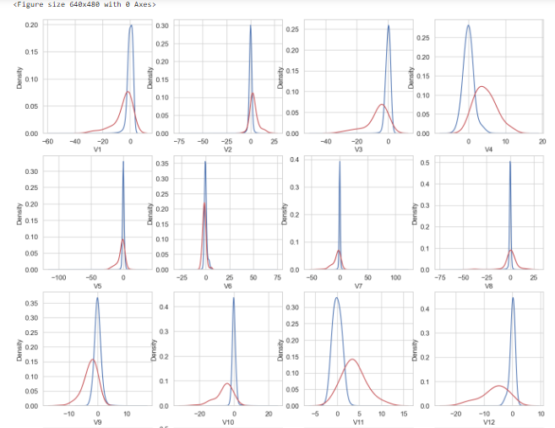

Slide 56
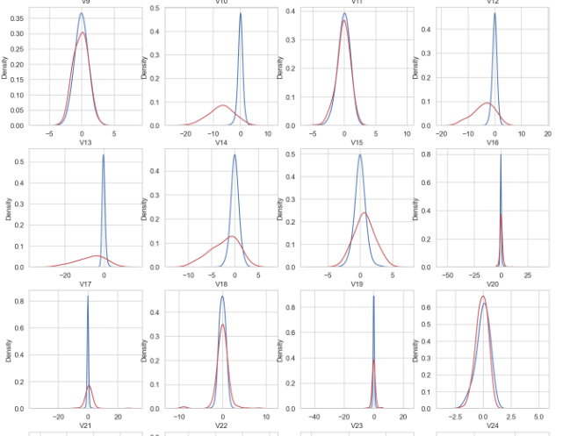

Slide 57


Slide 58

Q16. Create a countplot for the outcome class in seaborn using percentage instead of count for each bar.

Slide 59


Slide 60

Only 492 (or 0.2%) of transaction are fraudulent.
That means the data is highly unbalanced with respect with target variable Class.

Slide 61

Q17. Plot a heatmap for correlation matrix for the given dataset. Write the Observation. Especially note down columns that are highly correlated (Positive and Negative Correlation, Consider 0.7 to 1 as high).

Slide 62


Slide 63

Correlation can have a value:
1 is a perfect positive correlation (between 'Amount' and V7, 'Amount' And 'V20') 0 is no correlation (between features V1-V28) -1 is a perfect negative correlation (between 'Time' and V3, 'Amount' and V2, 'Amount' and V5)

Slide 64

Q18. With the help of hypothesis testing check whether fraudulent transactions of higher value than normal transactions?

Slide 65
As the z_stat is more than z_critical we reject the Null hypothesis(H0). So there is a 99% chance that the amount spend on fraudulent transactions are on average significantly lower than normal.

Slide 66

Q19. Perform ANOVA test for Statistical feature selection.

Slide 67


Slide 68

The reject=True for group1 and group2 denotes that we reject the null hypothesis
and conclude that the average amount is not the same.
The values in the columns lower and upper represent the lower and upper bound of the 95% confidence interval for the mean difference.

Slide 69

Q20. Split the dataset randomly into train and test datasets. Use a train -test ratio of 70:30 ratio.

Slide 70
Q21. These are just checkpoints. Please use your best analytical approach to build this report. You can mix match columns to create new ones which can be used for better analysis.
Create your own features if required. Be highly experimental and analytical here to find hidden patterns. You can use the following as checklist pointers :
What is the shape and size of the dataset?
Which columns are highly skewed?
Which columns are highly Kurtosis driven?
Which columns have Wrong data type?
What columns seem to have outliers based on min, max and percentile values, IQR range along with the standard deviation and mean absolute deviation?
What columns have missing values? (Check the Missing Values section in Pandas Profiling)
What columns have high amount of zero and make sure that these zeroes are supposed to be there( for eg. Weight cannot be zero and any percentage of zero in column zero is erroneous)
What columns have high variance and standard deviation?
Comment on the distribution of the continuous values (Real Number: ℝ≥0)
Do you see any alarming trends in the extreme values (minimum 5 and maximum 5)?
How many Boolean columns are there in the data set and out of those how many are imbalanced?
Check for duplicate records across all columns (Check Warning Section)
Is there any imbalance in the categorical columns? (for example Gender Male and Female in which Male is 95% and Female is just 5%- How many columns are categorical?)
Are those categories in sync with the domain categories?
Check if all the categories are unique and they represent distinct information Based on the above questions and your observations, chart out a plan for Data Pre-processing and feature engineering Note: Feature Engineering (Feature Selection

Slide 71
CONCLUSION
The dataset contains transactions made by credit cards by European cardholders.
This dataset presents transactions that occurred in two days, where we have 492 frauds out of 284,807 transactions. The dataset is highly unbalanced. The positive class (fraud transactions) accounts for 0.172% of all transactions.
It contains only numeric input variables, which are the result of a PCA transformation. Unfortunately, due to confidentiality issues, the original features and more background information about the data are not provided. Features V1, V2, … V28 are the principal components obtained with PCA, the only features which have not been transformed with PCA are ‘Time’ and ‘Amount.’ Feature ‘Time’ contains the seconds elapsed between each transaction and the first transaction in the dataset. The feature ‘Amount’ is the transaction Amount. This feature can be used for example-dependent cost-sensitive learning. Feature ‘Class’ is the response variable, and it takes value 1 in case of fraud and 0 otherwise.
The shape of the dataframe is(284807, 31).
As noted earlier, the dataset is highly skewed, which can be seen from the below bar plot. Only 492 (or 0.172%) of the transactions are fraudulent. That means the data is highly unbalanced with respect to the target variable Class.
Fraudulent transactions have an even distribution compared to non-fraudulent transactions. It means that fraudsters continue to operate at abnormal times as well, compared to the real customers who mostly transact between business hours.
Genuine or real transactions have a larger average value, larger first quartile or Q1, smaller third quartile, and fourth quartile or Q3, Q4 respectively, besides large outliers. Fraud transactions, on the other hand, have a smaller first quartile (Q1) and mean larger fourth quartile (Q4), and smaller outliers.
Let us now plot the number of fraud transactions by time; we see that a lot of these transactions are outliers, which means that fraud is skewed towards larger transactions.
We can see that there is no correlation between the independent variables, and that is expected as the data providers have done PCA on the input variables except Time and Amount (PCA -> Principal component analysis). There are some small correlations between some of the independent variables and Time (inverse correlation with V3) and Amount (good correlation with V7 and V20, inverse correlation with V1 and V5).
For some of the independent variables, we can see a good separation between the distributions of the two classes that is fraud versus nonfraud. For example, V4 and V11 have different distributions for both classes. V12, V14, and V18 are somewhat separated. V1, V2, V3, V10 have quite a distinct distribution, while V25, V26, V28 have similar distribution for both the classes.
As a general statement, with the exception of the two independent variables, Time and Amount, the distribution for non-fraud transactions is centered on zero, sometimes with a long tail for the extreme or outlier observations. At the same time, fraud transactions have a skewed distribution.
V3, V4, V10, V11, V17-V19 have clearly separated distributions for Class values 0 and 1
V1, V2, V7, V9, V12, V14, V16, V18 have partially saperated distribution for Class 0 and 1
V13, V15, ,V20, V22-V28 have almost similar distribution for Class 0 and 1
V5, V6, V8, V21 have quite similar distribution for Class 0 and 1
In general, with just few exceptions (Time and Amount), the features distribution for legitimate transactions (values of Class = 0) is centered around 0, sometime with a long queue at one of the extremities. In the same time, the fraudulent transactions (values of Class = 1) have a skewed (asymmetric) distribution.
It is clearly visible that there are frauds only on the transactions which havetransaction amount approximately less than 2500. Transactions which have transaction amount approximately above 2500 have no fraud. As per with the time, the frauds in the transactions are evenly distributed throughout time.
V1 to V28 variables are normally distributed. Variable 'Time' and 'Amount' do not follow normal distribution

Slide 72
THANK YOU

