Slide 1

Mini-Project [Group 6]
TITLE : Asset Management Company Dataset
Submitted by : Mayur, Pratiksha, Ashish, Piyush, Pratik

Slide 2
Problem Definition
Dataset
Company Details and Rounds2
Attributes | Description
Permalink | Unique ID of Companies
name | name of Companies
homeurl_page | Website URL
Category_list | Categories to which company belong
Status | Operational Status
country_code | country_code
state_code | state
Rounds2
Attributes | Description
company_permalink | Unique ID of company
funding_round_permalink | Unique ID of funding round
funding_round_type | Type of funding - Venture,angel, private equity
funding_round_code | Round of venture funding (round A,B..)
Funding_at | Date of funding
raised_amount_usd | Money raised in funding (USD)

Slide 3
Problem Definition
Problem Statement :
The Objective is to identify the best countries and a suitable investment type for making the investment. The overall strategy is to invest where others are investing, implying that the best countries are the ones ‘where most investors are investing’.

Slide 4
Data Set Description
This is real investment data taken from crunchbase.com.
Company details: The data for different companies has been provided for investing in different sectors by taking reference from past investment strategies on several sectors in various countries. The company details include the unique company id’s their names, URL’s for their websites the category to which these said companies belong operational statuses countries in which they operate and their codes.
Round2: gives us the funding rounds, its types which are coded and include types such as seeds venture, private equity and many more. The date of fundings and money raised as per the investments.

Slide 5
Business Importance of Problem
The overall strategy is to invest where others are investing, implying that the 'best' sectors, countries and investment type where most investors are investing.
Business constrains:
• It see investments across different sectors 10 to 15 million USD per round of investment
• It wants to invest in countries with great prospect.
Business objective:
To identify the best sectors, countries, and a suitable investment type for making investments.
Goals of data analysis:
• Investment type analysis
Country Analysis
Sector Analysis

Slide 6
Question 1
1) Reading the Rounds2, companies.txt files.
data = pd.read_csv('rounds2.csv',encoding = 'ANSI')
data.head()
solution: The csv is uploaded in the data base to perform operation we import the csv file using the above command

Slide 7
Question 2
2)How many unique companies are present in rounds2?
len(rounds2['company_permalink'].unique())
solution: To find unique number of companies from the imported rounds2 csv file we use length(len)
inference: we get 90247 unique companies

Slide 8
Question 3
3)How many unique companies are present in the companies file?
len(companies['permalink'].unique())
solution: to find unique number of companies from the imported companies csv file we use length(len)
inference: we get 66368 unique companies

Slide 9
Question 4
4)Write the code to convert companies[‘permalink’] and \Round2[‘company_permalink’] columns to uppercase.
companies['permalink'] = companies['permalink'].str.upper()
companies.head()
rounds2['company_permalink'] = rounds2['company_permalink'].str.upper()
rounds2.head()
solution: we find that all permalinks and company_permalinks have been converted in uppercase
inference: This is done to make the permalinks and company_permalinks uniques to discard any duplication while performing further tasks while merging the data.

Slide 10
Question 5
5)Are there any companies in the rounds2 file which are not present in companies.txt ?
df1 = pd.DataFrame(rounds2.company_permalink.unique())
df2 = pd.DataFrame(companies.permalink.unique())
df2.equals(df1)
solution: False
inference: There are no duplicated attributes in the data of permalinks

Slide 11
Question 6
6)Merge the two data frames so that all variables (columns) in the company's frame are added to the rounds2 data frame. Name the merged frame master_dataframe. How many observations are present in master_frame ?
master_dataframe = pd.merge(rounds2 , companies, left_on = 'company_permalink' , right_on= 'permalink', how = 'left')
master_dataframe.head()
len(master_dataframe)
solution: we get a common data frame in the form of master_frame which includes all the columns and rows from both data frames of companies and rounds. They are both combined on the columns of company_permalinks and permalinks respectively.
Inference: We do this to make it easy to perform operations on a single data frame and avoid complications and mistakes while working with two data frames.

Slide 12
Question 7
7)Write the code to drop the redundant column ‘'company_permalink' from the master_dataframe.?
master_dataframe = master_dataframe.drop('company_permalink', axis = 1)
master_dataframe.head()
solution: The data frame is now removed of unnecessary column which contains similar values as permalink
inference: removing clutter and duplicate column

Slide 13
Question 8
8)Write the code to find the percentage missing value (column-wise) in master_dataframe. Drop unnecessary columns.
(master_dataframe.isnull().sum()/ len(master_dataframe))*100
master_dataframe.drop('funding_round_code', axis = 1)
master_dataframe.drop('founded_at', axis = 1)
master_dataframe.head()
solution/inference: The funding_round_code does not serve us any purpose thus has been removed

Slide 14
Question 9
9)Create a pivot table to compare the mean and median values for ‘raised_amount_usd’ and ‘funding_round_type’ across different funding round categories..
df_pivot = pd.pivot_table(master_dataframe, index=['funding_round_type'], values=['raised_amount_usd'], aggfunc=[np.median,np.mean])
df_pivot
solution: A table comparing median and mean according to the raised_amount_usd is shown as output.
Inference: The average values of different funding types for investment.

Slide 15
Question 10
10)Filter the master_dataframe on ‘raised_amount_usd’ such as ‘raised_amount_usd’ lie between 4 Millions to 15 Millions.
master_dataframe.loc[(master_dataframe['raised_amount_usd']>400000) &
(master_dataframe['raised_amount_usd']>1500000)]
master_dataframe.head()
solution: We come across a table showing different columns of companies their names and countries which have raised amounts between 4 million and 15 million
inference: The objective here is to find out companies and countries which have invested money, check competitors and realise investing opportunities.

Slide 16
Question 11
11)Identify the top 9 countries in terms of highest investment in ‘venture’ fund type.
v_frame = master_dataframe.loc[master_dataframe['funding_round_type']=='venture']
v_frame.head()
top = pd.DataFrame(v_frame.groupby('country_code')['raised_amount_usd'].sum().sort_values(ascending= False).head(9))
top
solution: The output is given as a table that shows us investments in venture type across the top 9 countries.
Inference: From the above operation we see clearly that USA tops the list with the most amount.

Slide 17
Question 12
12)Create the ‘main_category’ column by extracting the first value using the column ‘category_list’.
Hint - Use the Lambda function or string function.
master_frame['main_category'] = master_frame['category_list'].str.split('|').str[0].copy()
master_frame
solution: To order the category for easy access and understanding as too many subtypes are present

Slide 18
Question 13
13)Using the user defined function convert the ‘rasied_amount_used’ column into a categorical column as follow-
If the amount is less than 5 Millions then recode as TypeA.
If the amount is greater than 5 Millions and less than 7 Millions then recode as TypeB.
If the amount is greater than 7 Millions then recode as TypeC.
def categorical_column(value):
if value < 500000:
return 'TypeA'
elif value > 500000 and value< 700000:
return 'TypeB'
elif value > 700000:
return 'Type C'
master_frame['categorical_column'] = master_frame['raised_amount_usd'].map(categorical_column)
display(master_frame.head(15))
solution: the master_frame is returned ordered by categorising into only 3 types.
Inference : This makes it easy to find companies and which deal with small, medium and large scale investments

Slide 19
Additional Question 1
Q1. How many company have venture or seed funding round type ?
filter1= rounds2['funding_round_type']=='venture'
filter2= rounds2['funding_round_type']=='seed'
len(rounds2[filter1|filter2])
Solution:In round 2 csv file, we have to first find which company have venture and seed funding_round_type and total how many company have venture and seed funding_round_type
Interference:Applying filter on the column funding_round_type.filter Filter the venture seed funding_round_type and just by applying len function we get number of company which having venture or seed funding round type.

Slide 20
Additional Question 2
Q2.In compnaies.text file find the name of company which having folowing url 'http://inovatiff.com‘
[companies['homepage_url']=='http://www.zznode.com']
Solution:In this question we have to find the name of company having url ‘http://inovatiff.com'.
companies[companies['homepage_url']=='http://www.zznode.com']['name']
Inference:we need filtering condition on column ['homepage_url'] .If the following condition true it return true or false.
But we intrested in name of company so just putting ['name'] column after giving condition we get name of company which having above url.

Slide 21
Additional Question 3
Q3. Create a pivot table to show the amount raised by each country in each category.
df_pivot1 = pd.pivot_table(master_dataframe,index=['country_code'] , columns=['categorical_column'], values=['raised_amount_usd'])
Solution:In this question we have to find, how the distribution of 'raised_amount_usd' by each country and each category
Inference:The solution may be written using pivot table, The pivot table takes simple column-wise data as input, and groups the entries into
a two-dimensional table that provides a multidimensional summarization of the data.
In above syntax country code columns taken as index and the numerical column taken as value using this pivot table we get distribution according to each country and each category.

Slide 22
Additional Question 4
Q4.Companies want to invest in top 2 English speaking countries like USA and IND.Create three separatedata frames D1 and D2 for each of the three countries containing the observations of funding type FT falling within the 10-15 million USD range.The two data frames should contain:
All the columns of the master_frame along with the primary sector and the main sector.
The total number (or count) of investments for each main sector in a separate column
The total amount invested in each main sector in a separate column
master_dataframe = master_dataframe[(master_dataframe['country_code'] == 'USA') | (master_dataframe['country_code'] == 'IND')]
master_dataframe.head()
D1 = master_dataframe[(master_dataframe['country_code'] == 'USA') & (master_dataframe['raised_amount_usd'] >= 10000000) &
(master_dataframe['raised_amount_usd'] <= 15000000)]
USA=D1[['raised_amount_usd','main_category']].groupby('main_category').agg(['sum', 'count']).rename(columns={'sum':'Total_amount','count' : 'Total_count'})
D1 = D1.merge(USA, how='left', on ='main_category')
D1.head()
D2 = master_dataframe[(master_dataframe['country_code'] == 'IND') & (master_dataframe['raised_amount_usd'] >= 10000000) &(master_dataframe['raised_amount_usd'] <= 15000000)]
IND=D2[['raised_amount_usd','main_category']].groupby('main_category').agg(['sum', 'count']).rename(columns={'sum':'Total_amount','count' : 'Total_count'})
D2 = D2.merge(IND, how='left', on ='main_category')
D2.head()

Slide 23
Additional Question 4
Solution:We have to create the two dataframe one is for IND and other for USA,but the condition is the funding type FT falling within the 10-15 million USD range.In this two dataframe we want the column of the master frame along with primary and main secor And the total amount of investement of main sector should have separate column.
Inference:First part is to create the two separate dataframe for USA and IND having funding type FT falling within the 10-15 million USD range.for that we need filter condition on ['raised_amount_usd’]
Next applying groupby on categorical column ['main_category'] and aggregate function on numerical column ['raised_amount_usd'] i.e sum and count and just giving merge left module function on categorical column we get accepted result.

Slide 24
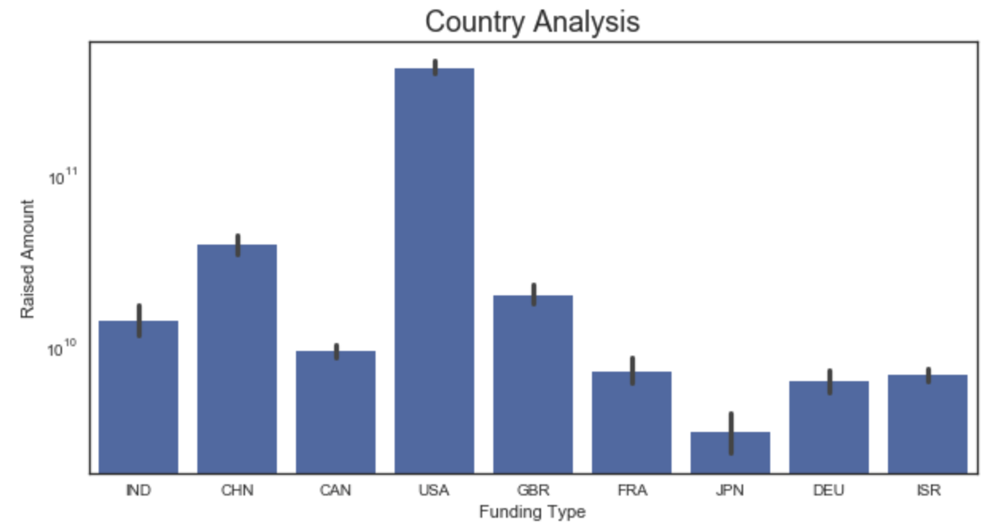
Conclusions
There are 14 different type of investments
USA amounts as the most invested country.
• China follows USA, United Kigdom ,India Canada are among the Top 5 countries to attract investments.
• France, Germany, Israel and Japan are other among the top 9 invested countries.

Slide 25
Conclusions
Results from jupyter notebook | raised_amount_usd
country_code | Investment in million USD
USA | 422510.842796
CHN | 39835.418773
GBR | 20245.627416
IND | 14391.858718
CAN | 9583.332317
FRA | 7259.536732
ISR | 6907.514579
DEU | 6346.959822
JPN | 3363.676611
• USA receives the highest investment amount (approx. 420k Million USD)

Slide 26
Conclusions
The 5 main sectors to invest in USA are
Biotechnology
Software
Enterprise Software
Advertising
Healthcare
Results from jupyter notebook |  | raised_amount_usd
 | Total_amount | Total_count
main_category
Biotechnology | 7314.424405 | 596
Software | 4878.997007 | 411
Enterprise Software | 3556.986494 | 292
Advertising | 2866.762379 | 237
Health Care | 2445.764085 | 201

Slide 27
Conclusions
The 5 main sectors to invest in India are
E-Commerce
Mobile
Software
Analytics
Real Estate
 | raised_amount_usd
Results from jupyter notebook | Total_amount | Total_count
main_category
E-Commerce | 218.50 | 17
Mobile | 113.49 | 10
Software | 80.80 | 7
Analytics | 76.00 | 6
Real Estate | 69.40 | 6

Slide 28
Thank You !!!....

