Slide 1

Candidate Recommendation System
Ashish Chhabbi
Ashwin Venkataraman
Sunny Patel

Slide 2
Motivation
Significant amount of resumes in the job market.
Submitting resumes is just one click of button.
Lot of resumes with irrelevant profiles
Filtering these resumes consumes a significant amount of time and resources.

Slide 3
Motivation
Application tackles real world problems.
Recruiter can obtain the candidates’ score based on the profile.
Processing resumes on a single machine is not feasible.

Slide 4
Design
Resume dataset from Kaggle which has more than 1200 records.
Hadoop Mapreduce to perform the task of finding the candidates’ skill score.
Processing the dataset parallely by placing it on HDFS.

Slide 5
Design
Created 1 name node and 3 data nodes.
Using Amazon Linux AMI, created EC2 instance.
Configured hadoop on the cluster of nodes.

Slide 6
Design
Top 5 candidate IDs with the provided skill set.
List of candidates with job experience and the provided skillset.
Sorted list of popular skills.

Slide 7
Implementation
Mapper
Task 1 - Calculating score of the candidate based upon the number of occurence of each skill in his/her resume.
Task 2 - Determining whether the candidate has previous experience for the specified job position.
Task 3 - From each resume, find which skills are present in order to generate a trend of skill sets.

Slide 8
Implementation
Reducer
Task 1 - Combining all the candidates and their scores and arranging them in descending order and getting top 5 result based on the scores.
Task 2 - Combining experienced candidates and their scores and arranging them in descending order based on their skill scores.
Task 3 - Aggregating the skills, their popularity and arranging them in descending order based on their popularity.

Slide 9
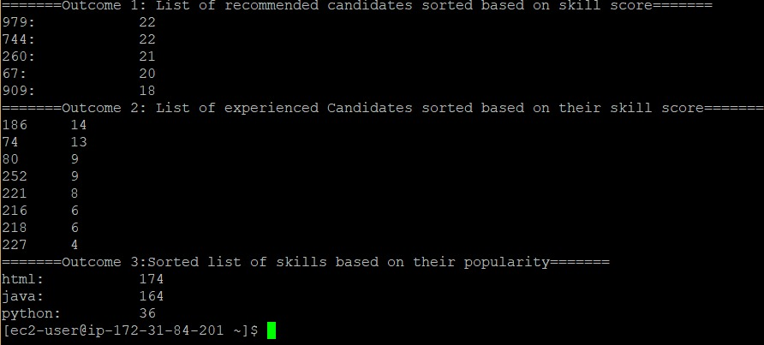
Implementation
Input: Skill set: Java, HTML, Python position: Software Architect

Slide 10
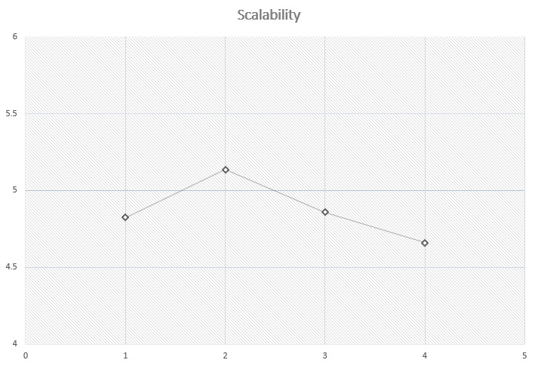
Evaluations

Slide 11
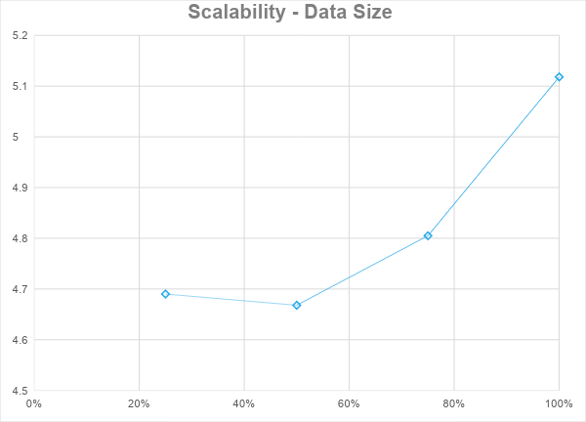
Evaluations

Slide 12
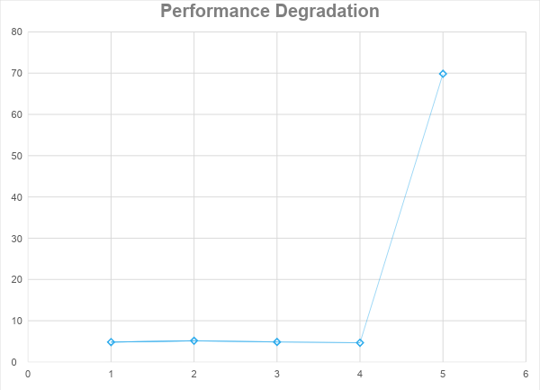
Evaluations

Slide 13
Conclusion
Successfully processed the dataset parallelly on a cluster of 4 nodes.
Tested the performance scalability.
Simulated a node failure scenario.
The system was able to recover on its own.

