Slide 1
Lending Club Case Study
By:
Ashish Chaudhary
Uma Hyndavi Simhadri

Slide 2
Problem Statement and Dataset
A consumer finance Company lending various types of loans to urban customers.
When company receives a loan application, the company has to make a decision for loan approval based on the applicant’s profile.
Given past loan data from 2007 to 2011, comprises of Current(still paying loan), Charged off(Defaulters) and fully paid data
The company wants to understand the driving factors (or driver variables) behind loan default, i.e. the variables which are strong indicators of default. The company can utilize this knowledge for its portfolio and risk assessment.
Aim is to Implement EDA on this real world problem

Slide 3
Data Cleaning and Analysis
Loading the Data set using pandas library
Dropping Null columns
Converting data type of column according to analysis
Split columns accordingly
Treating missing values
Removing Outliers from numerical columns.
Performing Univariate analysis on each column
Bivariate Analysis
Multivariate Analysis

Slide 4
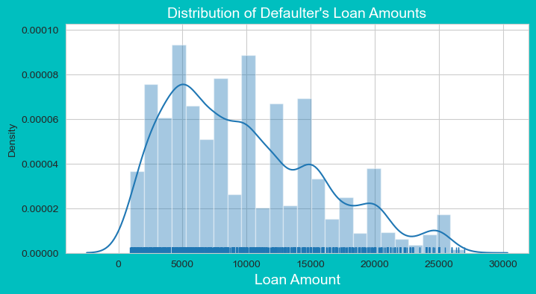
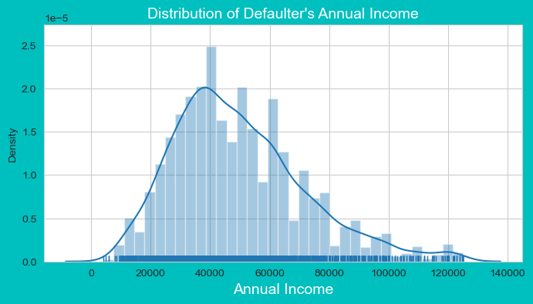
Univariate Analysis
Loan amount and Annual Income: Considering only charged off data, Borrowers who applied for Less loan amount with less annual income. Likely to become defaulters

Slide 5
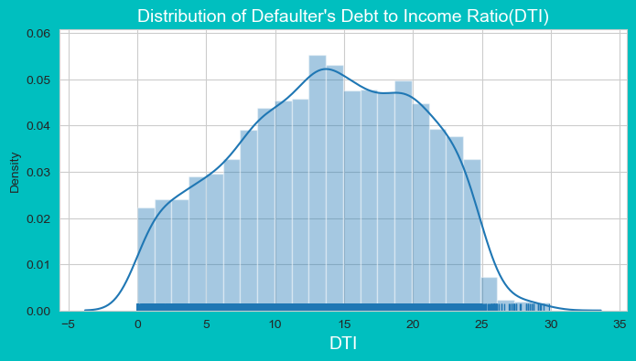
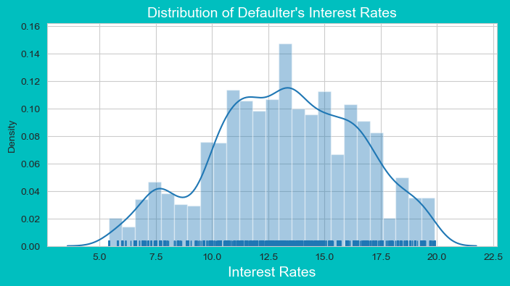
Univariate Analysis
DTI ratio and Interest Rates: Considering only charged off data ,Borrowers with High DTI ratio and high interest rates are likely to become defaulted.

Slide 6
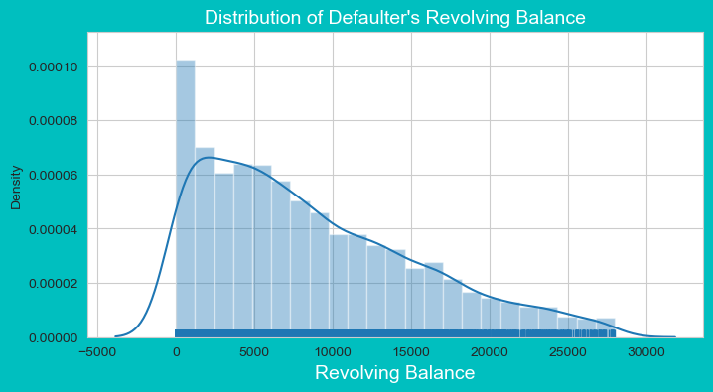
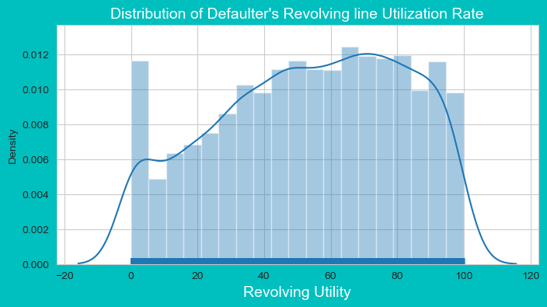
Univariate Analysis
Revolving balance and Revolving Utility: Considering only charged off data , Majority of Defaulters are from, Borrowers whose Revolving utility is high with Less Revolving balance.

Slide 7
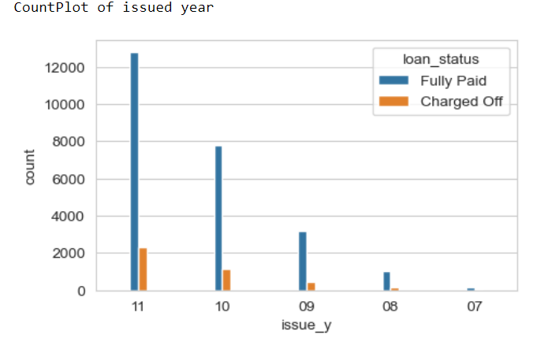
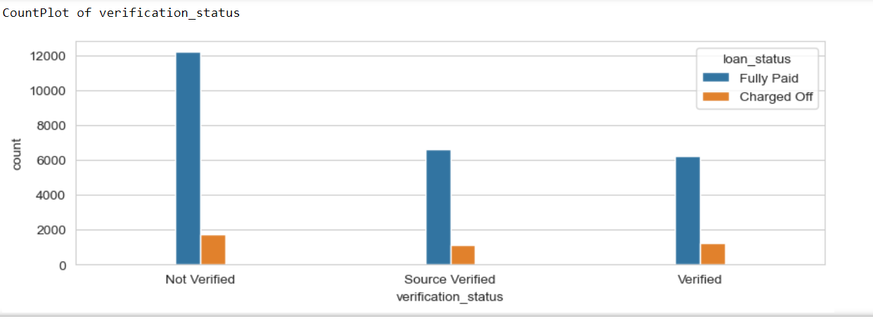
Univariate Analysis
Loan Issued Year and verification status: Considering only charged off data, Defaulter’s rate keep on increasing from 2008 to 2011 and Year ending months having more defaulters. Majority of defaulters falls under not verified status.

Slide 8
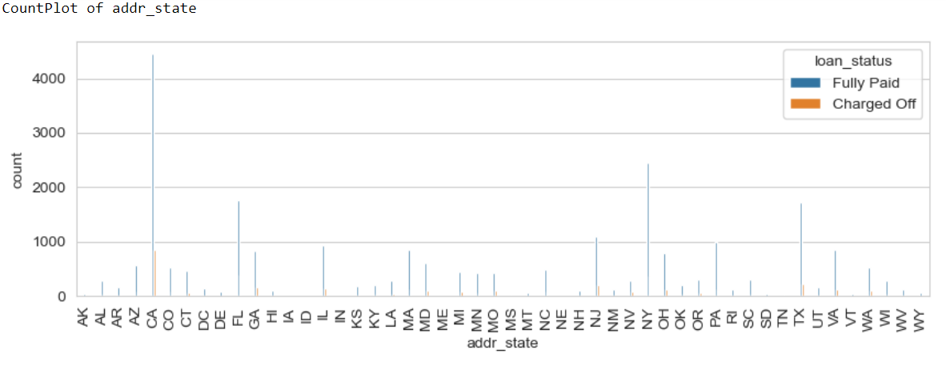
Univariate Analysis
Address state: Considering only charged off data , Majority of Defaulters are from, California . Georgia and Texas having moderate number of defaulters. so, mostly Defaulters are from metropolitan cities.

Slide 9
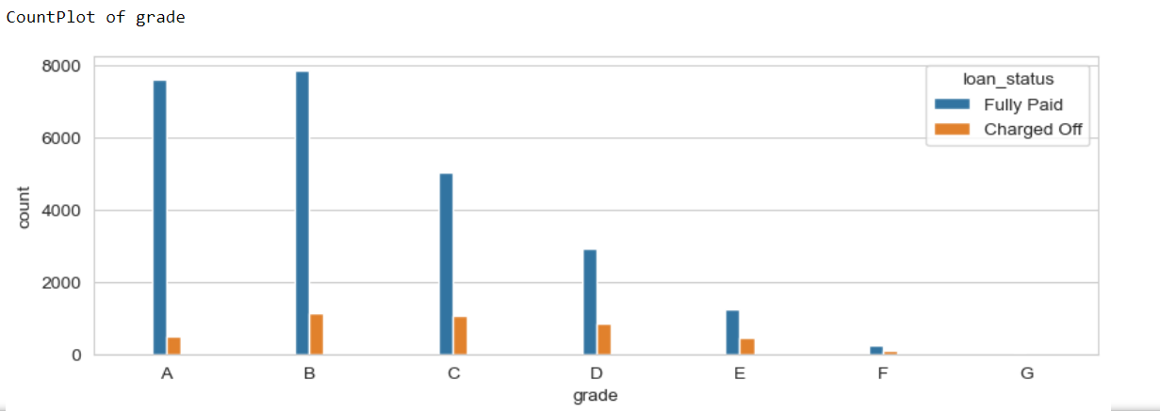
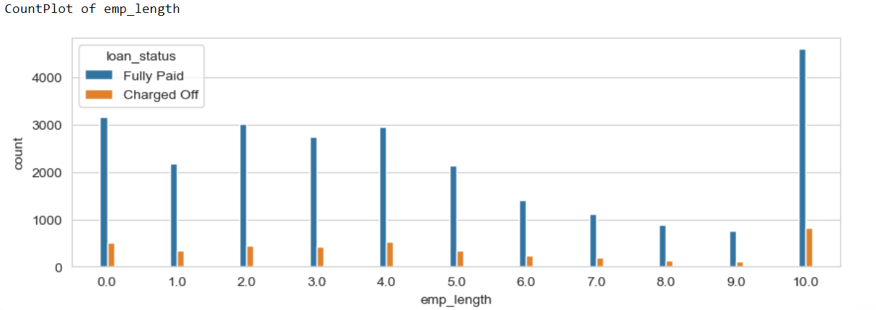
Univariate Analysis
Grades and Employment length: Considering only charged off data , Majority of Defaulters are from, Grade B and C having employment length 10years or above.

Slide 10
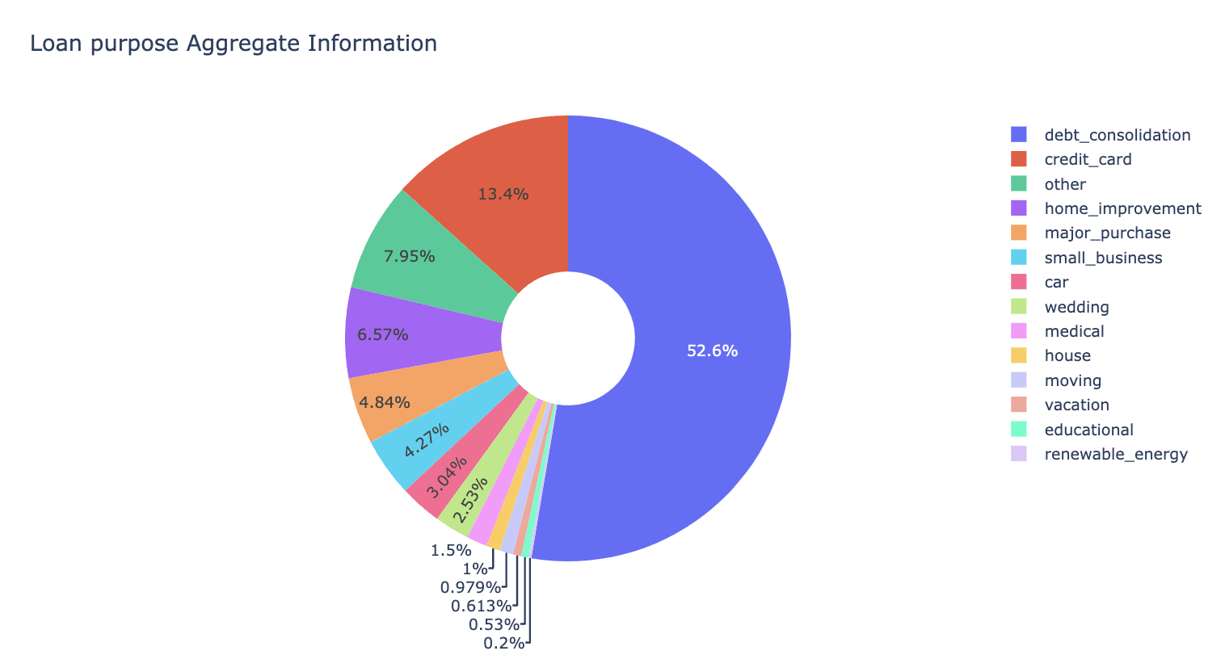
Univariate Analysis
Loan purpose : C Considering only charged off data ,Majority of Borrowers taken loan for purpose as debt consolidation.

Slide 11
Univariate Observations:
Grade B has Higher Defaulters
Sub grade B5 has higher Defaulters
Rented Home borrowers are likely to become Defaulters
No Inquiries in last 6 months likely to become Defaulters.
Borrowers with No Source/Annual Income verification likely to become Defaulters.
Higher the Revolving utility with loan amount under 15k has higher number of defaulters
Year End has Higher Defaulters.
Lesser Annual Income/Loan amount, Higher chance of Defaulters
Higher Interest rates, Higher chance of Defaulters.
Higher dti, Higher chance of Defaulter.
Lesser Revolving Balance, Higher chance of Defaulters.
Higher Revolving line utilization rate, Higher Chance of Defaulter.
Year 2011 has High number of Defaulters.

Slide 12
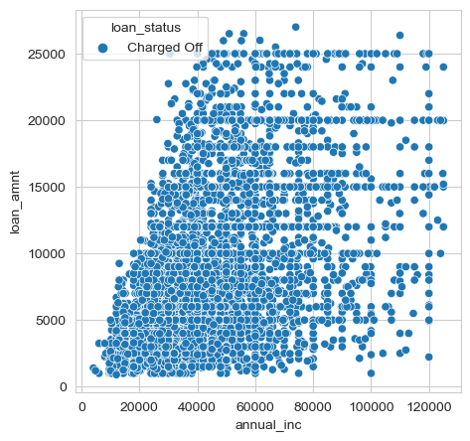
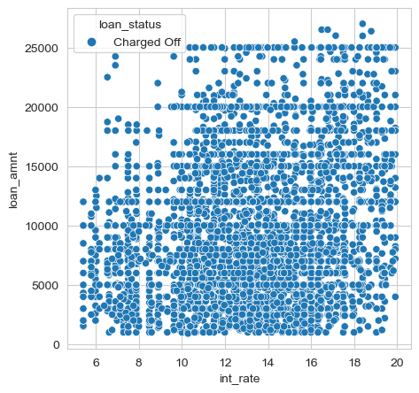
Bivariate Analysis:
Loan amount under 17k with annual income under 72k comprises majority of defaulters.
Loan amount under 15k with interest rates between 10 to 17 comprises majority of defaulters.
Loan amount vs Annual Income
Loan amount vs Interest rate

Slide 13
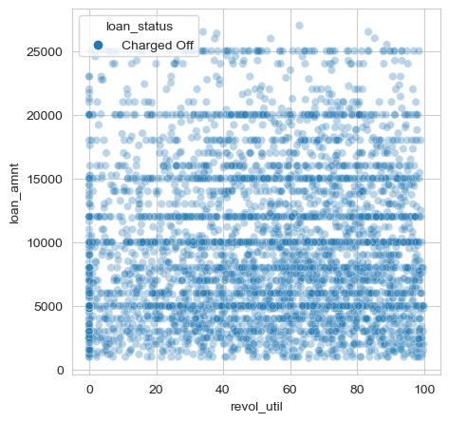
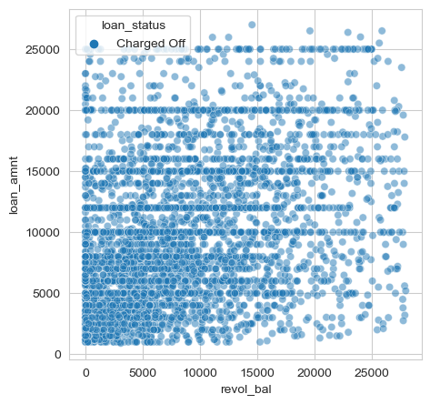
Bivariate Analysis
Loan amount under 11k with High revolving utility, comprises majority of defaulters.
Loan amount under 16k with less revolving balance, comprises majority of defaulters.
Loan amount vs Revolving utility
Loan amount vs Revolving Balance

Slide 14
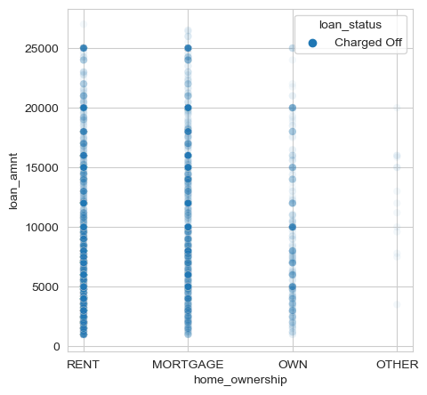
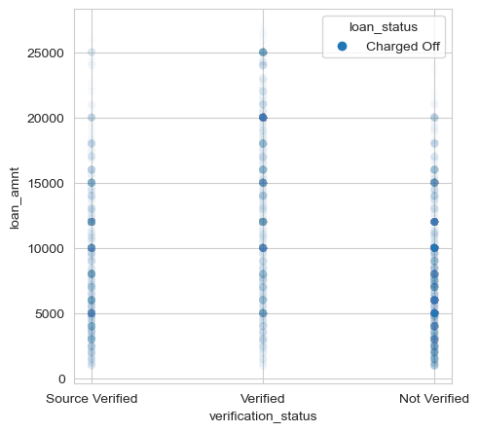
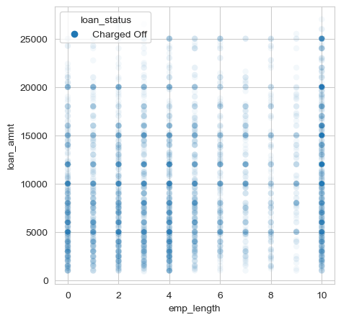
Bivariate Analysis
Borrowers whose Loan amount under 16k having rented home with 10 years of employment length are more likely to become defaulters.
Borrowers whose Loan amount under 11k with no source or income verification are more likely to become defaulters.
Loan amount vs Home Ownership
Loan amount vs Verification Status
Loan amount vs employment length

Slide 15
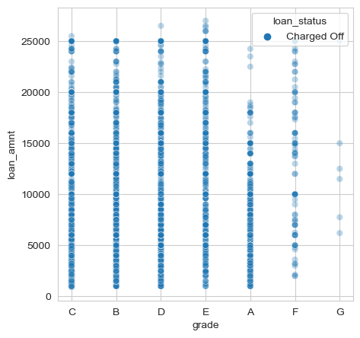
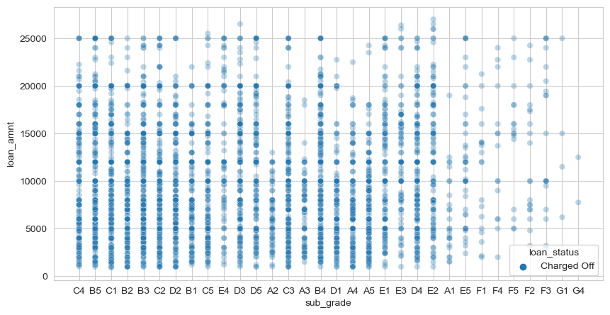
Bivariate Analysis
Loan amount under 20k with LC assigned grades as B,C and D, comprises majority of defaulters.
Loan amount under 16k with LC assigned sub grades as B3,B5,C1,B4, comprises majority of defaulters.
Loan amount vs Grade
Loan amount vs sub-grade

Slide 16
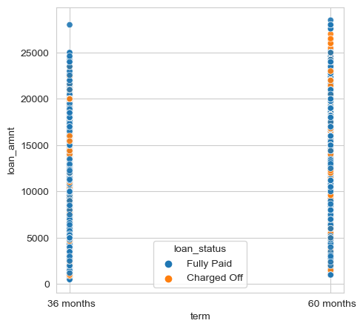
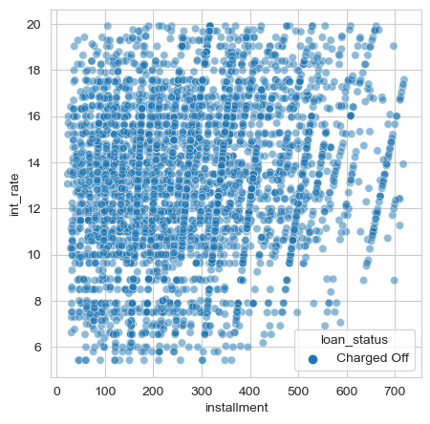
Bivariate Analysis
Regardless of loan amount, Defaulters are present in both term plans.
loan installment from 156 to 296 and interest rates from 8 to 17, Comprises majority of Defaulters
Loan amount vs term
Interest rate vs installment

Slide 17
Bivariate Observations:
Grades B,C & D Has high number of Defaulters
Sub grades B3,B5,C1,B4,C2,A5 has higher number of Defaulters
No source/Income verification has high Defaulters
Employment length within 10/4/0yrs has high number of defaulters.
Lower Revolving balance with loan amount under 10k has higher Defaulters
Higher the Revolving utility with loan amount under 15k has higher number of defaulters
Rented house Borrowers under 17.3k loan amount are likely to become of Defaulters.
Borrower's under loan amount under 17k, Interest rates from 8 to 13.49 are likely to become defaulters
Borrower's Loan purpose as Debt consolidation with loan amount under 23k are likely to become defaulters
Borrowers from California State with loan amount under 17k are likely to become defaulters
Regardless of loan amount Defaulters are high in both 60months and 30 months tenure
More Defaulter's DTI ranges from 10 to 25 and loan amount between 20k to 60k
Borrower's Annual income between 28k to 52k with B or C grades are likely to become defaulters
Majority of Defaulters comprises under 17.3k loan amount and annual income from 28.2k to 52.4k.
Borrower's Annual income from 28k to 53k with 10yrs of employment experience are likely to become defaulters
Borrowers from California and Florida states with annual income under 80k are likely to become defaulters
Borrower's with Installment from 156 to 296 with interest rates from 8 to 17 are likely to become defaulters.

Slide 18
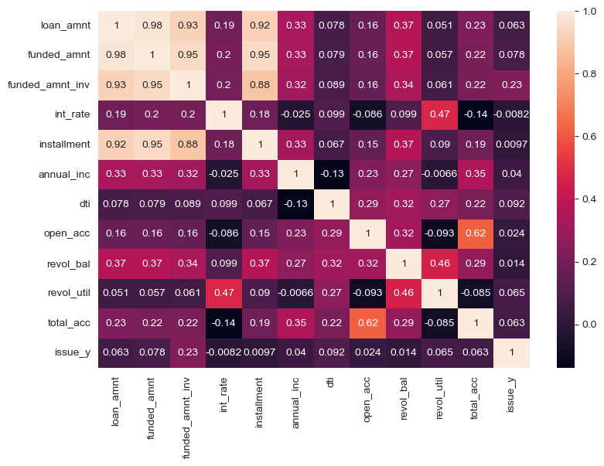
Multivariate analysis

Slide 19
Multivariate Observations:
Highly Correlated:
Loan amount is highly correlated with funded amount, funded amount by investors, installment.
Funded amount and funded amount by investors are highly correlated with installment and loan amount.
Less Correlated:
Loan amount is less correlated with interest rates, annual income, dti, open accounts, total accounts, revolving balance and revolving utility.
Interest rate is less correlated with dti ratio, revolving balance, revolving utility
Installment is less correlated with interest rates, dti, open accounts, total accounts, revolving balance and revolving utility.
Annual income is less correlated with other numerical columns.
Revolving balance, open accounts, total accounts and dti are less correlated with others.
Negatively correlated:
Interest rates negatively correlated with annual income, open accounts and total accounts.
Annual income and dti are negatively correlated.
Open accounts and total accounts are negatively correlated with revolving utility.

Slide 20
Strong Indicators of Default:
Grade as B
Sub grade as B3
Verification status as Not verified
Employment length of 10years
Revolving balance less
Revolving utility high
Home ownership as rented house
Interest Rates from 8 to 17
Loan purpose as debt consolidation
Address state from metropolitan cities
Debt to income ratio from 10 to 25
Annual income from 28k to 52k
Loan amount under 15k

