Slide 1
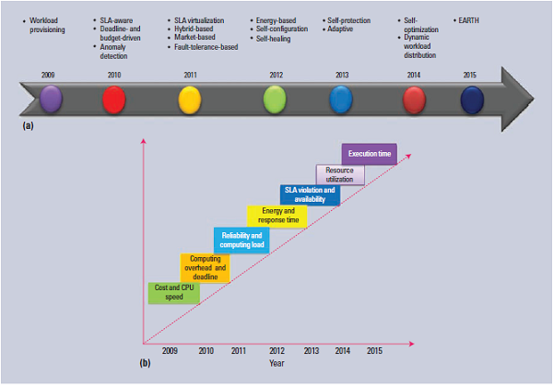
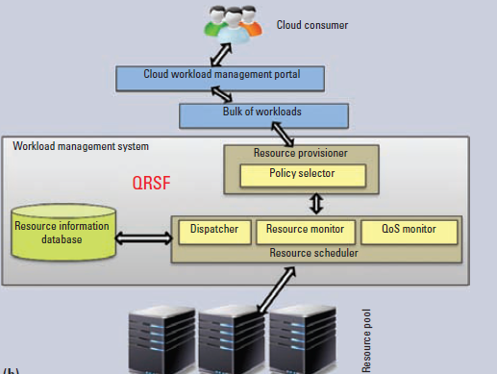
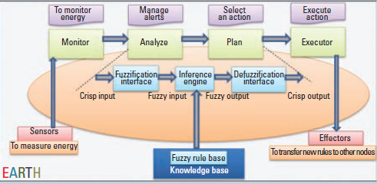
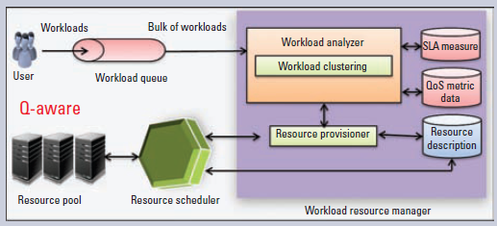
QoS-Aware Autonomic Cloud Computing
VIKESH KONDAPANENI 115CS0682
Department of Computer Science and Engineering, NIT ROURKELA
Abstract
Resource Scheduling
Resource allocation in the cloud can be challenging due to heterogeneity, dynamism, and failures. Autonomic computing, a radical change in the way businesses, academia, and even the government design, develop, manage and maintain computer systems. Autonomic computing calls for a whole new area of study and a whole new way of conducting business. Autonomic computing systems were basically inspired by the human autonomic nervous system (ANS).
Introduction
The cloud offers three main service types: infrastructure, platform, and software. Thus, quality of service (QoS) in the cloud means efficiently monitoring and measuring services and following service-level agreements (SLAs) to ensure their efficient delivery. Currently, cloud services are provisioned and scheduled according to resource availability but fail to ensure expected performance. Two important aspects must be considered that reflects the complexity cloud management introduces: QoS-awareness and self-management.
The QoS-aware aspect involves a services capacity to be aware of its behavior, thus ensuring its elasticity, high availability, and reliability, along with important QoS parameters (cost, time, energy, and so on). Self-management implies that the service can self-manage as its environment requires.
Existing autonomic systems encompass only a few QoS parameters; thus, an autonomic resource management system is necessary that considers all the important QoS parameters including availability, security, execution time, SLA violation rate, and energy consumption for better resource management.
Autonomic cloud computing (ACC) can provide one solution for effective resource allocation by fulfilling users QoS requirements and healing unexpected failures at runtime automatically, thus optimizing QoS parameters [1].
ACCs first objective is to identify and schedule the resources suitable to the appropriate workloads on time, thus increasing the effectiveness of resource utilization. In other words, the resource amount should be the minimum needed for a workload to maintain a required level of service quality or automatically minimize the workload completion time (maximize throughput).ACCs second objective is to identify an adequate and suitable workload that supports the scheduling of multiple workloads; this lets the cloud service fulfill numerous QoS requirements including resource utilization, availability, reliability, security, and energy for the cloud workload.
Autonomic Resource Provisioning and Scheduling
Resource Provisioning
Conclusion
Considerable progress has been achieved in autonomic cloud computing, and scalable computing infrastructures are easily implemented by cloud computing on a pay-per-use basis.
Present Autonomic computing systems work as single-tier architectures. To achieve better performance in terms of deadlines, job distribution, availability, and other important QoS parameters (cost, time, energy, and so on), cloud auto scaling architectures must shift to a multitier application environment.
Immediate decisions in autonomic systems can be improved using optimized data mining or machine learning techniques.
Previous Work
References
Autonomic computing systems were basically inspired by the human autonomic nervous system (ANS). Initially workload provisioning and self optimization [2] was put forward which showed improved cost and resource utilization. Then dynamic workload distribution based auto scaling [3] was put forward which reduced execution time and cost. The evolution of QoS aware autonomic cloud computing is shown in the Figure 1.
L. Mashayekhy, M.M.Nejad, and D.Grosu, “A PTAS Mechanism for Provisioning and Allocation of Heterogeneous Cloud Resources,” IEEE Trans. Parallel and Distributed Systems, vol. 26, no. 9,2015, pp. 2386-2399.
S. Singh and I. Chana, “Cloud Resource Provisioning: Survey, Status, and Future Research Directions,” Knowledge and Information Systems, vol.49, no.3, 2016, pp. 1-65.
S. Singh and I. Chana, “QoS-Aware Autonomic Resource Management in Cloud Computing: A Systematic Review,” ACM Computing Surveys, vol. 48, no. 3, 2015, pp. 1-46.
S. Singh and I. Chana, “EARTH: Energy-Aware Autonomic Resource Scheduling in Cloud Computing,” J. Intelligent and Fuzzy Systems, vol. 30, no. 3, 2016, pp. 1581-1600.

