Slide 1
Module FeDeration

Slide 2
What are micro frontends ?
What is module federation?
How module federation works ?

Slide 3

Let’s do this

Slide 4
Micro Frontends
Micro frontend is an architectural and organizational style in which the front-end of the app is decomposed into individual, loosely coupled “micro apps” that can be built, tested, and deployed independently.
Just like in the world of microservices where the backend is chopped into individual services.

Slide 5
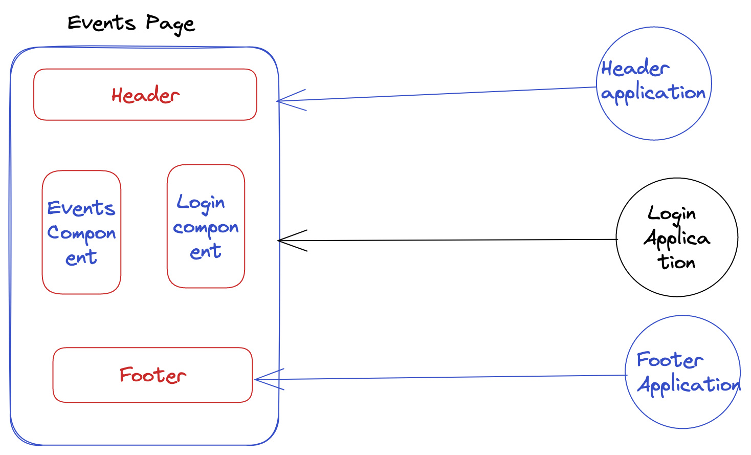

Slide 6
Existing Approaches
npm library:
Disadvantages:
Need to update package version manually everytime.
ESI :

Slide 7

Webpack

Slide 8

How Module federation Works ?

Slide 9
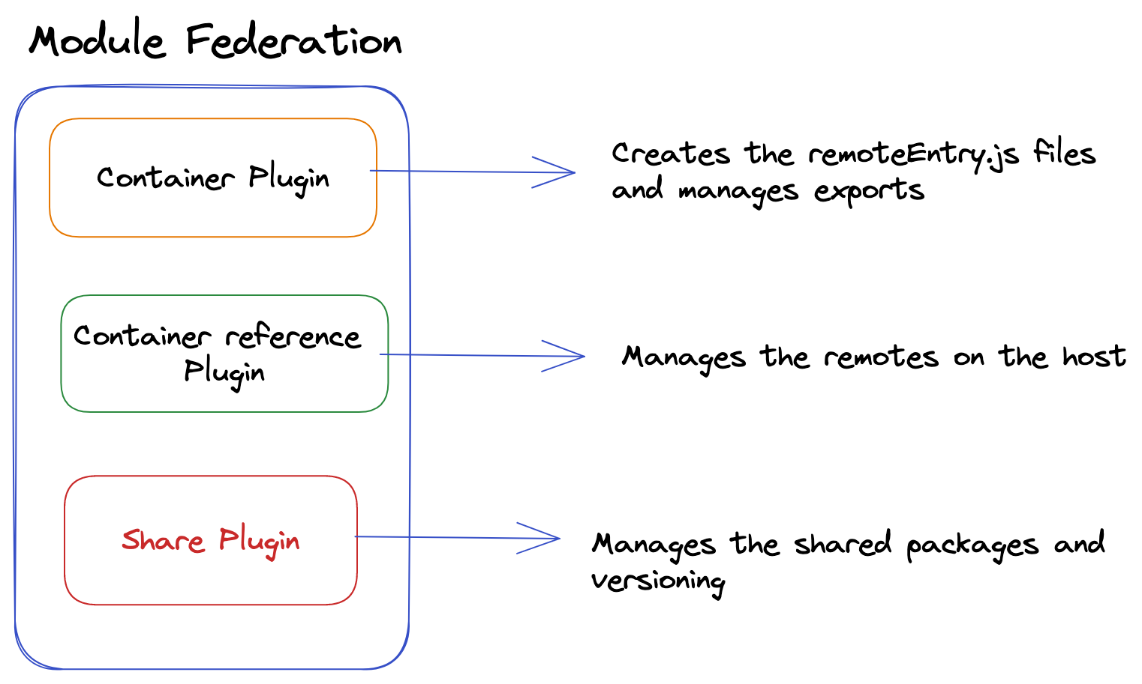
Build Stage

Slide 10
Run time

