Slide 1
CSE101-Lec#1
Computer Organization

Slide 2
OUTLINE
In this lecture we will study:
Computer Organization
Evolution of Operating Systems
Machine Languages, Assembly Languages, and High Level Languages
Key software and hardware trends
Procedural and Object Oriented Programming

Slide 3
What is a Computer?
Computer
Device capable of performing computations and making logical decisions (hardware)
Computers process data under the control of sets of instructions called computer programs (software)
Hardware
Various devices comprising a computer, such as central processing unit (CPU), memory, motherboard and hard disks as well as peripheral devices (keyboard, screen, mouse CD-ROM)
Software
Programs that run on a computer

Slide 4
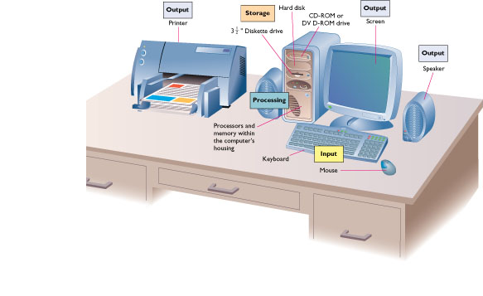
What is a Computer?

Slide 5
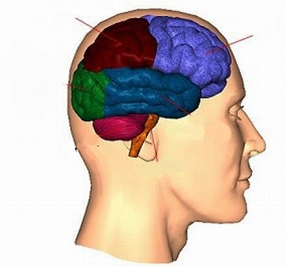
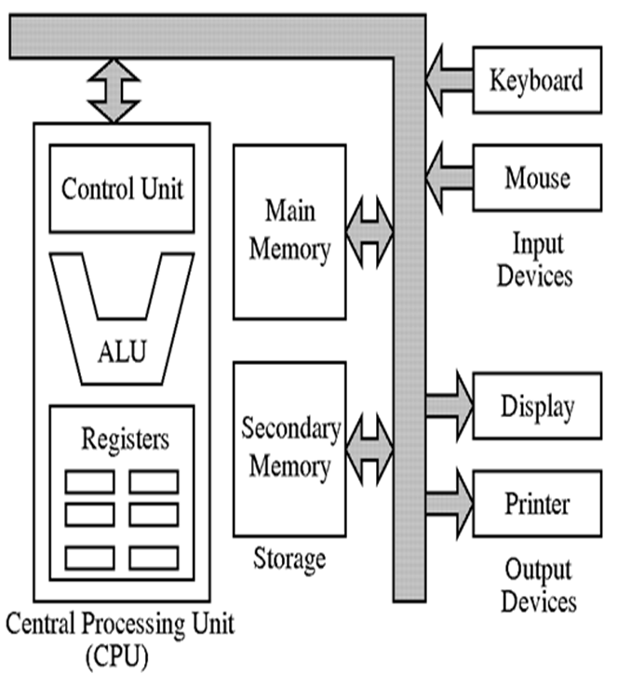
Computer Organization
CPU
Primary storage
Six logical units of Computer
Input Unit
Output Unit
Memory Unit (Primary Memory)
Arithmetic and
Logic Unit
CPU
Secondary Storage
Unit
Input
unit
Output
unit

Slide 6


Computer Organization
Input unit
“Receiving” section.
Obtains information (data and programs) from input devices
Input devices are: Keyboard, mouse, microphone, scanner, networks, etc
Quick yak:
Discuss some of the examples on input like mouth, ear, eyes and ask for more such examples…

Slide 7
Computer Organization
Output unit
“Shipping” section
Takes information processed by computer.
Places information on output devices.
Output devices are:
Screen, printer, speaker, etc.
Used information to control other devices.
Quick yak:
Discuss some of the examples on output like vocal chord etc. ask for more such examples…

Slide 8
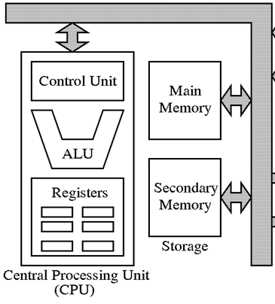
Computer Organization
Memory unit
Rapid access, relatively low capacity “warehouse” section
Retains information from input unit
Immediately available for processing
Retains processed information
Until placed on output devices
Information is Volatile
Called as memory or primary memory
Arithmetic and logic unit (ALU)
“Manufacturing” section
Performs arithmetic calculations and logic decisions

Slide 9
Computer Organization
Central processing unit (CPU)
“Administrative” section
Supervises and coordinates other sections of computer
Multiprocessors
Computers having multiple CPU’s
Multi-core processors
Implements multiprocessing on a single chip

Slide 10
Computer Organization
Secondary storage unit
Long-term, high-capacity “warehouse” section
Storage
Programs , data , information …...
Secondary storage devices
Disks, DVD’s, CD’s, Flash drives,….
Information is persistent (Non-volatile)
Longer to access than primary memory.
Less expensive per unit than primary memory.
Quick yak:
Secondary storage can be illustrated by examples on
Books
Note books
Telephone book etc.

Slide 11
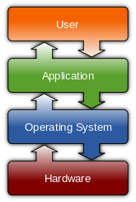
Operating System
Operating systems
A collection of programs that manages
resources of a computer, such as
- processors
- memory
- input/output devices
Perform basic tasks
Manage transitions between jobs
Increased throughput
Amount of work computers process
Multiprogramming
Many jobs or tasks sharing a computer’s resources
“Simultaneous” operation of many jobs.
Timesharing
Perform a small portion of one user’s job then moves on to service the next user

Slide 12
Batch Processing systems
First computer used batch OS in which computer ran batches of jobs without stop.
A 'batch' is the name given to the task of doing the same job over and over again
Programs were punched into card that were copied to tape for processing.
OS runs the series of jobs sequentially without user intervention.
When computer finished one job it would immediately start next one on tape.

Slide 13
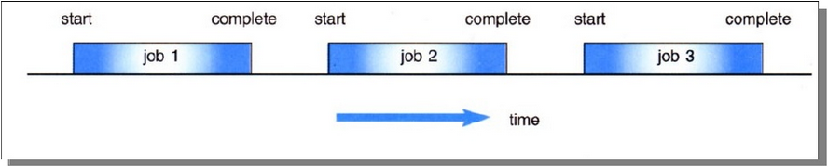
Batch Operating Systems
Jobs, together with input data, are fed into the system in a batch.
The jobs are then run one after another.
No job can be started until previous job is completed

Slide 14
The Advantages of batch based systems:
Significant savings
Reproducibility / elimination of human error
Transference of computer workload from prime (expensive) daytime to cheaper overnight off-peak times.

Slide 15
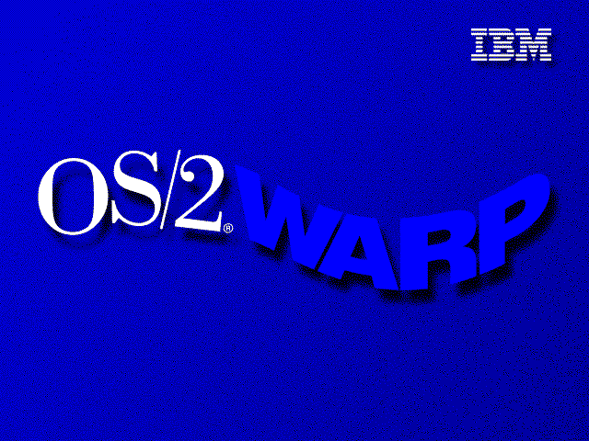


The Disadvantages of batch based systems
Lack of interaction between the user and job.
Inconvenient for users as users not interacted with machine. Only professional operator used this for stream.
CPU is often idle, because the speeds of the mechanical I/O devices is slower than CPU.
Examples of batch operating system are as follows: 1) DOS (Disk operating system) 2) IBM OS/2 3) Windows 1,2,3 95, 98 and ME

Slide 16
Time sharing Operating Systems
In 1960’s time shared replaced batch OS.
It allows many users to share the computer resources simultaneously.
Each user is given a time slice to interact with the CPU.
The size of the time slice will depend on the system.
Each user is served in sequence.

Slide 17
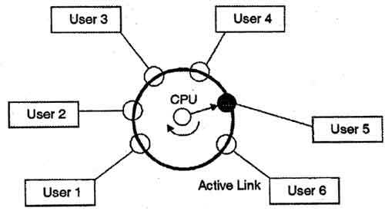
Example

Slide 18
Advantages of Timesharing operating systems
Provide advantage of quick response.
Reduces CPU idle time.
Disadvantages of Timesharing operating systems
Problem of reliability.
Question of security and integrity of user programs and data.
Problem of data communication.

Slide 19
Generations of Operating System
Operating systems have evolved through a number of distinct phases or generations :
First Generation
Second Generation
Third Generation
Fourth Generation
Fifth Generation

Slide 20
Generation | Duration | Memory Device | Features | Example
First (No operating system) | 1942-1955 | Vacuum Tubes or Valves | used vacuum tubes as electronic circuit magnetic drum for primary storage punch-card used as secondary storage machine level programming used operating speed was used in terms of millisecond | Mark-I, UNIVAC, ENIAC etc.
Second (First operating system started) | 1955-1964 | Transistor | magnet core memory used as internal storage magnet tapes used as secondary storage little bit faster I/O devices high level language used as programming processing speed measured in microsecond Beginning of batch processing systems | IBM 701, IMB 1401, ICL 2950/10 etc.
Third | 1964-1975 | IC(Integrated circuits) | semi-conductor memory used as primary storage magnetic discs were used as secondary storage massive use of high level language processing speed increased to nanosecond and even faster Concept of multiprogramming introduced Increased CPU utilization | IBM 360 series, UNIVAC 9000 etc.

Slide 21
Fourth | 1975-1990 | VLSI or Microprocessor | massive use of magnetic and optical storage devices with capacity more than 100 GB advancement in software and high level language operation speed increased beyond picoseconds and MIPS (Millions of Instructions Per Second) | IBM PC, Pentium PC, Apple/Macintosh etc.
Fifth | 1990+ to current state of the art | Bio-Chips | Artificial intelligence will make computer Intelligent and knowledge based very high speed, PROLOG (programming language) Concept of virtual machines introduced

Slide 22
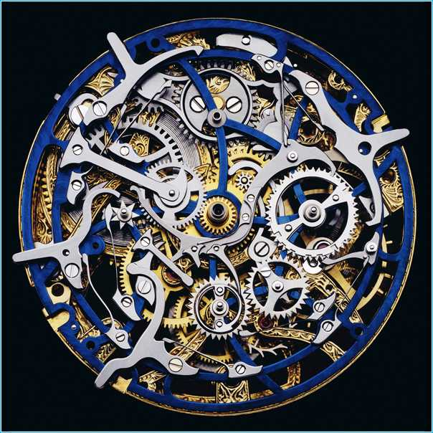
Machine Languages
Three types of computer languages
Machine language
Only language computer directly understands
“Natural language” of computer
Defined by hardware design
Machine-dependent
Generally consist of strings of nos.
Ultimately 0s and 1s
Cumbersome for human.
Slow, tedious and error prone

Slide 23
Assembly Languages
Assembly language
English-like abbreviations representing elementary computer operations
Clearer to humans
Program is in alphanumeric symbols
Incomprehensible to computers
Translator programs (assemblers).
Convert to machine language
Example:
LOAD ADD STORE
MUL
Usage of computer increases, but user had to use many instructions to accomplish even a simple task

Slide 24
High-level Languages
High-level languages
Similar to everyday English, use common mathematical notations
Single statements accomplish substantial tasks
Assembly language requires many instructions to accomplish simple tasks
Translator programs (compilers)
Convert to machine language
Interpreter programs
Directly execute high-level language programs
Example:
c = a+b

Slide 25
The Key Software Trend
Software technology did emerge from structured programming to object-oriented programming
Objects
Reusable software components that model items in the real world
Meaningful software units
Date objects, time objects, paycheck objects, invoice objects, audio objects, video objects, file objects, record objects, etc.
Very reusable
More understandable, better organized, and easier to maintain than procedural programming

Slide 26
Hardware Trends
Every year or two the following approximately double:
Amount of memory in which to execute programs
Amount of secondary storage (such as disk storage)
Used to hold programs and data over the longer term
Processor speeds
The speeds at which computers execute their programs

Slide 27
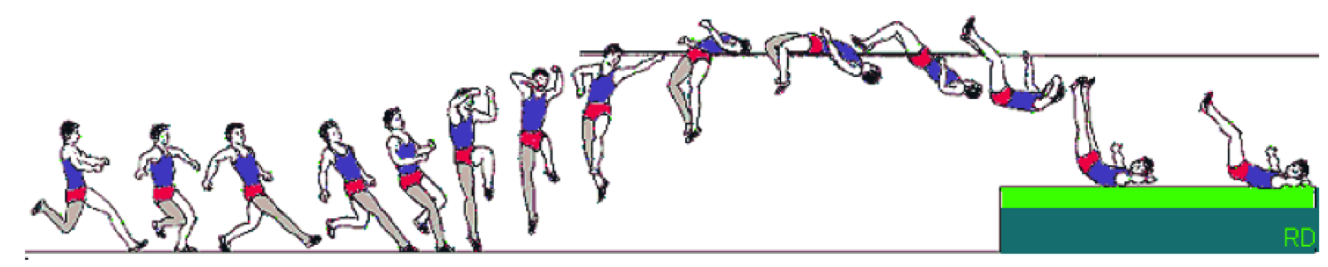
Procedural Programming
Involves procedures which are sequence of statements
The design method used in procedural programming is called Top Down Design. This is where you start with a problem and then systematically break the problem down into sub problems.
Traditional programming languages were procedural.
–C, Pascal, COBOL , etc
Quick yak:
Discuss about some of the PROCEDURAL daily routines, ask students to build examples….

Slide 28
Problems with Procedural programming language
Software maintenance can be difficult
Time consuming
When changes are made to the main procedure, those changes can cascade to sub procedures of main, and sub-sub procedures and so on..

Slide 29
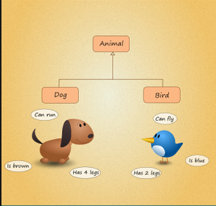
Object-Oriented Programming
Object-oriented programming is centered on creating classes and objects rather than procedures/ functions
Class is a combination of state (data) and behavior (methods)
Data in an object are known as attributes
Class is a data type and object is an instance of that data type
Examples- C++, Java,…
Notes:
A class is a set of functions that work together to accomplish a task. The object is for use with specific data or to accomplish particular tasks.
classes and objects, it might help to think of a class as the ability to do something and the object as the execution of that ability in a distinct setting.
AIM of OOP: to increase flexibility and maintainability of programs

Slide 30
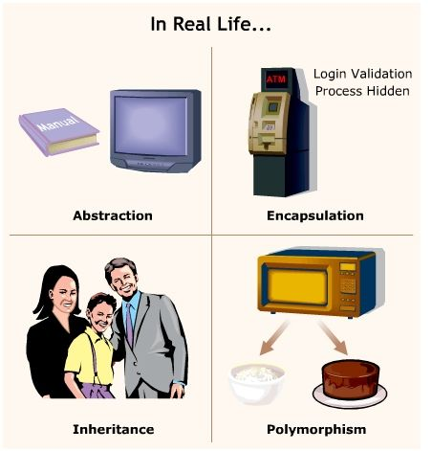
Principles of OOP
Object-oriented programming combines data and behavior (or method). This is called encapsulation.
Data hiding is the ability of an object to hide data from other objects in the program.
Inheritance is the ability to inherit attributes and behavior from existing classes (base class)

Slide 31
Benefits of Object-oriented programming
Modularity
Information hiding
Code re-use
Save development time (and cost) by reusing code
– once an object class is created it can be used in other applications
Easy debugging
– classes can be tested independently
– reused objects have already been tested

Slide 32
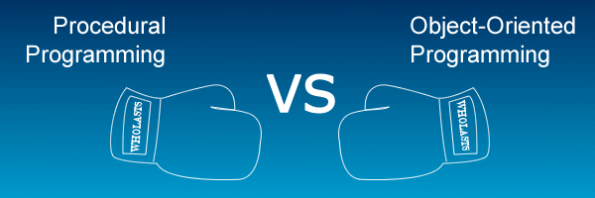
Procedure oriented programming | Object oriented programming
It is known as linear programming | It is not linear programming
Program is divided into small parts called functions | Program is divided into number of entities called objects.
In Procedural programming, Data can move freely from function to function in the system. | In OOP, objects can move and communicate with each other through member functions.
Procedural programming follows Top Down approach. | OOP follows Bottom Up approach
To add new data and function in Procedural programming is not so easy. | OOP provides an easy way to add new data and function.
Procedural programming does not have any proper way for hiding data so it is less secure. | OOP provides Data Hiding so provides more security.
There is no concept of reusability | Reusability concept is introduced here
Example of Procedural programming are : C, VB, FORTRAN, Pascal. | Example of OOP are : C++, JAVA, VB.NET, C#.NET.
Notes:
linear programming. One thing happens and then the next.

Slide 33
Next Class: Programming Basics C Program development environment & tools
cse101@lpu.co.in

