Slide 1
CSE101-Lec#2
Programming Methodologies
C Program Development Environment
Algorithm and Pseudo code

Slide 2
Outline
Program Development in C
Structured programming (Algorithm and Pseudocode)

Slide 3
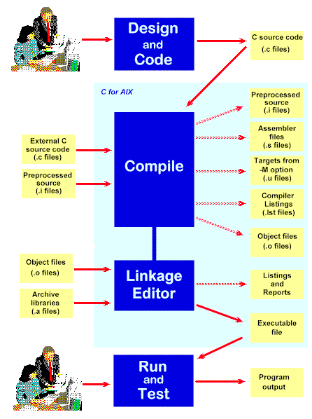
C Program Development Environment
A C program must go through various phases such as:
Creating a program with editor
Execution of preprocessor program
Compilation
Linking
Loading
Executing

Slide 4
Editor
Program is created in
the editor and stored
on disk.
Disk
Preprocessor
Disk
Preprocessor program
processes the code.
Compiler creates
object code and stores
it on disk.
Compiler
Disk
Linker links the object
code with the libraries,
Linker
Disk
Primary Memory
Loader
Loader puts program in memory.
Disk
.
.
.
.
.
.
Primary Memory
CPU
CPU takes each
instruction and
executes it, possibly
storing new data
values as the program
executes.
.
.
.
.
.
.

Slide 5
C Program Development Environment(cont.)
Phase 1: Create your program with an editor program
Phase 2: A preprocessor find some preprocessor directives (#include <stdio.h>) to include other files.
Phase 3: Compiler compiles the program into machine languages
Phase 4: A linker links the object code with the code in library or other places to produce an executable image.
Phase 5: A loader loads the executable image into memory (RAM).
Phase 6: CPU executes the program one instruction at a time. The load process in Windows OS is just input the name of the executable file.

Slide 6
Program Development Tools
Algorithm
Flow chart
Pseudo-code

Slide 7

Algorithm
Algorithm is defined as “ the finite set of steps, which provide a chain of action for solving a problem”
It is step by step solution to given problem.
Well organized, pre-arranged and defined textual computational module
Quick yak:
Various daily routine algorithms can be shared
Deciding on an Ice cream out of a lot
Chapati selection

Slide 8
Characteristics of good Algorithm
Correctness - terminates on ALL inputs (even invalid inputs!) and outputs the correct answer.
Simplicity - each step of the algorithm performs one logical step in solving the problem.
Precision - each step of the algorithm is unambiguous in meaning.
Comprehensibility - the algorithm is easy to read and understand.
Abstraction - presents the solution steps precisely and concisely without referring to low-level (program code) details.
Efficient - Gives results rapidly based on the problem size; does not waste any space or time.
Easy to Implement - relatively easy to translate into a programming language.

Slide 9
Steps to create an Algorithm
1. Identify the Inputs
What data do I need?
How will I get the data?
In what format will the data be?
2. Identify the Outputs
What outputs do I need to return to the user?
What format should the outputs take?
Quick yak:
Formulate examples on conversation…
Ask a question
When would you be 34 years old
Let them craft a logic for answer!!!

Slide 10
Steps to create an Algorithm
3. Identify the Processes
How can I manipulate data to produce meaningful results?
Data vs. Information
4. Break the Solution to steps
By breaking the solution to the steps we can easily understand the logic of program

Slide 11

Example of Algorithm
To establish a telephone communication
Step 1: Dial a phone number
Step 2: Phone rings at the called party
Step 3: Caller waits for the response
Step 4: Called party picks up the phone
Step 5: Conversation begins between them
Step 6: After the conversation, both disconnect the call

Slide 12
Algorithm: Add 2 Numbers
Problem: To add two numbers.
Step1. Start.
Step2. Take the two numbers.
Step3. Add them.
Step4. Print the result.
Step5. Stop.

Slide 13
Pseudocode
Pseudocode is similar to everyday English language, its convenient and user friendly
It’s not a actual computer programming language.
Pseudocode consist only of action statements
In pseudocode representation
Each of steps will be written via operators and statements equivalent to some programming language instructions.
The only difference will be that the exact syntax of the programming language will not be followed.

Slide 14
Pseudo code: Add 2 Numbers
Set A = 4.
Set B = 2.
Calculate Sum = A + B.
Print Sum.

Slide 15
Flow Chart
Flow Chart is pictorial representation of an algorithm.
Whatever we have done in algorithm we can represent it in picture.
It is easy to understand.
Shows the flow of the instruction

Slide 16
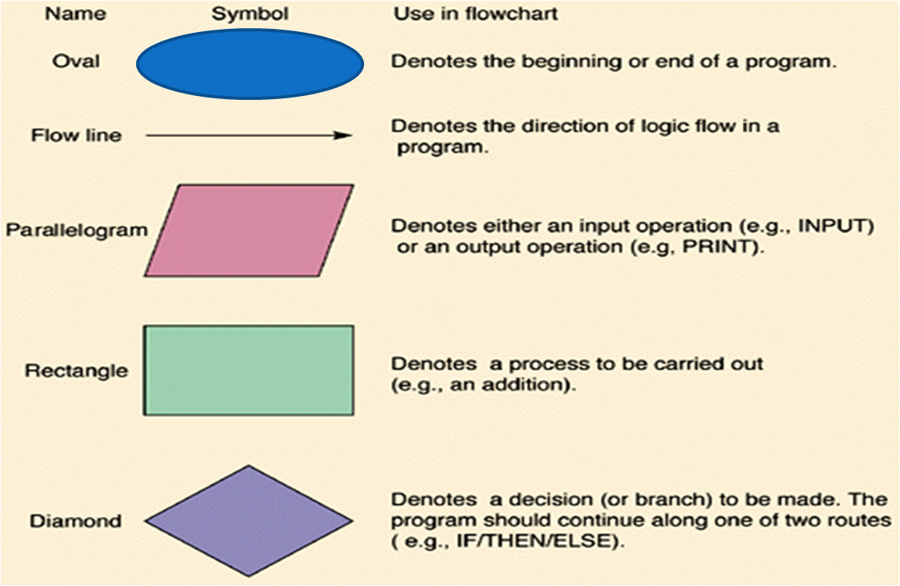
Flow Chart Symbols

Slide 17
Flow Chart: Add 2 Numbers
START
Quick yak:
Ask students to draw a flow chart for going to a movie…
TAKE TWO NUMBERS A and B
FIND SUM=A+B
PRINT SUM
STOP

Slide 18
Program in C: Add 2 Numbers
#include<stdio.h>
void main()
{
int a=4;
int b= 2;
int sum;
sum=a+b;
printf(“Sum is: %d”, sum);
}
Sum is: 6

Slide 19
Program in C
#include<stdio.h>
#include<conio.h>
int main()
{
int pr_per_kg = 45;
float no_of_kg = 7.5;
float t_pr;
t_pr = pr_per_kg * no_of_kg;
printf(“%f”, t_pr);
getch();
}
337.5

Slide 20
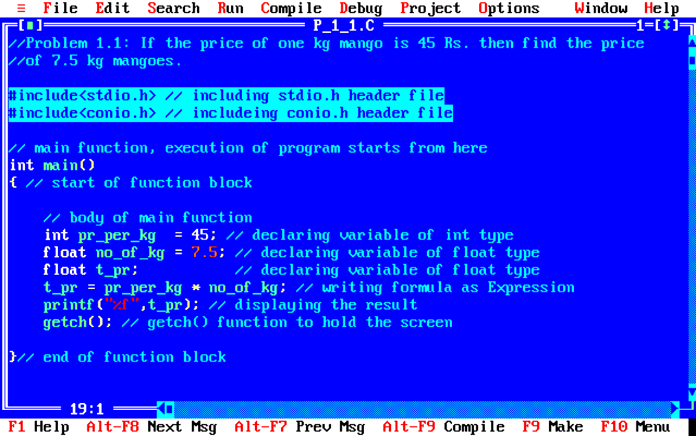
Structure of C program

Slide 21
Explanation
A simple C program consists of
Comments (optional)
//
/*….*/
Including header files
#include<header file name>
Functions
main function as special function
Other user defined functions (optional)
Let’s discuss these in detail..

Slide 22
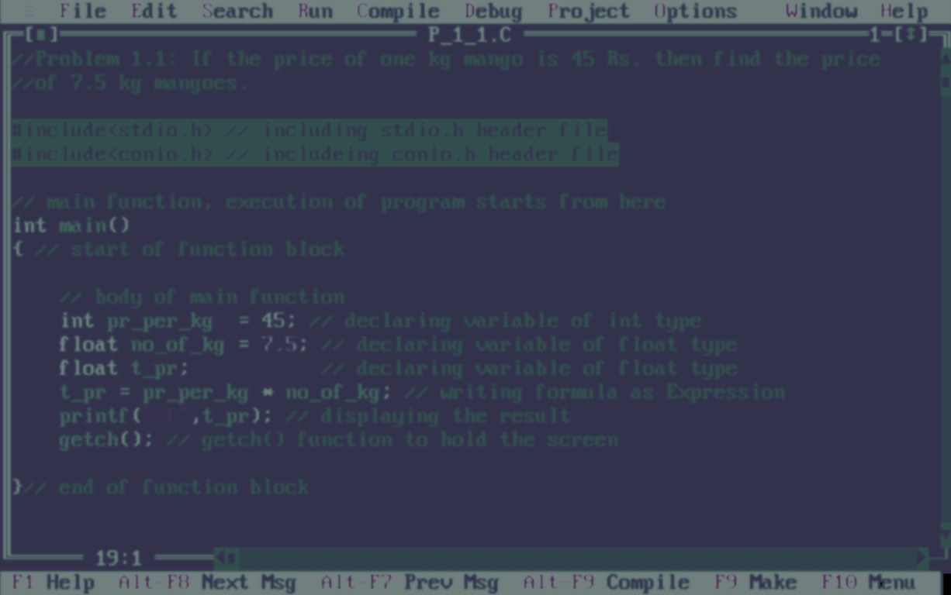
Comments
Two forward slashes ‘ // ’ (double forward slashes), are used to write single line comment
The next combination ‘ /*……..*/ ’ (forward slash with asterisk) is used for commenting multiple lines
These comments are not being executed by compiler
* comment can appear anywhere in a program where a white space can appear

Slide 23
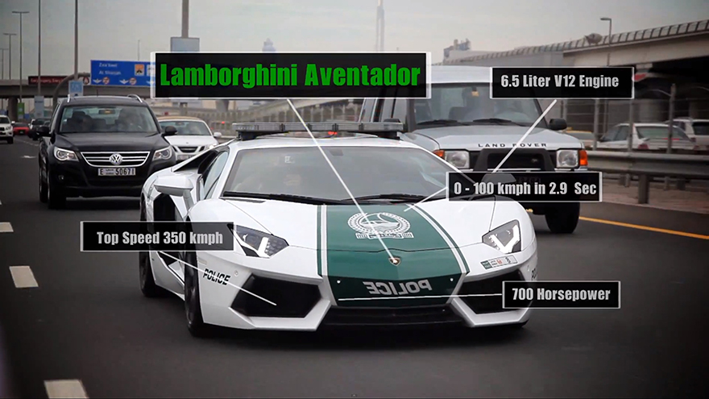
Comments
Enhances readability of program
Real life example
C code example
Fuel consumption: 16.0 L/100 km
Carbon fiber engine bonnet
//Prog. Name: addition of integers
//Another format
/*Prog. Name: addition of integers
Student Name: Chandra Prakash
UID: 11121415
Section: M4571 */
#include<stdio.h>
#include<conio.h>
int main()
{
}
Front tyre: 255/35 ZR19

Slide 24
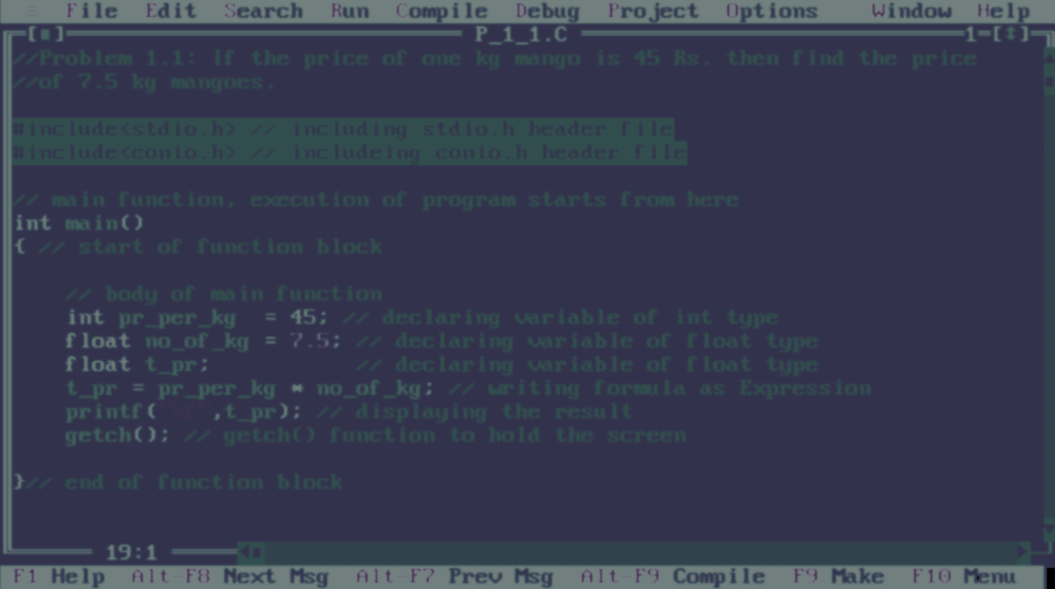

Header files
The next two lines are command for including header files
These two lines must be included in every C program
stdio.h: standard input output header file for functions printf(),scanf(),... and so on
conio.h: console input output header file for functions getch()…. and so on
Here ‘ # ‘ is called preprocessor directive

Slide 25

Header files
Real life example
C code example
Header for tires
Header for oil
Header for speakers
//Sample program
#include<stdio.h> //header file for printf()
#include<conio.h> //header file for getch()
int main()
{
//stdio.h is providing printf() function
printf(“Car is under process”);
//conio.h is providing getch() function
getch();
}
Ferrari car as output
Output:
Car is under process

Slide 26
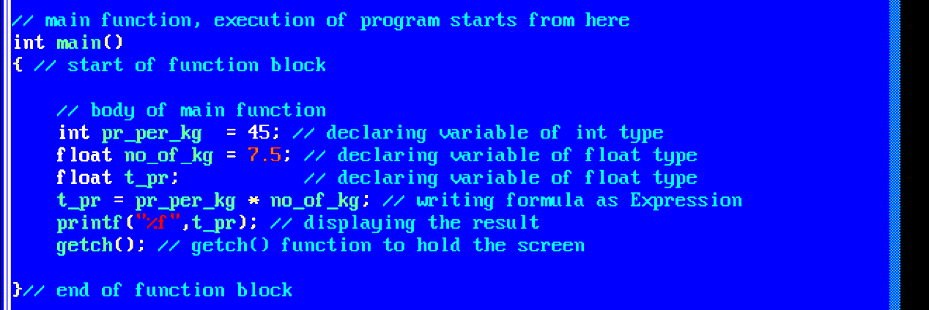
Function
main() as special function, execution starts from here
A program must have a single main() function
A program without main() function wont work
main() function will call other functions

Slide 27
main function in real life
Real life example
C code example
Before driving the car, we must start the car, a car won’t be driven without starting
Similarly our program must have a main function to start a program
//Prog. Name: display name
#include<stdio.h>
#include<conio.h>
int main()
{
printf(“My name is Aman”);
getch();
}
Starting engine
Driving car
Output:
My name is Aman

Slide 28
Next Class: Components of C Identifier and Keywords Data Type

