Slide 1
A Recommender System for New Restaurant
Applied Data Science Capstone
IBM Data Science Professional Certificate

Slide 2
Introduction
In this project we will try to find an optimal location for a restaurant. Specifically, this report will be targeted to stakeholders interested in opening a restaurant in Toronto.
Since there are lots of restaurant in Toronto, we will try to detect locations that are not already crowded with restaurants. We are also particularly interested in areas with no restaurants in the vicinity.
We will use our data science knowledge to find out most promising neighborhoods based on this criteria. Advantages of each area will then be clearly expressed so that best possible final location can be chosen by stakeholders.

Slide 3
Data
We will need geo-location information about that specific borough and the neighborhoods in that borough. We need to scrape the following Wikipedia page, https://en.wikipedia.org/wiki/List_of_postal_codes_of_Canada:_M, in order to obtain the data that is in the table of postal codes.
Now that when we have built a data frame of the postal code of each neighborhood along with the borough name and neighborhood name, in order to utilize the Foursquare location data, we need to get the latitude and the longitude coordinates of each neighborhood. Here is a link to a csv file that has the geographical coordinates of each postal code: http://cocl.us/Geospatial_data
We will need data about different venues in different neighborhoods of that specific borough. In order to gain that information we will use "Foursquare API" location information.

Slide 4
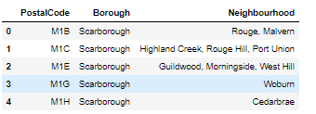
Main Article
Part 1: Identifying Postal Codes in Toronto

Slide 5
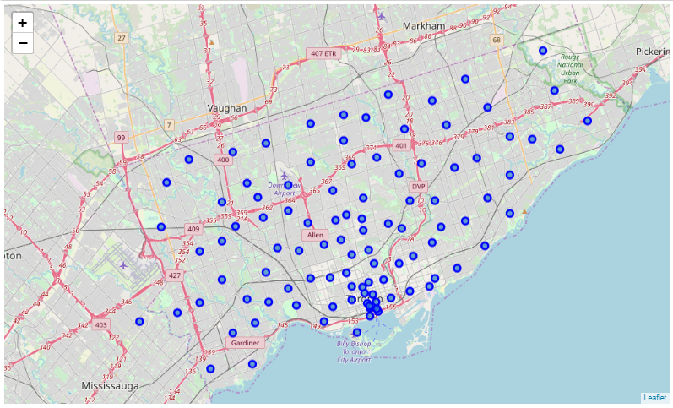
Main Article
Part 1: Identifying Postal Codes in Toronto

Slide 6
Main Article
Part 2: Connecting to Foursquare and Retrieving Locational Data for Each Venue in Every Neighborhood
After finding the list of neighborhoods, we then connect to the Foursquare API to gather information about venues inside each and every neighborhood. For each neighborhood, we have chosen the radius to be 500. It means that we have asked Foursquare to find venues that are at most radius of 500 far from the center of the neighborhood.

Slide 7
Main Article
Part 3: Processing the Retrieved Data and Creating a Data Frame for All the Venues Toronto
When the data is completely gathered, we will perform processing on that raw data to find our desirable features for each venue. Our main feature is the category of that venue. We will filter out venues based on when venues category contains word “Restaurant”. After this stage, the column "Venue's Category" will be One-hot encoded and different venues will have different feature-columns.

Slide 8
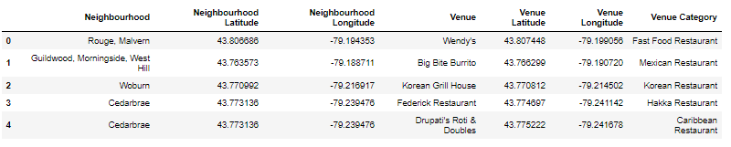
Main Article
Part 3: Processing the Retrieved Data and Creating a Data Frame for All the Venues in Toronto

Slide 9
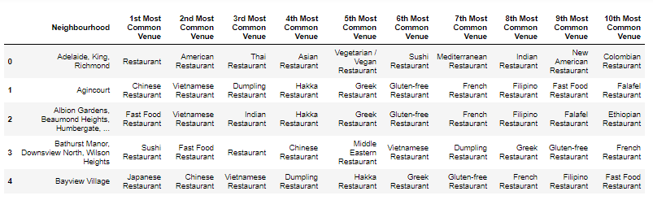
Main Article
Part 4: Now, the dataset is fully ready to be used for machine learning (and statistical analysis) purposes.

Slide 10
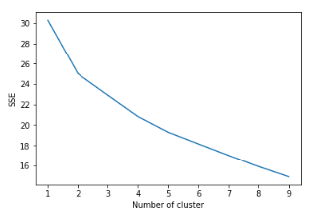
Main Article
Part 5: Find optimal value of k(number of clusters) using elbow method.
Where the curve bends we consider it as optimal k value. In our case it is k = 2.

Slide 11
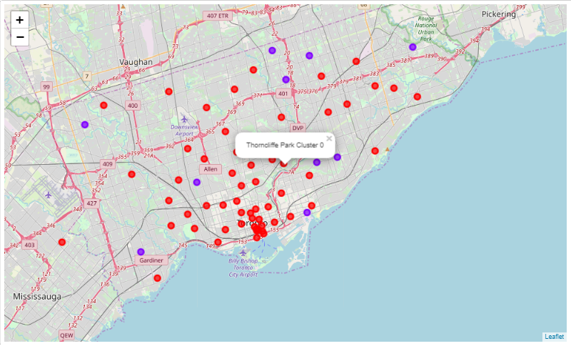
Main Article
Part 6: Applying one of Machine Learning Techniques (K-Means Clustering)

Slide 12
Decision Making and Reporting Results
Now, we focus on the centers of clusters and compare them to find out best possible location to open new restaurant. The place which has low density of restaurant will be our best recommendation to the stakeholders. This algorithm although is pretty straightforward yet is strongly powerful.
Based on result of all this East Toronto, East York, Etobicoke can be the potential new restaurant locations based on number of existing venues.

Slide 13
Conclusion
Final decision on optimal restaurant location will be made by stakeholders based on specific characteristics of neighborhoods and locations in every recommended zone, taking into consideration additional factors like attractiveness of each location (proximity to park or water), levels of noise / proximity to major roads, real estate availability, prices, social and economic dynamics of every neighborhood etc.

Slide 14


