Slide 1

Software Maintenance Management
SOFTWARE MAINTENANCE
(SE – 409)
Submitted by:
Ashish Kumar (2K18/SE/041)
Kevin Tirkey (2K18/SE/074)
Submitted to : Priya Singh

Slide 2
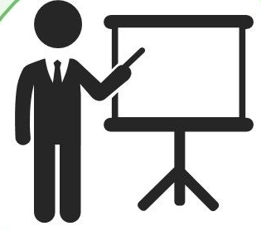
PRESENTATION OVERVIEW
Introduction
Methodology
Proposed Model
Result
Recommendations
Conclusion
References

Slide 3
INTRODUCTION
The process of software maintenance is very difficult and also the software development process. In the maintenance phase, software is customized according to the problems that are faced by the customer and improvement requests from the customers and then iteratively upgrading the software and after resolving issues it is released to the customers. This is a very complicated task and therefore Software maintenance management plays a very crucial role in the software maintenance phase.
Now what is Software Maintenance Management?
Software Maintenance Management forms the base for effectively managing the software maintenance activities and enforces management rules based on the performance of systems so as to increase the performance of a whole organization. Software Maintenance management helps organization to be proactive rather than reactive with how it approaches to maintenance and how to fix the issues during maintenance phase.
This presentation contains a brief introduction to Software maintenance management and it consists of comprehensive evaluation of a study which was conducted in 1977 by Lientz and Swanson regarding Software Maintenance Problems & issues followed by the recommendations to management which resulted from the study and how to deal with these problems by proposing a model and various hypotheses.

Slide 4
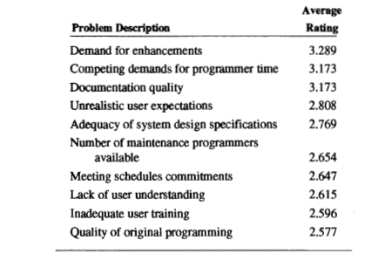
METHODOLOGY
In 1977, Lientz and Swanson performed a study of computer application software maintenance in data processing organizations. From their study, they identified the major issues of concern in software management, and made several specific recommendations for management concerning software maintenance.
Analysis was done and 26 maintenance problems were identified. These are as follows:
Maintenance personnel turnover, Documentation quality, System hardware and software changes, Demand for enhancements and extensions, Skills of maintenance programmers, Quality of original programming, Number of maintenance programmers available, Competing demands for programmer time, Lack of user interest, System run failures, Lack of user understanding, Program storage requirements, Program processing time requirements, Maintenance programmer motivation, Forecasting maintenance prog. Requirements, Maintenance programming productivity, System hardware and software reliability, Data integrity, Unrealistic user expectations, Adherence to programming standards, Management support, Adequacy of system design specs, Budgetary pressures, Meeting scheduled commitments, Inadequate user training, Turnover in user organization.
These were the 10 major issues that Lientz and Swanson had identified on the basis of average rating of the mentioned maintenance problems :
Table: Most Serious Maintenance Problems [5]

Slide 5
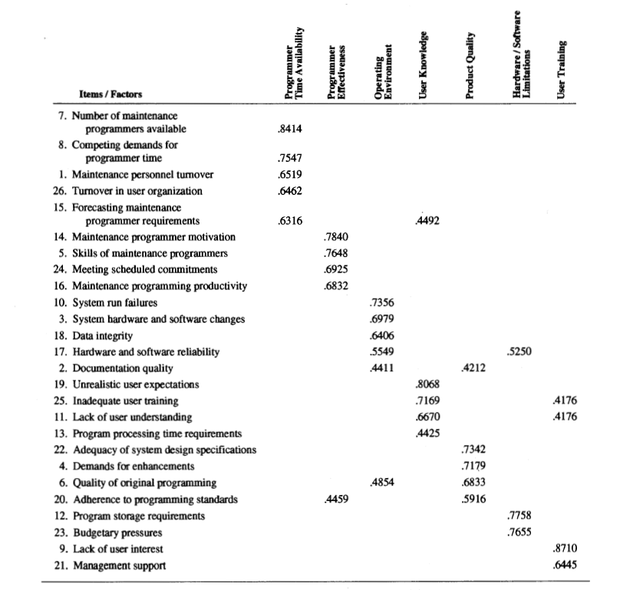
A factor analysis of the survey responses on the 26 problems was carried out in order to identify the problem dimensions and to aid contingency analysis. So from the factor analysis, Lientz and Swanson have identified following 7 dimensions:
1. Programmer Time availability
2. Programmer effectiveness
3. Operating environment
4. User knowledge
5. Product Quality
6. Hardware / Software Limitations
7. User Training
Table: Factor analysis result [5]

Slide 6
PROPOSED MODEL
The motivation of this proposed model is to determine the impact of scale of the effort factors such as system size, age and system complexity upon various software maintenance types, problems, and issues.
We have described a few independent variables based on the proposed model that were used to formulate the hypotheses and these are as follows:
1. System age: In general older systems may cause more problems due to lack of user knowledge, product quality, and programmer time along with h/w and s/w limitations .
2. System size: It basically tells us about the no. of programs and statements present within the system. As the system size gets larger, it gets quite complex.
3. Database size: It tells us about the no. of files and the no. of char(s) in the database. A large size database would require more changes in input files. Also, the users must be less knowledgeable when it comes to using a large database.
4. Size of staff: It tells us about the no. of people in the development and the maintenance staff. A large system would require large no. of staffs which would require a considerable amount of resource allocation which would in turn make the system more complex.
5. Percent of maintenance budget to overall budget: It tells us about the budget w.r.t maintenance activities. So systems that are provided with more resources tend to have less no. of problems.
6. Development Experience of the Maintenance Staff: It tells us about system development w.r.t maintenance staff’s experience, so with greater experience there should be less problems with productivity and quality of the product.

Slide 7
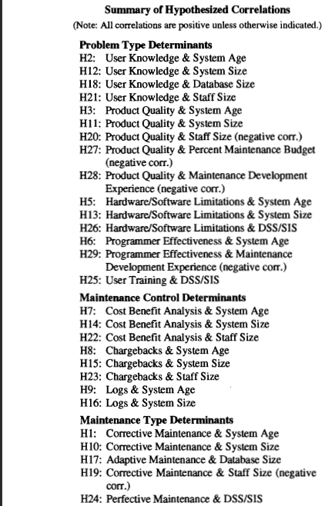
RESULT
After formulating these hypotheses it is essential to validate it, so we have regrouped the hypotheses based on each dependent variable (Problem Type, Maintenance control, Maintenance effort). Each of these hypotheses that we have mentioned in the proposed model was determined by calculating Pearson’s correlation coefficients. Not all the hypotheses are supported but many of them contribute to the validity of the model.
1. Problem Type Determinants: From our findings, system size was positively associated with user knowledge (H12: p = .067). Also the user training factor was positively correlated with system size (p =.075). Even though this finding wasn’t considered in above mentioned hypotheses, a probable justification is that systems that generally have a large size are mostly complex, so the amount of training required on the system by the user is less than adequate, it requires a high amount of training. In contradiction to the hypothesis (H20), the staff size is positively associated with the product quality (H20: p=.03). The probable reason for this finding is that a large no. of staff works on larger & complex systems which are harder to maintain which therefore results in problems in product quality. Therefore, staff size is not an independent variable but an intermediate variable.
2. Maintenance control determinants: In general, large size systems are associated with excessive utilization of maintenance controls as there is a wide use of user request logs in large size systems (H14: p =.000).
3. Maintenance effort distribution: Larger systems are positively associated with the corrective maintenance (H1: p = .088). Systems with larger databases are positively associated with adaptive maintenance (H17: p = .001).
Table: Summary of Hypothesized correlation[5]

Slide 8
RECOMMENDATIONS
Even after technological advancements problems still continue to persist in software maintenance. These problems generally are associated with the procedure & rules related to maintenance management. So, on the basis of our analysis we come up with the below recommendations:
1. From our study it is made evident that maintenance is considered to have lower significance than new development which is one the main problems that are mentioned in this report. So we need to focus on the management view of the maintenance part by giving maintenance and equal status to new development.
2. From our study we also observed that the maintenance staff’s lack of experience in their domain aggravated the problems related to staff’s efficiency, so our recommendation is that we can improve the working environment of the organization and also by hiring skilled & experienced folks in the maintenance department.
3. Another suggestion is to include allocating additional budget to maintenance activities as the budget has an important role in improving product quality and also by changing management techniques.
4. User knowledge is considered as the major problem which includes unrealistic user expectations and users not having enough experience in training and understanding. So to address this problem we can give user training on a monthly basis so as to adjust them with the system operations.
5. The maintenance activities are directly proportional to quality design, so it is essential to follow quality standards, proper documentation (SRS) and good programming skills while developing a system to avoid any problems in future.
6. Monitoring of maintenance: There should be an effective database that records the no. of hours & resources allocated to a maintenance activity to efficiently manage the organization.

Slide 9
CONCLUSION
In this study, we have overlooked the software maintenance issues and provided a new perspective to tackle these problems. A study was conducted in 1977 by Lientz & Swanson and the some methodology was used to gather data for the study. In addition to this, a model and various hypothesis have been proposed to analyze and find the cause behind these problems. One of the conclusions that have been discovered is that even after technological advancements, the same issues that existed a decade ago, continue to scourge maintenance activities and their management even today. The most effective way to overcome these issues is to identify the problems and enforcing good management strategies that ensure system availability & reliability along with user satisfaction and timely responses to problem reports which can overall improve the productivity of an organization.
REFERENCES
We have used 4 research papers from various citations and 1 book by James A. McCall, Mary A. Herndon and Wilma M.
Osborne.
1. https://nvlpubs.nist.gov/nistpubs/Legacy/SP/nbsspecialpublication500-129.pdf
2. “Problems and issues in Software Maintenance management” by Prashant Palvia, Aaron Patula
3. “Software maintenance management: Changes in the last decade” by John T. Nosek
4. “Software Errors and Software Maintenance Management” by Rajiv D.Banker, Srikant M. Darter, Chris F. Kemerer
5. “Software Maintenance Management Strategies: Observations from the Field” by George Stark, Paul Oman

Slide 10
THANK YOU

