Slide 1

DELHI TECHNOLOGICAL UNIVERSITY
SOFTWARE QUALITY & METRICS (SE-411) PROJECT STEP 2
Submitted To:
Dr. Marouane Kessentini
Submitted By:
Ankit (2K18/SE/021) Ankit Kumar Yadav (2K18/SE/024)
Anmol Yadav (2K18/SE/028) Ashish Kumar (2K18/SE/041) Palak Yadav (2K18/SE/092)

Slide 2
Team Introduction:
In order to do the Software Quality & Metric Project, a group of 5 members is formed. Details are mentioned below:
Ankit | 2K18/SE/021 | ankit_2k18se021@dtu.ac.in
Ankit Kumar Yadav | 2K18/SE/024 | ankitkumaryadav_2k18se024@dtu.ac.in
Anmol Yadav | 2K18/SE/028 | anmolyadav_2k18se028@dtu.ac.in
Ashish Kumar | 2K18/SE/041 | ashishkumar_2k18se041@dtu.ac.in
Palak Yadav | 2K18/SE/092 | palakyadav_2k18se092@dtu.ac.in
Requirements modeling
Requirements’ modeling is the process used in software development projects where requirements and solutions constantly evolve through collaborative efforts and teamwork.
The main aim of requirements modeling is to support the end goals of software development. It also
aims to achieve these objectives:
Identify and establish the best practices required to create an effective model.
Outline the ways you intend to put said practices into action.
Always have alternatives to improve the overall modeling approa ch.
We have made 6 Sequence diagrams (of basic flows of each use case), 1 Class diagram and 1 Activity diagram (of whole scenario).
In software engineering, a class diagram in the Unified Modeling Language (UML) is a type of static structure diagram that describes the structure of a system by showing the system's classes, their attributes, operations (or methods).
A sequence diagram is a Unified Modeling Language (UML) diagram that illustrates the sequence of messages between objects in an interaction. A sequence diagram consists of a group of objects that are represented by lifelines, and the messages that they exchange over time during the interaction.
In software engineering, an activity diagram is a behavioral diagram i.e. it depicts the behavior of a system.

Slide 3
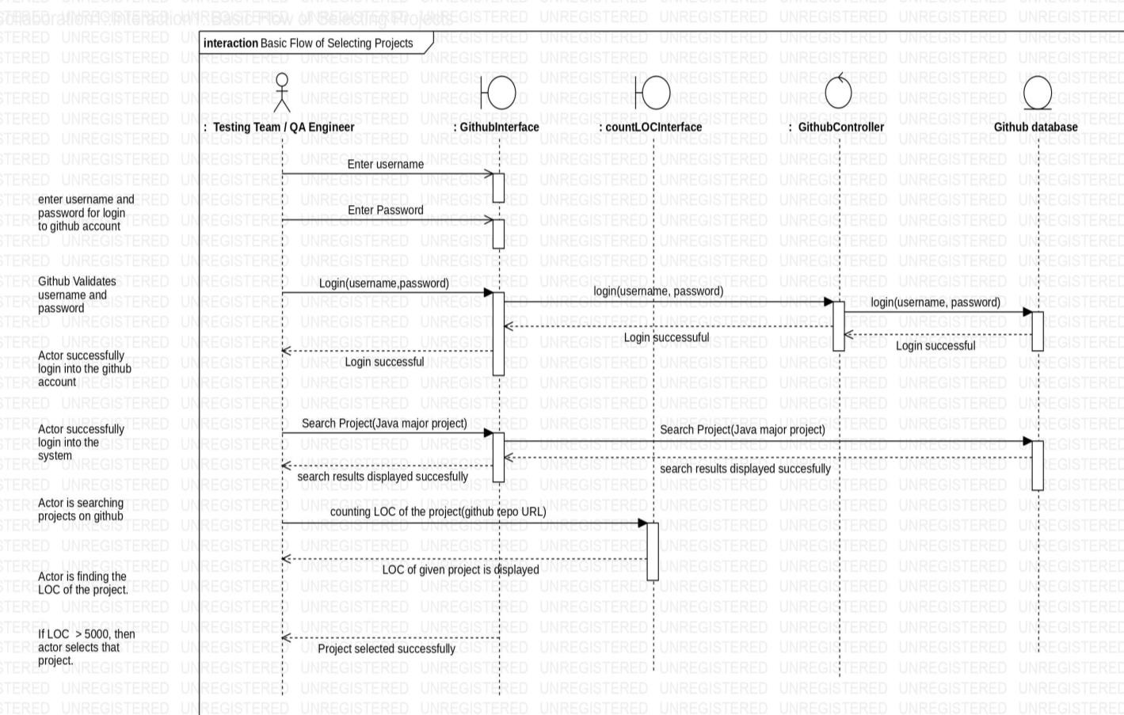
SEQUENCE DIAGRAMS
Basic Flow – Selecting Projects

Slide 4
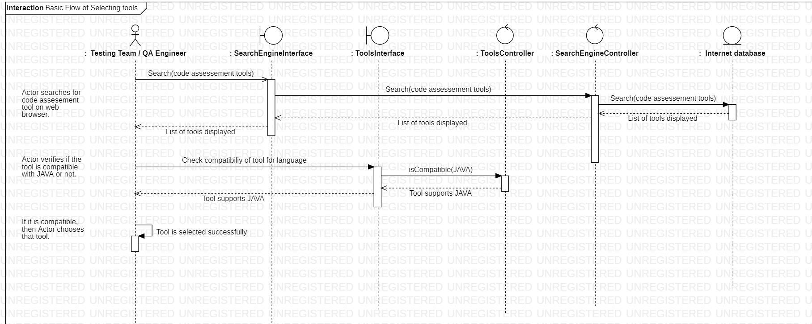
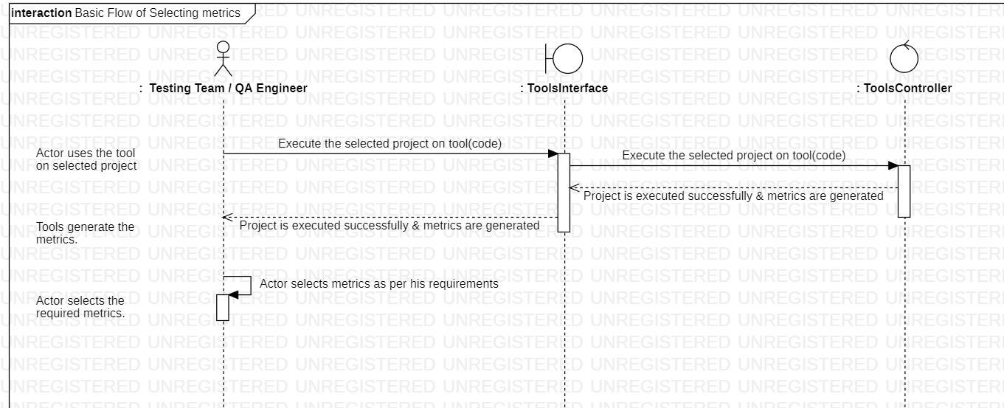
Basic Flow – Selecting Tools
Basic Flow – Selecting Metrics

Slide 5
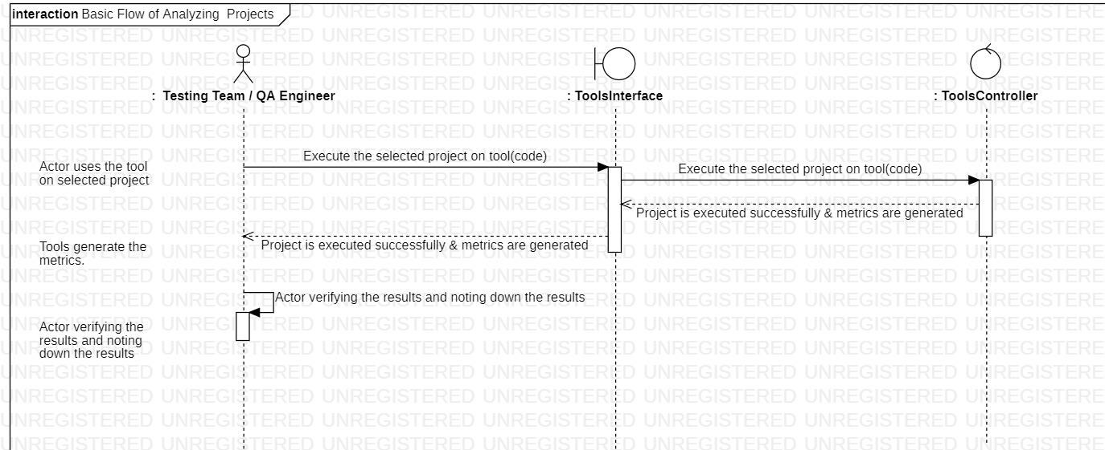
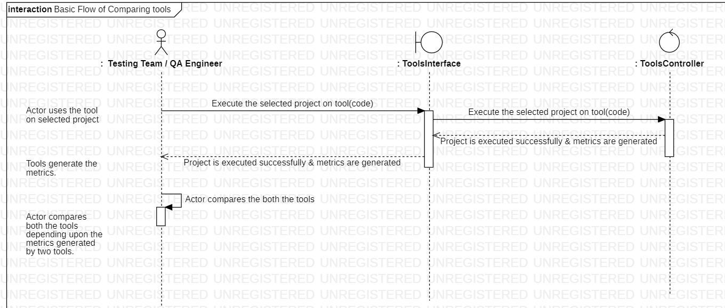
Basic Flow – Analyzing Projects using tools
Basic Flow – Comparing the tools

Slide 6
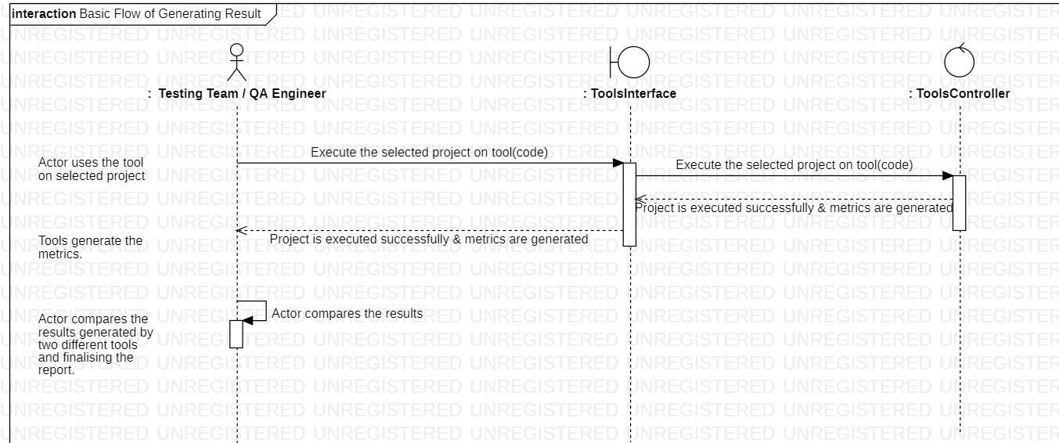
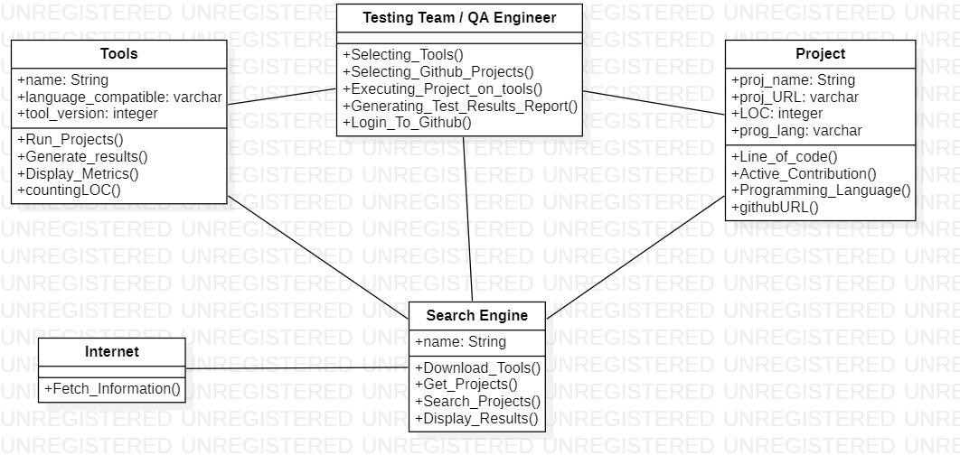
Basic Flow – Generating Results
CLASS DIAGRAM

Slide 7
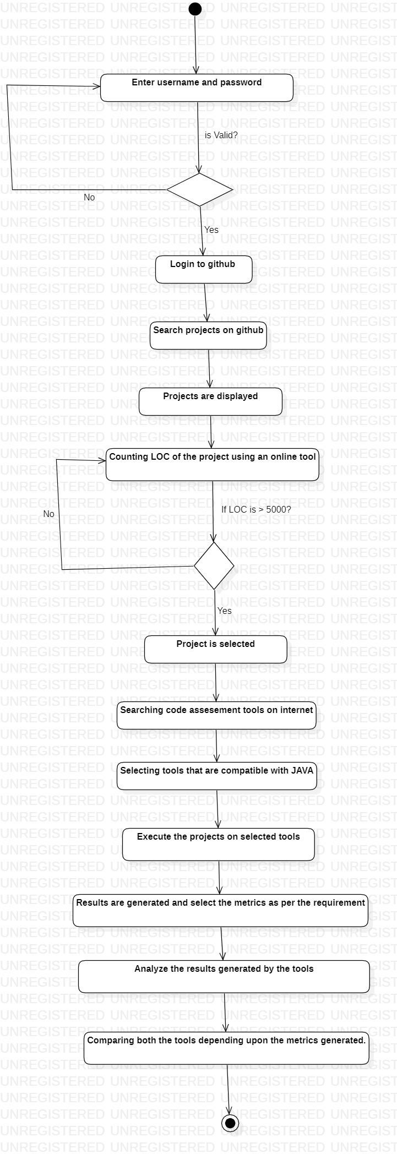
ACTIVITY DIAGRAM

