Slide 1


Creating Tomorrow Together
IT Intern Innovation Challenge
Team : printf(“ord”)

Slide 2

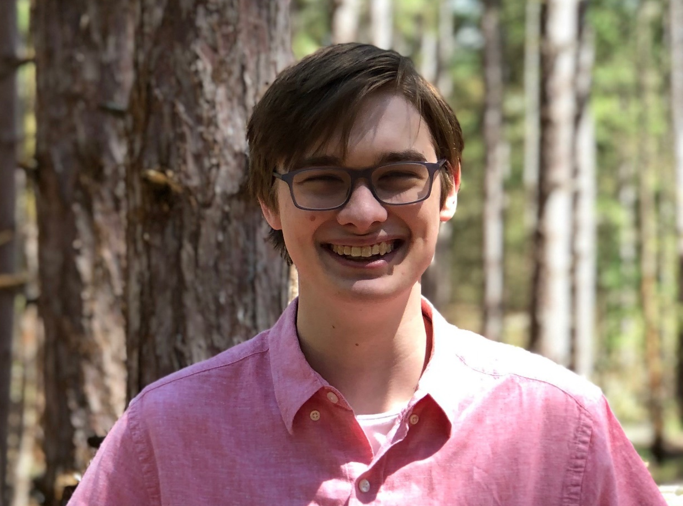
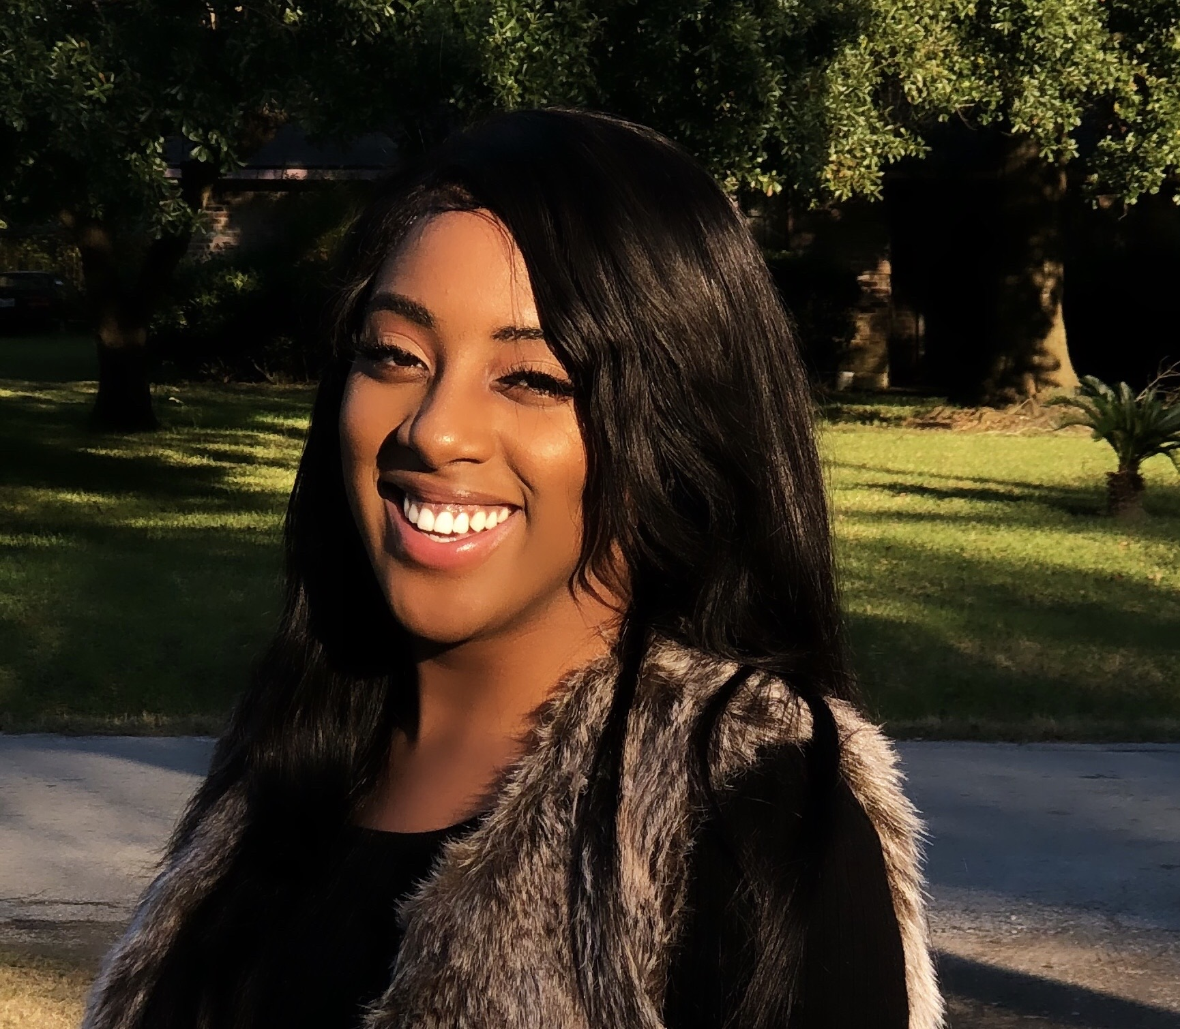
Who are we?
Rakiya McClure
Rising Senior in Cybersecurity, Clark Atlanta University
Jonathan Parks
Rising Senior in Computer Science, Michigan Technological University – Houghton
Ashish Patel
Rising Sophomore in Computer Science, University of Michigan – Ann Arbor

Slide 3
Agenda
Central Question (Jonathan)
Product Intro (Jonathan)
What is HSAS? (Rakiya)
Technical Overview (Ashish)
How we meet Ford’s Goals (Ashish)
Special Thanks (Rakiya)
Live Demo (Jonathan)
Notes:
65% of Americans are concerned about Covid according to fivethirtyeight
First bullet point -> Quote -> powerpoint info (use cases) -> end of pitch

Slide 4
Central Question
How might we leverage the connected-vehicle to improve customer experience with our vehicles?
Why this prompt?
Interest in connected vehicles and Ford’s relationship with them
Wanted to know where they were going in the near future
We thought we should grow our knowledge on a topic of interest

Slide 5

YOU DRIVE!
Health & Safety Alert System
(HSAS)

Slide 6

What is HSAS?
Important notifications on local health/safety concerns while traveling.
Use cases
Coronavirus Alerts
Air Quality Alerts
Crime/Safety Alerts
How does this proposal look in Ford’s system?
Notes:
65% of Americans are concerned about Covid according to fivethirtyeight
First bullet point -> Quote -> powerpoint info (use cases) -> end of pitch

Slide 7
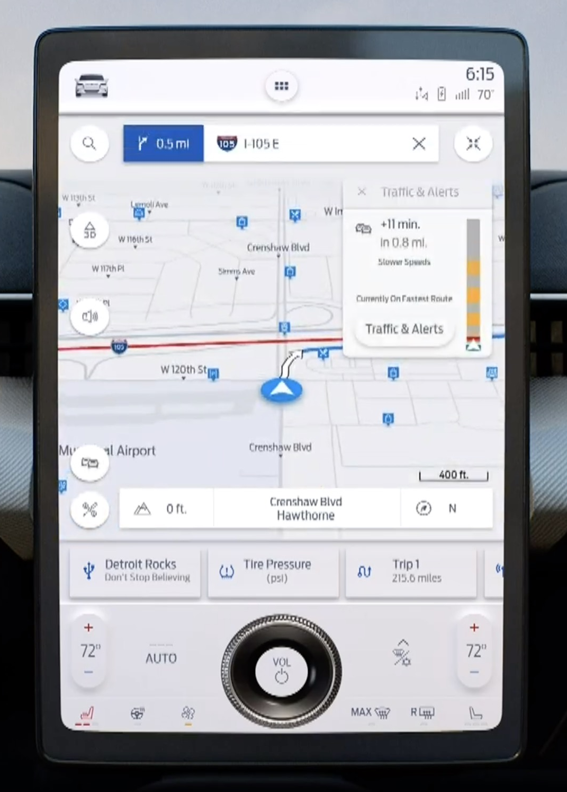





Awareness: The area you are in has reported 243 coronavirus in the past 30 days. The 7-day moving average has been down 4%. As per CDC guidelines, please exercise caution
Health Related APIs
4G LTE
OUTPUT ALERT
Location Data
Notes:
Lets say you are going on that Grand Rapids to Detroit road trip in your Ford Mach-E.
Every time you move through a new county, your car would send location data to the cloud via a 4G LTE connection
Calls to air quality, crime tracking, and pandemic related APIs would be made. That information would be sent back to you in the form of a brief notification that cautions you and makes you aware
Our idea is ideal for a connected vehicle system (versus a phone) since location services are already turned on for other features and are more likely to be used.

Slide 8

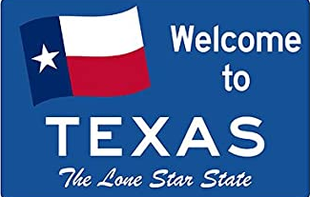
Welcome to Texas, local regulations require masks be worn in restaurants, stores, and government buildings
Notes:
Our product would also give brief, yet detailed, information about local mandates and regulations regarding the pandemic.
This helps our customers to be safe and follow the law.

Slide 9
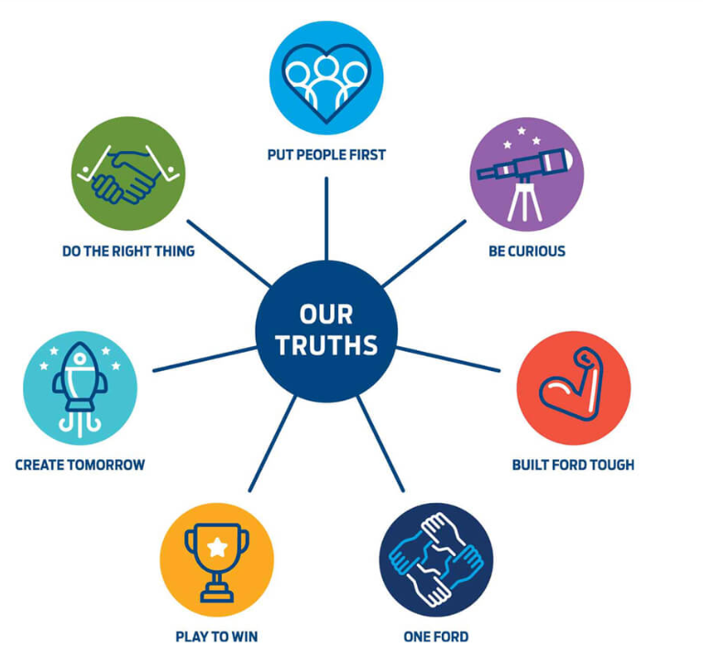
How this meets Ford’s goals
Quick and Easy Development Timeline
Very Valuable in Other Markets
Putting people first and doing the right thing
Sets us up to be the most trusted company
Notes:
The development period for this feature would be short and light on resources but can have a significant impact on our customer’s interactions outside the vehicle.
This feature would be extremely valuable in domestic markets where coronavirus cases are high and people are concerned about safety with regards to crime, but even more so in foreign ones like Asia-Pacific, where many customers are more conscious about pathogens and air quality.
The result of this would be Ford showing that we can put people first and do the right thing for the communities we impact.
Our idea leads to greater trust, thus creating customer advocates by delivering owner and user experiences with honesty, expertise, and care.
Overall, this is a step towards our mission statement of being the most trusted company. A trusted companion is one that looks out for you, with modern technology, our vehicles can do the same.

Slide 10
Special Thanks
Nichole Mackey and Omar Atcho
(Smart Charging with Connected Vehicles)
Padmaja Yerasi
(Senior Product Manager for Connectivity and Cloud Delivery)
James Wasnick
(Senior Leader for Connectivity and Cloud Delivery)

Slide 11
Live Demo

Slide 12

Q & A

