Slide 1

Thesis
Action Recognition is Dark Using Deep Learning
By:
Ashish Dhyani
Notes:
Hi My name is Ashish Dhyani, Here I am going to present you my Dissertation study which I have done as part of Masters in Data Science program by LJMU. The topic of this research is “Action Recognition in Dark using Deep Learning techniques”

Slide 2
Agenda
Introduction
Aim and Objectives
Dataset
Research Methodology
Results and Discussions
Conclusion and Future Work
Notes:
Here is the agenda of this presentation, First I will Introduce the thesis Topic, later as the presentation progresses I will talk about Dataset, Aim and Objectives, Research Methodology used and Results of this research. And at the end I will talk about the conclusion and future work which can be helpful to improve this research.

Slide 3
Introduction
Videos
Properly Illuminated
Low Illuminated / Dark
Example: Videos recorded during day light Videos recorded during night but with proper light
Example: Videos recorded during night time without proper
Lighting condition
Use Cases
Night Surveillance
Surveillance at Country Borders
Self Driving Cars at Night
Traffic Management During night hours
Wild Animal Breeding and Behaviour during night
Notes:
So first let me set the context and tell the background of this study
In today’s world, machines are helping us in various ways by identifying various situations and problems around us. Human action recognition is one of the areas where these machine learning algorithms can help us and augment our capabilities around it. It is important to have the capability to identify human actions not only in good lighting conditions but also in dark or low lighting conditions.
Action recognition on normal videos with good visibility has done a lot of progress in recent times and many machine learning algorithms are able to do it efficiently but action recognition in the low light situations is still pretty challenging and a hard nut to crack because the pictures or videos captured during the night time or low light situations suffer from poor visibility and contains a lot of noise and sometimes these videos are even difficult for human eyes to recognize accurately. Innovations at hardware side also have done lot of progress where cameras are getting equipped with night vision capabilities but the night vision sensors degrade the quality of the images or videos by introducing lot of noise and it gets more difficult for present day feature extraction algorithms to deal with these noises. Another drawback with the night vision sensors is that they make the surveillance cameras more expensive and it’s difficult for everyone to afford and adopt these technologies. So there is a need of software solutions which are capable of recognizing the actions in videos which are shot in dark without the help of any night vision capabilities.
Here are the different use cases for Action recognition in dark
First is Night Survillence and Survillence at the country borders to stop the illegal infiltration. As we know, In a vast country like india we can't do the surveillance manually so we need an automated way to do these kind of surveillance.
According to an article (TheSleepJudge Editorial Team, 2020) about crimes in United States, more than 50% of the major crimes happen during night time.
Self driving car is another challenge. Self driving cars during the day time is still pretty challenging so self driving during night is more challenging compare to day time.
One of the important areas for action recognition in dark is study of Animal breeding and their behaviour during night time without the use of flash lights. There was one articles about that how wild mammal animals turning nocturnal because of the human activities in the forests during day time. But humans use cameras with flash lights to study the wild animals’ behaviours during night time which actually disturbs them a lot during night time as well. To avoid this, we need to learn to see in the dark without the use of flash lights, this research will also help in this area.

Slide 4
Aims and Objectives
To analyze the most popular low light enhancement methods and identify the best method among all of them which works the best for human action recognition.
To propose a deep learning model which works the best in identifying the human actions with low light enhanced videos.
Notes:
The main objective of this research is to recognize the human action in dark, for that we will need to analyze various popular low light enhancement methods and identify which suits the best for action recognition. And then propose a deep learning model or pre-trained neural network which will work the best with this.
Also I would like to know whether the best illumination technique is really required for human action recognition because focus here is to identify the action not the visual quality of the videos.

Slide 5
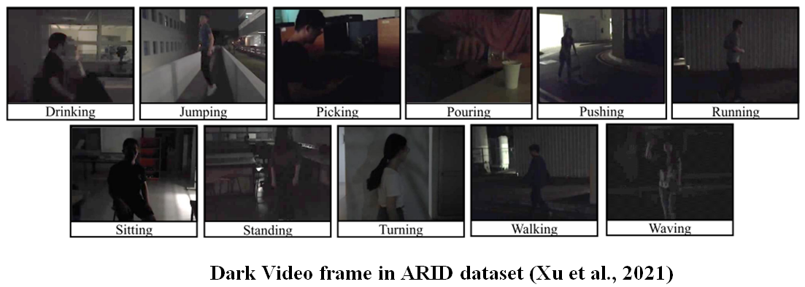
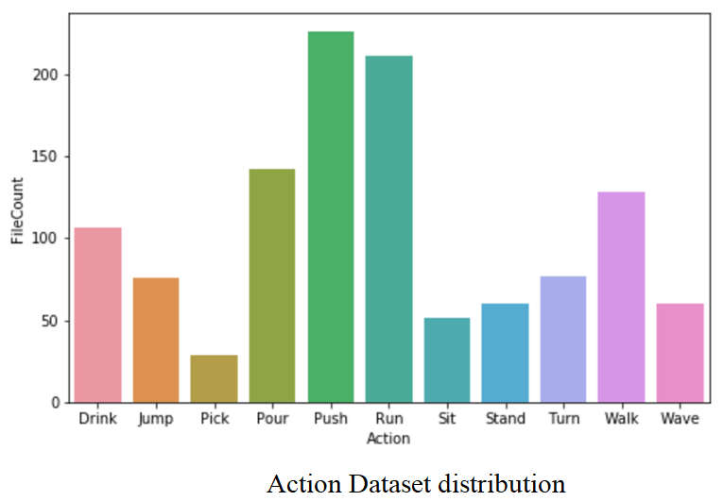
Dataset
Notes:
Recently Xu et all proposed a dataset ARID which was specifically created for action recognition in dark and these video are shot in dark without the help of a direct light source, some videos are so dark that its difficult to see the action in the videos with naked eyes.
In this dataset, there are 11 classes for human action recognition and all of them have different lighting conditions.
Also the dataset distribution is shown here, we can see some actions do not have enough videos so we will have to consider data augmentation here.

Slide 6
Research Methodology
Video Standardization
Low Light Enhancement
Split Dataset
Model Building and Training
Build Model Repository
Conclude Research
Propose Future Work
Model Evaluation
Model Evaluation
Research Steps
Notes:
These are research steps
First we have to pre-process the dataset, split the dataset, build and train the dataset and evaluate the model with unseen data.

Slide 7
Research Methodology
Start
Data Pre-Processing
Number of Frames
Video Frames Standardization
Video Length Standardization
Data Augmentation
Low Light Enhancement
Load Data
Split 70/30
Train Set
Test Set
Model Building & Training
…
…
…
Epoch 1
Epoch 2
…..
Epoch 100
Machine Learning Models
Trained Model
Hyper-Parameter
Predict
Training Accuracy
ADAM
Learning Rate
Reduce LR on Plateau
Test Accuracy
Model Evaluation
Precision
Recall
Best Deep Learning Model
F1-Score
Save
End
Comparative Analysis
For All Methods
Model Repository
Conclude Research
Notes:
Here is the detailed version of Research Steps.
In the first step, we will have to load the videos one by one and pre-process them one by one.
There are number of steps for data pre-processing, like Number of frames, video frame standardization, data augmentation and the low light enhancement which is very important part of data pre-processing. There are many illumination techniques were used like Gamma intensity correction, EGAN, KiND and LIME. These are different techniques with different approaches for low light enhancements.
For data augmentation, very basic augmentation techniques were used. There are some deep learning data augmentation techniques are there which are not used in this research.
Pre-processing steps need to repeated for each illumination technique and save them for later processing.
Then dataset needs to be split in 70/30 ratio. 70% of the dataset will be used for model training and 30% of data will used for model evaluation.
For model building and training steps, we will have to do some hyper parameter tuning.100 epochs were used by default for all, all the algorithms converged and acquired the minima with in 60 epochs. ADAM was used as the optimization technique and default learning rate was used for ADAM and patience level was set to 5 epochs.
Once the model is built, it needs to be evaluated on the test set. Model generated with this process will be saved to model repository for each illumination technique and later decision will be made based on evaluation metrics.
Accuracy of the model on the validation data
Precision is Proportion of positive identifications was actually correct
Recall is Proportion of actual positives was identified correctly
F1-Score is a harmonic mean of Precision and Recall

Slide 8
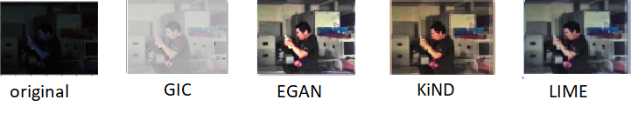
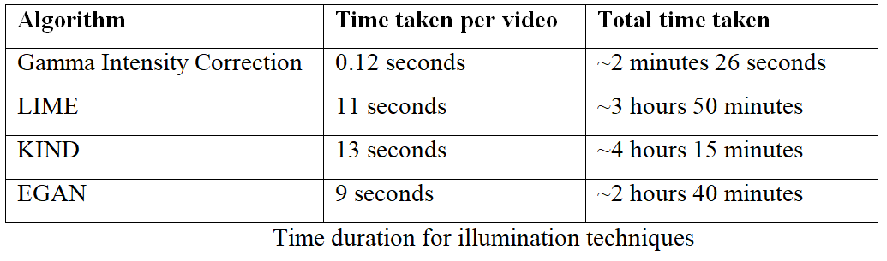
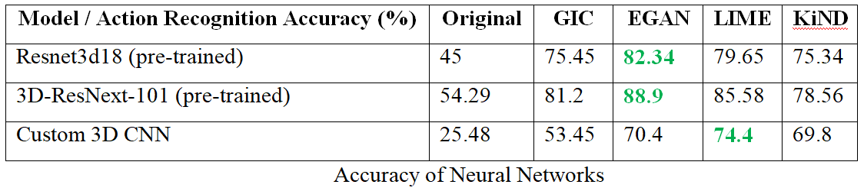
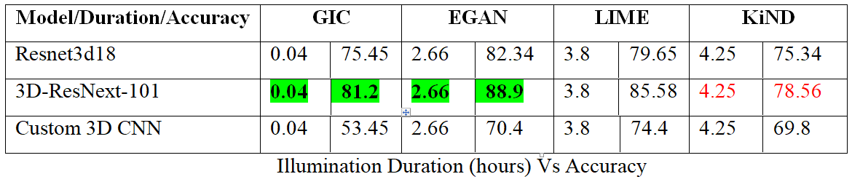
Results and Discussions
Notes:
Here we can see how different illumination techniques are performing. Based on the image displayed, we can clearly see that EGAN is the best performing illumination technique followed by LIME, GIC and KiND.
GIC corrects the gamma intensity of the frames.
Lime is low light enhancement using Illumination Map and refines the image by finding the maximum intensity of each pixel in RGB channel.
KiND is deep learning method and is inspired by Retinex Theory, this research is using pre-trained model of KiND for enhancing the image.
EGAN is also a deep learning based method and also doesn’t require paired supervision. EGAN stands for enlightenment GAN. Similar to other GANs it contains generator and discriminator. EGAN internally used attention U-net neural network as the generator and use global and local discriminator to maintain the texture or the details of the image. It uses self–regularized attention map instead of supervised learning which makes it unique.
Now if start looking at the numbers, GIC is the fastest illumination techniques which is taking around 120milliliseconds to convert a 30 frames video while EGAN takes around 9 seconds to convert 30frames which comes to 300 ms for each frame. Followed by LIME which takes around 11 seconds and Kind takes 13 Seconds.
If we look at the accuracy EGAN could gain the highest accuracy of 89% followed by LIME, GIC and KiND.
Now if we compare the illumination duration and accuracy…..
Now the question arises “is it really required to have best illumination technique in order to identify the human action?” because GIC technique is giving pretty impressive accuracy which can further improved by giving better resources and by changing some of the hyperparameters.

Slide 9
Conclusion and Future works
Conclusion
Combination of 3D-ResNext-101 and EGAN gave the best accuracy of around 90%
Combination of KiND and neural network gave lowest accuracy of around 70% among 4 illumination techniques used in this research
Combination of GIC and 3D-ResNext-101 gives the good accuracy
Future Work
Training the models with better resources and improve the accuracy. Batch size needs to be increased.
Use other neural networks of recent times to evaluate the accuracy.
Advanced Deep learning based data augmentation techniques
Evaluate Action Bank features and use 2D CNN and compare the accuracy with 3D CNN approach.
Notes:
Now I would like to conclude this research by discussing following points
Combination of 3D-ResNext-101 and EGAN gave the best accuracy of around 90% but EGAN is expensive than GIC
Combination of KiND and neural network gave lowest accuracy of around 70%
Combination of GIC and 3D-ResNext-101 also gives the good accuracy and also its time efficient
So usage of these algorithm will be based on use case
Like in case of Self Driving Car EGAN can not be used, because its taking around 300ms to illuminate a video frame. Here GIC could be useful because its taking only 40ms to illuminate a video frame. But in case of GIC, we will have to improve the accuracy of the model which can be done using some hyperparameter tuning.
EGAN can be used where visual quality of image is also important and not too much time sensitive.
As the future work
We will have to train these models with better resources so that we can get better accuracy. We can adjust the batch size to better train the models.
We can use other illumination techniques and neural network of recent times to evaluate the accuracy which actually require a lot of resources.
As a future development, I would like to implement Action Bank Feature approach which I could not perform because of time constraint which will help reduce the training time and will require less number of resources due to 2D CNN approach.
With that I will end this presentation and thank LJMU for giving me this opportunity to do Masters in Data Science.
Thank You!!

Slide 10
Thank You!

