Slide 1
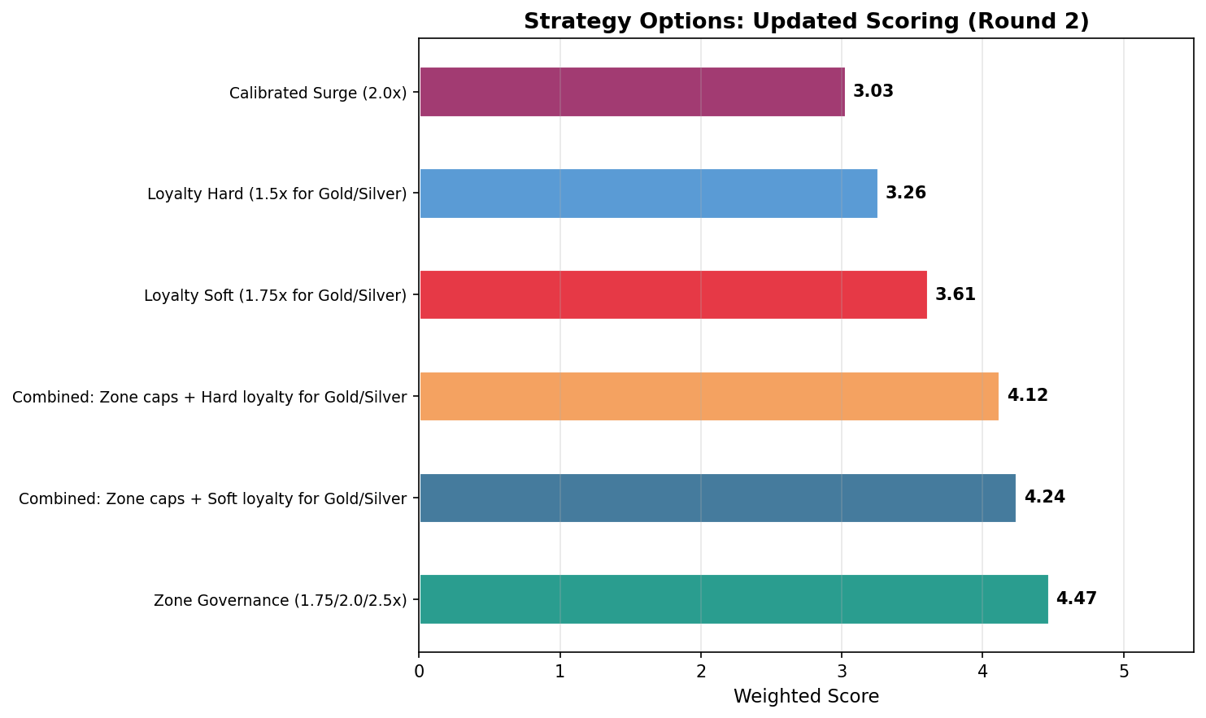
Surge Pricing Drives Revenue but Erodes Retention — Zone Governance Restores Balance
• Current surge pricing generates 62.8% of CM from 31.2% of trips, but satisfaction drops from 4.14→2.36 across the surge range, driving ~14% annual churn
• Zone-governed caps (1.75/2.0/2.5x) reduce CM by 6.06% but structurally diversify revenue; LTV/CAC could reach 1.47-1.84x (churn improvement uncertain: 0.15-0.64pp)
• Recommendation: Option 2 (Zone Governance) as primary, with Option 3 (Loyalty Protection) as Phase 3 enhancement
• Weighted scores: Calibrated=3.02 | Zone Governance=4.46 | Loyalty Soft=3.60
Notes:
KEY MESSAGE: Zone Governance is the clear winner across all scoring scenarios. It trades a manageable 6.06% CM reduction for structural revenue diversification and competitive defensibility. The three key numbers: 62.8% CM concentration in surge, satisfaction cliff from 4.14 to 2.36, and Zone Governance winning 6/6 weight scenarios.

Slide 2
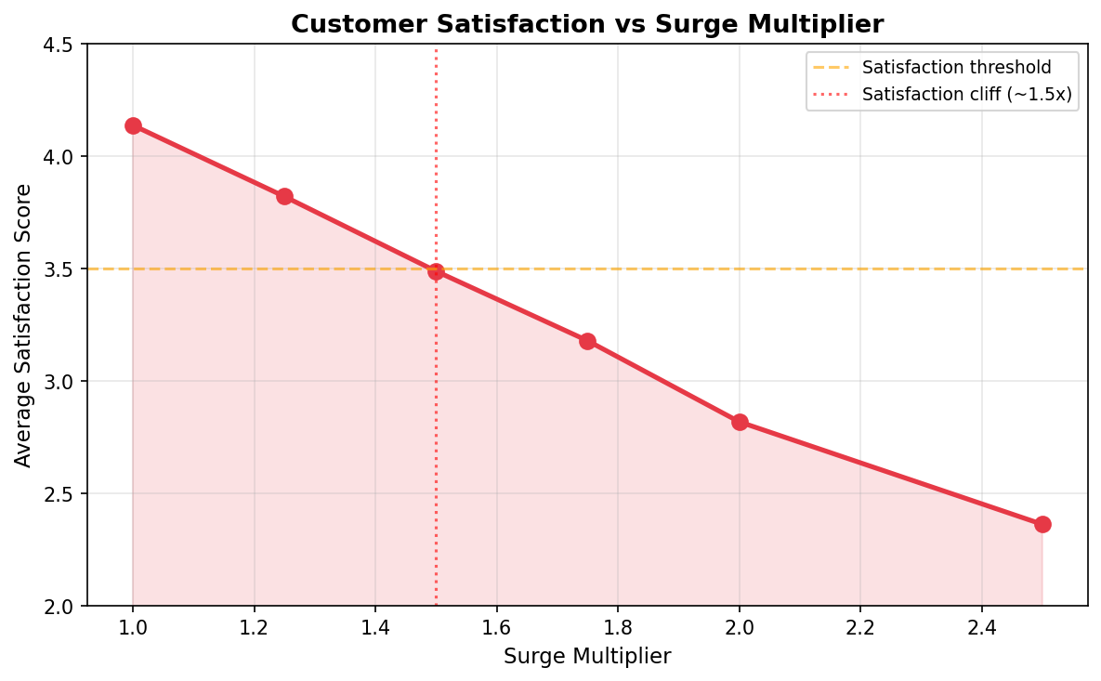
The Problem: Surge Pricing Satisfaction Cliff and Revenue Concentration
• Satisfaction drops sharply with surge: 4.14 (1.0x) → 3.49 (1.5x) → 2.36 (2.5x)
• Bracketed churn model: 14% → 20% → 38% annual churn across this range
• 62.8% of CM from 31.2% of trips — extreme revenue concentration risk
• 39.6% of trips have NEGATIVE margin (cross-subsidy from surge to non-surge)
• Completion rate non-monotonic at 1.75x (61.8% of subgroups show data artifact)
• Implication: Current pricing is profitable but fragile — retention erosion threatens long-term CM sustainability
Notes:
The core problem: surge pricing creates a satisfaction cliff. Riders at 2.5x surge have satisfaction scores of 2.36/5, driving churn up to 38%. Meanwhile, the business is over-dependent on surge: 62.8% of CM from just 31.2% of trips. This is a structural vulnerability.

Slide 3
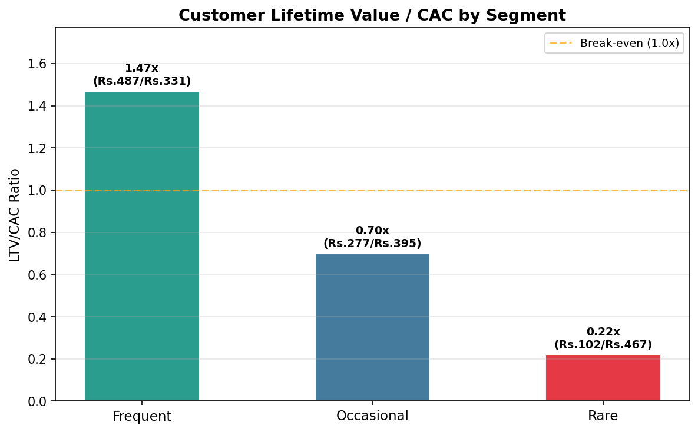
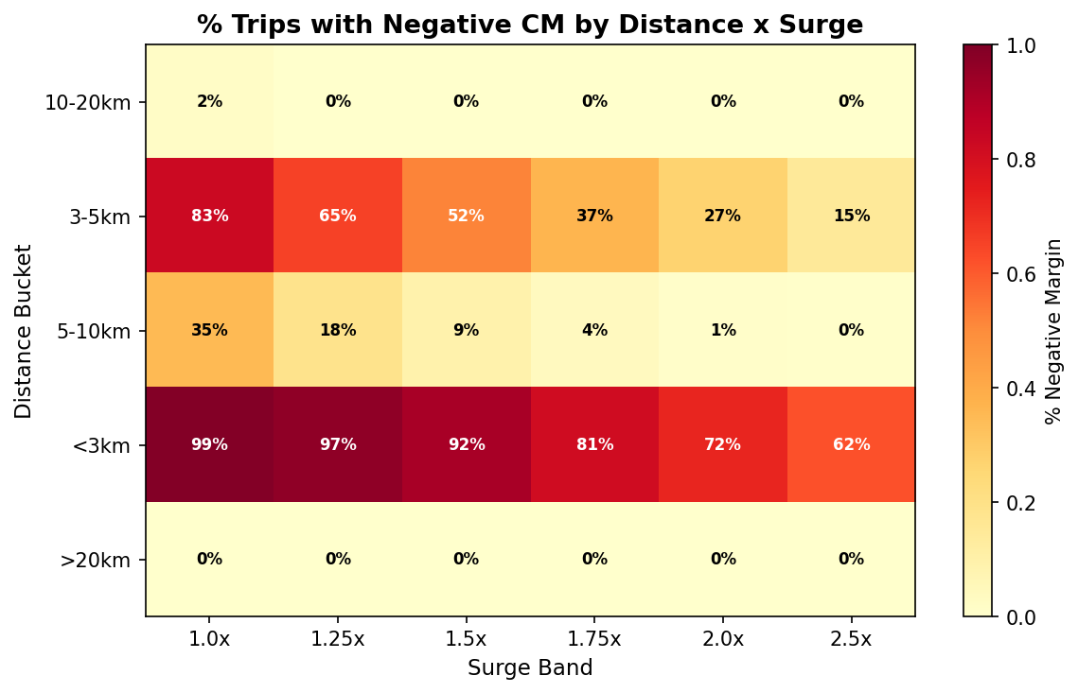
Segment Impact: Who Is Affected and Where Margins Collapse
• Frequent riders: LTV/CAC 1.47x (current), churn-sensitive, highest value
• Occasional riders: LTV/CAC 0.87x, low retention leverage
• Rare riders: LTV/CAC 0.44x, negative margin, churn less impactful
• Negative margins concentrated in residential, short-distance, low-surge trips
• Min fare Rs.125/zone eliminates negative CM across all segments
• Zone caps protect the segments most vulnerable to satisfaction erosion
Notes:
Frequent riders have the highest LTV/CAC at 1.47x and are the most churn-sensitive. The heatmap shows negative margins are concentrated in residential short-distance trips. Zone caps + min fare floor target exactly these problem areas.

Slide 4
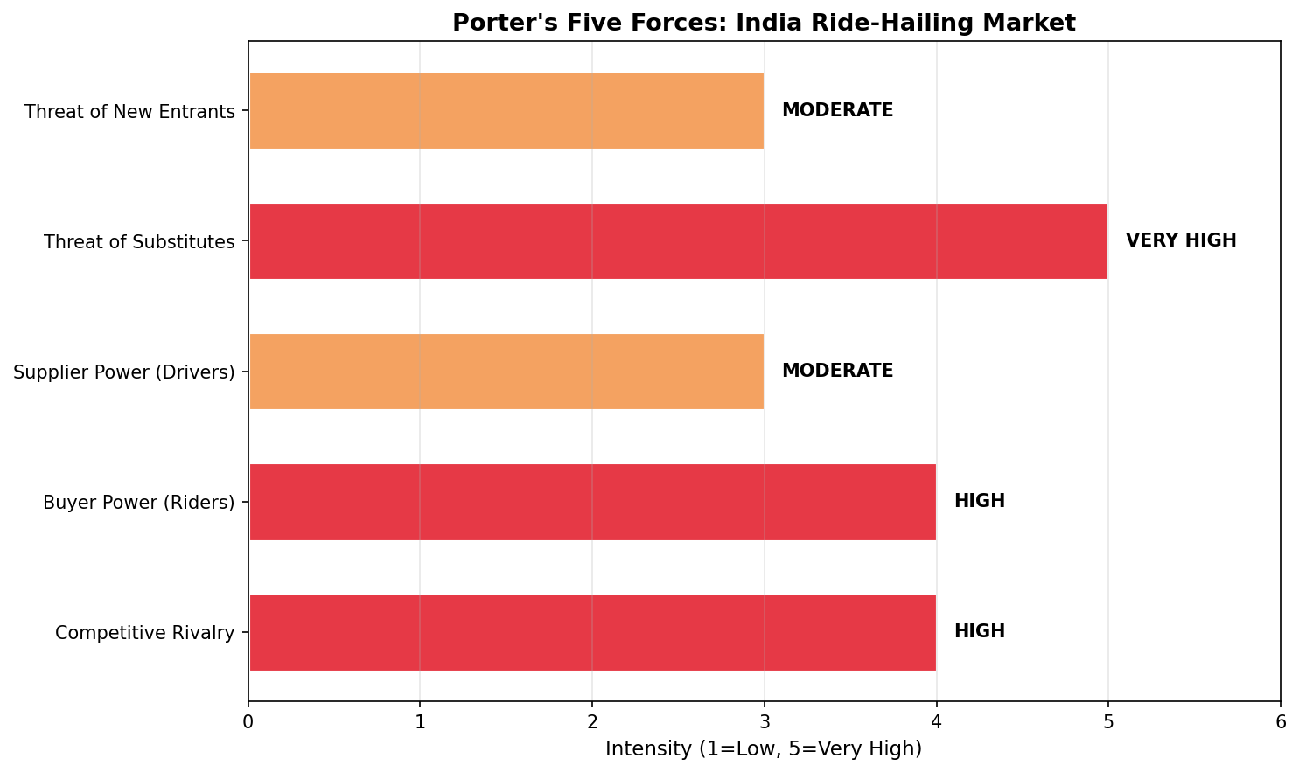
Porter's Five Forces: India Ride-Hailing — High Rivalry, Zero Switching Costs
• Buyer Power: HIGH — Multi-apping norm (75%+ have 2+ apps); zero switching cost; real-time price comparison
• Supplier Power (Drivers): MODERATE — Platform-dependent for demand; earnings sensitivity to caps creates retention risk
• Rivalry: HIGH — Ola, Uber, Rapido; margin pressure; winner-take-most dynamics
• Substitutes: VERY HIGH — Metro (Delhi/Mumbai), autos, buses; short-distance substitutable
• New Entrants: MODERATE — Network effects barrier; zero-surge positioning can attract switchers
• KEY: Zone caps are DEFENSIBLE (invisible until ride request); uniform caps are NOT (immediately observable)
Notes:
The competitive landscape makes zone caps strategically superior: they're invisible until a ride request, making them hard for competitors to match. A uniform 2.0x cap would be immediately observable and easily matched by Ola or Rapido.

Slide 5
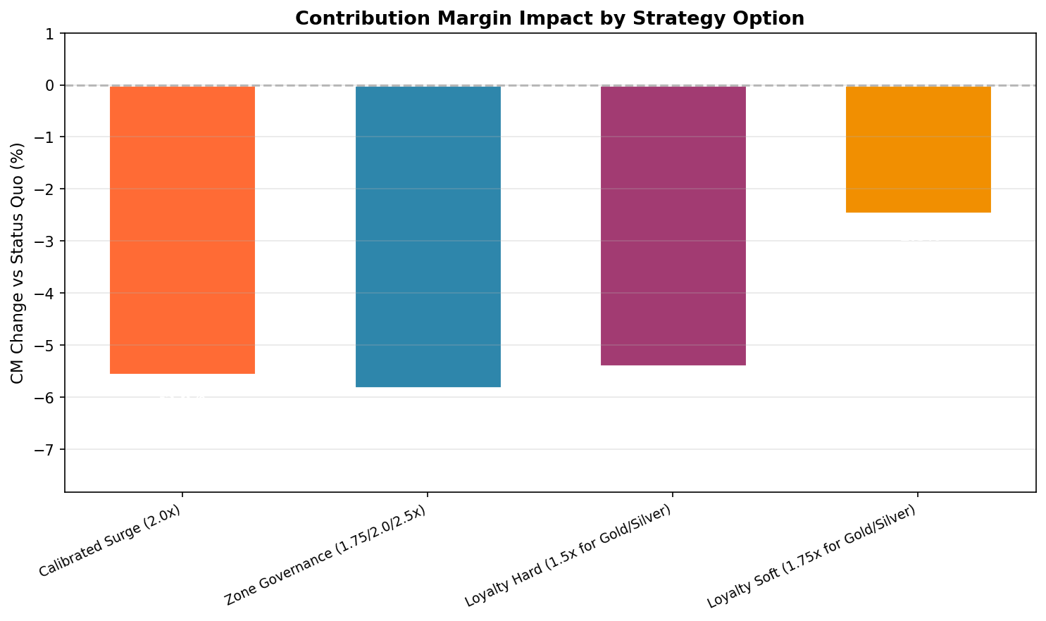
Recommendation: Zone-Governed Surge Caps — What, Where, Why
• WHAT: Differentiated surge caps by zone type
Residential: 1.75x | Commercial: 2.0x | Transit Hub: 2.5x
• WHERE: Mumbai, Bangalore, Delhi — all zone types
• WHY (trip-level simulation, 97% baseline):
— CM impact: -6.06%
— Trips protected: 10.7%
— Satisfaction: +0.061 pts avg
— Min fare Rs.125/zone eliminates negative CM
— Wins 6/6 weight scenarios (score 4.46)
• Phase 3: Add loyalty cap (1.75x for Gold/Silver)
Dimension | Calibrated (2.0x) | Zone Gov (1.75/2.0/2.5x) | Loyalty Soft (1.75x GS)
Revenue Impact | -2.20% | -1.79% | -0.58%
CM Impact | -5.89% | -6.06% | -2.55%
Churn Improvement | +0.53pp | +0.64pp | +0.25pp
Weighted Score | 3.02 | 4.46 | 3.60
Notes:
Zone Governance caps at 1.75/2.0/2.5x by zone type. CM impact is -6.06% but the structural benefits outweigh: revenue diversification, competitive defensibility, and regulatory positioning. The table shows Zone Governance wins on churn improvement and weighted score. Calibrated is easily matched; Loyalty only protects 10-15% of trips.

Slide 6
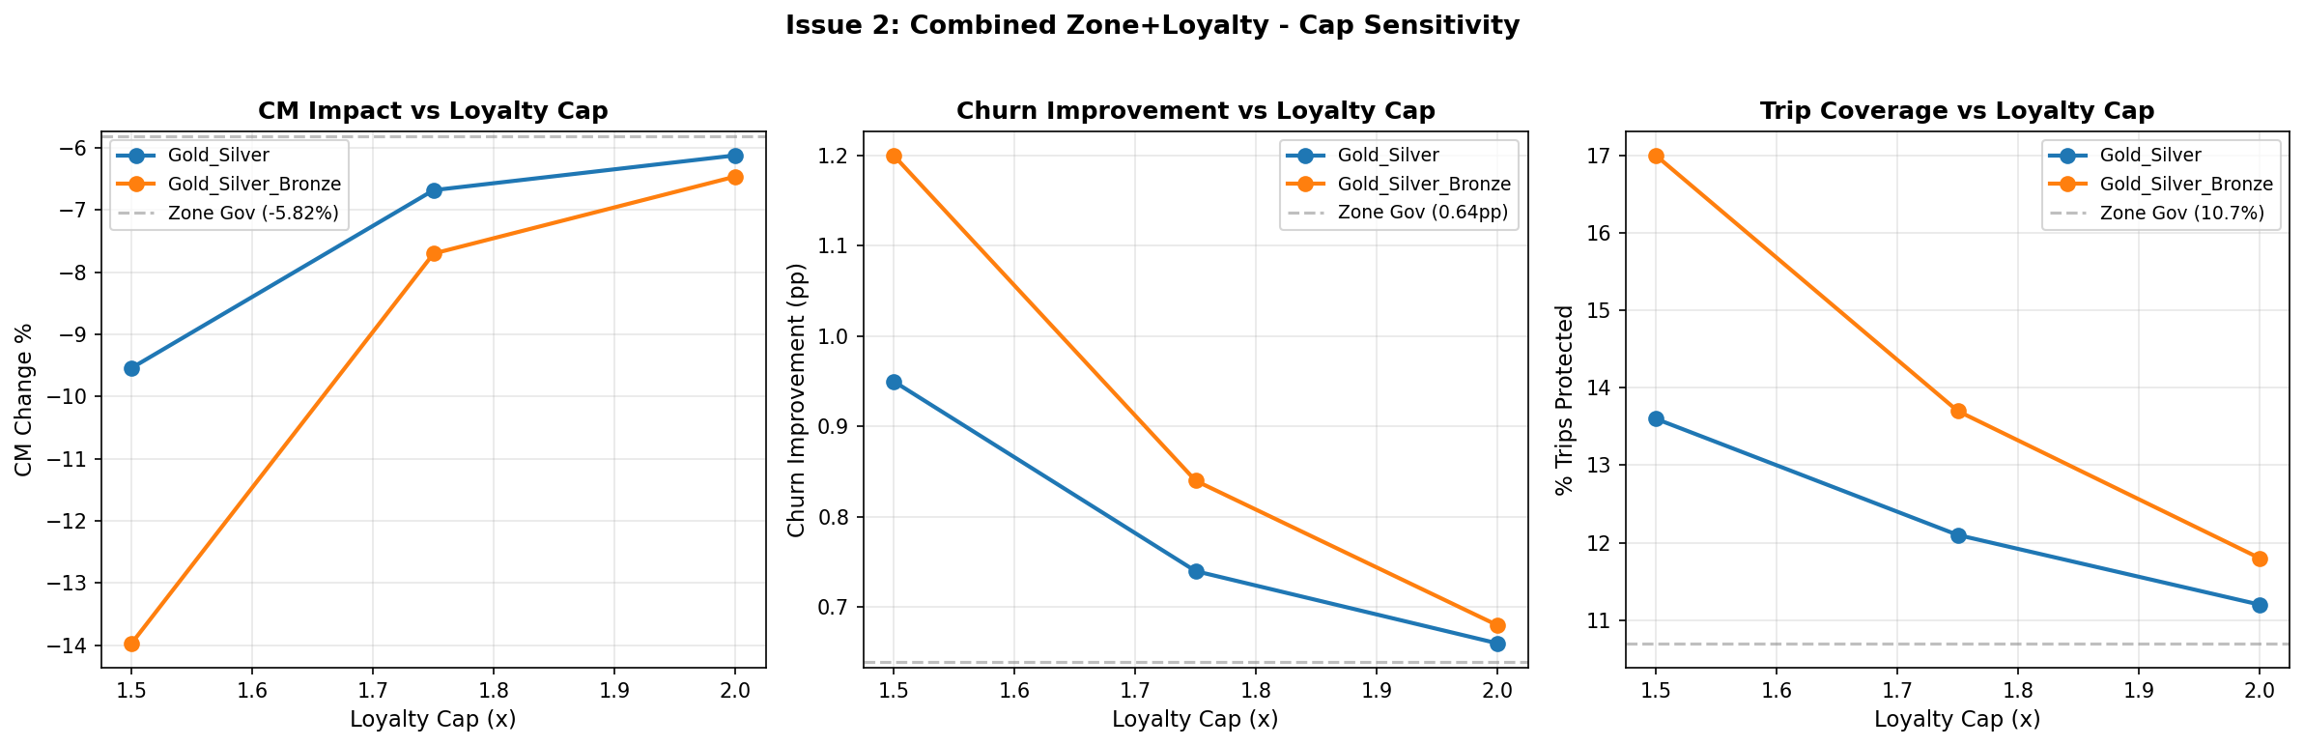
Phase 3 Enhancement: Loyalty Protection on Top of Zone Caps
• Combined Zone + Loyalty (1.75x for Gold/Silver): CM -6.92%, churn +0.74pp
• 1.5x loyalty cap too aggressive; 2.0x provides minimal additional benefit over zone caps alone
• 37.1% of riders are Unknown tier — unprotected by loyalty caps alone
— "Path to Silver" program: 5 rides → Silver status, gradually expanding coverage
• Recommended sequencing: Zone caps first (Phase 2), loyalty overlay (Phase 3)
— Allows measurement of zone-only impact before adding complexity
— Driver earnings guarantee already in place before loyalty cap reduces driver revenue further
• Sensitivity: Combined option CM impact ranges from -6.06% to -6.92% depending on loyalty tier scope
Notes:
The combined zone+loyalty option provides incremental churn improvement (+0.74pp vs +0.64pp zone-only) but at higher CM cost (-6.92% vs -6.06%). The 37.1% Unknown tier gap is the key limitation. Recommended approach: deploy zone caps first, measure impact, then add loyalty overlay in Phase 3.

Slide 7
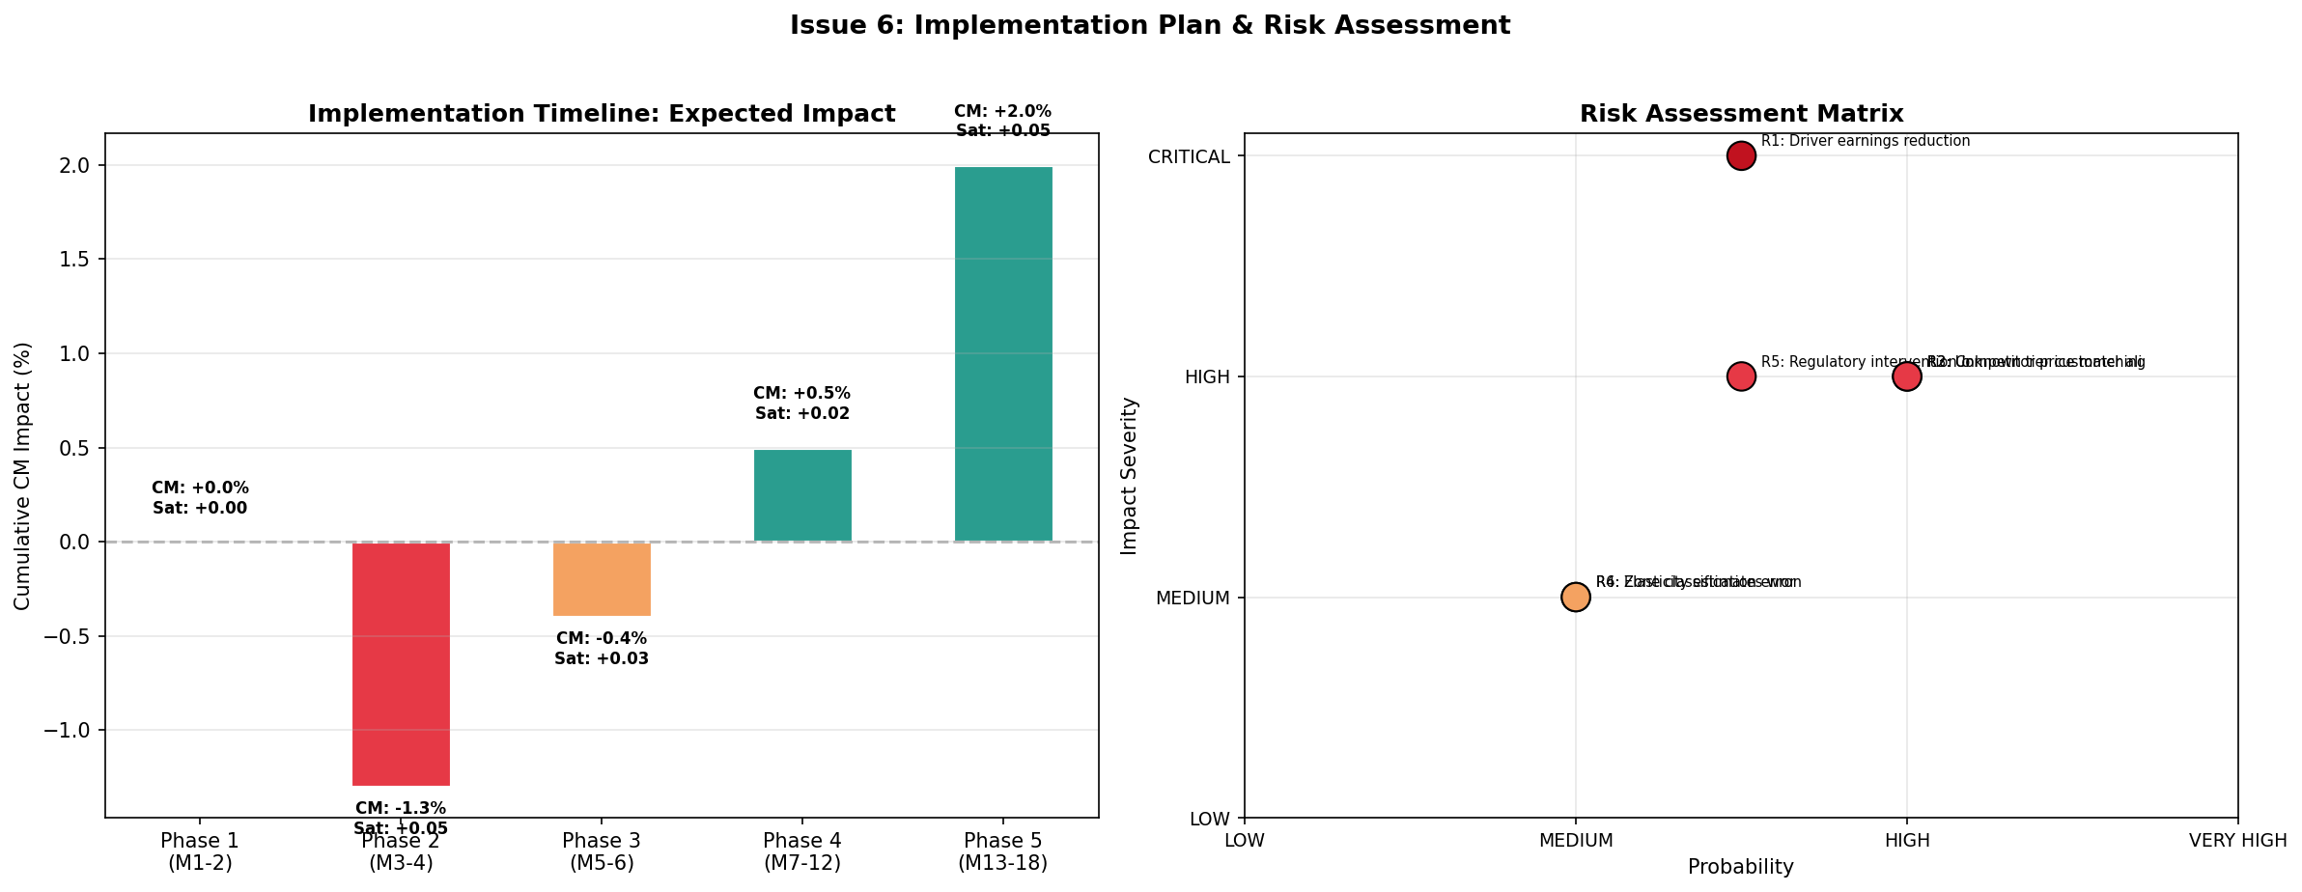
5-Phase Rollout: Key Risks and Mitigations
• Phase 1 (M1-2): Foundation — Zone classification engine, shadow-mode testing
• Phase 2 (M3-4): Zone Caps Live — 1.75/2.0/2.5x, driver earnings guarantee
• Phase 3 (M5-6): Loyalty Protection — 1.75x cap for Gold/Silver, Path to Silver
• Phase 4 (M7-12): Optimization — A/B test fine-tuning, dynamic caps
• Phase 5 (M13-18): Scale & Series D — Full governance operational
• KEY RISKS:
R1: Driver earnings reduction — CRITICAL — Earnings guarantee fund (2% of CM)
R2: Competitor price matching — HIGH — Zone caps invisible until request
R3: Unknown tier alienation (37.1%) — HIGH — Path to Silver program
R4: Data artifact in completion rates — MEDIUM — 97% baseline; monitor post-launch
R5: Regulatory intervention — MEDIUM — Proactive self-regulation narrative
• SUCCESS (Phase 5): LTV/CAC ≥1.47x frequent; NRR ≥95%; CM <55% surge-dependent
Notes:
5-phase rollout over 18 months. Critical risk is driver earnings reduction in capped zones - mitigated by earnings guarantee fund. Zone caps invisible to competitors until ride request, making defensive moat sustainable. Key success metrics: LTV/CAC >= 1.47x for frequent riders, NRR >= 95%, CM surge dependency < 55%.

Slide 8
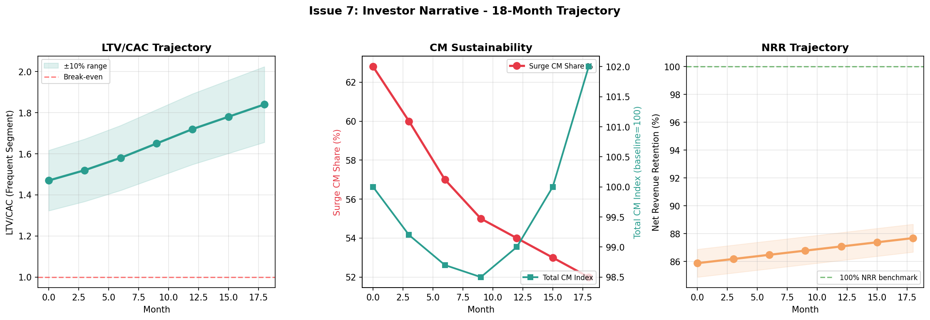
Retention-Driven Unit Economics: 3 Metrics, 18-Month Horizon
• LTV/CAC Ratio (Frequent Segment)
Current: 1.47x → Target: 1.47-1.84x (18 months)
Confidence: MEDIUM-LOW for magnitude; MEDIUM-HIGH for structural thesis
• Net Revenue Retention (NRR)
Current: ~94% (revenue-weighted) → Target: ~95%+ (18 months)
Confidence: MEDIUM-HIGH (NRR already strong; churned are low-value rare riders)
• CM Sustainability
Current: 62.8% surge-dependent → Target: <55% surge-dependent (18 months)
Confidence: MEDIUM-HIGH (structural shift; less dependent on churn model)
• CAVEAT: Churn causation NOT validated. Recommendation rests on STRUCTURAL thesis (CM diversification, defensibility, regulatory positioning)
Notes:
Three metrics for investors: LTV/CAC upside depends on churn model validity (uncertain), but structural thesis is strong. NRR already at 94% - zone governance protects high-value riders. CM sustainability is the strongest argument: reducing surge dependency from 63% to <55% makes the business more defensible. Key caveat: churn causation not validated in data - recommendation rests on structural benefits, not churn improvement projections.

