Slide 1
STATE EDUCATION MANAGEMENT INFORMATION SYSTEM • MADHYA PRADESH
Shaikshik Samwaad Master Executive Studio
A Complete Navigation, Telemetry & Decision Architecture Guide
Exhaustive walkthrough of all 11 studio modules, interactive slicers, psychometric diagnostics, and data-driven governance protocols for state leadership.
TARGET CADRE
68,427 Middle School Teachers across 52 Educational Districts
REPORTING CYCLES
August 2026, September 2026 & Consolidated Longitudinal Data
SYSTEM AUDIENCE
RSK Directorate, Joint Directors, DPCs, APCs, BEOs & Academic Mentors

Slide 2
STUDIO PURPOSE & CONTEXT
Executive Overview: Who, What, Where, Why & When
FOUNDATION
01 • WHAT IS IT?
02 • WHO IS IT FOR?
03 • WHERE TO ACCESS IT?
A single-screen interactive intelligence platform tracking 68,427 middle-school teachers across MP. It bridges administrative attendance logs with teacher psychometric and pedagogical survey data.
State leadership (RSK), Joint Directors (JDs), District Project Coordinators (DPCs), BEOs, and academic mentors who require verifiable evidence to guide school visits.
Available locally as an all-in-one interactive web studio (index.html) running directly in any modern browser with zero server setup or external plugins.
04 • WHY DOES IT EXIST?
05 • WHEN IS THE DATA FROM?
06 • STATE HEADLINE RECORD
To move beyond simple headcounts. It measures whether teachers actively understand constructivist classroom methods, what misconceptions persist, and where logistical support is needed.
Encompasses the dual rollout cycles of August and September 2026, tracking cumulative reach, monthly repeat attendance, facilitator retention, and district trajectories.
• 68,427 Total Sanctioned Middle School Cadre
• 33,866 Unique Teachers Reached (49.49% State Reach)
• 3,014 Unique Reporting Physical Clusters Reached
• 6,658 Unique Master Facilitators Prepared

Slide 3
SYSTEM TELEMETRY
Studio Navigation: Global Slicers & Strategic Briefing Drawer
NAVBAR
CONTROLS • Global Slicers & Viewport Controls
DRAWER • Executive Strategic Briefing Drawer
1. Reporting Cycle Slicer
Toggle August 2026, September 2026, or Consolidated (Aug + Sep). Switching this recalculates all turnout charts, block directories, and psychometric scores across the entire studio in real time.
Location & Access:
Click the prominent 'Strategic Briefing' button on the top-right header to slide out a high-priority advisory tray.
Purpose & Value:
Synthesizes urgent qualitative alerts for senior decision-makers, eliminating the need to search through 70+ survey tables.
2. Program Mode Slicer
Switch between Consolidated (All Data), CLSS (Cluster Level Samwaad for frontline teachers), and DO (District Orientation sessions for block/cluster resource persons).
Priority Alert 1: TLM Deficit (Q95 & Q178)
Exposes whether teachers lack physical kits or classroom preparation time to execute activity-based learning.
3. Cadre & Role Filter
Filter views by Teachers, Master Facilitators, or Observers & Monitors to examine metrics specific to frontline instruction versus administrative oversight.
Priority Alert 2: Observer Blackouts
Surfaces clusters operating without registered BAC/CAC monitors, highlighting supervision gaps.
4. Bilingual Language Switcher
Instant English / Hindi toggle in the header. Dynamically translates titles, labels, diagnostic options, and table columns for field officers.
Priority Alert 3: Hardware Gaps
Flags training centers lacking electricity or projection equipment required for digital modules.

Slide 4
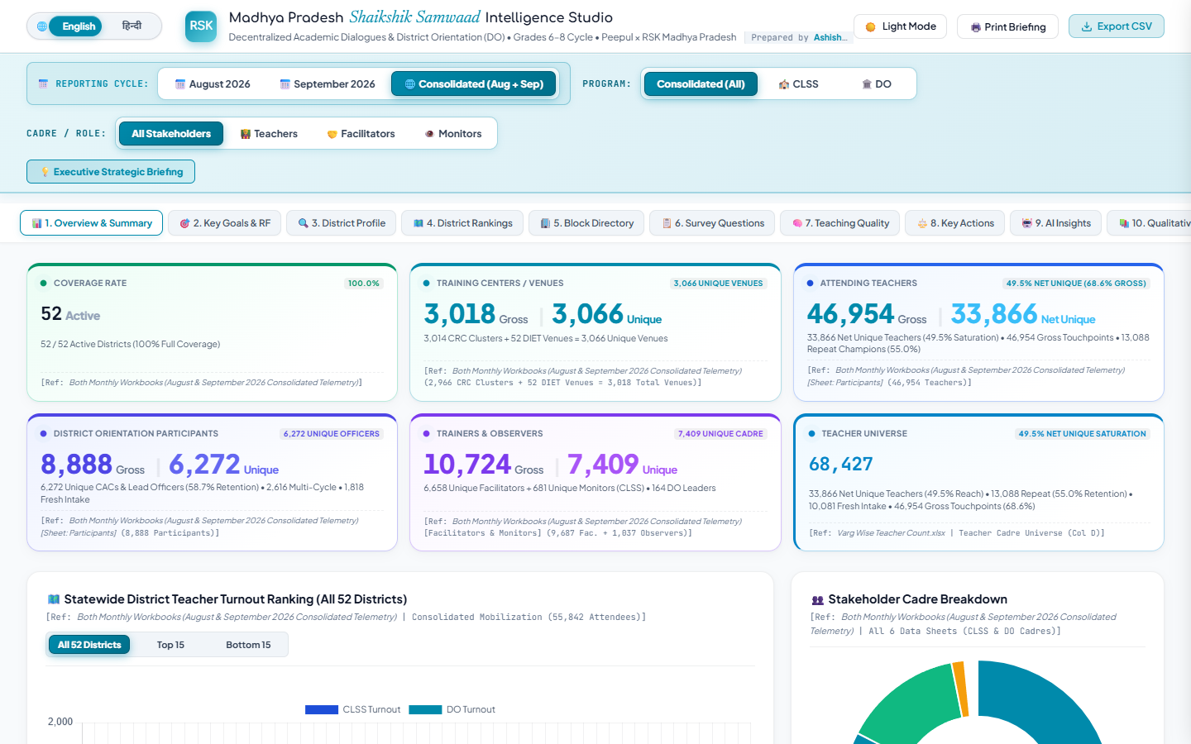
HEADLINE METRICS
Top Bento Scorecards: Core State Operational Telemetry
BENTO RIBBON
DISTRICT COVERAGE
ACTIVE VENUES
UNIQUE TEACHERS
DISTRICT ORIENTATION
FACILITATOR RETENTION
100%
52 / 52 Districts Active
Full state footprint across all 52 educational units.
2,972
3,014 Unique Clusters Reached
2,872 venues in Aug expanded to 2,972 in Sep.
33,866
49.49% State Cadre Reached
De-duplicated individual teachers trained.
8,888
6,272 Unique Individuals
Total DO attendance across Aug and Sep.
60.2%
2,896 Repeat Leads
6,658 total facilitators with strong continuity.
INTERFACE PROOF • Live Studio Telemetry Ribbon Capture

Slide 5
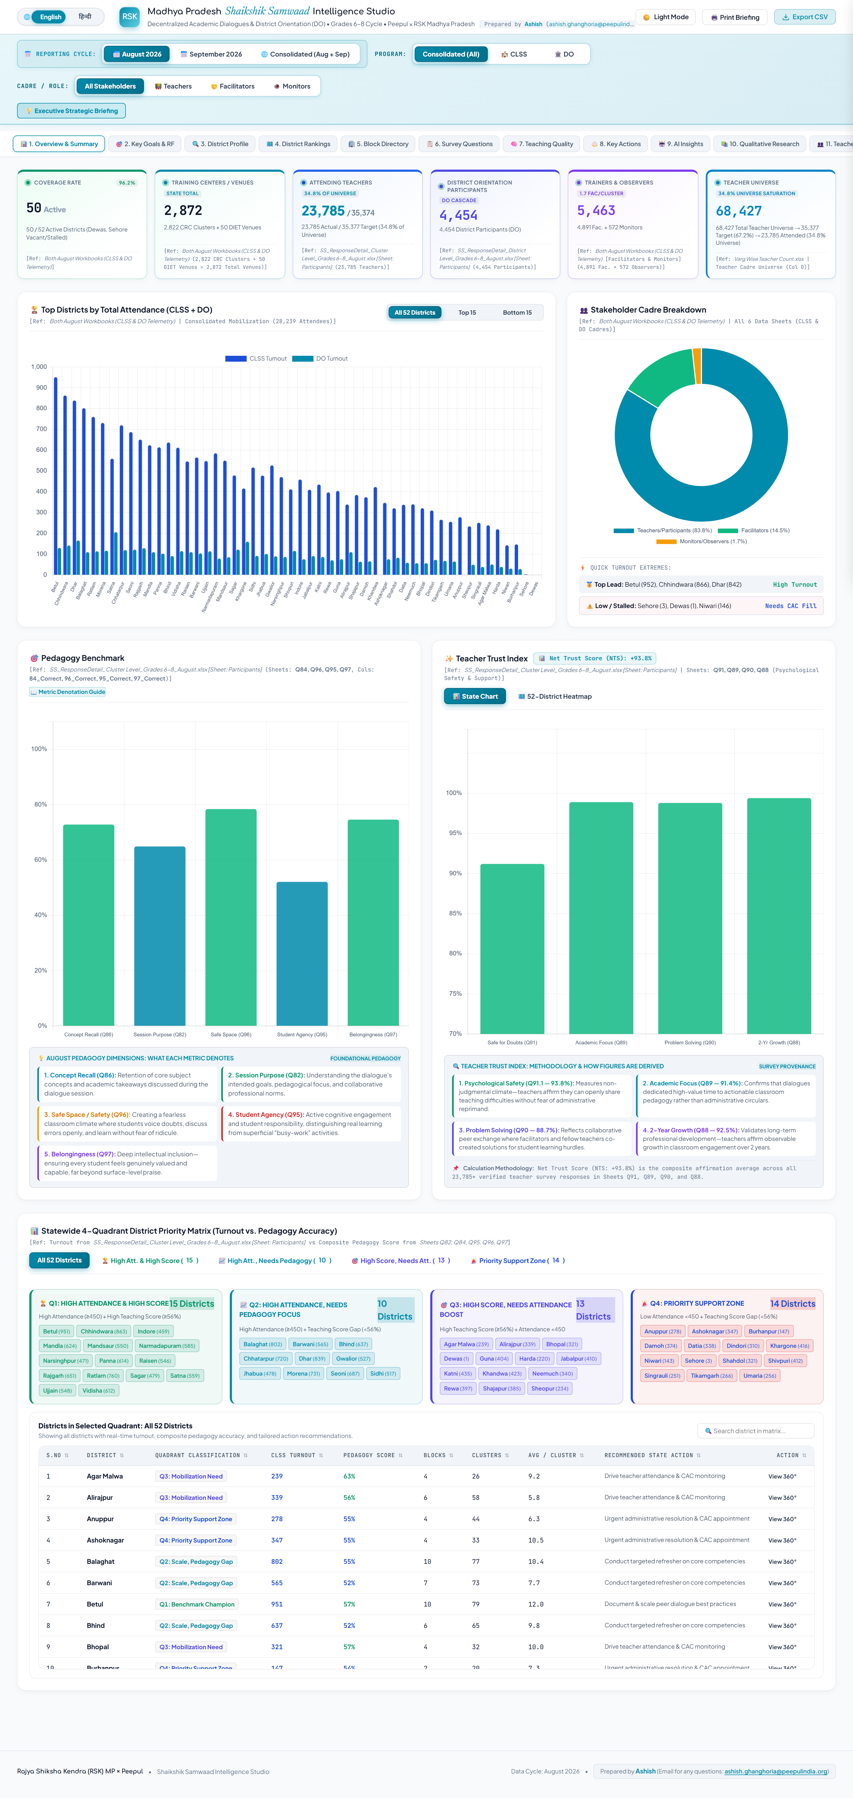
TAB 1 ARCHITECTURE
Tab 1: Overview & Summary — Turnout Rankings & Stakeholder Mix
OVERVIEW
EXPLANATION • Visual Typology & Decision Insights
STUDIO VIEW • Live Studio View (Tab 1 Interface)
Horizontal Ranking Bar Chart (Top Turnout):
Why Used: Accommodates long district names cleanly while ranking performance from highest to lowest.
Insight: Highlights benchmark districts (e.g., Alirajpur 87.2%, Datia 78.4%, Dindori 76.1%).
Decision: Leadership can pair top-performing teams with lagging districts for peer learning.
Doughnut Chart (Cadre Composition):
Why Used: Depicts proportions without center clutter.
Insight: Confirms that the audience is composed of 88.4% frontline Teachers, 8.9% Facilitators, and 2.7% Observers.
Decision: Ensures sessions remain teacher-centered rather than administrative inspections.
Trust & Psychological Safety Gauges:
Why Used: Instant visual benchmarking against 100% thresholds.
Insight: Measures whether teachers feel comfortable voicing instructional challenges.

Slide 6
DIAGNOSTIC ARCHITECTURE
Tab 1 (Cont): The 52-District Strategic Quadrant Scatter Matrix
QUADRANT MATRIX
METHODOLOGY • Why a 2D Scatter Matrix Outperforms One-Dimensional Rankings
Simple rankings reward districts solely on attendance, masking whether teachers actually understand the material. The Strategic Quadrant plots Operational Turnout (X-Axis) against Pedagogical Understanding (Y-Axis), segmenting all 52 districts into 4 distinct action groups.
QUADRANT 1: STATE CHAMPIONS
QUADRANT 2: PROCESS-DRIVEN
High Turnout (>50%) & High Pedagogical Quality (>70%)
Exemplary implementation districts with strong attendance and deep pedagogical mastery.
Action: Document local practices and designate as regional mentor hubs.
High Turnout (>50%) & Low Pedagogical Quality (<70%)
Strong administrative mobilization, but teachers struggle with core concepts.
Action: Avoid administrative pressure; dispatch DIET mentors for facilitator coaching.
QUADRANT 3: ACADEMIC ENCLAVES
QUADRANT 4: CRITICAL SUPPORT
Low Turnout (<50%) & High Pedagogical Quality (>70%)
Teachers demonstrate strong comprehension, but overall attendance is low.
Action: Issue administrative directives to improve school release and attendance.
Low Turnout (<50%) & Low Pedagogical Quality (<70%)
Districts lagging in both attendance and instructional understanding.
Action: Immediate joint administrative and academic intervention by RSK directorate.

Slide 7
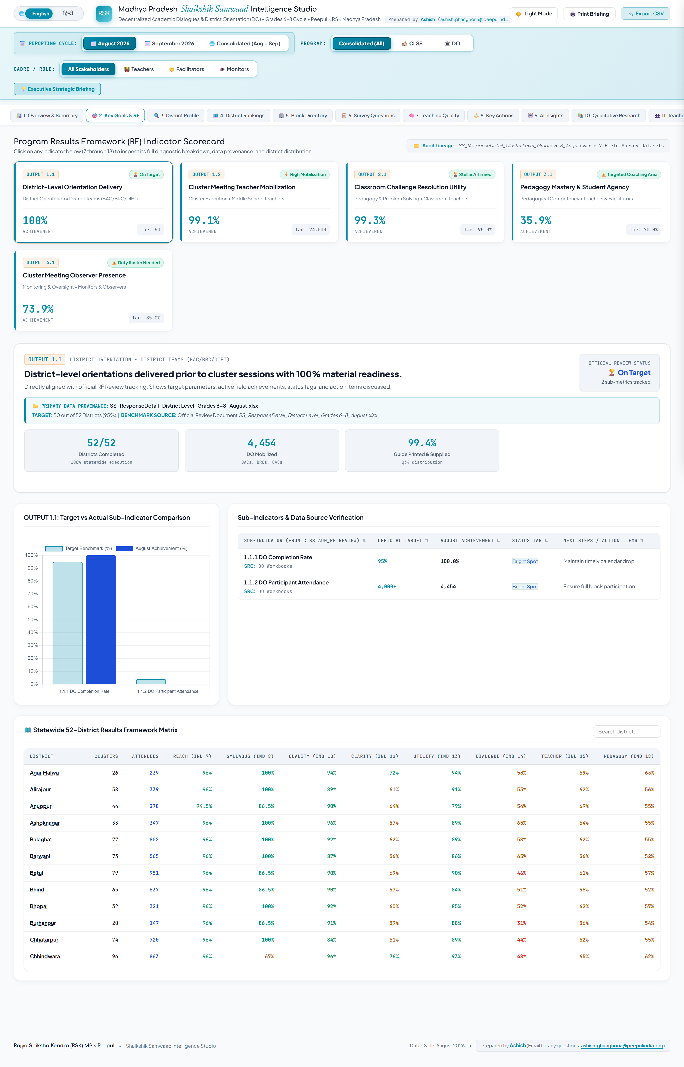
TAB 2 ARCHITECTURE
Tab 2: Key Goals & Results Framework — Mobilization Funnel
RESULTS FRAMEWORK
FUNNEL & FIDELITY • Visual Typology & Operational Integrity
STUDIO VIEW • Live Studio View (Tab 2 Interface)
Multi-Stage Mobilization Funnel:
Why Used: Illustrates sequential drop-off from official HR records down to verified physical attendance.
• Sanctioned Strength (68,427): Total approved middle school cadre.
• Expected Active (48,000–52,000): Adjusts for vacancies, leaves, and deputations.
• Unique Attendees (33,866): De-duplicated individual teachers trained.
Decision: Distinguishes between vacant teacher posts and active teacher absenteeism.
Active Venue Saturation (2,972 Venues):
Why Used: Progress bars tracking cluster activation.
Insight: 3,014 unique physical clusters reached across both cycles.
Observer Presence Rate:
Why Used: Quality certification bars.
Insight: Measures the percentage of sessions verified by external DIET/CAC monitors.

Slide 8
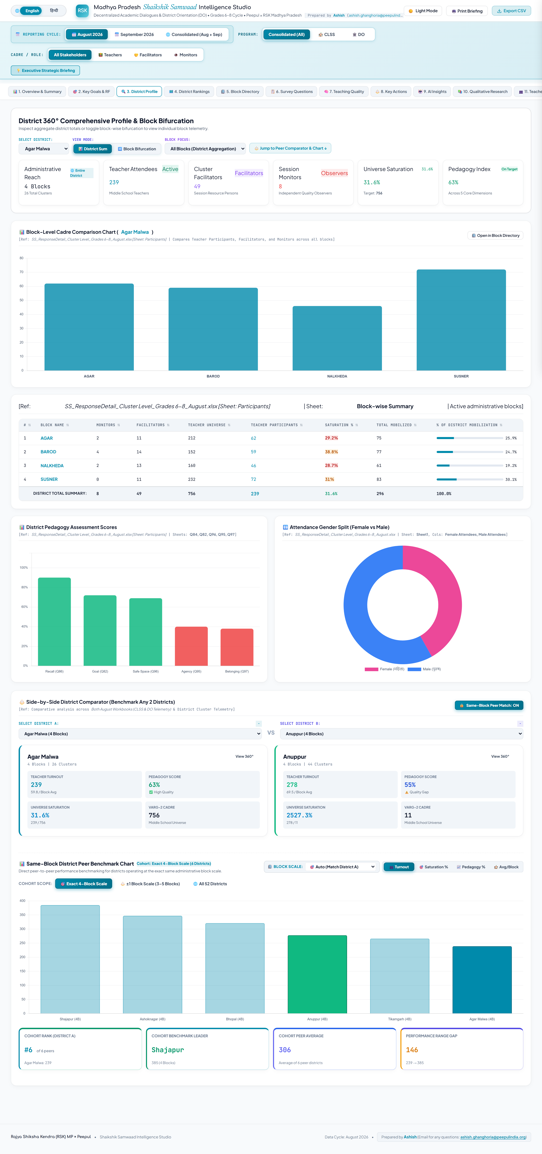
TAB 3 ARCHITECTURE
Tab 3: District 360 Profile — Radar Diagnostics & Block Variance
DISTRICT 360
MULTI-AXIAL DIAGNOSIS • Diagnostic Visuals & Analysis
STUDIO VIEW • Live Studio View (Tab 3 Interface)
Clustered Block Comparison Bar Chart:
Why Used: Displays all blocks in the selected district side-by-side against district and state benchmarks.
Insight: Exposes internal block disparities. A district averaging 55% may have one block at 85% and another at 22%.
Decision: DPCs can focus administrative reviews on specific lagging blocks.
5-Axis Pedagogical Spider / Radar Chart:
Why Used: Visualizes balance across 5 dimensions: TLM Usage, Error Culture, Lesson Design, Student Voice, and Assessment.
Insight: A distorted shape pinpoints exact instructional gaps.
Decision: DIET faculty can tailor academic inputs to the district's specific needs.
Peer & Gender Distribution Bars:
Insight: Ensures equitable teacher participation across cadres and genders.

Slide 9
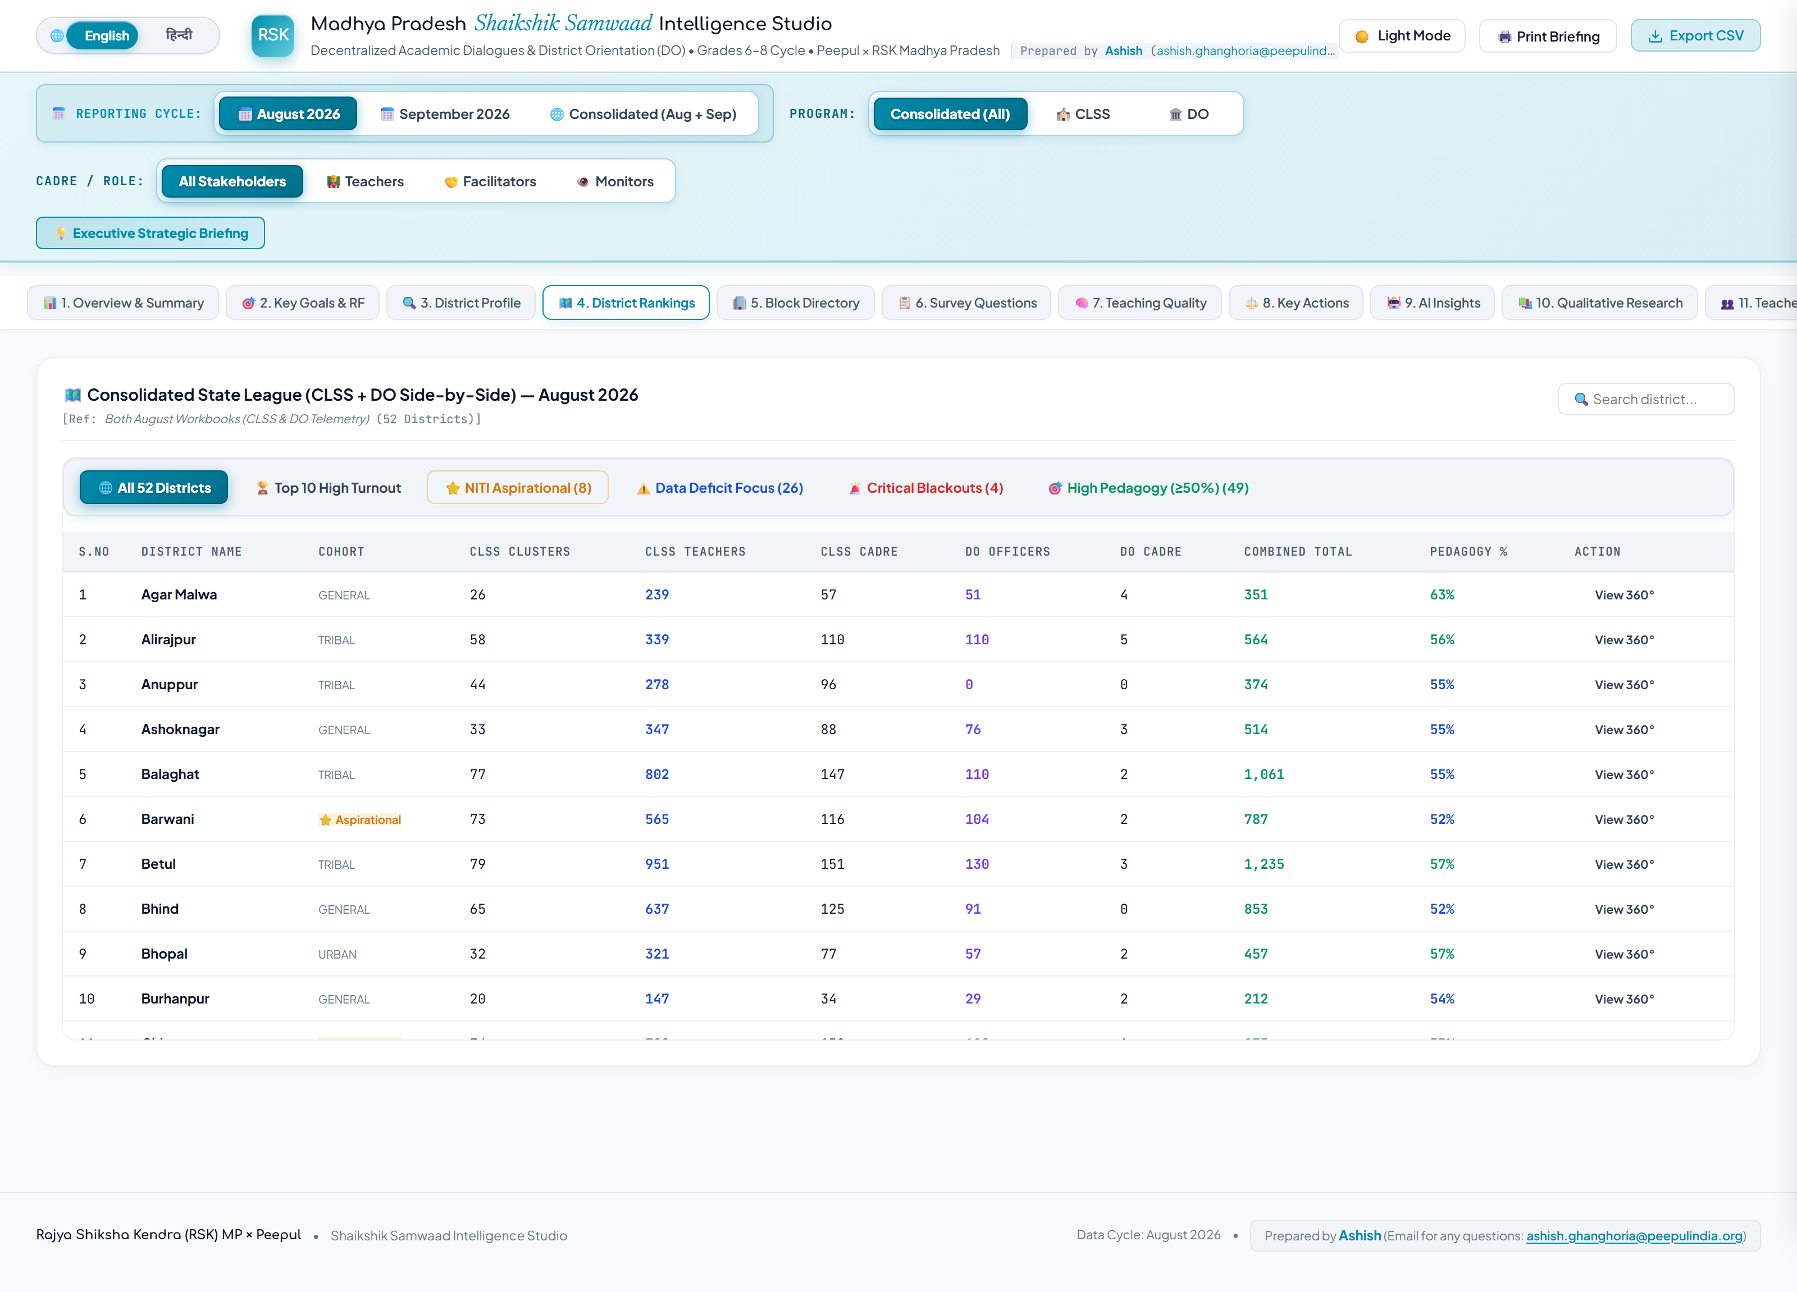
TAB 4 ARCHITECTURE
Tab 4: District Rankings — Interactive League Table & Slicers
STATE LEAGUE
SORTABLE MATRIX • Table Capabilities & Dynamic Filters
STUDIO VIEW • Live Studio View (Tab 4 Interface)
Multi-Column Sortable Data Table:
Why Used: Provides full transparency across all 52 districts. Allows one-click sorting by Turnout %, Attendance, Active Venues, and Pedagogical Score.
Status Badges: Green (>65% turnout), Amber (40-65%), Red (<40%).
Pre-Configured Focus Filters:
• All 52 Districts: Statewide baseline.
• Top 10 High Turnout: Benchmark districts (e.g., Alirajpur, Datia, Dindori) for recognition.
• NITI Aspirational (8): Focus on designated transformation districts.
• Data Deficit Focus: Highlights reporting delays.
• Critical Blackouts: Districts under 35% attendance threshold.
Decision You Can Make:
Provides direct evidence for monthly review meetings with DPCs and Collectors.

Slide 10
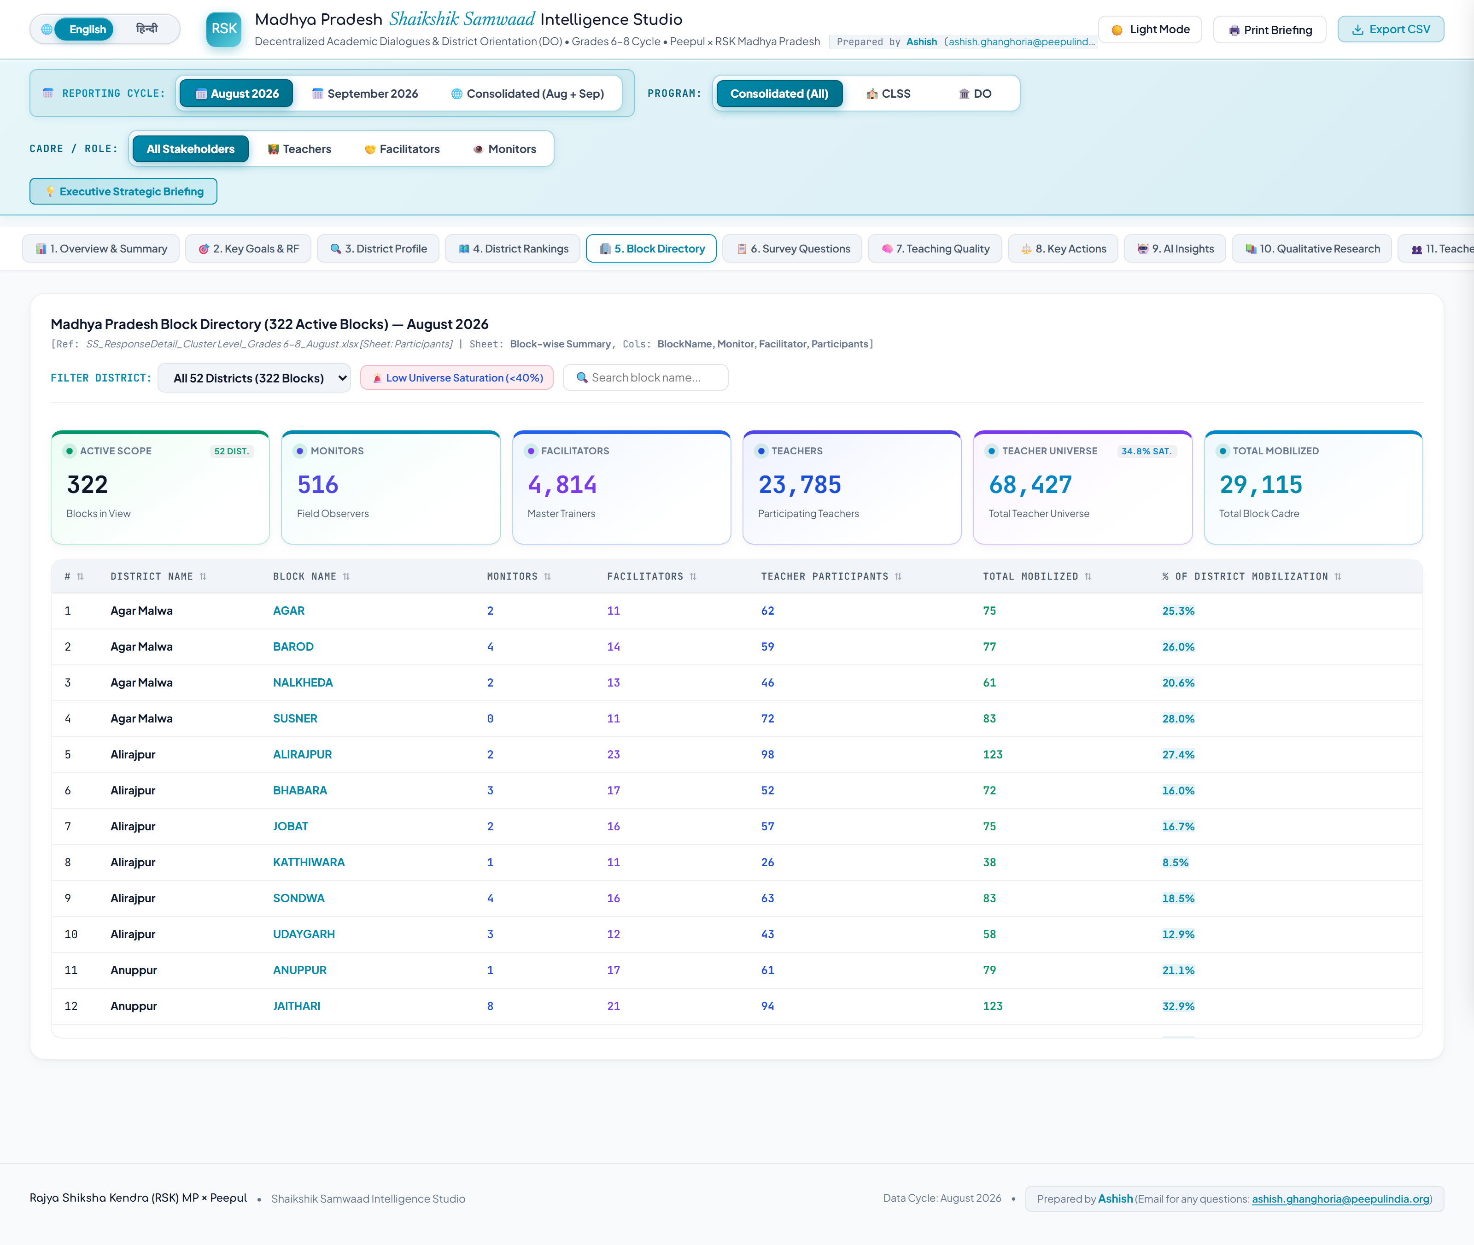
TAB 5 ARCHITECTURE
Tab 5: Block Directory — 322-Block Operational Administration
SUB-DISTRICT OPERATIONS
LOCAL ROSTER • Granular Sub-District Administration
STUDIO VIEW • Live Studio View (Tab 5 Interface)
The Need for Sub-District Telemetry:
Statewide and district averages often mask local execution issues. Tab 5 delivers an operational directory of all 322 educational blocks in MP, empowering BEOs and BACs to inspect local data.
Real-Time Search & Lookup:
Type any block or district name into the search bar. The directory filters 322 records instantly without page reloads.
Cluster Activation Audits:
Shows active reporting clusters against total approved clusters in each block, flagging locations where scheduled sessions submitted zero logs.
Decision You Can Make:
Allows BEOs to address specific logistical bottlenecks and transport issues in low-turnout clusters.

Slide 11
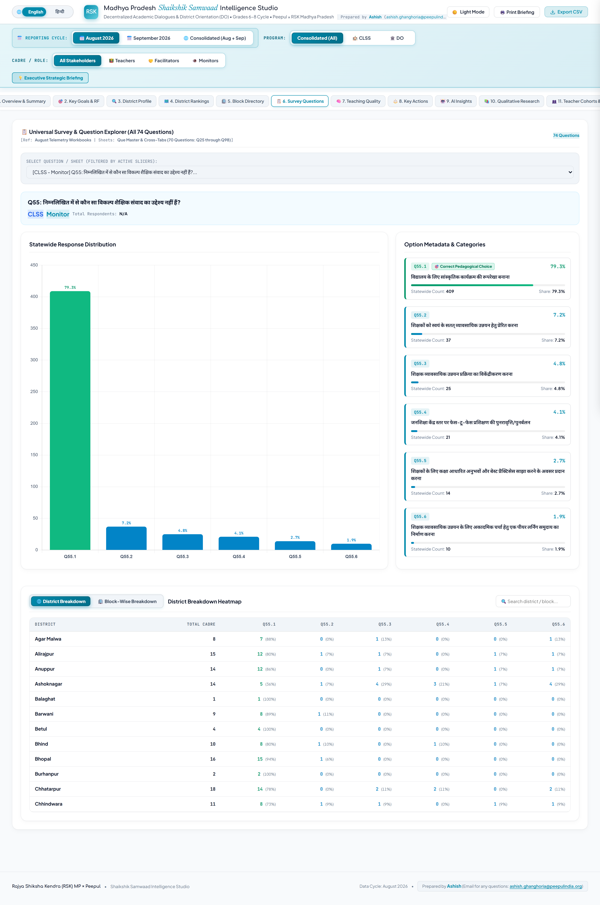
TAB 6 ARCHITECTURE
Tab 6: Survey Questions & Psychometrics — 70+ Item Diagnostic Bank
QUESTION BANK
RESPONSE SPLIT • Item-by-Item Psychometric Analytics
STUDIO VIEW • Live Studio View (Tab 6 Interface)
Stacked Proportion Distribution Bars:
Why Used: Each survey item has 3 to 4 multiple-choice options. Stacked distribution bars show the percentage split across responses in a compact visual.
• Teal: Constructivist / Pedagogically Sound Option
• Slate/Gray: Traditional / Passive Option
• Red: Misconception / Distractor Trap
Exhaustive Question Coverage:
Tracks 70+ evaluation items (Q82 to Q179) covering teacher confidence, TLM barriers, and lesson planning.
Filtering by Domain & Competency:
Filter by General Feedback, Classroom Observation, or Pedagogical Mindsets to isolate specific instructional themes.
Decision You Can Make:
Curriculum teams can see which survey questions had high error rates to revise training modules for subsequent cycles.

Slide 12
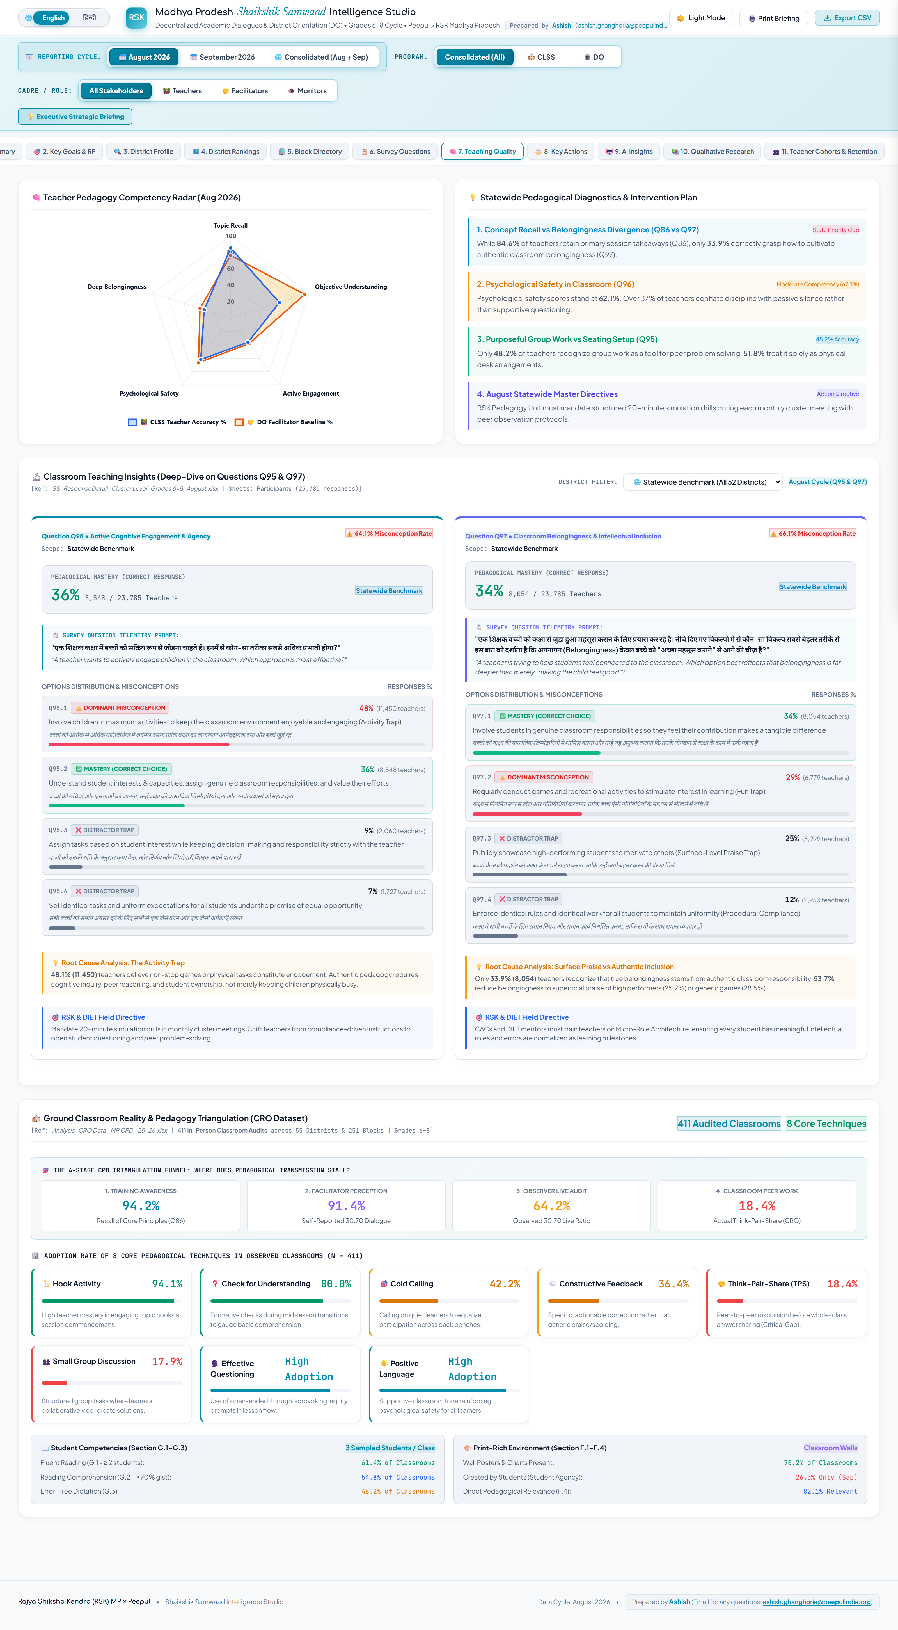
TAB 7 ARCHITECTURE
Tab 7: Teaching Quality — Misconception Case Studies (Q95, Q96, Q97)
PEDAGOGY DEEP-DIVE
MISCONCEPTION AUDIT • Diagnostic Breakdown of Core Questions
STUDIO VIEW • Live Studio View (Tab 7 Interface)
Q95: TLM Integration Barriers:
The Diagnostic: Examines why teachers avoid physical teaching learning materials.
The Insight: Teachers often cite syllabus pressure and lack of planning time rather than missing materials.
Decision: Moves policy from simply distributing kits to embedding materials into lesson plans.
Q96: Error Culture & Psychological Safety:
The Diagnostic: Evaluates how teachers respond to student mistakes.
The Insight: Tracks the shift from punitive correction toward viewing errors as learning opportunities.
Decision: Focuses training on creating supportive classroom environments.
Q97: Student Voice & Belonging:
The Diagnostic: Measures participation equity across gender and ability.
Decision: Directs teachers toward structured group work and cold-calling techniques.
Q177-Q179: Post-Training Application:
Tracks conversion of training concepts into regular classroom habits.

Slide 13
TAB 8 ARCHITECTURE
Tab 8: Key Actions & Governance — Administrative Directives
GOVERNANCE
DIRECTIVES • Accountability & Escalation Framework
STUDIO VIEW • Live Studio View (Tab 8 Interface)
Actionable Directives for Administrative Tiers:
Connects analytics directly to responsibilities for each administrative tier:
• DPCs: Issue targeted review notices to blocks below 40% turnout.
• BEOs: Verify cluster facilitator attendance and resolve local logistics.
• DIET Mentors: Deploy to Quadrant 2 districts (High Turnout, Low Quality) to strengthen training quality.
Operational Compliance Milestones:
• Pre-Session (T-7): Finalize venue readiness and digital modules.
• Session Day (Day 0): Live attendance and observer logging.
• Post-Session (T+3): Complete psychometric submissions and resolve data gaps.
• State Review (Monthly): Review progress with RSK leadership using Tab 4 (Rankings) and Tab 1 (Quadrant).

Slide 14
ADVANCED MODULES
Tabs 9, 10 & 11: AI Insights, Field Research & Cohort Retention
ANALYTICS & RETENTION
THEMATIC AI • TAB 9: AI THEMATIC TOPOLOGY
FIELD VOICES • TAB 10: QUALITATIVE FIELD MONOGRAPH
COHORT RETENTION • TAB 11: TEACHER COHORT RETENTION
Visual Tool: Natural language topic clustering cards.
What It Contains: Synthesizes open-text teacher feedback using AI thematic grouping.
Key Insights: Surfaces recurring field themes including material shortages, scheduling needs, and peer exchanges.
Decision: Highlights on-ground issues that structured survey options may overlook.
Visual Tool: Case study logs and immersion records.
What It Contains: Field observations from physical school visits and facilitator interviews across MP.
Key Insights: Provides context behind low scores, such as multi-grade pressures and facility constraints.
Decision: Adds qualitative context before taking administrative actions.
Visual Tool: 3-way cohort retention matrix.
What It Contains: Verified breakdown of all 33,866 unique teachers reached:
• 13,023 Persistent Core (attended both cycles)
• 10,622 August-only attendees
• 9,962 September-only new attendees
Decision: Evaluates teacher retention across cycles and tracks onboarding of new schools.

Slide 15
DECISION RUNBOOK
Decision-Maker's Cheat Sheet: Which Chart to Use for Which Question
CHEAT SHEET
If Your Core Question Is: | Look at This Tab & Chart: | What You Will Discover: | Action to Take:
Are we reaching enough teachers statewide? | Top Bento Cards & Tab 2 Funnel | Cumulative unique reach (33,866) vs total sanctioned cadre (68,427). | Evaluate whether overall mobilization targets are on schedule.
Which districts require administrative escalation? | Tab 4: District Rankings (Filter: Critical Blackouts) | Districts below 35% attendance threshold. | Schedule targeted review calls with concerned DPCs.
Which districts need training quality support, not attendance pressure? | Tab 1: Strategic Quadrant (Quadrant 2: Process-Driven) | Districts with high turnout but low pedagogical scores. | Send DIET mentors to strengthen facilitator capabilities.
Why are teachers struggling within a specific district? | Tab 3: District Profile (5-Axis Radar Chart) | The district's specific weakness among the 5 competencies. | Provide targeted modules on that specific area.
Are teachers actually understanding child-centered pedagogy? | Tab 7: Teaching Quality (Misconceptions Benchmark) | Teacher response patterns on Q95, Q96, and Q97. | Refine next month's session plans to address root misconceptions.
Did we retain teachers or did a new group attend? | Tab 11: Teacher Cohorts & Retention Matrix | Split of repeat attendees (13,023) vs single-cycle attendees. | Decide whether to run refresher sessions or repeat core modules.

Slide 16
GOVERNANCE STANDARDS
Operational Best Practices, Data Lineage & Verification
STANDARDS
PRACTICES • How to Run Monthly Reviews Using the Studio
AUDIT TRAIL • Data Lineage & Mathematical Audit Integrity
1. Begin with the Consolidated View:
Start monthly reviews with the Consolidated view to assess cumulative state reach, then switch to the current month to evaluate immediate operational trends.
Source Data Reconciliation:
All metrics are calculated directly from official RSK Samwaad Google Forms and attendance registers, cross-verified with TPD baseline files.
2. Use the Strategic Quadrant to Set Agendas:
Avoid spending meeting time on Top Benchmark districts. Focus reviews on Quadrant 4 (Critical Support) and Quadrant 2 (Process-Driven).
Cadre Deduplication:
The 33,866 teacher reach figure is fully de-duplicated using unique teacher identifiers, ensuring repeat attendees are not double-counted.
3. Drill Down to Block Level During Inquiries:
When a DPC explains low attendance, open Tab 5 (Block Directory) to identify which specific blocks drove the shortfall.
District Mapping Consistency:
The 3 newly formed districts (Mauganj, Maihar, Pandhurna) are mapped consistently to parent districts (Rewa, Satna, Chhindwara) to maintain longitudinal accuracy across 52 educational units.
4. Connect Data to Administrative Actions:
Conclude every review by referencing Tab 8 (Key Actions) to establish clear accountability and follow-up deadlines for field officers.
Zero Server Dependency:
The standalone HTML file runs entirely client-side, ensuring complete data security and offline functionality during field visits.

