Slide 1
Augmenting Qualitative & Predictive Research with AI
Exploring AI tools to deepen insights
Leveraging Qwen, DeepSeek-R1, TabFM & Colab for Interventions

Slide 2
Current research workflow - challenges
Multilingual Field Notes: Researchers collect unstructured Hindi & English observation notes from CLSS / CM RISE visits.
Manual Thematic Coding: Bottlenecked by manual reading to code themes (e.g., Compliance Barriers, Informal Cascades).
Time & Scalability ConstraintsRisk of Nuance Loss: High volume of text increases the risk of overlooking subtle qualitative insights.
Field Notes -> manual coding -> Synthesis -> Report

Slide 3
TabFM: Bridging Qualitative Themes to Quantitative Predictions
I experimented with Google’s TabFM, a zero-shot foundation model for tabular data.
TabFM can read an entire spreadsheet and run classification/regression without training a separate model per dataset.
I applied TabFM to the 60-teacher EDS dataset (103 features) to forecast brand recall, lesson-plan execution and digital module completion.
Evidence-Based Forecasting: Rapidly forecasts program outcomes (e.g., adoption rates, implementation success).
Econometric Rigour: Merges observational field narratives with quantitative statistical modeling.

Slide 4
Key findings from current EDS study
Findings_merged.pdf
Compliance vs engagement: many teachers complete digital courses mainly for compliance, requesting PDFs of answers or multitasking during videos.
Systemic barriers: teachers report implementing only a small portion of training due to time, administrative load, large classes and single-teacher school constraints.
Informal cascade: CLSS learnings are shared through informal conversations; WhatsApp groups become inactive and there is no formal CLSS debrief slot.
Digital funnel: only 38% of teachers are actively aware of digital training, yet WhatsApp links drive strong participation.
Preference for after-hours, short, interactive modules, and strong evidence for consolidating on DIKSHA and introducing micro-learning formats.

Slide 5
Qwen & DeepSeek-R1: AI Copilots for Qualitative Analysis
Multilingual Zero-Shot Coding: Qwen 2.5 extracts initial codebooks from bilingual (Hindi/English) notes.
Auditable Reasoning Chains: DeepSeek-R1's <think> tags provide transparent, step-by-step logic for theme classification.
Human-in-the-Loop Supervision: AI acts strictly as a copilot—suggesting themes while researchers retain final validation.

Slide 6
Rapid Evidence-Based Forecasting from Coded Themes
Closed-Loop Pipeline: Qwen/DeepSeek outputs feed directly as features into TabFM predictive models.
Rapid Policy Testing: Test 'what-if' scenarios before full field deployment to optimize intervention strategies.

Slide 7
Automation & Reproducibility: Antigravity & Colab Pipeline
Antigravity Operations: AI-native data cleaning, text normalization, and automated chart generation.
Zero Hardware Cost: Google Colab provides free T4 GPU access—no expensive server infrastructure required.
Full Reproducibility: Complete audit trail from raw field notes to final leadership charts in a single notebook.

Slide 8
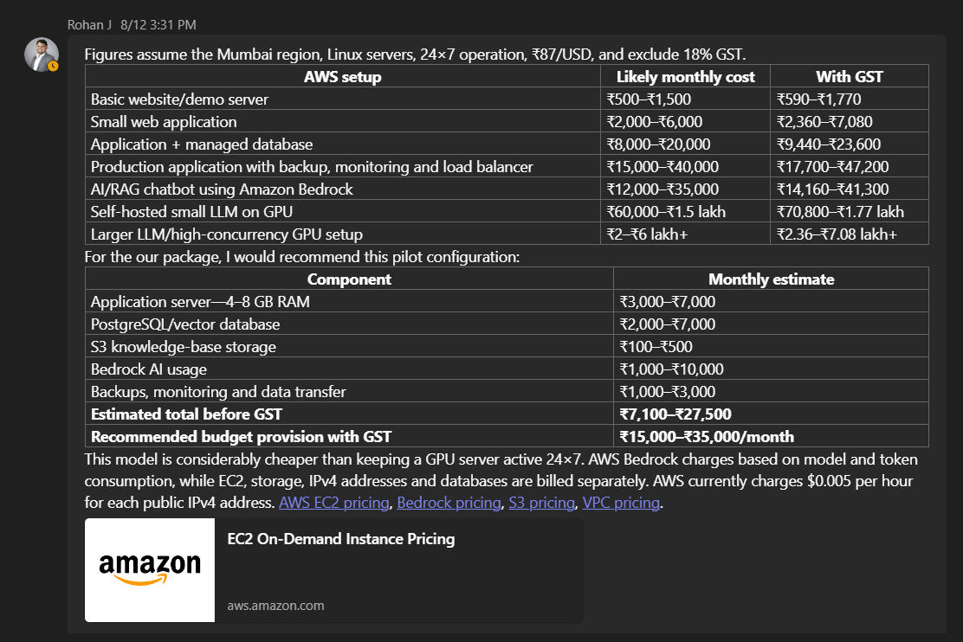

Slide 9
Integrated AI-supported pipeline
Step 1: Multilingual Field Notes ->
Step 2: Qwen/DeepSeek Zero-Shot Coding & Audit
Step 3: Feature Extraction ->
Step 4: TabFM Predictive Forecasting
Step 5: Antigravity/Colab Data Prep
Step 6: Senior Leadership Briefing
Key Advantage: 70% faster turnaround, standardized coding consistency, and evidence-grounded forecasting.

Slide 10
Benefits and guardrails
Local Execution & Confidentiality: Running models locally in Colab ensures sensitive field data is never sent to 3rd-party APIs.
RAG Context Integration: Models are anchored with project-specific domain documents to eliminate hallucinations.
Bias Mitigation Protocols: Regular spot-checks and interpretable reasoning chains ensure academic rigour.

Slide 11
Roadmap and next steps
Phase 1 : Prototype pipeline with anonymized EDS data & establish RAG context definitions.
( RAG adds a retrieval step before the LLM answers.
The flow is: Your documents → Convert to chunks → Embeddings → Vector database → Retrieve relevant chunks → LLM → Answer )
Phase 2 : Research on old projects (CLSS, etc.): “Re‑analyse our past projects (especially CLSS and earlier CM RISE studies) with the AI pipeline, compare what Qwen + TabFM suggest and predict against our original human findings, and document where they match, differ, or add new nuance.”
Phase 3 : Full deployment across active research projects & standardize validation SOPs.
Phase 4 : Evaluate long-term impact on research quality, iterate models, and scale across departments.

