Slide 1
Auth otp - v2.5

Slide 2
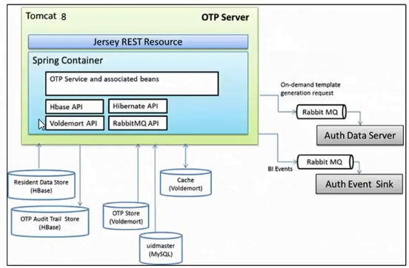
OTP Architecture

Slide 3
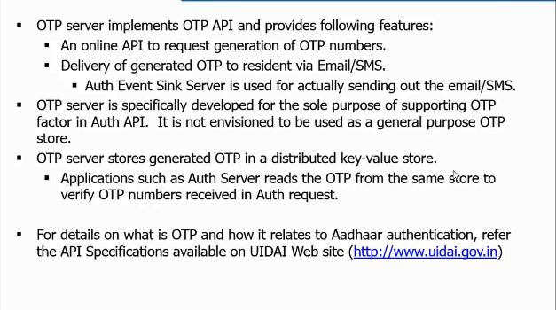
Overview

Slide 4
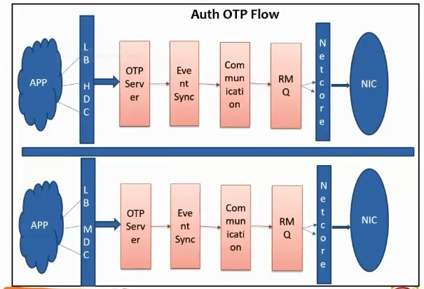
OTP Data flow

Slide 5
Auth OTP Request/Response
Following is the URL format for Aadhaar OTP service:
https://<host>/otp/<ver>/<ac>/<uid[0]>/<uid[1]>/<asalk>
XML data format for OTP API:
<?xml version="1.0" encoding="UTF-8" standalone="yes"?>
<Otp uid=”” ac=”” sa=”” ver=”” txn=”” ts=”” lk=”” type=””>
<Opts ch=””/>
<Signature>Digital signature of AUA</Signature>
</Otp>
Response XML is :
<OtpRes ret=”” code=”” txn=”” err=”” ts=”” info=””/>

Slide 6
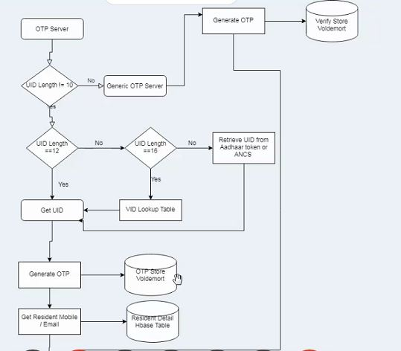
OTP Flow Diagram

Slide 7
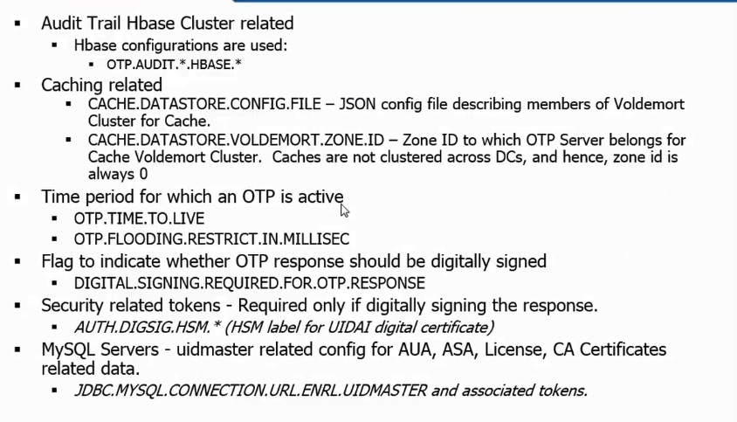
OTP Configuration

Slide 8
Q & Ans

