Slide 1
Voldemort
Voldemort is a distributed Key value storage system.

Slide 2
Data is automatically replicated over multiple servers across multiple datacenters.
Data is automatically partitioned so each server contains only a subset of the total data
Server failure is handled transparently
Pluggable serialization is supported to allow rich keys and values including lists and tuples with named fields, as well as to integrate with common serialization frameworks like Protocol Buffers, Thrift, and Java Serialization
Data items are versioned to maximize data integrity in failure scenarios without compromising availability of the system
Each node is independent of other nodes with no central point of failure or coordination
Pluggable storage engines, to cater to different workloads
SSD Optimized Read Write storage engine, with support for multi-tenancy
Built in mechanism to fetch & serve batch computed data from Hadoop
Support for pluggable data placement strategies to support things like distribution across data centers that are geographical far apart.

Slide 3
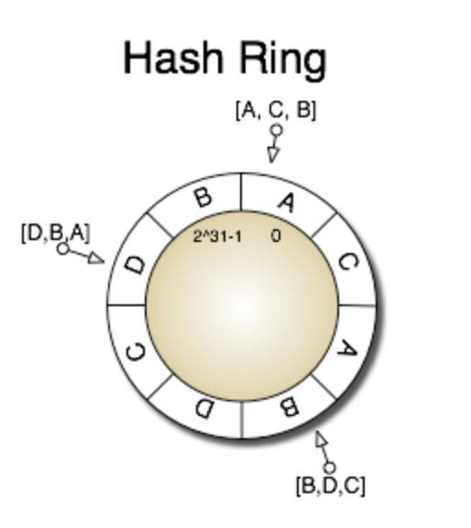
Overall Structure
Clusters, Nodes and Stores
A Voldemort cluster contains multiple nodes
A physical host can run multiple nodes
Each node has a given numbers of stores
Attributes of a store
Replication factor → no of nodes that contain this store
Read/Write quorum size R+W>N
Serialization(xml/json) and compression
Storage engine : Berkley DB or MySQL

Slide 4
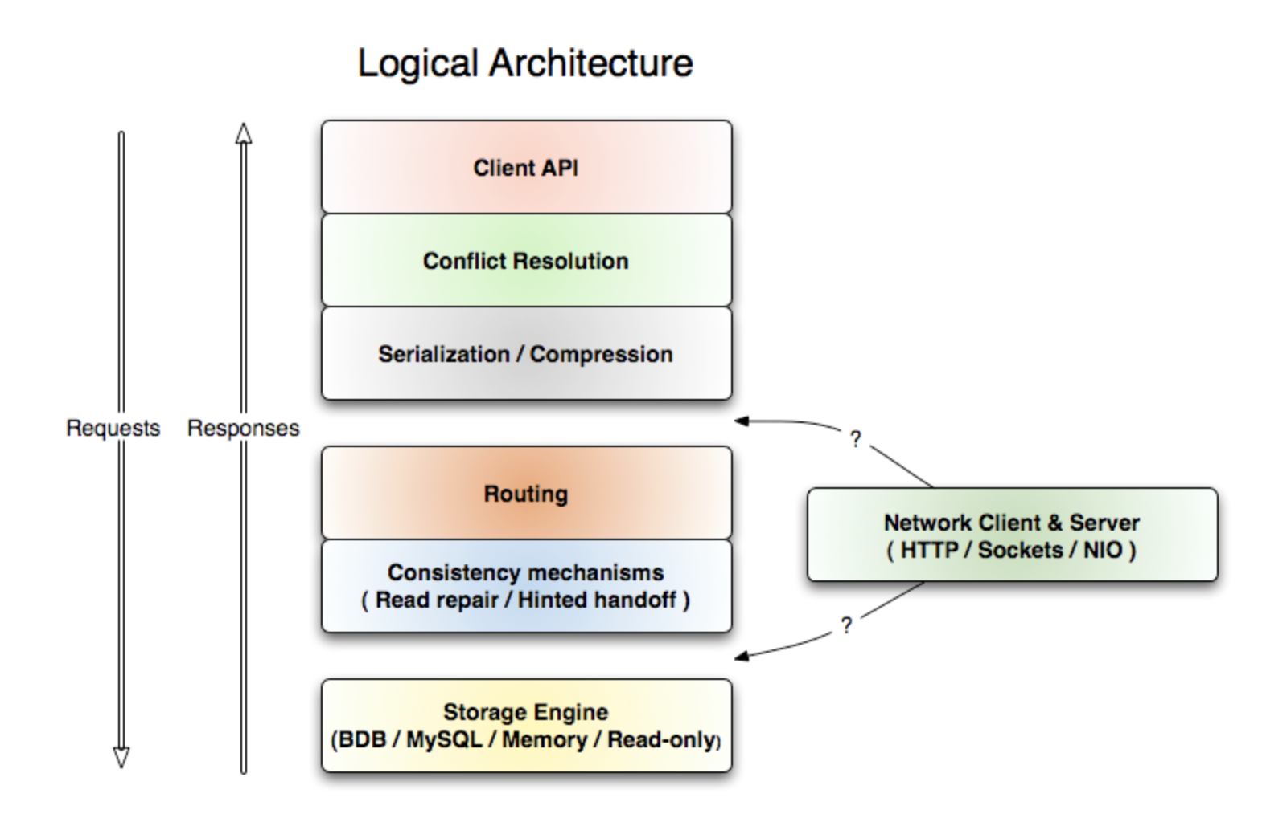

Slide 5
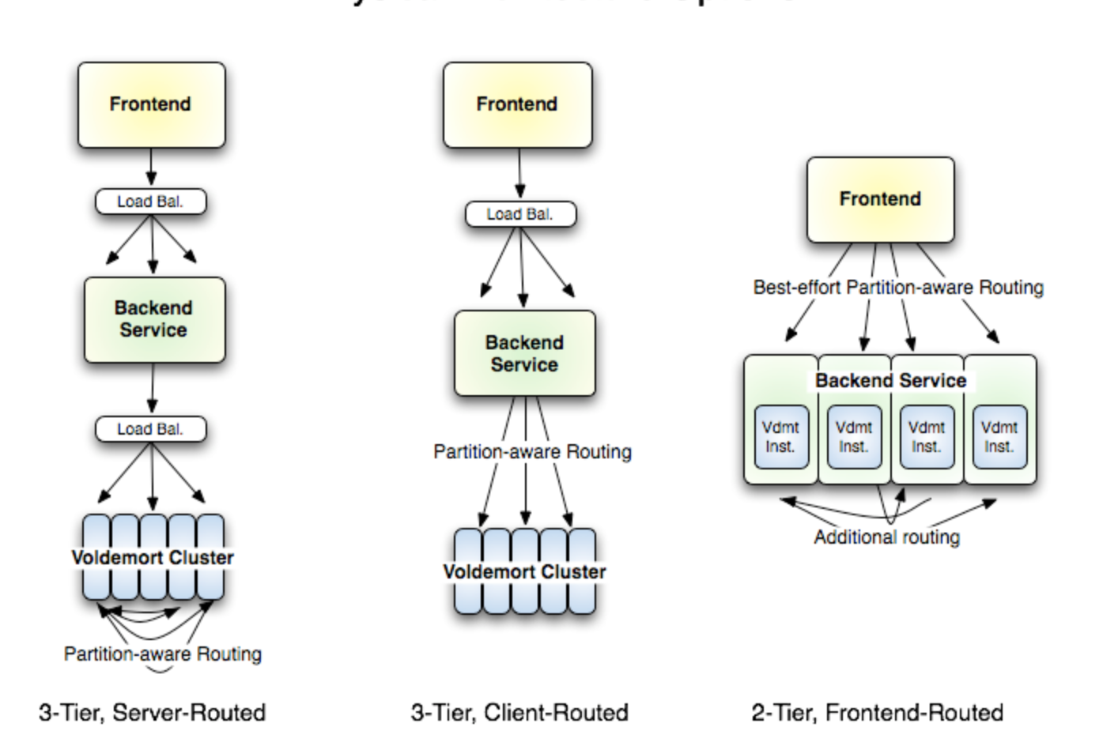
Physical Architecture

Slide 6
Configurations
There are three configuration files that control server operation:
cluster.xml – This holds the information about all the nodes (i.e. servers) in the cluster, what hostname they are at, the ports they use, etc. It is exactly the same for all voldemort nodes. It does not hold tuning parameters or data directories for those nodes, since that is not information public to the cluster but is specific to that particular nodes configuration.
stores.xml – This holds the information about all the stores (i.e. tables) in the cluster. This includes information about the required number of successful reads to maintain consistency, the required number of writes, as well as how keys and values are serialized into bytes. It is the same on all nodes in the cluster.
server.properties – This contains the tuning parameters that control a particular node. This includes the id of the local node so it knows which entry in cluster.xml corresponds to itself, also the threadpool size, as well as any configuration needed for the local persistence engine such as BDB or mysql. This file is different on each node.

Slide 7
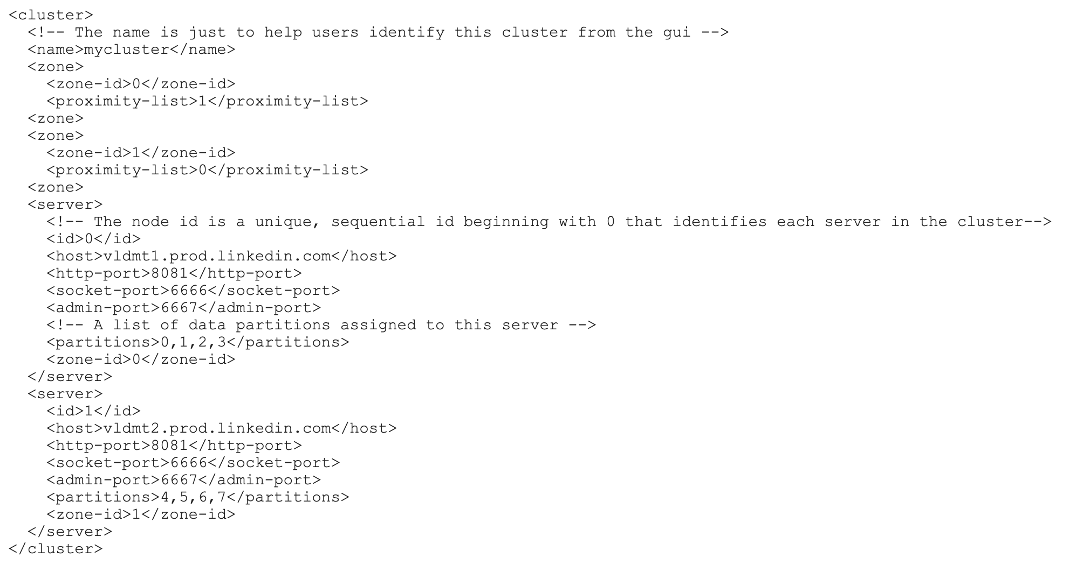
Cluster Configuration

Slide 8
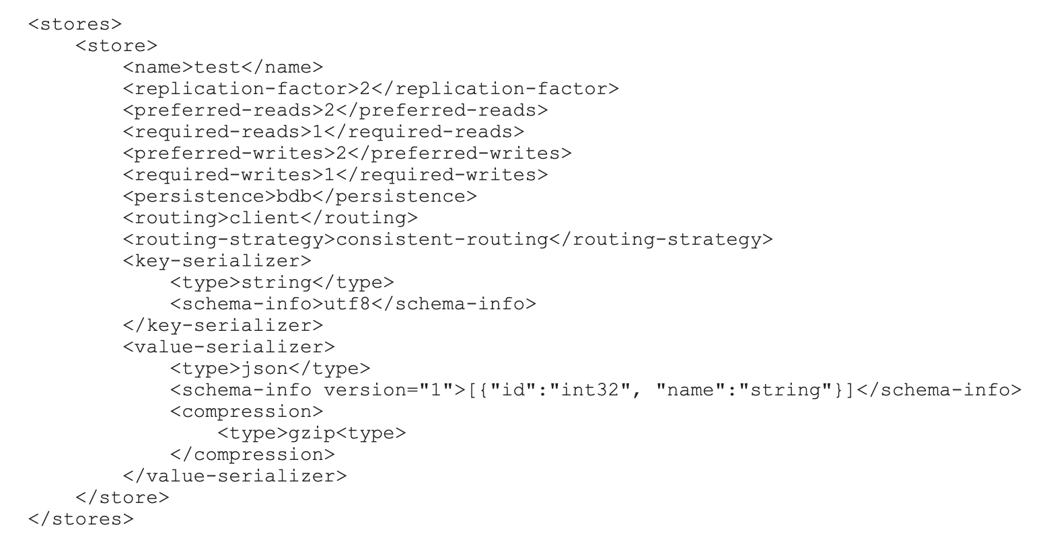
Store Configuration

Slide 9
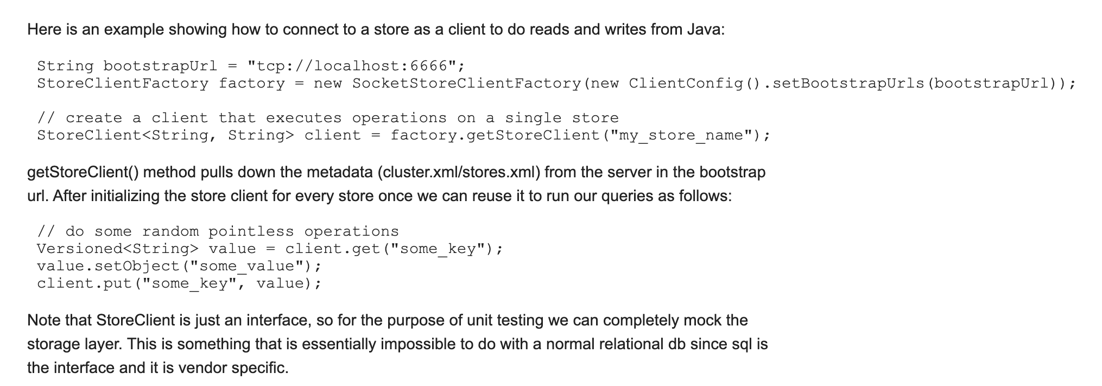
Client Configuration

Slide 10
Server Configuration
There are three methods for using the server
1.Start from command line
2.Embedded Server
3.Deploy as a war

Slide 11
Routing Module
Deals with partioning and replication
Splits the hash ring into equal size partitions
Maps partitions to nodes
Each key is map to a preference list(of partition)
Map to a primary partition(based on its hash)
N- 1 subsequent partition(clockwise)
Pluggable Storage Layer
Traditional get and put functions
Block-read functions(Streaming)
Read Only Operations
Administrative functions

Slide 12
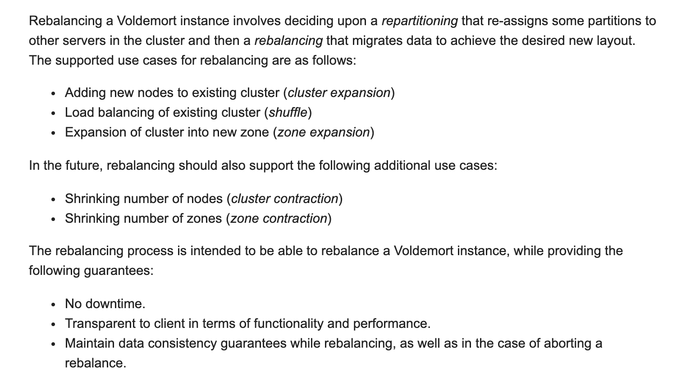
Rebalancing

Slide 13
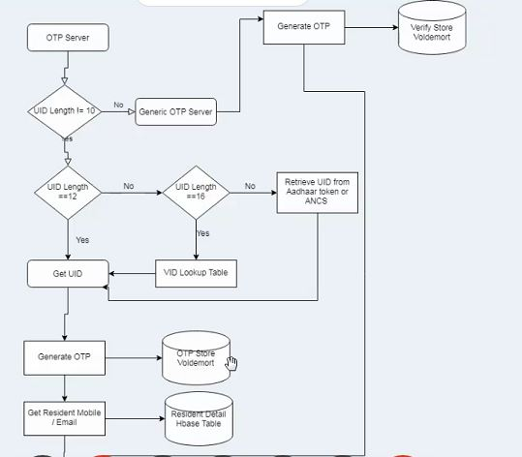

Slide 14
Storage format
Voldemort is java based (on a jvm) and uses OS to manage its memory
In Auth
Otp store,Verify Store,Cache Store
Keys used in Voldemort
OTP ->the timestamp
Generic OTP -> mobile no

Slide 15
Routing Modes
Client Side routing Retrieves
meta-data and cluster topology makes the routing decision locally.
Server Side routing
Server takes all the routing decision

Slide 16
etc
Commit related details
https://code.google.com/archive/p/project-voldemort/source/default/commits?page=5
87 releases. Latest 28 July 2017

