Slide 1
Voldemort

Slide 2
Data is automatically replicated over multiple servers across multiple datacenters.
Data is automatically partitioned so each server contains only a subset of the total data
Server failure is handled transparently
Pluggable serialization is supported to allow rich keys and values including lists and tuples with named fields, as well as to integrate with common serialization frameworks like Protocol Buffers, Thrift, and Java Serialization
Data items are versioned to maximize data integrity in failure scenarios without compromising availability of the system
Each node is independent of other nodes with no central point of failure or coordination
Pluggable storage engines, to cater to different workloads
SSD Optimized Read Write storage engine, with support for multi-tenancy
Built in mechanism to fetch & serve batch computed data from Hadoop
Support for pluggable data placement strategies to support things like distribution across data centers that are geographical far apart.

Slide 3
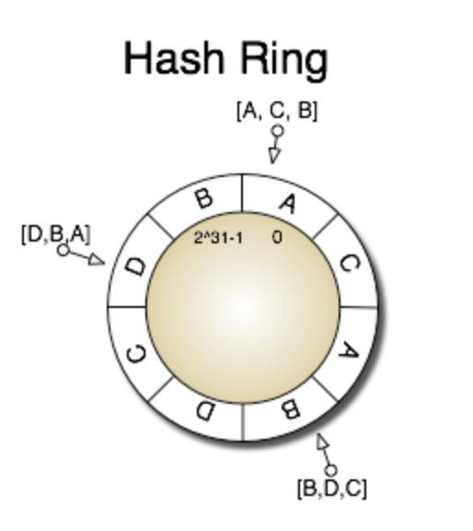
Overall Structure
Clusters, Nodes and Stores
A Voldemort cluster contains multiple nodes
A physical host can run multiple nodes
Each node has a given numbers of stores
Attributes of a store
Replication factor → no of nodes that contain this store
Read/Write quorum size R+W>N
Serialization(xml/json) and compression
Storage engine : Berkley DB or MySQL

Slide 4
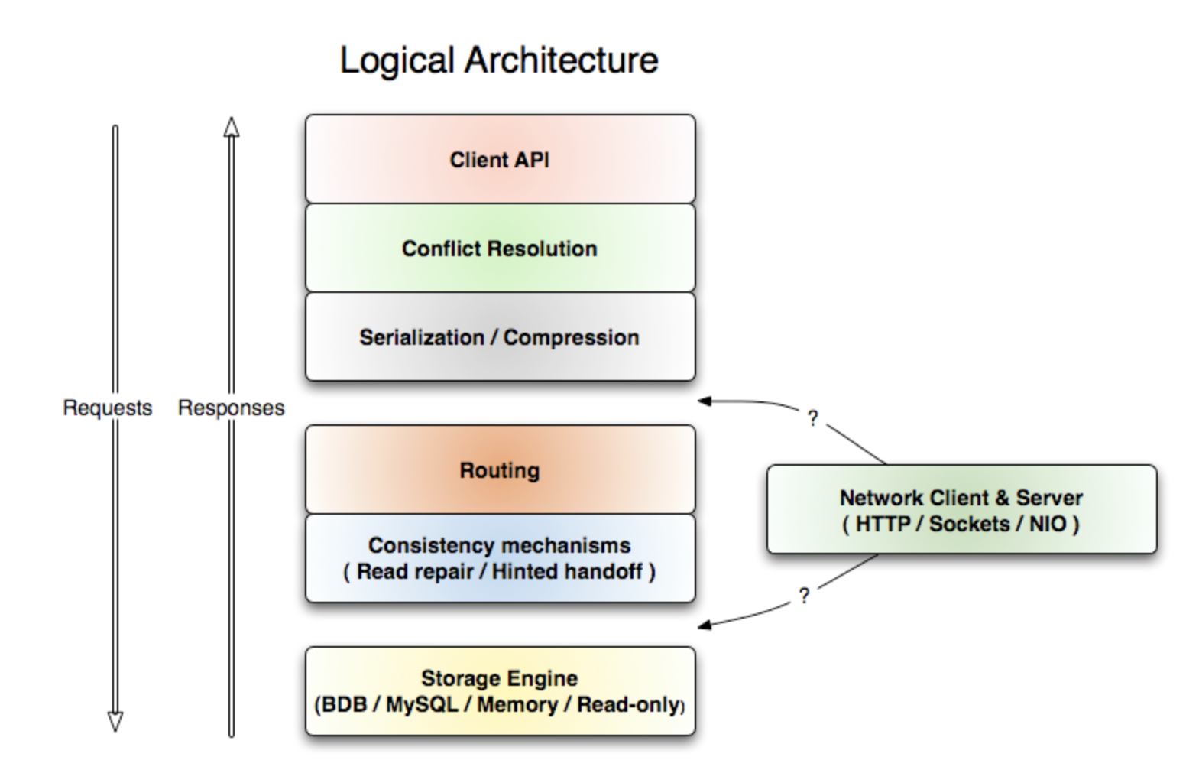

Slide 5
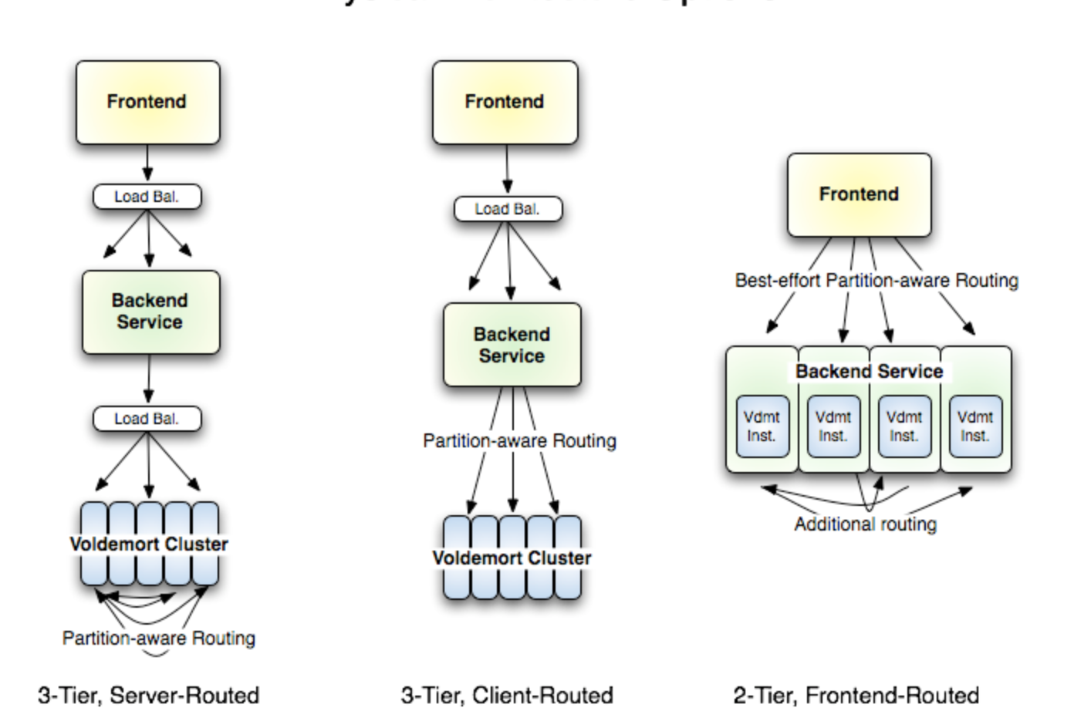
Physical Architecture

Slide 6
Routing Module
Deals with partioning and replication
Splits the hash ring into equal size partitions
Maps partitions to nodes
Each key is map to a preference list(of partition)
Map to a primary partition(based on its hash)
N- 1 subsequent partition(clockwise)
Pluggable Storage Layer
Traditional get and put functions
Block-read functions(Streaming)
Read Only Operations
Administrative functions

Slide 7
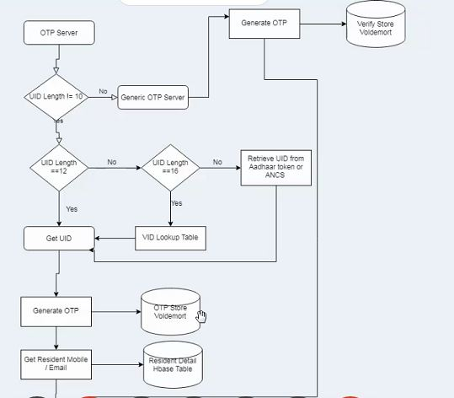

Slide 8
Storage format
Voldemort is java based (on a jvm) and uses OS to manage its memory
In Auth
Otp store,Verify Store,Cache Store
Keys used in Voldemort
OTP ->the timestamp
Generic OTP -> mobile no

Slide 9
Routing Modes
Client Side routing Retrieves
meta-data and cluster topology makes the routing decision locally.
Server Side routing
Server takes all the routing decision

Slide 10
extra
For programmers interested in getting to know the source code, here are a few pointers to get started. One good starting place is the Amazon Dynamo paper, it is a bit dense in places but will give an idea of why certain things are done a given way.
Most packages have a javadoc.html file that describes what the code in that package does, this can help to get a broad overview of the areas of the code.
Internally much of Voldemort implements a single very simple interface that provides basically put/get/delete given in Store.java.

Slide 11
Commit related details
https://code.google.com/archive/p/project-voldemort/source/default/commits?page=5
87 releases. Latest 28 July 2017

