Slide 1
What is Kubernetes
Kubernetes is a free and opensource technology for automating the deployment, Scaling and management of containerized applications.
It is being used by major cloud providers like Google, Microsoft, IBM and Alibaba to run their container-based workloads
Kubernetes is an open-source platform for managing containerized workloads and services. Kubernetes take care of scaling and failover for our application running on the container.

Slide 2
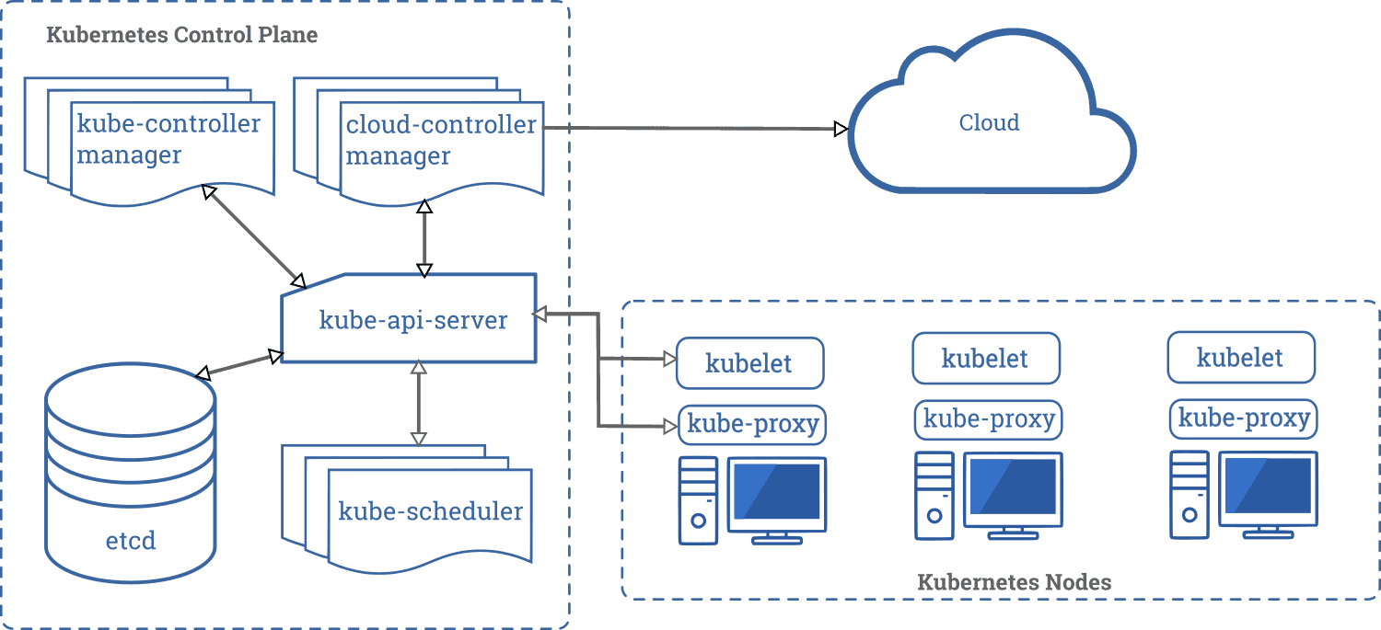
Master Node and Worker node
Kubernetes Architecture

Slide 3
Kubernetes Control Plane
:
The Control Plane is responsible for managing the overall state of the cluster and the orchestration of container deployment and management. It consists of the following components:
API Server: The central management component that provides an interface for interacting with the Kubernetes control plane.
2.etcd: A distributed key-value store that stores the state of the entire Kubernetes cluster.
3.Scheduler: The component that assigns workloads to specific worker nodes in the cluster.
4.Controller Manager: The component that manages the various controllers responsible for the state of the cluster.
Make sure actual state of a cluster matches to desired state

Slide 4
Kube Scheduler
:
Kub Scheduler- When users make request for the creation and management of pods, kube scheduler is going to act on these request.
Handles POD creation and Management.
Kube Scheduler match/assign any node to create and run pods.
A Scheduler waits for newly created pods that have no nodes assigned for every pod that the scheduler discover the scheduler becomes responsible for finding best nodes for that pod run on.
Scheduler gets the information for hardware configuration from configuration file and schedule the pods on nodes accordingly.

Slide 5
Kube API Server
:
Kub API Server – It is a front face (for all communication).
The API server is responsible for receiving and processing API requests from various Kubernetes components, including the Kubernetes CLI (kubectl), Kubernetes dashboard, and other Kubernetes control plane components. It performs operations such as creating, modifying, and deleting Kubernetes objects (such as pods, deployments, services, and config maps), scheduling workloads to nodes, and authenticating and authorizing access to the Kubernetes API.
The API server is designed to be scalable and highly available and can be configured to run in a single-node or multi-node configuration..

Slide 6
Kubelet, Container Engine, Kube Proxy
:
Kubelet - Agent running on the node
Listen to Kubernetes Master example (Pod creation requests)
Sends Success/Fail report to master.
Container Engine - works with kubelet.
Pulling images.
Start/Stop Containers.
Kube Proxy- Assign IP to each POD.
Kube-Proxy runs on each nodes and this make sure that each pod will get its own unique IP add.

Slide 7
POD, Nodes,
:
Pod is a smallest unit in Kubernetes.
Pod is a group of one or more containers that are deployed together on same host.
A cluster is a group of nodes.
In Kubernetes Control unit is POD not containers.
Consist of one or more tightly-coupled containers
Pods runs on node which is control by master
Kubernetes only knows about pods does not know about individual containers.
Cluster
Nodes
Pods
Containers

Slide 8
Labels Selectors
:
Labels – labels are the mechanism you use to organise Kubernetes objects.
A label is a key-value pair without any predefined meaning can be attached to the objects.
Labels are similar to tags in Aws or git where you use a name to quick reference
Selectors- one label are attached to an object we would need filters to narrow down and these are called as label selectors.
The API currently supports two types of selectors equality based and set based.
environment = production
Set Based label requirement allow filtering keys according to a set of values.
environment in (production, qa)

Slide 9
Labels Selectors
:
apiVersion: v1
kind: pod
metadata:
name: label-demo
labels:
environment: production
app: nginx
spec:
containers:
- name : ngnix
image: nginx:1.14.2
ports:
- containerPort: 80

Slide 10
Kubernetes Commands
:
kubectl get pods -l environment=production
kubectl get pods -l 'environment in (production, qa)’
Kubectl get pods –l ‘env not in (development, testing)’
Kubectl get pods -o wide to know the IP of pod and where the pod is running on which node
kubectl describe pod <podname> - know the events of pod or detail of pod
Kubectl get pods –show-labels

Slide 11
Replication Controllers
A Replication Controller is an object that enables you to easily create multiple pods, then make sure that number of pods always exist
If a pod created using RC will be automatically replaced if they does crash, failed or terminated.
RC is recommended if you just want to make sure 1 Pod is always running, even after reboot
replicas = 2
Kind : replication controller
:

Slide 12
Replication Controllers example
apiVersion: v1
kind: ReplicationController
metadata:
name: nginx
spec:
replicas: 3
selector:
app: nginx
template:
metadata:
name: nginx
labels:
app: nginx
spec:
containers:
- name: nginx
image: nginx
ports:
- containerPort: 80
:

Slide 13
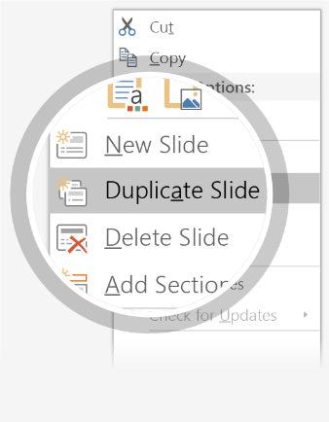
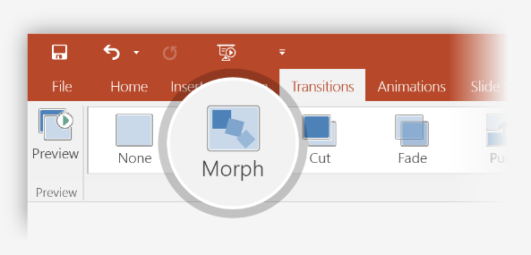
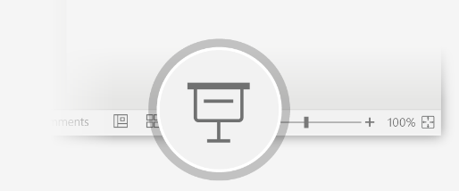
Setting up Morph
Try it yourself with these two simple “planets”:
1
Duplicate this slide: Right-click the slide thumbnail and select Duplicate Slide.
2
In the second of these two identical slides, change the shapes on the right in some way (move, resize, change color), then go to Transitions > Morph.
3
Return to the first of the two slides and press Slide Show button and then select Play to see your circle morph!
Hint: Effect Options gives you even more options for Morph.

Slide 14
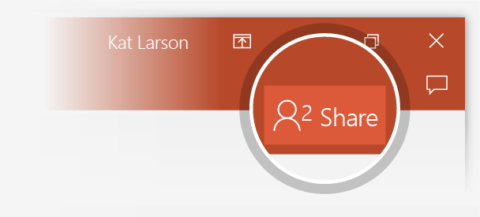
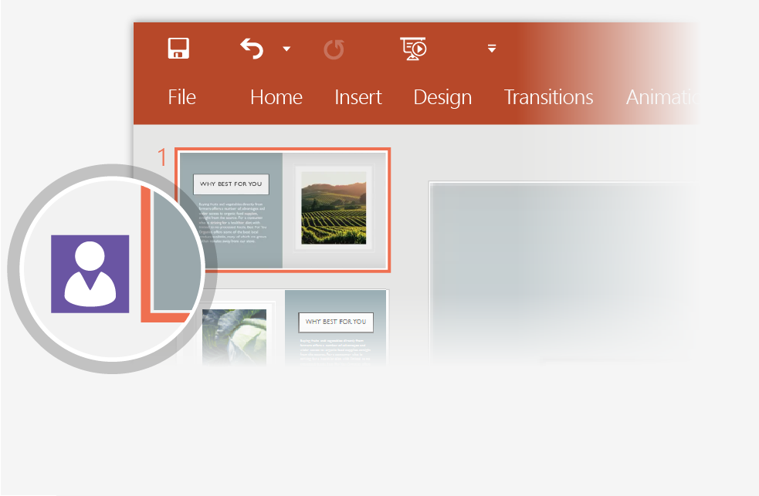
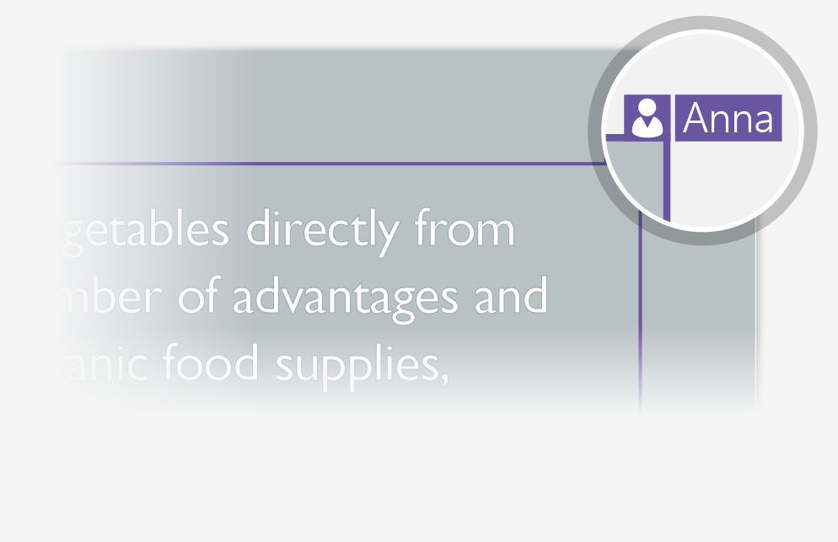
Working together in real time
When you share your presentation with others, you’ll see them working with you at the same time. How it works:
1
Select Share from above the ribbon, or by using short-key Alt-ZS, to invite people to work with you (You can save to the cloud at this point.)
2
When other people are in the presentation, a marker shows who is on which slide…
3
…and the part of the slide they're editing.

Slide 15
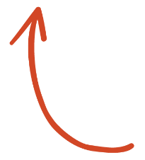

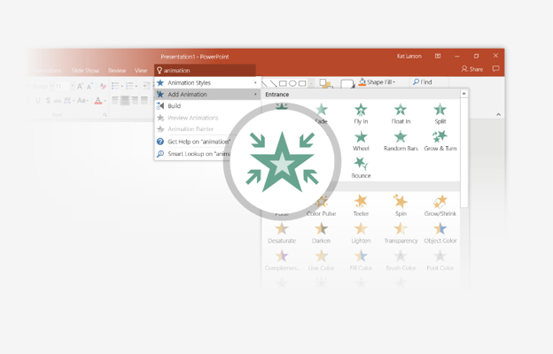
You’re an expert with Tell Me
The Tell Me box finds the right command when you need it, so you can save time and focus on your work. Try it:
SELECT ME
1
Select the Robot picture on the right.
2
Type animation in the Tell Me box, and then choose Add Animation.
3
Choose an animation effect, like Zoom, and watch what happens.

Slide 16
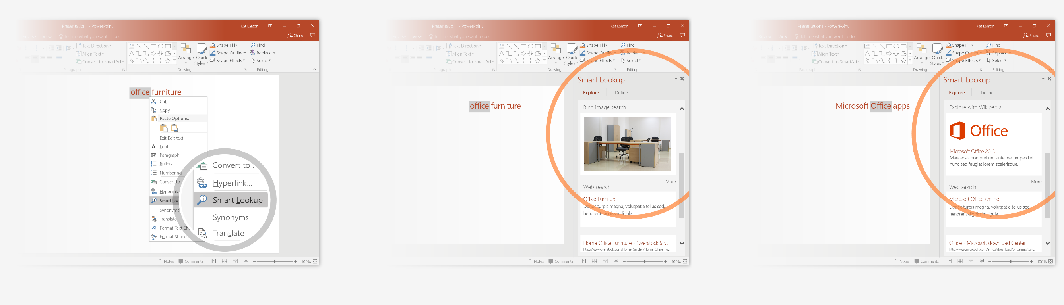
Explore without leaving your slides
Smart Lookup brings research directly in to PowerPoint. Try it:
1
Right-click in the word office in the following phrase: office furniture
2
Choose Smart Lookup, and notice that results are contextual for that phrase, not Microsoft Office apps.
3
Just for fun, try Smart Lookup again by right-clicking in the word Office in Step 2.

Slide 17

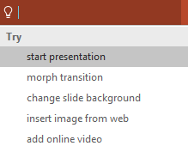

More questions about PowerPoint?
Select the Tell Me button and type what you want to know.
Visit the PowerPoint team blog
Go to free PowerPoint training
SELECT THE ARROW WHEN IN SLIDE SHOW MODE

